Slide 1
DI BELLA DANILO
O46002060

Slide 2

Header
width: 90px, height: 45px;
Margin: 18px
Max width:750px, letter-spacing : 2px
Height: 600px

Slide 3
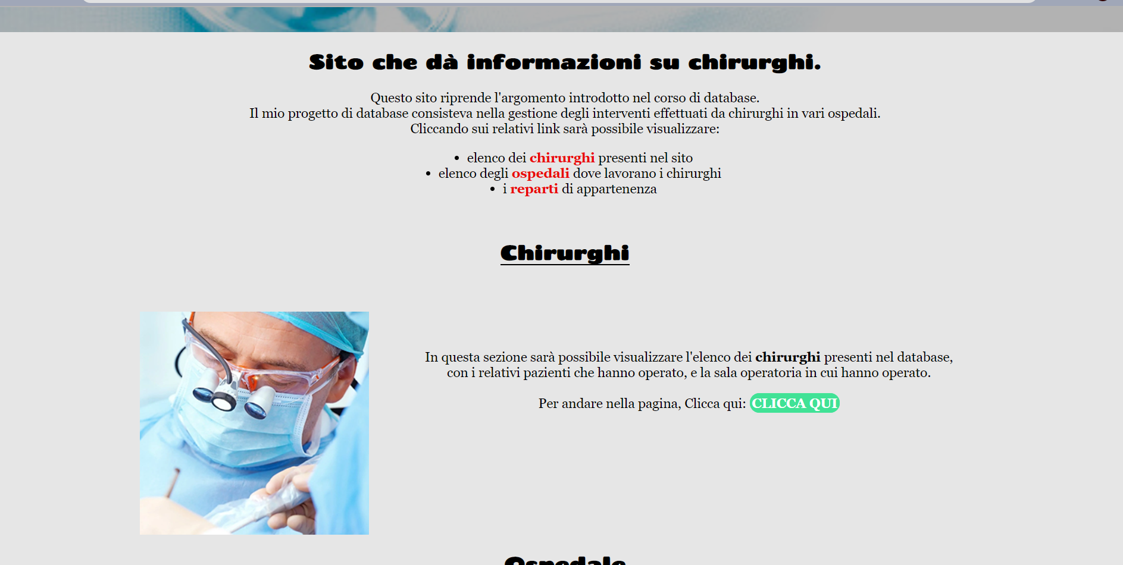
Section
Margin: 18px
Padding:18px
Margin: 20px
Margin-top: 40px
Margin-top e margin-right: 50px
Margin-left: 75px

Slide 4
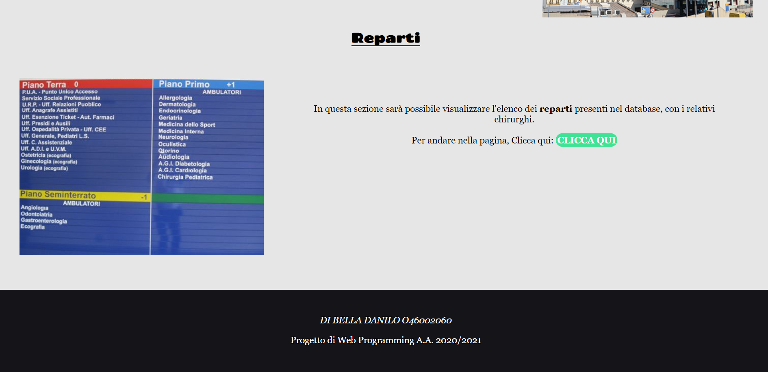
Footer
Margin-bottom: 50px
Padding: 50px

