Slide 1
DSAA4012 · FINAL PROJECT
Serving choices
follow workload shape
SmolLM2-360M-Instruct on AMD EPYC 9654 and RTX 6000 Ada
Hanxiao · Haiyang Peng
TTFT · TPOT · throughput · memory · quality
Notes:
[Sources]
- report/latex/report.tex
- results/validation/hardware_dsaa4012_rerun.json

Slide 2
The experiment asks a frontier question—not a hardware contest
How do batch and context reshape TTFT, TPOT, and decode throughput—and when do three serving interventions move that frontier?
1 · PREFILL
2 · DECODE
Complete context → first token
One token per sequence per step
TTFT
TPOT / TPS
3 · INTERVENE
4 · VALIDATE
SDPA · KV cache · W8A8
memory · profiler · quality
normalized effect
honest boundary
02
Notes:
[Sources]
- report/latex/report.tex, Sections II-A through II-C
- src/mlsys360/timing.py
- src/mlsys360/decode.py

Slide 3
A one-line logits fix moved the measured memory boundary
The original prefill materialized every vocabulary logit. Serving needs only the final position; schema v3 enforces this on every forward.
BEFORE · DIAGNOSTIC ONLY
AFTER · SUBMISSION GRADE
[B, L, V] logits
[B, 1, V] logits
Artificial OOMs at 2048/128 and 4096/64
4096/128 succeeds at 31.95 GiB allocated
22
520
100×2
unit tests passed
baseline observations
rotated headline repetitions
Lesson: measurement semantics can dominate the apparent systems boundary.
03
Notes:
[Sources]
- docs/CORRECTION_AND_RERUN_CHECKLIST.md
- results/validation/corrected_results_audit.txt
- results/processed/cpu_epyc9654_baseline_last_logits.csv
- results/processed/gpu_rtx6000_ada_baseline_last_logits.csv

Slide 4
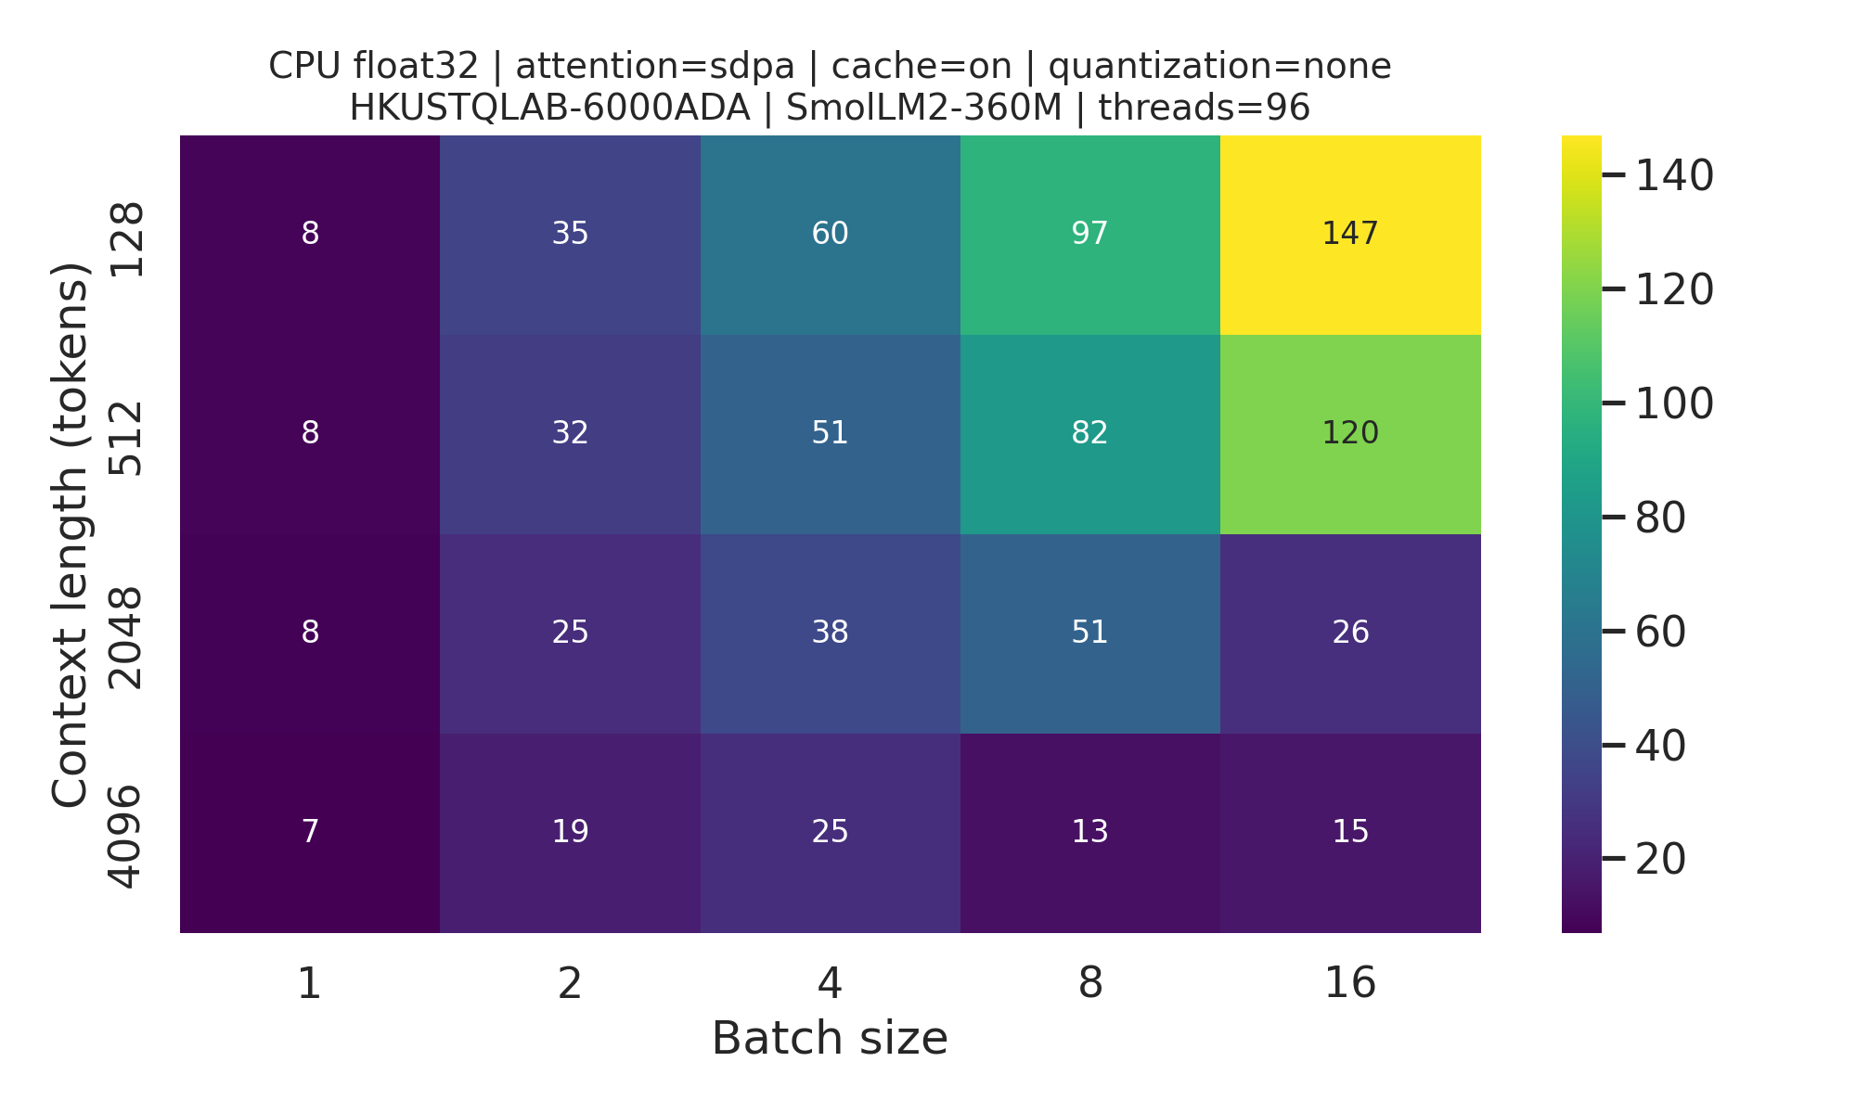
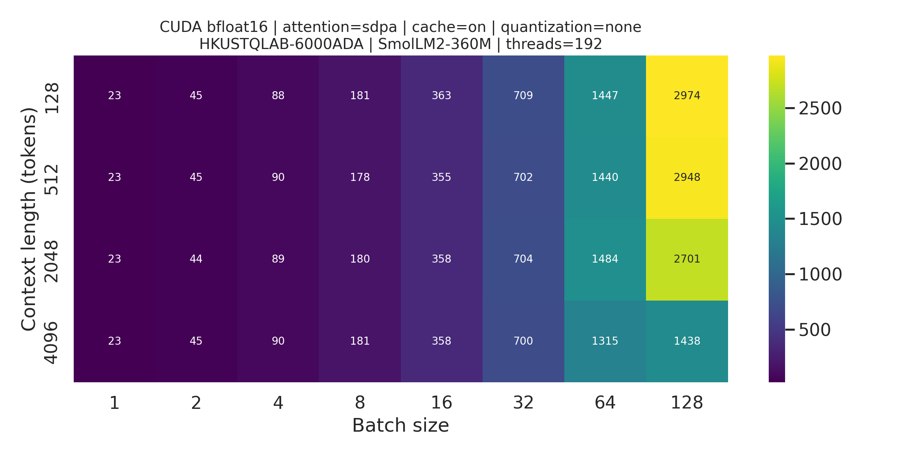
Batching pays until long context turns latency and memory into constraints
CPU · ONE EPYC SOCKET
GPU0 · RTX 6000 ADA
CPU knees: 2048/16 · 4096/8
GPU knee: only 4096/128
04
Notes:
[Sources]
- results/figures/corrected_baseline/tps_heatmap_HKUSTQLAB-6000ADA_cpu_float32_sdpa_cache-on_none_SmolLM2-360M.png
- results/figures/corrected_baseline/tps_heatmap_HKUSTQLAB-6000ADA_cuda_bfloat16_sdpa_cache-on_none_SmolLM2-360M.png
- results/processed/cpu_epyc9654_baseline_last_logits.csv
- results/processed/gpu_rtx6000_ada_baseline_last_logits.csv

Slide 5
GPU scaling persists; CPU knees arrive earlier at long context
Peak median decode throughput within each tested grid
2,974 TPS
GPU · ctx 128 · batch 128
2,701 TPS
GPU · ctx 2048 · batch 128
1,438 TPS
GPU · ctx 4096 · batch 128
Absolute CPU/GPU values are separate hardware lines; compare scaling behavior, not fairness.
05
Notes:
[Sources]
- results/processed/cpu_epyc9654_baseline_last_logits.csv
- results/processed/gpu_rtx6000_ada_baseline_last_logits.csv
- report/latex/report.tex, Section IV-A

Slide 6
SDPA becomes decisive as contexts grow
9.34×
GPU TTFT at 4096/4
6.23×
CPU TTFT at 4096/4
PROFILER EVIDENCE
eager: bmm + softmax
SDPA: pytorch_flash::flash_fwd_kernel
06
Notes:
[Sources]
- results/processed/cpu_epyc9654_operator_last_logits.csv
- results/processed/gpu_rtx6000_ada_operator_last_logits.csv
- results/validation/gpu_attention_profile.txt

Slide 7
KV caching is a workload-dependent crossover—not a universal rule
SMALL GPU LOADS
cache-off is 1–5% faster
bookkeeping outweighs recomputation
LONG / BATCHED LOADS
4.22× slower without cache
CPU repeated points: 1.85×–17.62×
Single CPU 2048/8 boundary: 88.99× and 891.7 s—reported as a boundary, not a percentile.
07
Notes:
[Sources]
- results/processed/cpu_epyc9654_cache_off_last_logits.csv
- results/processed/gpu_rtx6000_ada_cache_last_logits.csv
- report/latex/report.tex, Section IV-B

Slide 8
CPU W8A8 buys speed—not memory—and loses substantial quality
11.27 → 44.16
WikiText-2 perplexity
56.44% → 42.21%
ARC-Easy accuracy
GPU NEGATIVE PROBE
real INT8 GEMMs · 9,025 D→H scalars · 0.21 TPS
224 Transformer linears quantized; lm_head remains FP32. This recipe is not quality-preserving.
08
Notes:
[Sources]
- results/processed/cpu_epyc9654_quantization_w8a8_last_logits.csv
- results/raw/cpu_epyc9654_quality_arc_easy_w8a8_last_logits.jsonl
- results/raw/gpu_rtx6000_ada_quality_hellaswag.jsonl
- results/validation/gpu_torchao016_profile.txt

Slide 9
The right optimization follows the workload region
A practical selection map from the measured frontier
SHORT · SMALL BATCH
SHORT · LARGE BATCH
Overhead dominates
Utilization wins
GPU cache may hurt slightly. Keep the path simple; measure before enabling more state.
Increase batch: GPU TPS still rises to batch 128; CPU gains remain context-dependent.
LONG · SMALL BATCH
LONG · LARGE BATCH
Attention dominates prefill
Cache + memory set the boundary
Use SDPA. TTFT advantage grows sharply with context on both hardware lines.
Keep KV cache, budget activations, and expect latency to rise before throughput plateaus.
09
Notes:
[Sources]
- report/latex/report.tex, Sections IV-A through IV-D
- results/validation/corrected_results_audit.txt

Slide 10
Three conclusions—and three limits
WHAT THE DATA SUPPORTS
WHAT THIS STUDY DOES NOT CLAIM
1 · Workload shape defines the frontier
No production scheduler
Long context changes both batching knees and memory pressure.
Synchronous, model-only timing excludes networking and queueing.
2 · SDPA is the clearest general win
No universal CPU–GPU fairness
Its value grows with context; profiling confirms the fused kernel.
Hardware lines are interpreted independently.
3 · Cache and W8A8 require qualification
One model and one stable GPU path
Cache crosses over; W8A8 speeds CPU but raises RSS and hurts quality.
Generalization requires more models, runtimes, and continuous batching.
Takeaway: optimize the region you actually serve.
Questions
10
Notes:
[Sources]
- report/latex/report.tex, Sections IV-D through VI
- results/validation/corrected_results_audit.txt

