Slide 1

Applied AI, built for Sudan.
Our leading projects: SudaTutor, NodeGrid and SmartSelect. Three platforms, live today, designed around Sudanese realities.
3 live
AR + EN
Your servers
platforms in this profile
Arabic-first, bilingual by design
self-hosted options for sensitive data
Photo: Christopher Michel, CC BY 2.0
Notes:
Sudaverse is a Sudanese AI and digital systems company. This profile covers our three leading projects, all live: sudatutor.sudaverse.com, nodegrid.sudaverse.com and smartselect.sudaverse.com. Cover photo: Khartoum, Sudan, by Christopher Michel, CC BY 2.0, via Wikimedia Commons.

Slide 2
Sudanese engineers and researchers building applied AI and digital systems.
We help institutions and companies adopt AI, secure their systems and build reliable digital infrastructure. One engineering team works from the network up to the model, in Arabic and English.
10
7
projects across education, agriculture, geospatial, security and language
engineers and researchers in the core team
Infrastructure setup
AI adoption
Cybersecurity
2
6
IT consulting
Training
Data and analytics
peer-reviewed papers at IEEE FITAT 2026
research directions feeding the products
Sudaverse | Leading projects
02
Notes:
Who we are. Figures from sudaverse.com: ten projects including NodeGrid, a seven-person core team, two papers at IEEE FITAT 2026, and six research directions.

Slide 3
Global AI tools are not built around Sudan.
Language
Context
Control
Sudanese Arabic is a low-resource dialect. General-purpose models and tokenizers break its words apart and miss its vocabulary.
Curricula, admission policies and institutions are local. Tools designed elsewhere do not follow them.
Institutions need AI they can run in their own environment, with decisions they can explain and audit.
Sudaverse builds the missing layer: Arabic-first products that follow local rules and can run where the data lives.
Sudaverse | Leading projects
03
Notes:
The problem in three words: language, context, control. Each of the three projects answers one or more of them.

Slide 4

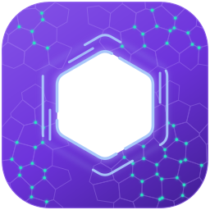

Three leading projects
SudaTutor
NodeGrid
SmartSelect
Education
AI infrastructure
Selection decisions
AI tutoring that follows the Sudanese national curriculum, adapted to each learner's level and age.
A self-hosted control plane to build, run and supervise AI agents from the browser.
Explainable decision support for admission, hiring, promotion and scholarships.
sudatutor.sudaverse.com
nodegrid.sudaverse.com
smartselect.sudaverse.com
Sudaverse | Leading projects
04
Notes:
The three projects at a glance, each live at its own sudaverse.com address.

Slide 5
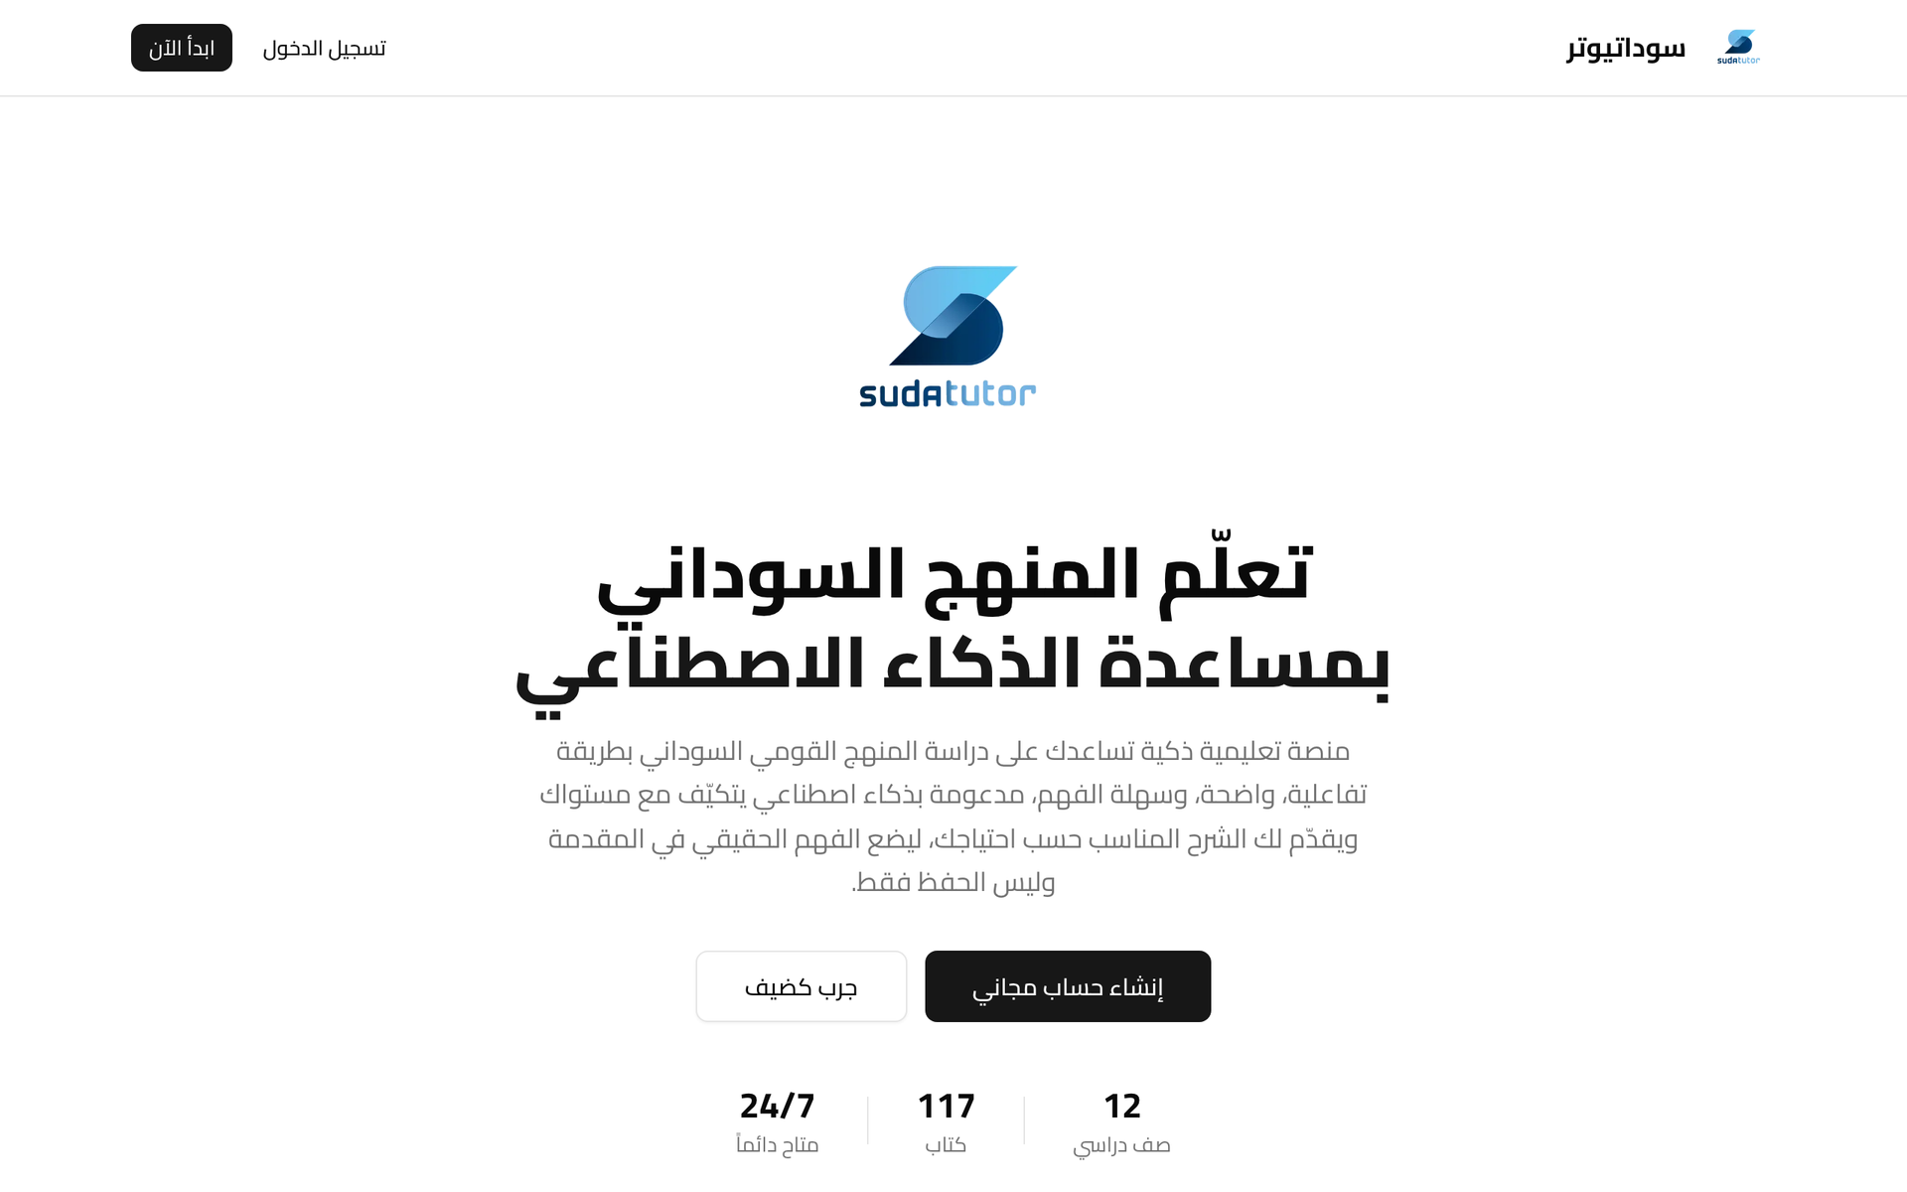
Learn the Sudanese curriculum with AI assistance.
Learners need explanations that match their grade, their books and their context. SudaTutor is built around the curriculum itself and adapts each explanation to the learner's level and age.
12
117
24/7
sudatutor.sudaverse.com | Live
grade levels
curriculum books
available
Sudaverse | SudaTutor
05
Notes:
SudaTutor is live: 12 grade levels and 117 books of the Sudanese national curriculum, available around the clock. The screenshot is the real public home page, in Arabic. Learners start as a guest or create a free account.

Slide 6

How a learner uses it
01
Start
Begin as a guest, or create a free account.
02
Choose
Pick your grade and the book you are studying.
03
Ask
Ask about a lesson, in Arabic.
04
Learn
Get an explanation adapted to your level and age.
05
Track
Follow progress through continuous assessment.
Built for learners studying the Sudanese national curriculum, and the schools and families supporting them.
Sudaverse | SudaTutor
Photo: African Union Mission in Somalia, public domain
06
Notes:
The learner journey in five steps. Photo: students writing a national examination, African Union Mission in Somalia, public domain.

Slide 7

A self-hosted control plane for AI agents.
Running AI agents in production takes more than a prompt. Teams need to control who can do what, keep their data in their own environment, and see what every agent did and why. NodeGrid brings agents, models, documents, tools and workflows into one browser-based control plane on your own infrastructure.
v1.0
Multi-tenant
Edge-ready
first tagged release, live
with role-based access
agents on machines across your network
nodegrid.sudaverse.com
Notes:
NodeGrid is our AI infrastructure platform. Version 1.0 is released and running at nodegrid.sudaverse.com. It is self-hosted: agents, data and history stay on the customer's own servers. Server room photo: rawpixel, CC0.

Slide 8
How NodeGrid is put together
Operators
Control plane
Execution
A browser dashboard: agents, chat, pipelines, workflows, usage and alerts.
Sign-in, tenants and roles, workflow engine, activity record, cost tracking.
Language models, hosted or local; documents and memory; tools; remote edge agents.
Your infrastructure
Isolated by design
Secure at the edge
The whole stack runs on the customer's servers, in containers.
Every query is scoped to its tenant; one tenant cannot see another's data.
Edge agents connect over mutual TLS to run jobs across the network.
Sudaverse | NodeGrid
08
Notes:
Operators work in the browser; the control plane owns identity, tenants, workflows and the record of every run; execution happens on models, tools and edge agents the customer controls. Cross-tenant reads return not-found, so a probe cannot confirm a record exists.

Slide 9
What teams get with NodeGrid
Self-hosted
Many models
Grounded answers
Agents, data and history stay on your own infrastructure.
Works with multiple language models and falls back automatically when one is unavailable.
Answers drawn from your own documents, with custom tools and shared memory.
Workflows
Governance
Edge agents
Pipelines and versioned workflows for unattended, multi-step work.
Separate workspaces per organisation, role-based access, usage and cost tracking, alerts.
Run jobs on machines across your network, with installers for Windows and Linux.
Sudaverse | NodeGrid
09
Notes:
Six capabilities, all shipped in NodeGrid v1.0.

Slide 10
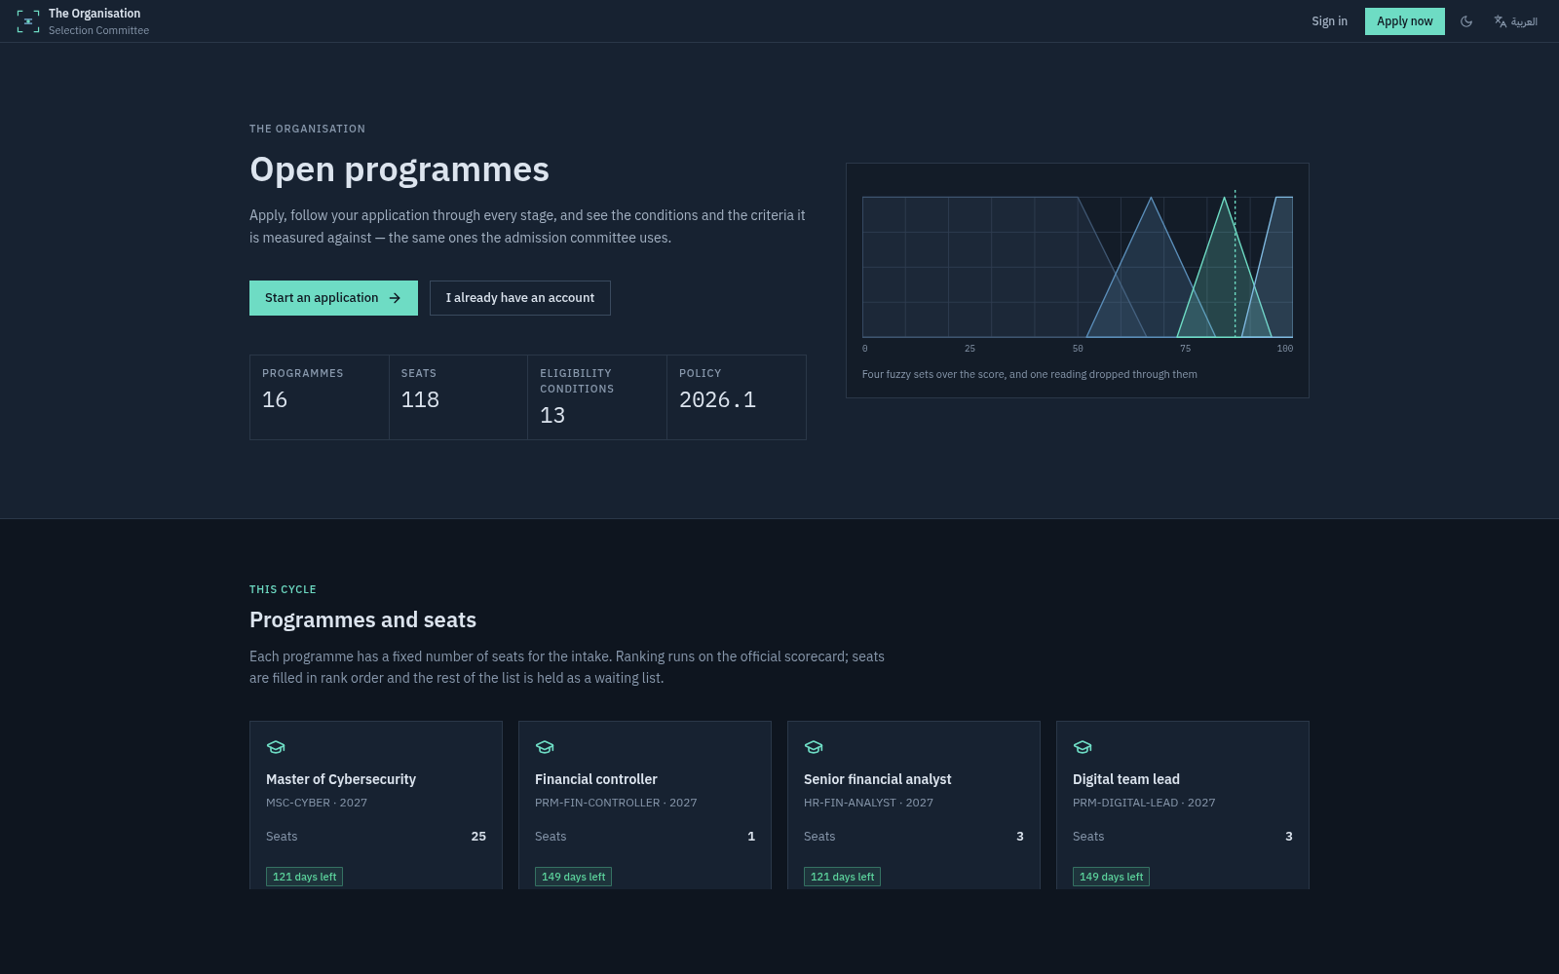
It screens, scores, ranks and explains. People decide.
Explainable decision support for selection: admission, hiring, promotion, clinical residency, scholarships and grants. The organisation's panel decides and its approving authority approves.
AR + EN
Audited
Configured
Arabic by default
every rule, versioned
per industry, not coded
smartselect.sudaverse.com | Live demo
Sudaverse | SmartSelect
10
Notes:
SmartSelect never selects anyone; it supports the panel. Each organisation runs its own deployment, picks an industry preset and edits the form, rules, scorecard, fuzzy rule base, workflow and roles, all versioned and audited. Screenshot: the live applicant page.

Slide 11

From application to approved decision
Eligibility
Scorecard
Fuzzy advice
Ranking
Governance
A rules engine checks each application against policy. Every rule cites its source.
The official score: weighted criteria, out of 100.
A recommendation band and the rules that fired. Advisory only.
The official score orders the cohort; capacity sets the cut-off.
Panel decision, sign-offs and an approval chain with separation of duties.
Two tracks, kept apart on purpose.
The scorecard is the number the panel signs and publishes. The fuzzy layer never changes it, and when the two disagree beyond a set threshold, the file goes to manual review instead of being quietly resolved.
Sudaverse | SmartSelect | Photo: Evon2023, CC0
11
Notes:
The five stages of a selection cycle. The official scorecard and the fuzzy advice are kept apart. Photo: the main gate of the University of Khartoum Library, by Evon2023, CC0, via Wikimedia Commons.

Slide 12

The sectors we serve
Education
Enterprise and tech
Universities
Public sector and HR
Learners, schools and families following the national curriculum.
Teams running AI agents on their own infrastructure.
Admission committees, scholarships and grants.
Hiring, promotion and clinical residency.
SudaTutor
NodeGrid
SmartSelect
SmartSelect
Photos: AMISOM (public domain), rawpixel (CC0), Evon2023 (CC0), Alan Cleaver (CC BY 2.0)
12
Notes:
Four sectors, three platforms. Photos: classroom, African Union Mission in Somalia, public domain; server room, rawpixel, CC0; University of Khartoum Library gate, Evon2023, CC0; job interview, Alan Cleaver, CC BY 2.0.

Slide 13
What every platform shares
Built for Sudan
SudaTutor follows the Sudanese national curriculum. SmartSelect opens in Arabic, right to left, by default.
Arabic-first, designed around local realities.
Secure by design
NodeGrid isolates every tenant and enforces roles. SmartSelect separates duties along its approval chain and audits every change.
Protected from the first decision.
Yours to run
NodeGrid and SmartSelect deploy inside the customer's own environment. Training and documentation leave the team owning what we deliver.
Your environment, your data.
Sudaverse | Leading projects
13
Notes:
The three principles from the Sudaverse website, each backed by a concrete feature of the platforms.

Slide 14
A clear path from first conversation to a system your team owns
01
02
03
04
Understand
Plan
Build and secure
Hand over
Every engagement starts with a conversation about the problem, the people and the constraints.
We recommend the architecture and technology before anything is bought or built.
We deliver inside your environment, cloud or on-premises, tested, secured and documented.
Training and documentation leave your team confident to run and extend what we built.
Partnering with us: pilots, institutional deployments, research collaboration and technical integration.
Sudaverse | Leading projects
14
Notes:
How we work, as published on sudaverse.com. At Web Summit the ask is a conversation: pilots, deployments, research collaboration or integration.

Slide 15

Build with Sudaverse.
Tell us what you are working on, and our engineering team will reply.
Email
info@sudaverse.com
Website
www.sudaverse.com
SudaTutor
sudatutor.sudaverse.com
NodeGrid
nodegrid.sudaverse.com
SmartSelect
smartselect.sudaverse.com
Notes:
Close on the contact details and the three live addresses.

