Slide 1
OpenAPI v3.1 Fundamentals
Module 2: OpenAPI Basics

Slide 2
Who is course this for?
Anyone looking for more detail on the nuts-and-bolts of OpenAPI
Developers looking to build or consume APIs using OpenAPI

Slide 3
What we’ll cover
How OpenAPI represents HTTP and APIs
The basic structure of OpenAPI
The most commonly used objects and how they relate to each other
How to describe security requirements
What Specification Extensions mean

Slide 4
HTTP, APIs and OpenAPI

Slide 5
HTTP, APIs and OpenAPI
URLs
In Module 1 we explained the growth and features of API specification languages.
These languages represent the features of HTTP and APIs more generally, including:
URLs
Supported HTTP methods
Request properties
Response properties
Security Requirements
These features are present in OpenAPI.
HTTP Methods
Request Properties
Response Properties
Query String
Payload
HTTP Status Code
Payload
Headers
Headers
Security

Slide 6
HTTP, APIs and OpenAPI
If we map the features of HTTP:
URL: Paths and Path Item Object
Methods: Operation Object
Query String (and other parameter types): Parameters Object
Request payload (where supported, encoded): Request Body Object
Supported response codes: Responses Object
Response payload (encoded, with headers): Response Object
OpenAPI is (largely) a representation of HTTP APIs in a specification language

Slide 7
Basic Structure

Slide 8
Basic Structure
Primary root-objects objects:
Info Object
Paths Object
Components Object
Supported by nested objects that support the function each.

Slide 9
Providing Information

Slide 10
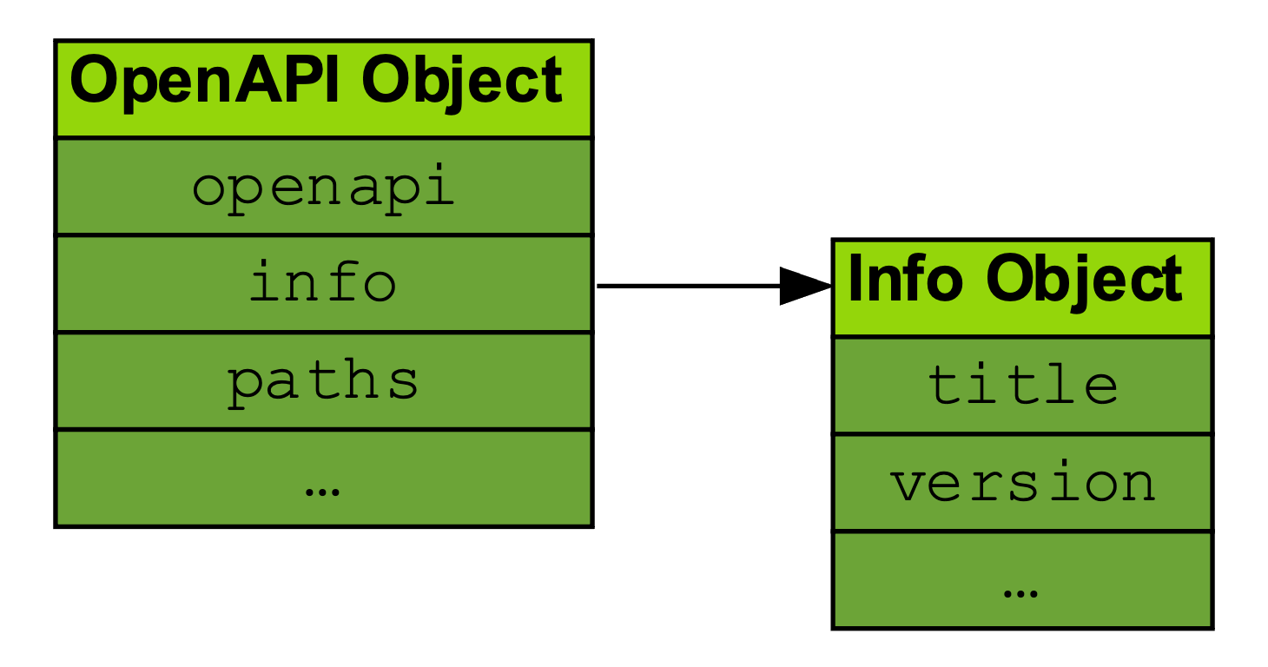
Providing Information
Provides high-level information to readers of OpenAPI document:
Title
Description (supported by Markdown)
Version (ideally using Semantic Versioning)
Other properties available (depending on how to choose to publish information like contact, license, etc.)
info:
title: OpenAPI Basics API
description: |
An example of an Info Object in an OpenAPI document
## Introduction to API
This provides a high-level summary. An image is provided below:
![Image embedded in OpenAPI document](images/example-image.png)
version: 0.0.1

Slide 11
URLs, Paths and Methods

Slide 12
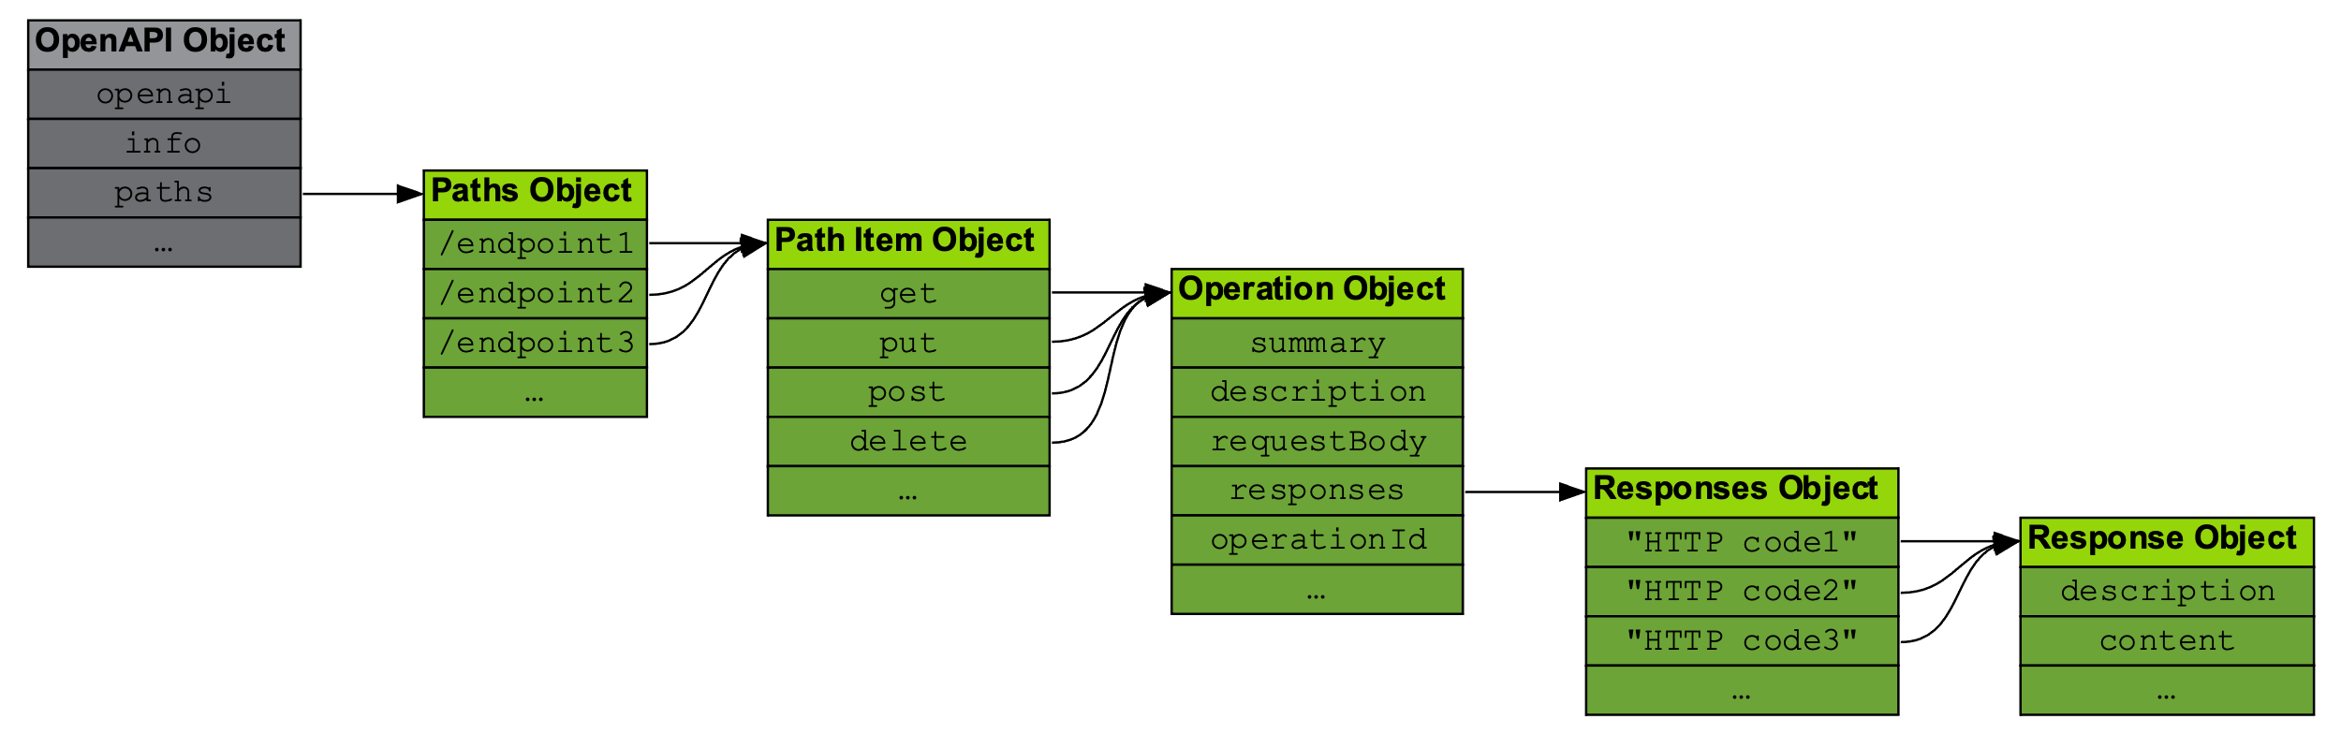
URLs, Paths and Methods
Paths Object is a map of URLs exposed by the API
Paths point to Path Item Objects, providing one-or-more HTTP methods supported by the API
Each method points to a given Operation Object, which defines the properties of the request and response, along with documentation
/pets/{petId}:
get:
summary: Info for a specific pet
operationId: showPetById
tags:
- pets
parameters:
- name: petId
in: path
required: true
description: The id of the pet to retrieve
schema:
type: string
responses:
"200":
description: Expected response to a valid request
content:
application/json:
schema:
$ref: "#/components/schemas/Pet"
default:
description: unexpected error
content:
application/json:
schema:
$ref: "#/components/schemas/Error"

Slide 13
Providing Parameters

Slide 14
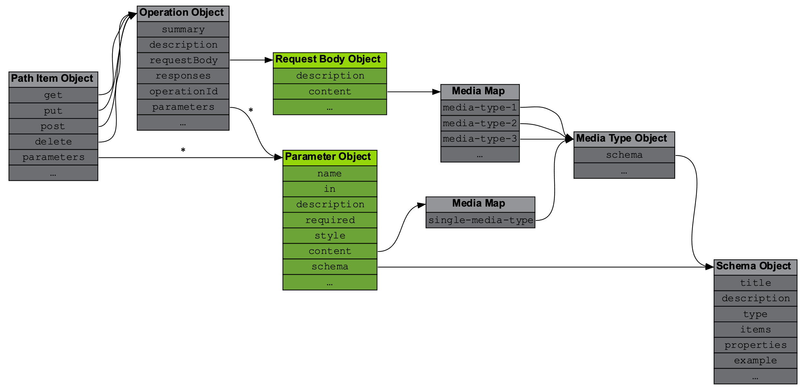
Providing Parameters
Implemented in an Operation Object
Provides the means to send arguments to a given operation
Several types supported:
Path: Part of a URL
Query: A HTTP Query string
Header: A HTTP header
Cookie: Cookie data
Parameter type supported by Schema Object to allow rich parameter definition
name: petId
in: path
required: true
description: The id of the pet to retrieve
schema:
type: string

Slide 15
Creating Request and Response Objects

Slide 16
Creating Request and Response Objects
Implemented by an Operation Object
Request Body Object implements Media Type Object
Media Type implements underlying Schema Object
Expected request payload can therefore be well-described
description: Request body containing expected strings
content:
application/json:
schema:
type: object
properties:
names:
type: array
items:
type: string
minLength: 1
maxLength: 100
pattern: ^\w$
maxItems: 5

Slide 17
Creating Request and Response Objects
Referenced (indirectly) by Operation Object
Response Object is defined using same approach, namely:
Media Type Object provides expected encoding
Schema Object adds expected payload
Response Object also supports headers and other properties
Multiple Media Type Objects can be specified with the same Schema Object, providing a use case for reusability
description: Response payload including expected HTTP headers
headers:
"x-example-header":
description: Example header using deprecated x- nomenclature
schema:
type: string
content:
application/json:
schema:
type: object
properties:
names:
type: array
items:
type: string
minLength: 1
maxLength: 100
pattern: ^\w$
maxItems: 5

Slide 18
Defining Reusable Objects

Slide 19
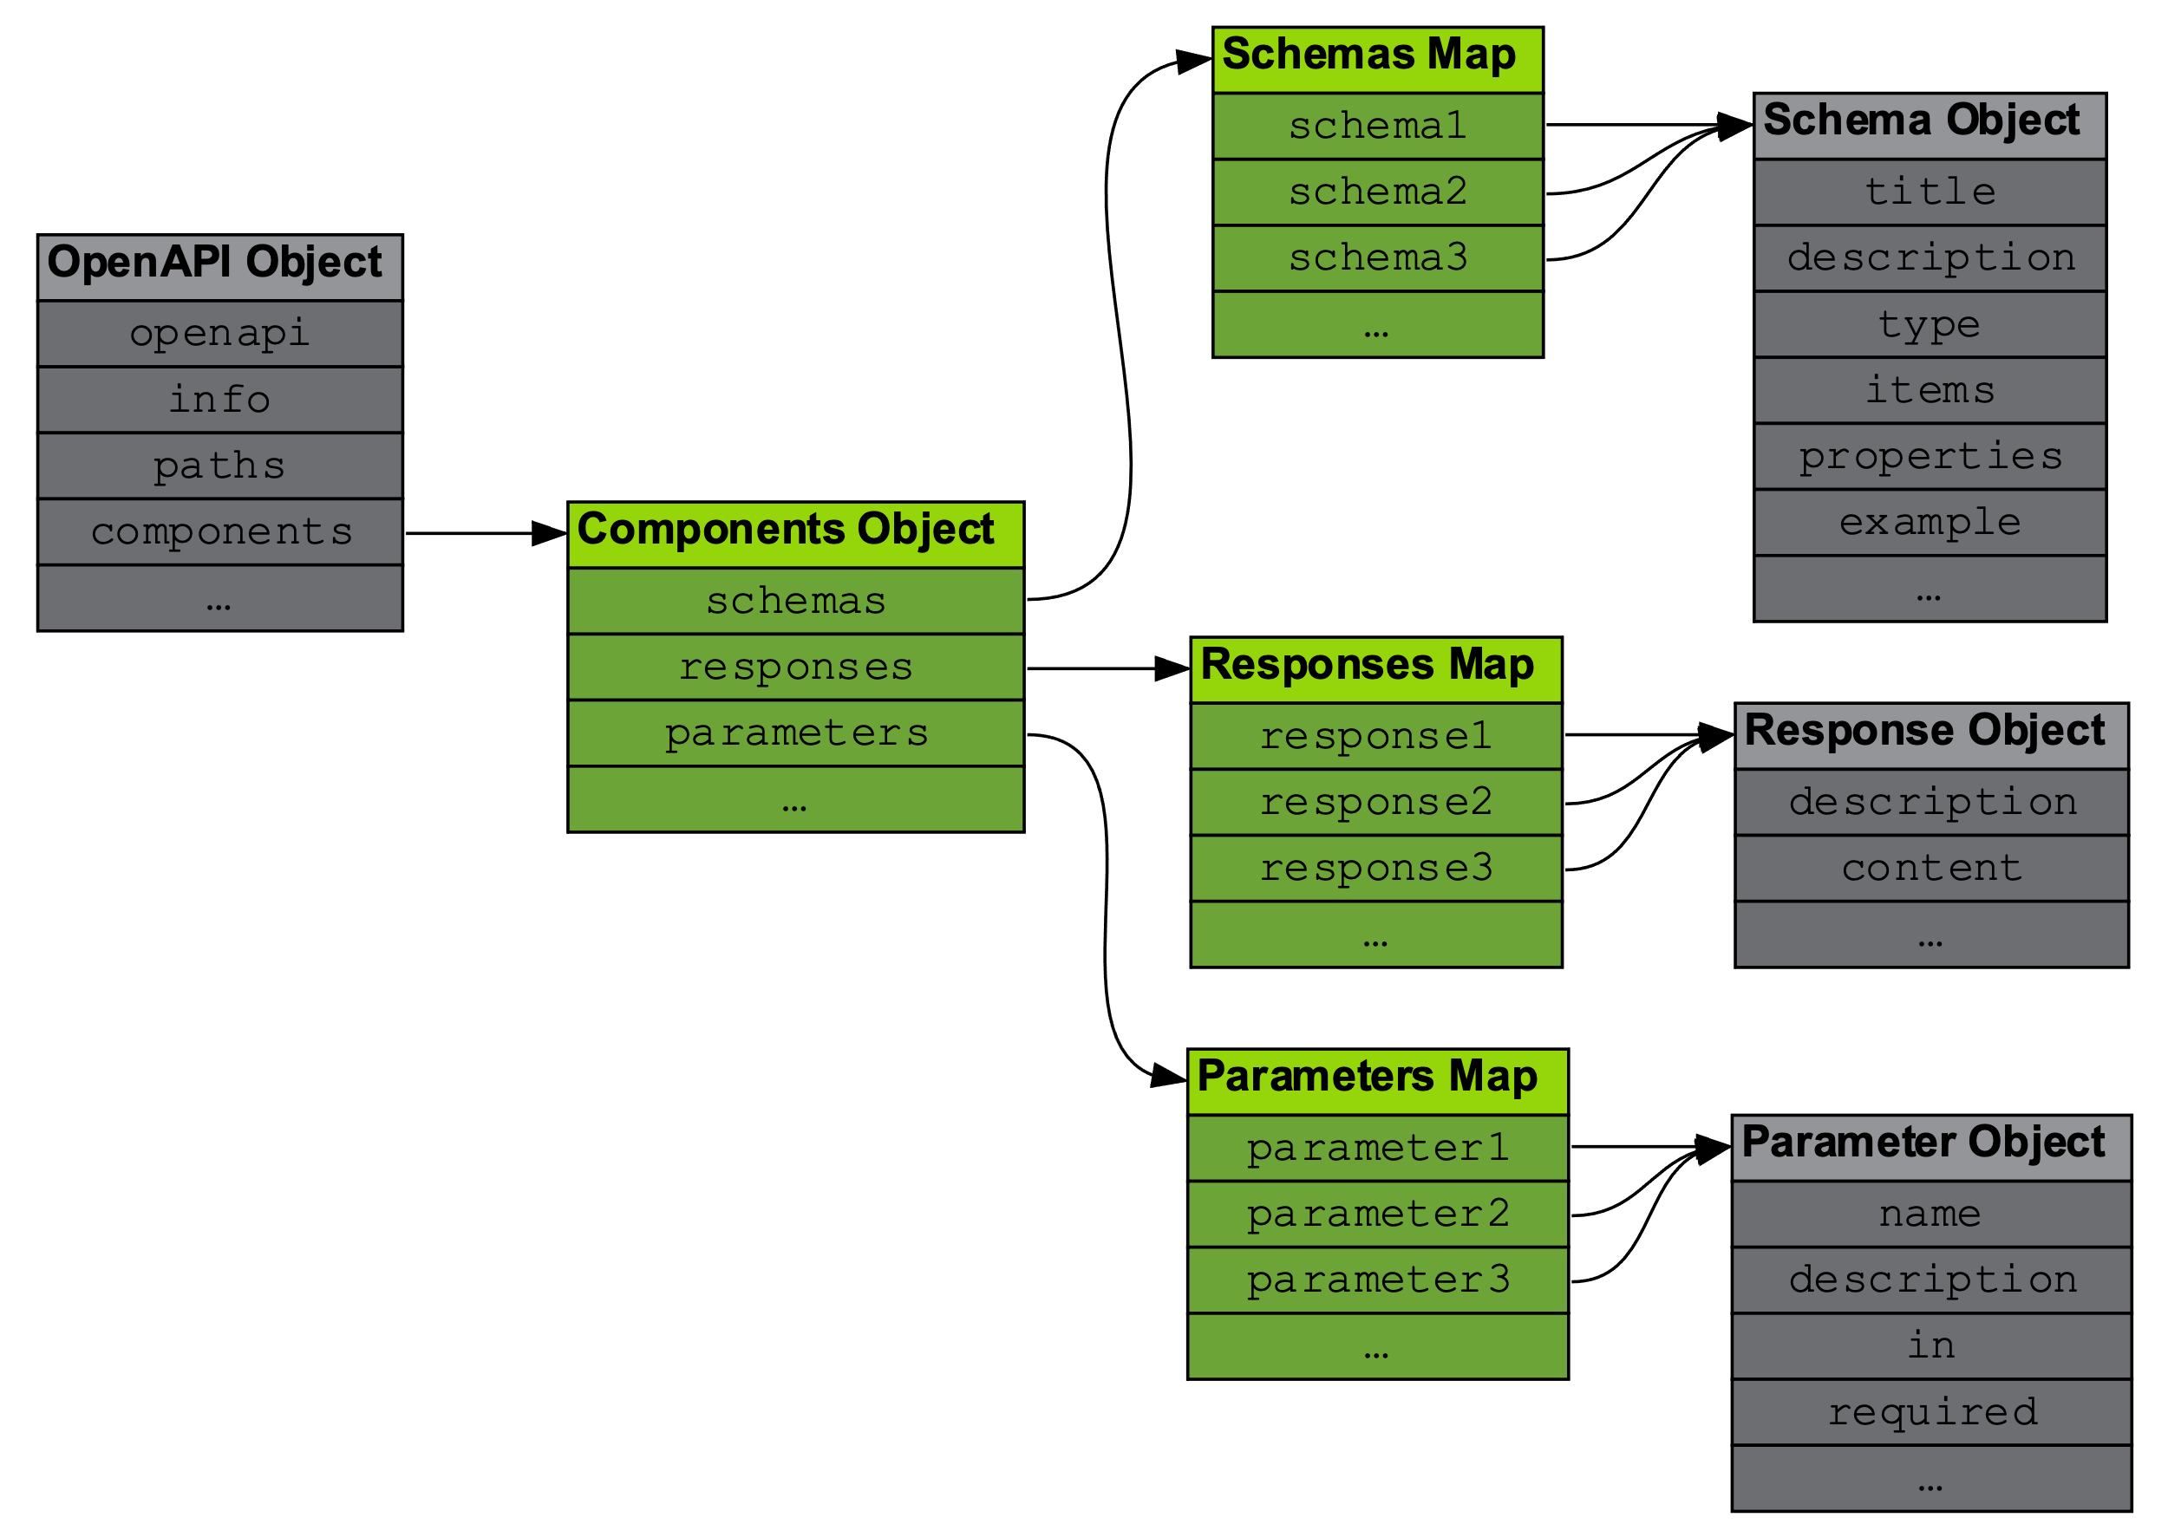
Defining Reusable Objects
Components Object is a “wrapper” for objects that can be reused, including:
Callbacks
Examples
Headers
Links
Path Items
Parameters
Request Bodies
Responses
Schemas
Security Schemes
Remote references also supported, meaning objects can be standardized across APIs, organizations or industries

Slide 20
Describing Security Requirements

Slide 21
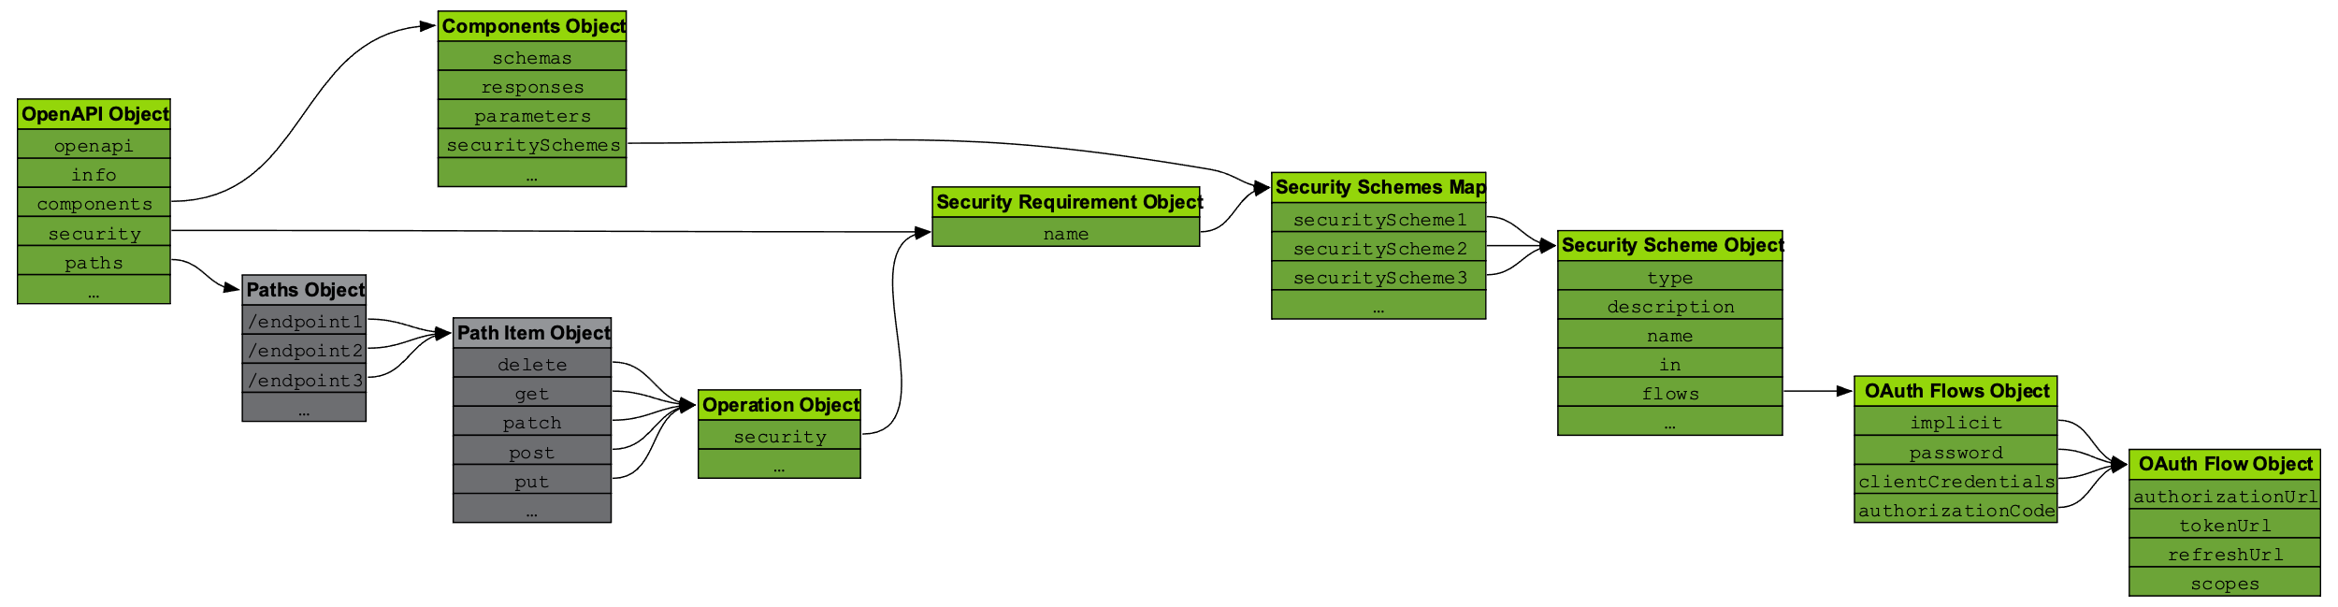
Describing Security Requirements
Support for a number of security approaches/protocols:
API Key
HTTP-based Authentication
Mutual Authentication over TLS
OAuth 2.0
OpenID Connect
Security requirements can be applied globally or to a specific Operation
Security Requirements reference a Security Scheme Object that must be declared in the Components Object
openapi: 3.1.0
...
security:
- basicAuth: []
components:
securitySchemes:
apiKey:
description: API Key
type: apiKey
name: api-key
in: header
basicAuth:
description: Basic Authentication
type: http
scheme: basic

Slide 22
Using Specification Extensions

Slide 23
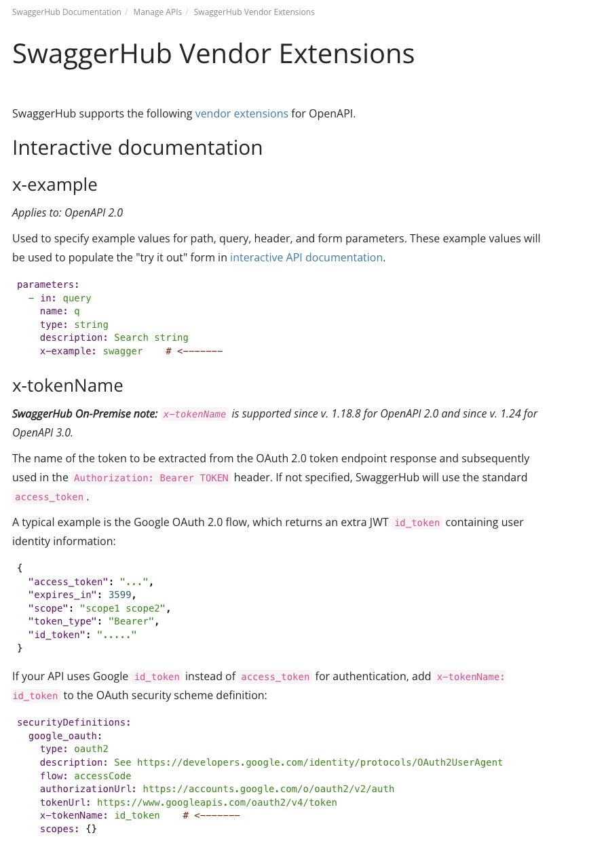
Using Specification Extensions
Provides the means to extend OpenAPI using a standardized pattern
Denoted using x- prefix
Can be implemented anywhere in the specification
Commonly used by vendors to extend implement features complementary to their products e.g. SwaggerHub

Slide 24
What We’ve Covered
HTTP in the context of OpenAPI
How an OpenAPI document is structured
The objects that make up an OpenAPI document
Where security and specification extensions fit in

Slide 25
Up Next
Module 3: Creating an OpenAPI document

