Slide 1

Stock Market Prediction Techniques
KNN, SVM, Naive Bayes, Logistic Regression, Linear Regression, CNN, and Transfer Learning
Ahmed Medhat 230065
Omar Ayman 234809
Shaza Ashraf 238765
Mohamed Sherif 234323
Andrew Talaat 237011

Slide 2
1. Introduction
• Goal: Predict future stock prices using machine learning and deep learning models.
• We explore 7 different techniques ranging from traditional algorithms to advanced deep learning.
• Performance is evaluated using multiple metrics to compare models objectively.

Slide 3
2. K-Nearest Neighbors (KNN)
• A simple algorithm that predicts based on the closest historical data points.
• Pros: Easy to understand and implement.
• Cons: Sensitive to scale and slow with large datasets.

Slide 4

3. Support Vector Machine (SVM)
• Finds the best boundary between classes or trends using support vectors.
• Can be used for regression (SVR) as well as classification.
• Works well in high-dimensional spaces.

Slide 5
4. Naive Bayes
• Based on Bayes' Theorem with an assumption of predictor independence.
• Fast and suitable for classification problems.
• Not ideal for continuous value prediction like stock prices.

Slide 6

5. Logistic Regression
• A classification algorithm that predicts the probability of a binary outcome.
• Used in stock prediction for direction (up/down) rather than exact price.
• Interpretable and fast, but limited for continuous prediction tasks.

Slide 7

6. Linear Regression
• Predicts continuous stock prices based on linear relationships.
• Pros: Simple and interpretable.
• Cons: Can underperform with nonlinear trends or complex patterns.

Slide 8

7. Convolutional Neural Networks (CNN)
• The CNN model processes a 30-day window of stock features ('Open', 'High', 'Low', 'Close', 'Volume').
• Architecture includes Conv1D, MaxPooling, Dropout, Flatten, and Dense layers.
• The model is trained using 'adam' optimizer and 'mean_squared_error' loss function for 20 epochs.
• RMSE and R² metrics are used to evaluate prediction accuracy of future 'Close' prices.

Slide 9
8. Transfer Learning
• Transfer learning adapts a pre-trained deep learning model for time series stock prediction.
• Data is scaled, sequenced in time windows, and fed into a model with pre-trained base and custom output layers.
• Performance is measured using standard regression metrics (MAE, MSE, RMSE, R²).
• Offers improved generalization with limited data by leveraging learned features from another task.

Slide 10

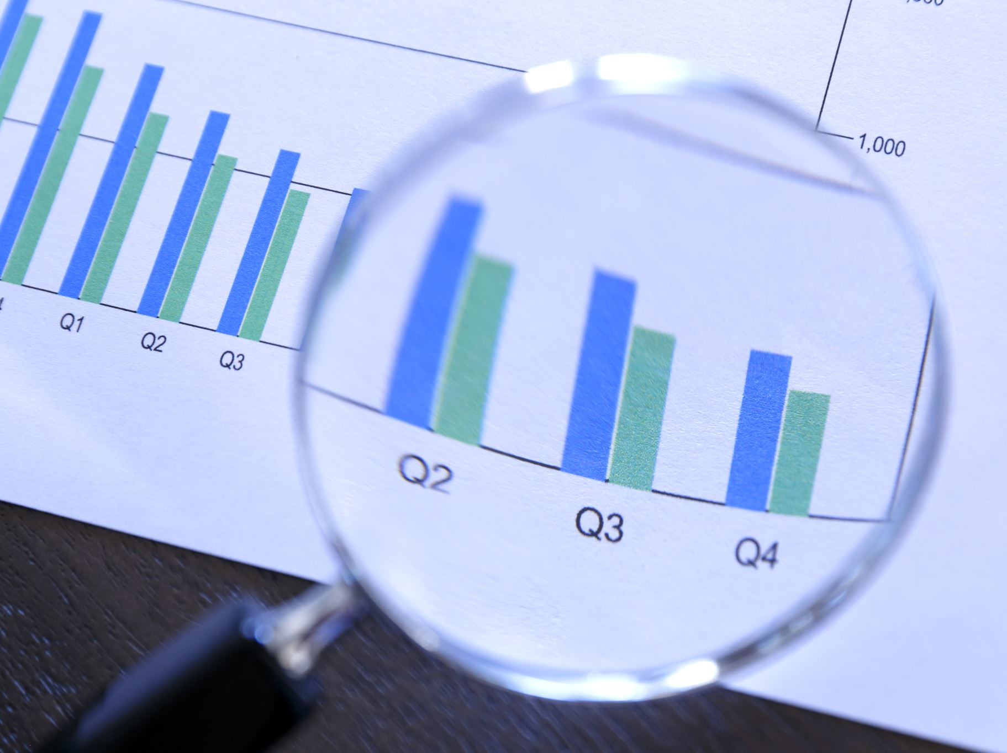
9. Summary & Comparison
• KNN, SVM, Naive Bayes, and Logistic Regression are traditional ML models.
• Linear Regression offers a basic regression baseline.
• CNN and Transfer Learning offer superior results with deeper data patterns.
• Best model depends on accuracy, training time, and data availability.

Slide 11
10. Conclusion
• Combining traditional and deep learning techniques enhances forecasting.
• Evaluation metrics such as MAE, RMSE, R² help compare models.
• Future improvements: feature engineering, hybrid models, and real-time prediction.

