Slide 1

Your name
Your email address
Notes:
Introduce yourself and other youth and adult presenters.
We are here to tell you about SURGE and how it can be implemented in our Lodge and your Chapter.
SURGE was developed in Section W-2W, that includes lodges in Utah, Idaho and Wyoming, specifically for outreach to units that are chartered by the Church of Jesus Christ of Latter-day Saints. The units make up the vast majority of Scouting in section W-2W.

Slide 2
S UPPORTING
U NITS through
R EALLY
G REAT
E LECTIONS
Notes:
SURGE (letters are revealed with each click)
SURGE - Strengthening Units through Really Great Elections.
But it goes beyond elections! SURGE starts with the unit election, but it also requires a strong lodge and chapter program, including:
An effective and meaningful Induction Weekend
Meaningful service projects
Polished induction ceremonial teams
Meaningful interaction with lodge and chapter members including Elangomats
A great new member orientation
Organized fellowship and service activities
Productive quality chapter and lodge meetings
If you do not have a quality program it is unlikely you will be able to maintain a continued relationship with your LDS units or their members.
This course is created to provide Arrowmen with necessary information on how to engage LDS Units and begin to establish a tradition of each unit holding an annual Order of the Arrow unit election. You (unit election teams/coordinators) are the most critical part of SURGE. We need you to establish a relationship that leads to annual elections into Scouting’s National Honor Society.

Slide 3
WHY SURGE?
Two Main Pain Points:
1. Low participation in Scouting’s National Honor Society by units chartered by the Church of Jesus Christ of Latter-day Saints.
The OA has lost, or never had, a relationship with their LDS units.
Notes:
What are the main pain points?
Low participation in Scouting’s National Honor Society by LDS Units.
In most BSA councils, the OA has lost, or never had, a relationship with their LDS units.

Slide 4
WHY SURGE?
2. Poorly trained election teams leave a poor impression on the members of the units
  Bad impressions discourage candidates from becoming inducted
Notes:
Poorly trained election teams leave a poor impression on the members of the units, youth and adults.
We find we often hurt ourselves with poorly trained election teams, which leave a bad impression that results in newly elected Scouts not attending their “Induction Weekend”. These bad impressions are also left on parents, church leaders, and Scoutmasters, making our outreach much more difficult long-term.

Slide 5
The Facts
1 in 6 Scouts are LDS
Less than 1 in 100 Arrowmen are LDS
LDS units are in every council – including yours
Incredible untapped potential
Notes:
The Facts
1 in 6 Boy Scouts are in an LDS unit, yet less than 1 in 100 Arrowmen are LDS.
There are LDS units in every council in the BSA - including every council in your area!
SURGE is designed to help you reach out to them, maybe for the first time in decades!
There is an incredible amount of untapped potential and that potential also exists in your chapters, lodges and section.

Slide 6
The Question:
The Facts
If the Order of the Arrow had proportional participation by LDS units, how many additional Arrowmen would you guess would be in the OA?
Notes:
Ask the audience, “If the Order of the Arrow had proportional participation by LDS units, how many additional Arrowmen would you guess would be in the OA? Raise your hand if you would guess 2,500. Keep them up if you think 5,000? ...8,000?
… Keep them raised if you think 10,000? Would you believe…

Slide 7
The Answer!
35,000!
Notes:
Over 35,000 more members! And the lion share is in the Western Region! (does not apply if you aren’t in the Western Region)
This is why we’re here today. We want to help your lodges reach out to the LDS units in our council to both strengthen our lodge and provide the chance for the LDS youth in the council that are missing out on the incredible opportunity that is the OA.

Slide 8
The Facts
What do we do about it?
Notes:
This is the Set Up / Intro to the SURGE Video

Slide 9

Video to be placed here.
Notes:
Play the video – 6 minutes

Slide 10
SURGE: Solutions
We dropped using “Ordeal Weekend” in favor of more positive “Induction Weekend.”
We rely heavily on term, “Scouting’s National Honor Society”.
Created LDS Unit Election Video!
Notes:
We have dropped the term “Ordeal Weekend” in favor of the more positive, encouraging term “Induction Weekend”.
We emphasize the term “Scouting’s National Honor Society”. Parents and Scoutmasters should want their boys to be part of the OA and not left out of our great Brotherhood.
Created LDS Unit Election Video!
We want this to be a tool for lodges and chapters to use, think of it as an Arrow in your Quiver (meaning it is a tool, when used properly can be effective). It is not a replacement for quality program – Quality Induction Weekends, meaningful chapter and lodge meetings and fellowships.
The video has two purposes. It is designed it to be shown at a troop meeting the night of the OA unit election. It is also designed to be shown to parents, Scoutmasters, Church Leaders, at round-tables, and other meetings to tell the story of “Scouting’s National Honor Society”
It is intentionally made to be familiar to any LDS Scout or Scouter. LDS Scouts will immediately recognize the church, the meeting room, and even the hymns used in the scoring of the video.
Be aware that your Induction Weekends must be compatible with the needs of LDS Scouts – That means being flexible about time of your Saturday ceremony for LDS Scouts so they can return home at a reasonable hour Saturday evening. This enables them to attend Sunday LDS services. This is an essential part of LDS unit outreach and in W-2W it has become an easy and inclusive accommodation to make.
This video, along with a “How to use it” guide is available for your use with LDS units in your lodge or chapter.

Slide 11
The Facts
Mark Francis
Director of LDS-BSA Relationships
15 West South Temple, Suite 1070
Salt Lake City, UT 84101-1579
Phone: (801) 530-0004
Mark.Francis@scouting.org
Notes:
If your lodge or chapters are having problems reaching a Stake President or a Stake Young Men’s President, Mr. Francis can help facilitate a contact for you. He is a former Lodge Chief and a youth Vigil Honor member. He is interested in helping. He is not your contact for scheduling a unit election.

Slide 12
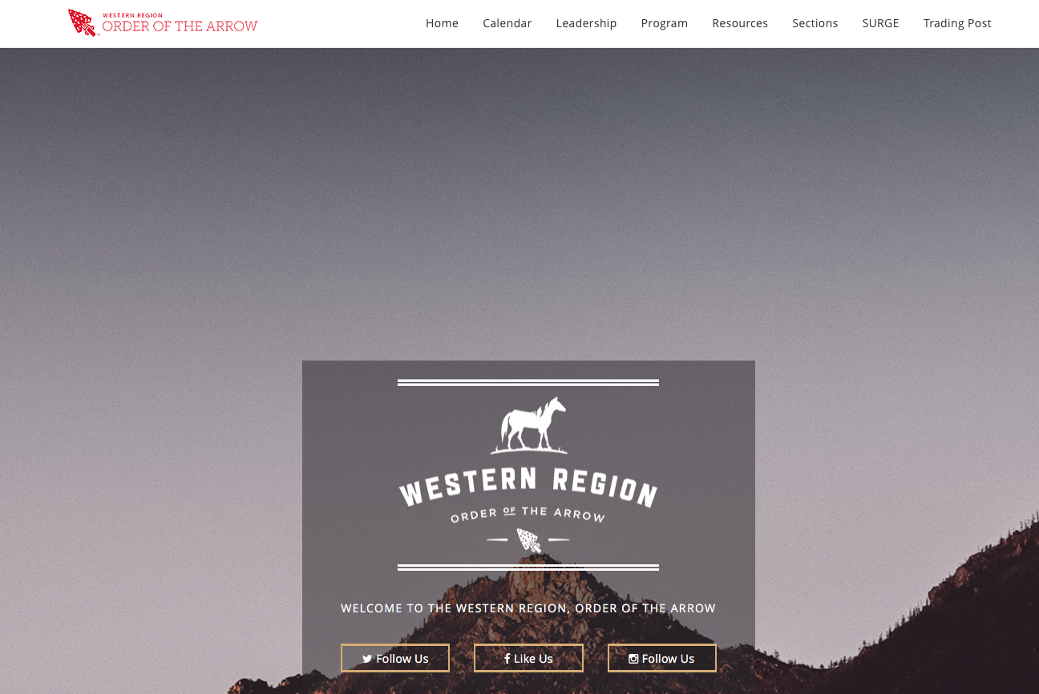
To obtain LDS Unit Election video and other
resources, select the SURGE tab at the top of the Western Region website:
http://western.oa-bsa.org
Notes:
Direct Arrowmen to the SURGE tab at the top of the Western Region website - http://western.oa-bsa.org homepage for SURGE information and to request the video. There is a SURGE tab in the upper right corner of the landing page.
This is also where you download the “How to Guide”.

Slide 13
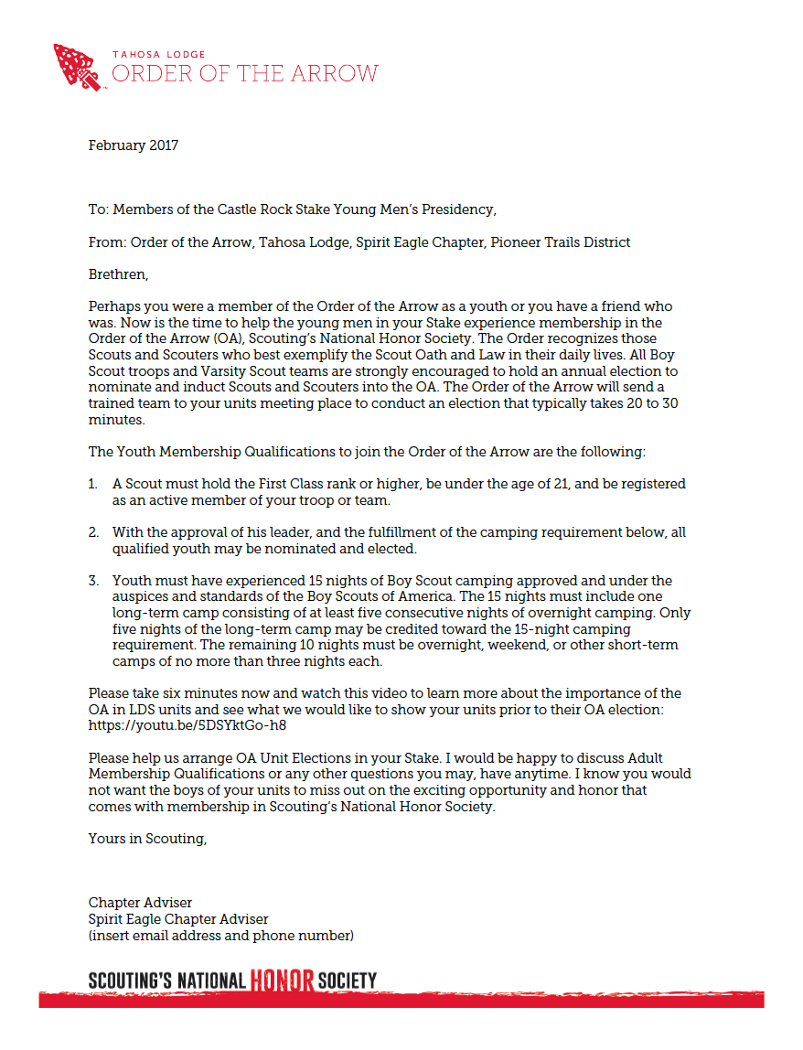
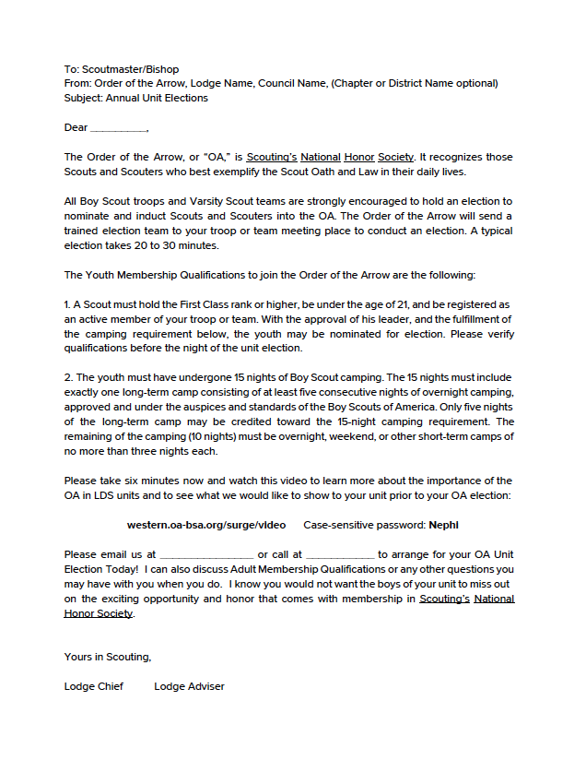
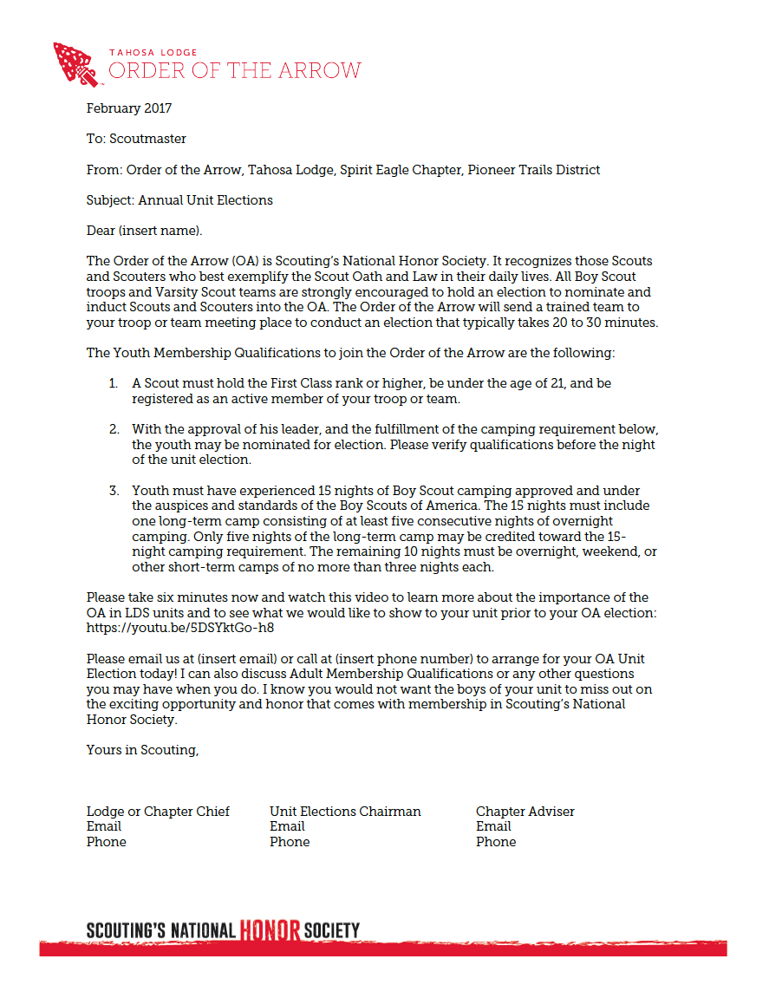
Sample Letters
Notes:
Communication is important. This is a sample letter that can be used to make a first contact with the unit leader
How to use this letter:
This letter can be sent as an email or as a mailed letter. It is recommended that you contact the unit/church leaders two months in advance of an anticipated unit election.
Approximately two weeks after this letter is sent, it is appropriate to follow up with a phone call to coordinate the details of the unit election.

Slide 14
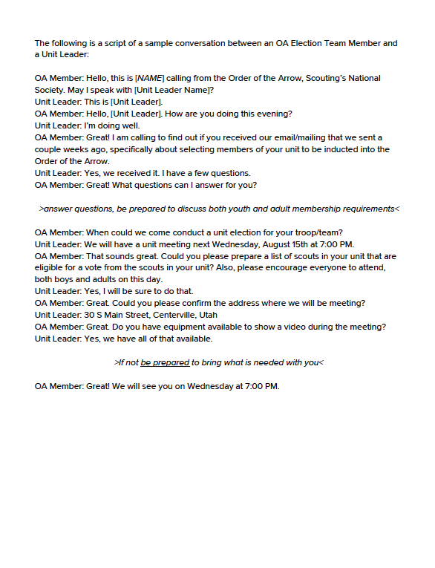
Sample Conversation
Notes:
You are going to be speaking to Scoutmasters and Bishops about the Order of the Arrow and arranging for their units to have OA elections. This may be new for some of you, so we are going to practice how to make such a phone call.
The following is a script of a sample conversation between an OA Election Team Member and a Unit Leader:

Slide 15
Guidelines
Complete Scout Uniform
Arrive early
Be prepared
Notes:
General Guidelines when conducting a Unit Election
Always wear a complete and clean Scout Uniform. (including the OA sash, a key symbol of our Order)
Arrive 15 minutes early to talk with unit leaders before the unit election begins
Have materials ready for voting.

Slide 16
Conducting an Election
Discuss the importance of the OA
You are a representative of the OA
Have a copy of the Guide to Unit Elections available
Notes:
Be Prepared to discuss the importance of the OA and the exact youth and adult membership requirements.
Remember that you are a representative for Scouting’s National Honor Society.
Have a copy Guide to Elections available (can be on your phone, if you need to look something up.

Slide 17
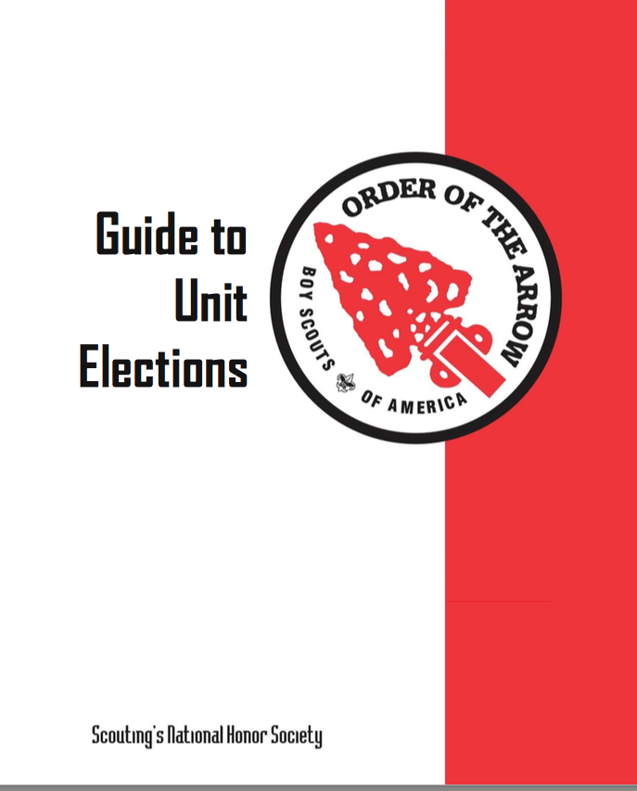
Guide to Unit Elections
http://www.oa-bsa.org/pages/content/guide-to-unit-elections
Notes:
After the Unit Election Team shows the LDS unit election video to the unit, the election team is encouraged to answer any questions Scouts may have.
When using the LDS Unit Election Video, it is important that the election team is prepared to present the program using a computer and projector or large screen TV. If you have access to a projector, make sure it is available and in your possession at the time of your appointment. Make sure you have rehearsed using your computer, the cable connecting the computer to the projector, the projector and an extension cord and plug strip.

Slide 18
The Facts
Any Questions?
Notes:
Introduce any LDS or Lodge leaders that are present and able to answer questions.
Take questions.

Slide 19
Email us with questions!
surge@oa-bsa.org
Notes:
For more information contact surge@oa-bsa.org

Slide 20
2.24.17
Notes:
The end!

