Slide 1
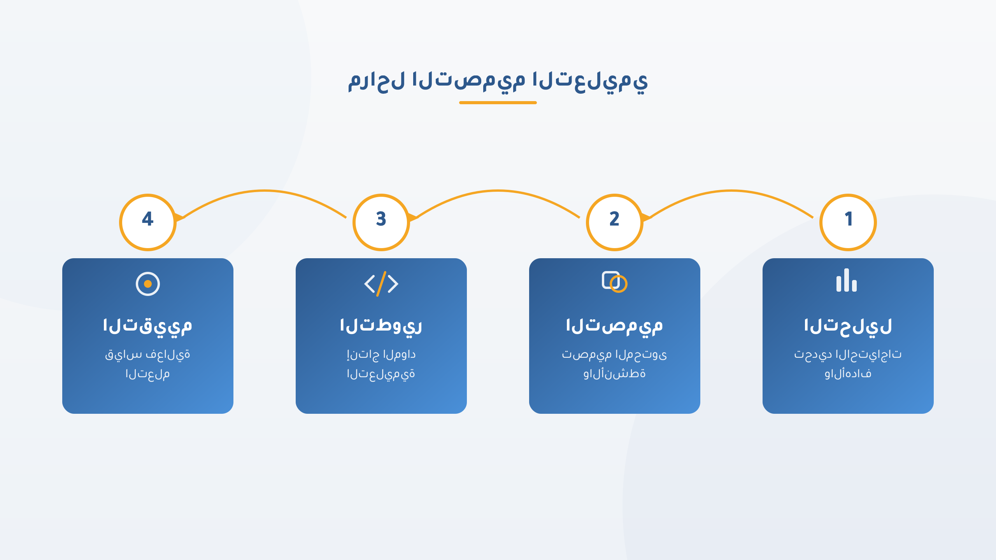
process_flow
Notes:
SVG Pattern: process_flow
File: /Users/qusaiabushanap/dev/storyboard/output/TEST/slides/pattern_process_flow.png

Slide 2
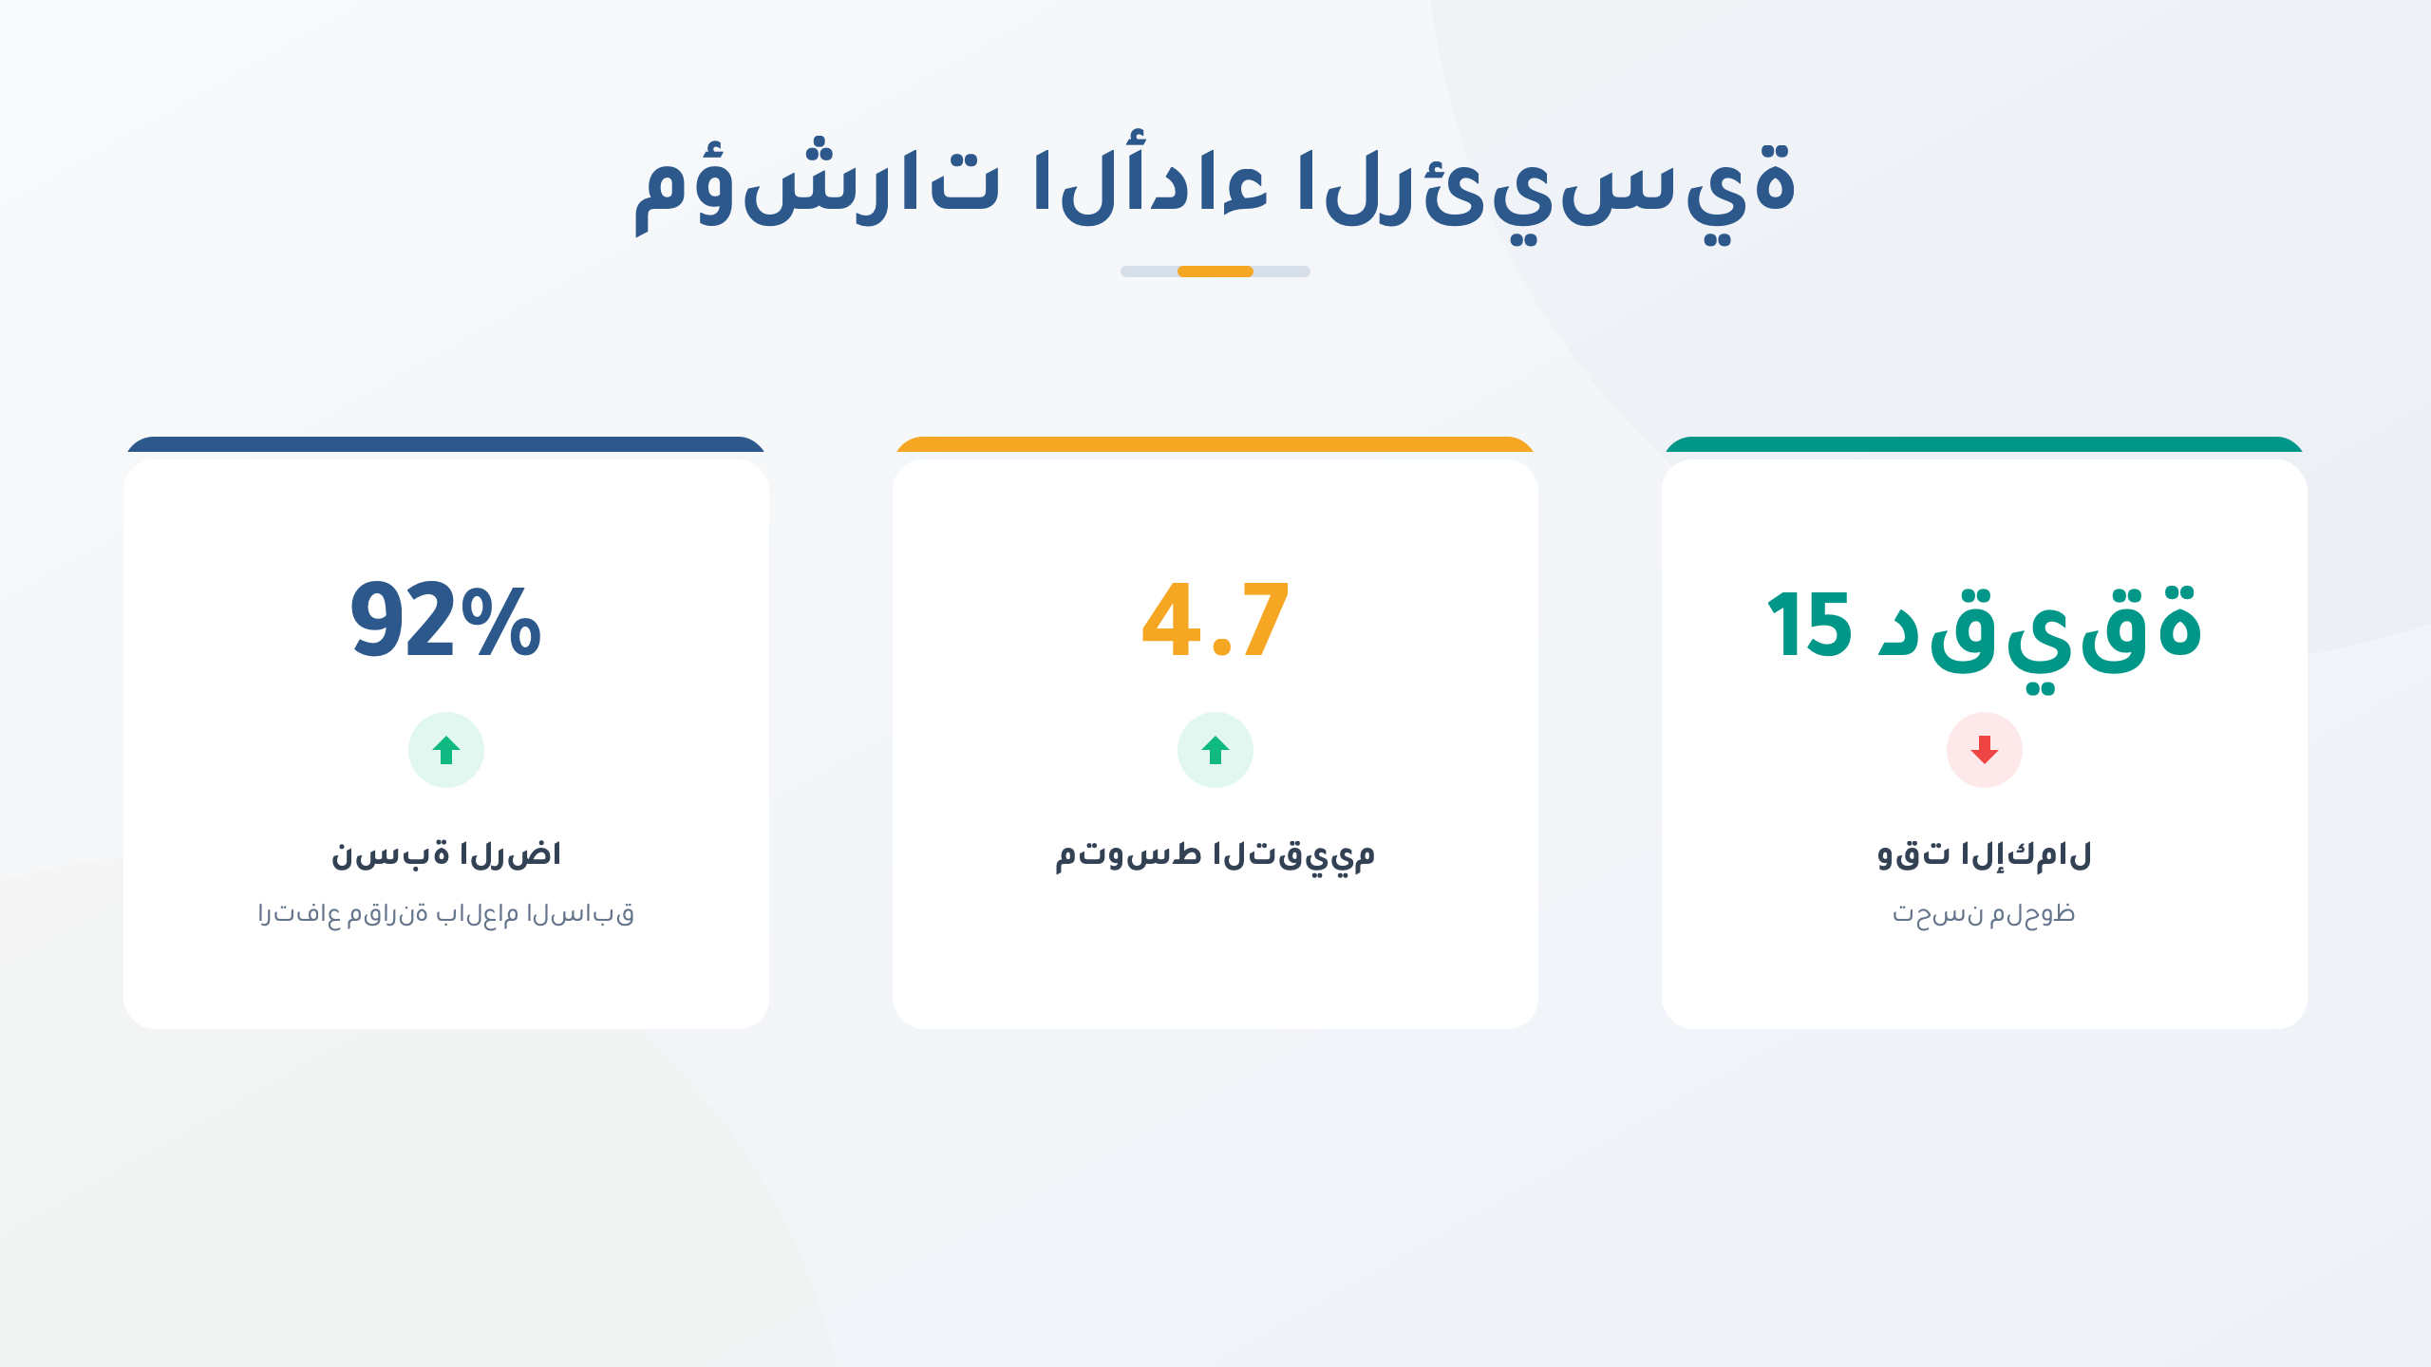
stat_cards
Notes:
SVG Pattern: stat_cards
File: /Users/qusaiabushanap/dev/storyboard/output/TEST/slides/pattern_stat_cards.png

Slide 3
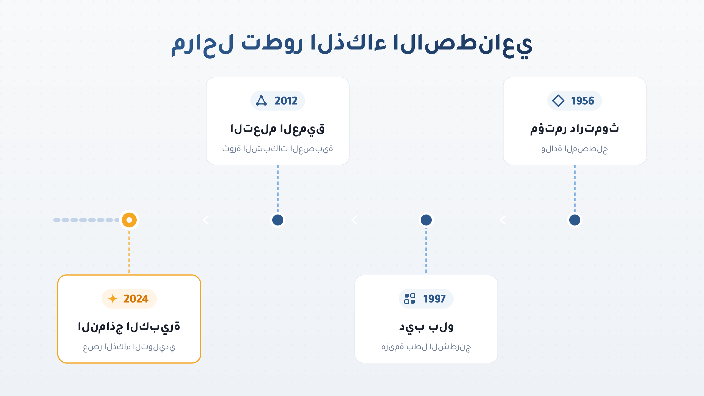
timeline
Notes:
SVG Pattern: timeline
File: /Users/qusaiabushanap/dev/storyboard/output/TEST/slides/pattern_timeline.png

Slide 4
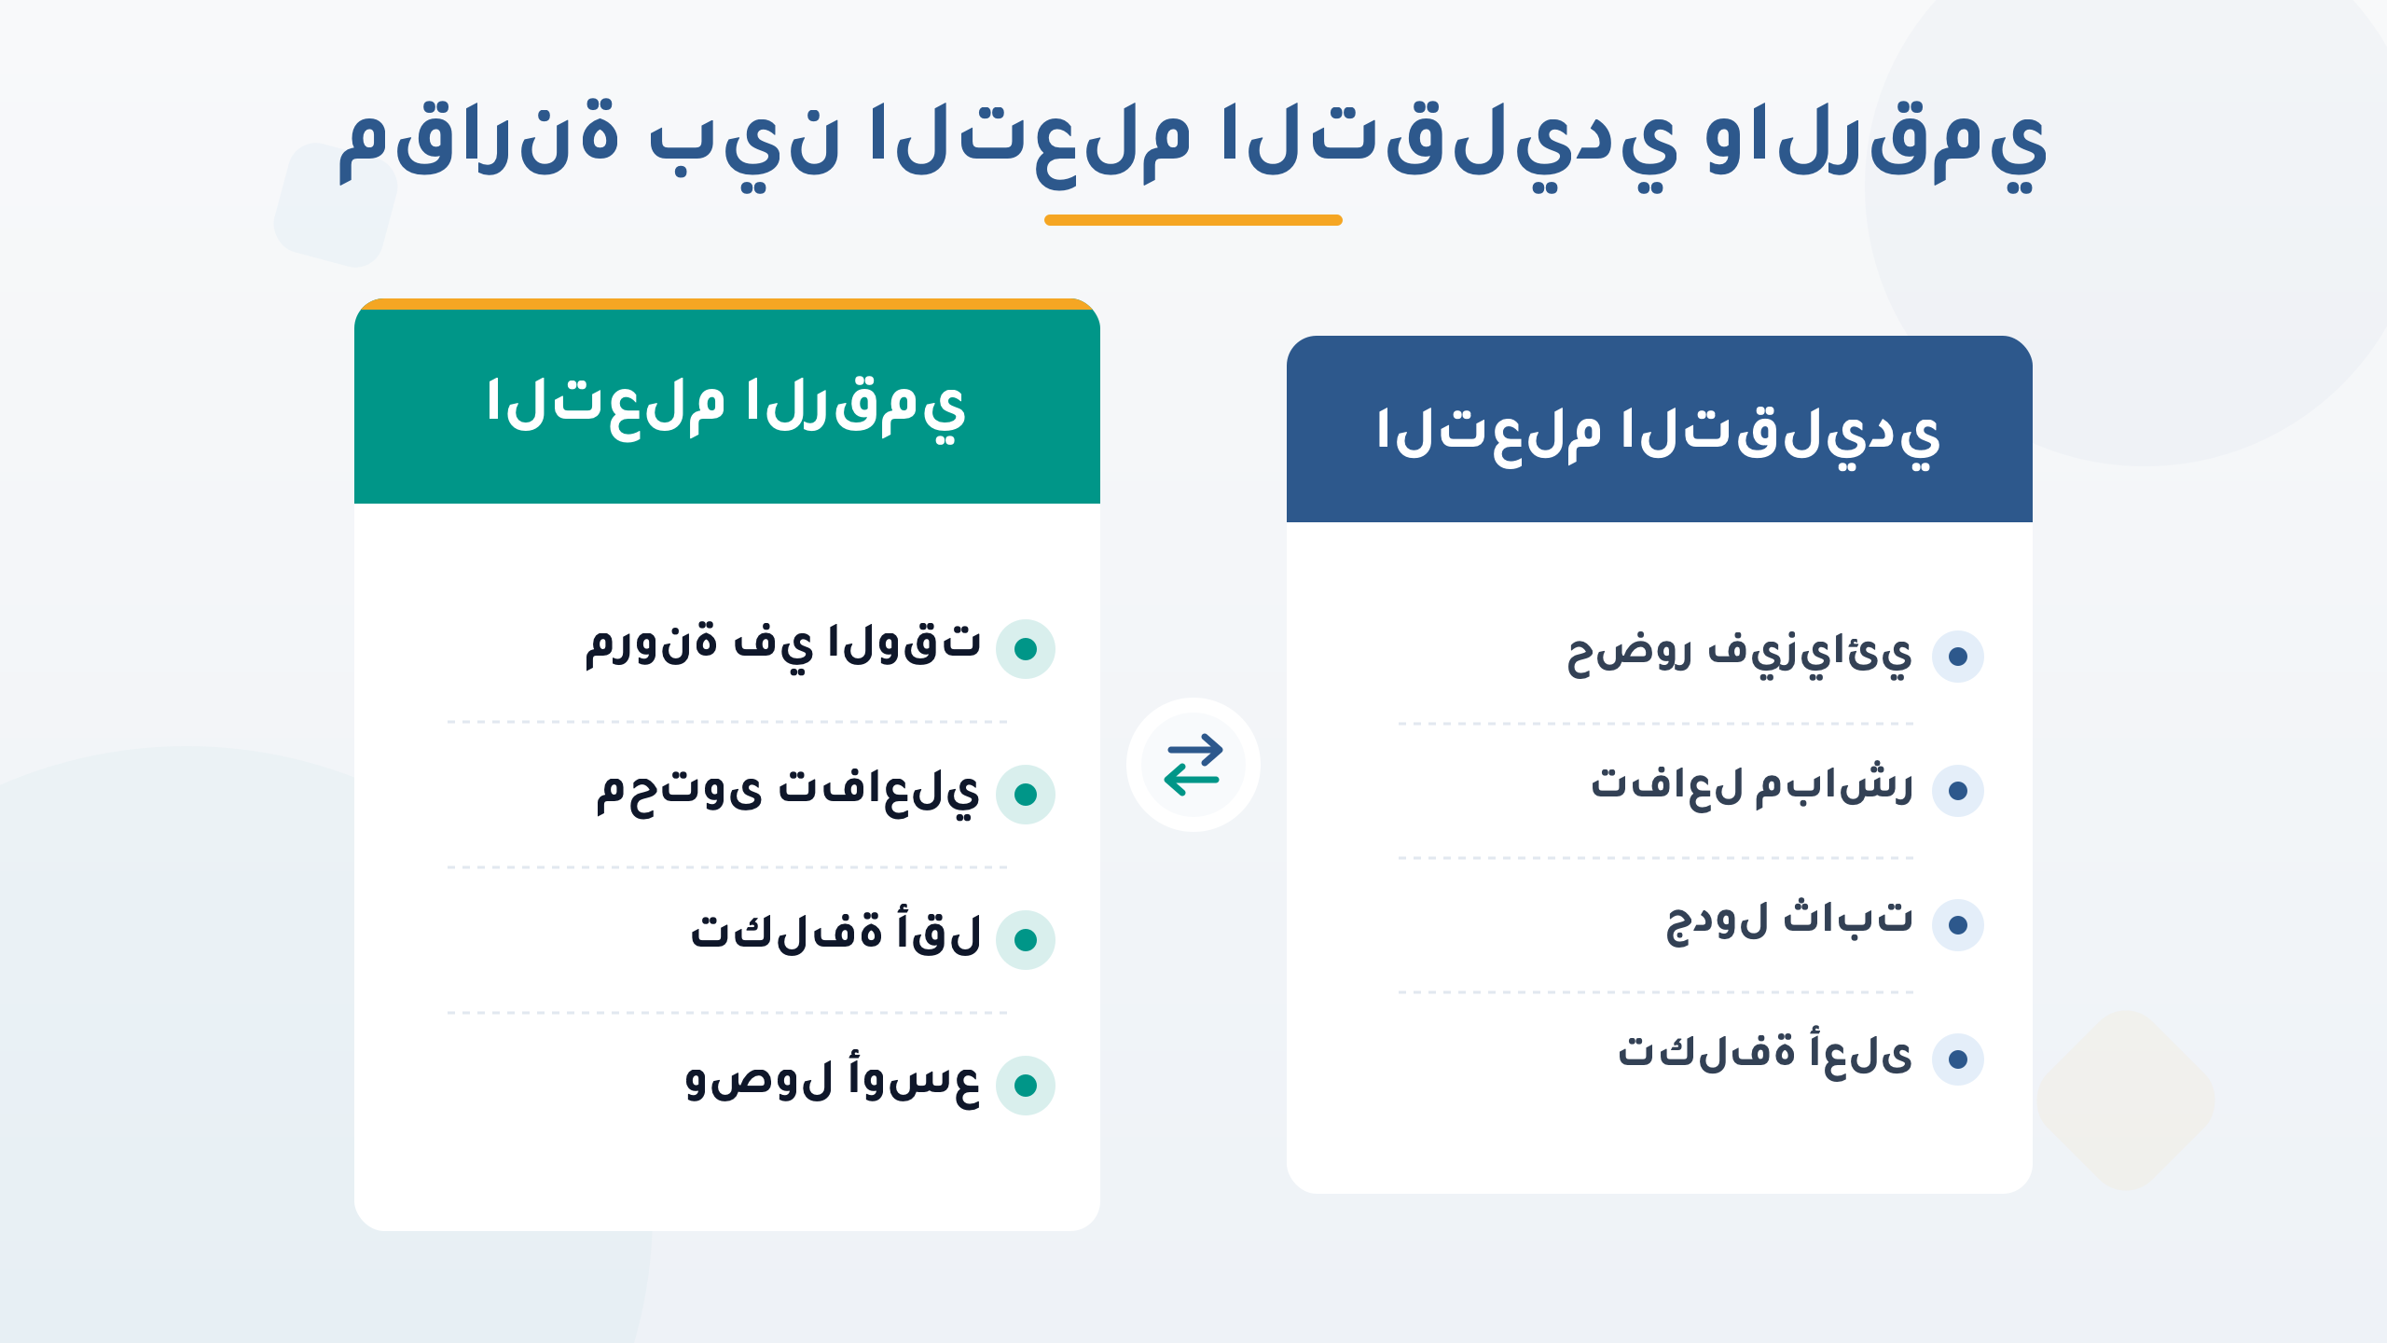
comparison
Notes:
SVG Pattern: comparison
File: /Users/qusaiabushanap/dev/storyboard/output/TEST/slides/pattern_comparison.png

Slide 5
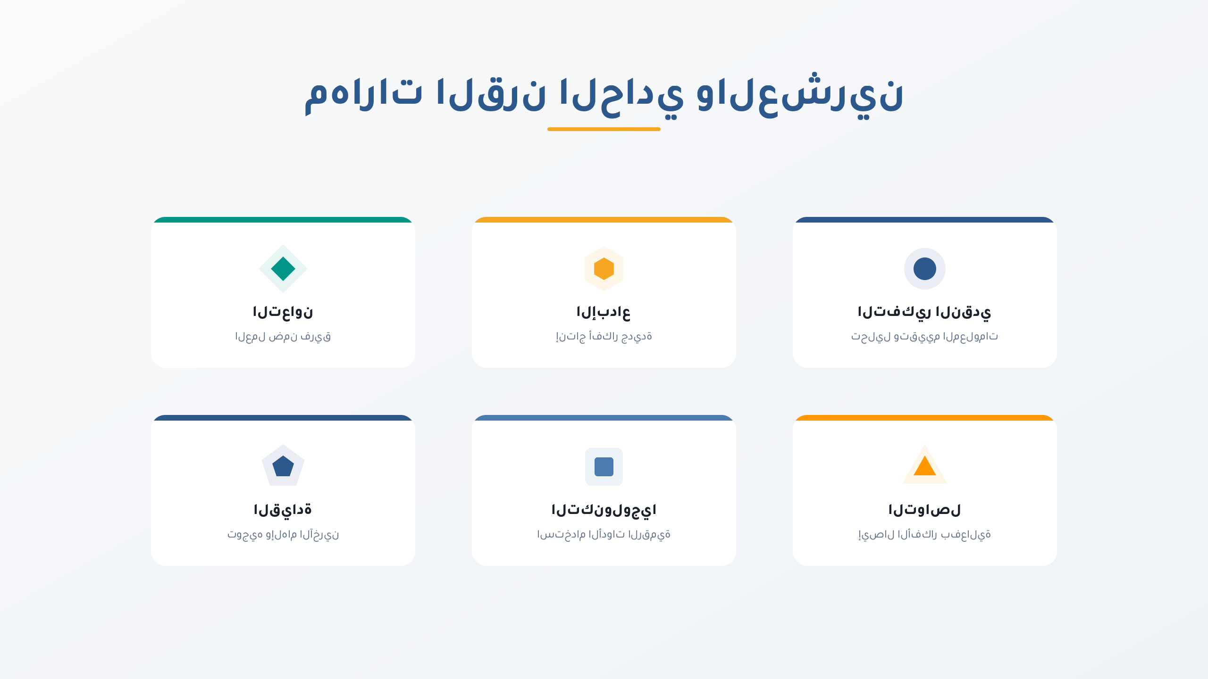
icon_grid
Notes:
SVG Pattern: icon_grid
File: /Users/qusaiabushanap/dev/storyboard/output/TEST/slides/pattern_icon_grid.png

Slide 6
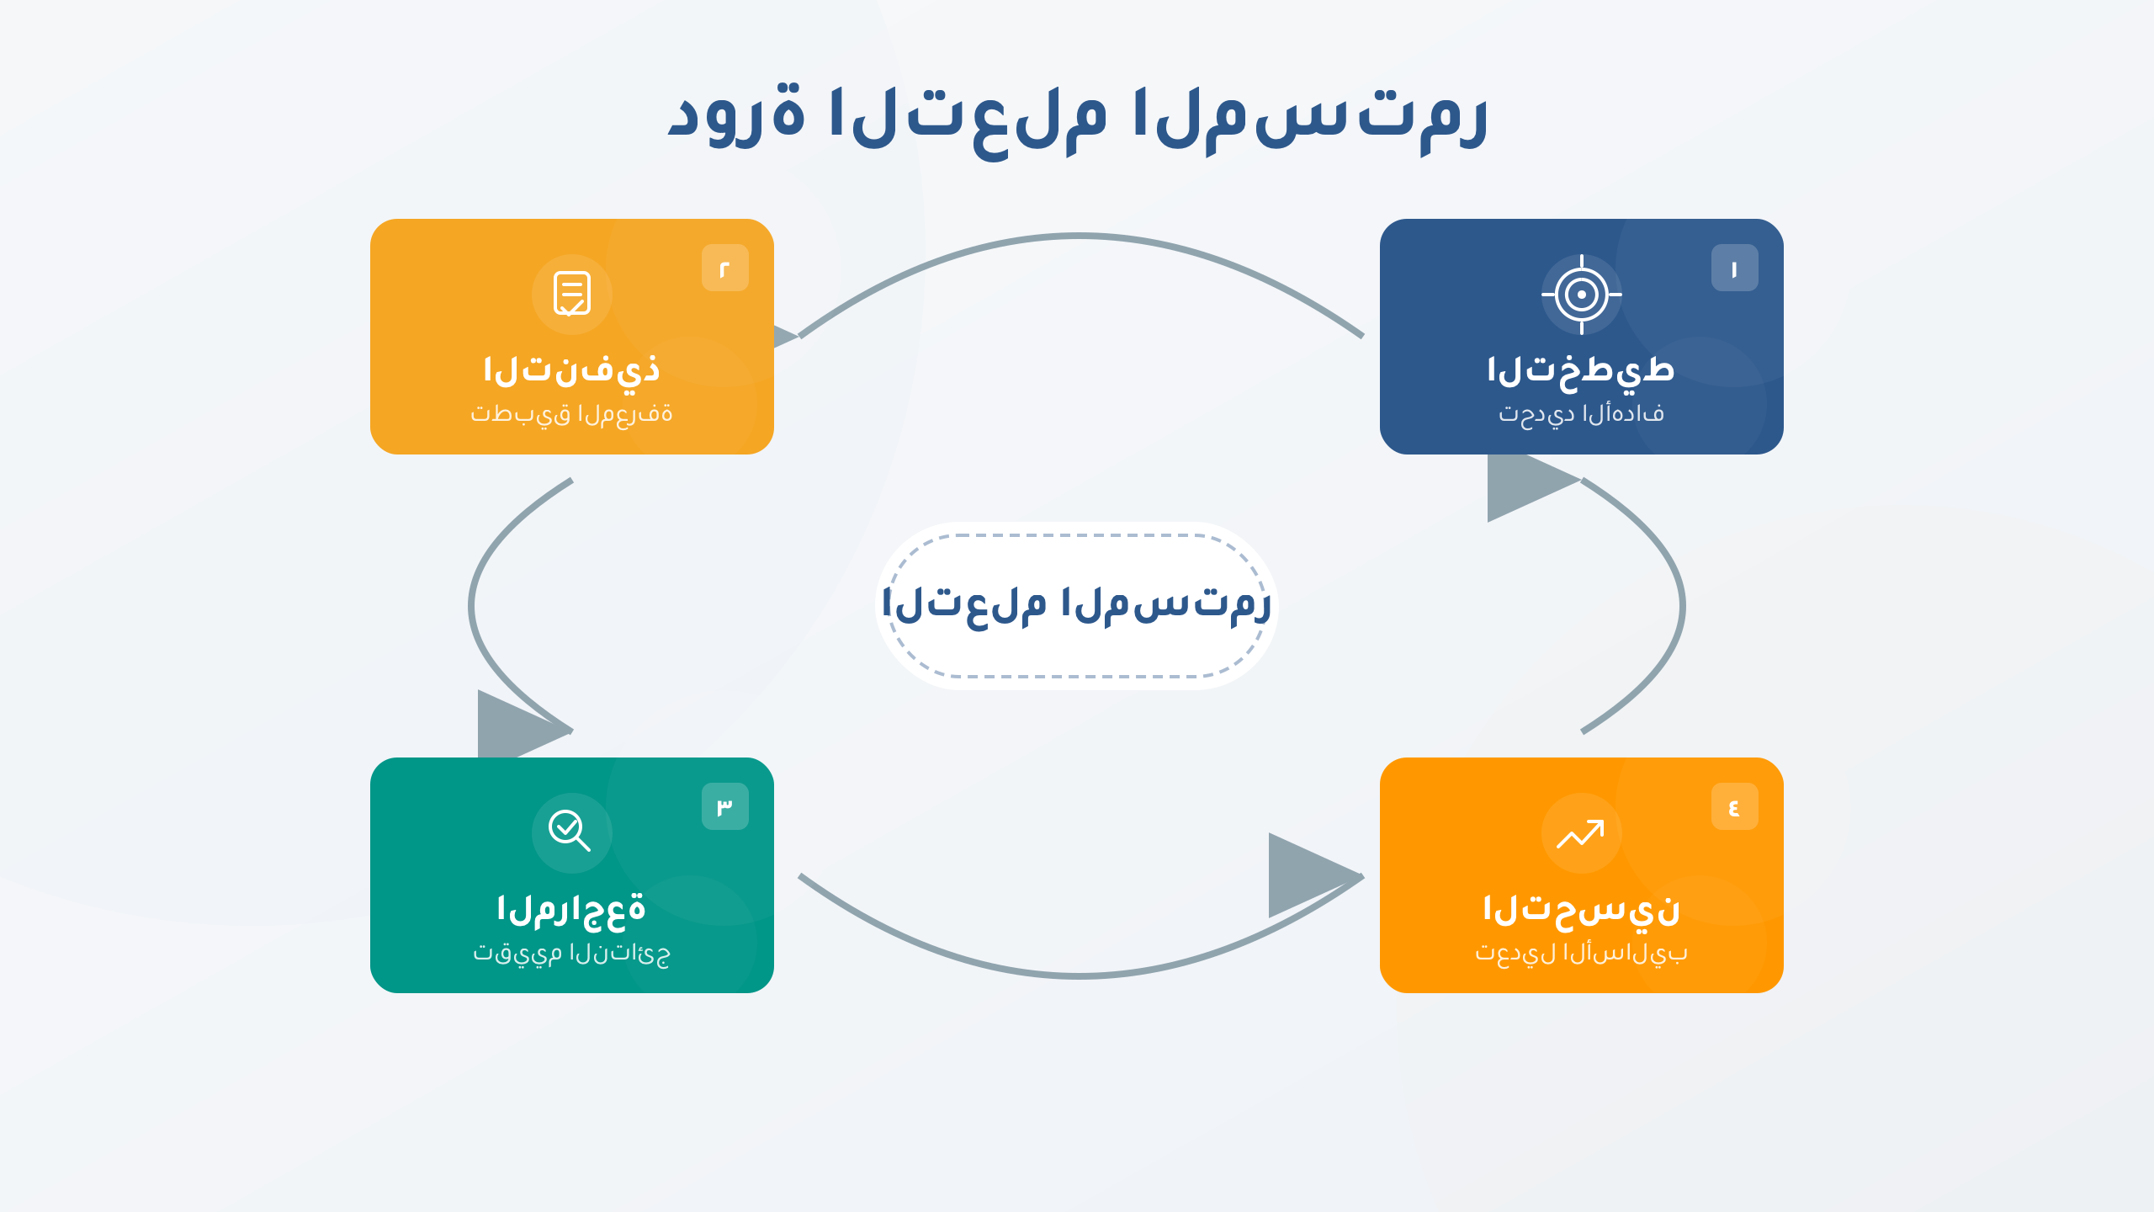
cycle
Notes:
SVG Pattern: cycle
File: /Users/qusaiabushanap/dev/storyboard/output/TEST/slides/pattern_cycle.png

Slide 7

quote
Notes:
SVG Pattern: quote
File: /Users/qusaiabushanap/dev/storyboard/output/TEST/slides/pattern_quote.png

