Slide 1
Analysis of New York City Condo Evaluation for Fiscal year 2011-2012
Team:
Femi Adesanya
Dominique Edwards
scott AndErwald

Slide 2
Introduction
This project explores the New York City housing market.
Before the recession of 2008 there has been an increase in housing prices within the Boros of New York.
The dataset is from a 2011 project by New York City from several public agencies.
This dataset includes information on housing data split by Boros which consist of 14 variables and 2626 records.

Slide 3
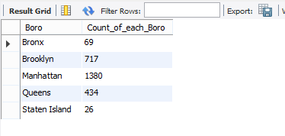
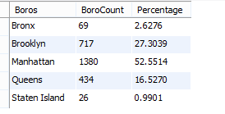
Data Analysis
Dataset was stored in a csv format and imported into a MySQL server.
Analysis is based on comparing the five different Boros .
Manhattan Boro had the highest number of
records.
Further analysis revealed the Manhattan Boro
contained over 52 % of the records

Slide 4
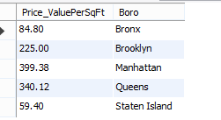
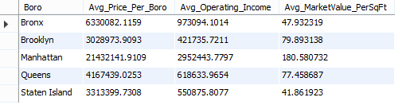
Data Analysis cont.
Upon further analysis the Manhattan Boro had the highest value per sq. ft.
The lowest value per sq. ft. belongs to the Bronx.
Next the average of the three variables were
compared.

Slide 5
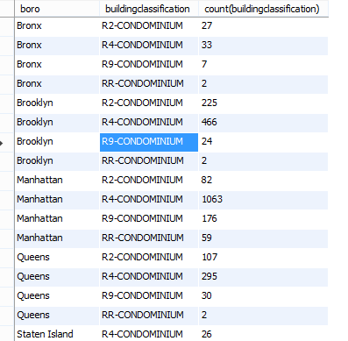
Data Analysis cont.
Next we looked the most common building classification per Boro
The Manhattan Boro has the highest
number of condos for.

Slide 6
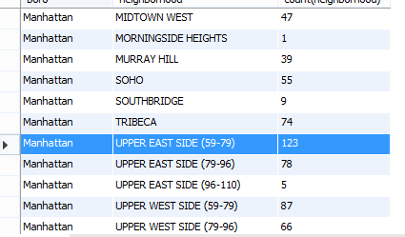
Within the Manhattan Boro the Upper East Side has the highest amount

Slide 7
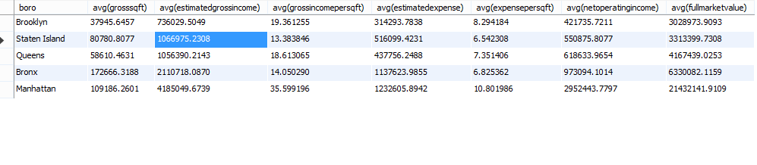
Summary
Based on the analysis we found that
Manhattan Boro has the most expensive condos on average
Manhattan highest average as it relates to
gross income
expense per sq. ft.
Despite the fact of the higher expense of living in Manhattan there appears to a large amount of condos in the Boro

Slide 8
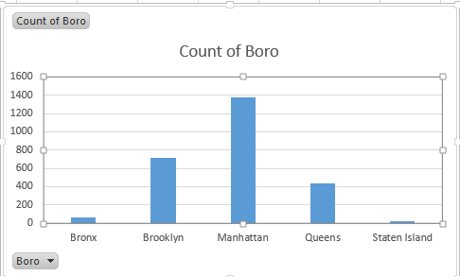
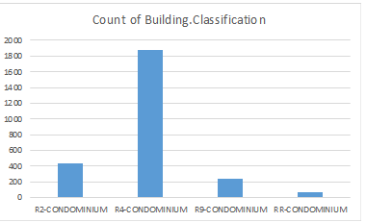
Data Visualization

Slide 9
Experimental Specification
Olufemi Adesanya
Scott Anderwald
Dominique Edwards
Software: MySQL 5.7.15
Database Server: MySQL/university
Cpu Memory : 64-bit Operating System, x64-based processor/ 8.00GB Ram
Processor: Intel(R) Core™ i7-4700MQ CPU @2.40GHz
Data Size: 276kb
Software: MySQL 5.7
Database Server: MySQL/root
Cpu Memory : 64-bit Operating System, x64-based processor/ 6.00GB Ram
Processor: Intel(R) Core™ i3-5015U CPU @2.10GHz
Data Size: 276kb
Software: MySQL 5.7
Database Server: MySQL/root
Cpu Memory : 32-bit Operating System, x64-based processor/ 4.00GB Ram
Processor: Intel(R) Core™ i3-5015U CPU @2.10GHz
Data Size: 276kb

Slide 10
References
http://www.jaredlander.com/datasets/
https://nycopendata.socrata.com/data?cat=housing
https://github.com/OAdesanya/MSDS7330
database size = 276 kb

