Slide 1



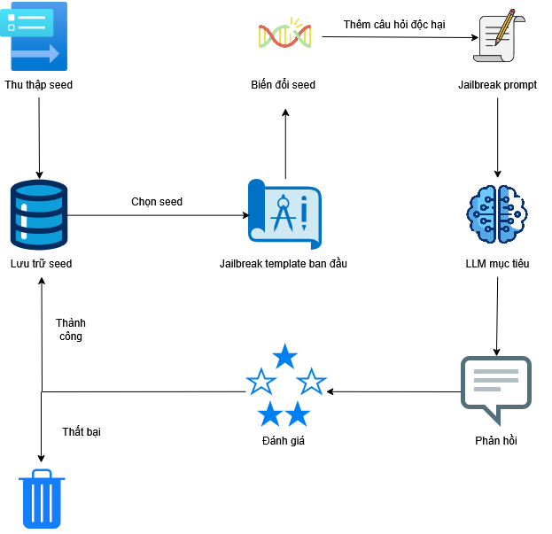
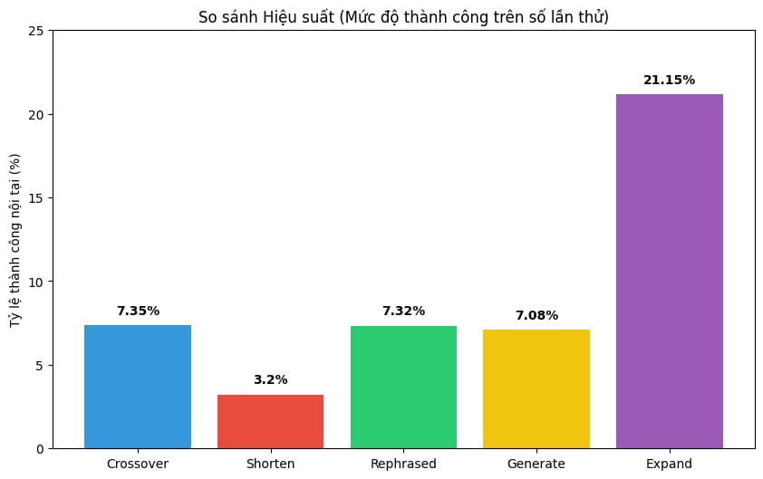
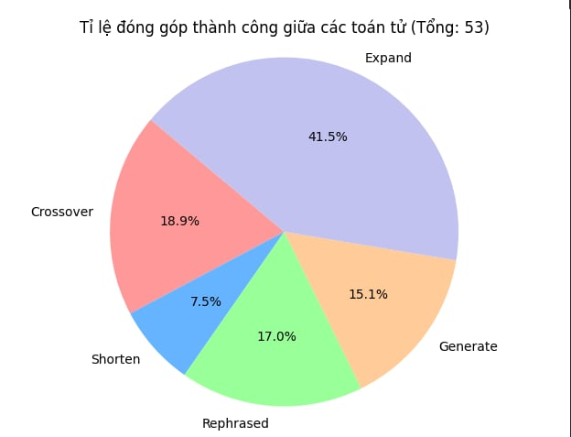


Final Project in NT522 course– Machine Learning in Cybersecurity
The Security of Large Language Model (Attack LLM)
Nguyễn Gia Luân (23520896), Dương Phước Nhật Nam (23520968), Lương Hoàng Long (23520879), Lê Minh (23520928)
Group ID: G04, Project ID: CK17
Introduction
Large Language Models (LLMs) have played an integral part of the society, assisting in both education and work. However, LLMs are vulnerable against jailbreak prompts, which are designed to make LLMs perform illegal operations. To address this, GPTFuzzer, a blackbox framework that can generate jailbreak template, which can consequently help LLMs identify existing and novel jailbreak prompts, ultimately improving the defense mechanism of LLMs.
Methodology
GPTFuzzer has the following procedure: Seed initialization, Seed selection, Mutation, and Execution.
Seed initialization: Initial dataset including handwritten jailbreak templates.
Seed selection: Uses MCTS-Explore algorithm to ensure good seeds are prioritized, while also occasionally exploring other potential seeds.
Mutation: Generate new jailbreak templates after seed selection. There are five mutation operators: Generate, Crossover, Rephrase, Expand and Shorten. This process uses Qwen2.5-7B-Instruct to generate jailbreak templates.
Execution: Uses Llama3.2-3B-Instruct as the target model and the original paper’s model as the judgment model to classify successful and failed jailbreak prompts.
Figure 1: GPTFuzzer workflow
Experiments and Results
Experiments: The paper tested 600 times, with 136 times on Crossover as the mutation operator, 125 times on Shorten, 123 times on Rephrase, 113 times on Generate, and the remaining 104 times on Expand.
Overall result: The experiment has 53 successful runs, achieving a success rate of 8.33%.
Mutation operators’ efficiency: Out of all selected runs, Expand is the best at 21.15%, followed by Crossover, Rephrase and Generate at 7.35%, 7.32% and 7.08%. Shorten is the worst at 3.2%.
Comparing operators: Expand proves to be the best, taking 41.5% of all successful runs, followed by Crossover, Rephrase, Generate and Shorten respectively.
Figure 2: Success rate of each operator
Figure 3: Comparing the performance between different operators
A project at NT522 course – Semester 1 – School Year of 2025-2026, UIT-VNUHCM– Copyright: UIT InSecLab

