Slide 1
Predicting CRIME type ,District,DAY IN CHICAGO through machine learning

Slide 2
CRIME IN CHIGAGO PROJECT
TOOLS USED
PYTHON PROGRAMMING
CHIGAGO CRIME DATASET

Slide 3
PROBLEM STATEMEMT
Project Brief
Crime in Chicago has been worrisome to the Chicago PD. Reported crimes have been tracked on a daily basis since 2001 and have been provided in the project data file. The Chicago PD would like to drastically reduce the spate of violent crimes reported in the city. Being effective involves knowing crime patterns and where they are likely to occur. It also involves equipping the Police Department appropriately. They have recruited you to conduct full data analytics and predictive modeling to uncover insights from the data that can be used to effectively mobilize and respond to crimes in shorter time cycles. They are interested in gleaning any insights that can help them determine What type of crimes to prepare for, Where these crimes are most likely to occur, What days of the week and periods to expect these crimes

Slide 4
Task
Conduct complete data analytics and predictive modeling to predict crime types by day type and district

Slide 5
MACHINE LEARNING ALGORITH USED
DECISION TREE CLASSIFIER
RANDOM FOREST
CATBOOST

Slide 6
STEP 1 : DATA STRUCTURE OVERWIEW
THE DATA has 2,278,726 rows and 23 columns with data value size of 52,410,698
THE DATA range from year 2001 - 2022
Due to some restriction I took a sample out of the data 100,000 sample data to be use

Slide 7
FEATURE OF THE DATA
YEAR : Year the crime occurred
FBI CODE : numeric code indication fbi crime categorization
X&Y CORDINATE : exact location where crime occurred
Latitude & Longitude : latitude and longitude where the crime occurred
Beat : smallest police area at where the crime occur
District : police district
Ward : city where the incident occur
DATE : Date the crime occur
BLOCK : Block the crime occur
IUCR: Illinois crime reporting codes
Primary type : The type of crime
LOCATION: location where the crime occurred in map format
ARREST : Whether arrest was made or not
DOMESTIC: Whether or not the crime was domestic
Community Area : numeric value indicating area in community where the crime occurred

Slide 8
Step 2: data cleaning
I Checked and remove the unnamed index columns
I checking and remove of missing value: the missing value is less than 2% of the entire data
I Checked for duplicate: the data has no duplicate
Checking for the data columns data type
Extracting 100,000 data due to large volumes of the entire data
Converting date & updated date columns from object to datetime
Extracting month ,week , day from updated Date columns
Extracting month, week, day from Date columns
Extracting and creating periodic season columns
Converting Categorical data to Numeric with Label encoder from sklearn

Slide 9
STEP 3 DATA EXPLORATION
Few of the date have outlier in it which I removed
Most of the data are not normally distributed its requires normalizing the data

Slide 10
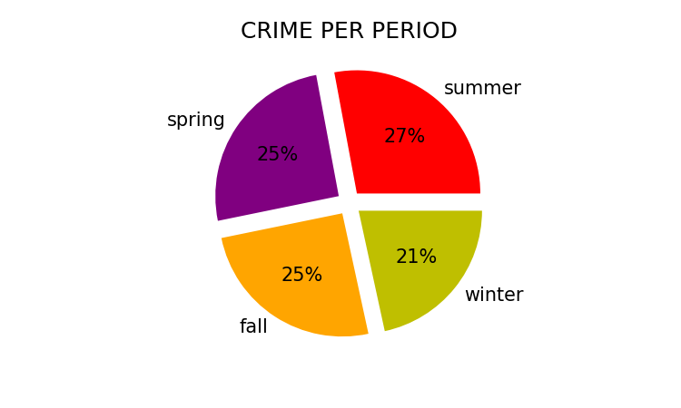
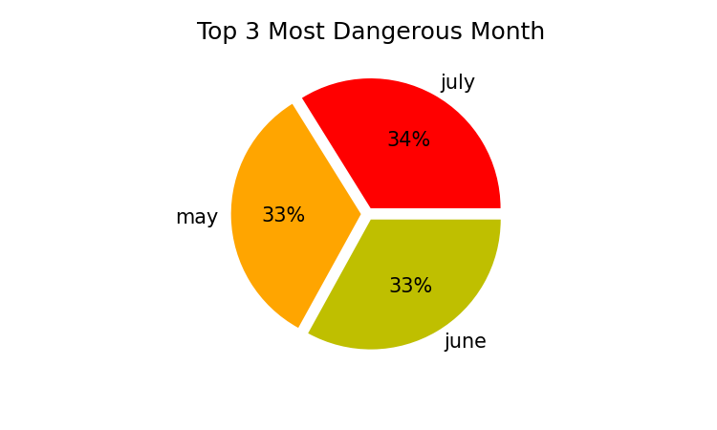

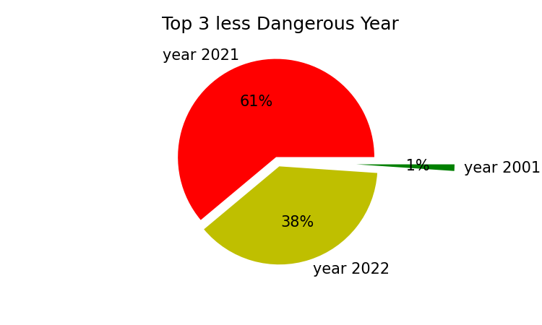
Step 4 Discovery OF insight in the SAMPLE data)

Slide 11
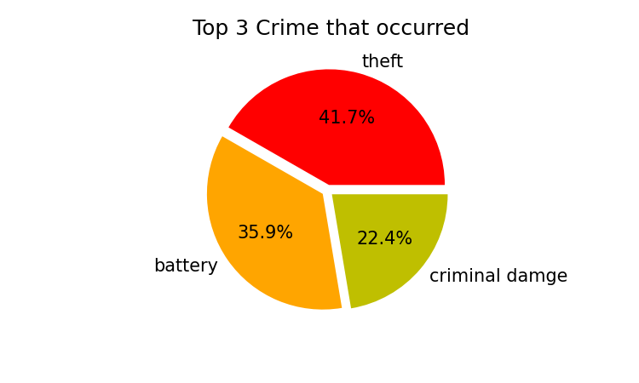
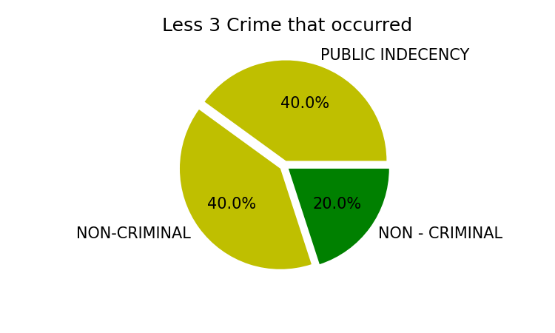
Discovery OF insight in the SAMPLE data

Slide 12
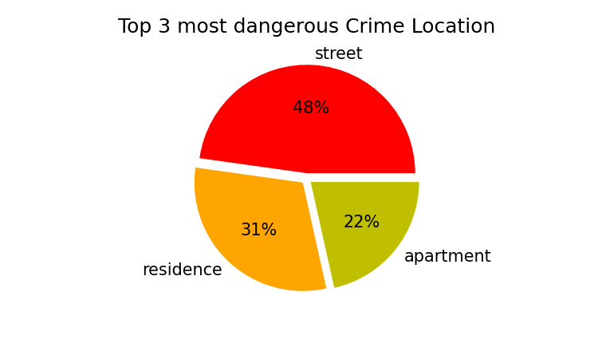
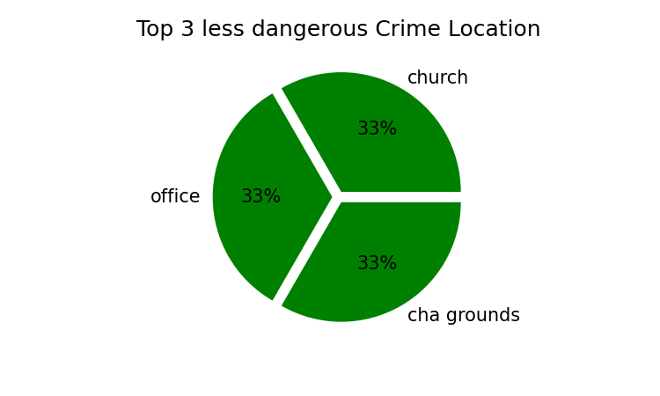
Discovery OF insight in the SAMPLE data

Slide 13
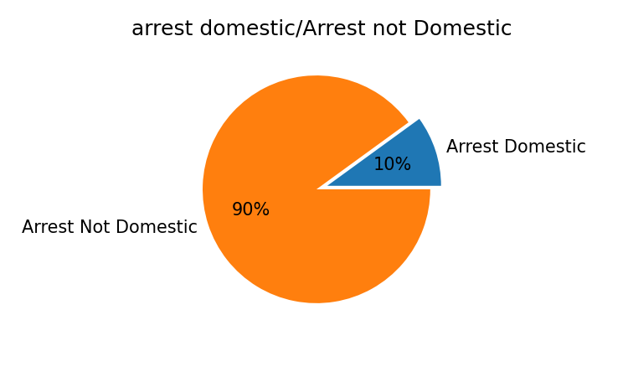
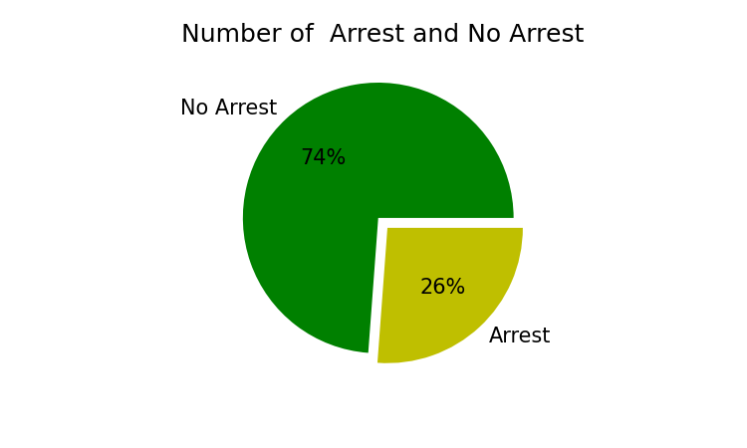
Discovery OF insight in the SAMPLE data

Slide 14
Step 4 normalizing the data
I RESCALED , STANDARDIZED AND NORMALIZED THE DATA

Slide 15
STEP 4 FEATURE ENGINEERING
I select the best feature by using the Recursive feature Elimination
FOR
District
Primary
Day

Slide 16
MODEL PERFORMANCE
District
Primary type
day
Best Model used : Random Forest
Accuracy : 98%
MSE : 0.064
Best Model : Decision tree classifier
Accuracy : 79%
MSE : 28
Model : catboost
Accuracy : 13%
MSE : 15

