Slide 1
Web Design and Programming Lab
Outcome Based Education System
Dr. Abu Sayed Md. Mostafizur Rahman
Professor
Anup Majumdar
Assistant Professor
Bulbul Ahammad
Assistant Professor
Subarna Shaha
Class Roll: 349
Exam Roll: 202165
Trisha Sarkar
Class Roll:
Exam Roll:
Rubayed All Islam
Class Roll: 370
Exam Roll: 202182
Department of Computer Science and Engineering
Jahangirnagar University, Savar,
Dhaka-1342, Bangladesh

Slide 2
Contents
Add your first bullet point here
Add your second bullet point here
Add your third bullet point here

Slide 3
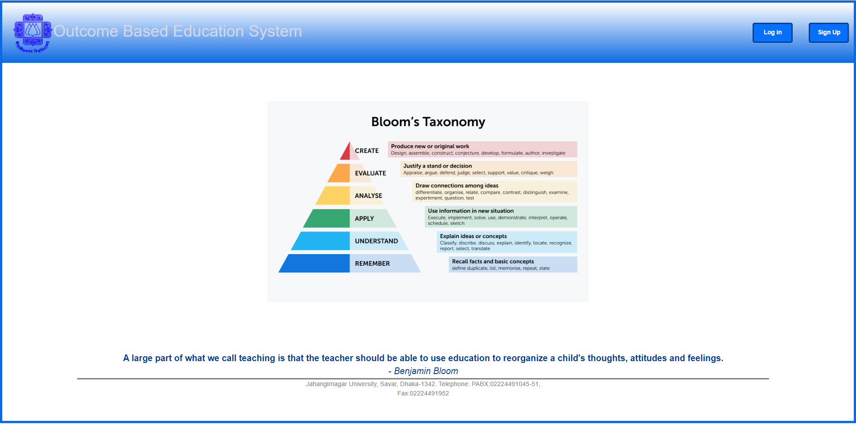

Slide 4
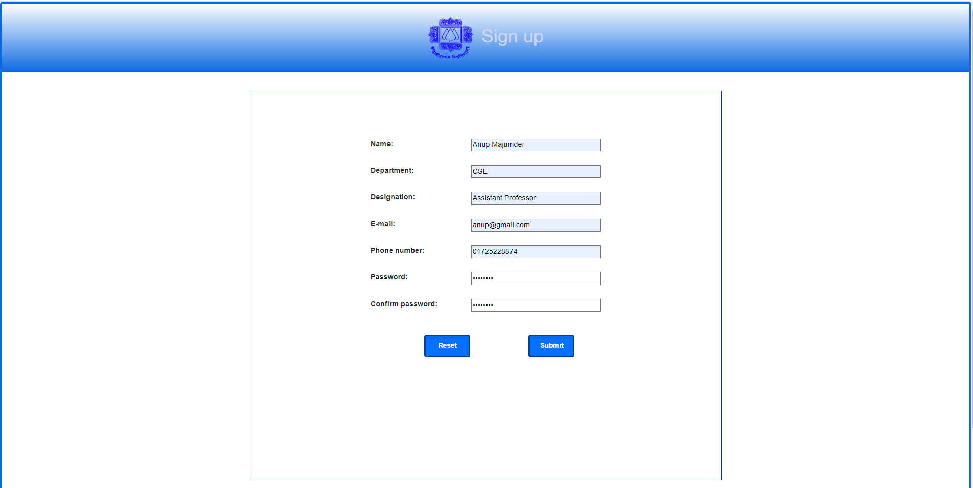

Slide 5
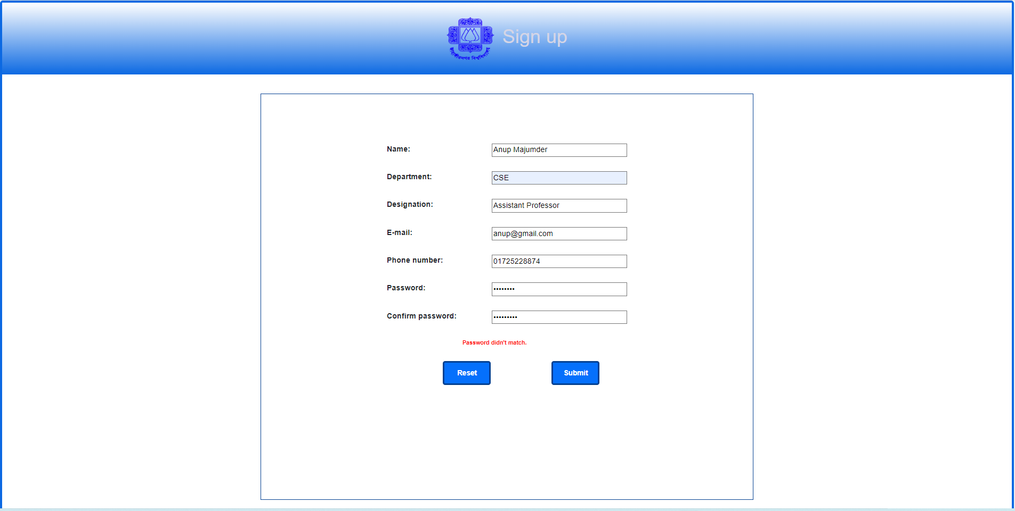

Slide 6
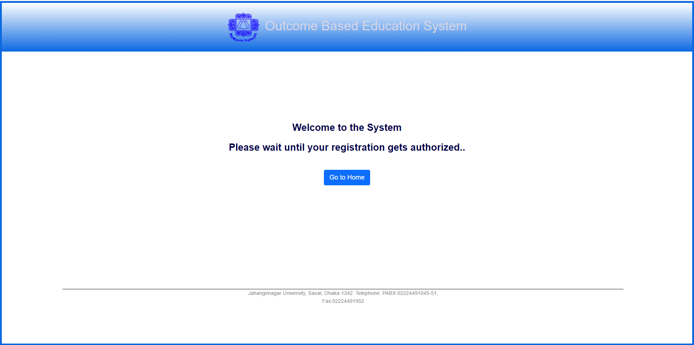

Slide 8
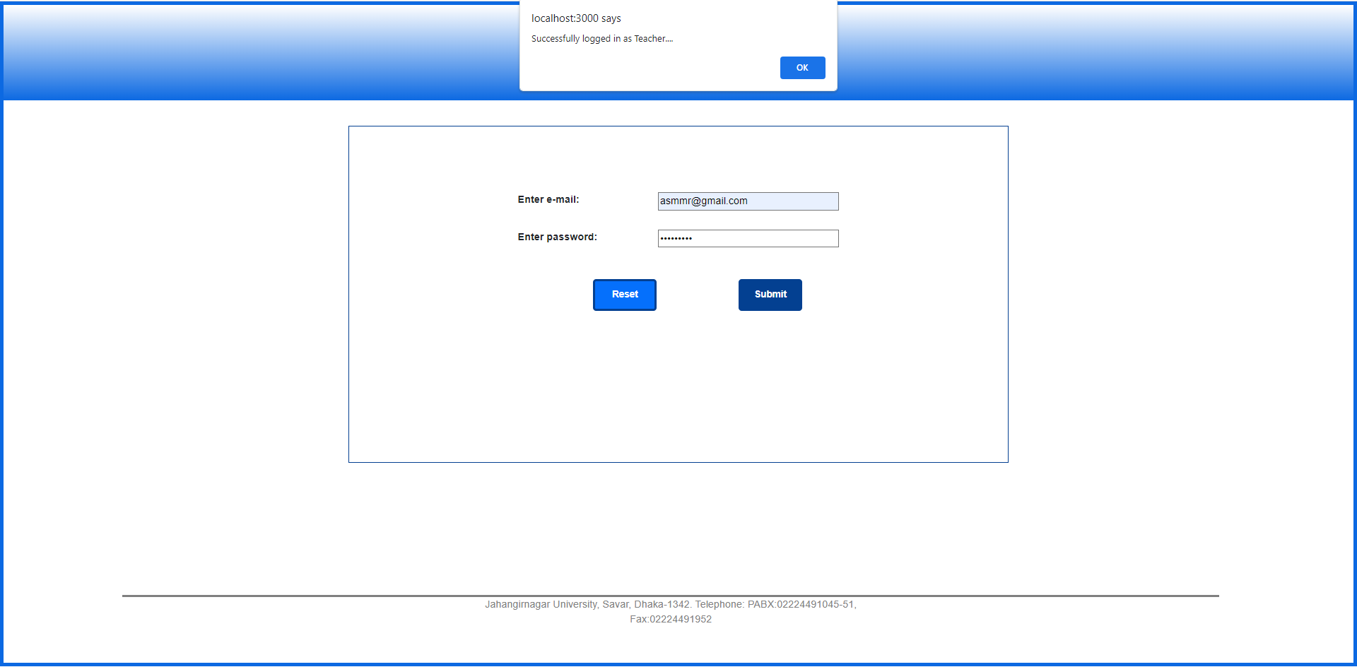

Slide 9
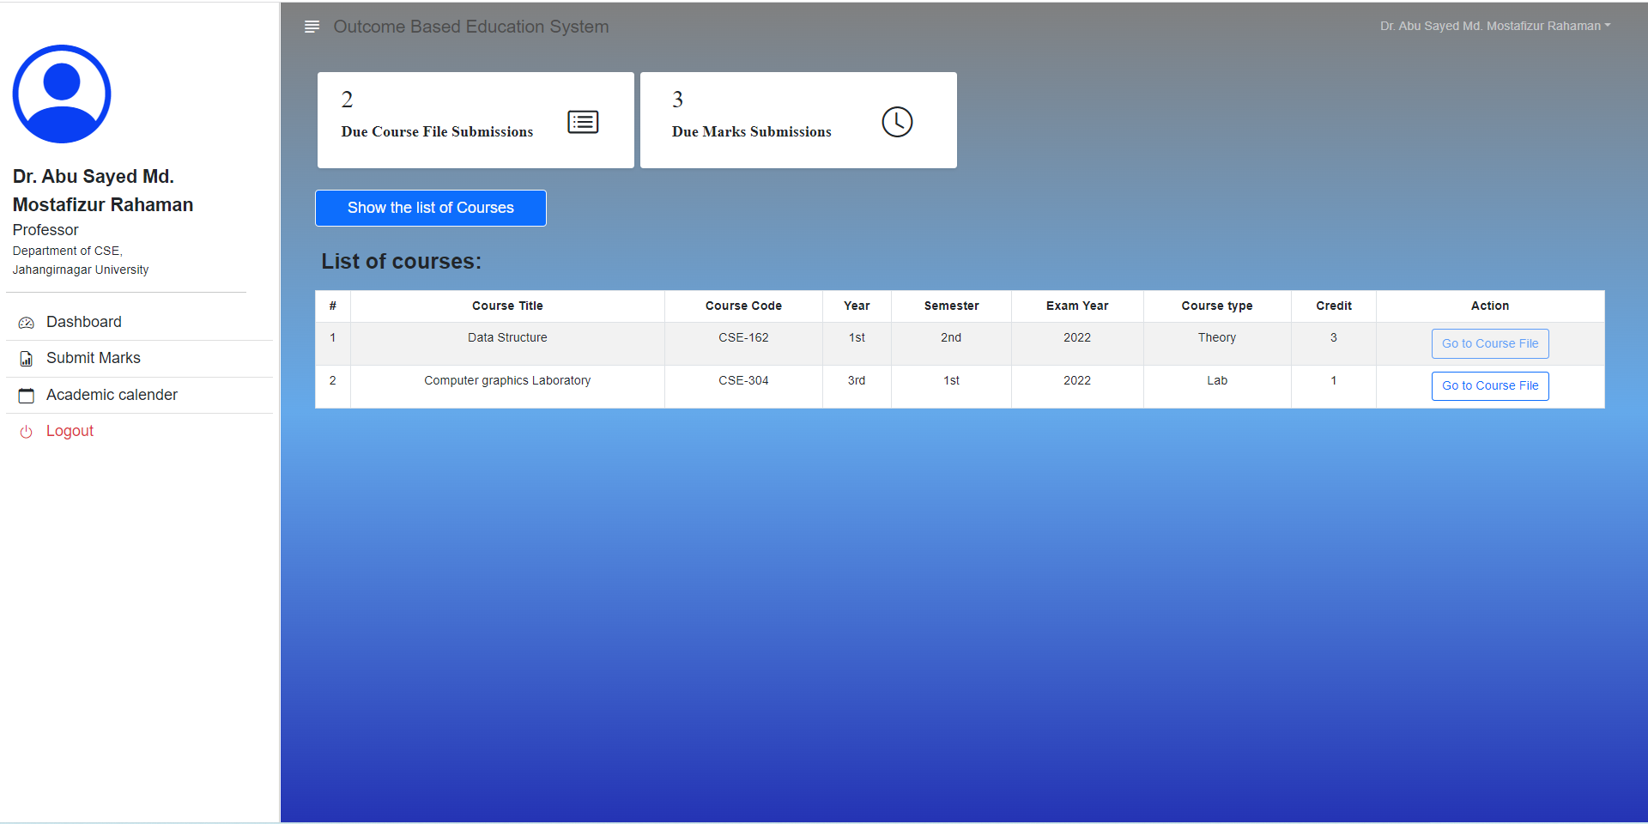

Slide 10
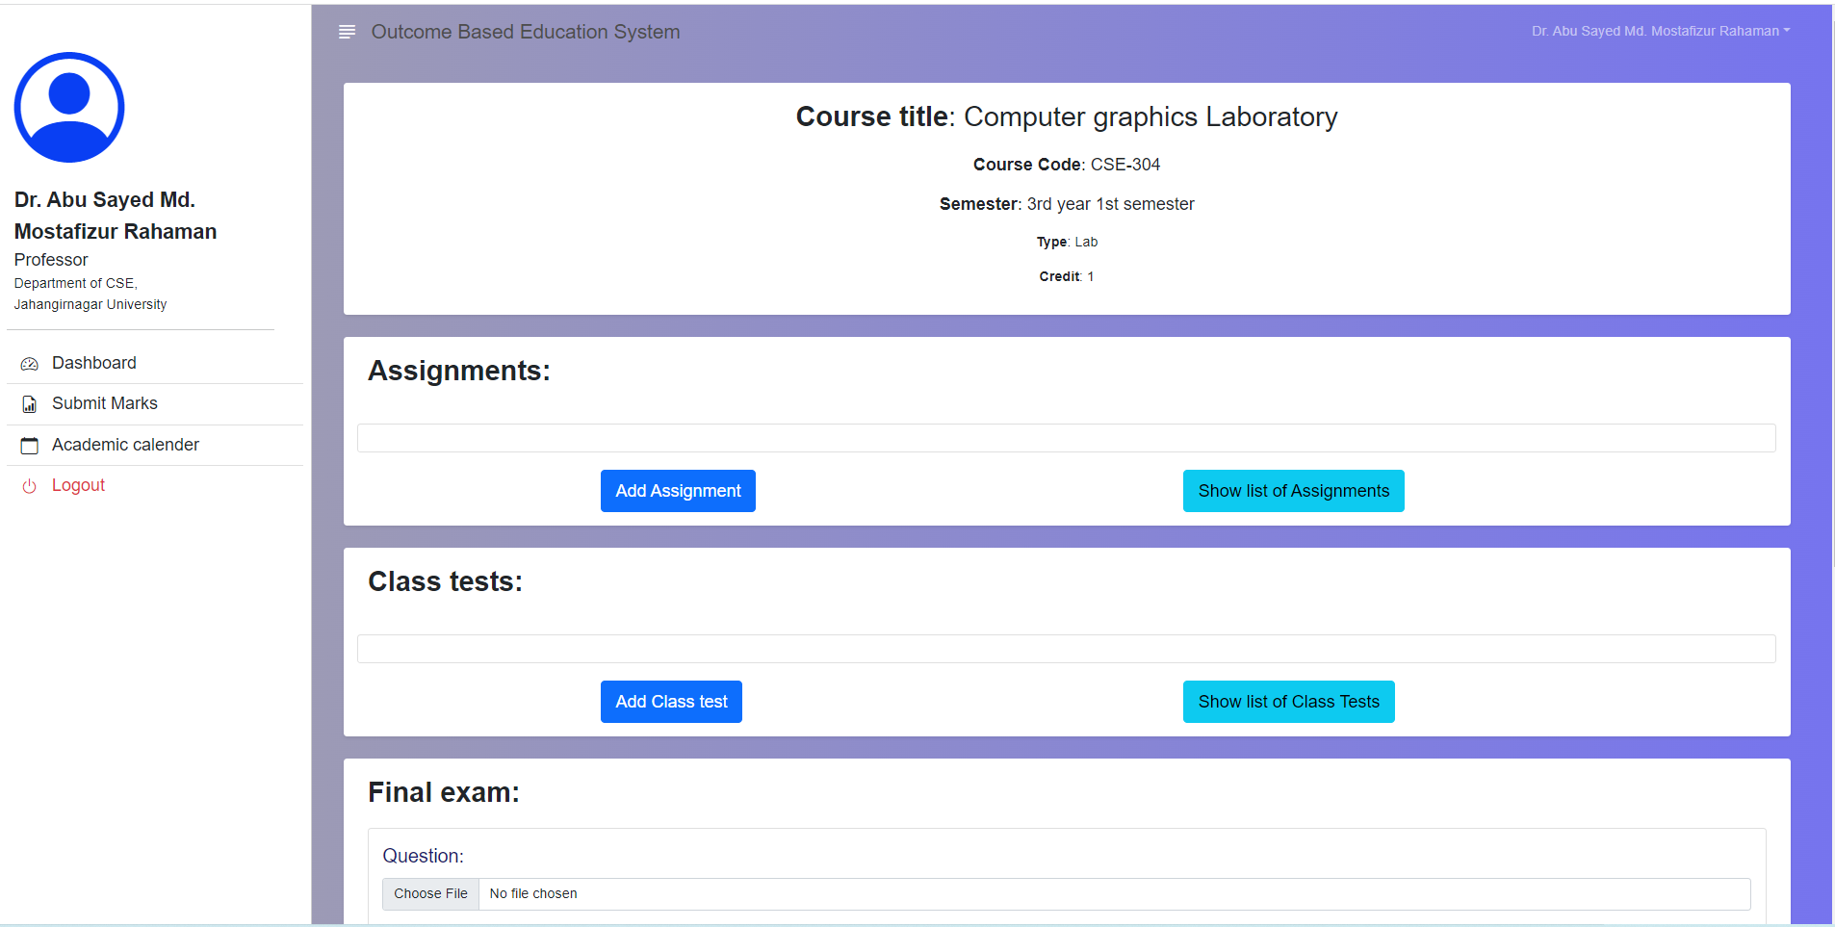

Slide 11
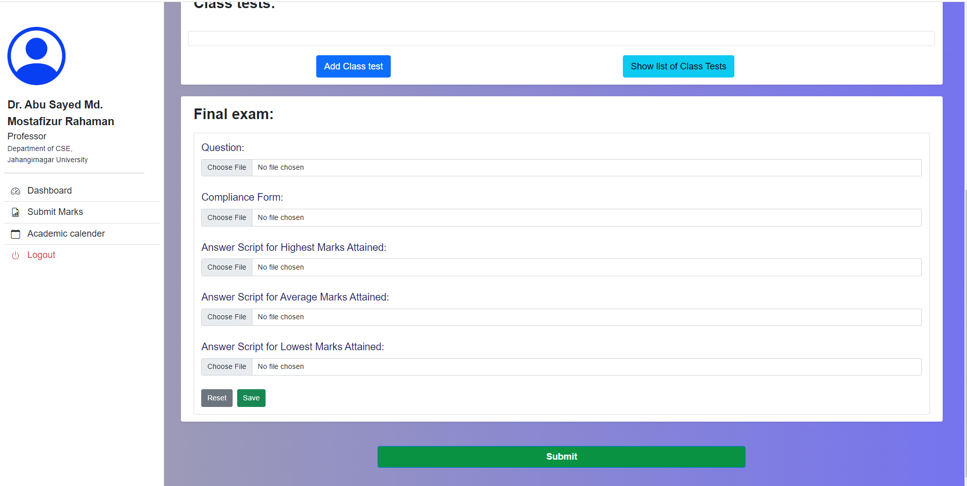

Slide 12
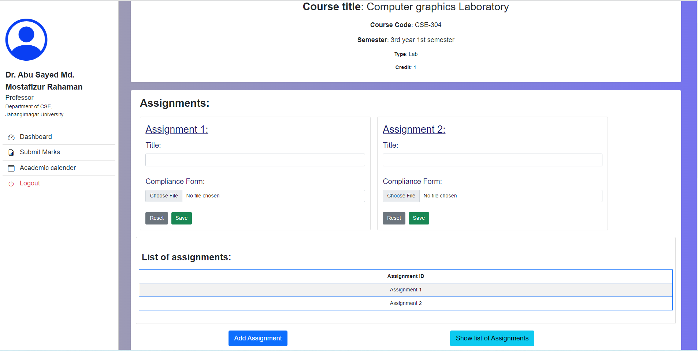

Slide 13
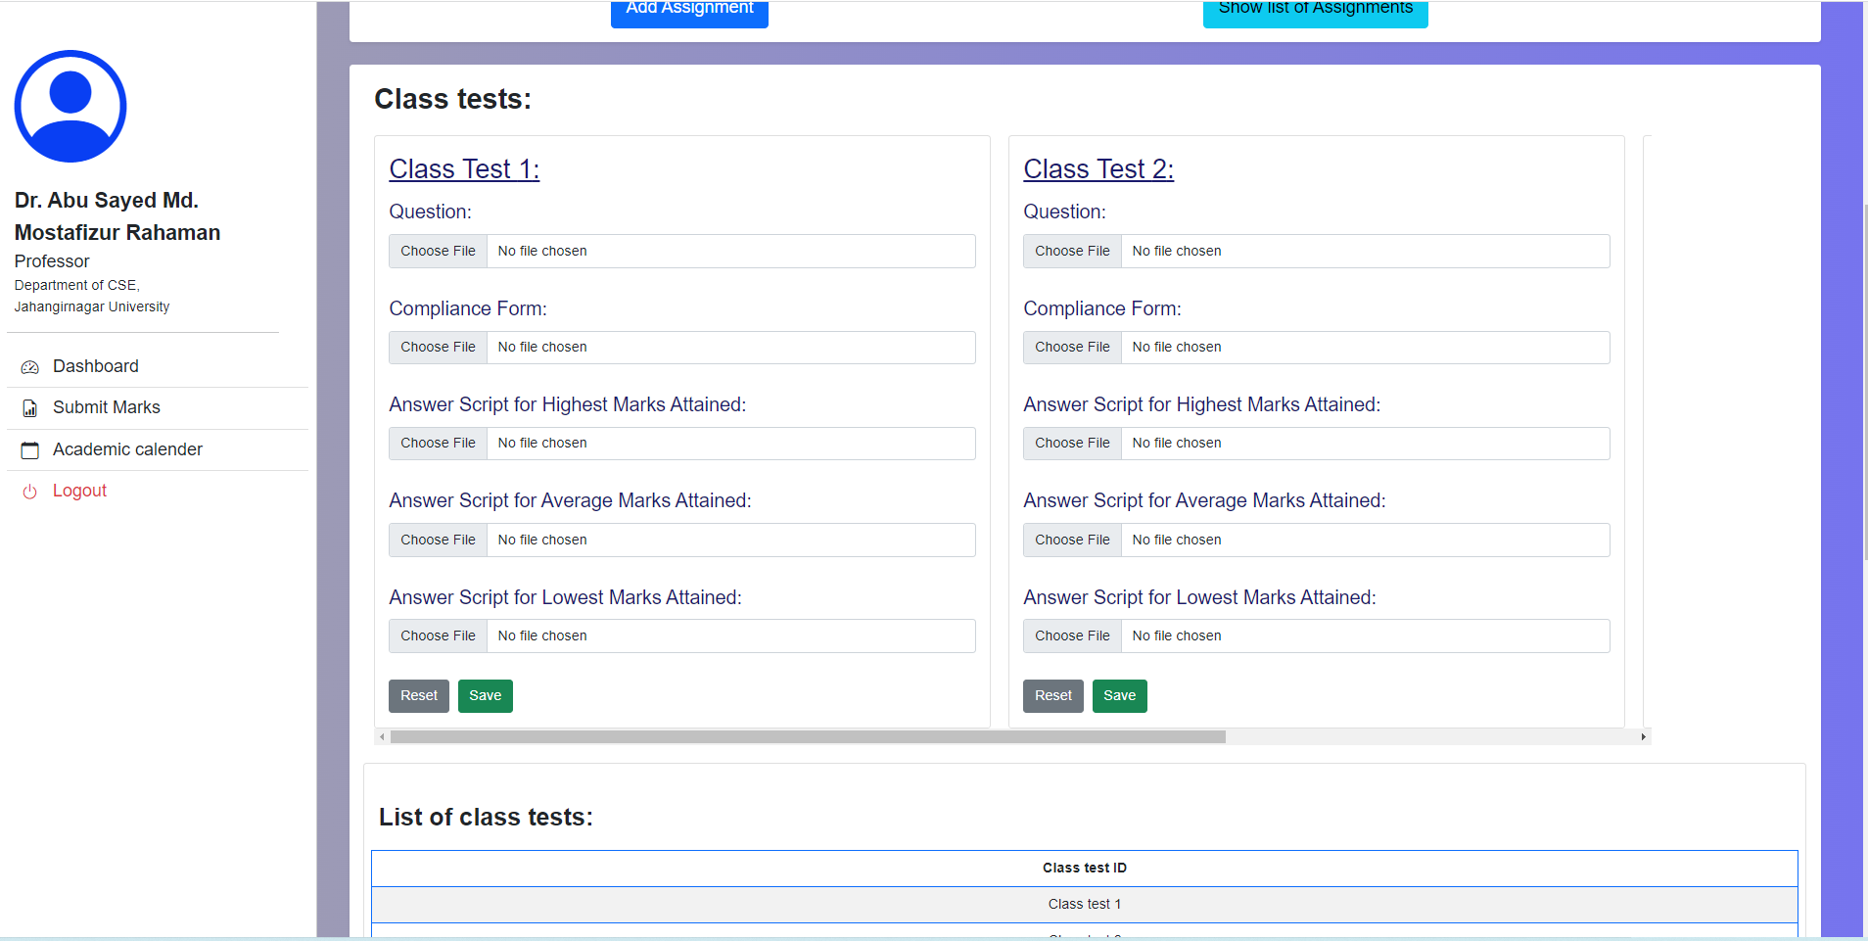

Slide 14
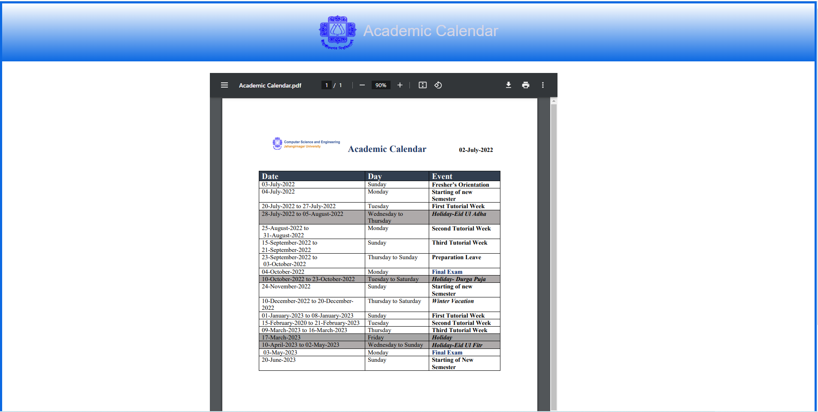

Slide 16
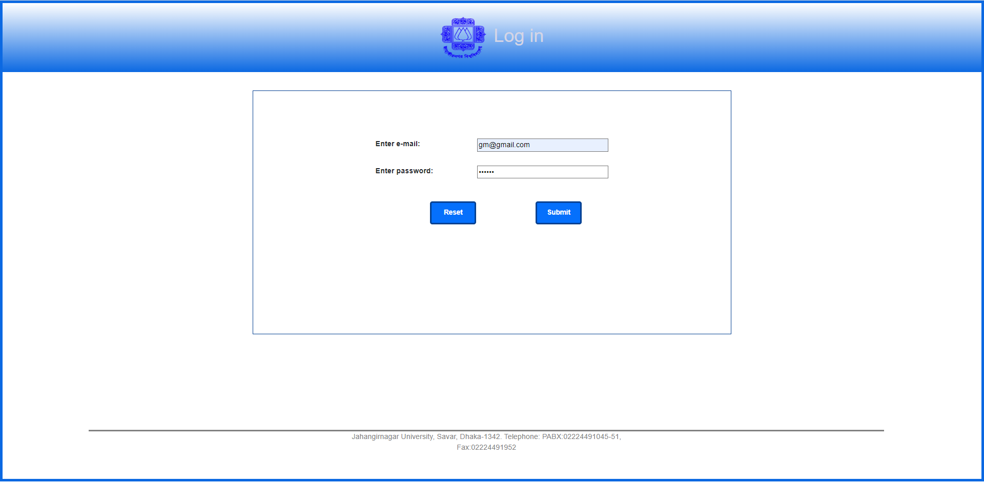

Slide 17
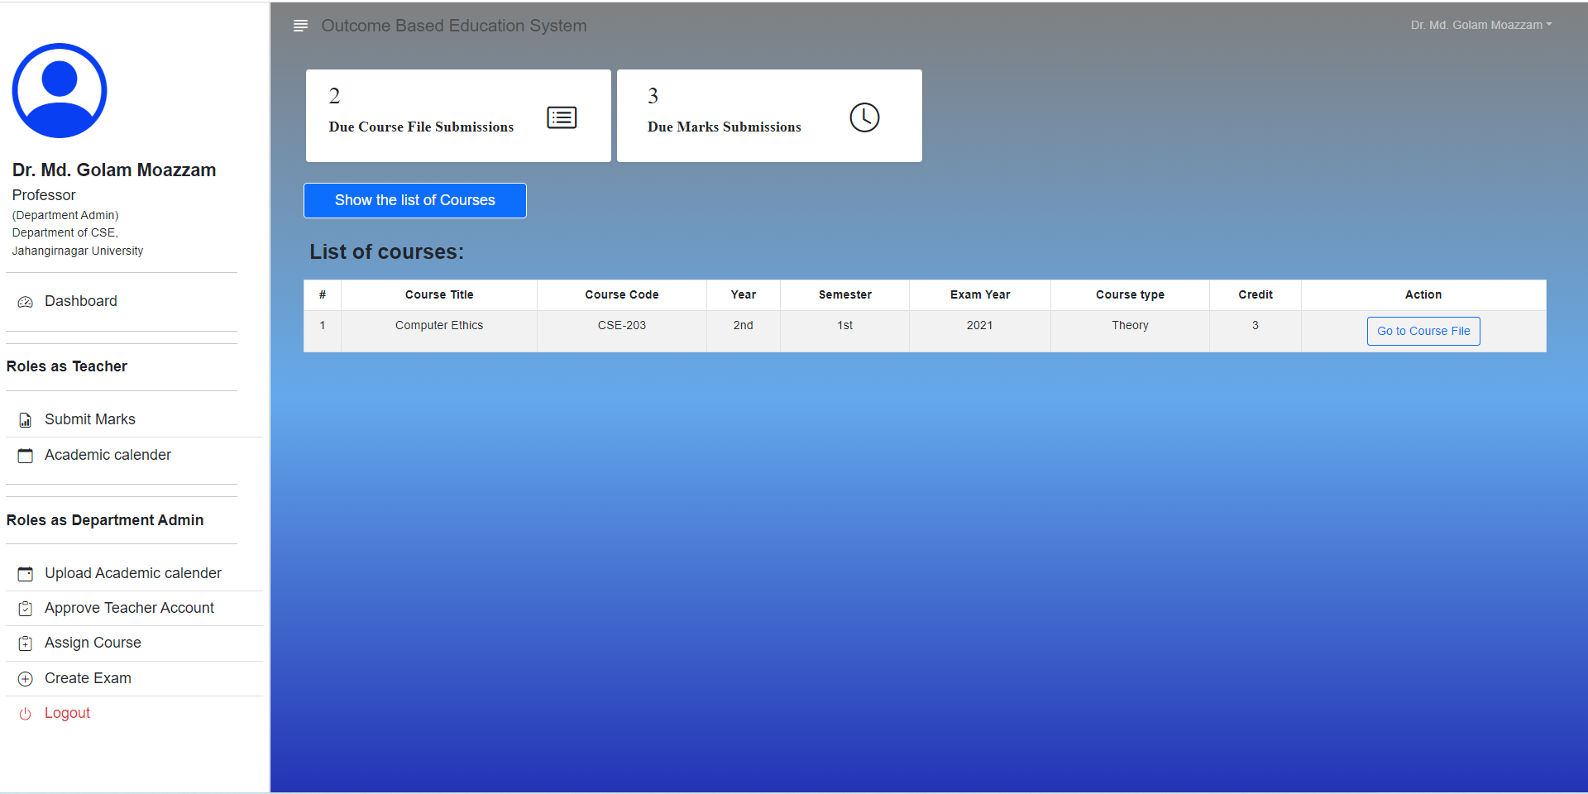

Slide 18
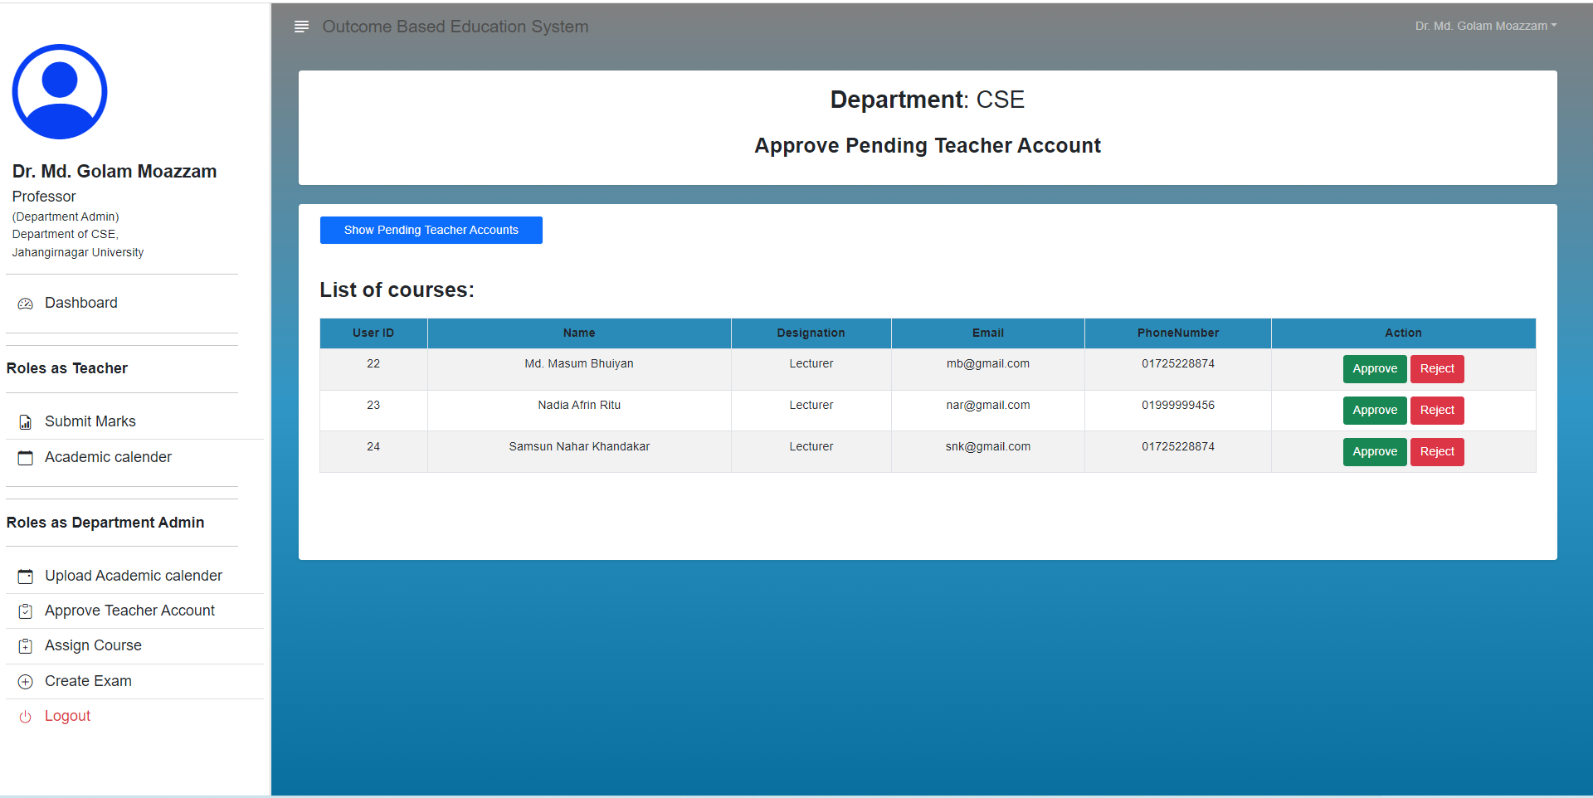

Slide 19
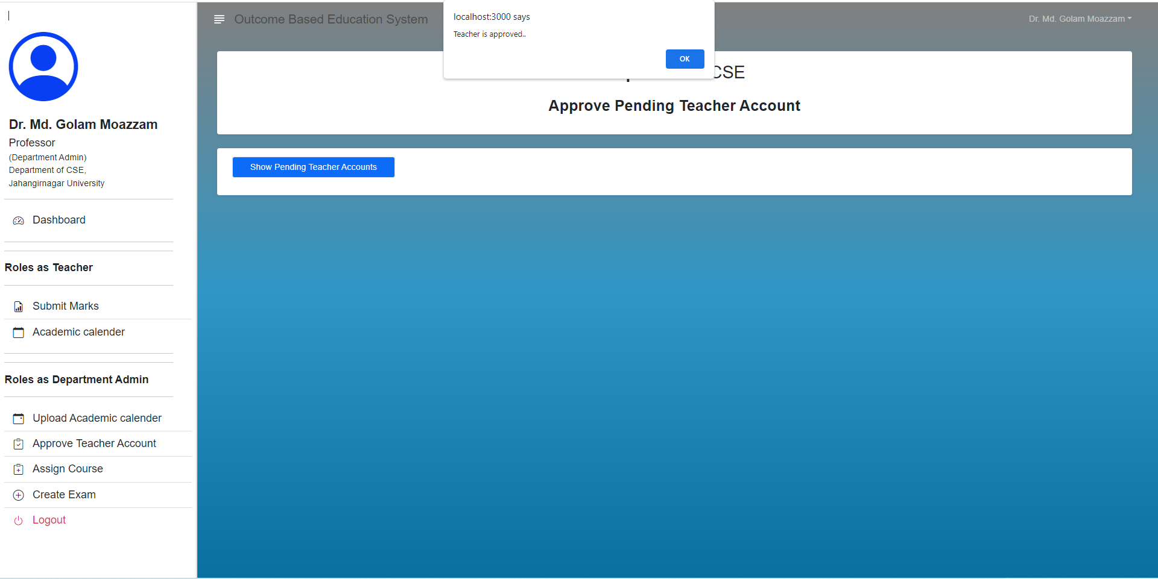

Slide 20
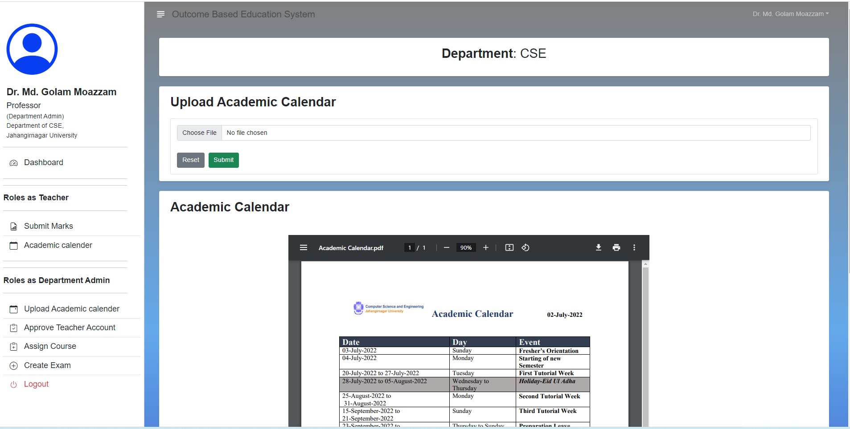

Slide 22
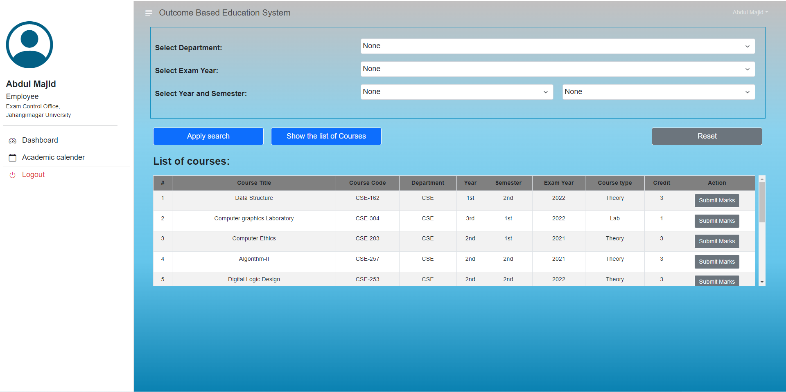

Slide 23
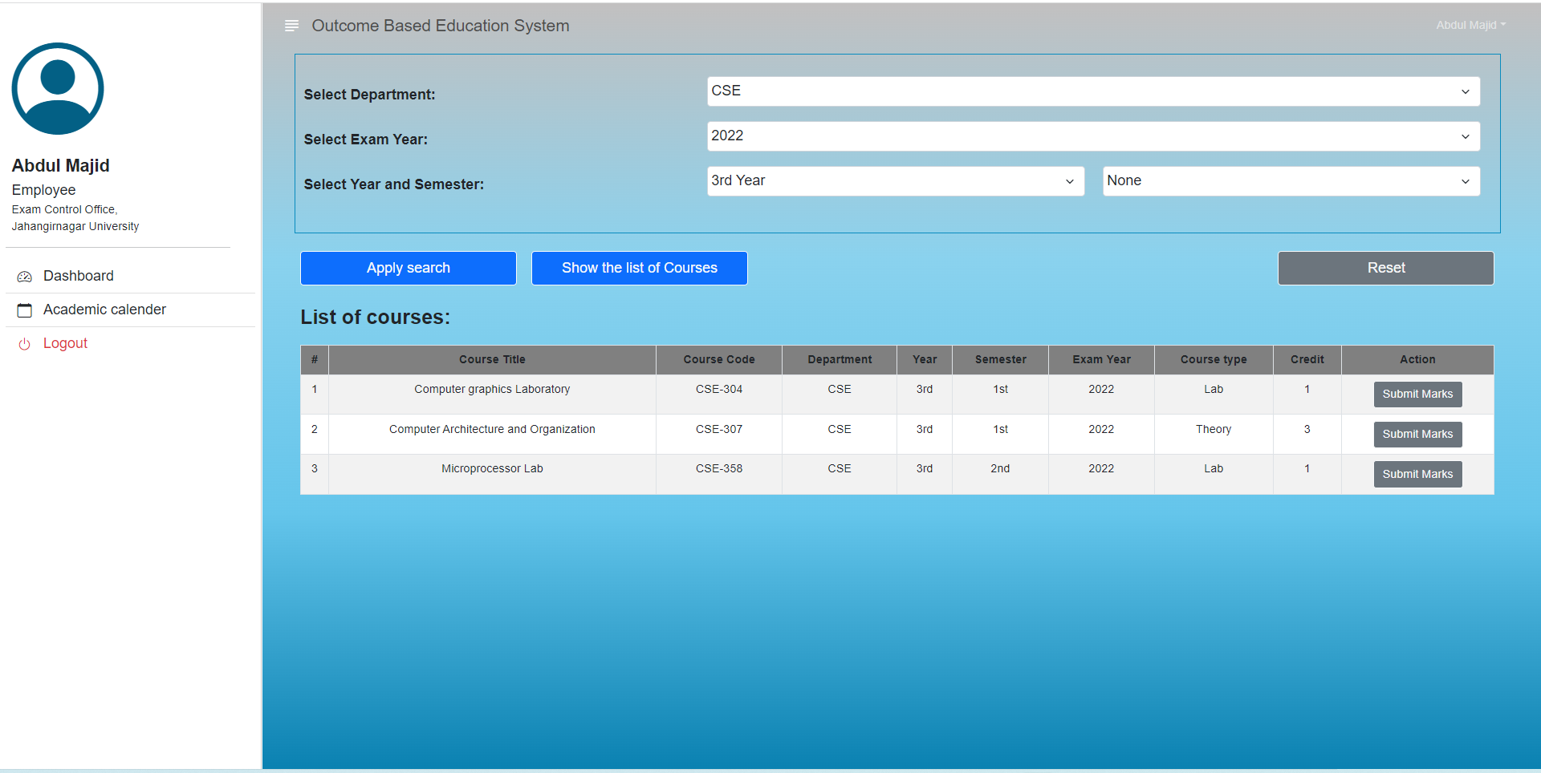

Slide 24
Thank You

