Slide 1
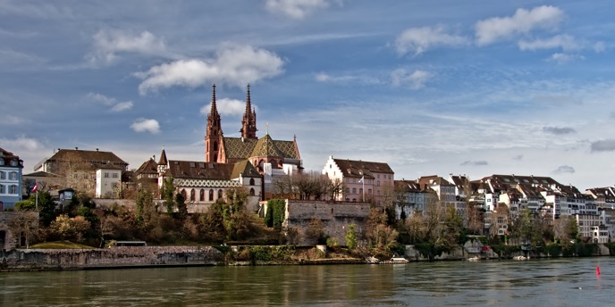




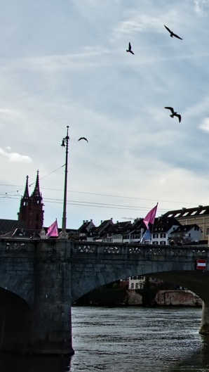




BOSC 2019
BIOINFORMATICS OPEN SOURCE CONFERENCE
JULY 24-25, 2019
BASEL, SWITZERLAND
@OBF_BOSC | #BOSC2019
KEYNOTE SPEAKER
PROF. NICOLA MULDER
COMPUTATIONAL BIOLOGY DIVISION
UNIVERSITY OF CAPE TOWN
SPONSORS
COMPUTATIONAL BIOLOGY
IMPORTANT DATES
June 20: Early registration discount ends
July 21-25: ISMB/ECCB 2019
July 24-25 (last two days of ISMB): BOSC 2019
July 26-27: CollaborationFest 2019
Sponsored by
TOPICS
Open Science and Reproducible Research
Open Biomedical Data
Citizen/Participatory Science
Standards and Interoperability
Data Science
Workflows
Translational Bioinformatics
Developer Tools and Libraries
Inclusion, Outreach and Training
Bioinformatics Open Source Project Reports
https://open-bio.org/events/bosc

