Slide 1


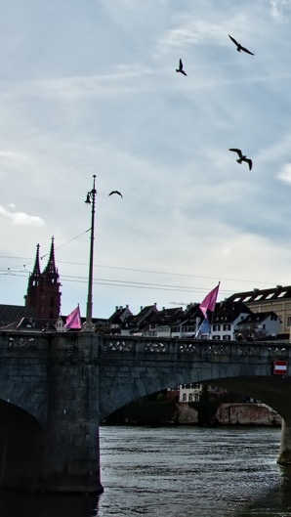
BOSC 2019
BIOINFORMATICS OPEN SOURCE CONFERENCE
JULY 24-25, 2019
BASEL, SWITZERLAND
@OBF_BOSC | #BOSC2019
KEYNOTE SPEAKER
PROF. NICOLA MULDER
COMPUTATIONAL BIOLOGY DIVISION,
UNIVERSITY OF CAPE TOWN
IMPORTANT DATES
April 11: Abstract deadline
April 15: OBF travel fellowship deadline
May 9: First-round authors notified
May 15: Late poster, late-breaking lightning talk abstract deadline
May 23: Late round authors notified
July 21-25: ISMB/ECCB 2019
July 24-25 (last two days of ISMB): BOSC 2019
July 26-27: CollaborationFest 2019
TOPICS
Open Science and Reproducible Research
Open Biomedical Data
Citizen/Participatory Science
Standards and Interoperability
Data Science
Workflows
Open Approaches to Translational Bioinformatics
Developer Tools and Libraries
Inclusion, Outreach and Training
Bioinformatics Open Source Project Reports
https://www.open-bio.org/wiki/BOSC_2019

