Slide 1
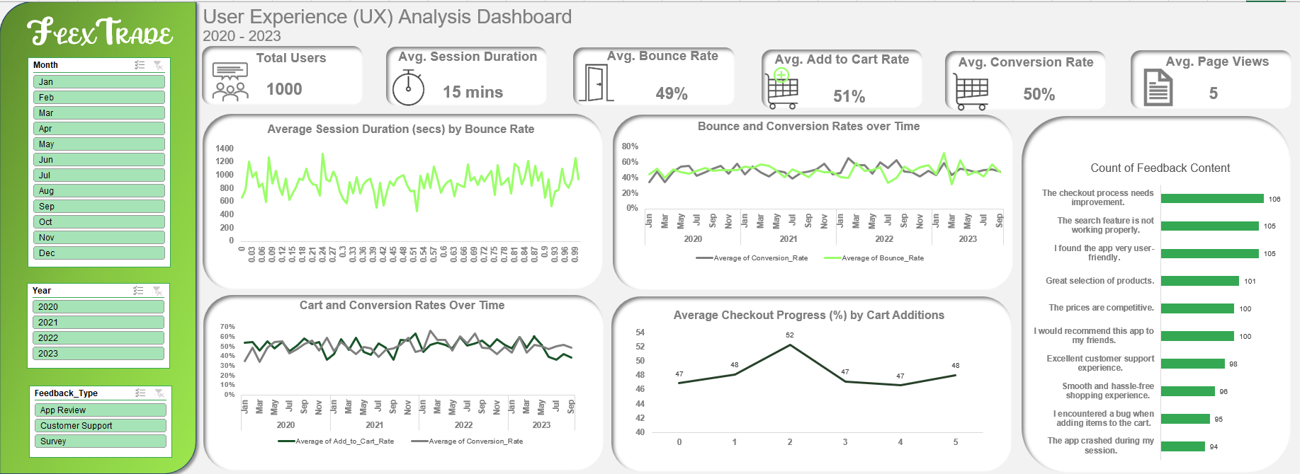

Slide 2
FLEXTRADE
Session Duration
From the chart, session duration fluctuates significantly but generally falls between 600 and 1200 secs (10 to 20 mins) on average, which indicates users spend a considerable amount of time on the app, which could also be an indication of strong engagement.
As bounce rate increases, there is no immediate clear downward trend in session duration, however at higher bounce rates (near 1.0 or 100%), the session duration changes, which suggests, when users bounce, they spend less time with the app.
High bounce rates with fluctuating session durations, indicate some users might be bouncing quickly while others could be spending time before deciding to leave
Shorter sessions are also associated with higher bounce rates

Slide 3
Bounce and Conversion Rates
Conversion Rate and Bounce rate fluctuate over time, indicating a dynamic relationship between both metrics.
Both metrics stay within the 40% - 60% range, with frequent peaks and dips
Early 2020 to Mid 2021, bounce rate and conversion rate move closely, slight increases in bounce rate sometimes coincide with dips in conversion rate.
Late 2021 to Early 2022, conversion rate saw an upward trend, while bounce rate fluctuated.
Late 2022 to Early 2023, indicates a pike in bounce rate. Conversion rate is still at a stable rate, meaning users who stay are still converting just doing it at a stable rate.
FLEXTRADE

Slide 4
Cart Behavior
As cart additions increase from 0 to 2, average checkout progress rises, indicating users are more likely to proceed to checkout when they add more items to the cart.
When cart additions = 2, checkout progress is at its highest. Beyond 2, average checkout progress declines before recovering slightly at cart additions = 5, which suggests that users adding more than 2 items hesitate or do not proceed to checkout more often.
FLEXTRADE

Slide 5
Feedback Analysis
1. Negative Feedback
Checkout Issues (Most Common Concern)
This suggests potential friction in the checkout process, leading to cart abandonment.
Search Functionality Problems
Users are struggling to find products, which could lead to frustration and higher bounce rates.
Technical Issues & Bugs
These issues can hurt user trust and prevent successful transactions.
2. Positive Feedback (Strengths of the App)
User Experience & Navigation
Despite some issues, many users appreciate the UI/UX design of the app.
Product & Pricing Appeal
Users find the product variety and pricing attractive, which is a strong selling point.
Customer Support & Recommendations
Good customer support and word-of-mouth recommendations contribute to brand loyalty.
FLEXTRADE

