Slide 1
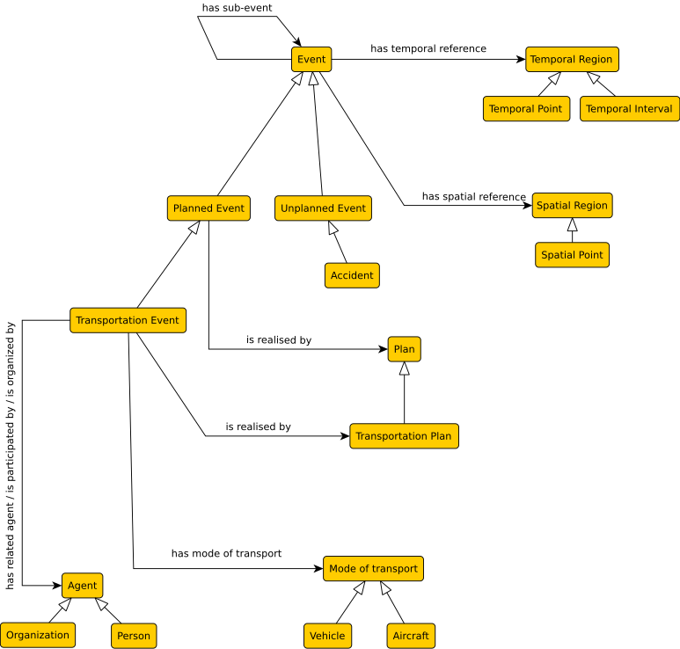
Suggested solution
Has suggestion
Unplanned public transportation irregularity
Was not present so was added
Planned public transportation irregularity
has an effect on

