Slide 1
The 1D Ising Model on a Quantum Computer
Hackathon Cuántico Madrid
Octubre 2021
Manuel Eduardo González Lastre
Francisco Jesús Matute Fernández-Cañadas
Jorge Vega Martín
Jaume Zuriaga Puig
Omar Bouzid Mambrilla

Slide 2
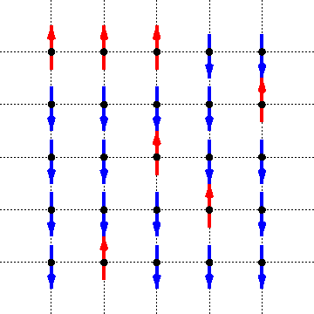
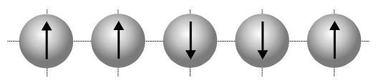
Background: Metropolis sampling of the Ising model
Prepare initial system configuration with energy Econf
Generate test configuration with energy Etest
If Etest < Econf the test configuration becomes the new system configuration
If not, the test configuration becomes the new configuration with probability
p = exp(-(Etest-Econf)/T)
Repeat
Image from https://personal.math.ubc.ca/~andrewr/research/intro_html/node14.html

Slide 3

Background: Metropolis sampling of the Ising model
S
S’
Image from https://personal.math.ubc.ca/~andrewr/research/intro_html/node14.html

Slide 4
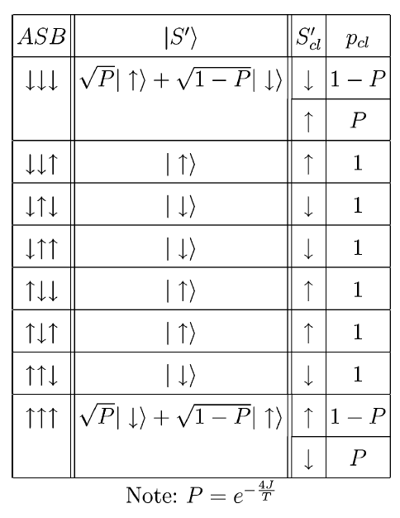
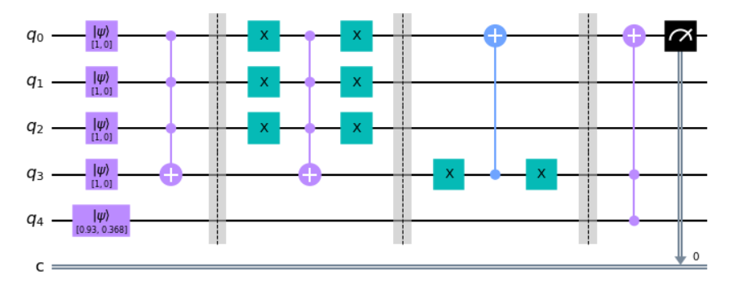
1D Ising Model at H=0: the algorithm
Table from: https://arxiv.org/abs/quant-ph/0404143

Slide 5
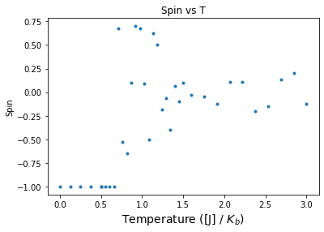
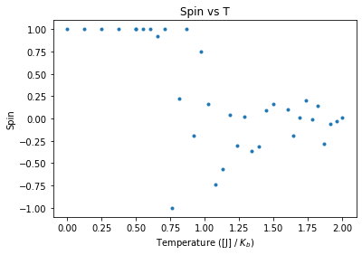


1D Ising Model at H=0: magnetization vs. temperature
Initial states

Slide 6
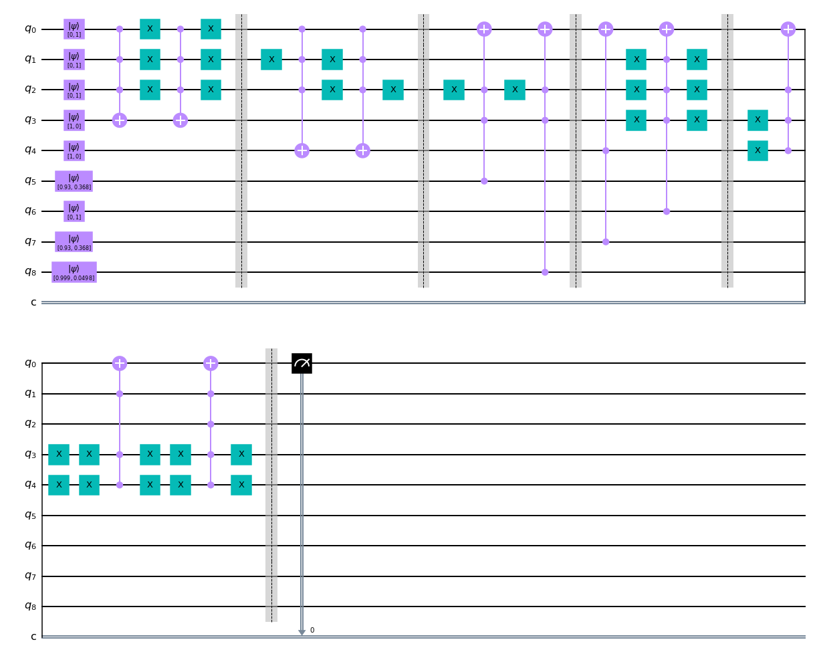
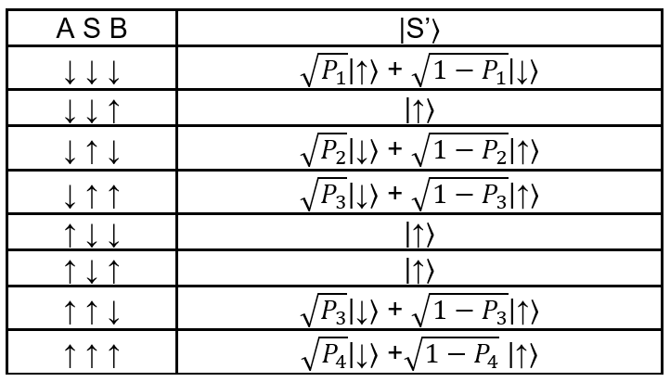
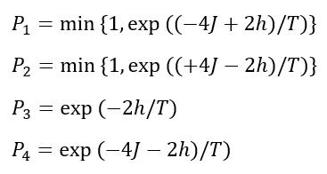
Extending 1D Ising Model for H≠0: the algorithm
aquí circuito y tabla de verdad

Slide 7
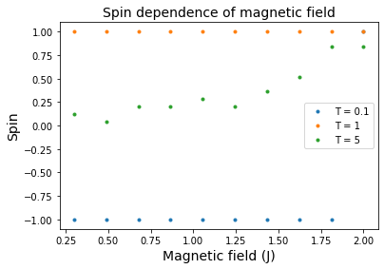
Extending 1D Ising Model for H≠0: the results

Slide 8
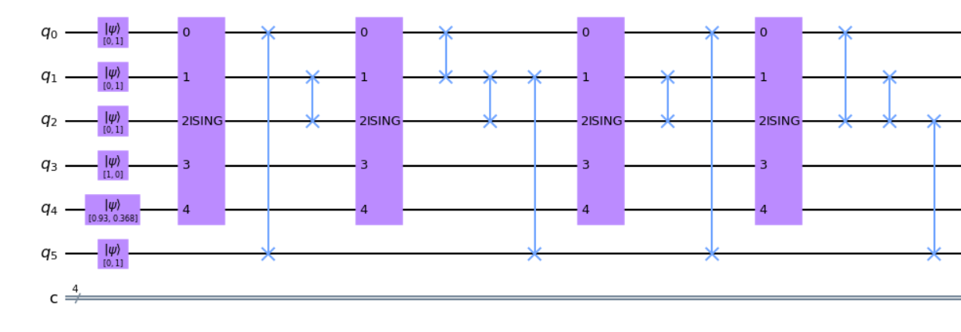
Introducing entanglement: the algorithm
aquí circuito
...

Slide 9
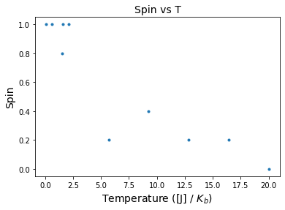
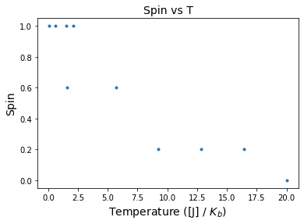

Introducing entanglement: the results
(1 iteration)
(4 iterations)

