Slide 1
Python, C++ to Java Comparison Chapters 2-6
Java™ How to Program, 9/e

Slide 2

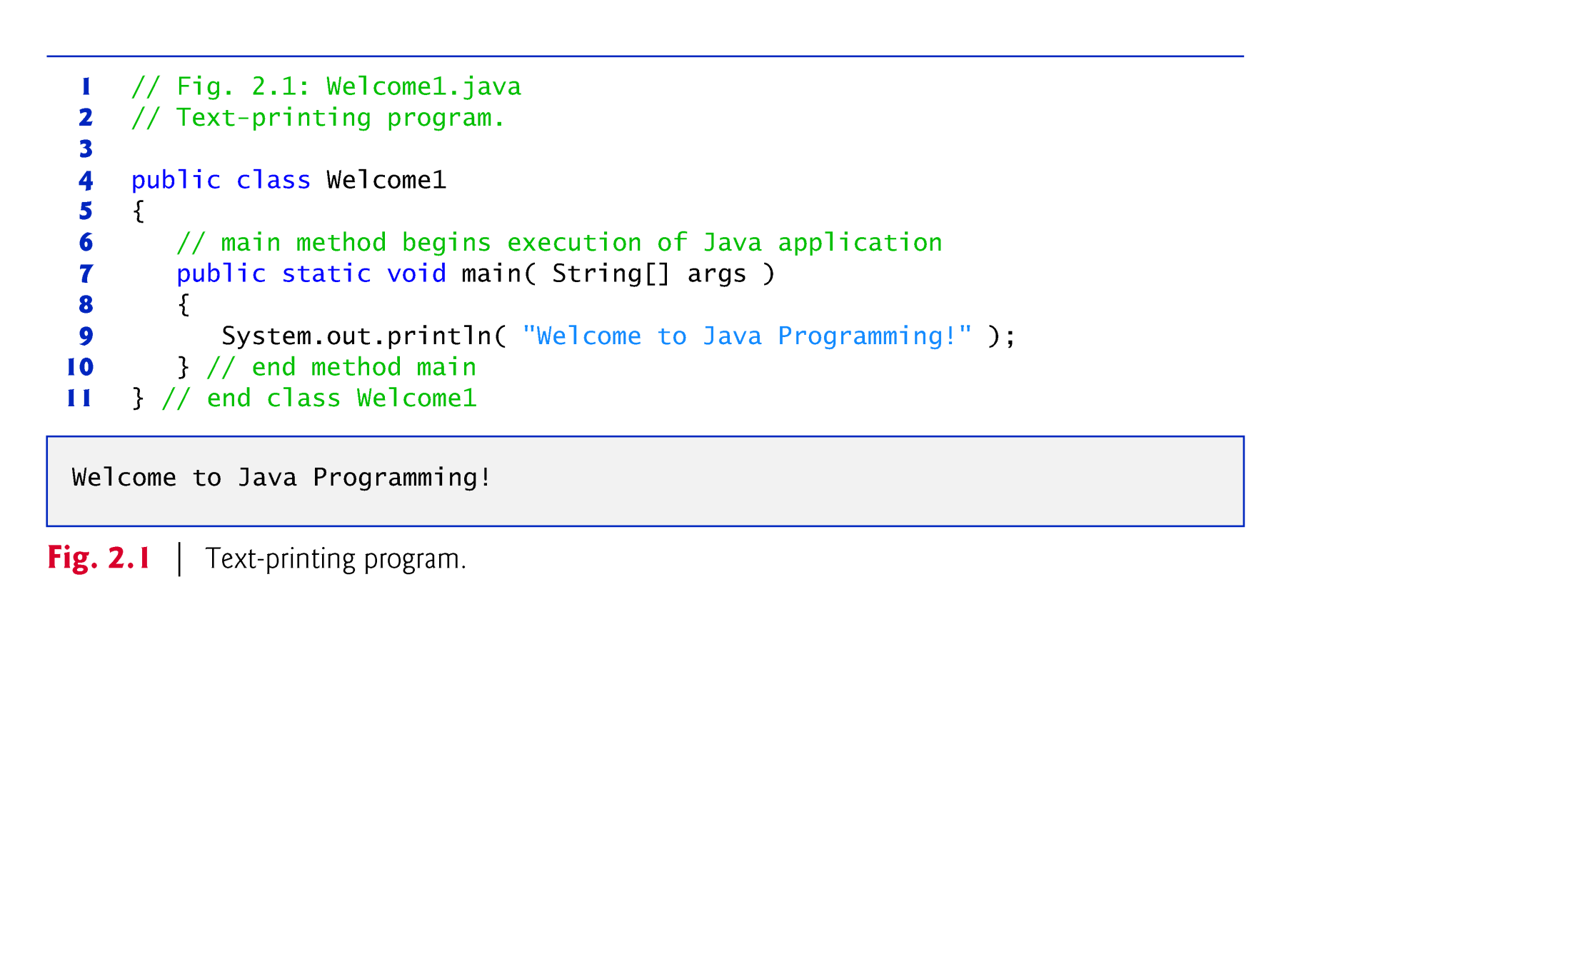

Slide 3
2.2 Our First Program in Java: Printing a Line of Text (Cont.)
Compiling and Executing Your First Java Application
Open a command window and change to the directory where the program is stored.
Many operating systems use the command cd to change directories.
To compile the program, type
javac Welcome1.java
If the program contains no syntax errors, preceding command creates a.class file (known as the class file) containing the platform-independent Java bytecodes that represent the application.
When we use the java command to execute the application on a given platform, these bytecodes will be translated by the JVM into instructions that are understood by the underlying operating system.

Slide 4
2.2 Our First Program in Java: Printing a Line of Text (Cont.)
To execute the program, type java Welcome1.
Launches the JVM, which loads the .class file for class Welcome1.
Note that the .class file-name extension is omitted from the preceding command; otherwise, the JVM will not execute the program.
The JVM calls method main to execute the program.

Slide 5
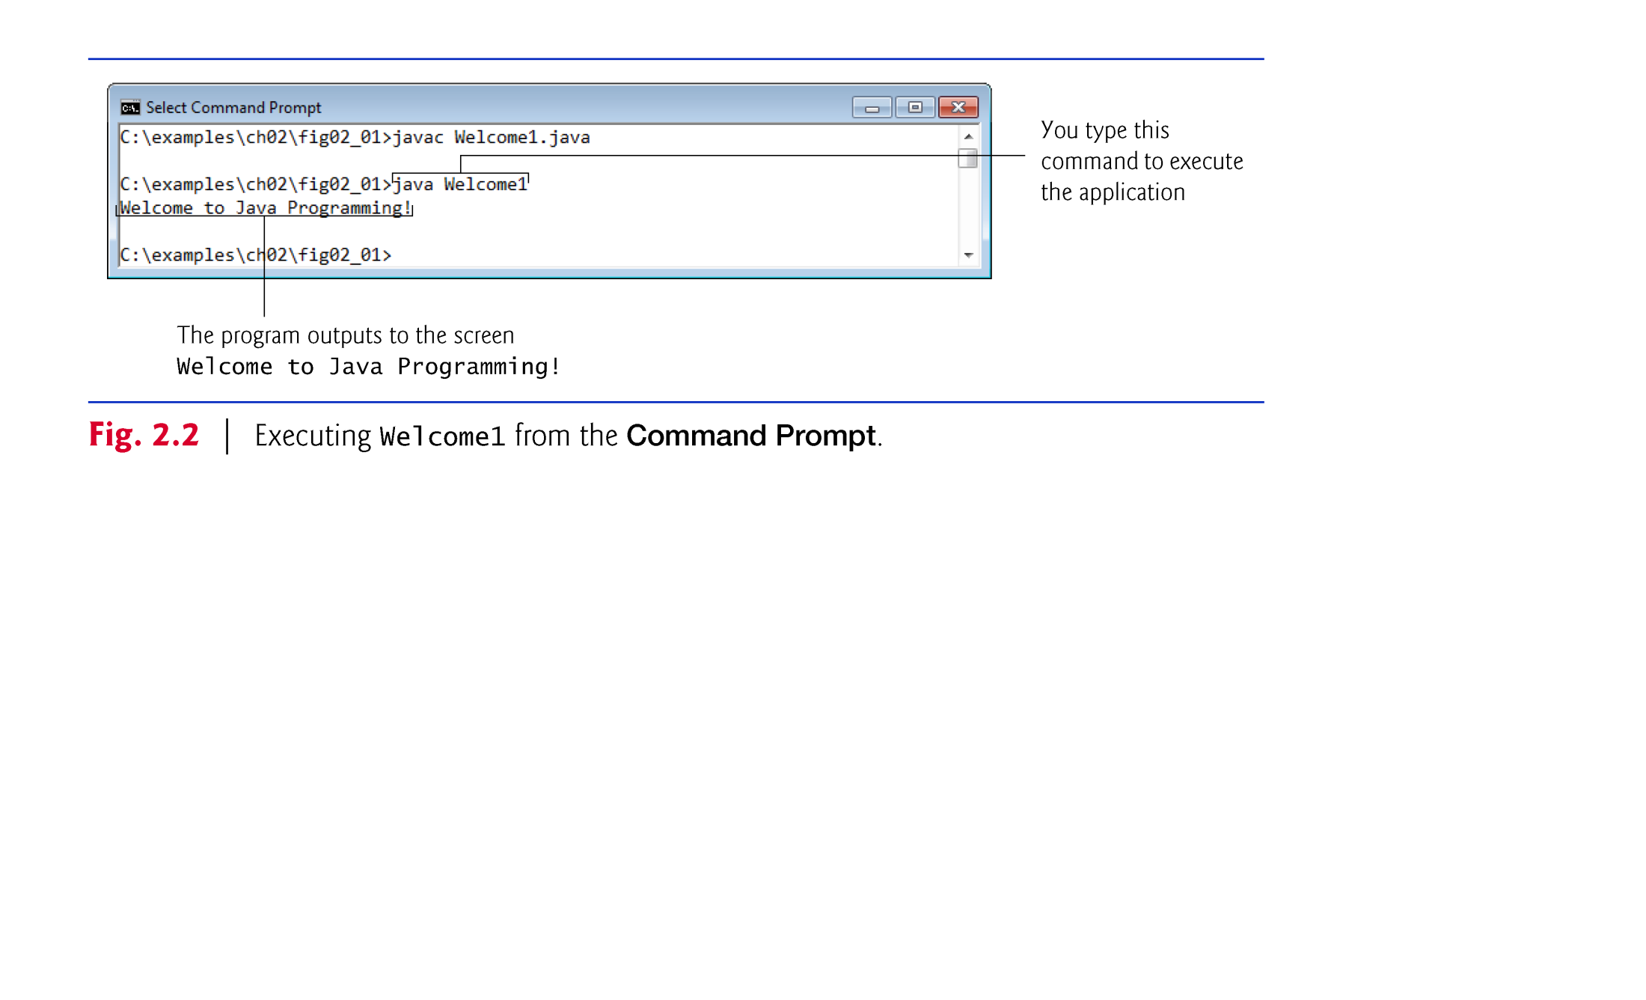

Slide 6
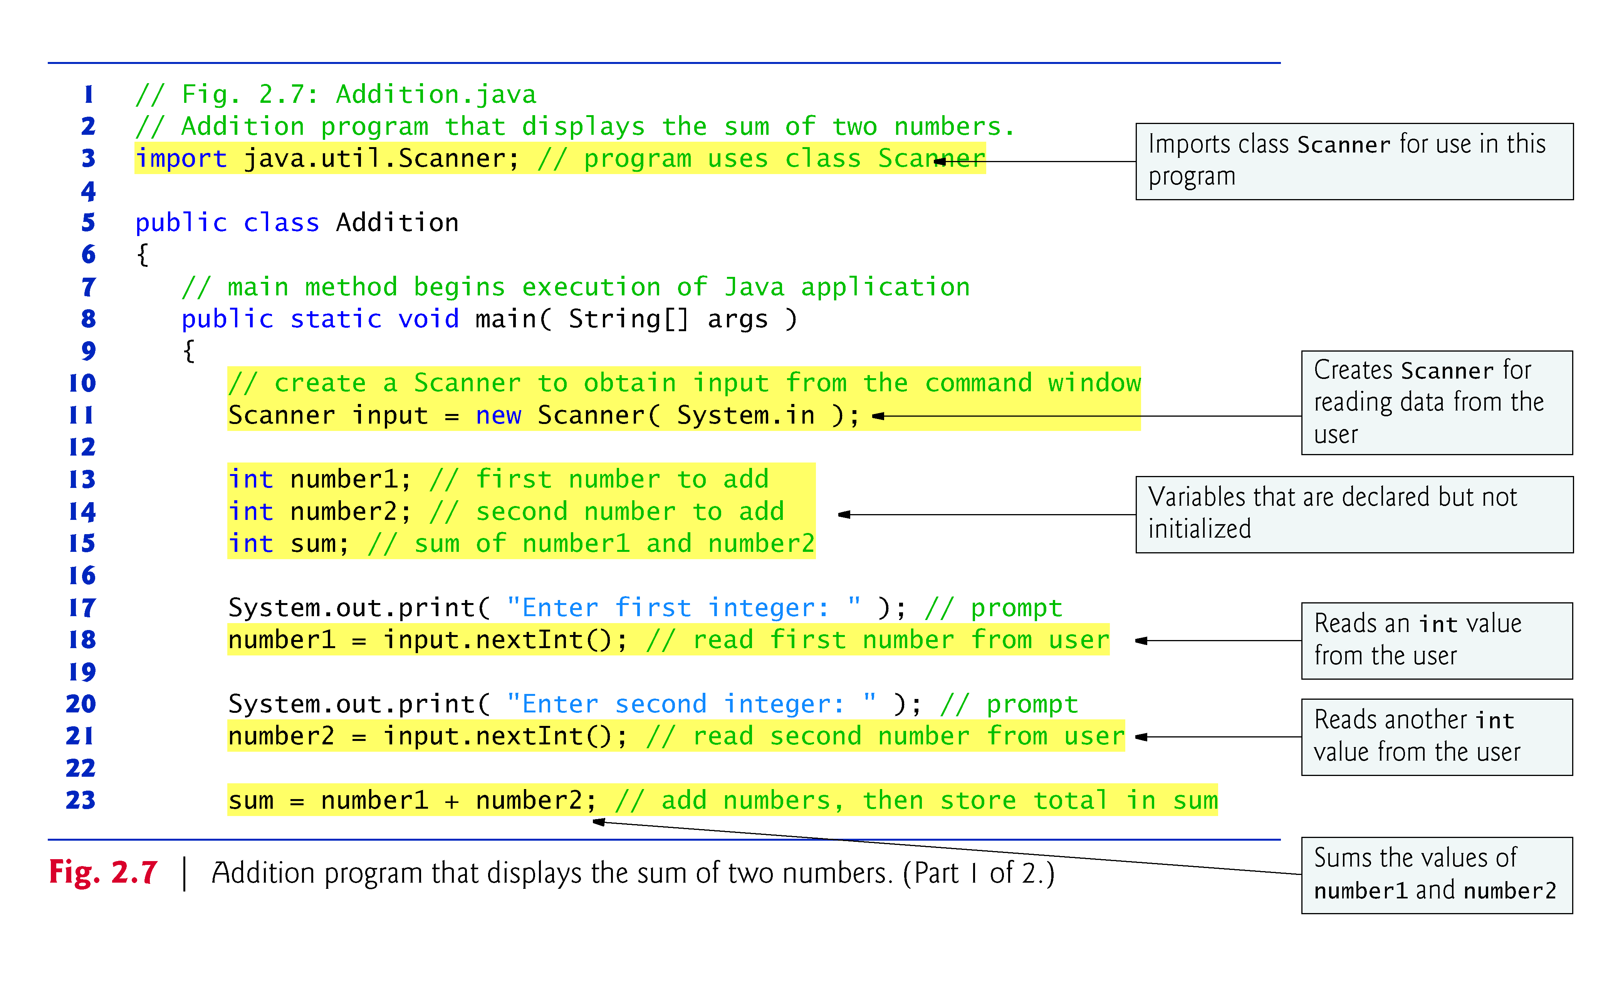

Slide 7
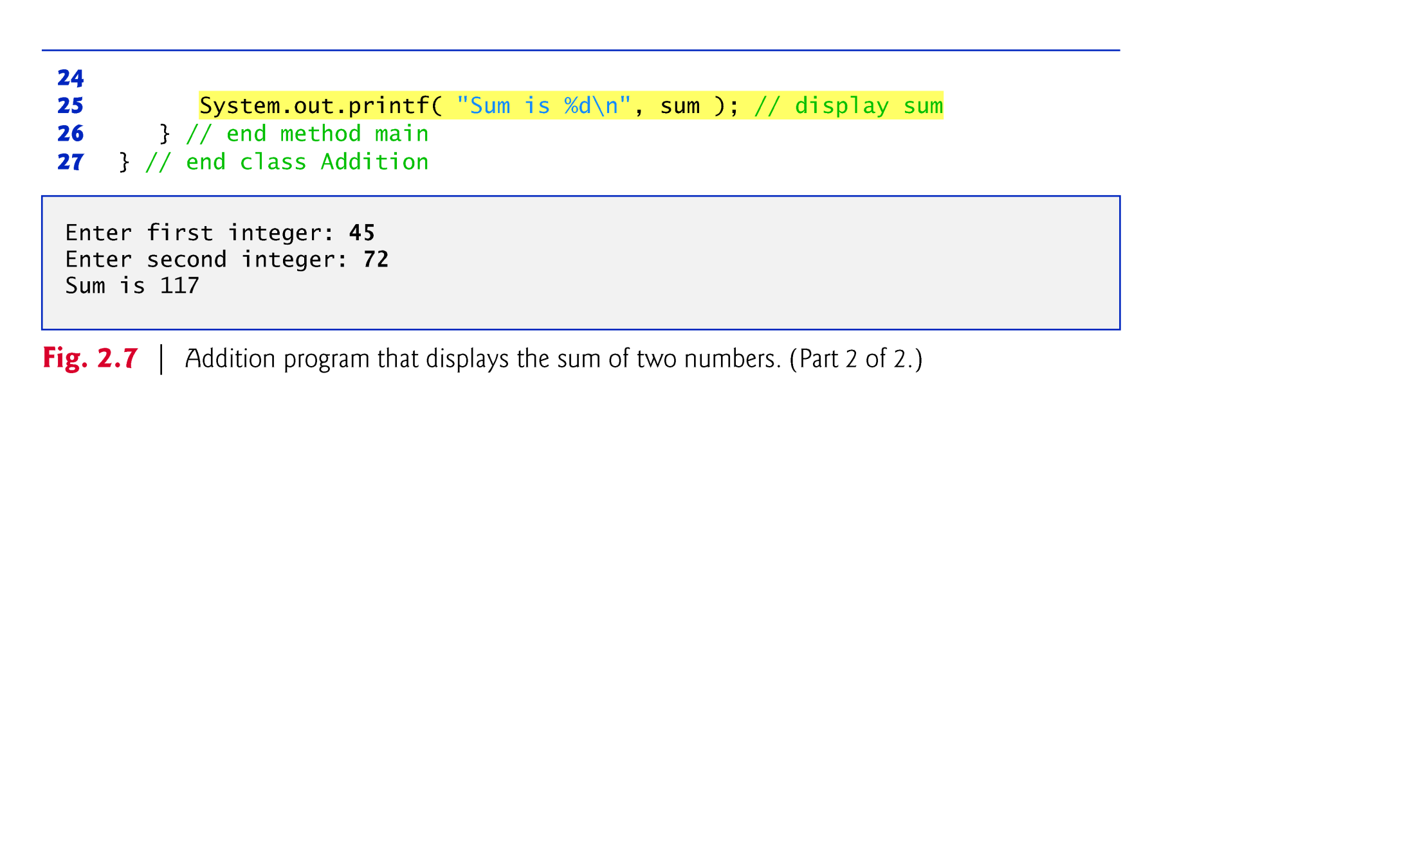

Slide 8
2.4 Reading data from keyboard with Scanner
To read from the input, we'd make a call to one of the following methods for numeric data:
nextInt()
nextDouble()
For example, we could have the following, using two int variables hourPart and minPart:
Scanner input = new Scanner(System.in); System.out.print("Enter the hour: "); hourPart = input.nextInt(); System.out.print("Enter the minute: "); minPart = input.nextInt();
To read in text, we have the following two methods:
next(), which reads text up to whitespace
nextLine(), which reads text up to a line break (like getline in C++)

Slide 9
2.4 Displaying Text with printf
System.out.printf method
f means “formatted”
displays formatted data
Multiple method arguments are placed in a comma-separated list.
Java allows large statements to be split over many lines.
Cannot split a statement in the middle of an identifier or string.
Method printf’s first argument is a format string
May consist of fixed text and format specifiers.
Fixed text is output as it would be by print or println.
Each format specifier is a placeholder for a value and specifies the type of data to output.
Format specifiers begin with a percent sign (%) and are followed by a character that represents the data type.
Format specifier %s is a placeholder for a string.

Slide 10
3.7 Floating-Point Numbers and Type double (Cont.)
System.out.printf
%d for an int value.
%f for an double or float value.
%3d for an int value printed to the right of a field of width 3. (Of course, the 3 can change. This is analogous to cout << setw(3) << ....)
%.2f for an double or float value with 2 decimal places. (Of course, the 2 can change.)
%s for a string
Scanner method nextDouble returns a double value entered by the user.

Slide 11
2.5 Another Application: Adding Integers (Cont.)
import declaration
Helps the compiler locate a class that is used in this program.
Rich set of predefined classes that you can reuse rather than “reinventing the wheel.”
Classes are grouped into packages—named groups of related classes—and are collectively referred to as the Java class library, or the Java Application Programming Interface (Java API).
You use import declarations to identify the predefined classes used in a Java program.

Slide 12
3.5 Primitive Types vs. Reference Types
Types are divided into primitive types and reference types.
The primitive types are boolean, byte, char, short, int, long, float and double.
All nonprimitive types are reference types.
A primitive-type variable can store exactly one value of its declared type at a time.
Primitive-type instance variables are initialized by default—variables of types byte, char, short, int, long, float and double are initialized to 0, and variables of type boolean are initialized to false.
You can specify your own initial value for a primitive-type variable by assigning the variable a value in its declaration.

Slide 13
3.6 Initializing Objects with Constructors
When an object of a class is created, its instance variables are initialized by default.
Each class can provide a constructor that initializes an object of a class when the object is created.
Java requires a constructor call for every object that is created.
Keyword new requests memory from the system to store an object, then calls the corresponding class’s constructor to initialize the object.
A constructor must have the same name as the class.

Slide 14
3.6 Initializing Objects with Constructors (Cont.)
By default, the compiler provides a default constructor with no parameters in any class that does not explicitly include a constructor.
Instance variables are initialized to their default values.
Can provide your own constructor to specify custom initialization for objects of your class.
A constructor’s parameter list specifies the data it requires to perform its task.
Constructors cannot return values, so they cannot specify a return type.
Normally, constructors are declared public.
If you declare any constructors for a class, the Java compiler will not create a default constructor for that class.

Slide 15
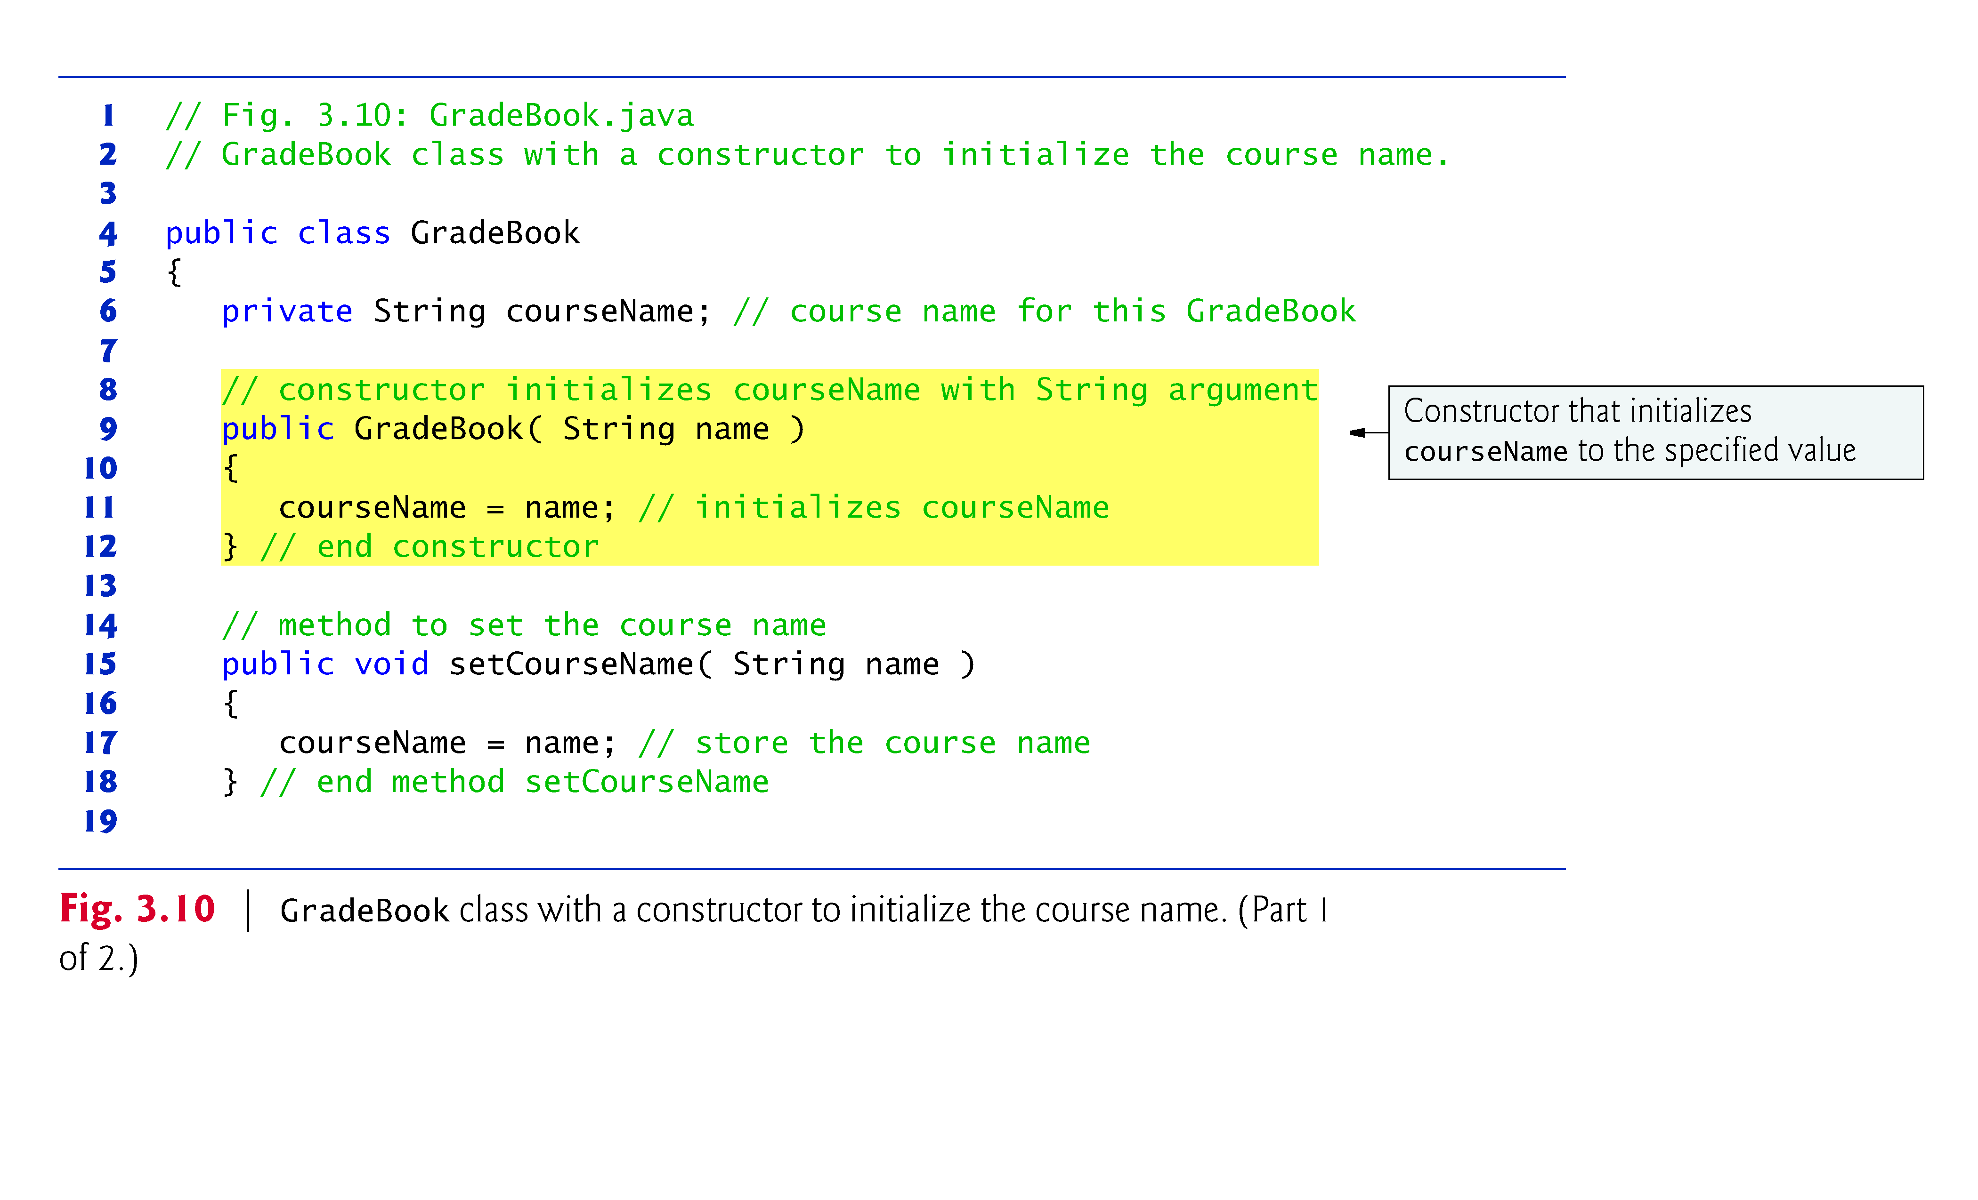

Slide 16
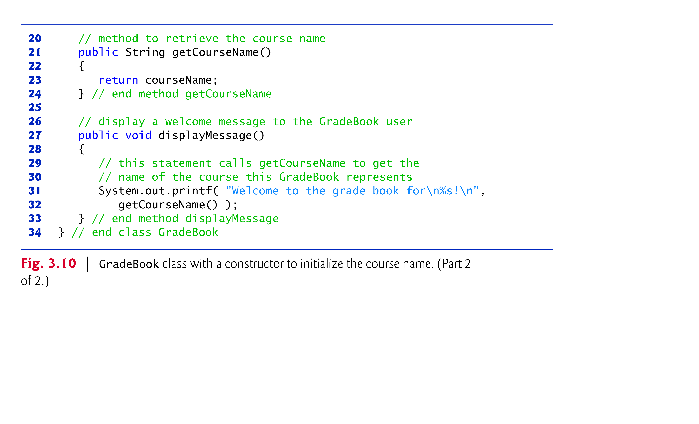

Slide 17
5.6 switch Multiple-Selection Statement (Cont.)
When using the switch statement, remember that each case must contain a constant integral expression.
An integer constant is simply an integer value.
In addition, you can use character constants—specific characters in single quotes, such as 'A', '7' or '$'—which represent the integer values of characters.
The expression in each case can also be a constant variable—a variable that contains a value which does not change for the entire program. Such a variable is declared with keyword final.
Java has a feature called enumerations. Enumeration constants can also be used in case labels.

Slide 18
5.6 switch Multiple-Selection Statement (Cont.)
As of Java SE 7, you can use Strings in a switch statement’s controlling expression and in case labels as in:
switch( city ) { case "Maynard": zipCode = "01754"; break; case "Marlborough": zipCode = "01752"; break; case "Framingham": zipCode = "01701"; break; } // end switch

Slide 19
6.3 static Methods, static Fields and Class Math
Sometimes a method performs a task that does not depend on the contents of any object.
Applies to the class in which it’s declared as a whole
Known as a static method or a class method
It’s common for classes to contain convenient static methods to perform common tasks.
To declare a method as static, place the keyword static before the return type in the method’s declaration.
Calling a static method
ClassName.methodName( arguments )
Class Math provides a collection of static methods that enable you to perform common mathematical calculations.
Method arguments may be constants, variables or expressions.

Slide 20
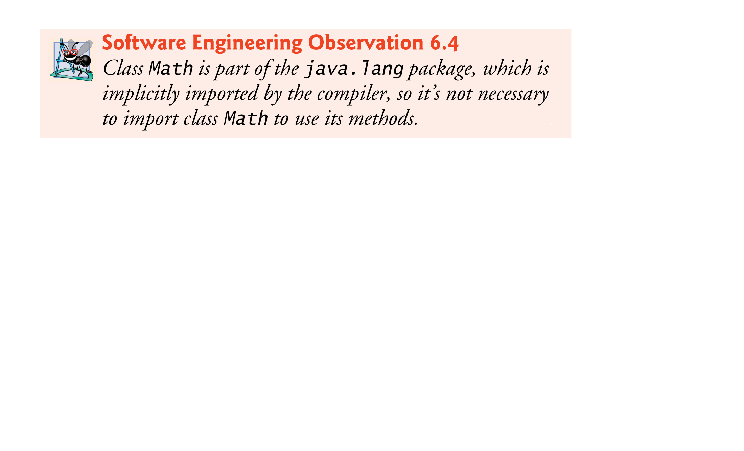

Slide 21
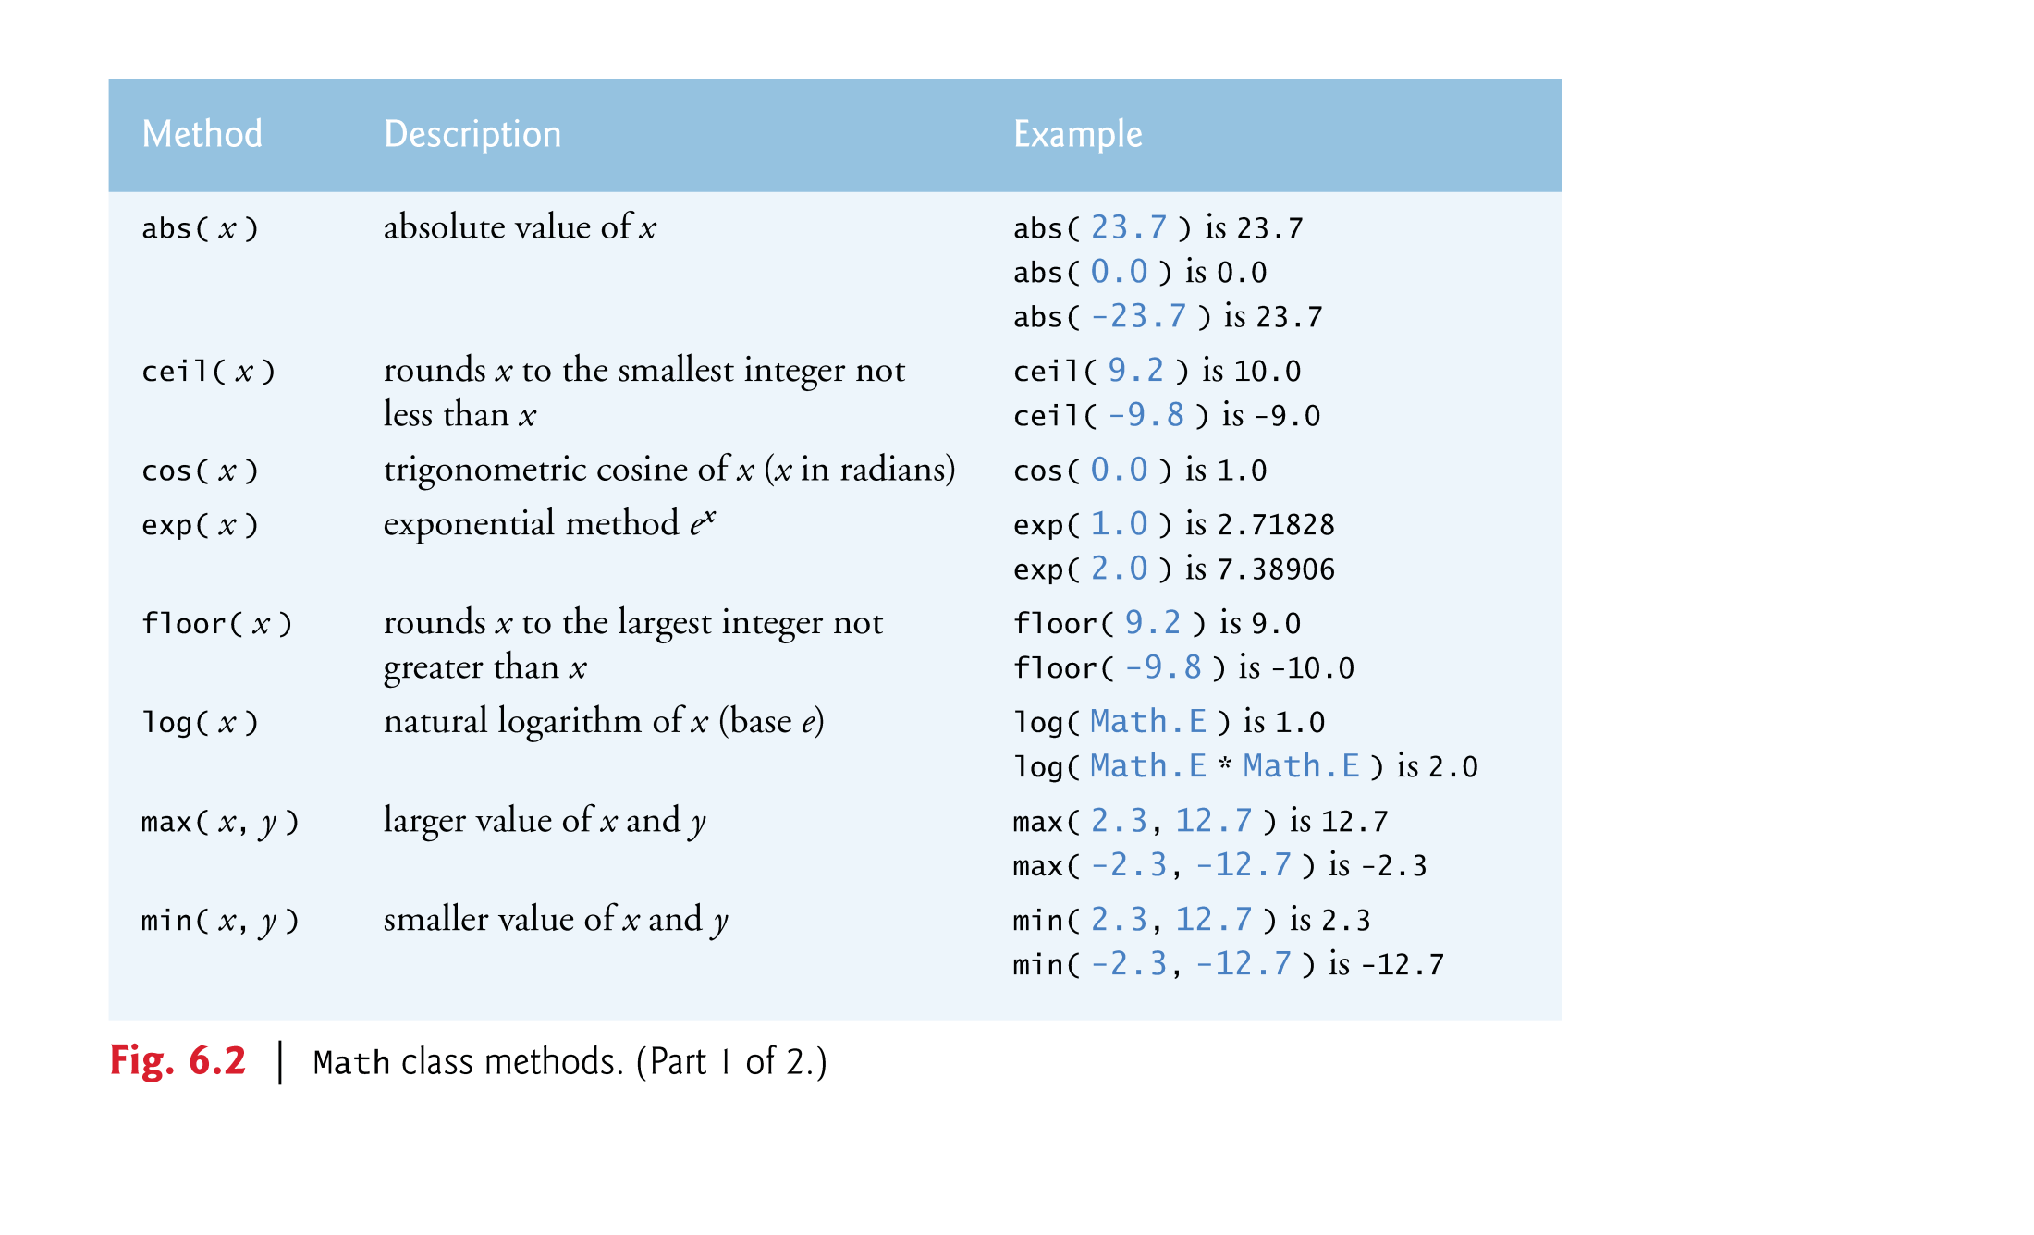

Slide 22
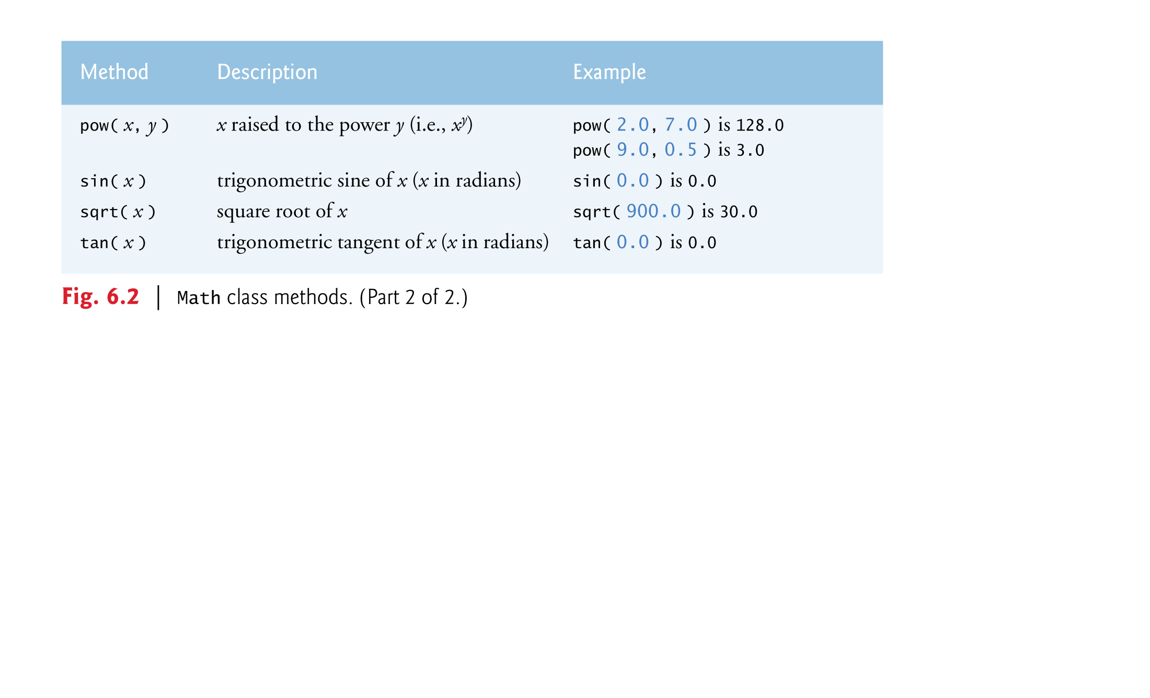

Slide 23
6.3 static Methods, static Fields and Class Math (Cont.)
Math fields for common mathematical constants
Math.PI (3.141592653589793)
Math.E (2.718281828459045)
Declared in class Math with the modifiers public, final and static
public allows you to use these fields in your own classes.
A field declared with keyword final is constant—its value cannot change after the field is initialized.
PI and E are declared final because their values never change.

Slide 24
6.3 static Methods, static Fields and Class Math (Cont.)
A field that represents an attribute is also known as an instance variable—each object (instance) of the class has a separate instance of the variable in memory.
Fields for which each object of a class does not have a separate instance of the field are declared static and are also known as class variables.
All objects of a class containing static fields share one copy of those fields.
Together the class variables (i.e., static variables) and instance variables represent the fields of a class.

Slide 25
6.5 Notes on Declaring and Using Methods (Cont.)
A non-static method can call any method of the same class directly and can manipulate any of the class’s fields directly.
A static method can call only other static methods of the same class directly and can manipulate only static fields in the same class directly.
To access the class’s non-static members, a static method must use a reference to an object of the class.

Slide 26
6.3 static Methods, static Fields and Class Math (Cont.)
Why is method main declared static?
The JVM attempts to invoke the main method of the class you specify—when no objects of the class have been created.
Declaring main as static allows the JVM to invoke main without creating an instance of the class.

Slide 27
6.4 Declaring Methods with Multiple Parameters (Cont.)
String concatenation
Assemble String objects into larger strings with operators + or +=.
When both operands of operator + are Strings, operator + creates a new String object
characters of the right operand are placed at the end of those in the left operand
Every primitive value and object in Java has a String representation.
When one of the + operator’s operands is a String, the other is converted to a String, then the two are concatenated.
If a boolean is concatenated with a String, the boolean is converted to the String "true" or "false".
All objects have a toString method that returns a String representation of the object.

Slide 28
6.8 Java API Packages
Java contains many predefined classes that are grouped into categories of related classes called packages.
A great strength of Java is the Java API’s thousands of classes.
Some key Java API packages are described in Fig. 6.5.
Overview of the packages in Java SE 6:
download.oracle.com/javase/6/docs/api/ overview-summary.html
Java API documentation
download.oracle.com/javase/6/docs/api/

Slide 29
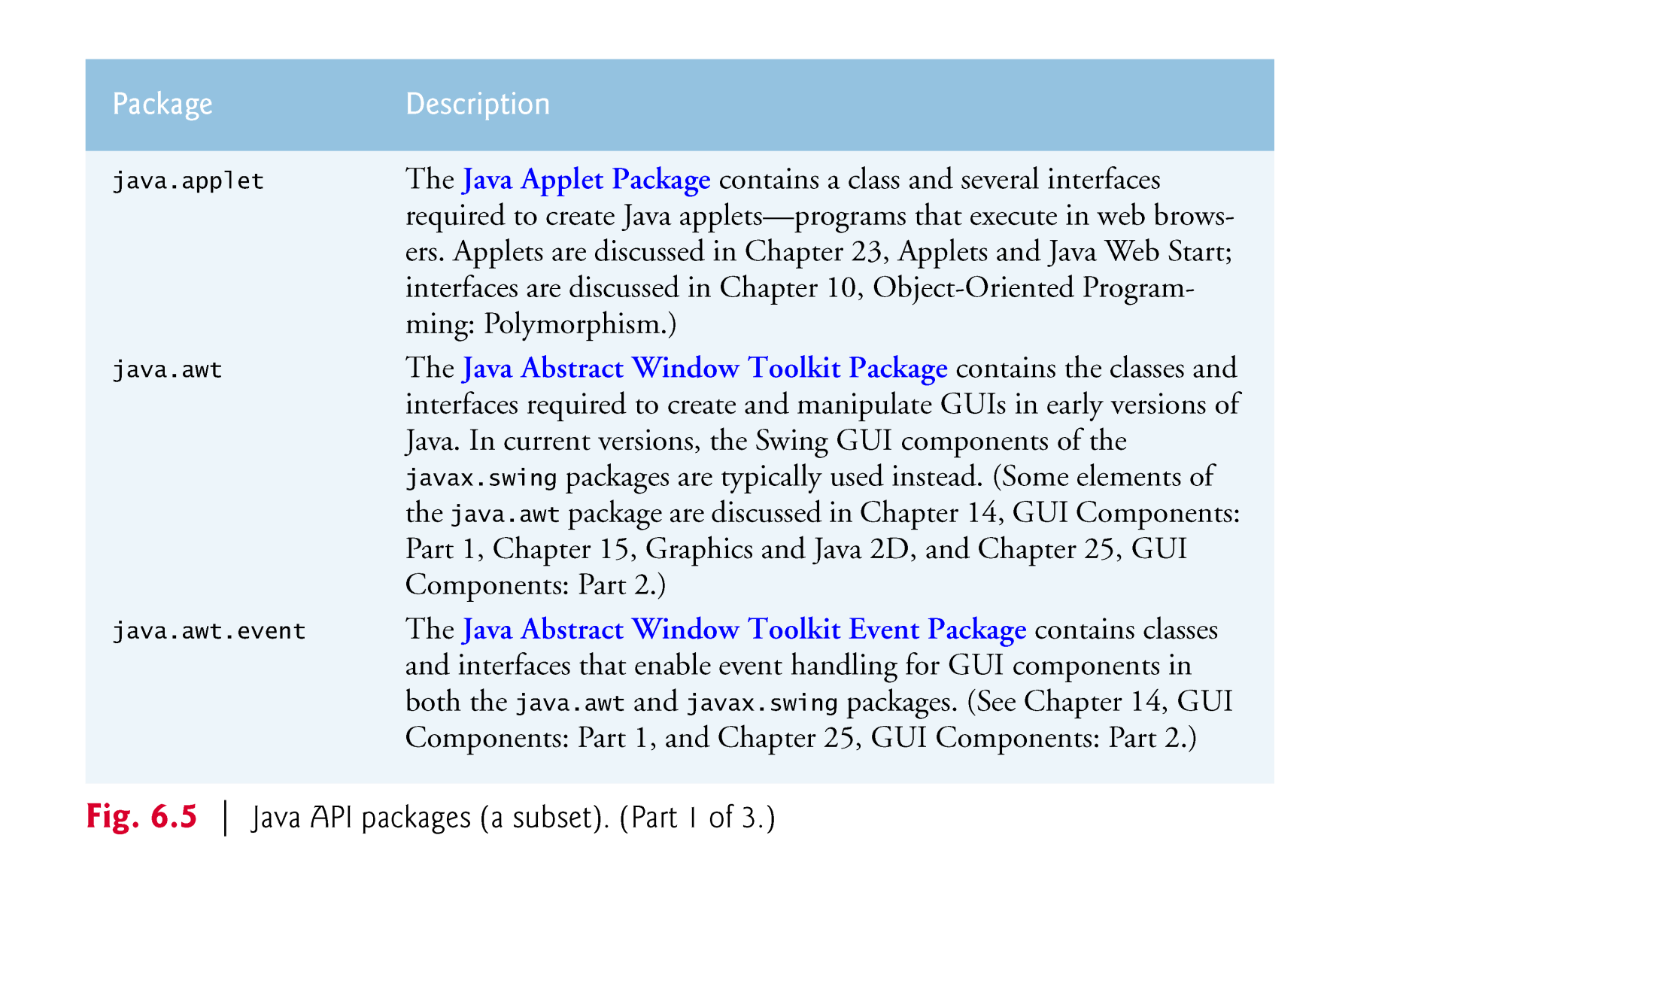

Slide 30
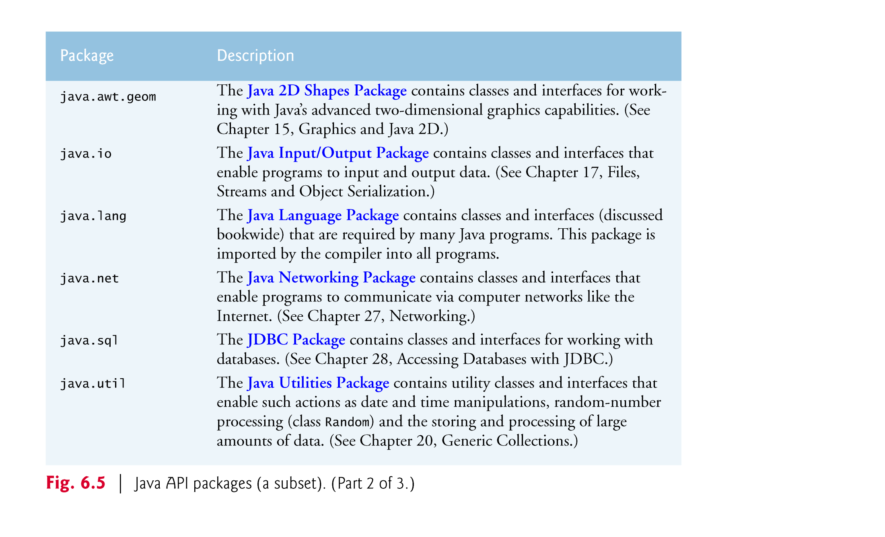

Slide 31
