Slide 1
Chapter 6: Link layer and LANs
our goals:
understand principles behind link layer services:
error detection, correction
sharing a broadcast channel: multiple access
link layer addressing
local area networks: Ethernet, VLANs
instantiation, implementation of various link layer technologies

Slide 2
Link layer, LANs: outline
6.1 introduction, services
6.2 error detection, correction
6.3 multiple access protocols
6.4 LANs
addressing, ARP
Ethernet
switches
VLANS
6.5 link virtualization: MPLS
6.6 data center networking
6.7 a day in the life of a web request

Slide 3
Link layer: introduction
terminology:
hosts and routers: nodes
communication channels between adjacent nodes: links
data-link layer’s responsibility is to
transfer datagram from one node to physically adjacent node
CPU
CPU
datagram
datagram
controller
controller
NIC
NIC
sending host
receiving host
datagram
frame
link layer’s communicating entity: adaptor
Notes:
from one (layer-3) node to the next-hop (layer-3) node (i.e., from source host to first-hop router, between adjacent routers, or from last-hop router to destination host)

Slide 4
Link layer services
link access:
medium access control (MAC) if shared medium
error detection/correction:
detection: receiver detects presence of errors
correction: receiver localizes errors & fixes them
reliable delivery between adjacent nodes (optional):
seldomly used on low bit-error link (fiber, some twisted pair)
commonly used on high bit-error link (wireless)
Q: why both link-level and end-end reliability?
Notes:
A: 1. heterogeneous links on e2e path, need mechanism to guarantee e2e reliability as long as at least one link is not reliable;
2. low bit-error link: best to enforce reliability at endpoints (layer-4); high bit-error link: best to enforce reliability at the link (layer 2)

Slide 5
Link layer, LANs: outline
6.1 introduction, services
6.2 error detection, correction
6.3 multiple access protocols
6.4 LANs
addressing, ARP
Ethernet
switches
VLANS
6.5 link virtualization: MPLS
6.6 data center networking
6.7 a day in the life of a web request

Slide 6
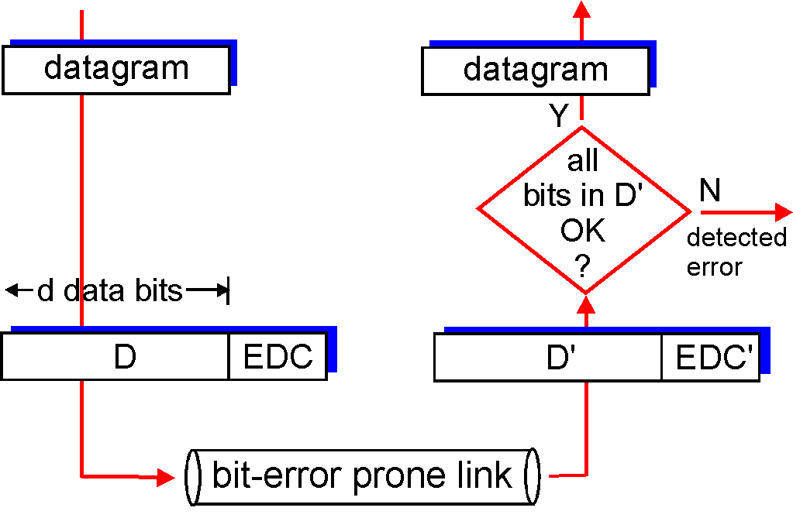
Error detection
EDC= Error Detection and Correction bits
D = Data protected by error checking
f(.) = EDC code
f(D’) = EDC’?
otherwise
drop
f(D)

Slide 7
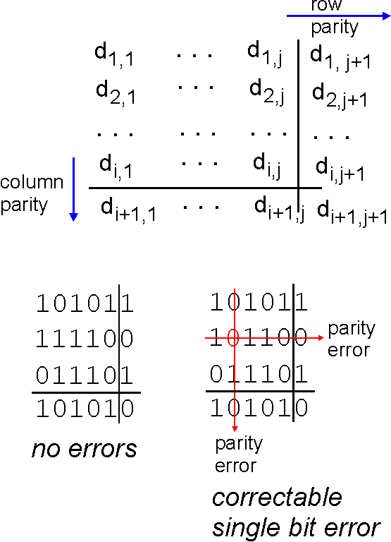
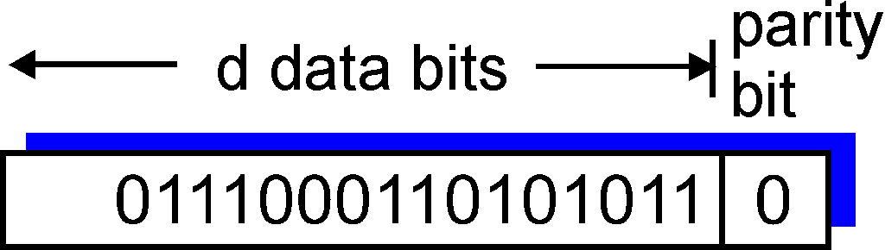
Parity checking
1-D parity check:
detect single bit errors
2-D parity check:
detect and correct single bit errors
odd parity check: total #1’s is odd
even party check: total #1’s is even
0
0
* Check out the online interactive exercises for more examples: http://gaia.cs.umass.edu/kurose_ross/interactive/
Notes:
2-dimensional parity check can detect (not correct) any 2 bit errors. Why?
odd parity check: total #1’s is odd
even party check: total #1’s is even

Slide 8
Internet checksum (review)
goal: detect single bit errors & most multiple bit errors
some multiple bit errors are undetectable
sender:
treat segment contents as sequence of 16-bit integers X1, X2,...
checksum: X1+X2+... (with wraparound), then take the complement sum
sender puts checksum value into UDP/TCP checksum field
receiver:
compute checksum of received segment
check if computed checksum equals checksum field value:
NO - error detected
YES - no error detected

Slide 9
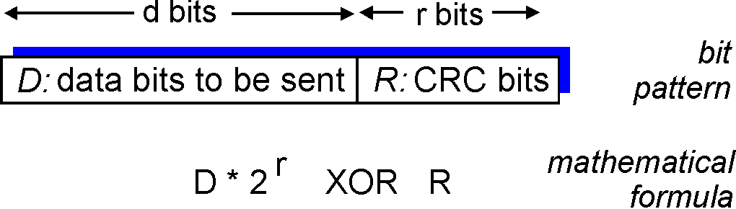
Cyclic redundancy check (CRC)
view data bits, D, as a binary number
choose r+1 bit pattern (generator), G
goal: choose r CRC bits, R, such that
<D,R> exactly divisible by G (modulo 2)
receiver knows G, divides <D’,R’> by G. If non-zero remainder: error detected!
can detect all odd number errors & burst errors of < r+1 bits
burst error ≥ r+1 bits can be detected with prob. 1-0.5^{r}
widely used in practice (Ethernet, 802.11 WiFi, ATM)
Notes:
Ethernet: CRC-32 (G is 33-bit long)
USB: CRC-16-IBM

Slide 10
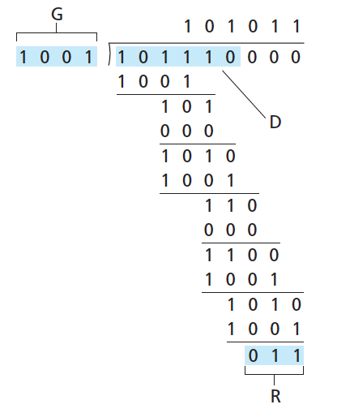
CRC example
want:
D.2^{r} XOR R = nG
equivalently:
D.2^{r} = nG XOR R
equivalently:
if we divide D.2^{r} by G, want remainder R to satisfy:
D.2^{r}
G
R = remainder[ ]
no borrow!
* Check out the online interactive exercises for more examples: http://gaia.cs.umass.edu/kurose_ross/interactive/
Notes:
D*2^r: dividend
G: divisor
result: quotient
leftover: remainder

Slide 11
Review
Link layer overview:
Link layer services
What are the communication endpoints at link layer?
Error detection codes:
Parity check (1D, 2D)
Checksum
CRC
Notes:
End of lecture 1.

Slide 12
Link layer, LANs: outline
6.1 introduction, services
6.2 error detection, correction
6.3 multiple access protocols
6.4 LANs
addressing, ARP
Ethernet
switches
VLANS
6.5 link virtualization: MPLS
6.6 data center networking
6.7 a day in the life of a web request

Slide 13




Multiple access links, protocols
two types of “links”:
point-to-point
PPP for dial-up access
point-to-point link between Ethernet switch, host
broadcast (shared wire or medium)
old-fashioned Ethernet
upstream HFC
802.11 wireless LAN
coordinated by MAC protocols
shared wire (e.g.,
cabled Ethernet)
shared RF
(e.g., 802.11 WiFi)
shared RF
(satellite)
humans at a
cocktail party
(shared air, acoustical)
Notes:
In link layer terminology, “access a link” = “transmit on a link”
wireless links are often shared (e.g., WiFi link, satellite link); but wired links can also be shared (e.g., old-fashioned Ethernet link)

Slide 14
MAC protocols: taxonomy
three broad classes:
channel partitioning
divide channel into smaller “pieces” (time slots, frequency, code)
allocate piece to node for exclusive use
random access
channel not divided, allow collisions
“recover” from collisions
“taking turns”
nodes take turns, but nodes with more to send can take longer turns
Notes:
Let’s look at what have been developed so far.
These three classes basically represent three approaches to multi-access control.

Slide 15
Channel partitioning MAC protocols: TDMA
TDMA: time division multiple access
access to channel in "rounds"
each node gets a fixed slot (length = packet transmission time) in each round
unused slots go idle
example: 6-node LAN
6-slot
round
6-slot
round
1
3
4
1
3
4
Notes:
partition time into slots (each of L/R seconds for packet length L bits and link capacity R bps) -> group slots into rounds (n nodes, then every n slots is a round)
-> assign slots in each round to the nodes.
If a node (e.g., node 2) has no data in a round, its slot will remain empty (i.e., the channel will be idle during that slot).

Slide 16
Channel partitioning MAC protocols: FDMA
FDMA: frequency division multiple access
channel spectrum divided into frequency bands
each node assigned fixed frequency band
unused frequency bands go idle
example: 6-node LAN
time
frequency bands
FDM cable
Notes:
Good things about channel partitioning protocols: simple, deterministic, collision-free
Drawbacks: low efficiency

Slide 17
Random access protocols
node sends packets probabilistically
fully decentralized (no a priori coordination among nodes)
two or more transmitting nodes ➜ “collision”
random access MAC protocol specifies:
when to transmit
how to recover from collisions
examples:
slotted ALOHA
ALOHA
CSMA, CSMA/CD, CSMA/CA
Notes:
Adapting to demands by only letting nodes that have data to send probabilistically compete for channel access.

Slide 18
Slotted ALOHA
assumptions:
all frames same size
time divided into equal size slots (time to transmit 1 frame)
operation:
when node obtains fresh frame, transmits in next slot
if no collision: node can send new frame in next slot
if collision: node retransmits frame in each subsequent slot with prob. p until success
1970: ALOHAnet satellite network in Hawaii (“Additive Links On-line Hawaii Area”)
node 1
1
1
1
1
node 2
2
2
2
node 3
3
3
3
C
E
C
S
E
C
E
S
S

Slide 19

Slotted ALOHA
efficiency: long-term fraction of successful slots (assuming nodes all with infinitely many frames to send)
Suppose: N nodes, each transmits with prob. p
Q1: Prob. that a given node has success = p(1-p)^{N-1}
Q2: Prob. that any node has a success (efficiency) = Np(1-p)^{N-1}
Q3: The p* that maximizes efficiency = 1/N
Q4: Taking limit of the max efficiency as N goes to infinity = 1/e
$$\frac{∂}{∂p}\left(Np{\left(1−p\right)}^{N−1}\right)=0$$
!
at best: Channel used for useful transmissions 1/e = 37% of time!

Slide 20
Pure (unslotted) ALOHA
unslotted ALOHA: simpler, no synchronization
collision probability:
frame sent at [t-1,t] collides with frames sent at t-1 and t
will collide with node i
will collide with node i
node i’s frame
node j’s
time system
t-1
t
t+1
Q1: P(success by node i) = P(node i transmits).P(no other transmits in [t-1,t+1]
= p . (1-p)^{2(N-1)}
Q2: P(success by any node) = N . p . (1-p)^{2(N-1)}
Q3: optimum p* = 1/(2N-1)
Q4: limit when N → ∞: 1/(2e) = 0.18
efficiency
even worse!
Notes:
Lecture 1.

Slide 21
Review
Multiple access protocols
What are the 3 broad classes of multiple access protocols?
What do they control?
Channel partitioning protocols: TDMA, FDMA
Random access protocols: pure/slotted ALOHA
Notes:
End of lecture 2.

Slide 22
CSMA (carrier sense multiple access)
CSMA: “listen before transmit”
if channel sensed idle: transmit entire frame
if channel sensed busy, defer transmission
Q: is CSMA collision-free?
Notes:
ALOHA: don’t look, don’t listen, just randomly decide at each time whether you will talk or not
CSMA: listen before you talk

Slide 23
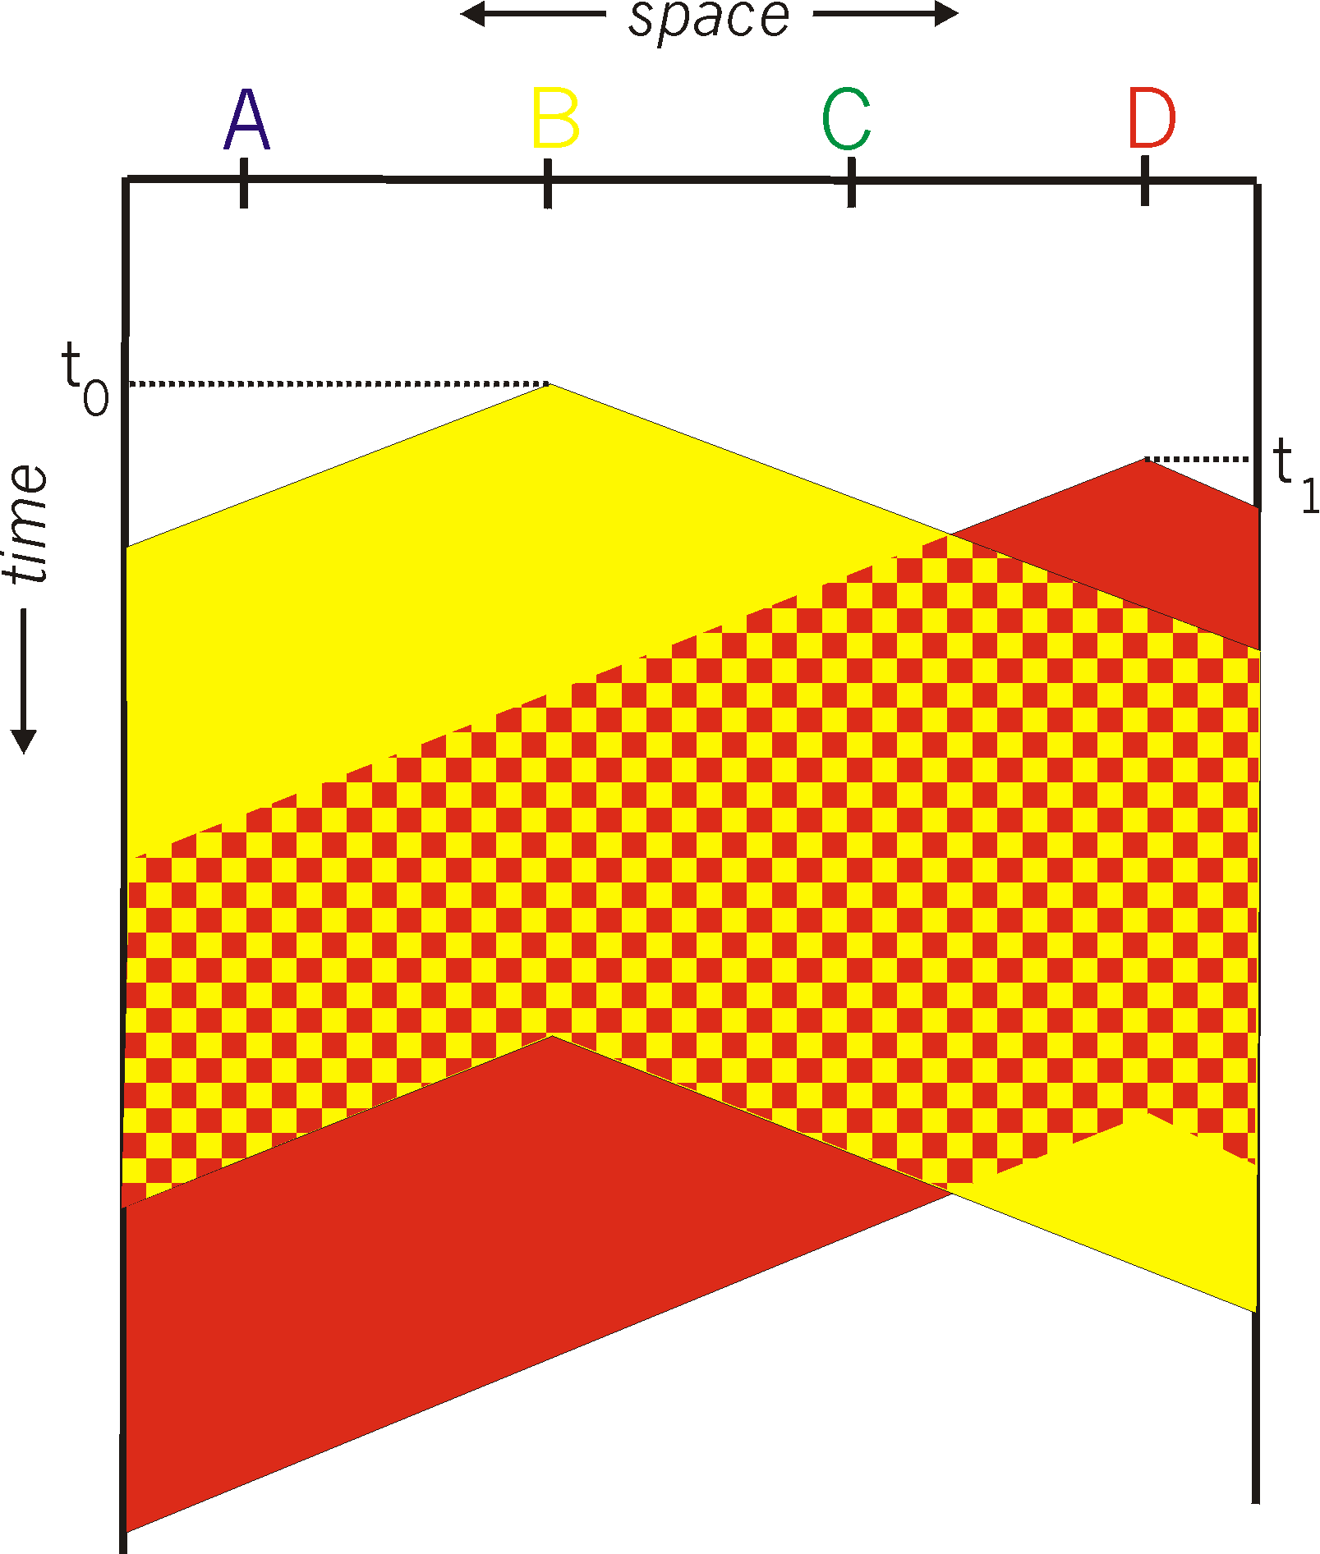
CSMA collisions
A B C D
collisions can still occur: propagation delay means two nodes may not hear each other’s transmission
collision: entire packet transmission time wasted
distance & propagation delay play role in determining collision probability
Notes:
The fact that you don’t hear anyone talking does not mean no one is talking.
Therefore, a CSMA protocol should still have mechanism to recover from collision.

Slide 24
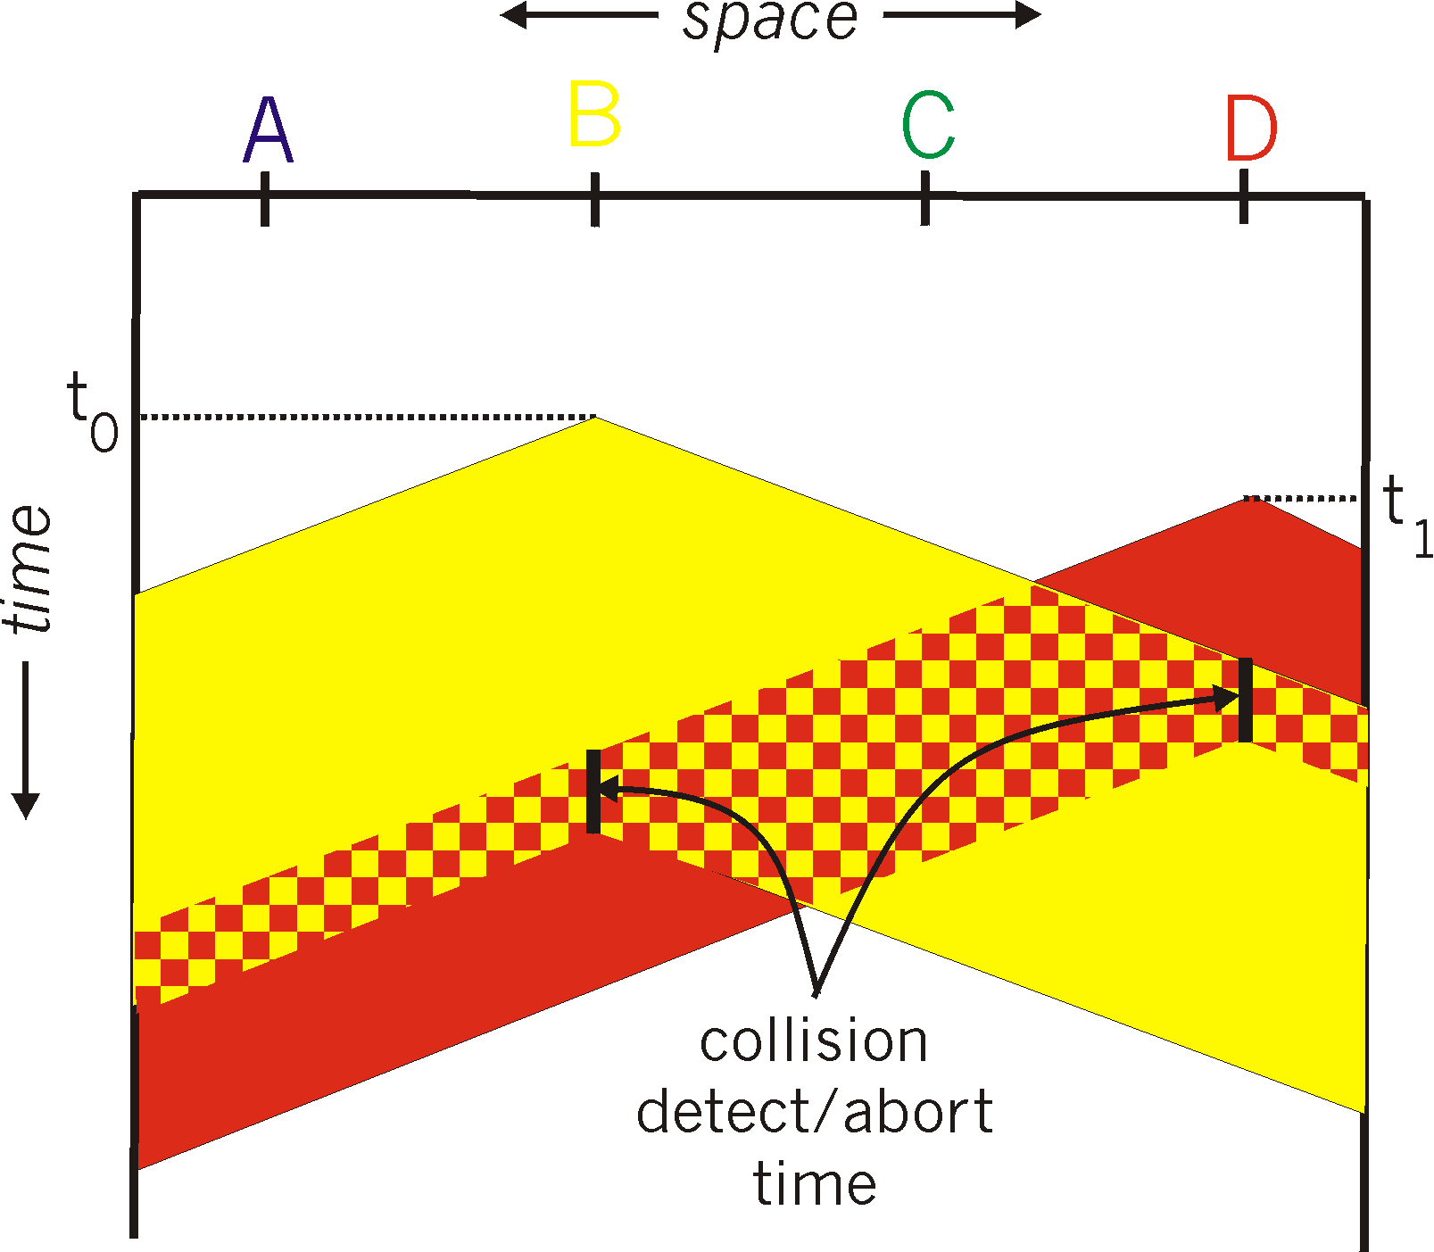
CSMA/CD (collision detection)
CSMA/CD: carrier sensing, deferral as in CSMA
If collisions detected, abort transmission
collision detection:
measure signal strengths, compare transmitted and received signals
Notes:
One way to recover from collision under CSMA is collision detection.
The idea is, after you sense an idle channel and start transmitting, keep listening on the channel in case there is a remote transmission that is still propagating.
Once you detect a collision, abort current transmission (as it won’t be successful anyway) and try again later.

Slide 25
Ethernet CSMA/CD algorithm
NIC receives datagram from network layer, creates frame.
2. If NIC senses channel idle, starts frame transmission. If NIC senses channel busy, waits until channel idle, then transmits.
3. If NIC transmits entire frame without detecting another transmission, NIC is done with frame!
4. If NIC detects another transmission while transmitting, aborts and sends jam signal.
5. After aborting, NIC enters binary (exponential) backoff:
After m^{th} collision, NIC chooses K at random from {0,1,2, …, 2^{m}-1}. NIC waits K· (512 bit time), returns to Step 2.
Notes:
Ethernet’s MAC protocol uses CSMA/CD combined with another idea: exponential backoff. Here is how it works...
The efficiency of CSMA/CD is determined by two parameters: t_prop and t_trans
It shows that in theory, we could use CSMA/CD to increase efficiency to 1 (as t_prop goes to 0 or t_trans goes to infinity).

Slide 26
“Taking turns” MAC protocols
channel partitioning MAC protocols:
share channel efficiently and fairly at high load
inefficient at low load: delay in channel access, 1/N bandwidth allocated even if only 1 active node!
random access MAC protocols
efficient at low load: single node can fully utilize channel
high load: collision overhead
“taking turns” protocols
look for best of both worlds!

Slide 27

“Taking turns” MAC protocols
polling:
master node “invites” slave nodes to transmit in turn
typically used with “dumb” slave devices
concerns:
polling overhead
latency
single point of failure (master)
Example: Bluetooth protocol
data
poll
master
slaves

Slide 28
“Taking turns” MAC protocols
token passing:
control token passed from one node to next sequentially.
token frame
concerns:
token overhead
latency
single point of failure (token)
Example: FDDI (fiber distributed data interface), token ring protocol
T
(nothing
to send)
T
data
Notes:
FDDI: fiber distributed data interface
If you think of polling protocol as a “client-server” based taking turns protocol, then token passing protocol is the P2P counterpart.

Slide 29
Summary of MAC protocols
channel partitioning, by time, frequency or code
Time Division, Frequency Division
random access (dynamic),
ALOHA, S-ALOHA, CSMA, CSMA/CD
CSMA/CD used in Ethernet
CSMA/CA used in 802.11
taking turns
polling from central site, token passing
Bluetooth, FDDI, token ring

Slide 30
Review
Multiple access protocols
What are the 3 broad classes of multiple access protocols?
What do they control?
Channel partitioning protocols: TDMA, FDMA
Random access protocols: pure/slotted ALOHA, CSMA, CSMA/CD
Taking-turns protocols: polling, token passing
Notes:
End of lecture 3.

Slide 31
Link layer, LANs: outline
6.1 introduction, services
6.2 error detection, correction
6.3 multiple access protocols
6.4 LANs
addressing, ARP
Ethernet
switches
VLANS
6.5 link virtualization: MPLS
6.6 data center networking
6.7 a day in the life of a web request

Slide 32
MAC addresses
IP address: 32-bit (v4) or 128-bit (v6)
network-layer address for interface
used for layer 3 (network layer) forwarding
MAC (or physical) address:
function: used “locally” to get frame from one interface to another interface within the same subnet
48 bit MAC address (for most LANs) burned in NIC ROM
e.g.: 1A-2F-BB-76-09-AD
hexadecimal (base 16) notation
(each “numeral” represents 4 bits)
Notes:
E.g., 1A: 00011010

Slide 33
MAC addresses (more)
MAC address allocation administered by IEEE
manufacturer buys portion of MAC address space (to assure uniqueness)
analogy:
MAC address: like Social Security Number
IP address: like postal address
MAC flat address ➜ portability
IP hierarchical address ➜ not portable
address depends on subnet to which node is attached

Slide 34




ARP: address resolution protocol
Question: how to determine
interface’s MAC address, knowing its IP address?
ARP table: each IP node (host, router) on LAN has table
IP/MAC address mappings for some LAN nodes:
< IP address; MAC address; TTL>
TTL (Time To Live): time after which address mapping will be forgotten (typically 20 min)
C
137.196.7.78
1A-2F-BB-76-09-AD
137.196.7.23
137.196.7.14
A
LAN
B
71-65-F7-2B-08-53
58-23-D7-FA-20-B0
0C-C4-11-6F-E3-98
137.196.7.88
D
Notes:
Corresponding to DNS service for IP address.
Human analogy: translating postal address into SSN

Slide 35
ARP protocol: same LAN
A wants to send datagram to B
B’s MAC address not in A’s ARP table.
A broadcasts ARP query, containing B's IP address
destination MAC address = FF-FF-FF-FF-FF-FF
all nodes on LAN receive ARP query
B receives ARP packet, replies to A with B's MAC address
frame sent to A’s MAC address (unicast)
C
137.196.7.78
1A-2F-BB-76-09-AD
137.196.7.23
137.196.7.14
A
LAN
B
71-65-F7-2B-08-53
58-23-D7-FA-20-B0
0C-C4-11-6F-E3-98
137.196.7.88
D
ARP is “plug-and-play”:
nodes create their ARP tables without intervention from net administrator
Notes:
Compared to: Manually entering entries in DNS database.
Each adaptor compares the received frame’s destination MAC address with its own MAC address, and only passes the contained datagram to its network layer if the MAC addresses match.

Slide 36




Addressing: routing to another LAN
walkthrough: send datagram from A to B via R
focus on addressing – at IP (datagram) and MAC layer (frame)
assume A knows B’s IP address (how?)
assume A knows IP address of first hop router, R (how?)
assume A knows R’s MAC address (how?)
A
B
R
111.111.111.111
222.222.222.222
74-29-9C-E8-FF-55
49-BD-D2-C7-56-2A
222.222.222.220
1A-23-F9-CD-06-9B
111.111.111.112
111.111.111.110
222.222.222.221
CC-49-DE-D0-AB-7D
E6-E9-00-17-BB-4B
88-B2-2F-54-1A-0F
Notes:
A1: from DNS server
A2: from DHCP server
A3: from ARP

Slide 37
Addressing: routing to another LAN
A creates IP datagram with IP source A, destination B
A creates link-layer frame with R's MAC address as destination address, frame contains A-to-B IP datagram
MAC src: 74-29-9C-E8-FF-55
MAC dest: E6-E9-00-17-BB-4B
IP
Eth
Phy
IP src: 111.111.111.111
IP dest: 222.222.222.222
A
B
R
111.111.111.111
222.222.222.222
74-29-9C-E8-FF-55
49-BD-D2-C7-56-2A
222.222.222.220
1A-23-F9-CD-06-9B
111.111.111.112
111.111.111.110
222.222.222.221
CC-49-DE-D0-AB-7D
E6-E9-00-17-BB-4B
88-B2-2F-54-1A-0F

Slide 38
Addressing: routing to another LAN
frame sent from A to R
frame received at R, datagram removed, passed up to IP
MAC src: 74-29-9C-E8-FF-55
MAC dest: E6-E9-00-17-BB-4B
IP src: 111.111.111.111
IP dest: 222.222.222.222
IP
Eth
Phy
IP src: 111.111.111.111
IP dest: 222.222.222.222
IP
Eth
Phy
A
B
R
111.111.111.111
222.222.222.222
74-29-9C-E8-FF-55
49-BD-D2-C7-56-2A
222.222.222.220
1A-23-F9-CD-06-9B
111.111.111.112
111.111.111.110
222.222.222.221
CC-49-DE-D0-AB-7D
E6-E9-00-17-BB-4B
88-B2-2F-54-1A-0F

Slide 39
Addressing: routing to another LAN
R forwards datagram with IP source A, destination B
R creates link-layer frame with B's MAC address as destination address, frame contains A-to-B IP datagram
MAC src: 1A-23-F9-CD-06-9B
MAC dest: 49-BD-D2-C7-56-2A
IP
Eth
Phy
IP
Eth
Phy
IP src: 111.111.111.111
IP dest: 222.222.222.222
A
B
R
111.111.111.111
222.222.222.222
74-29-9C-E8-FF-55
49-BD-D2-C7-56-2A
222.222.222.220
1A-23-F9-CD-06-9B
111.111.111.112
111.111.111.110
222.222.222.221
CC-49-DE-D0-AB-7D
E6-E9-00-17-BB-4B
88-B2-2F-54-1A-0F

Slide 40
Addressing: routing to another LAN
R forwards datagram with IP source A, destination B
R creates link-layer frame with B's MAC address as destination address, frame contains A-to-B IP datagram
MAC src: 1A-23-F9-CD-06-9B
MAC dest: 49-BD-D2-C7-56-2A
IP
Eth
Phy
IP
Eth
Phy
IP src: 111.111.111.111
IP dest: 222.222.222.222
A
B
R
111.111.111.111
222.222.222.222
74-29-9C-E8-FF-55
49-BD-D2-C7-56-2A
222.222.222.220
1A-23-F9-CD-06-9B
111.111.111.112
111.111.111.110
222.222.222.221
CC-49-DE-D0-AB-7D
E6-E9-00-17-BB-4B
88-B2-2F-54-1A-0F
Notes:
Lecture 2.

Slide 41
Review
Link layer addressing:
What is MAC address associated with? How is it different from IP address?
ARP (address resolution protocol): What is it used for? How does it work?
Notes:
End of lecture 4.

Slide 42
Link layer, LANs: outline
6.1 introduction, services
6.2 error detection, correction
6.3 multiple access protocols
6.4 LANs
addressing, ARP
Ethernet
switches
VLANS
6.5 link virtualization: MPLS
6.6 data center networking
6.7 a day in the life of a web request

Slide 43



Ethernet: physical topology
bus: popular through mid 90s
all nodes in same collision domain (can collide with each other)
star: prevails today
active switch in center
each “spoke” runs a (separate) Ethernet protocol (nodes do not collide with each other)
switch
star
bus: coaxial cable

Slide 44
Ethernet frame structure
sending adapter encapsulates IP datagram (or other network layer protocol packet) in Ethernet frame
preamble:
7 bytes with pattern 10101010 followed by one byte with pattern 10101011
“self-synchronized”: preamble used to synchronize receiver & sender clocks
type
preamble
dest.
address
source
address
data (payload)
CRC

Slide 45
Ethernet frame structure (more)
addresses: source & destination MAC addresses
if adapter receives frame with matching destination address, or with broadcast address (e.g. ARP query), it passes data to network layer protocol
otherwise, adapter discards frame
type: indicates higher layer protocol (mostly IP but others possible, e.g., Novell IPX, AppleTalk)
EtherType values
CRC: cyclic redundancy check at receiver
error detected: frame is dropped
type
preamble
dest.
address
source
address
data (payload)
CRC
Notes:
Type 0x0806 (“0x” means hexadecimal, i.e., type field is 2-byte long) means the Ethernet frame contains an ARP in the payload.
Ethernet uses a 32-bit CRC.

Slide 46
Switch table
Q: how does switch know A’ reachable via interface 4, B’ reachable via interface 5?
A
C’
B
A: each switch has a switch table, each entry:
(destination MAC address, output interface, time stamp)
looks like a routing table, but configured differently
6
1
2
5
4
3
B’
C
A’
switch with six interfaces
(1,2,3,4,5,6)
Notes:
A can talk to A’ while B talks to B’ and C talks to C’ simultaneously, without collision, as the switch will selectively forward each frame towards the intended destination.

Slide 47
Switch: self-learning
Source: A
Dest: A’
switch learns which hosts can be reached through which interfaces
when frame received, switch records sender/location pair in switch table
A
A A’
C’
B
6
1
2
5
4
3
B’
C
A’
MAC addr interface Time
A
1
9:32
Switch table
(initially empty)

Slide 48
Switch: frame filtering/forwarding
when frame received at switch:
1. record incoming link, MAC address of sending host
2. index switch table using MAC destination address
3. if entry found for destination then {
if destination on segment from which frame arrived then drop frame
else forward frame on interface indicated by entry
}
else flood /* forward on all interfaces except arriving
interface */

Slide 49
Self-learning, forwarding: example
Source: A
Dest: A’
A
A A’
frame destination, A’, location unknown:
flood
C’
B
destination A location known:
6
1
2
A A’
A A’
A A’
A A’
selectively send
on just one link
A A’
5
4
3
B’
C
A’ A
A’
MAC addr interface Time
A
1
9:32
switch table
(initially empty)
A’
4
9:39

Slide 50


Switches vs. routers
application
transport
network
link
physical
both are store-and-forward:
routers: network-layer devices (examine network-layer headers)
switches: link-layer devices (examine link-layer headers)
both look up tables:
routers: compute tables using routing algorithms
switches: learn forwarding actions using self-learning
datagram
frame
link
physical
frame
switch
network
link
physical
datagram
frame
application
transport
network
link
physical

Slide 51
Review
Ethernet:
What is the benefit of using switch instead of bus/hub?
How is switch table configured?
What are the similarities and differences between switch and router?
Notes:
End of lecture 5.

Slide 52
Link layer, LANs: outline
6.1 introduction, services
6.2 error detection, correction
6.3 multiple access protocols
6.4 LANs
addressing, ARP
Ethernet
switches
VLANS
6.5 link virtualization: MPLS
6.6 data center networking
6.7 a day in the life of a web request

Slide 53

VLANs: motivation
consider:
CS user moves office to EE, but wants connect to CS switch?
single broadcast domain:
all layer-2 broadcast traffic (ARP, DHCP, unknown location of destination MAC address) must cross entire LAN
security/privacy, efficiency issues
Computer
Science
Computer
Engineering
Electrical
Engineering

Slide 54

VLANs
port-based VLAN: switch ports grouped (by switch management software) so that single physical switch ……
Virtual Local
Area Network
1
7
9
15
2
8
10
16
switch(es) supporting VLAN capabilities can be configured to define multiple virtual LANS over single physical LAN infrastructure.
…
…
Electrical Engineering
(VLAN ports 1-8)
Computer Science
(VLAN ports 9-15)
… operates as multiple virtual switches
1
7
9
15
2
8
10
16
…
…
Electrical Engineering
(VLAN ports 1-8)
Computer Science
(VLAN ports 9-16)

Slide 55

Benefits of VLAN
router
traffic isolation: frames to/from ports 1-8 can only reach ports 1-8
can also define VLAN based on MAC addresses of endpoints, rather than switch port
1
7
9
15
2
8
10
16
dynamic membership: ports can be dynamically assigned among VLANs
…
…
Electrical Engineering
(VLAN ports 1-8)
Computer Science
(VLAN ports 9-15)
forwarding between VLANS: done via routing (just as with separate switches)
in practice vendors sell combined switches plus routers
Notes:
consequence of partitioning switch ports into multiple groups

Slide 56


VLANS spanning multiple switches
1
7
9
15
1
3
5
7
2
8
10
16
2
4
6
8
…
…
Electrical Engineering
(VLAN ports 1-8)
Computer Science
(VLAN ports 9-15)
Ports 2,3,5 belong to EE VLAN
Ports 4,6,7,8 belong to CS VLAN
trunk port: carries frames between VLANS defined over multiple physical switches
frames forwarded within VLAN between switches can’t be vanilla Ethernet frames (must carry VLAN ID info)
802.1Q protocol adds/removed additional header fields for frames forwarded between trunk ports
Notes:
Ethernet is standardized in 802.3
“trunk port” is a special type of port supported by VLAN-capable switches to connect different physical switches.

Slide 57
802.1Q VLAN frame format
type
preamble
dest.
address
source
address
data (payload)
CRC
Ethernet frame
(802.3)
type
preamble
dest.
address
source
address
data (payload)
CRC
802.1Q frame
2-byte Tag Protocol Identifier
(value: 81-00)
Recomputed
CRC
Tag Control Information (3 bit priority field like IP TOS ,
1 bit Canonical Format Indicator, 12 bit VLAN ID field)
Notes:
Lecture 3.
Canonical Format Indicator: always 0 for Ethernet frame (CFI = 1 is used for Token Ring LAN frame)

Slide 58
Link layer, LANs: outline
6.1 introduction, services
6.2 error detection, correction
6.3 multiple access protocols
6.4 LANs
addressing, ARP
Ethernet
switches
VLANS
6.5 link virtualization: MPLS
6.6 data center networking
6.7 a day in the life of a web request

Slide 59
MultiProtocol Label Switching (MPLS)
initial goal: high-speed IP forwarding using fixed length label (instead of IP prefix)
fast lookup using fixed length identifier (rather than longest prefix matching)
borrowing ideas from Virtual Circuit (VC) approach
1
PPP or Ethernet
header
IP header
remainder of link-layer frame
MPLS header
label
Exp
S
TTL
20
3
1
5

Slide 60
MPLS-capable routers
a.k.a. label-switched router
forward packets to outgoing interface based only on label value (don’t inspect IP address)
MPLS forwarding table distinct from IP forwarding tables
flexibility: MPLS forwarding decisions can differ from those of IP
use destination and source addresses to route flows to same destination differently (traffic engineering)
re-route flows quickly if link fails: pre-computed backup paths (useful for VoIP)
2

Slide 61
MPLS versus IP paths
R6
D
R4
R3
R5
A
R2
IP routing: path to destination determined by destination address alone
IP router

Slide 62
MPLS versus IP paths
entry router (R4) can use different MPLS routes to A based on source address
R6
D
R4
R3
R5
A
R2
IP routing: path to destination determined by destination address alone
IP-only
router
MPLS routing: path to destination can be based on source and destination address
fast reroute: precompute backup routes in case of link failure
MPLS and
IP router

Slide 63
MPLS signaling
modify OSPF, IS-IS link-state flooding protocols to carry info used by MPLS routing,
e.g., link bandwidth, amount of “reserved” link bandwidth
entry MPLS router uses RSVP-TE (resource reservation protocol – traffic engineering) signaling protocol to set up MPLS forwarding at downstream routers
R6
RSVP-TE
D
R4
R5
modified
link state
flooding
A

Slide 64
MPLS versus SDN
Both generalize IP-based forwarding
Different approaches:
MPLS: extend packet header, simplify lookup, incompatible with non-MPLS-capable routers
SDN: same packet header, generalize lookup, compatible with non-SDN-enabled switches

Slide 65
Chapter 6: Summary
principles behind data link layer services:
error detection, correction
sharing a broadcast channel: multiple access
link layer addressing
link-layer technologies in practice
Ethernet
switched LANS, VLANs
virtualized networks as a link layer: MPLS
synthesis: a day in the life of a web request
Notes:
End of lecture 6.

Slide 66
SKIPPED SLIDES

Slide 67
Link layer services (more)
error detection:
errors caused by signal attenuation, noise.
receiver detects presence of errors:
signals sender for retransmission or drops frame
error correction:
receiver identifies and corrects bit error(s) without resorting to retransmission
half-duplex and full-duplex
with half duplex, nodes at both ends of link can transmit, but not at same time

Slide 68
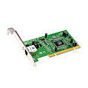
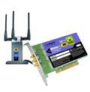

Where is the link layer implemented?
in every host, router, switch
link layer implemented in “adaptor” (aka network interface card NIC) or on a chip
Ethernet card, 802.11 card; Ethernet chipset
implements link, physical layer
attaches into host’s system buses
combination of hardware, software, firmware
application
transport
network
link
cpu
memory
link
physical
host
bus
(e.g., PCI)
controller
physical
transmission
network interface card

Slide 69
Multiple access protocols
single shared broadcast channel
two or more simultaneous transmissions by nodes: interference
collision if node receives two or more signals at the same time
multiple access protocol
distributed algorithm that determines how nodes share channel, i.e., determine when node can transmit
communication about channel sharing must use channel itself!
no out-of-band channel for coordination
Notes:
MAC for point-to-point link is pretty trivial, but MAC for broadcast link is tricky. Accordingly, a family of protocols have been developed to control how to access the shared link, known as “multiple access protocols”.

Slide 70
An ideal multiple access protocol
given: broadcast channel of rate R bps
desiderata:
1. when one node wants to transmit, it can send at rate R.
2. when M nodes want to transmit, each can send at average rate R/M
3. fully decentralized:
no special node to coordinate transmissions
no synchronization of clocks, slots
4. simple
Notes:
If you were tasked to develop a multi-access protocol, what would you like to achieve?

Slide 71
CSMA/CD efficiency
t_{prop} = max prop delay between 2 nodes in LAN
t_{trans} = time to transmit max-size frame
efficiency goes to 1
as t_{prop} goes to 0
as t_{trans} goes to infinity
better performance than ALOHA, and simple, cheap, decentralized!
Derivation skipped
Notes:
not required to memorize this formula
The efficiency of CSMA/CD is determined by two parameters: t_prop and t_trans
It shows that in theory, we could use CSMA/CD to increase efficiency to 1 (as t_prop goes to 0 or t_trans goes to infinity).

Slide 72

MAC addresses and ARP
each adapter on LAN has unique MAC address
1A-2F-BB-76-09-AD
LAN
(wired or
wireless)
adapter
71-65-F7-2B-08-53
58-23-D7-FA-20-B0
0C-C4-11-6F-E3-98

Slide 73
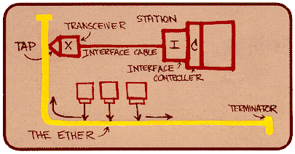
Ethernet
“dominant” wired LAN technology:
single chip, multiple speeds (e.g., Broadcom BCM5761)
first widely used LAN technology
simple, cheap
kept up with speed race: 10 Mbps – 10 Gbps
Metcalfe’s Ethernet sketch
Notes:
Robert Melancton Metcalfe (born April 7, 1946^{[2]}) is an electrical engineer from the United States who co-invented Ethernet, founded 3Com and formulated Metcalfe's Law. As of January 2006, he is a general partner of Polaris Venture Partners. Starting in January 2011, he holds the position of Professor of Electrical Engineering and Director of Innovation at The University of Texas at Austin

Slide 74
Ethernet: unreliable, connectionless
connectionless: no handshaking between sending and receiving NICs
unreliable: receiving NIC doesn't send acks or nacks to sending NIC
data in dropped frames recovered only if initial sender uses higher layer rdt (e.g., TCP), otherwise dropped data lost
Ethernet’s MAC protocol: unslotted CSMA/CD with binary backoff
Notes:
So Ethernet is an example of a link layer protocol that does not provide reliable delivery guarantee. (kind of like UDP, but for link layer)

Slide 75
Ethernet switch
link-layer packet switch
store, forward Ethernet frames
examine incoming frame’s MAC address, selectively forward frame to one-or-more outgoing links; when frame is to be forwarded on segment, uses CSMA/CD to access segment
transparent
hosts are unaware of presence of switches
plug-and-play, self-learning
switches do not need to be configured

Slide 76
Switch: multiple simultaneous transmissions
hosts have dedicated, direct connection to switch
switches buffer packets
Ethernet protocol used on each incoming link, but no collisions; full duplex
each link is its own collision domain
switching: A-to-A’ and B-to-B’ can transmit simultaneously, without collisions
A
C’
B
6
1
2
5
4
3
B’
C
A’
switch with six interfaces
(1,2,3,4,5,6)
Notes:
this is about “selective forwarding” functionality of Ethernet switch

Slide 77


Interconnecting switches
self-learning switches can be connected together:
S₄
S₁
S₃
A
S₂
F
I
B
C
D
E
G
H
Q: sending from A to I - how does S₁ know to forward frame destined to I via S₄ and S₃?
A: self learning! (works exactly the same as in single-switch case!)

Slide 78
Link layer, LANs: outline
6.1 introduction, services
6.2 error detection, correction
6.3 multiple access protocols
6.4 LANs
addressing, ARP
Ethernet
switches
VLANS
6.5 link virtualization: MPLS
6.6 data center networking
6.7 a day in the life of a web request

Slide 79
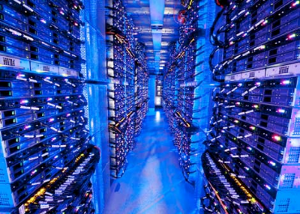
Data center networks
10’s to 100’s of thousands of hosts, often closely coupled, in close proximity:
e-business (e.g. Amazon)
content-servers (e.g., YouTube, Akamai, Apple, Microsoft)
search engines, data mining (e.g., Google)
challenges:
multiple applications, each serving massive numbers of clients
managing/balancing load, avoiding processing, networking, data bottlenecks
Inside a 40-ft Microsoft container,
Chicago data center

Slide 80
Data center networks
load balancer: application-layer routing
receives external client requests
directs workload within data center
returns results to external client (hiding data center internals from client)
Internet
Border router
Load
balancer
Load
balancer
Access router
B
Tier-1 switches
A
C
Tier-2 switches
TOR switches
Server racks
1
2
3
4
5
6
7
8

Slide 81
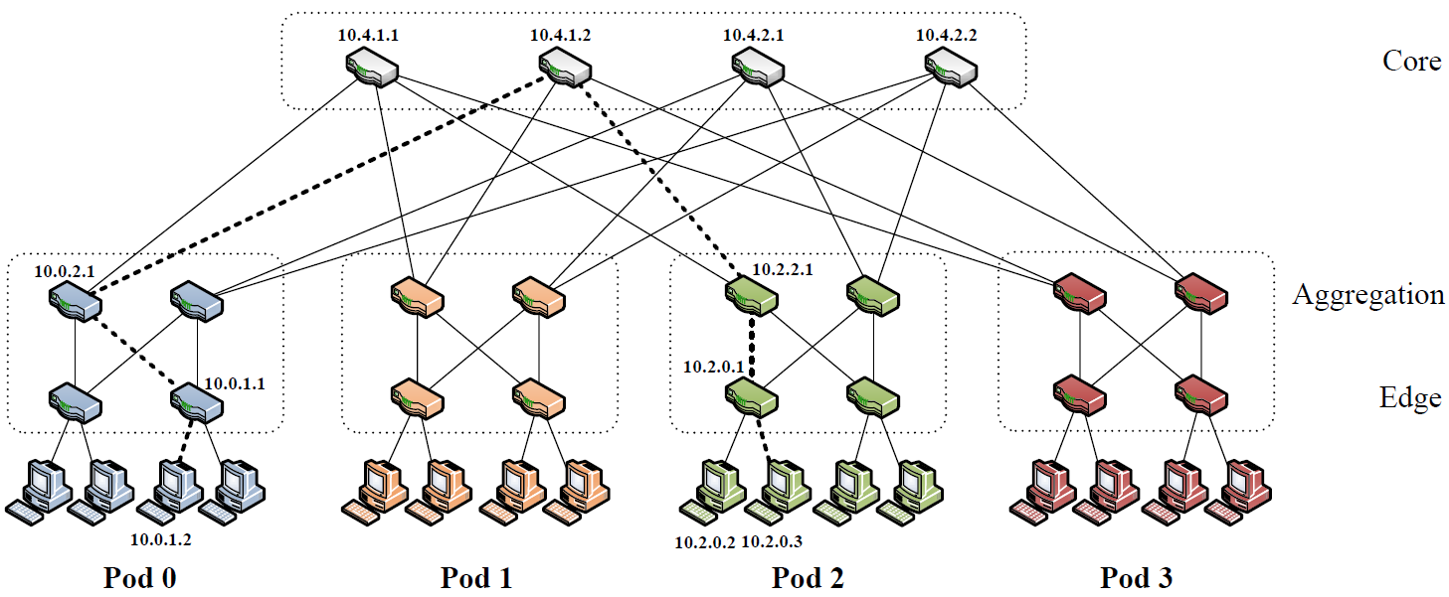
Data center networks
rich interconnection among switches, racks:
increased throughput between racks (multiple routing paths possible)
increased reliability via redundancy
Notes:
Source: A salable, commodity datacenter network architecture, SIGCOMM 2008.

Slide 82
Link layer, LANs: outline
6.1 introduction, services
6.2 error detection, correction
6.3 multiple access protocols
64 LANs
addressing, ARP
Ethernet
switches
VLANS
6.5 link virtualization: MPLS
6.6 data center networking
6.7 a day in the life of a web request

Slide 83
Synthesis: a day in the life of a web request
journey down protocol stack complete!
application, transport, network, link
putting-it-all-together: synthesis!
goal: identify, review, understand protocols (at all layers) involved in seemingly simple scenario: requesting www page
scenario: student attaches laptop to campus network, requests/receives www.google.com

Slide 84





A day in the life: scenario
browser
DNS server
Comcast network
68.80.0.0/13
school network
68.80.2.0/24
web page
web server
Google’s network
64.233.160.0/19
64.233.169.105

Slide 85

A day in the life… connecting to the Internet
DHCP
DHCP
UDP
IP
Eth
Phy
connecting laptop needs to get its own IP address, addr of first-hop router, addr of DNS server: use DHCP
DHCP
DHCP
DHCP
DHCP
DHCP request encapsulated in UDP, encapsulated in IP, encapsulated in 802.3 Ethernet
DHCP
DHCP
UDP
IP
Eth
Phy
DHCP
DHCP
DHCP
DHCP
router
(runs DHCP)
Ethernet frame broadcast (dest: FFFFFFFFFFFF) on LAN, received at router running DHCP server
Ethernet demuxed to IP demuxed, UDP demuxed to DHCP

Slide 86
A day in the life… connecting to the Internet
DHCP
DHCP
UDP
IP
Eth
Phy
DHCP server formulates DHCP ACK containing client’s IP address, IP address of first-hop router for client, name & IP address of DNS server
DHCP
DHCP
DHCP
encapsulation at DHCP server, frame forwarded (switch learning) through LAN, demultiplexing at client
DHCP
DHCP
UDP
IP
Eth
Phy
DHCP
DHCP
DHCP
router
(runs DHCP)
DHCP
DHCP client receives DHCP ACK reply
Client now has IP address, knows name & addr of DNS
server, IP address of its first-hop router

Slide 87
A day in the life… ARP (before DNS, before HTTP)
DNS
UDP
IP
Eth
Phy
before sending HTTP request, need IP address of www.google.com: DNS
DNS
DNS
DNS
ARP
ARP query
DNS query created, encapsulated in UDP, encapsulated in IP, encapsulated in Eth. To send frame to router, need MAC address of router interface: ARP
ARP
ARP reply
Eth
Phy
ARP query broadcast, received by router, which replies with ARP reply giving MAC address of router interface
router
(runs DHCP)
client now knows MAC address of first hop router, so can now send frame containing DNS query

Slide 88
A day in the life… using DNS
DNS
UDP
IP
Eth
Phy
DNS
DNS server
DNS
UDP
IP
Eth
Phy
DNS
DNS
DNS
DNS
DNS
DNS
DNS
DNS
Comcast network
68.80.0.0/13
IP datagram forwarded from campus network into Comcast network, routed (tables created by RIP, OSPF, IS-IS and/or BGP routing protocols) to DNS server
router
(runs DHCP)
IP datagram containing DNS query forwarded via LAN switch from client to 1st hop router
demuxed to DNS server
DNS server replies to client with IP address of www.google.com

Slide 89
A day in the life…TCP connection carrying HTTP
HTTP
HTTP
TCP
IP
Eth
Phy
SYNACK
SYN
SYNACK
SYN
SYNACK
SYN
SYN
to send HTTP request, client first opens TCP socket to web server
router
(runs DHCP)
TCP
IP
Eth
Phy
TCP SYN segment (step 1 in 3-way handshake) inter-domain routed to web server
SYNACK
SYN
SYNACK
SYN
SYNACK
SYNACK
SYN
web server responds with TCP SYNACK (step 2 in 3-way handshake)
web server
64.233.169.105
TCP connection established (for client!)

Slide 90
A day in the life… HTTP request/reply
HTTP
HTTP
TCP
IP
Eth
Phy
web page finally (!!!) displayed
HTTP
HTTP
HTTP
HTTP
HTTP
HTTP
HTTP
HTTP
HTTP request sent into TCP socket
router
(runs DHCP)
IP datagram containing HTTP request routed to www.google.com
HTTP
HTTP
TCP
IP
Eth
Phy
HTTP
HTTP
HTTP
web server responds with HTTP reply (containing web page)
HTTP
web server
64.233.169.105
IP datagram containing HTTP reply routed back to client
Notes:
Lecture 4.

