Slide 1
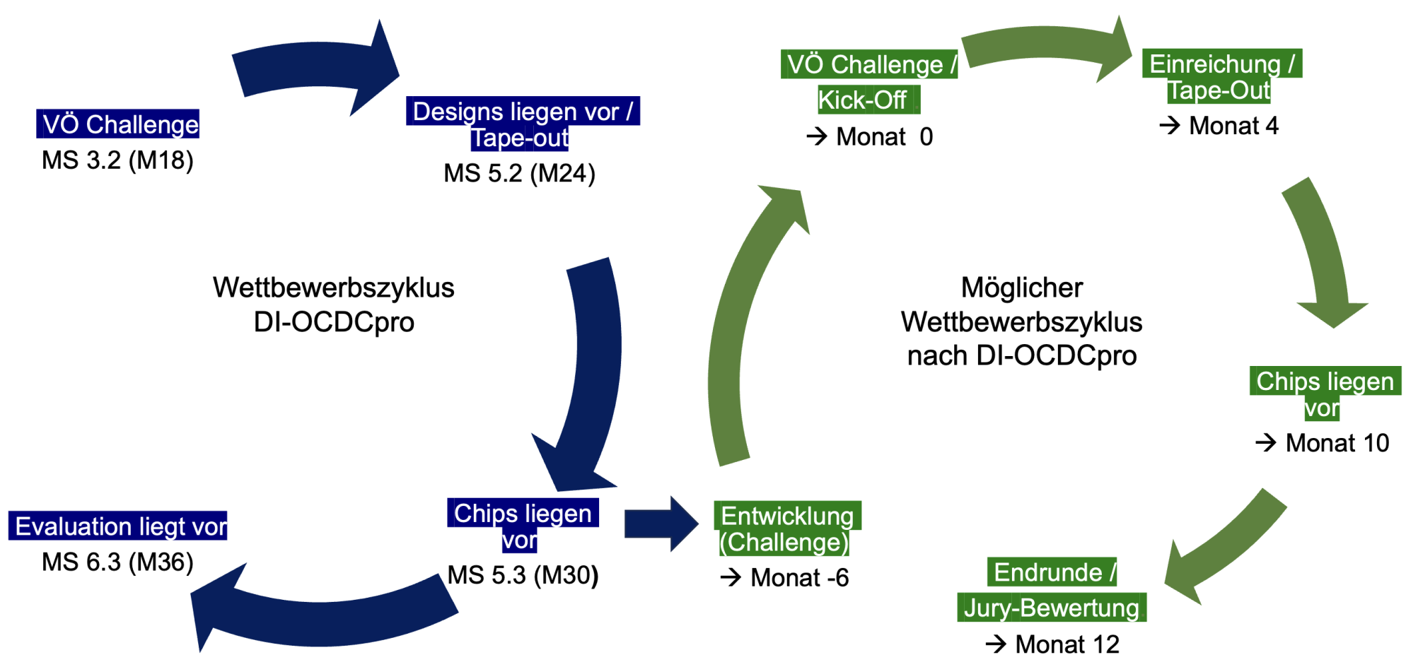
AP 5: Demonstrator
AP5:
HSRM
29.10.24

Slide 2
Give HW-Kits to Teams
AP5:
HSRM
29.10.24
Handout
HW-Kits
To Teams
Handout
HW-Kits
To Teams

Slide 3
Insert Microchips into HW-Kits
AP5:
HSRM
29.10.24
Handout
HW-Kits
To Teams
Handout
HW-Kits
To Teams
Insert
Microchips
Into HW-Kits
Insert
Microchips
Into HW-Kits

Slide 4
Battle of the Microchips (HW-Kits)
AP5:
HSRM
29.10.24
Handout
HW-Kits
To Teams
Handout
HW-Kits
To Teams
Insert
Microchips
Into HW-Kits
Battle of the
HW-Kits
Insert
Microchips
Into HW-Kits
Battle of the
HW-Kits

Slide 5
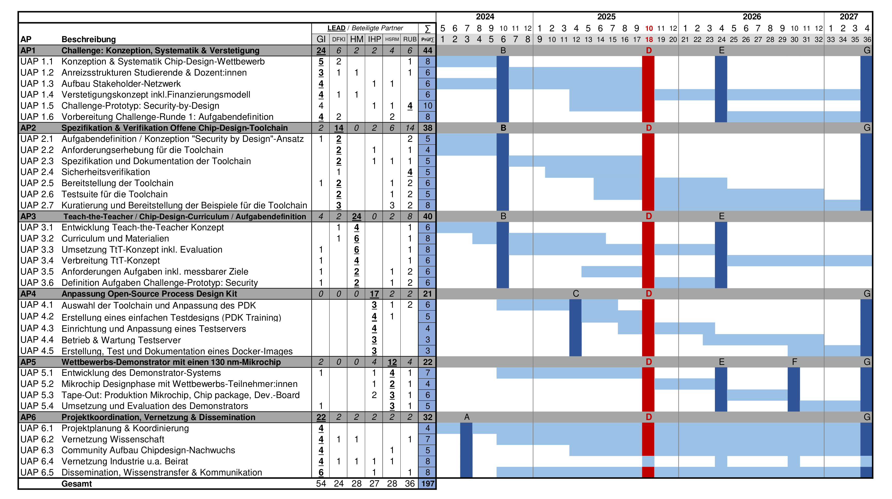
Teams
create designs
Handout
HW-Kits
to Teams
Insert
Microchips
into
HW-Kits
Battle
of the
HW-Kits
Handout
HW-Kits
to Teams

Slide 6
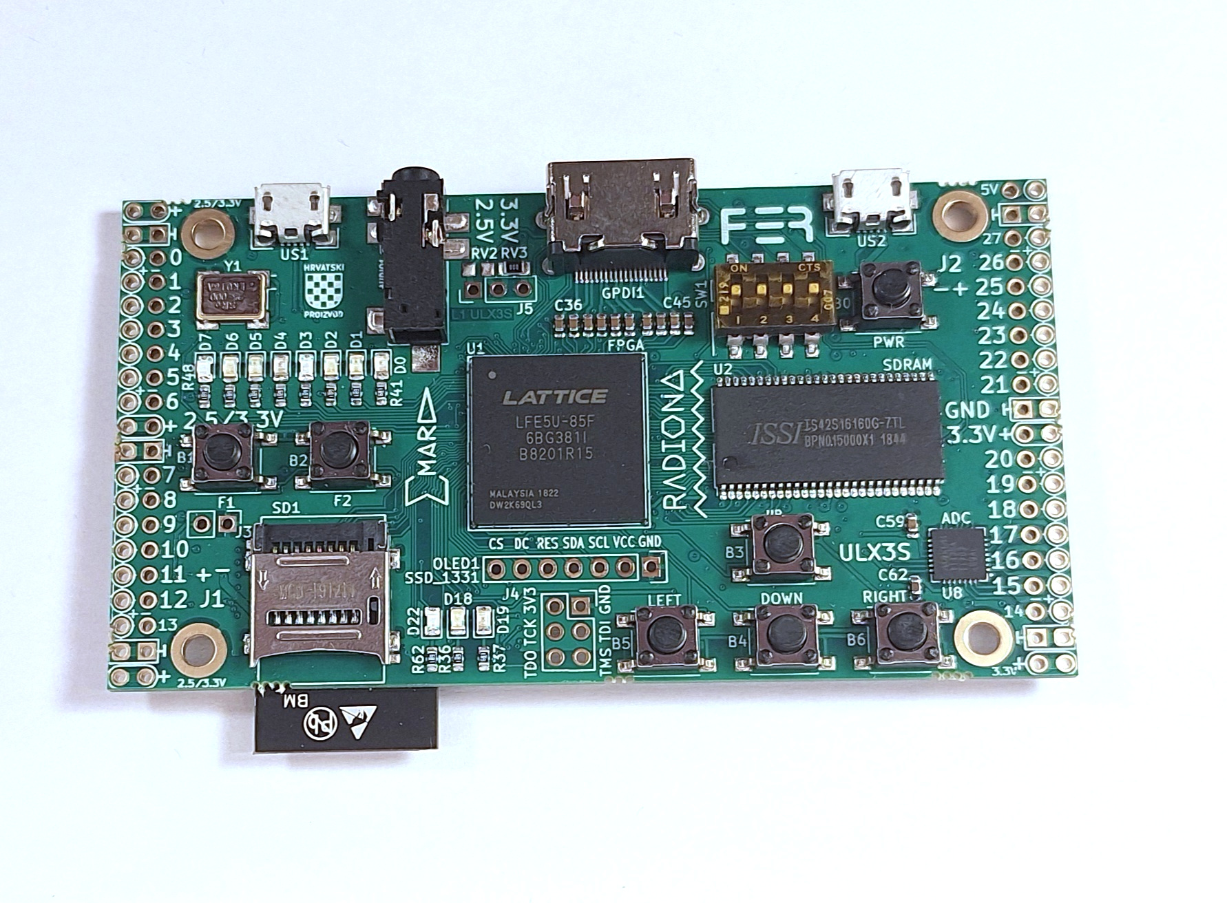
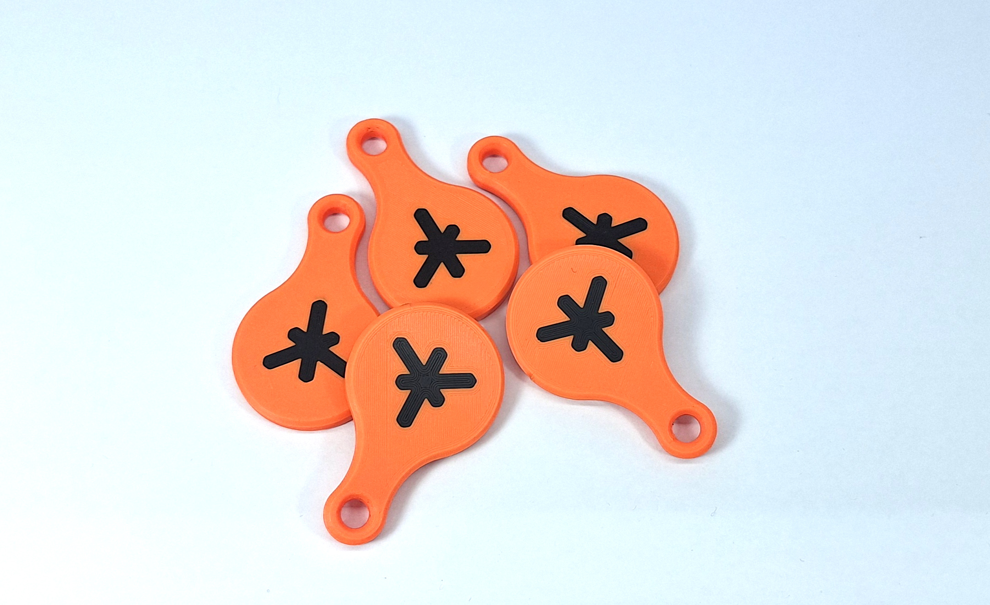
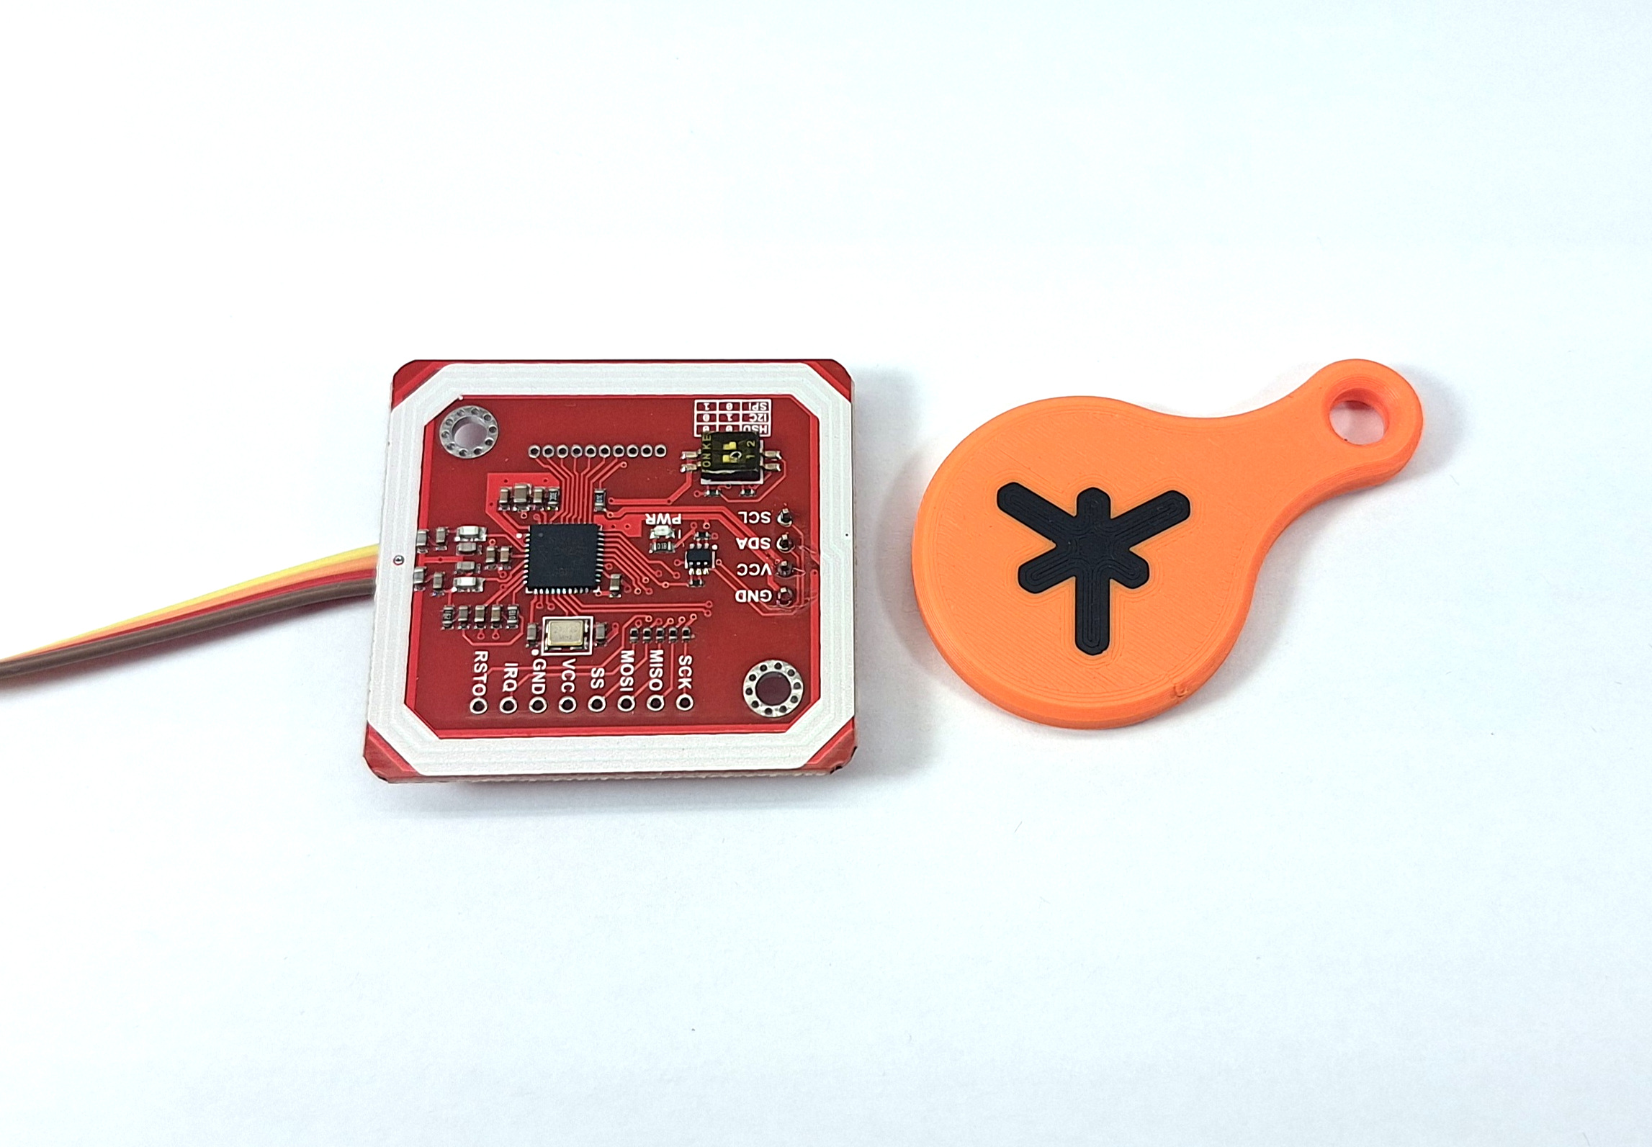
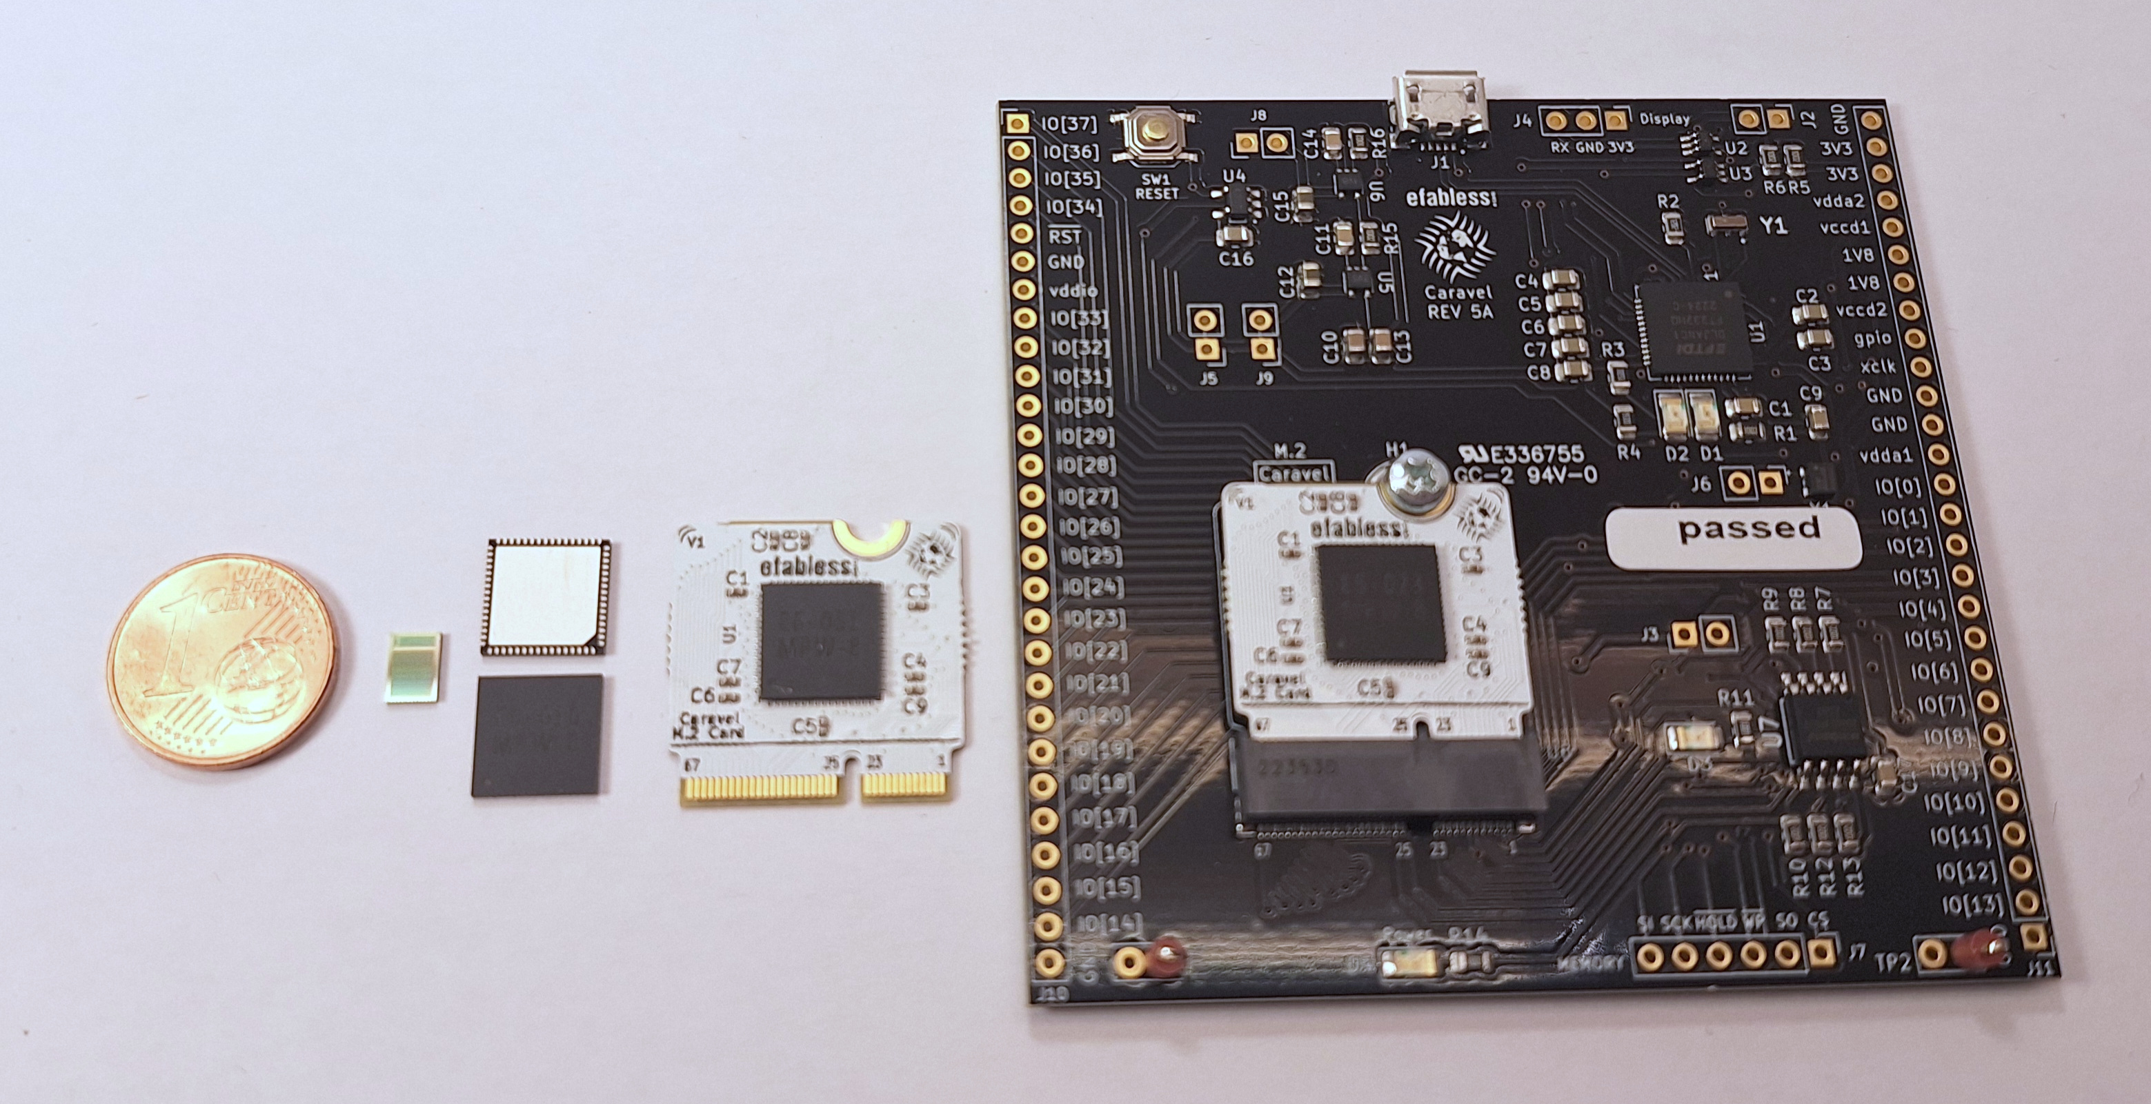
ChipCup 2025
AP5:
HSRM
29.10.24
HW-Kits
for the Teams:
During design:
FPGA
In competition:
Microchip
NFC / RFID
keys
NFC / RFID
reader
Door:
t.b.d.
Electro-mechanic handle
Electronic key
wireless
Electronic
lock
wired
Pics: T.Knoll, CC 4.0 by-sa

Slide 7
ChipCup 2025
AP5:
HSRM
29.10.24
During design:
FPGA
Handout
HW-Kits
To Teams
PM
30-33
In competition:
Microchip
NFC / RFID
reader
Insert
Microchips
into
HW-Kits
wireless
Electronic
lock
wired
Pics: T.Knoll, CC 4.0 by-sa

Slide 8
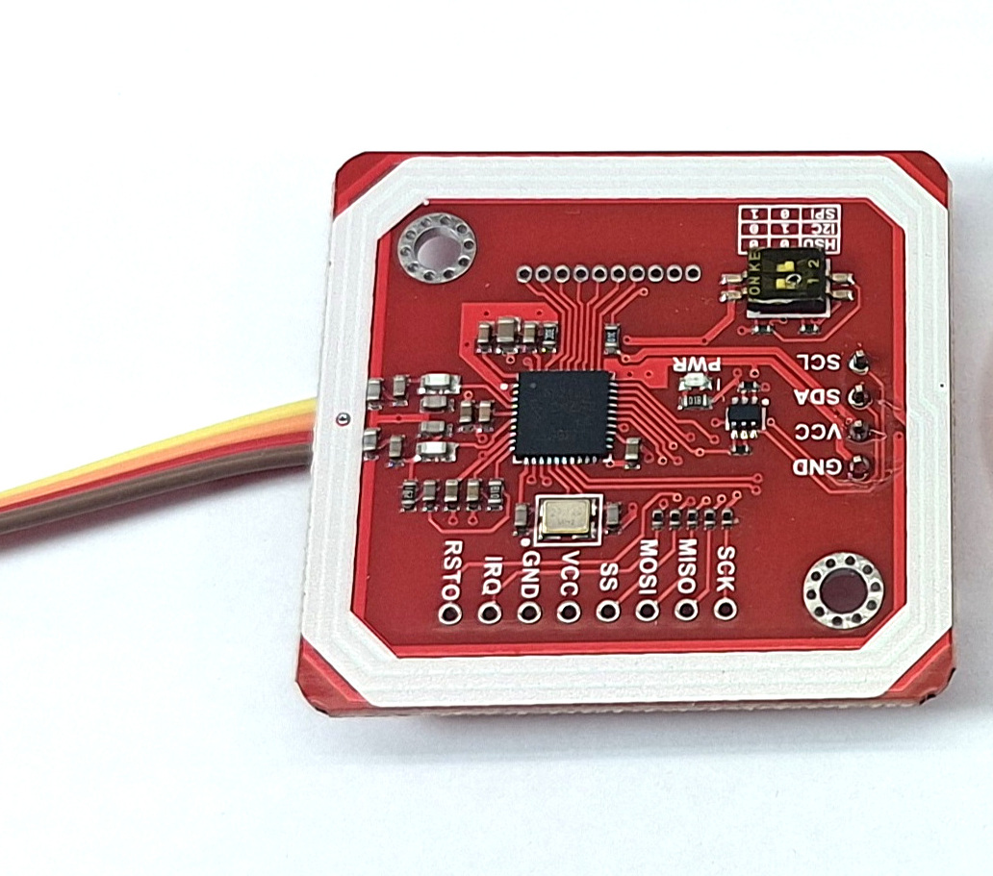
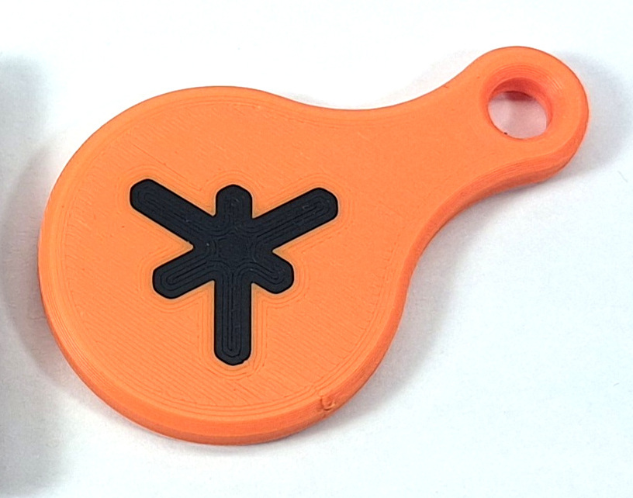
ChipCup 2025
AP5:
HSRM
29.10.24
HW-Kits
for the Teams:
Serial protocol
I2C ?
One pin high?
2 wires
4-8 wires
NFC / RFID
reader
Door
Chipdesign from Teams:
- Verilog HDL (generated?)
- Teach the teacher
- Security by design
- Verification
- PDK
Tools:
- FPGA: YosysHQ releases
- ASIC: OpenROAD stable
FPGA:
- ECP5 Chip (Size LUTs?)
Pics: T.Knoll, CC 4.0 by-sa

