Slide 1
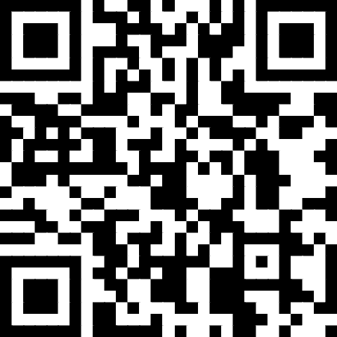
The Importance of Accurate Foster Youth Data
October 28, 2025
Facilitated by the Assessment, Accountability, and Continuous Improvement Unit
Division of Educational Services
https://tinyurl.com/FY-data-2025summit

Slide 2
Today’s Topics
Introductions
Data Accuracy
Annual Outcomes
Data Reconciliation
High School Indicators
Monthly Data Survey

Slide 3



Introductions
Dr. Melissa Bazanos Hutton
Executive Director - Assessment, Accountability & Continuous Improvement (AACI)
mbazanos@rcoe.us
Kerry Bobbitt
Administrator - Data & Analytics, AACI
kbobbitt@rcoe.us
Steven Johnson
Coordinator - Foster Youth Data Systems and Reporting, AACI
smjohnson@rcoe.us

Slide 4
Data Accuracy
https://tinyurl.com/FY-data-2025summit

Slide 5
Why Is Accurate Data So Important?
💰 1. Funding & Resource Allocation Integrity
California’s Local Control Funding Formula (LCFF) depends on accurate student demographic data — like English learner status, socioeconomic status, and foster youth identification.
If data is wrong or outdated, districts risk losing millions in funding.
Conversely, overcounting or misclassification can trigger audit findings and repayment issues.
📊 2. Accountability & Credibility
Accurate data powers the California School Dashboard, the California Longitudinal Pupil Achievement Data System (CALPADS), and federal reporting.
Errors in attendance, graduation, or subgroup data distort performance indicators.
That means the district’s state and federal accountability ratings (and public reputation) are impacted.

Slide 6
Why Is Accurate Data So Important?
🧭 3. Continuous Improvement & Equity
District leaders can’t improve what they can’t measure. Reliable data helps teams:
Identify achievement gaps and respond early
Track the effectiveness of interventions.
Ensure equitable access to programs and supports.
👮 4. Legal & Ethical Obligations
State and federal laws — like the Every Student Succeeds Act (ESSA) and Ed Code §49073 — require districts to maintain and protect accurate student records.
Inaccurate data can lead to compliance violations or loss of trust with families and oversight agencies.
🚀 5. Strategic Decision-Making
From staffing and program planning to facilities management and college/career readiness, data-informed decisions rely on solid inputs.

Slide 7

One Example:
Annual Outcome Data
https://tinyurl.com/FY-data-2025summit

Slide 8


At least one indicator for each LCFF Priority
8 Priorities |  | State Indicators | Local Indicators
1 | Basic Services |  | Basics Conditions
2 | Implementation of Standards |  | Implementation of State Academic Standards
3 | Parent Engagement |  | Parent Engagement
4 | Pupil Achievement | Academic Indicator (Gr. 3-8, 11) English Learner Progress Indicator
5 | Pupil Engagement | Chronic Absence Indicator (K-8) Graduation Rate Indicator (HS)
6 | School Climate | Suspension Rate Indicator | Local Climate Survey
7 | Course Access |  | Course Access Survey
8 | Other pupil outcomes | College/Career Indicator (HS)

Slide 9
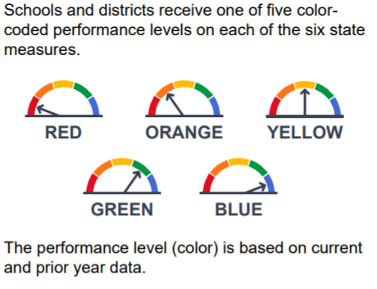
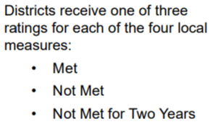
State and Local Indicators
State Indicators | Local Indicators
Reported for all districts, schools, and student groups with sufficient N-size. *N-size is 30 students unless noted. | Reported by the district at the district level. Schools do not submit or receive local indicator information.
*LEAs, schools, and student groups must have at least 30 or more students in both the current and prior year to receive a performance level or color. Data used to determine the N-size of “30 or more” differs by each state indicator. For Foster Youth, Homeless Youth, and Long Term English Learners, the N-size is 15 students (not 30) at the district level. Site level N-size for Foster Youth and Homeless Youth is 30 students.
Notes:
State indicators are provided for schools and districts for each student group. The district’s performance level is an aggregate of all sites including alternative schools.
Local indicators are only reported at the district level however implementation occurs at the site level so sites contribute to district performance.

Slide 10
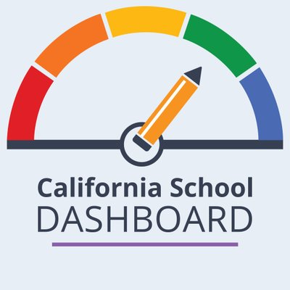
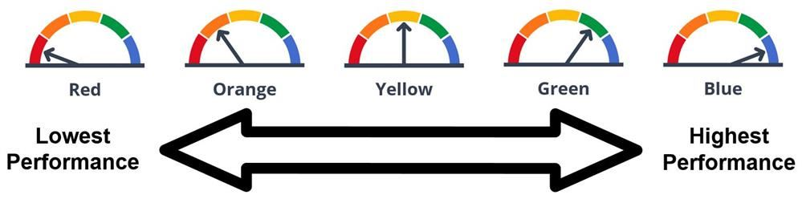
CA School Dashboard

Slide 11
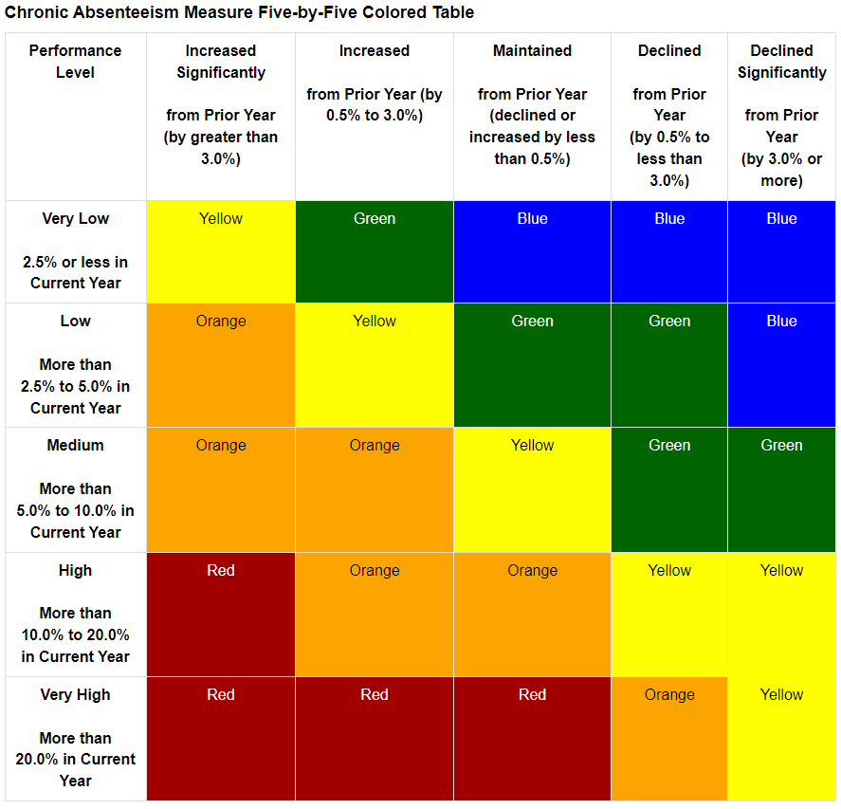
Where do the Dashboard “colors” come from?
Each state indicator has a 5x5 table with “cut scores” for status and change. (Posted on CDE website)
STATUS = student performance in the most recent year. The 2025 Dashboard reports outcome data from the 2024-2025 school year.
CHANGE = the difference between the current year and the previous year. The 2025 Dashboard compares 2024 and 2025 data.
Example:
Foster Youth have a Chronic Absenteeism “status” of 23% on the 2025 Dashboard.
Last year, Foster Youth had a Chronic Absenteeism rate of 26.3%.
If the student group has a current “status” of 23% and declined by 3.3 percentage points from prior year, their 2025 Dashboard color will be _____________.

Slide 12
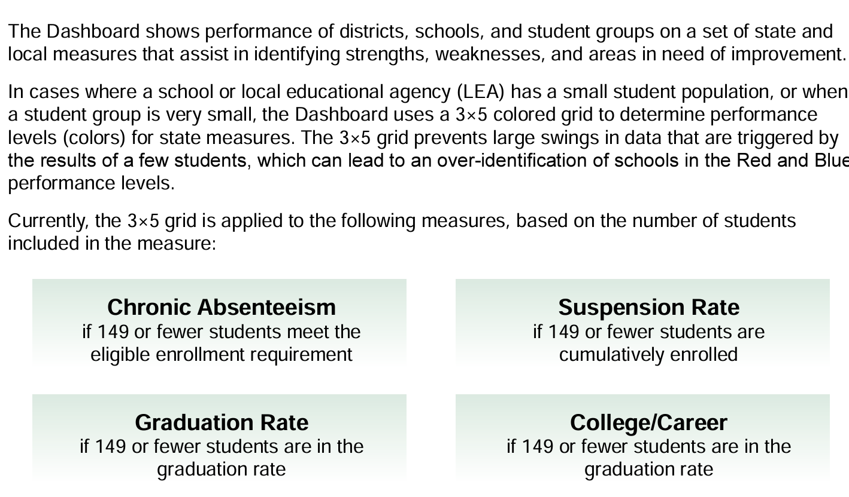
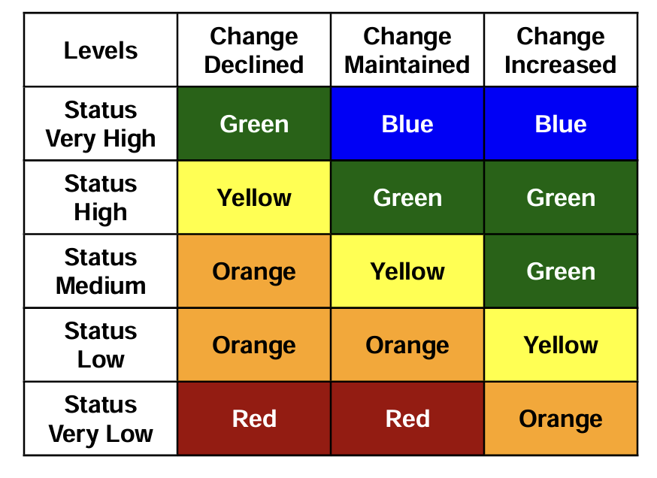
3x5 Grid for Small Populations

Slide 13
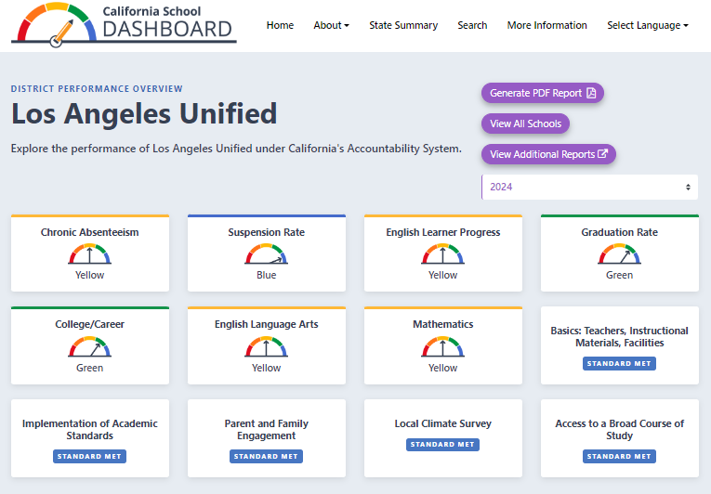
CA School Dashboard
Additional Reports

Slide 14
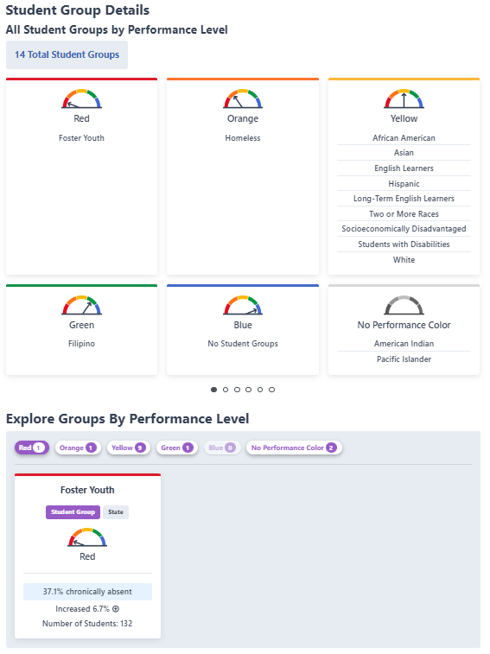
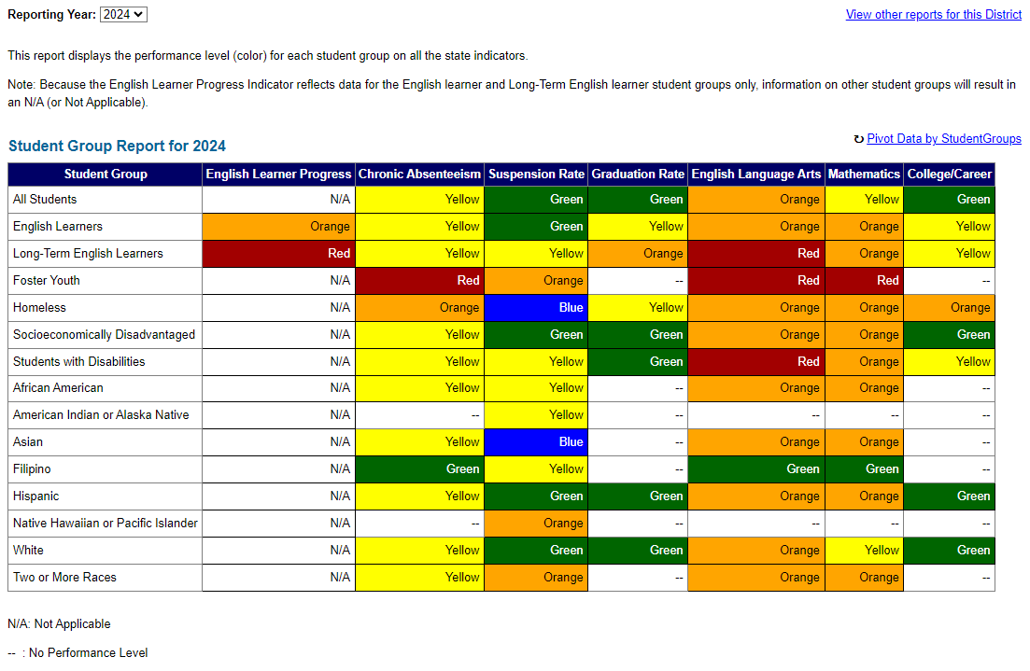
Student Group Report

Slide 15

Partner Discussion
How (and when) do we analyze our data to understand the needs of our Youth?
How do we know the data is accurate?
https://tinyurl.com/FY-data-2025summit
Notes:
2025 estimates will be ready at the end of August

Slide 16
Ensuring Foster Youth Data Accuracy Through Data Reconciliation
https://tinyurl.com/FY-data-2025summit

Slide 17
District SIS
CDSS
Foster Youth Data
Student Data
Child Welfare Data
CALPADS:
State Foster Match - Automatic
District SIS - Student Data
+
CDSS CWS\CMS - Social Services Case Data
Local Foster Match - Manual
SSID + Case ID
Social Worker or RCOE \ FYSCP
Student Information System:
Foster statuses are NOT exchanged with CALPADS
Districts need to reconcile status manually.
CALPADS
5.7 Report
5.9 Report
District SIS
Foster Student Data

Slide 18
Data Reconciliation - Overview
Foster Youth Data Reconciliation - The process of updating your SIS to ensure all of your foster youth are properly identified, by using the CALPADS reports.
Who, What, When, Where, Why, and How?
Who should be a part of this process?
Foster youth team - CWA Directors, Foster Youth Liaisons, and Counselors
Data team - CALPADS and SIS Administrators/Technicians
Enrollment team - Clerks, Registrars, Attendance and Registration Technicians
What do we need to do?
Ensure that foster youth are flagged during the enrollment process
Ensure your SIS foster youth match the CALPADS 5.7 and 5.9 Reports
Update SIS Foster Youth (Program 190) start and end dates
CALPADS Local Force Match
RCOE or DPSS Foster Youth Check

Slide 19
Data Reconciliation - Overview
Who, What, When, Where, Why, and How? (Continued)
When does this need to be done?
On a weekly basis
New enrollments
Where does this need to be done?
In your District SIS
Why do we need to do it?
Identify and support foster youth
Improve Foster Youth Student Outcomes
California School Dashboard Accountability
Foster Youth Cohort Reporting
Differentiated Assistance

Slide 20
Data Reconciliation - Process
Reports Needed:
CALPADS - 5.7 Foster Youth Report
CALPADS - 5.9 Former Foster Youth Report
SIS - Foster Youth Student Query Report
Manual Process:
Download and review 5.7 Report
Look up each student in your SIS
Populate Program 190 (Foster Youth) Start Date
Download and review 5.9 Report
Look up each student in your SIS
Populate Program 190 (Foster Youth) End Date
Download and review SIS Foster Youth Report
Reconcile the Remaining Youth

Slide 21
Data Reconciliation Activity - Manual Process

Slide 22
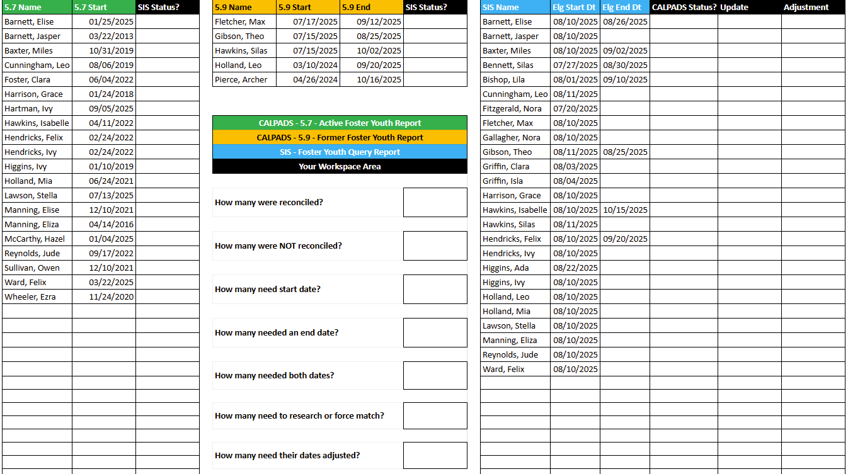
Reconcile the data using the three reports:
Green - CALPADS 5.7 Active Foster Youth Report
Orange - CALPADS 5.9 Former Foster Youth Report
Blue - SIS Foster Youth Query Report
Use the Status/Update column for notes
Answer the questions in the middle boxes

Slide 23
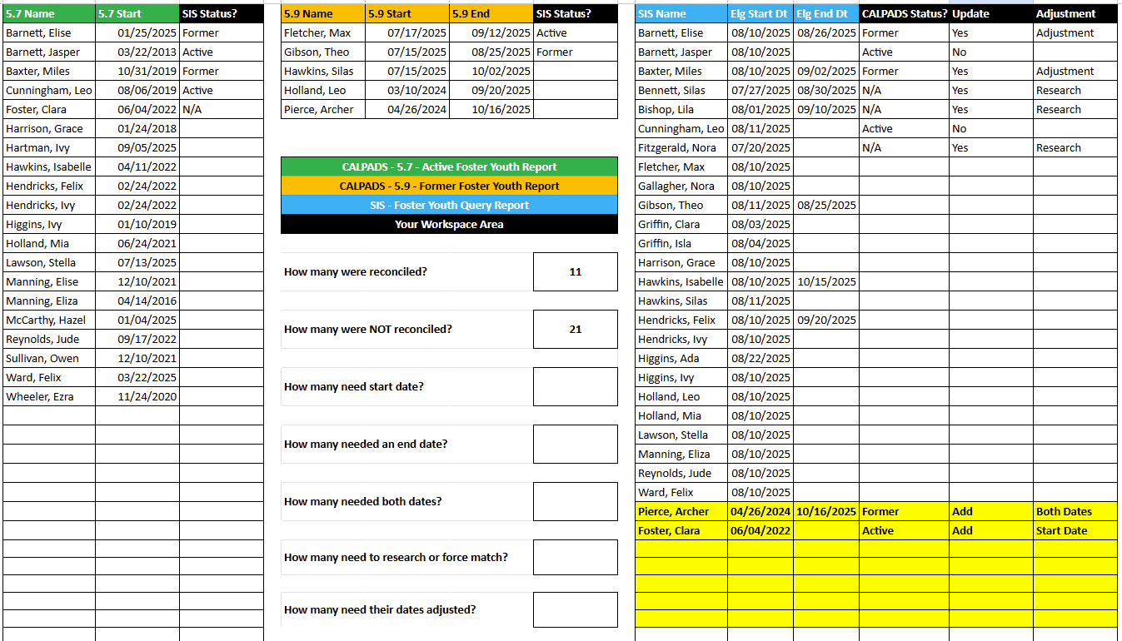


Slide 24
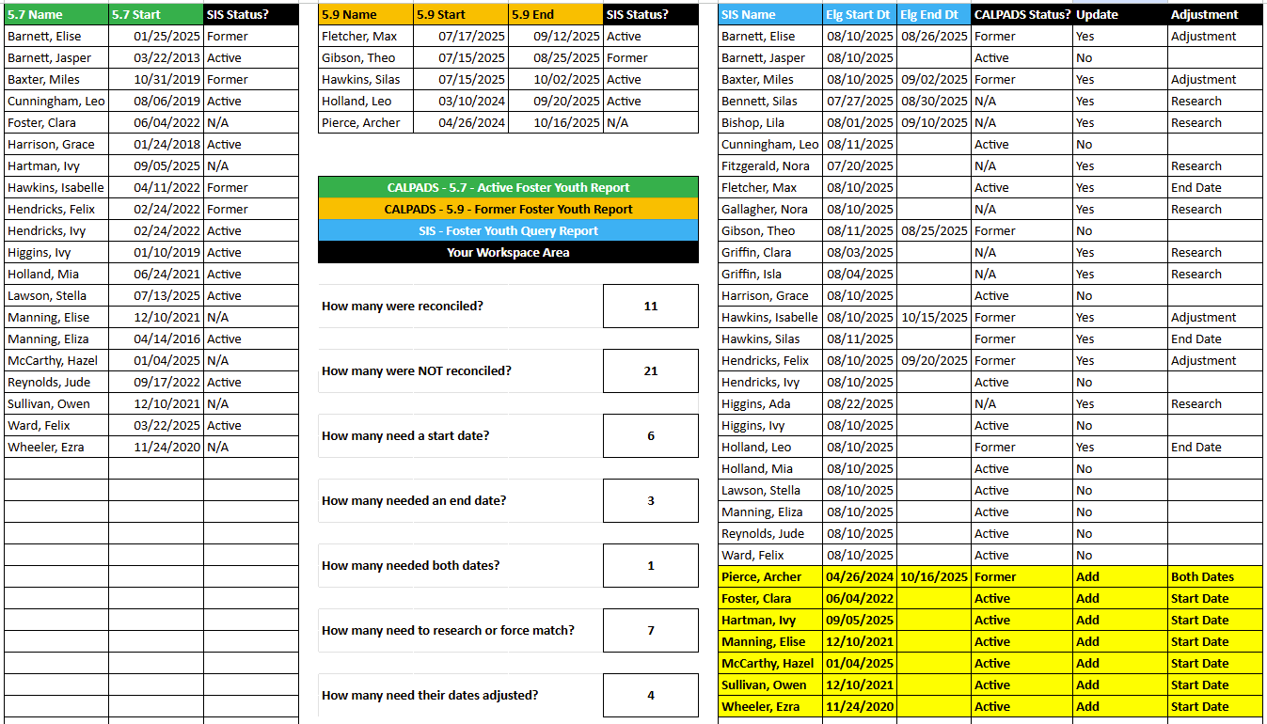

Slide 25
Data Reconciliation - Process
Data Reconciliation Tool Process:
Download the 5.7, 5.9, and Foster Youth SIS Report
Open the Data Reconciliation Tool
Copy and Paste Reports into their tabs
Review the “SIS vs CALPADS” tabs
Follow the action items in the orange column
DEMO

Slide 26
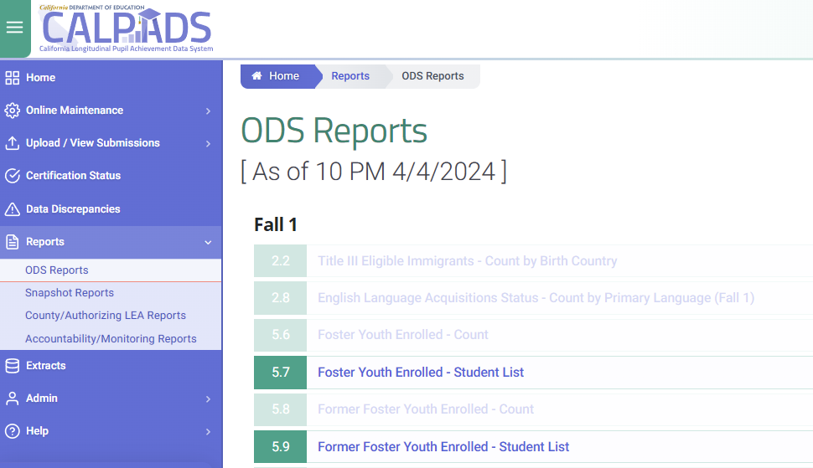


Data Reconciliation Tool - Demo

Slide 27
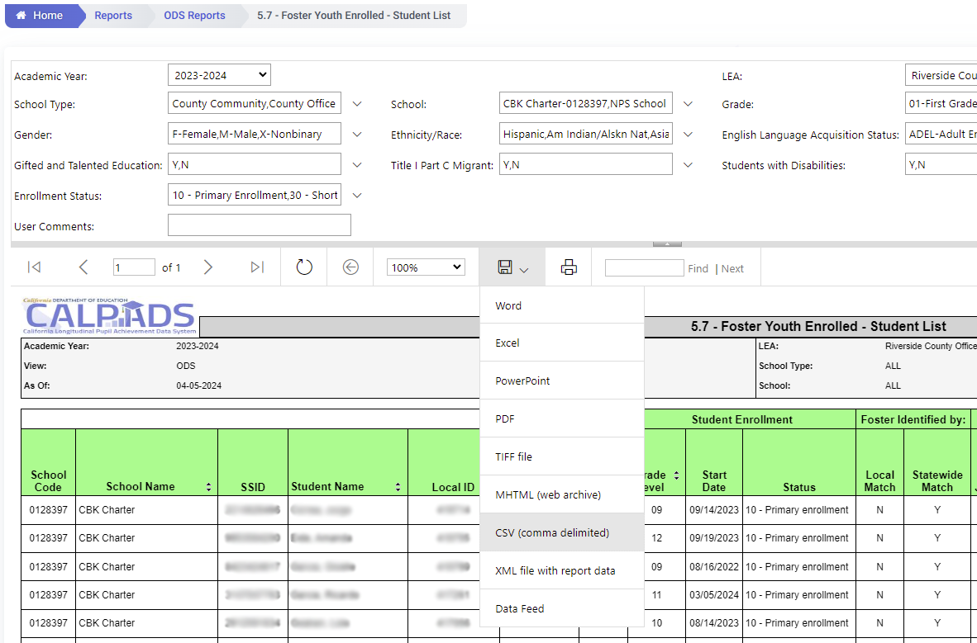
Data Reconciliation Tool - Demo

Slide 28
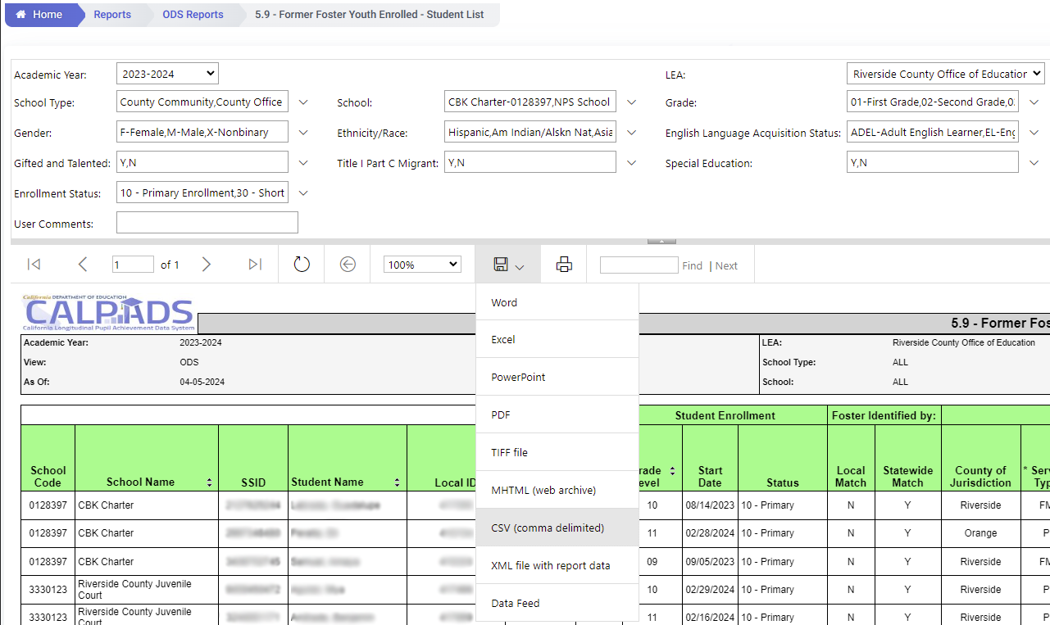
Data Reconciliation Tool - Demo

Slide 29
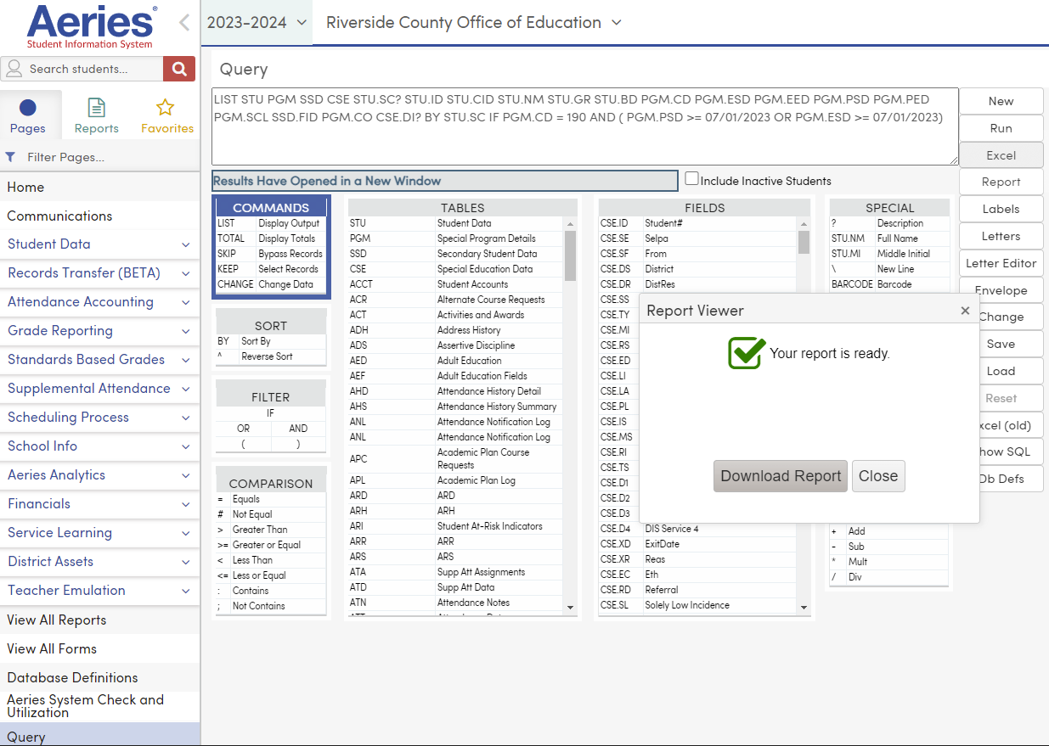
Data Reconciliation Tool - Demo

Slide 30
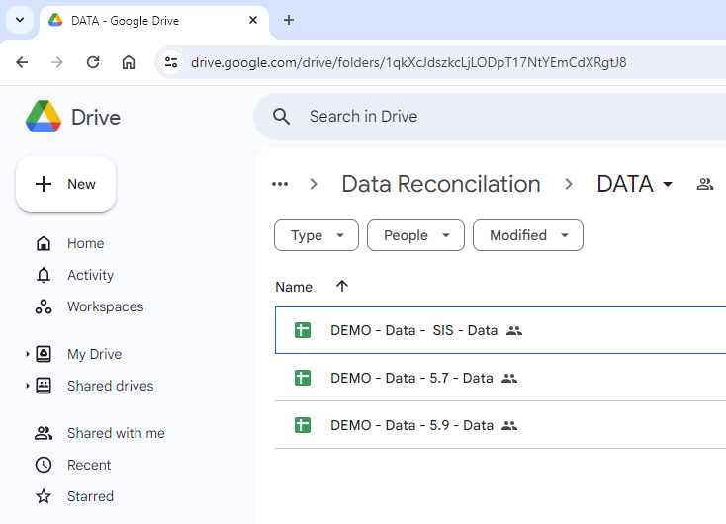
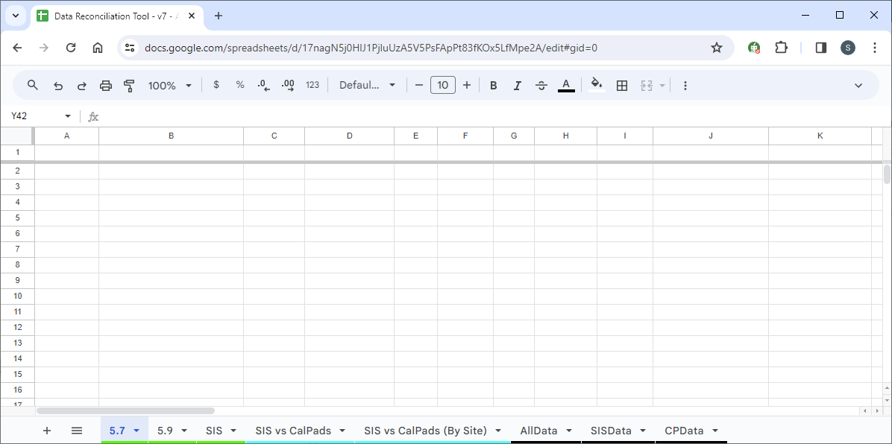
Data Reconciliation Tool - Demo

Slide 31
Data Reconciliation Tool - Demo

Slide 32
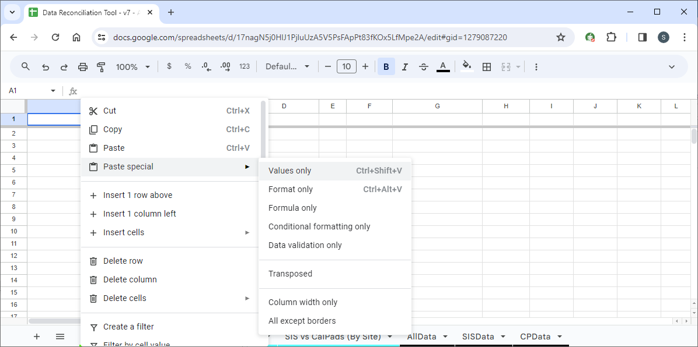
Data Reconciliation Tool - Demo

Slide 33
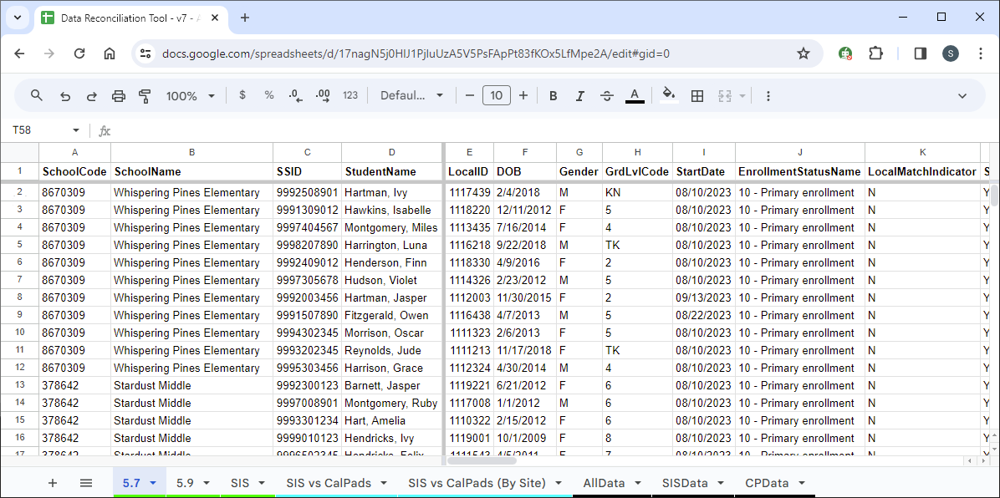
Data Reconciliation Tool - Demo

Slide 34
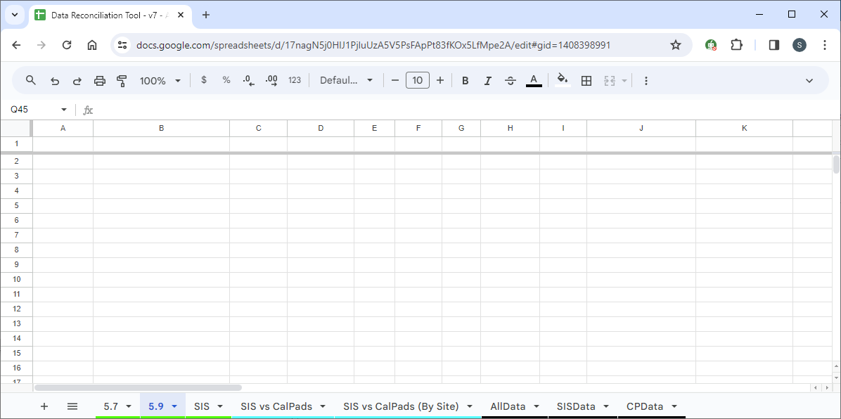
Data Reconciliation Tool - Demo

Slide 35
Data Reconciliation Tool - Demo

Slide 36
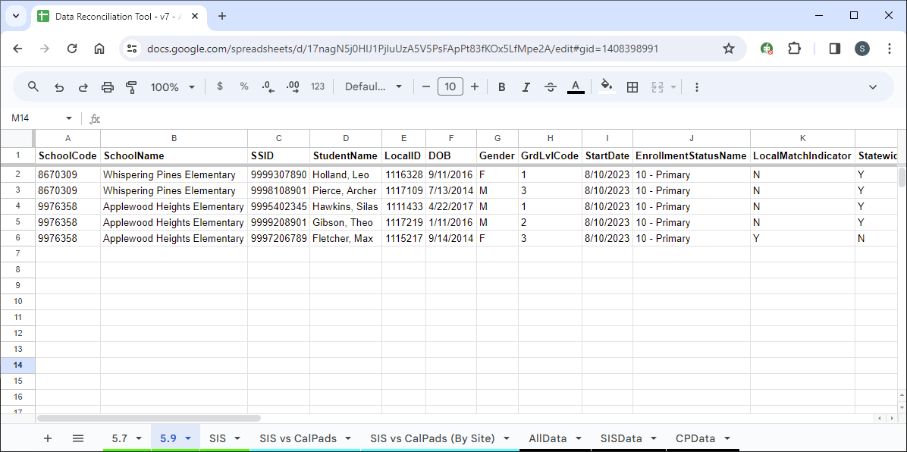
Data Reconciliation Tool - Demo

Slide 37
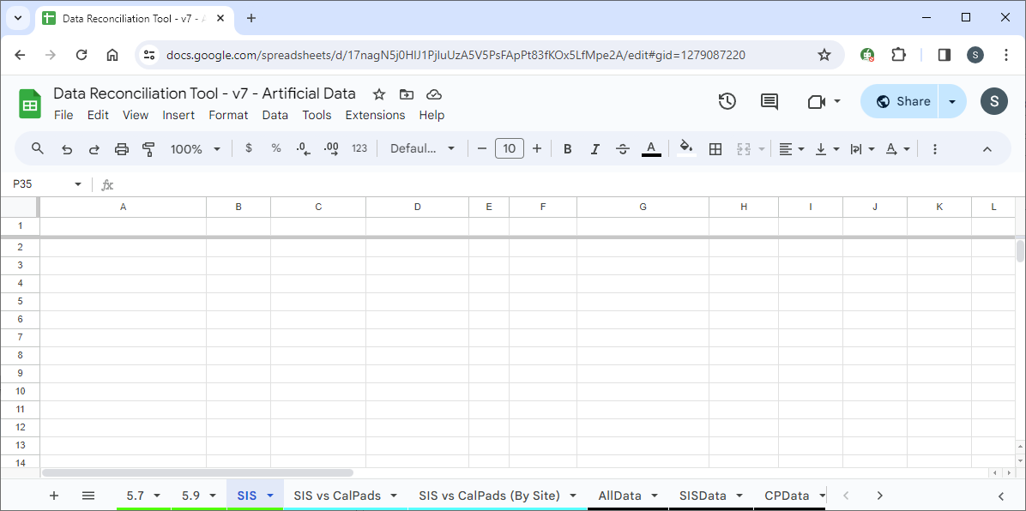
Data Reconciliation Tool - Demo

Slide 38
Data Reconciliation Tool - Demo

Slide 39
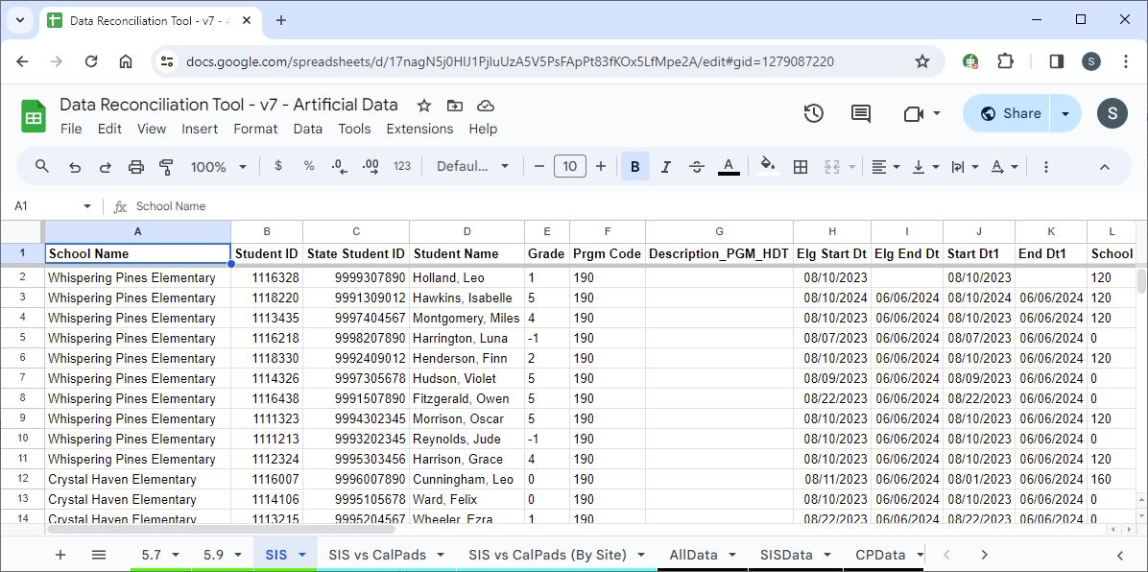
Data Reconciliation Tool - Demo

Slide 40
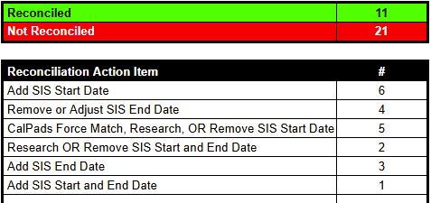
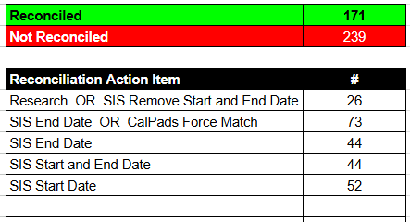
Data Reconciliation Tool - Demo
Demo Data Set Large District Data Set
Data Reconciliation Tool

Slide 41
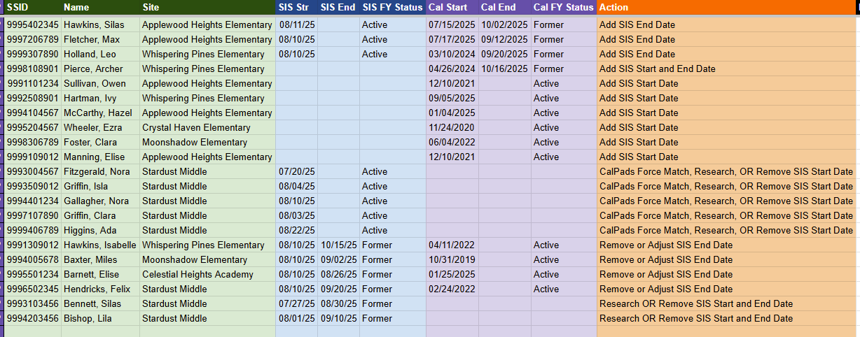
Data Reconciliation Tool - Demo

Slide 42
Importance of Data Reconciliation
Example District Scenario
CDE Released Several Reports
Reports Indicated High Discipline Rates with Foster Youth
District attempted to research these youth to get some insight
Internal SIS report did match CDE’s reports
District Contacted RCOE
RCOE had them send me their SIS multi-year foster youth report
RCOE tweaked the Data Reconciliation Tool for multi-year support
This revealed over 150+ Foster Youth not reconciled
RCOE reviewed each of those youth in CALPADS
Over 50+ of those youth had discipline records
District now had the information they need to support those youth

Slide 43
Additional Information
Data Reconciliation Tool
CALPADS 5.7 - RealReport vs County Report
Accommodations for or SIS report formats
SIS - Program 190 (Foster Youth)
Recommend Exiting - End of Fiscal Year
CALPADS
2025-26 5.7 Report Issues (09/15 - 10/15/2025)
5.9 Refreshes July 1st - Download before then
Common Mismatch - Welcome center or funding
Local Foster Match - Not Working for nearly 3 years
Student - Foster Youth Status or Information
FY Info Request Form - go.rcoe.us/FYRequest

Slide 44
High School Indicators
https://tinyurl.com/FY-data-2025summit

Slide 45

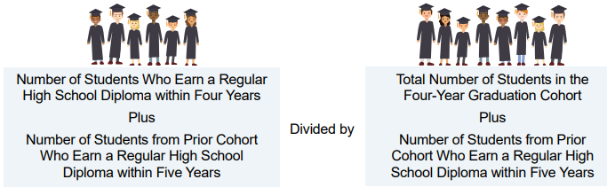
Graduation Rate Indicator
Regardless of whether students go on to college, a high school diploma is the minimum requirement for most entry-level jobs in today’s economy. It represents mastery of foundational skills.
High schools will receive Graduation Rate for students within the 4-year cohort and receive credit for 5th year graduates. This means that schools receive graduation rate credit if a student graduates by meeting local graduation requirements within four or five years of entering high school.
https://www.cde.ca.gov/ta/ac/cm/documents/graduationrate.pdf

Slide 46
Graduation Rate Indicator
Who is a graduate?
Only students who receive a standard high school diploma are counted as graduates.
Due to the restrictions by the US Department of Education, students earning all other high school equivalency certificates and examinations (e.g., GED® and HiSET® and the California High School Proficiency Examination [CHSPE]) cannot be counted as graduates.
For a student to be counted as a graduate in the current year, the student must graduate by August 15.
Students who graduate high school in less than four years are counted in the original cohort in which they began.

Slide 47
Graduation Rate Indicator
How Do Students Get in a Cohort?
When students first enroll in ninth grade, they become part of the denominator of a four-year graduation rate (the student becomes a part of a graduating class).
Students included in the denominator of the cohort include those who
Dropped out during the last four-year period
Transferred into a school during the last four-year period
Lost transfers (these are students who exited out of a school as a transfer, but never enrolled in another school by Fall Census Day)
Transferred to an Adult Education Program or Community College.

Slide 48
Graduation Rate Indicator
Calpads Denominator Exclusions
CALPADS Exit Category Code | Description
E130 | Died
T180 | Transfer to Private School
T200 | Transfer to a High School Out of California
T240 | Transfer/Emigrated out of the U.S.
T310 | Transfer to a health facility
T370 | Transfer to an Institution with a High School Diploma Program
T460 | Transfer to home school program
Notes:
460 is being phased out
370 has been updated to specifically state not an adult school

Slide 49

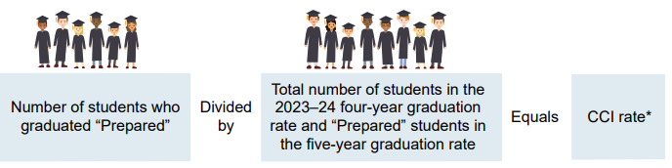
College/Career Indicator
The College/Career measure shows how many students graduate from high school prepared for college or a career. It uses many different measures of college and career preparedness.
For comprehensive high schools, the last four years of data (or 5 years for 5th year graduates) including courses, exams, etc., for each student in four-year cohort are used to to place students in Prepared or Approaching Prepared levels.
https://www.cde.ca.gov/ta/ac/cm/documents/collegecareer.pdf
Notes:
\

Slide 50
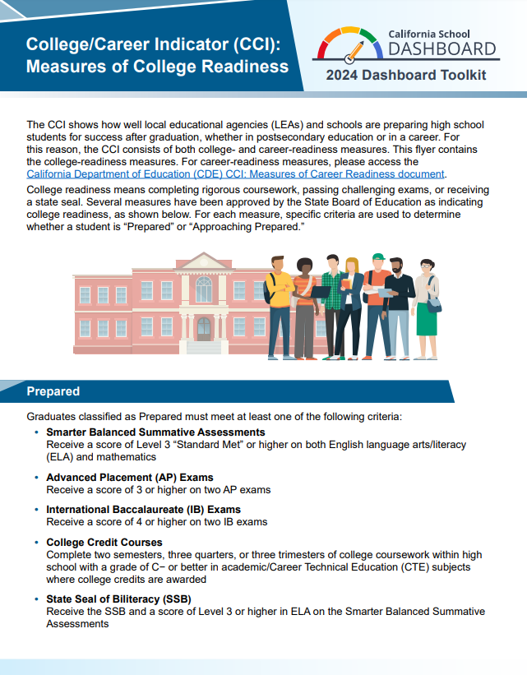
College Readiness Measures
ELA/Math - Score Level 3 “met” or higher
AP - Score 3 or higher on two exams (Starting with 2025 Dashboard - two AP courses with a grade of C− or better)
IB - Score 4 or higher on two exams
College credit courses - Two semesters, three quarters, or three trimesters of college coursework within high school with a grade of C− or better
State Seal of Biliteracy (plus 3 or higher on ELA)
A-G plus one additional requirement
www.cde.ca.gov/ta/ac/cm/documents/ccicollege.pdf

Slide 51
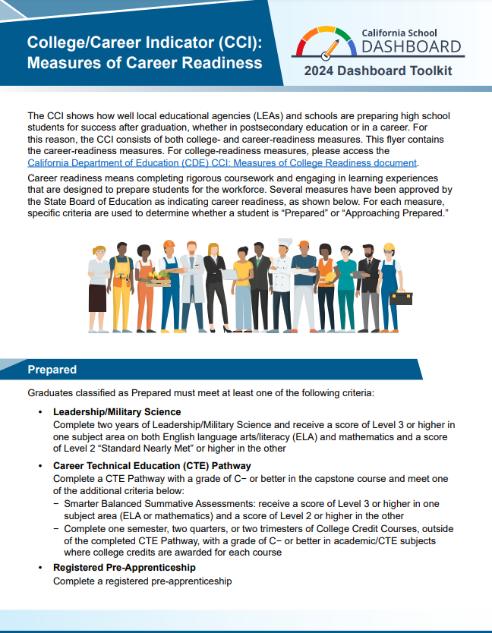
Career Readiness Measures
Leadership/Military Science
CTE Pathway
Registered Pre-Apprenticeship
State and Federal Job Programs (Dashboard Alternative School Status [DASS] schools only)
Transition Classroom and Work-Based Learning Experiences (available only to students with individualized education programs [IEPs] who earn a Special Education Certificate of Completion)
www.cde.ca.gov/ta/ac/cm/documents/ccicareer.pdf

Slide 52
Student Groups Defined
State Indicator | Race/ Ethnicity | SED | EL | LTEL | SWD | Homeless | Foster Youth
Graduation Rate (Combined 4- and 5-Year) 2024–25 | Most recent race/ ethnicity at the LEA in ODS | SED any time during the last 4 or 5 years in high school in ODS | EL any time during the last 4 or 5 years in high school in ODS | LTEL any time during the last 4 or 5 years in high school in ODS | SWD any time during the last 4 or 5 years in high school in ODS | Homeless any time during the last 4 or 5 years in high school in ODS | Foster any time during the last 4 or 5 years in high school in ODS
CCI (Combined 4- and 5-Year) 2024–25 | Most recent race/ ethnicity at the LEA in ODS | SED any time during the last 4 or 5 years in high school in ODS | EL any time during the last 4 or 5 years in high school in ODS | LTEL any time during the last 4 or 5 years in high school in ODS | SWD any time during the last 4 or 5 years in high school in ODS | Homeless any time during the last 4 or 5 years in high school in ODS | Foster any time during the last 4 or 5 years in high school in ODS

Slide 53
Manual Entry for CCI Metrics
The following data elements are manually entered into the Student Information System (SIS)
Seal of Biliteracy
A-G completion (sort-of)
Registered Pre-Apprenticeship
CTE Completion
Transition Classroom/Work-based Learning
State and Federal Jobs Programs

Slide 54
Partner Discussion
A student you once worked with has shown up on a drop out report that has come to you. According to the report, the student will count as a dropout for this year’s cohort. However, it was last year you worked with this student. Upon investigation, you have found the student’s placement changed to out of state.
Who in your school or district would you want to follow up with to make sure the data is accurate?
https://tinyurl.com/FY-data-2025summit
Notes:
2025 estimates will be ready at the end of August

Slide 55
How Will We Monitor Student Progress?
https://tinyurl.com/FY-data-2025summit

Slide 56
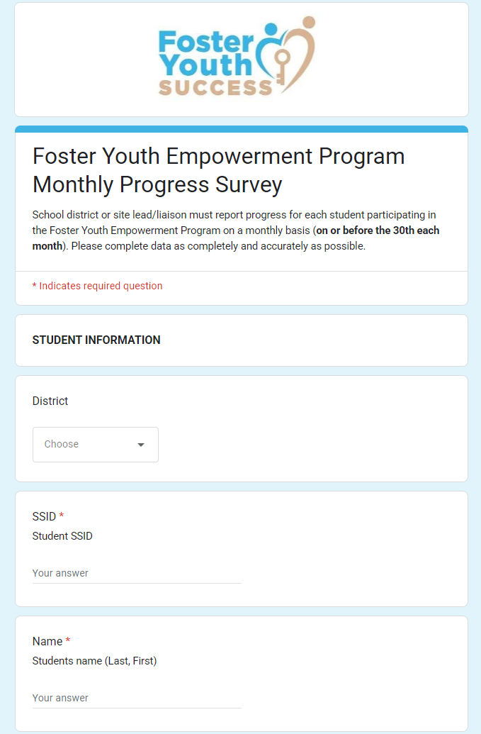
Monthly Empowerment Program
Student Progress Data
District lead/liaison to complete one survey per student by the end of each month beginning November 28, 2025.

Slide 57
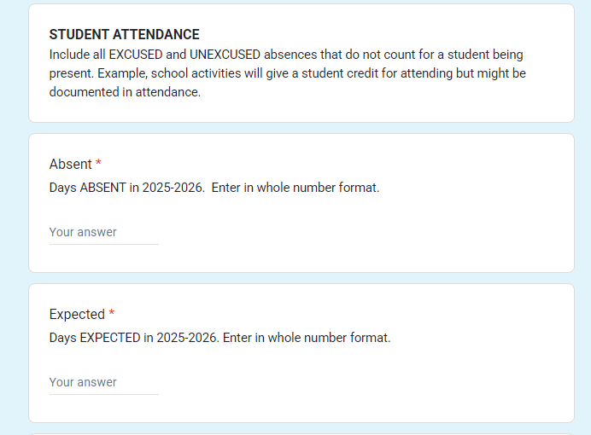
Monthly Empowerment Program
Student Progress Data

Slide 58
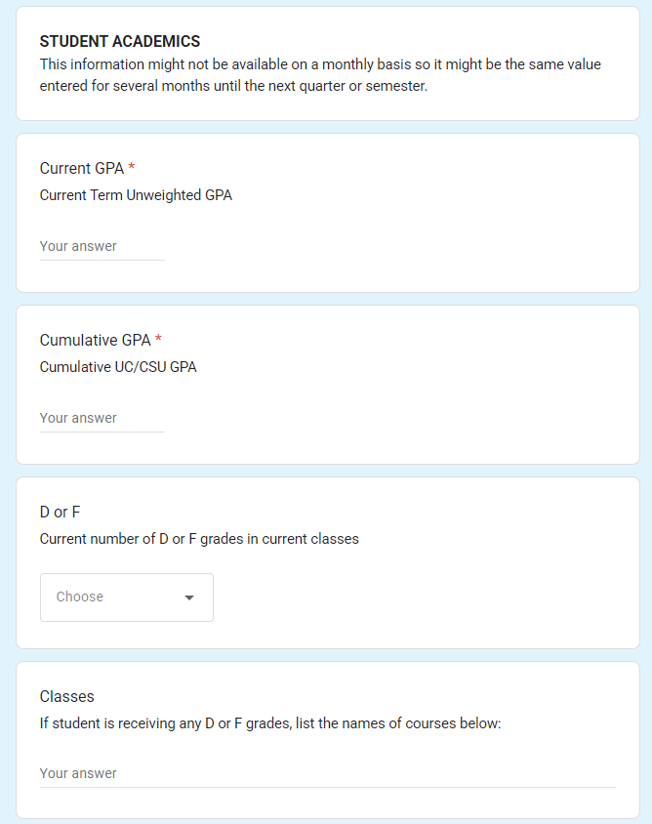
Monthly Empowerment Program
Student Progress: Academic Data

Slide 59
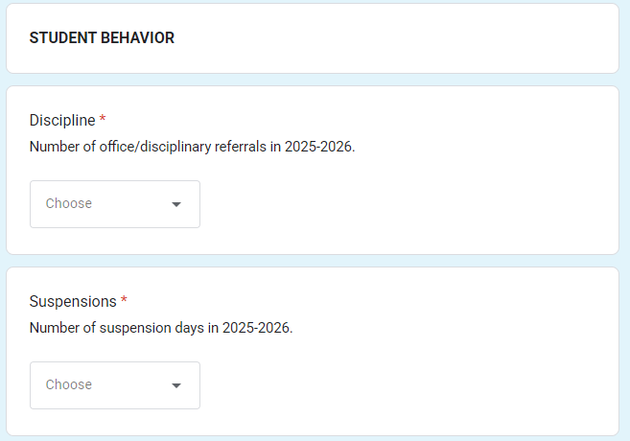
Monthly Empowerment Program
Student Progress Data

Slide 60
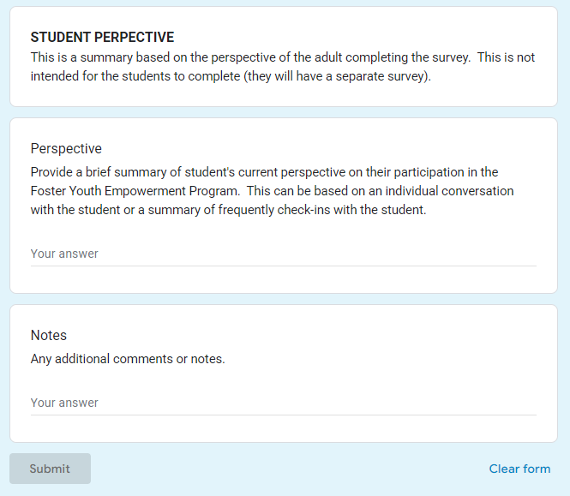
Monthly Empowerment Program
Student Progress Data

Slide 61

Questions
Assessment, Accountability, and Continuous Improvement
Division of Educational Services
Riverside County Office of Education
aacidata@rcoe.us

Slide 62
Acronyms and Initialisms
ATSI: Additional Targeted Support and Improvement (school accountability under ESSA)
CAASPP: CA Assessment of Student Performance and Progress
CDE: CA Department of Education
CSI: Comprehensive Support and Improvement (school accountability under ESSA)
EL: English Learner
ELPAC: English Language Proficiency Assessments for CA
ESSA: Every Student Succeeds Act
FY: Foster Youth
HY: Homeless Youth
LCAP: Local Control and Accountability Plan
LCFF: Local Control Funding Formula
LEA: Local Educational Agency
LTEL: Long Term English Learner
SBE: State Board of Education
SPSA: School Plan for Student Achievement
SWD: Students with Disabilities

