Slide 1
Somalia riverine floods:
choosing the data and the rules for anticipatory action
Multi-source trigger evidence for the Juba and Shabelle | GEOGloWS | GloFAS v4/v5 | Google GRRR | SWALIM gauges
OCHA Centre for Humanitarian Data | Data Science | August 2026

Slide 2
What this is: evidence for a flood trigger that releases funds before the peak
Anticipatory action pre-arranges CERF financing against a pre-agreed trigger: when the trigger condition is met, money moves automatically, days before the flood impact peaks. The negotiation happens at design time, not crisis time.
That design needs evidence for three questions:
which flood data source can be trusted, and where
how much lead time the forecasts genuinely carry
what rule detects the real flood years at an acceptable false-alarm rate
4
18
global streamflow products evaluated head-to-head
monitoring points on the two rivers
26 yrs
2
of benchmark record (1998-2023)
flood seasons per year: Gu | Deyr
Every number in this deck traces to an executed notebook in the repo, reading shared data on Azure blob.
Method: ds-knowledge-base trigger-design + NGA 2026 workflow, adapted | ds-aa-som-floods | analysis 01-10 | Aug 2026
2

Slide 3
How: the team's Nigeria workflow, adapted to Somalia
1
2
3
4
5
Audit the models
Define: a flood year
Correlate & select
Search trigger rules
Assemble mechanism
bias vs real gauge discharge (nb 02-04)
satellite vs gauge benchmark (nb 05)
which stations track the benchmark (nb 06-07)
N-of-M stations over RP thresholds (nb 08-09)
readiness + action, RP bookkeeping (nb 10)
Two Somalia twists the Nigeria design never needed:
two wet seasons (Gu: Mar-May | Deyr: Oct-Dec), so every window is designed per season
real river gauges (SWALIM): Nigeria had to trust satellite flood extent; Somalia can check it, and that check changed the design
Workflow: frameworks/nga-flooding 2026-06-18 | methods/trigger-design.md | ds-aa-som-floods | analysis 01-10 | Aug 2026
3

Slide 4
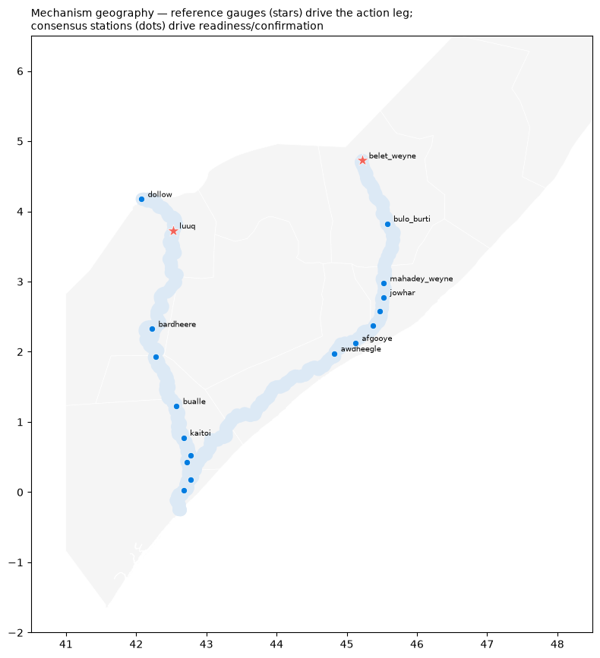
Where we monitor: 18 points, 2 rivers, 1 reference gauge each
The canonical set: 7 Shabelle + 8 Juba points on the GloFAS grid, plus 3 retained stations (Dollow, Mahadey Weyne, Saakow).
Reference gauges (stars) carry the action leg: Belet Weyne for the Shabelle | Luuq for the Juba.
Each point is matched to its model counterparts: a TDX-Hydro river reach (GEOGloWS), a HydroBASINS basin (Google GRRR), and a GloFAS grid cell: matching validated by walking the river network, after nearest-point matching mis-assigned 2 stations at confluences.
11 of 18 points link to a SWALIM gauge: the rest are model-only and cannot be verified against observations.
nb 10 | registry: src/constants.py | ds-aa-som-floods | analysis 01-10 | Aug 2026
4

Slide 5
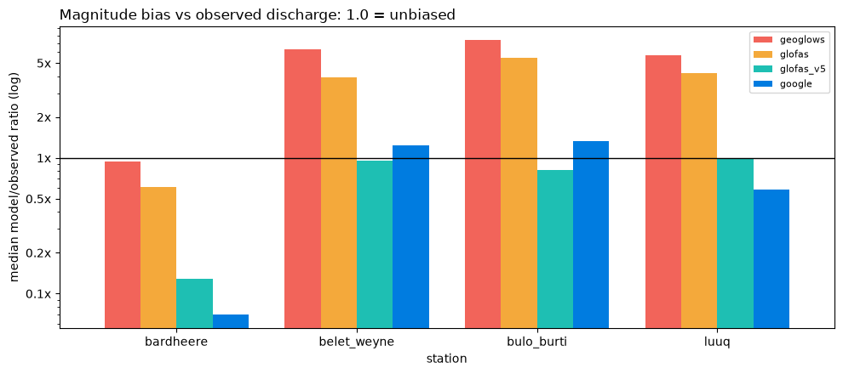
Can we trust the models? Two of four, and only after checking
What it shows: each model's median flow vs real observed discharge (log scale). 1.0 = unbiased.
GloFAS v5 and Google GRRR sit near 1.0: usable as-is. GEOGloWS runs 6-7x too wet, GloFAS v4 4-5x: their absolute values are unusable without correction; only rank-based (return-period) use is safe.
Bardheere: every model 'fails' the same way, which indicts the gauge, not the models.
The catch that shapes the whole design: GloFAS v5 (the best-calibrated reanalysis) publishes no reforecast, so it cannot be evaluated at lead time. And GEOGloWS forecasts run at 0.6-0.7x its own history, so thresholds fitted on its past never fire on its forecasts: a structural break we also confirmed in the team's Nepal work.
nb 04 | observed discharge: SNRFA station pages (EF5 work) | ds-aa-som-floods | analysis 01-10 | Aug 2026
5

Slide 6
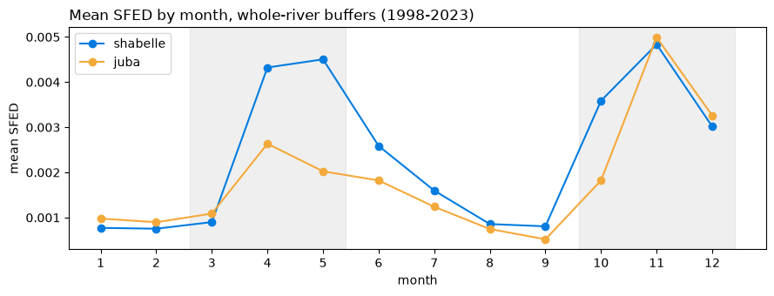
What counts as a flood year? The satellite and the gauges disagree
1 / 6
4 / 6
top flood seasons shared between satellite (Floodscan) and the Belet Weyne gauge: Shabelle
shared on the Juba at Luuq: satellite usable there as corroboration
Both flood seasons resolve cleanly in every dataset: the disagreement is about which years were extreme.
Why it matters: the gauge record contains the documented disasters (Deyr 2006, 2019, 2023); the satellite record does not. Calibrating triggers to the satellite would have optimised for the wrong events. All thresholds in this analysis are anchored to the SWALIM gauges.
nb 05-06 | Floodscan SFED 1998-2023 vs SWALIM seasonal max levels | ds-aa-som-floods | analysis 01-10 | Aug 2026
6

Slide 7
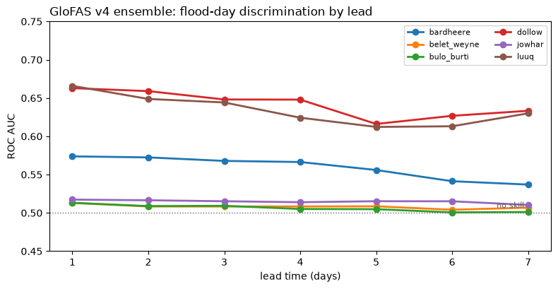
How much warning do forecasts really give?
What it shows: each source's ability to rank flood days above normal days (AUC; 0.5 = coin flip), by forecast lead.
The curves are flat from 1 to 7 days: forecasts add almost nothing beyond knowing today's river state. The skill that exists is memory, not weather prediction: the same conclusion as the EF5 modelling.
Flat is also good news: a 7-day trigger costs little vs a 1-day one, wherever skill exists at all.
GRRR is the only source with Shabelle skill (AUC 0.92-0.97 in its window). GloFAS is at chance there, but works at Dollow on the Juba.
Caveat: extremes are under-forecast: both models' 7-day reforecasts miss Deyr 2023 at return-period thresholds, even where day-ranking skill is high.
nb 03 | GRRR 2016-23 | GloFAS 2003-23 | GEOGloWS 2024-26 (different windows) | ds-aa-som-floods | analysis 01-10 | Aug 2026
7

Slide 8
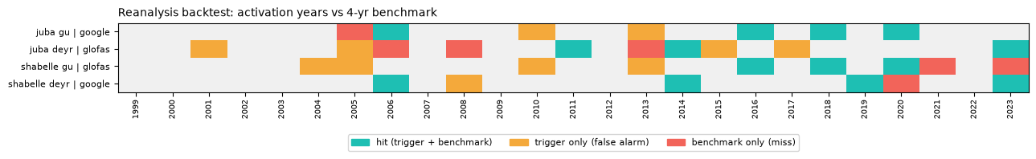
The rule that works: station consensus, validated on events, not correlation
What it shows: 25 years x 4 windows. Teal = trigger and benchmark agree | amber = false alarm | red = miss.
Chosen rule per window: at least N of 8 stations exceed their own return-period threshold on the same day.
Best windows (vs the 4-yr benchmark):
Shabelle Deyr: GRRR, RP5 at ≥2/8 stations: catches 2006 | 2014 | 2019 | 2023, one false alarm (2008, itself a real moderate-flood season)
Juba Gu: GRRR, RP4 at ≥2/8: POD 0.80 | FAR 0.33 | fires ~1-in-4.3 yrs
The lesson that generalises: GloFAS won the correlation ranking but rates the historic Deyr 2023 flood as unremarkable (0 of 8 stations over RP3). Correlation measures day-to-day tracking; triggers must be validated on which events they catch. Source selection by rho alone would have shipped a trigger blind to 2023.
nb 08-09 | thresholds: Weibull on each station's own seasonal maxima | ds-aa-som-floods | analysis 01-10 | Aug 2026
8

Slide 9
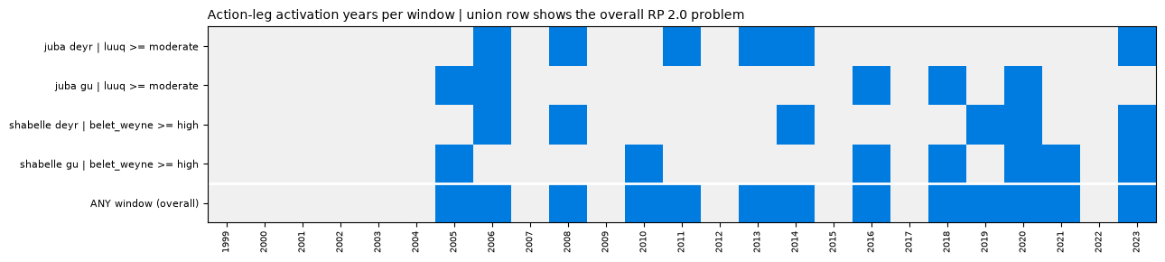
The mechanism: forecast readiness, observed action
READINESS | 7-12 days ahead
'Gauges are not forecasts?': anticipation comes from
the readiness leg having mobilised days earlier
upstream-to-downstream travel time: a crossing at Belet Weyne is hydraulic certainty for the reaches below
impact lagging the gauge: inundation and needs peak over 1-3 weeks
GloFAS ensemble at the reference station over its RP3
mobilise partners, ~5% of funds
ACTION | ≤6 days
SWALIM observed level: Belet Weyne ≥ high (7.3 m) | Luuq ≥ moderate (5.5 m)
bulk release: certain, cannot miss a real flood
Observed action years per window, 1999-2023. Bottom row: years at least one window fires.
nb 10 | precedent: Nepal action trigger includes observed danger levels | ds-aa-som-floods | analysis 01-10 | Aug 2026
9

Slide 10
How often would it fire? The number a donor reads first
3.3-4.6 yr
2.0 yr
> 2.0 yr
each window's own return period: all inside the 1-in-3..5 portfolio band
overall: some window fires in 13 of 25 years: the arithmetic of four 3-5 yr windows
effective (max spend): depends on the funding split: no year in the record fired all four windows
What this means: if the whole envelope releases on any window ('all-in'), the fund pays out every two years on average: likely too hot. Splitting the envelope per river or per window keeps each window at a defensible 1-in-3..5 while the maximum annual bill stays rare. The split is a framework-team decision; the numbers argue for it.
Team convention: report individual, overall and effective return periods together, always (methods/return-periods.md).
nb 10 | Weibull RP = (n+1)/activations | ds-aa-som-floods | analysis 01-10 | Aug 2026
10

Slide 11
How solid is this? Direction confident, magnitude approximate
Strengths
Limitations
validated at every join: 4 models x real gauges, 2 independent benchmarks, event-level checks
caught 3 silent failure modes before they shaped the trigger (satellite benchmark, GloFAS 2023 blindness, GEOGloWS forecast break)
findings replicate independent work: Nepal (GEOGloWS), EF5 (lead-time limits)
fully reproducible: 10 notebooks, shared data, team-standard methods
~5-7 flood events per window: one event moves POD by 0.2; best-of-grid configs flatter themselves
record starts 1998: the 1997/98 El Niño (worst in living memory) is outside every fit
hazard-to-impact link unverified: activation years not yet checked against displacement/needs
readiness band (7-12 d) still a lead-7 proxy: real data downloading
single analyst: needs peer re-derivation
Grade: solid pre-framework evidence | not yet a trigger report | ds-aa-som-floods | analysis 01-10 | Aug 2026
11

Slide 12
What happens next
Now
8-12 day GloFAS reforecast lands (downloading): readiness band evaluated for real; Juba delta points complete
Next
impact-record cross-check: do activation years match displacement and needs? (the mandatory second historical record)
Then
trigger specification with the working group: target RP, lead times, funding split: then the formal trigger report
Throughout
peer review: a colleague re-derives the headline numbers from the notebooks
Repo: ds-aa-som-floods (notebooks 01-10) | Data: Azure blob projects/dev | KB: analysis/som-flooding-multisource.md

