Slide 1
Venezuela: El Niño 2026/27
What past El Niño years brought, how this year has gone so far, and the forecast for the coming months
OCHA Centre for Humanitarian Data · rain to September 2026, vegetation to 11–20 October 2026, SEAS5 issued October 2026
Notes:
Three parts: what past El Niño years brought, how this year has gone so far, and the seasonal forecast for the coming months. For this season, plan on the forecast; past years are context.

Slide 2
Summary
1
Past El Niño years
A drier dry season in the south (21–33% less rain) and weaker rains in the north (8–19% less); fewer flood reports; the Guri reservoir fell further.
2
This year so far
May–September rain was 65–89% of normal, among the five driest since 1981. Cropland is below the warning level in Sucre, Zulia and Falcón. Guri is near full.
3
The forecast
SEAS5 (October 2026): October–February among the driest 10% of forecasts since 1981, wherever it is the rainy season. For this season, plan on the forecast.
Notes:
One line for each part of the deck: what past El Niño years brought, how this year has gone, and what the forecast says. Past years are context; the forecast is what to plan on.

Slide 3
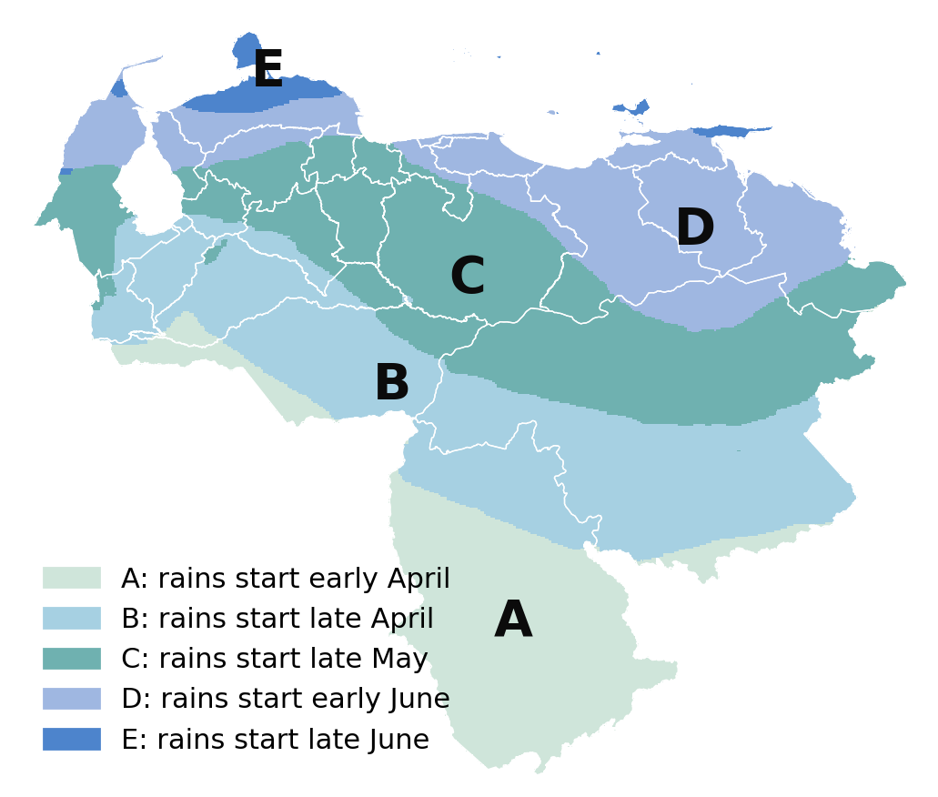
In past El Niño years, the dry season was drier in the south and the rains weaker in the north
1 · PAST EL NIÑO YEARS
21–33%
less dry-season rain in the south (zones A and B)
8–19%
less rainy-season rain in the north (zones C to E)
Medians over the 15 El Niño years since 1981. Zones: INAMEH’s map of rainy-season onset. Rain: CHIRPS v3.
Notes:
INAMEH’s zones by rainy-season onset run from early April in the far south (A) to late June on the northern coast (E). Each zone’s rainy season runs from its onset to November; its dry season from December to the onset.

Slide 4
El Niño years also had fewer flood reports, a larger fall in the Guri reservoir and poorer dry-season vegetation
1 · PAST EL NIÑO YEARS
30–64%
14 m
3 poorest
fewer flood and landslide reports in a typical El Niño year (DesInventar, 1975–2013)
fall of the Guri reservoir through the dry season after a typical El Niño year, against 5 m after La Niña
dry seasons for vegetation since 2000 all followed El Niño (2002/03, 2009/10, 2015/16)
Harvests show no clear link with El Niño (FAOSTAT maize and rice yields).
Notes:
Floods: DesInventar records, each year against the years around it. Guri: NASA G-REALM satellite altimetry since 1992. Vegetation: JRC ASAP FPAR, November–April, since 2000; 2023/24, a strong El Niño, was not among the poorest.

Slide 5
May–September 2026 rain was 65–89% of normal, among the five driest since 1981
2 · THIS YEAR SO FAR
CHIRPS v3 to September 2026, % of the 1991–2020 normal. ERA5 gives 57–81%. October data come out in November.
Notes:
Each region’s total for the months so far this rain year, as a share of its 1991–2020 normal.

Slide 6
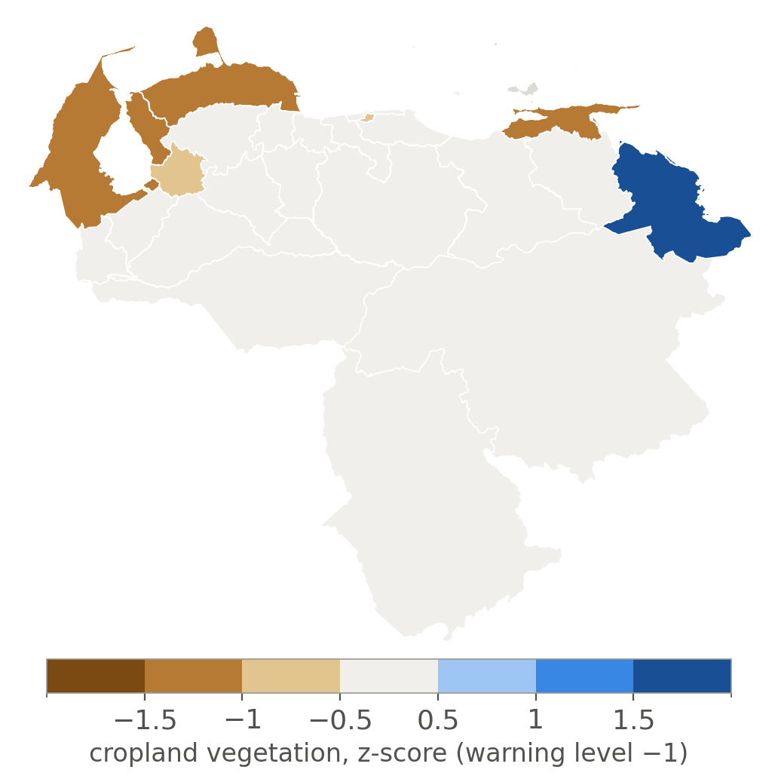
Mid-October: vegetation near normal nationally, cropland below the warning level in Sucre, Zulia and Falcón
2 · THIS YEAR SO FAR
Cropland below normal in 15 of 23 states
FEWS NET (August): localized soil-moisture deficits in rainfed areas, no major crop losses
JRC ASAP, 11–20 October 2026: MODIS FPAR z-score over cropland; ASAP’s warning level is −1.
Notes:
The full page also maps rangeland. ASAP updates every ten days.

Slide 7
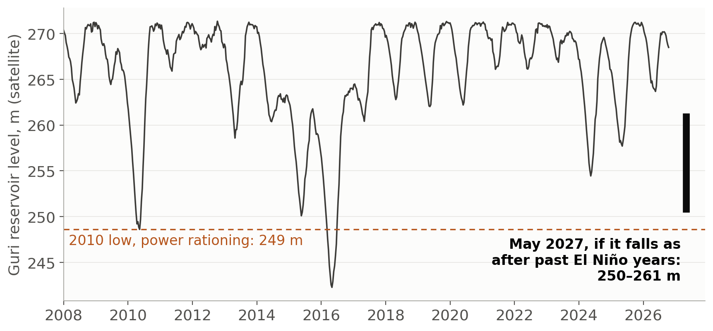
The Guri reservoir is near full (270.2 m); falls like those after past El Niño years would take it to 250–261 m by May 2027
2 · THIS YEAR SO FAR
The low end is 2 m above the 2010 low. How far it falls also depends on releases for power. NASA G-REALM satellite altimetry.
Notes:
Satellite heights above the EGM2008 geoid, not the operator’s gauge datum: compare falls, not levels.

Slide 8
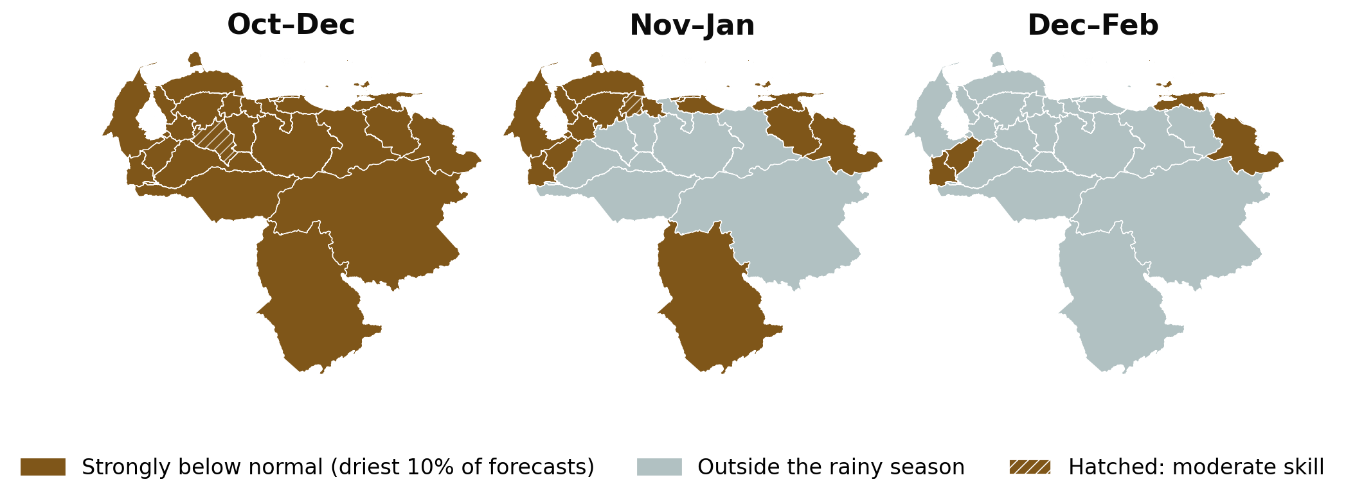
SEAS5, October 2026: one of the driest October–February forecasts since 1981, wherever it is the rainy season
3 · THE FORECAST
Every rainy-season state and season (45 in all) is among the driest 10% of forecasts since 1981
The forecast has skill for these months (correlation 0.4–0.7)
ECMWF issues a new forecast every month
ECMWF SEAS5, issued October 2026, detrended; classes as in the team’s seas5-skill viewer.
Notes:
The October forecasts in 1997 and 2015 ranked about as dry; the rain that followed was among the driest on record in 1997 and below normal in 2015. February–April leans wet in the west and centre, where the forecast has low skill or the months fall outside the rainy season.

Slide 9
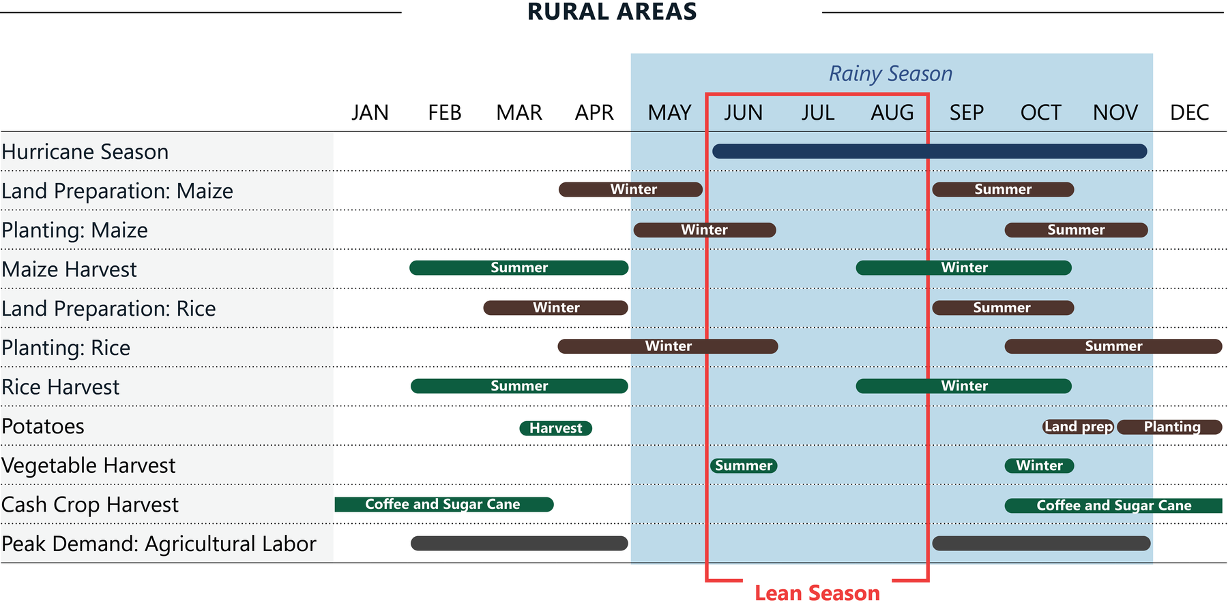
The forecast months cover the summer planting of maize and rice and the coffee and sugar-cane harvest
3 · THE FORECAST
FEWS NET expects Stressed (IPC Phase 2) outcomes for October 2026 to January 2027
It expects localized rainfed losses with limited impact, given irrigation and imports
It puts peak needs in August–October 2026, driven by the earthquake and the economy
FEWS NET: seasonal calendar (Venezuela page) and El Niño briefing, August 2026.
Notes:
Calendar: https://fews.net/latin-america-and-caribbean/venezuela

Slide 10
What to watch next
The November SEAS5 forecast, out in early November
October rain, from CHIRPS and ERA5 in November
The Guri reservoir level through the dry season
Cropland warnings in the north-west and north-east (JRC ASAP, every ten days)
Full analysis, in English and Spanish: https://ocha-dap.github.io/ds-teleconnections/enso/ven/
Notes:
Things that will change this picture over the coming weeks.

