Slide 1
ANTICIPATORY ACTION · TROPICAL CYCLONES · FIJI
The 2025–26 cyclone season:
how close did the trigger come?
RSMC Nadi sent forecasts for two cyclones near Fiji: Urmil in February and Vaianu in April. We step through every forecast and check it against the trigger.

Slide 2
REMINDER
What would have activated the framework
🌀
Readiness
≥ 5,000 people in the zone forecast to get 64-kt (hurricane-force) winds, in the 120-hour forecast
🌀
Action
The same, within the first 72 hours
🌧️
Observational
≥ 190 mm of rain over two days, averaged over the whole country
On each forecast slide: the number of people in the 64-kt zone, and how far the 64-kt winds stayed from land. 64 knots (118 km/h) is the minimum for a Category 3 cyclone.

Slide 3
2025–26 SEASON
13 forecasts, no activation
CYCLONE | FORECASTS | STRONGEST FORECAST | CLOSEST CENTRE TO LAND | MOST PEOPLE IN 64-KT ZONE
Urmil | 4 · 27–28 Feb | Category 2 | 430 km | 0
Vaianu | 9 · 5–8 Apr | Category 3 | 195 km | 0
Threshold: 5,000 people. Times are Fiji time, when the forecast was issued.

Slide 4
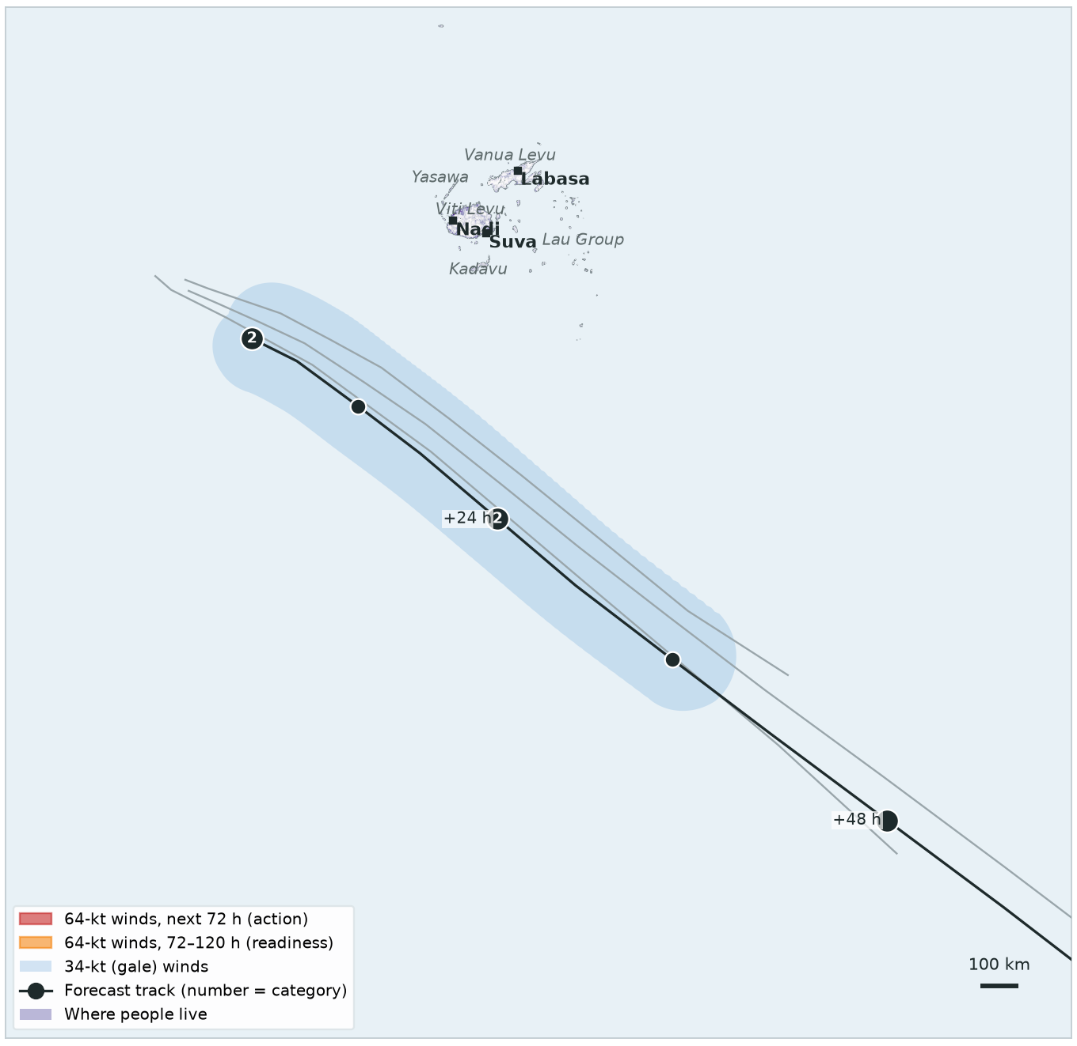
CYCLONE URMIL · 27–28 FEBRUARY
Never close
All 4 forecasts kept Urmil far to the south-west and south of Fiji, at most Category 2 — no hurricane-force winds were forecast at all. Its centre stayed at least 430 km from land.
TRIGGER | THIS FORECAST | STATUS
Readiness 120-hour forecast | 0 people in 64-kt zone threshold 5,000 | Not reached
Action 72-hour forecast | 0 people in 64-kt zone threshold 5,000 | Not reached
Observational 2-day rainfall | IMERG satellite, checked daily | —
Map: latest forecast in black, earlier forecasts in grey.

Slide 5
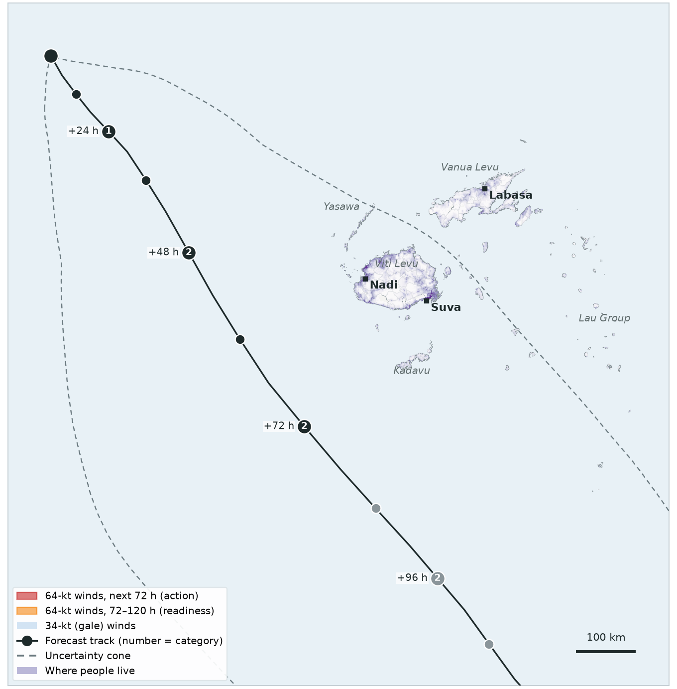
TROPICAL DISTURBANCE 11F · FORECAST 1 OF 9
Sun 5 Apr, 18:00
First forecast, before the system was named: forecast to reach Category 2 west of Fiji, with no hurricane-force winds.
TRIGGER | THIS FORECAST | STATUS
Readiness 120-hour forecast | 0 people in 64-kt zone threshold 5,000 | Not reached
Action 72-hour forecast | 0 people in 64-kt zone threshold 5,000 | Not reached
Observational 2-day rainfall | IMERG satellite, checked daily | —
How close? No 64-kt winds forecast. Storm centre 200 km from land at its closest.

Slide 6
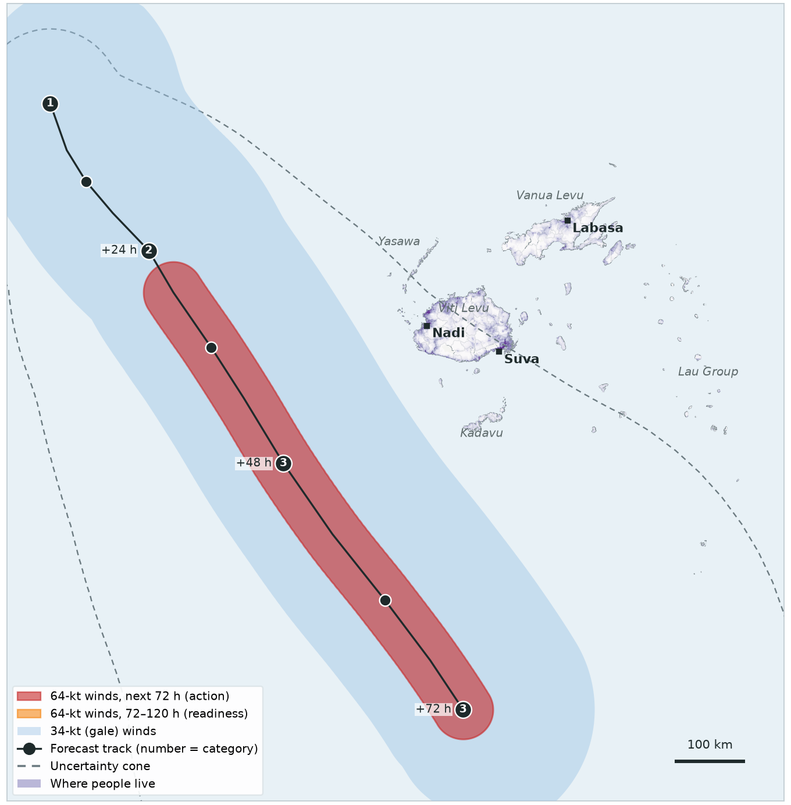
VAIANU · FORECAST 2 OF 9
Mon 6 Apr, 00:00
Forecast as a Category 3 passing west and south of Viti Levu. Its hurricane-force winds stay 215 km from land.
TRIGGER | THIS FORECAST | STATUS
Readiness 120-hour forecast | 0 people in 64-kt zone threshold 5,000 | Not reached
Action 72-hour forecast | 0 people in 64-kt zone threshold 5,000 | Not reached
Observational 2-day rainfall | IMERG satellite, checked daily | —
How close? 64-kt winds 215 km from land. Storm centre 260 km from land at its closest.

Slide 7
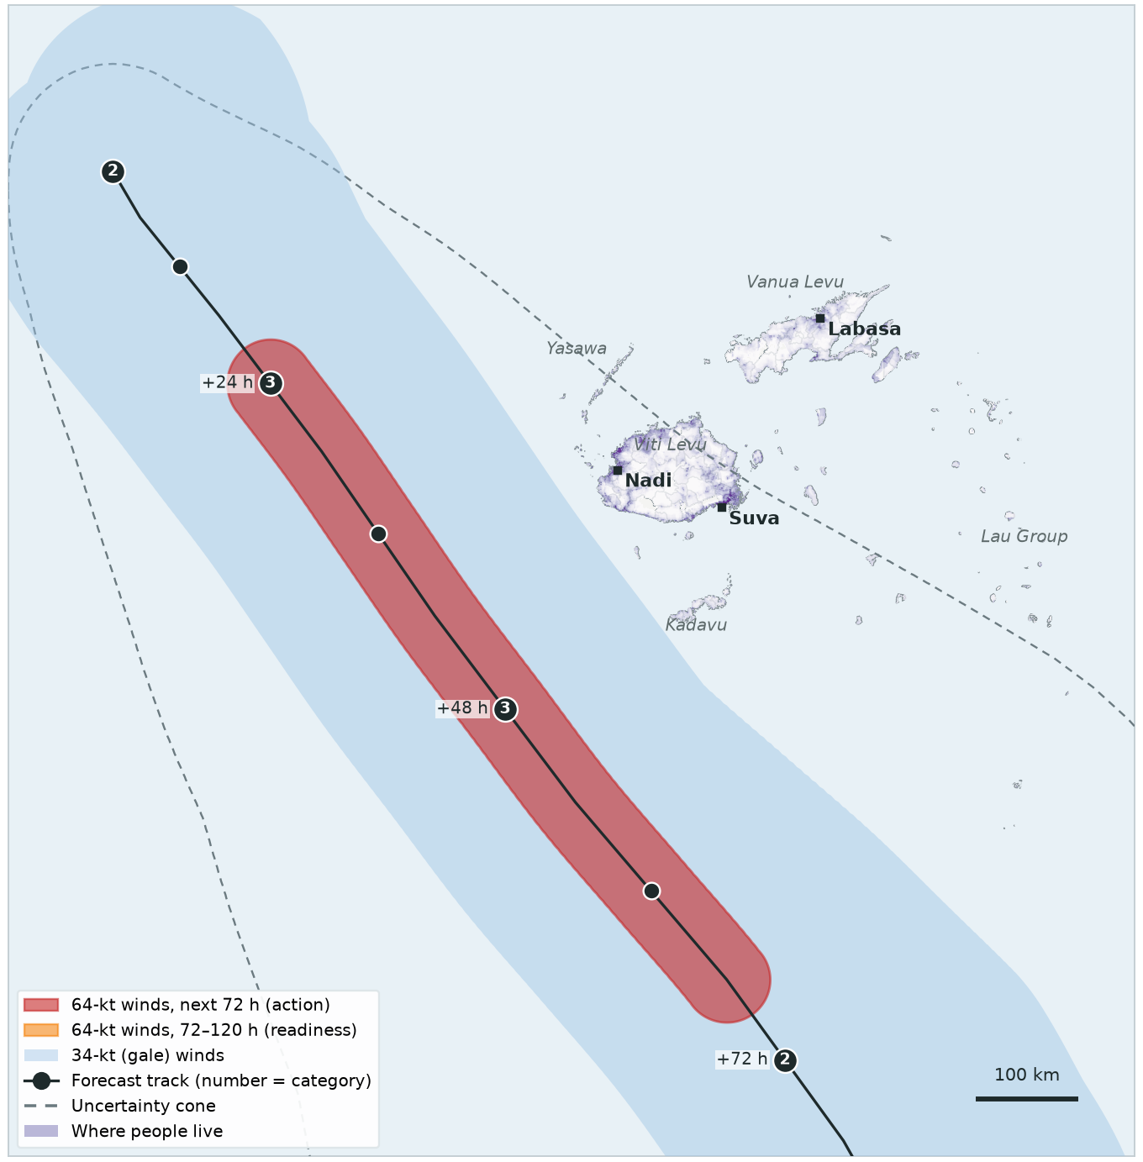
VAIANU · FORECAST 3 OF 9
Mon 6 Apr, 06:00
Forecast as a Category 3 passing west and south of Viti Levu. Its hurricane-force winds stay 155 km from land.
TRIGGER | THIS FORECAST | STATUS
Readiness 120-hour forecast | 0 people in 64-kt zone threshold 5,000 | Not reached
Action 72-hour forecast | 0 people in 64-kt zone threshold 5,000 | Not reached
Observational 2-day rainfall | IMERG satellite, checked daily | —
How close? 64-kt winds 155 km from land. Storm centre 200 km from land at its closest.

Slide 8
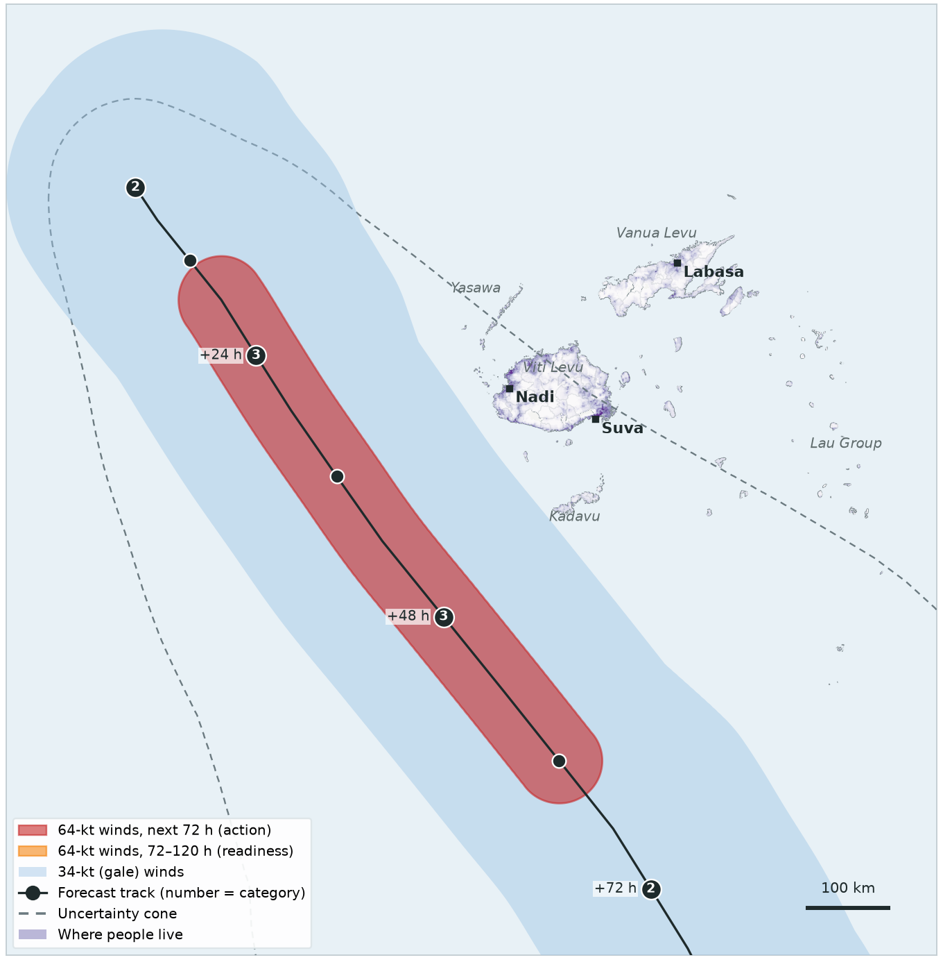
VAIANU · FORECAST 4 OF 9
Mon 6 Apr, 12:00
Forecast as a Category 3 passing west and south of Viti Levu. Its hurricane-force winds stay 140 km from land.
TRIGGER | THIS FORECAST | STATUS
Readiness 120-hour forecast | 0 people in 64-kt zone threshold 5,000 | Not reached
Action 72-hour forecast | 0 people in 64-kt zone threshold 5,000 | Not reached
Observational 2-day rainfall | IMERG satellite, checked daily | —
How close? 64-kt winds 140 km from land. Storm centre 195 km from land at its closest.

Slide 9
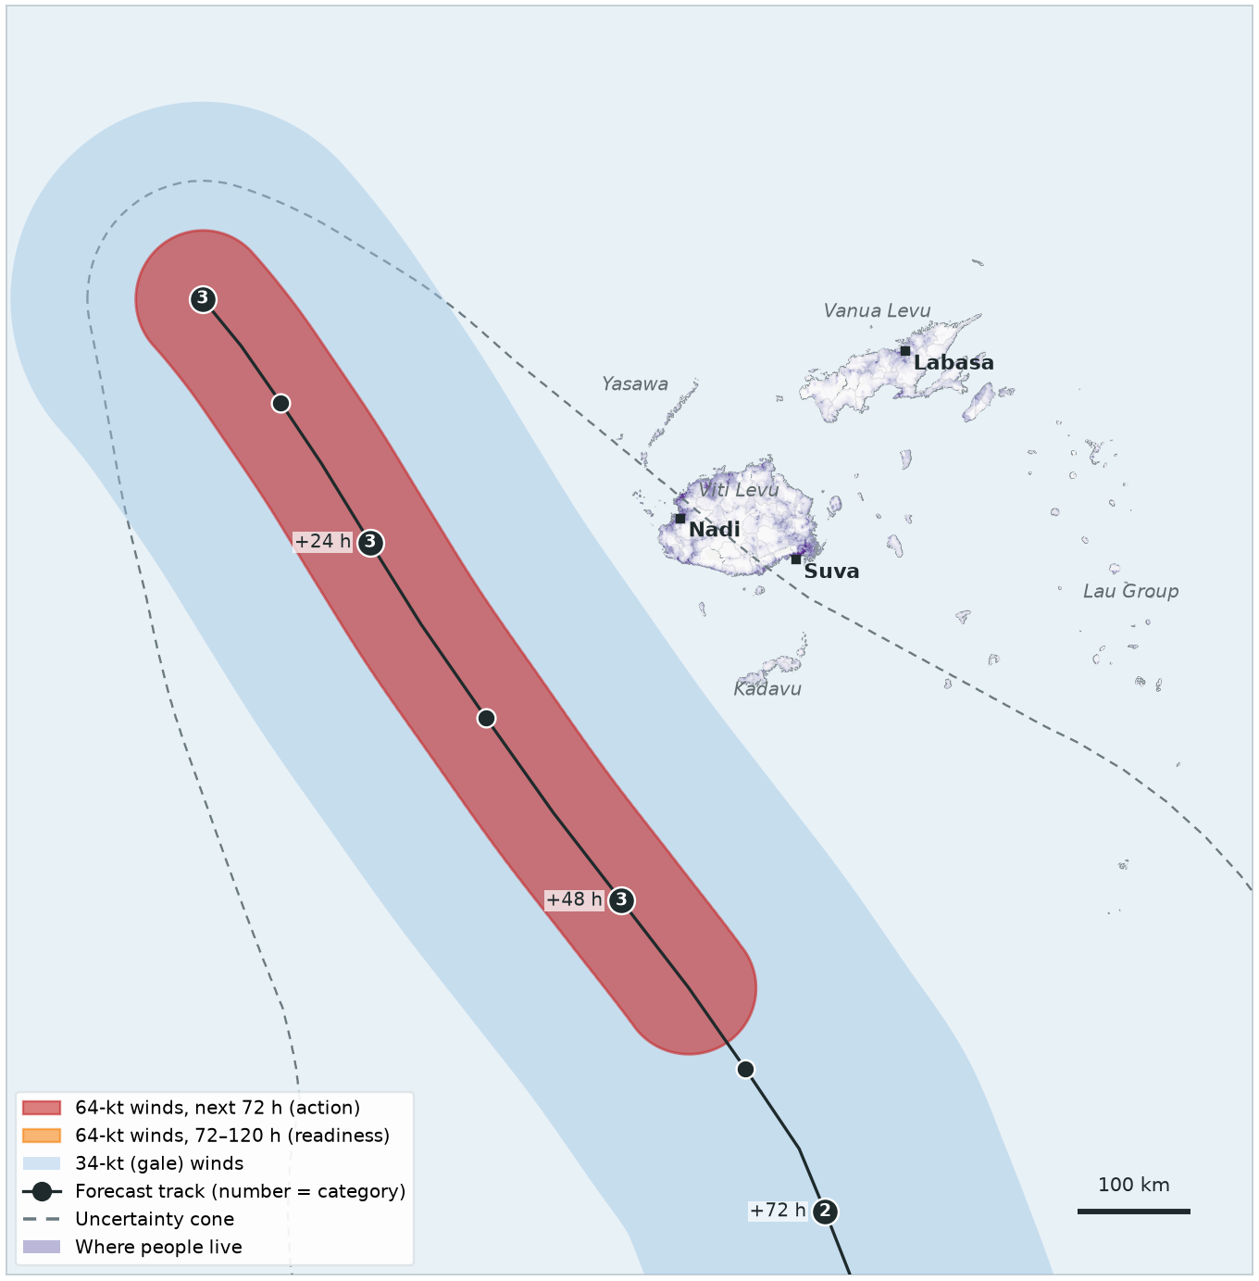
VAIANU · FORECAST 5 OF 9
Mon 6 Apr, 18:00
Forecast as a Category 3 passing west and south of Viti Levu. Its hurricane-force winds stay 155 km from land.
TRIGGER | THIS FORECAST | STATUS
Readiness 120-hour forecast | 0 people in 64-kt zone threshold 5,000 | Not reached
Action 72-hour forecast | 0 people in 64-kt zone threshold 5,000 | Not reached
Observational 2-day rainfall | IMERG satellite, checked daily | —
How close? 64-kt winds 155 km from land. Storm centre 220 km from land at its closest.

Slide 10
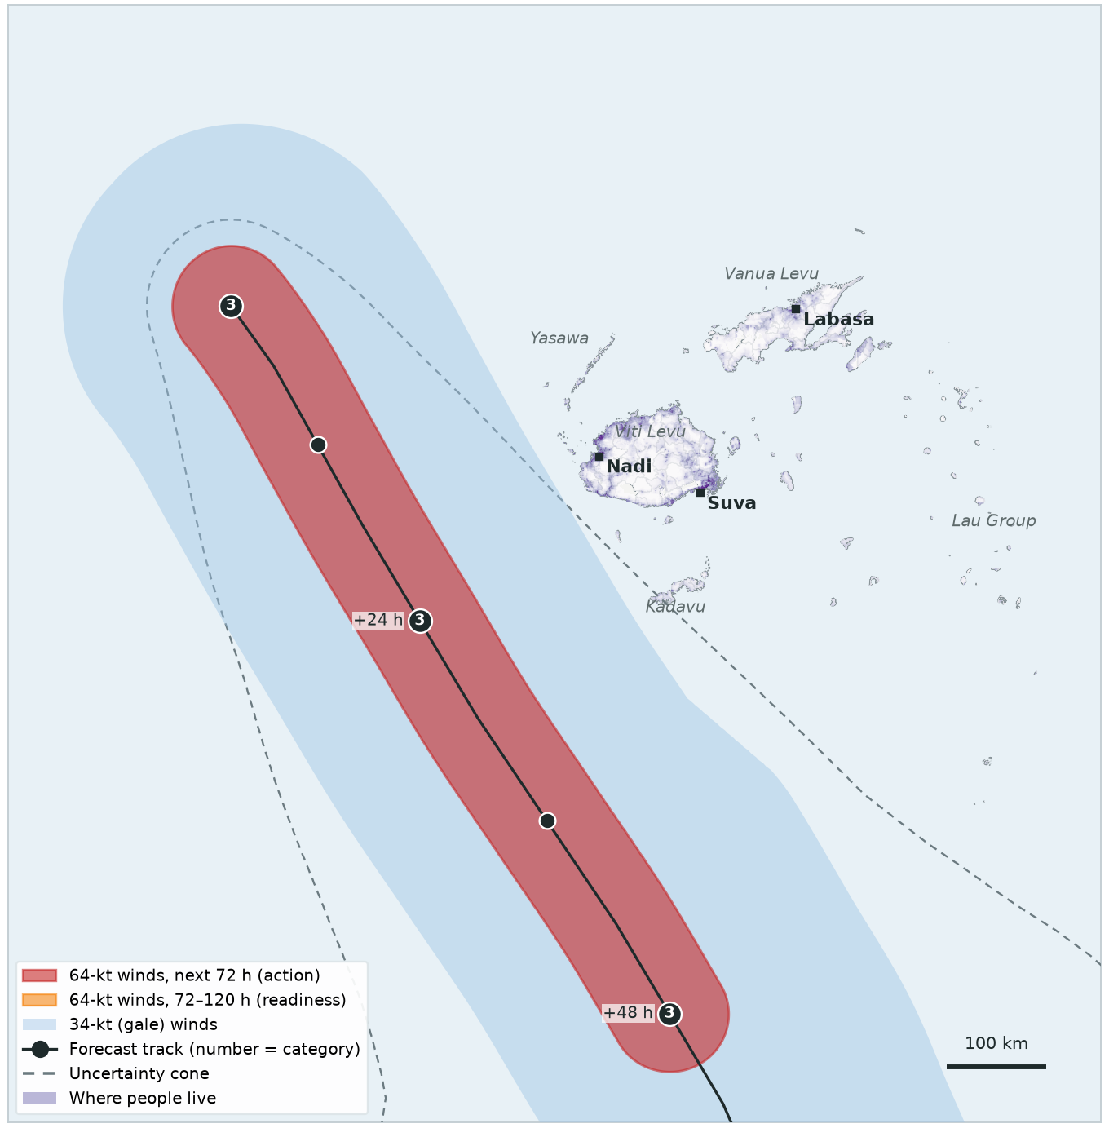
VAIANU · FORECAST 6 OF 9
Tue 7 Apr, 00:00
Forecast as a Category 3 passing west and south of Viti Levu. Its hurricane-force winds stay 165 km from land.
TRIGGER | THIS FORECAST | STATUS
Readiness 120-hour forecast | 0 people in 64-kt zone threshold 5,000 | Not reached
Action 72-hour forecast | 0 people in 64-kt zone threshold 5,000 | Not reached
Observational 2-day rainfall | IMERG satellite, checked daily | —
How close? 64-kt winds 165 km from land. Storm centre 230 km from land at its closest.

Slide 11
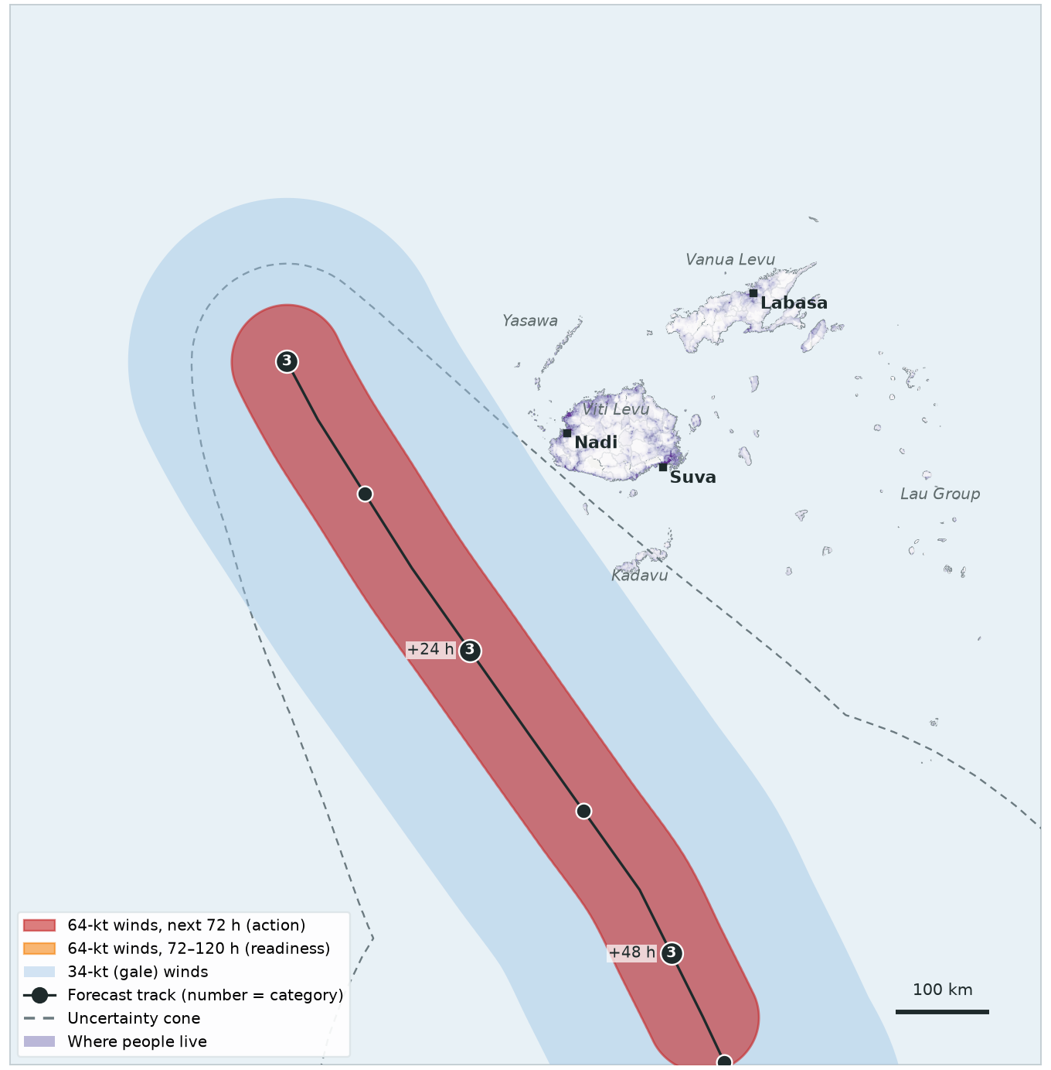
VAIANU · FORECAST 7 OF 9
Tue 7 Apr, 06:00
Forecast as a Category 3 passing west and south of Viti Levu. Its hurricane-force winds stay 130 km from land.
TRIGGER | THIS FORECAST | STATUS
Readiness 120-hour forecast | 0 people in 64-kt zone threshold 5,000 | Not reached
Action 72-hour forecast | 0 people in 64-kt zone threshold 5,000 | Not reached
Observational 2-day rainfall | IMERG satellite, checked daily | —
How close? 64-kt winds 130 km from land. Storm centre 195 km from land at its closest.

Slide 12
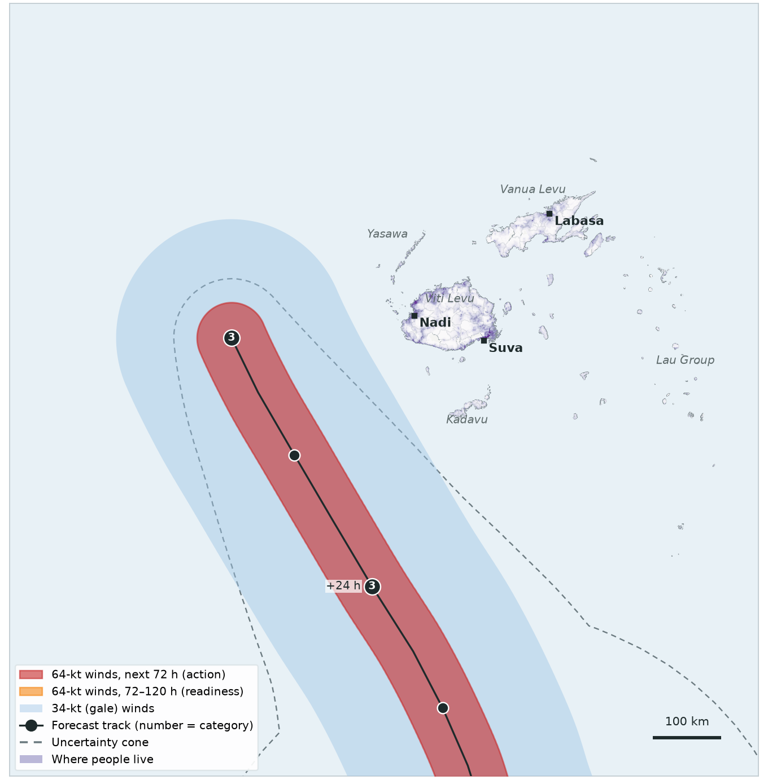
VAIANU · FORECAST 8 OF 9
Tue 7 Apr, 12:00
Forecast as a Category 3 passing west and south of Viti Levu. Its hurricane-force winds stay 190 km from land.
TRIGGER | THIS FORECAST | STATUS
Readiness 120-hour forecast | 0 people in 64-kt zone threshold 5,000 | Not reached
Action 72-hour forecast | 0 people in 64-kt zone threshold 5,000 | Not reached
Observational 2-day rainfall | IMERG satellite, checked daily | —
How close? 64-kt winds 190 km from land. Storm centre 250 km from land at its closest.

Slide 13
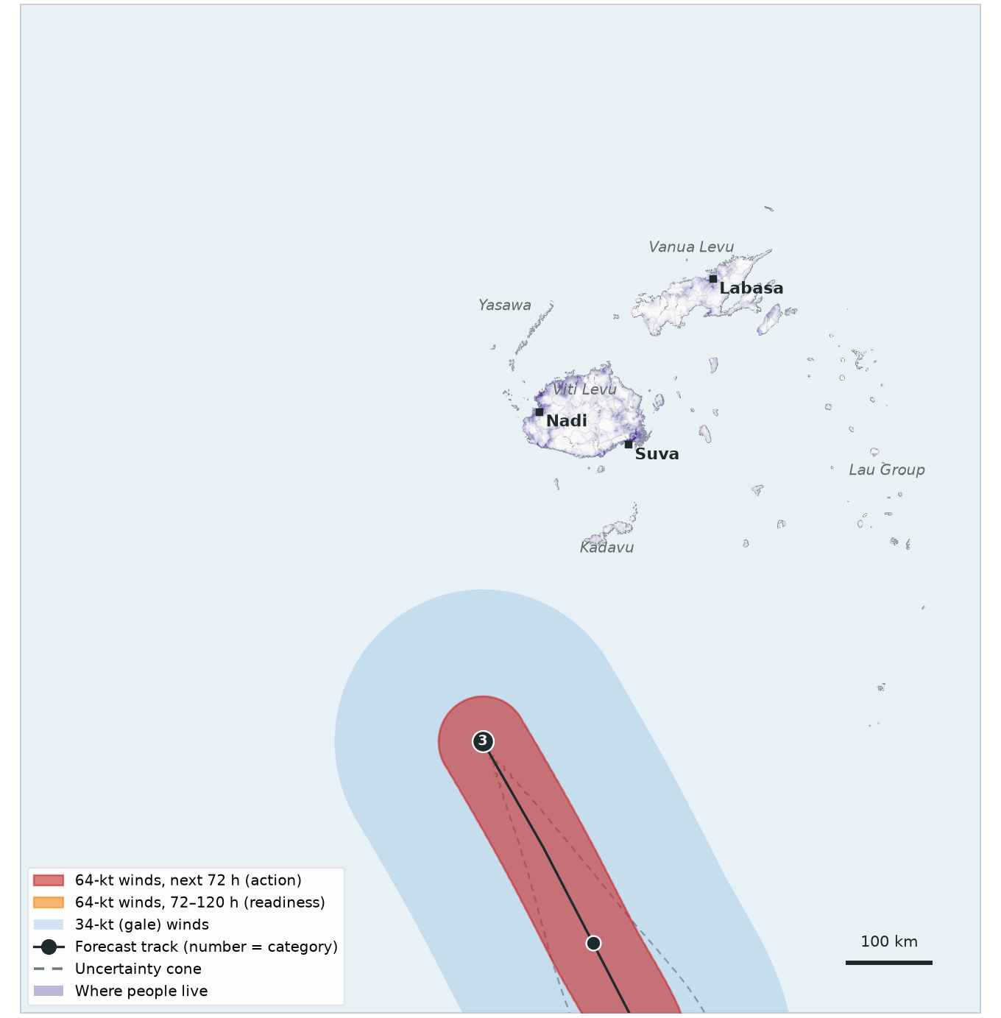
VAIANU · FORECAST 9 OF 9
Wed 8 Apr, 06:00
Forecast as a Category 3 passing west and south of Viti Levu. Its hurricane-force winds stay 220 km from land.
TRIGGER | THIS FORECAST | STATUS
Readiness 120-hour forecast | 0 people in 64-kt zone threshold 5,000 | Not reached
Action 72-hour forecast | 0 people in 64-kt zone threshold 5,000 | Not reached
Observational 2-day rainfall | IMERG satellite, checked daily | —
How close? 64-kt winds 220 km from land. Storm centre 275 km from land at its closest.

Slide 14
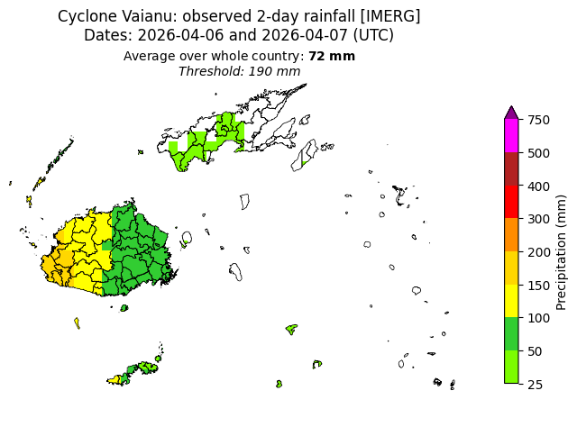
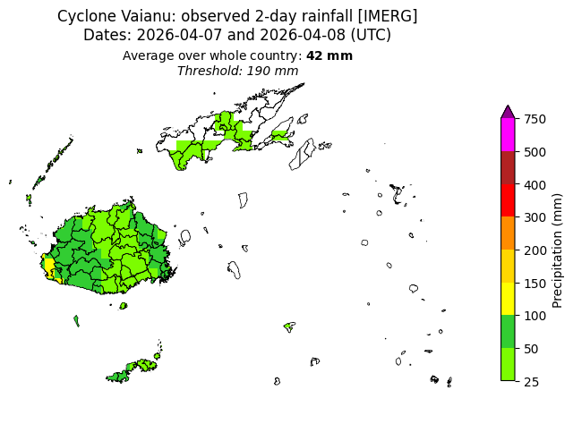
VAIANU · OBSERVATIONAL TRIGGER
Heavy rain in western Viti Levu — but far below the threshold
6–7 Apr: 72 mm country average (threshold 190 mm)
7–8 Apr: 42 mm country average (threshold 190 mm)
NASA IMERG satellite rainfall, as sent in the observational information emails on 7 and 8 April.

Slide 15
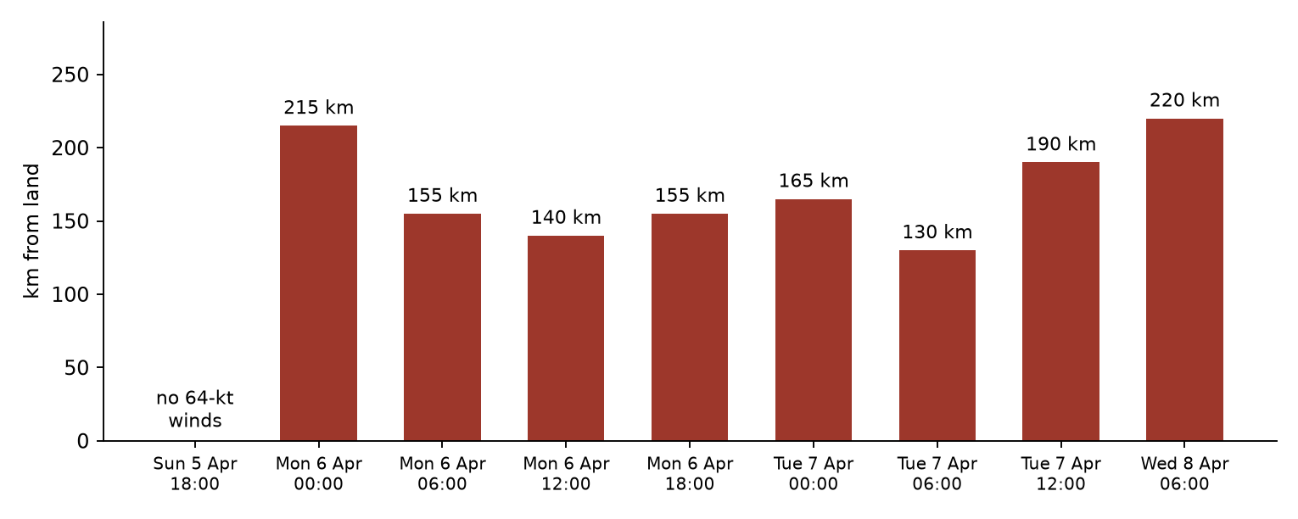
SUMMARY
Vaianu came closest — and it was not close
Every one of the 13 forecasts had 0 people in the 64-kt zone (threshold 5,000). Vaianu's hurricane-force winds stayed 130 km or more offshore.
Only the uncertainty cone's worst case reached populated areas, on 6–7 April. The trigger uses the forecast track itself, so this alone does not activate.
Rainfall peaked at 72 mm (2-day country average), against 190 mm.

