Slide 1
ANTICIPATORY ACTION · TROPICAL CYCLONES · FIJI
Simulation exercise:
three cyclones that never happened
We follow three fictional storms forecast by forecast, the way the monitoring system would see them, and stop at each step to see which triggers activate.
⚠️ Exercise only. Cyclones Alpha, Bravo and Charlie are invented. Their forecasts are written in RSMC Nadi's format and checked with the same code that monitors real forecasts, so every wind-exposure number shown is what the system would compute. Rainfall fields are invented for the exercise, and the emails are mock-ups. Times are Fiji time, counted from Day 1.

Slide 2
REMINDER
Three ways the framework can activate
🌀
Readiness
≥ 5,000 people in the zone forecast to get 64-kt (hurricane-force) winds, anywhere in the 120-hour forecast
🌀
Action
The same, but within the first 72 hours of the forecast
🌧️
Observational
≥ 190 mm of rain over two days, averaged over the whole country (NASA IMERG), while the storm is within 250 km of Fiji
Every RSMC Nadi forecast is checked automatically as soon as it arrives; rainfall is checked once a day. 64 knots (118 km/h) is the minimum for a Category 3 cyclone. Because the 72-hour forecast is part of the 120-hour forecast, action can only activate together with, or after, readiness.

Slide 3
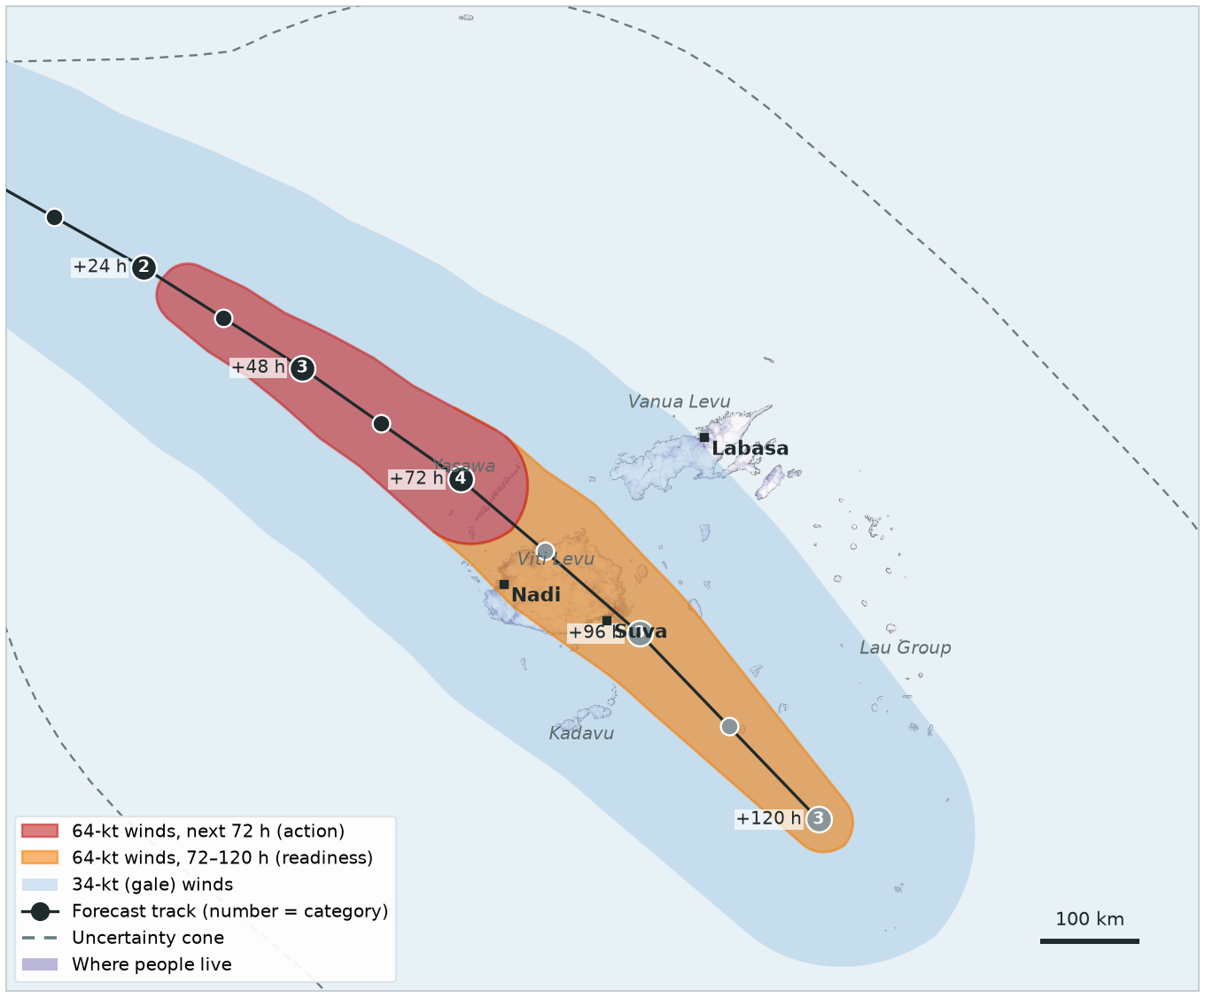
HOW TO READ THE SLIDES
Each slide is one forecast
Red: 64-kt winds in the next 72 hours — counts for action (and readiness).
Orange: 64-kt winds 72 to 120 hours ahead — counts for readiness only.
Light blue: gale-force (34-kt) winds — shown for context, not part of the trigger.
Dots: forecast position every 12 hours (black up to 72 h, grey after); the number is the category.
Purple: where people live. The trigger counts the people under the red and orange zones.
Dashed line: uncertainty cone — for information only, the trigger uses the forecast track.
STATUS IN THE TABLE
Not reached | below the threshold
ACTIVATED | activates on this forecast
✓ Activated Day 1 | activated earlier

Slide 4
THE EXERCISE
Three scenarios
1️⃣
Cyclone Alpha
Readiness, then action. A Category 4 heads straight for Viti Levu. Readiness activates four days out, action three days out.
2️⃣
Cyclone Bravo
Readiness, then nothing. Early forecasts take it over Vanua Levu; it turns away. Readiness activates; action never does.
3️⃣
Cyclone Charlie
Observational only. A weaker, slow storm that never brings hurricane-force winds, but stalls and floods Viti Levu.

Slide 5
REMINDER
What happens when a trigger activates
📧 Every activation: an automated email from OCHA goes to the trigger distribution list as soon as the forecast is checked (or at the daily rainfall check). A separate information email with maps and numbers follows every forecast.
🟧 Readiness: CERF sends approval letters and releases funds to the agencies. Agencies can spend the readiness share and start readiness activities.
🟥 Action: the rest of the CERF funds can be used and all anticipatory actions start. IFRC transfers the pre-approved DREF funds to Fiji Red Cross.
🟪 Observational: treated like the action trigger — all anticipatory actions start. (The framework does not spell this out; this is how it is applied in this exercise.)
⏸️ For outlier storms that clearly will have minimal impact, the Resident Coordinator, in consultation with the government, may pause an activation.

Slide 6
EXERCISE · FICTIONAL STORM
SCENARIO 1 OF 3
Cyclone Alpha
Readiness, then action

Slide 7
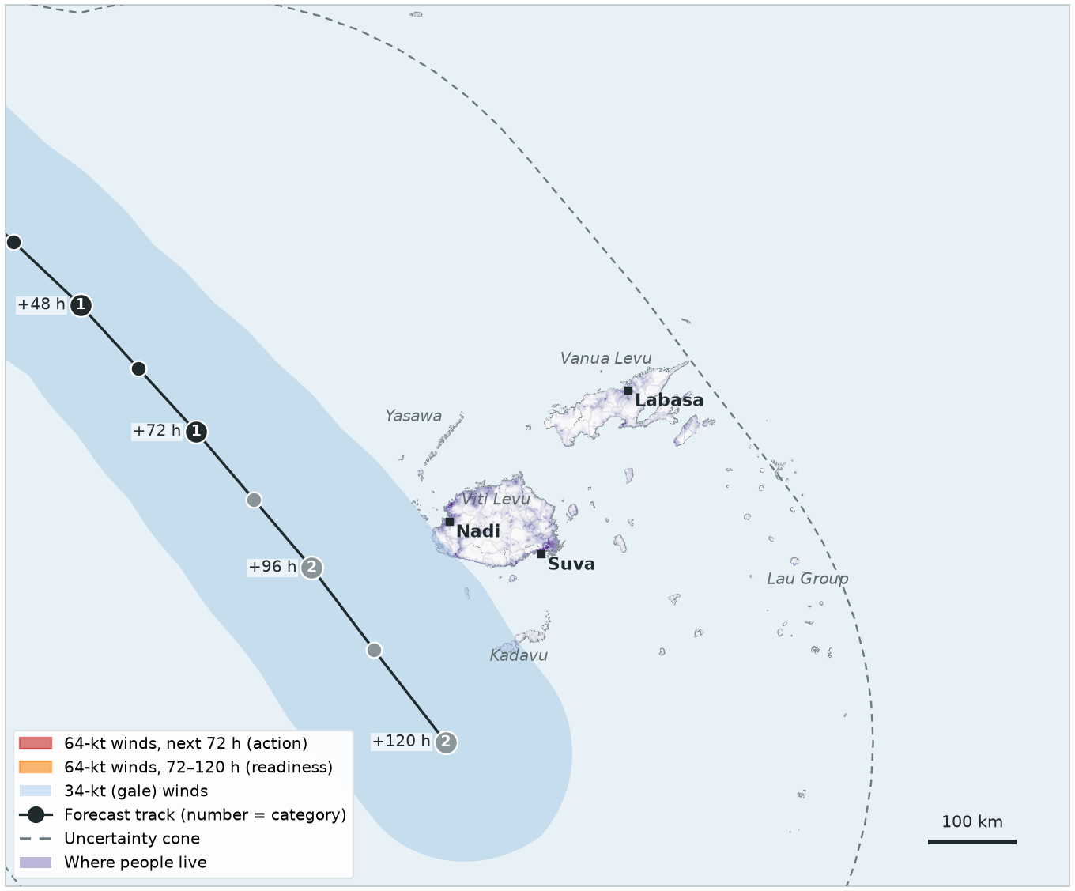
EXERCISE · FICTIONAL STORM
CYCLONE ALPHA · FORECAST 1 OF 5
Day 1, 00:00
RSMC Nadi issues its first forecast for Cyclone Alpha, west of Vanuatu. It is forecast to reach only Category 2: no hurricane-force (64-kt) winds anywhere, so nobody is in the red or orange zone.
TRIGGER | THIS FORECAST | STATUS
Readiness 120-hour forecast | 0 people in 64-kt zone threshold 5,000 | Not reached
Action 72-hour forecast | 0 people in 64-kt zone threshold 5,000 | Not reached
Observational 2-day rainfall | IMERG satellite, checked daily | —

Slide 8
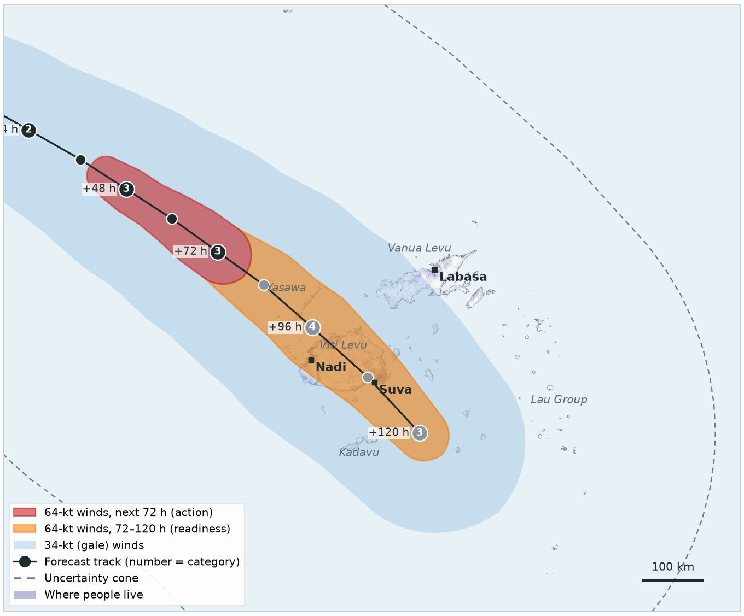
EXERCISE · FICTIONAL STORM
CYCLONE ALPHA · FORECAST 2 OF 5
Day 1, 12:00
Alpha is now forecast to become a Category 4 cyclone and cross Viti Levu in about four days. 649,967 people are in the 64-kt zone of the 120-hour forecast — but none in the first 72 hours.
TRIGGER | THIS FORECAST | STATUS
Readiness 120-hour forecast | 649,967 people in 64-kt zone threshold 5,000 | ACTIVATED
Action 72-hour forecast | 0 people in 64-kt zone threshold 5,000 | Not reached
Observational 2-day rainfall | IMERG satellite, checked daily | —
Readiness trigger activated. An automated email goes to the trigger distribution list. CERF sends approval letters to agencies and readiness activities start.

Slide 9
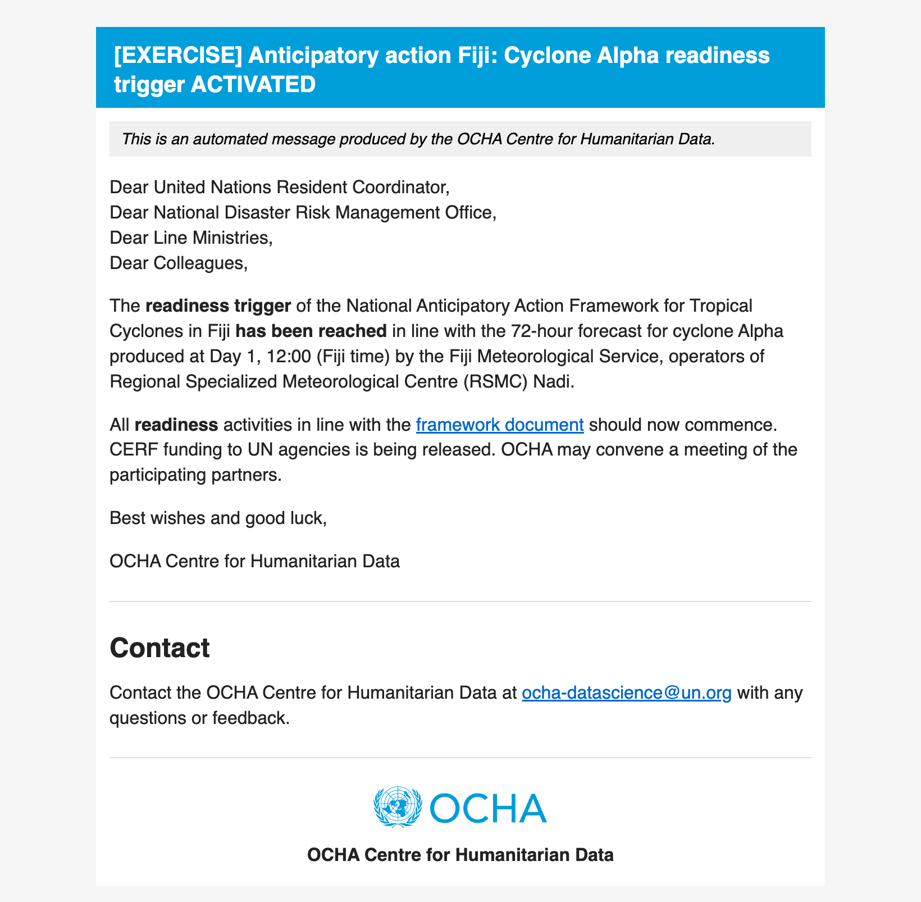
EXERCISE · FICTIONAL STORM
CYCLONE ALPHA · DAY 1, 12:00
The readiness trigger email
As soon as the forecast is checked, the monitoring system sends an email like this automatically to the trigger distribution list (framework Annex 4).
Mock-up for the exercise, based on the live email template.
Readiness trigger activated. An automated email goes to the trigger distribution list. CERF sends approval letters to agencies and readiness activities start.

Slide 10
EXERCISE · FICTIONAL STORM
CYCLONE ALPHA · FORECAST 3 OF 5
Day 2, 00:00
The track holds. Within the next 72 hours, hurricane-force winds now reach the Yasawa Group: 3,901 people — just below the 5,000 threshold. Readiness is already activated; action is not reached yet.
TRIGGER | THIS FORECAST | STATUS
Readiness 120-hour forecast | 637,137 people in 64-kt zone threshold 5,000 | ✓ Activated Day 1, 12:00
Action 72-hour forecast | 3,901 people in 64-kt zone threshold 5,000 | Not reached
Observational 2-day rainfall | IMERG satellite, checked daily | —

Slide 11
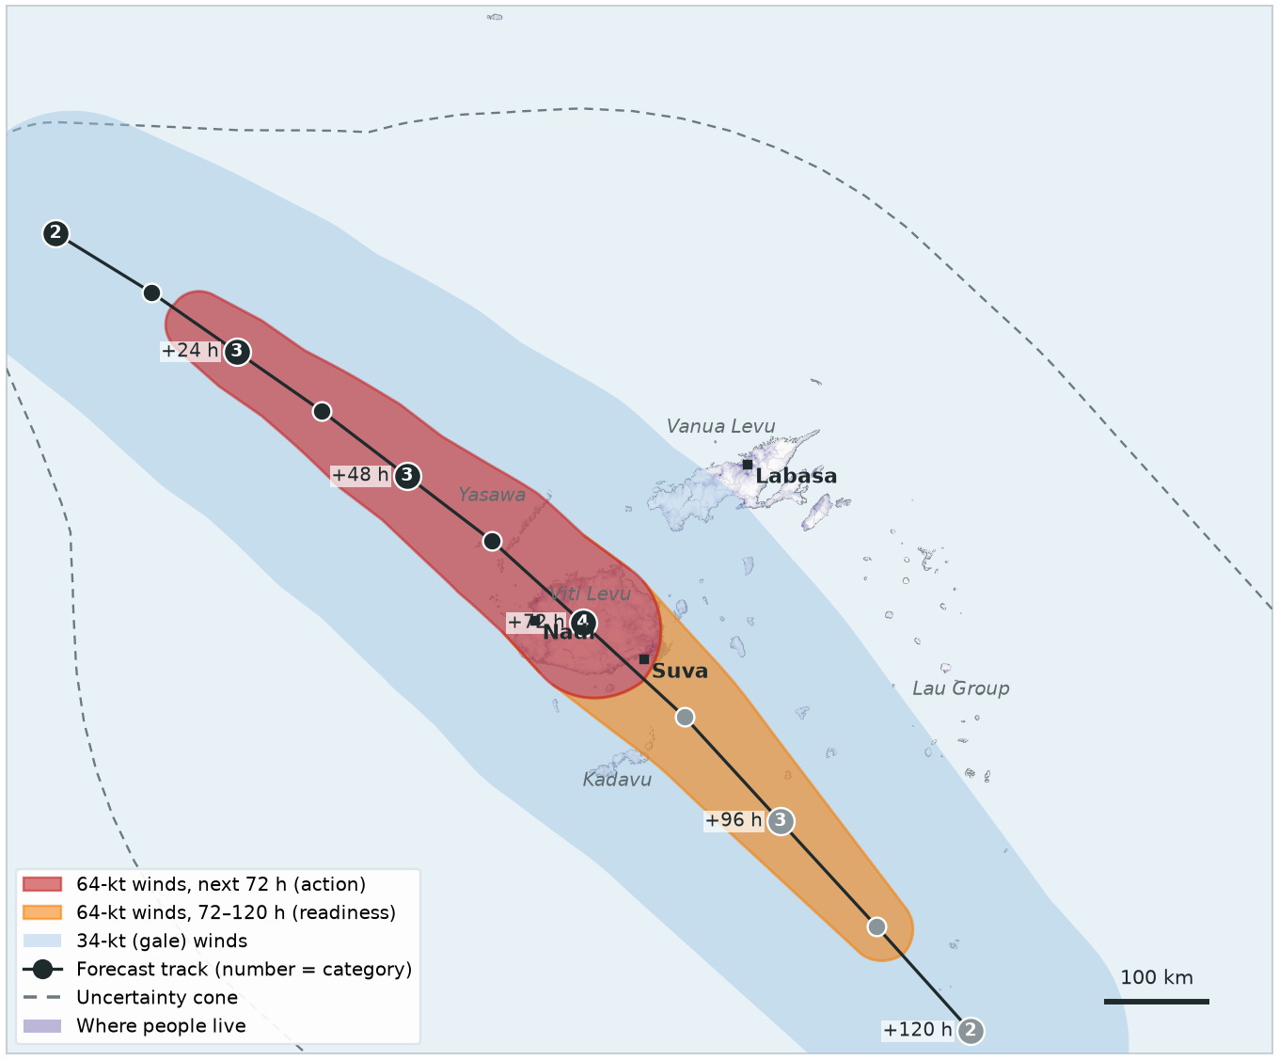
EXERCISE · FICTIONAL STORM
CYCLONE ALPHA · FORECAST 4 OF 5
Day 2, 12:00
Landfall is now about three days away: 658,281 people are in the 64-kt zone within the 72-hour forecast.
TRIGGER | THIS FORECAST | STATUS
Readiness 120-hour forecast | 678,500 people in 64-kt zone threshold 5,000 | ✓ Activated Day 1, 12:00
Action 72-hour forecast | 658,281 people in 64-kt zone threshold 5,000 | ACTIVATED
Observational 2-day rainfall | IMERG satellite, checked daily | —
Action trigger activated. An automated email goes to the trigger distribution list. All anticipatory actions start, and IFRC transfers the pre-approved DREF funds to Fiji Red Cross.

Slide 12
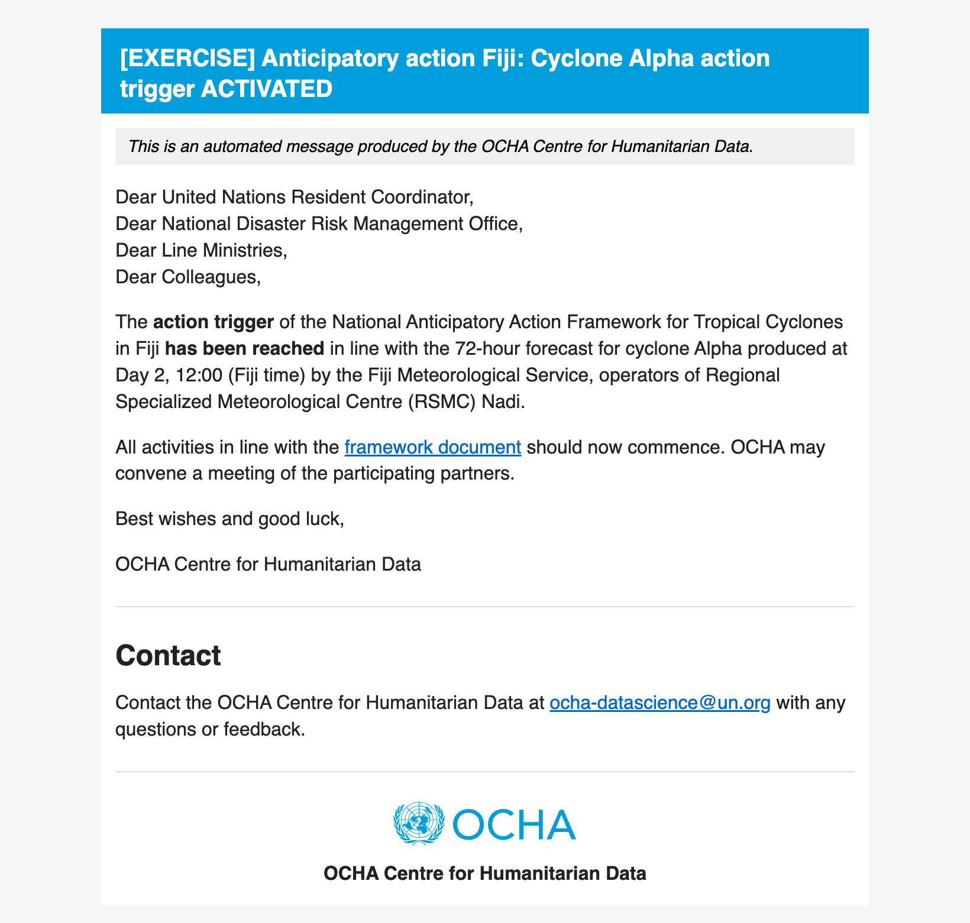
EXERCISE · FICTIONAL STORM
CYCLONE ALPHA · DAY 2, 12:00
The action trigger email
As soon as the forecast is checked, the monitoring system sends an email like this automatically to the trigger distribution list (framework Annex 4).
Mock-up for the exercise, based on the live email template.
Action trigger activated. An automated email goes to the trigger distribution list. All anticipatory actions start, and IFRC transfers the pre-approved DREF funds to Fiji Red Cross.

Slide 13
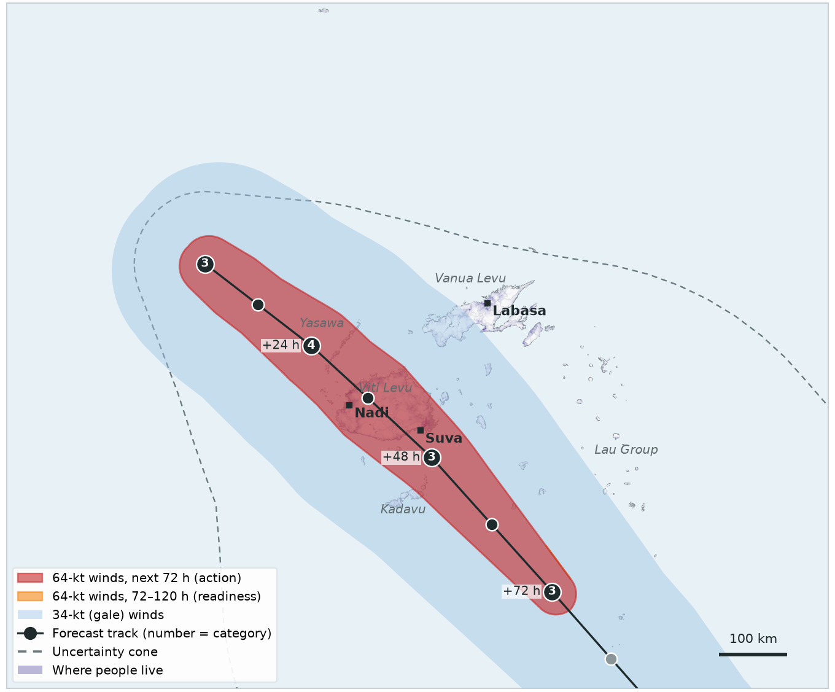
EXERCISE · FICTIONAL STORM
CYCLONE ALPHA · FORECAST 5 OF 5
Day 4, 00:00
Alpha is a Category 4 cyclone, about a day and a half from landfall on Viti Levu. Both forecast triggers have already activated. RSMC Nadi forecasts keep coming, and OCHA keeps sending a forecast information email for each one.
TRIGGER | THIS FORECAST | STATUS
Readiness 120-hour forecast | 678,270 people in 64-kt zone threshold 5,000 | ✓ Activated Day 1, 12:00
Action 72-hour forecast | 678,270 people in 64-kt zone threshold 5,000 | ✓ Activated Day 2, 12:00
Observational 2-day rainfall | IMERG satellite, checked daily | —

Slide 14
EXERCISE · FICTIONAL STORM
CYCLONE ALPHA · RECAP
Readiness, then action
WHEN | WHAT CAME IN | RESULT
Day 1, 00:00 | Forecast 1: 0 people in 64-kt zone (120 h), 0 (72 h) | no new activation
Day 1, 12:00 | Forecast 2: 649,967 people in 64-kt zone (120 h), 0 (72 h) | READINESS ACTIVATED
Day 2, 00:00 | Forecast 3: 637,137 people in 64-kt zone (120 h), 3,901 (72 h) | no new activation
Day 2, 12:00 | Forecast 4: 678,500 people in 64-kt zone (120 h), 658,281 (72 h) | ACTION ACTIVATED
Day 4, 00:00 | Forecast 5: 678,270 people in 64-kt zone (120 h), 678,270 (72 h) | no new activation
Readiness gave about four days of warning before landfall, and action about three days.

Slide 15
EXERCISE · FICTIONAL STORM
SCENARIO 2 OF 3
Cyclone Bravo
Readiness, then nothing

Slide 16
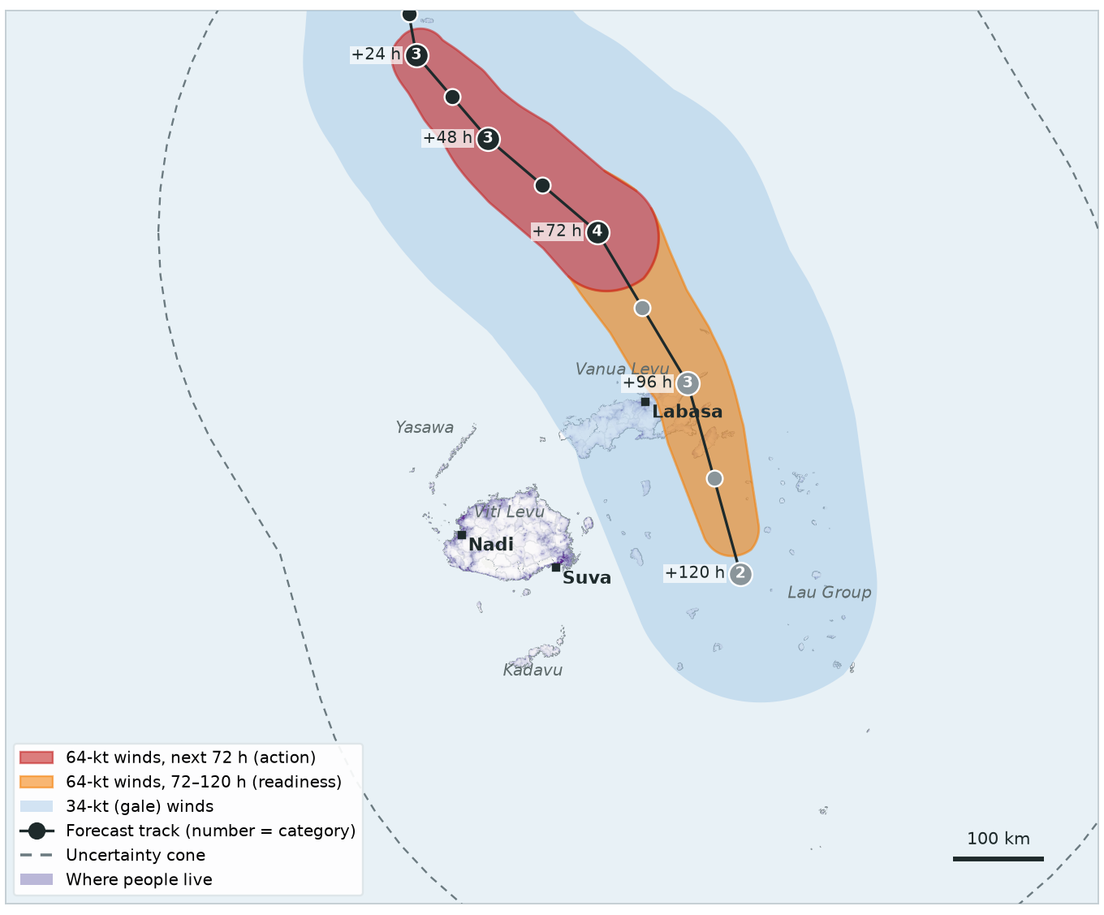
EXERCISE · FICTIONAL STORM
CYCLONE BRAVO · FORECAST 1 OF 5
Day 1, 00:00
Cyclone Bravo, north of Fiji, is forecast to strengthen to Category 4 and pass over Vanua Levu in about four days. 32,817 people are in the 64-kt zone of the 120-hour forecast, all beyond 72 hours.
TRIGGER | THIS FORECAST | STATUS
Readiness 120-hour forecast | 32,817 people in 64-kt zone threshold 5,000 | ACTIVATED
Action 72-hour forecast | 0 people in 64-kt zone threshold 5,000 | Not reached
Observational 2-day rainfall | IMERG satellite, checked daily | —
Readiness trigger activated. An automated email goes to the trigger distribution list. CERF sends approval letters to agencies and readiness activities start.

Slide 17

EXERCISE · FICTIONAL STORM
CYCLONE BRAVO · DAY 1, 00:00
The readiness trigger email
As soon as the forecast is checked, the monitoring system sends an email like this automatically to the trigger distribution list (framework Annex 4).
Mock-up for the exercise, based on the live email template.
Readiness trigger activated. An automated email goes to the trigger distribution list. CERF sends approval letters to agencies and readiness activities start.

Slide 18
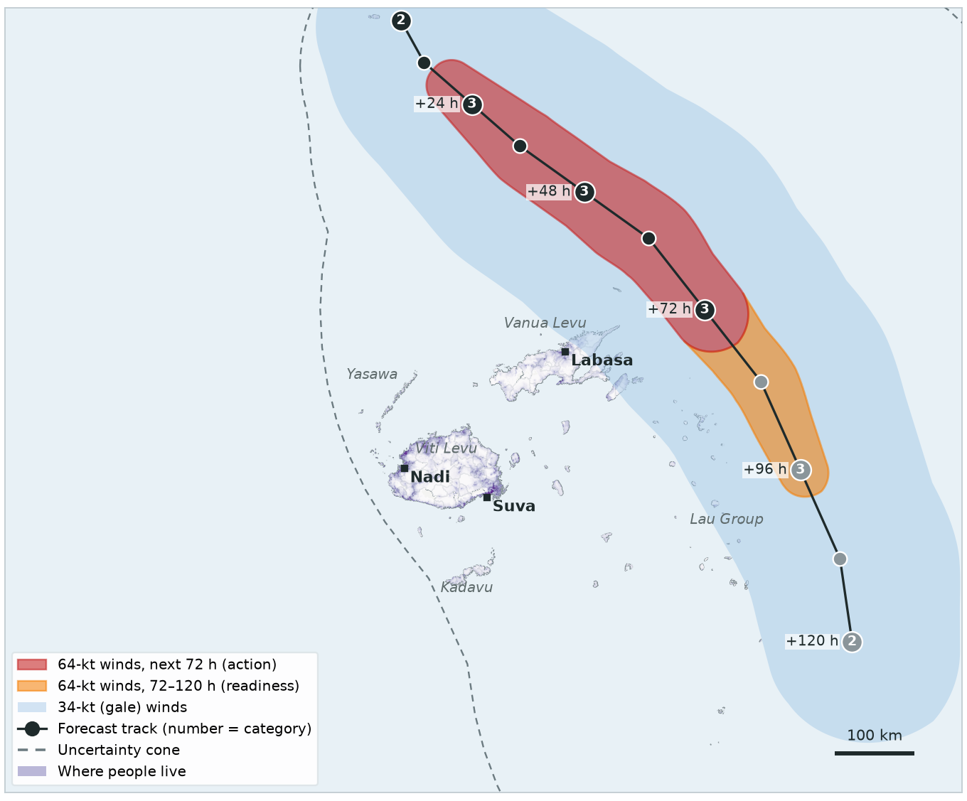
EXERCISE · FICTIONAL STORM
CYCLONE BRAVO · FORECAST 2 OF 5
Day 1, 12:00
The forecast shifts east: hurricane-force winds now pass about 20 km from land, so nobody is in the 64-kt zone. Readiness stays activated.
TRIGGER | THIS FORECAST | STATUS
Readiness 120-hour forecast | 0 people in 64-kt zone threshold 5,000 | ✓ Activated Day 1, 00:00
Action 72-hour forecast | 0 people in 64-kt zone threshold 5,000 | Not reached
Observational 2-day rainfall | IMERG satellite, checked daily | —

Slide 19
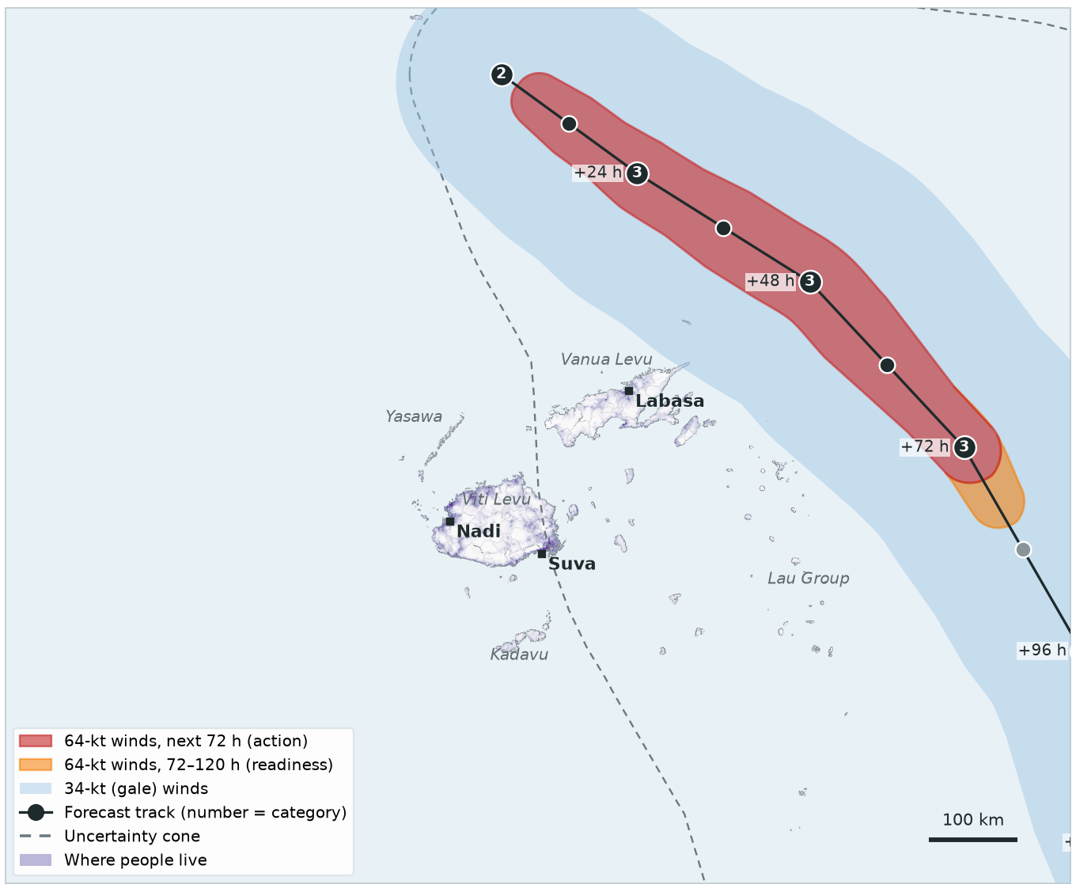
EXERCISE · FICTIONAL STORM
CYCLONE BRAVO · FORECAST 3 OF 5
Day 2, 00:00
Bravo is now forecast to curve south-east, away from Fiji. The 64-kt winds stay 65 km offshore.
TRIGGER | THIS FORECAST | STATUS
Readiness 120-hour forecast | 0 people in 64-kt zone threshold 5,000 | ✓ Activated Day 1, 00:00
Action 72-hour forecast | 0 people in 64-kt zone threshold 5,000 | Not reached
Observational 2-day rainfall | IMERG satellite, checked daily | —

Slide 20
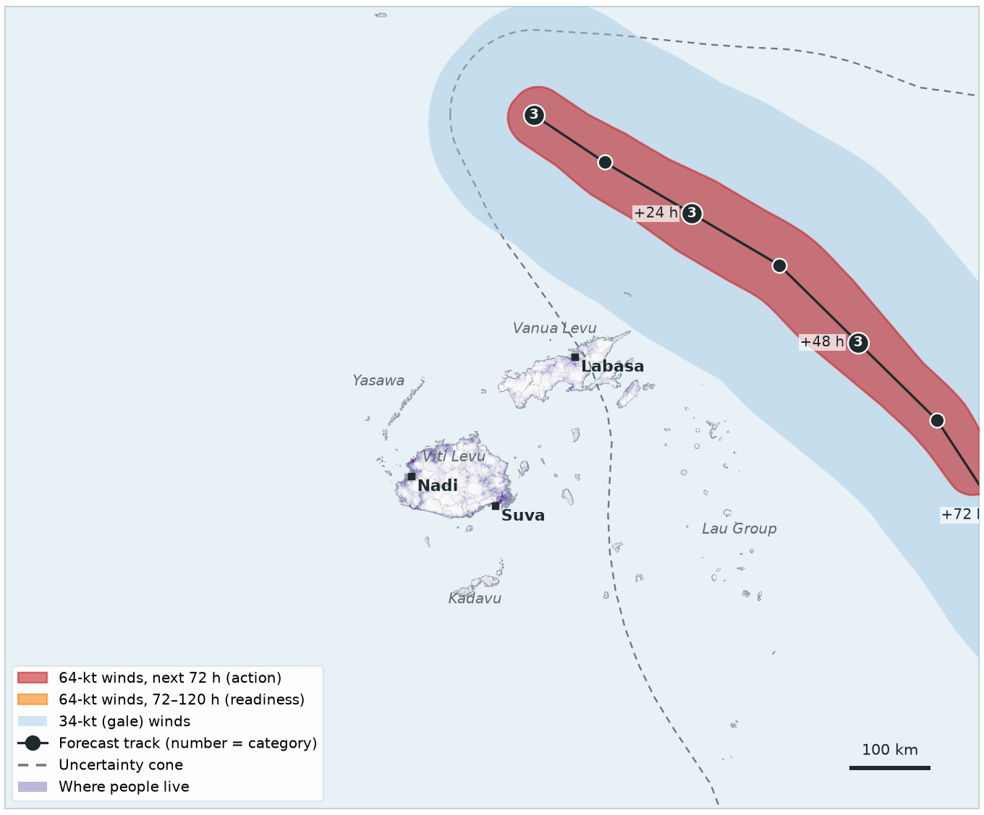
EXERCISE · FICTIONAL STORM
CYCLONE BRAVO · FORECAST 4 OF 5
Day 2, 12:00
Further east again: the closest hurricane-force winds are 85 km from land. The action threshold is not reached.
TRIGGER | THIS FORECAST | STATUS
Readiness 120-hour forecast | 0 people in 64-kt zone threshold 5,000 | ✓ Activated Day 1, 00:00
Action 72-hour forecast | 0 people in 64-kt zone threshold 5,000 | Not reached
Observational 2-day rainfall | IMERG satellite, checked daily | —

Slide 21
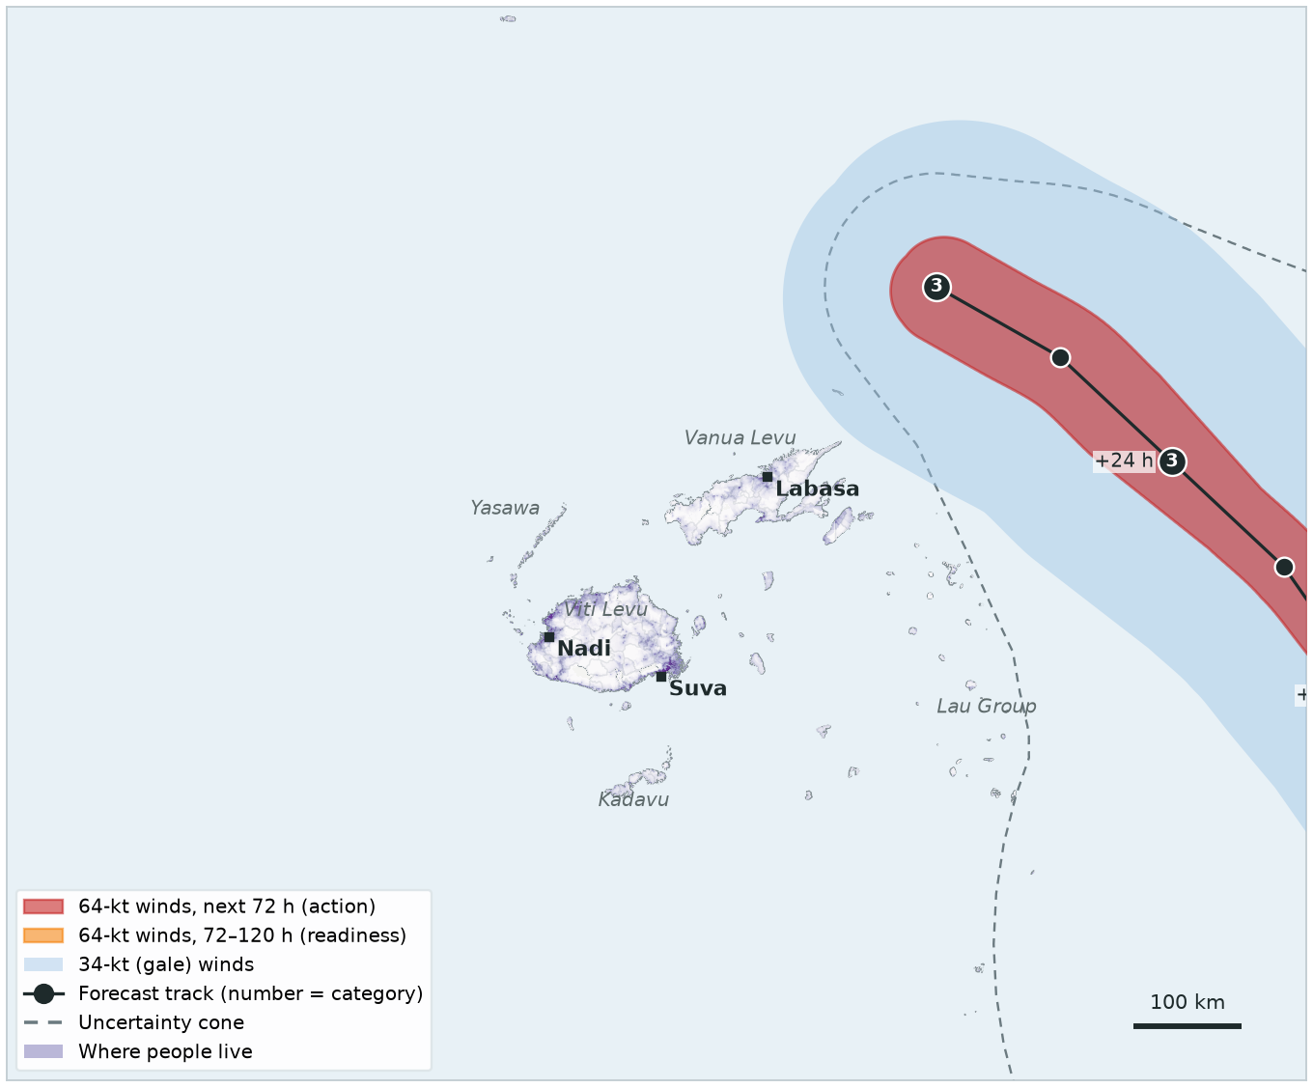
EXERCISE · FICTIONAL STORM
CYCLONE BRAVO · FORECAST 5 OF 5
Day 3, 12:00
Bravo passes east of the Lau Group, its centre 140 km from land at the closest. Its hurricane-force winds stay 90 km offshore.
TRIGGER | THIS FORECAST | STATUS
Readiness 120-hour forecast | 0 people in 64-kt zone threshold 5,000 | ✓ Activated Day 1, 00:00
Action 72-hour forecast | 0 people in 64-kt zone threshold 5,000 | Not reached
Observational 2-day rainfall | IMERG satellite, checked daily | —

Slide 22
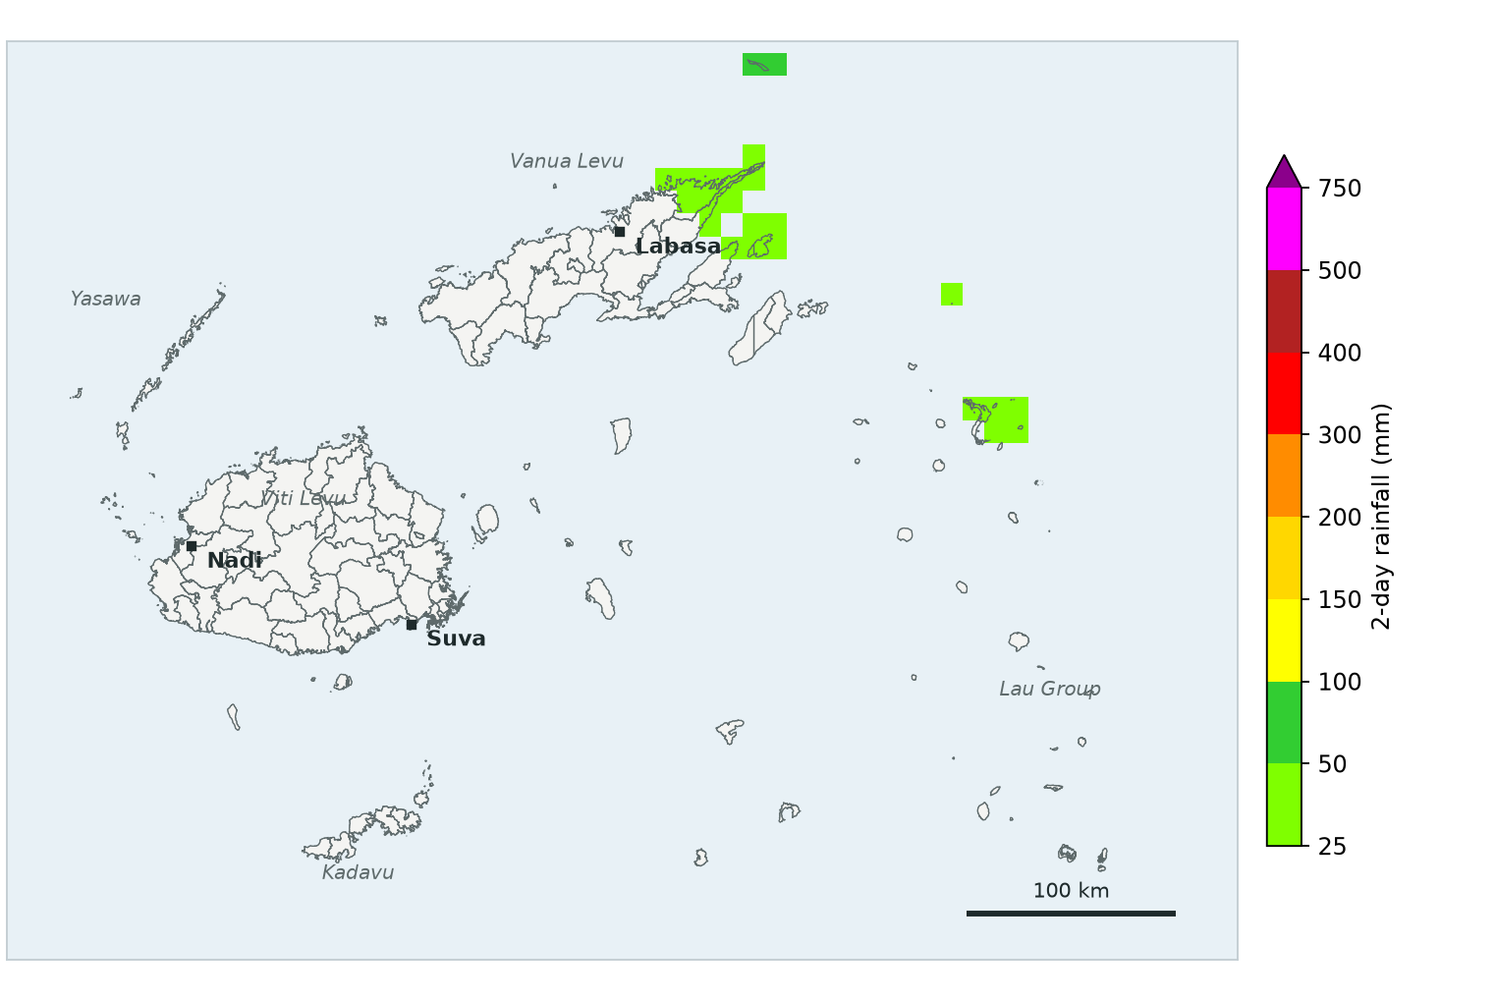
EXERCISE · FICTIONAL STORM
CYCLONE BRAVO · RAINFALL CHECK
Day 5, 12:00
Satellite rainfall for Days 3 and 4, while Bravo was within 250 km of Fiji: 5 mm averaged over the whole country — far below 190 mm. Nothing more activates for this storm.
TRIGGER | THIS RAINFALL CHECK | STATUS
Readiness 120-hour forecast | — | ✓ Activated Day 1, 00:00
Action 72-hour forecast | — | Not reached
Observational 2-day rainfall | 5 mm country average threshold 190 mm | Not reached
Storm centre within 250 km of Fiji during these days (±1 day): ✓ (closest 115 km). Rainfall here is invented for the exercise.

Slide 23
EXERCISE · FICTIONAL STORM
CYCLONE BRAVO · RECAP
Readiness, then nothing
WHEN | WHAT CAME IN | RESULT
Day 1, 00:00 | Forecast 1: 32,817 people in 64-kt zone (120 h), 0 (72 h) | READINESS ACTIVATED
Day 1, 12:00 | Forecast 2: 0 people in 64-kt zone (120 h), 0 (72 h) | no new activation
Day 2, 00:00 | Forecast 3: 0 people in 64-kt zone (120 h), 0 (72 h) | no new activation
Day 2, 12:00 | Forecast 4: 0 people in 64-kt zone (120 h), 0 (72 h) | no new activation
Day 3, 12:00 | Forecast 5: 0 people in 64-kt zone (120 h), 0 (72 h) | no new activation
Day 5, 12:00 | Rainfall, Days 3 and 4: 5 mm country average | below 190 mm
Readiness activities went ahead — CERF disburses on a no-regrets basis. Action was never reached, so the action share of the CERF funds is not used and no DREF transfer is made.

Slide 24
EXERCISE · FICTIONAL STORM
SCENARIO 3 OF 3
Cyclone Charlie
Observational trigger only

Slide 25
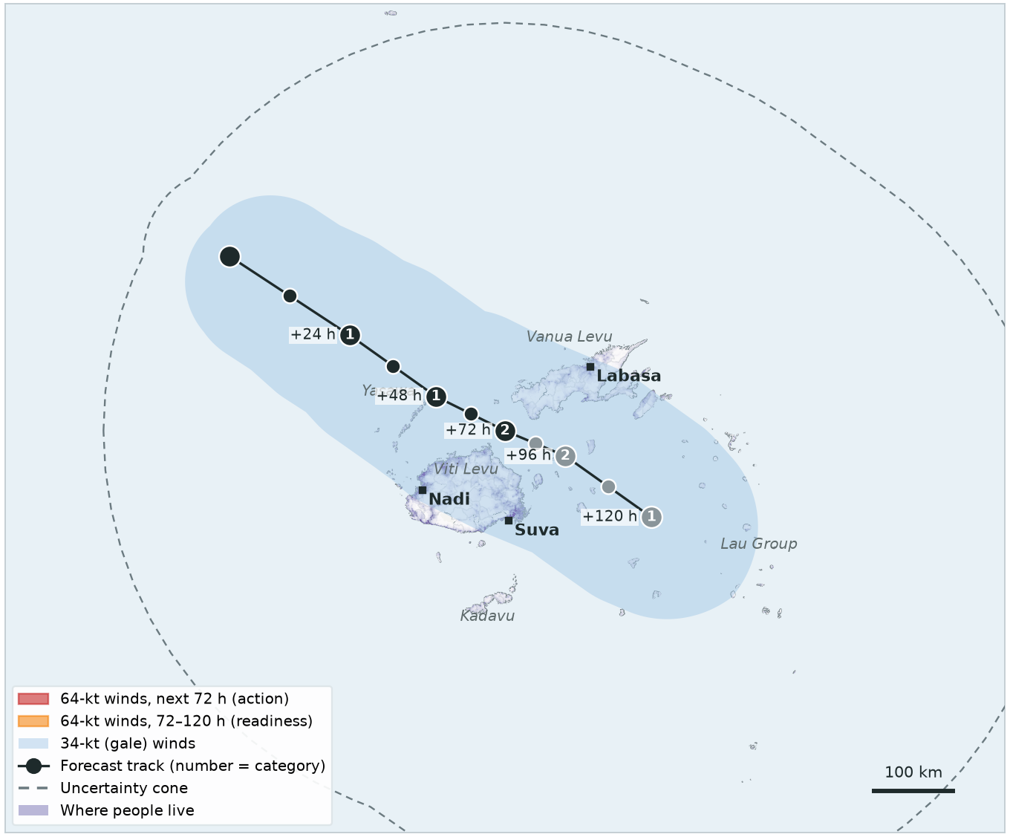
EXERCISE · FICTIONAL STORM
CYCLONE CHARLIE · FORECAST 1 OF 4
Day 1, 00:00
Cyclone Charlie, west of Fiji, is forecast to move slowly across Viti Levu — but only as a Category 2. No hurricane-force winds are forecast, so nobody is in the 64-kt zone.
TRIGGER | THIS FORECAST | STATUS
Readiness 120-hour forecast | 0 people in 64-kt zone threshold 5,000 | Not reached
Action 72-hour forecast | 0 people in 64-kt zone threshold 5,000 | Not reached
Observational 2-day rainfall | IMERG satellite, checked daily | —

Slide 26
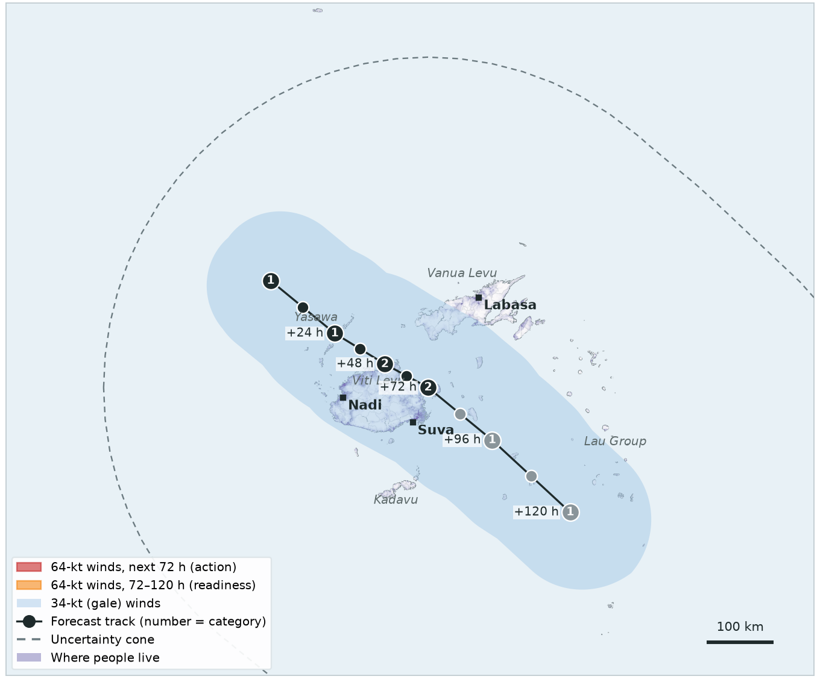
EXERCISE · FICTIONAL STORM
CYCLONE CHARLIE · FORECAST 2 OF 4
Day 2, 00:00
Charlie is slowing down. Gale-force winds are forecast over most of Viti Levu (719,509 people in the 34-kt zone) for the next two to three days — but still no 64-kt winds.
TRIGGER | THIS FORECAST | STATUS
Readiness 120-hour forecast | 0 people in 64-kt zone threshold 5,000 | Not reached
Action 72-hour forecast | 0 people in 64-kt zone threshold 5,000 | Not reached
Observational 2-day rainfall | IMERG satellite, checked daily | —

Slide 27
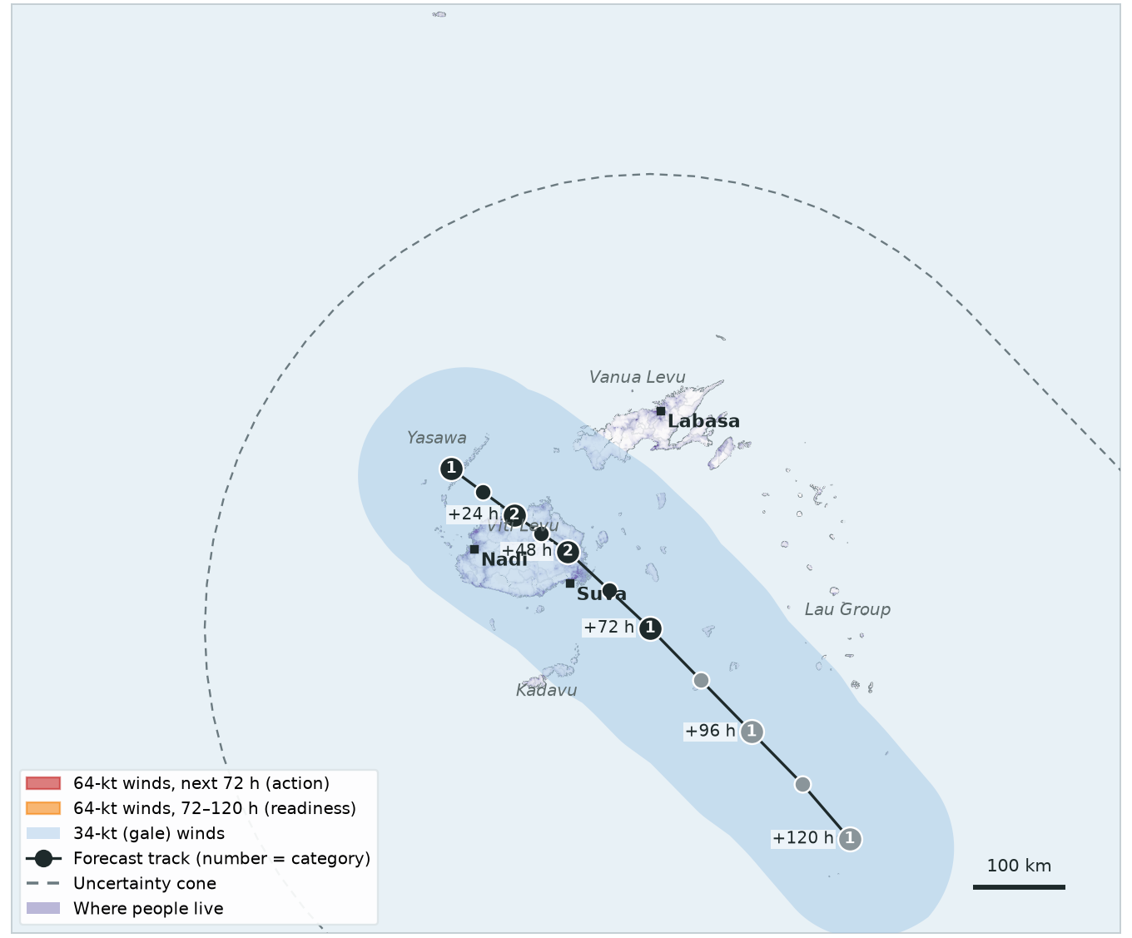
EXERCISE · FICTIONAL STORM
CYCLONE CHARLIE · FORECAST 3 OF 4
Day 3, 00:00
Charlie is almost stationary over western Viti Levu, with very heavy rain. The forecast triggers only look at 64-kt winds, so they do not activate.
TRIGGER | THIS FORECAST | STATUS
Readiness 120-hour forecast | 0 people in 64-kt zone threshold 5,000 | Not reached
Action 72-hour forecast | 0 people in 64-kt zone threshold 5,000 | Not reached
Observational 2-day rainfall | IMERG satellite, checked daily | —

Slide 28
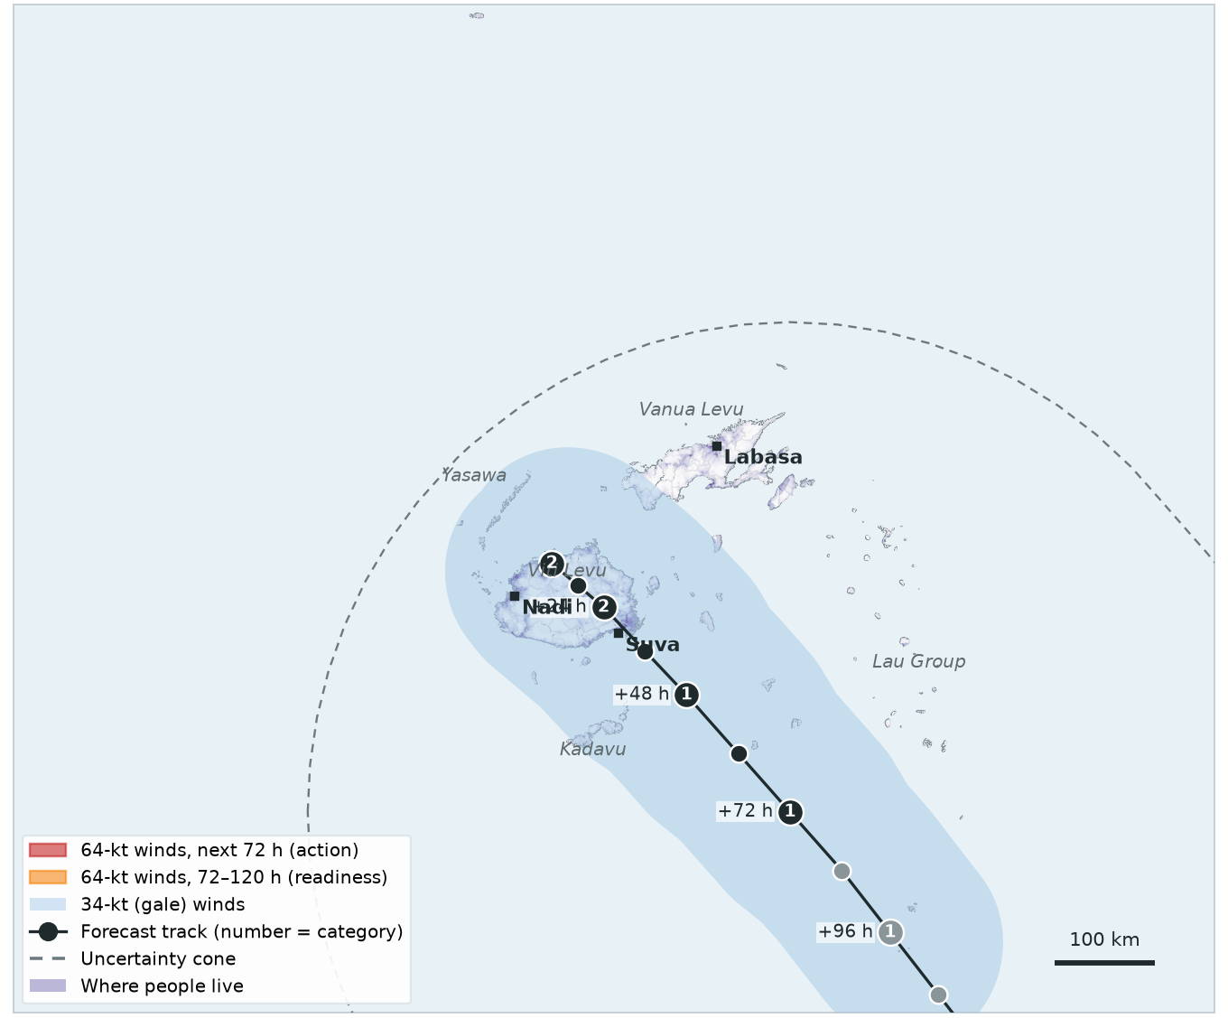
EXERCISE · FICTIONAL STORM
CYCLONE CHARLIE · FORECAST 4 OF 4
Day 4, 00:00
Still Category 2, still no 64-kt winds forecast. For this storm, it is the rainfall that matters.
TRIGGER | THIS FORECAST | STATUS
Readiness 120-hour forecast | 0 people in 64-kt zone threshold 5,000 | Not reached
Action 72-hour forecast | 0 people in 64-kt zone threshold 5,000 | Not reached
Observational 2-day rainfall | IMERG satellite, checked daily | —

Slide 29
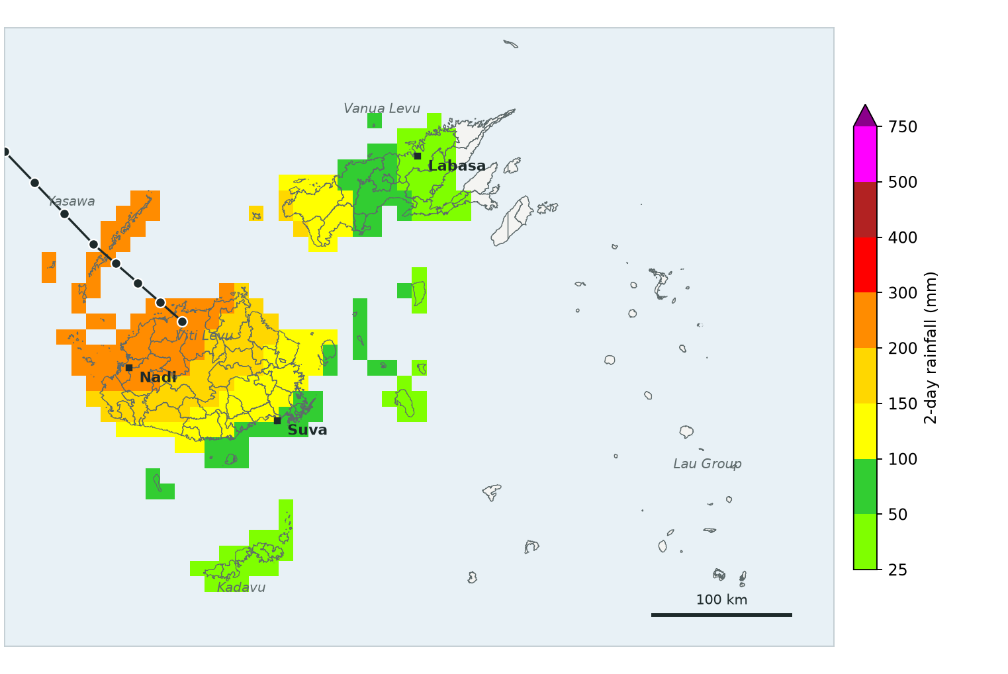
EXERCISE · FICTIONAL STORM
CYCLONE CHARLIE · RAINFALL CHECK
Day 4, 12:00
Rainfall check covering Days 2 and 3: 125 mm averaged over the whole country. Very heavy in places (up to 280 mm), but the country average is below 190 mm.
TRIGGER | THIS RAINFALL CHECK | STATUS
Readiness 120-hour forecast | — | Not reached
Action 72-hour forecast | — | Not reached
Observational 2-day rainfall | 125 mm country average threshold 190 mm | Not reached
Storm centre within 250 km of Fiji during these days (±1 day): ✓ (closest 0 km). Rainfall here is invented for the exercise.

Slide 30
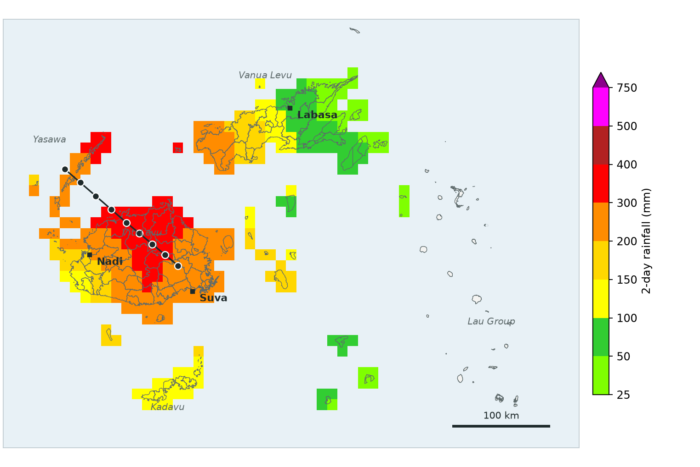
EXERCISE · FICTIONAL STORM
CYCLONE CHARLIE · RAINFALL CHECK
Day 5, 12:00
Satellite rainfall for Days 3 and 4, with Charlie's centre over Viti Levu: 210 mm averaged over the whole country (up to 380 mm locally). That is above 190 mm.
TRIGGER | THIS RAINFALL CHECK | STATUS
Readiness 120-hour forecast | — | Not reached
Action 72-hour forecast | — | Not reached
Observational 2-day rainfall | 210 mm country average threshold 190 mm | ACTIVATED
Storm centre within 250 km of Fiji during these days (±1 day): ✓ (closest 0 km). Rainfall here is invented for the exercise.
Observational trigger activated. An automated email goes to the trigger distribution list. It is treated like the action trigger: all anticipatory actions start.

Slide 31
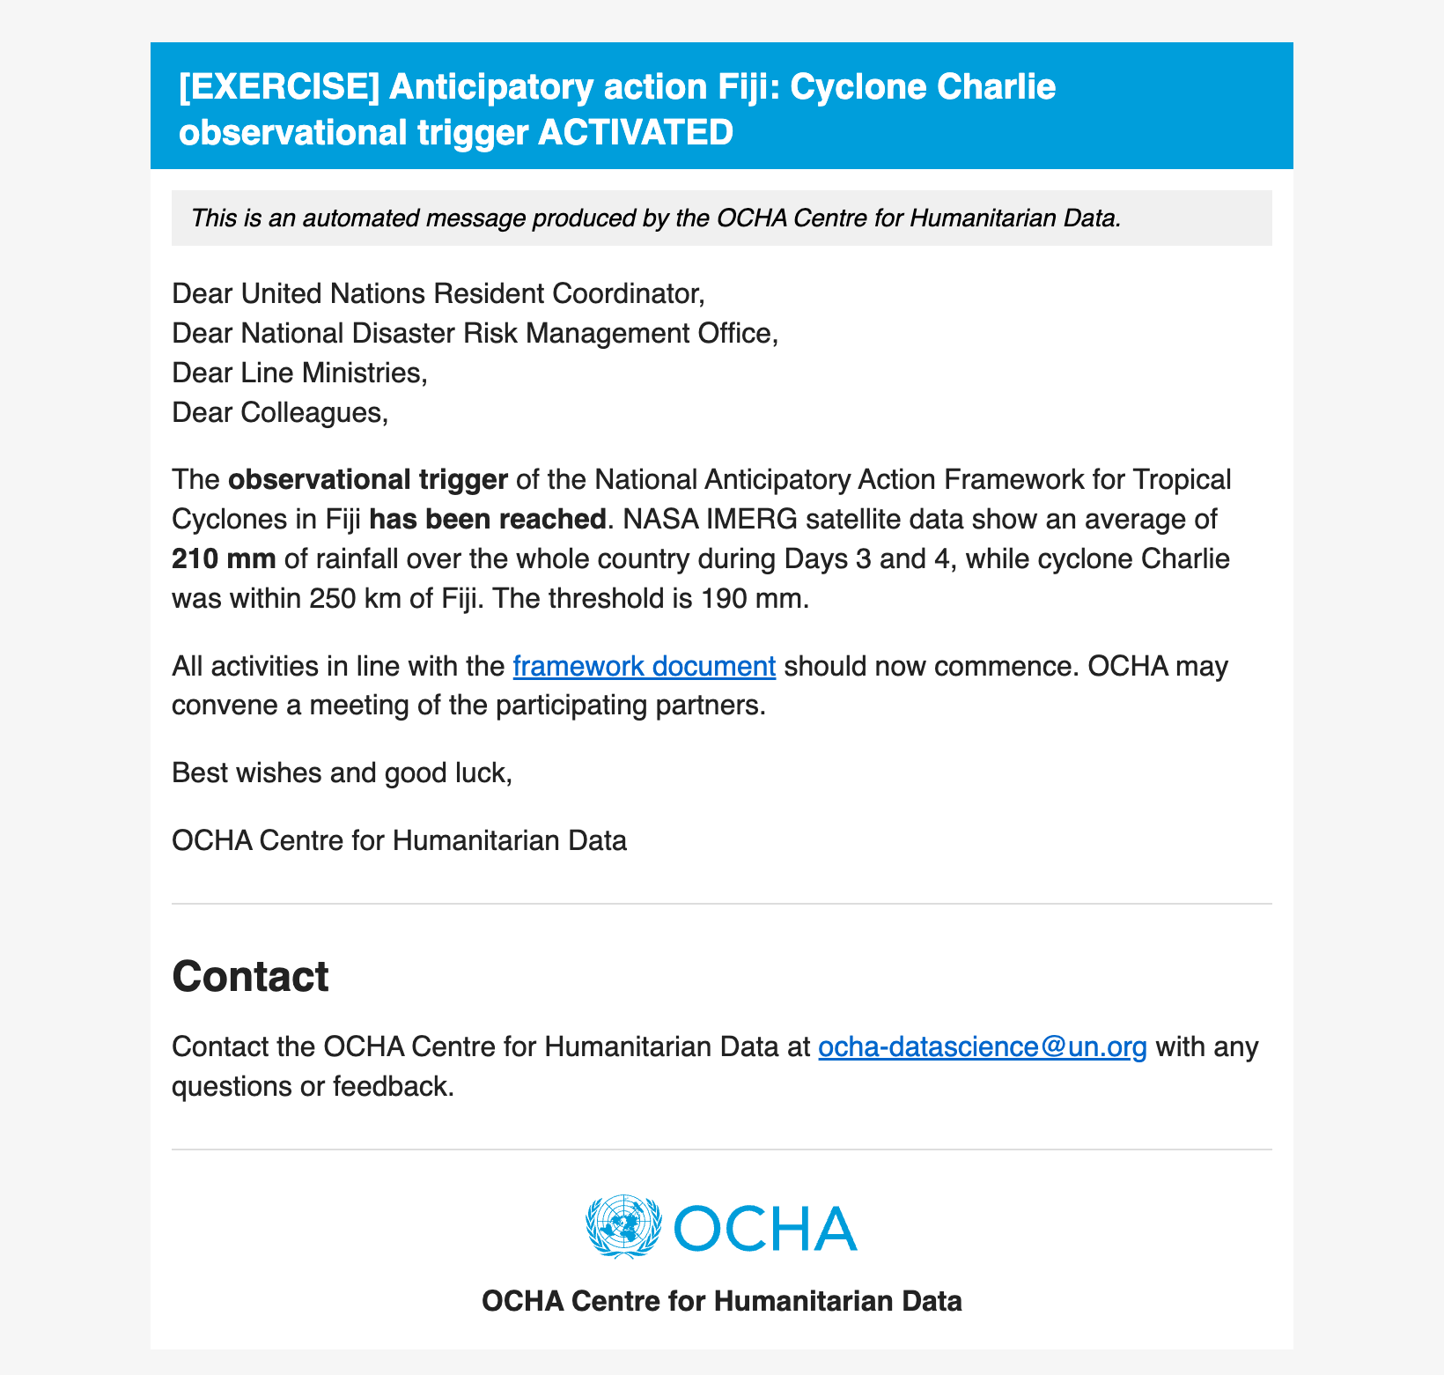
EXERCISE · FICTIONAL STORM
CYCLONE CHARLIE · DAY 5, 12:00
The observational trigger email
At the daily rainfall check, the monitoring system sends an email like this automatically to the trigger distribution list (framework Annex 4).
Mock-up for the exercise.
Observational trigger activated. An automated email goes to the trigger distribution list. It is treated like the action trigger: all anticipatory actions start.

Slide 32
EXERCISE · FICTIONAL STORM
CYCLONE CHARLIE · RECAP
Observational trigger only
WHEN | WHAT CAME IN | RESULT
Day 1, 00:00 | Forecast 1: 0 people in 64-kt zone (120 h), 0 (72 h) | no new activation
Day 2, 00:00 | Forecast 2: 0 people in 64-kt zone (120 h), 0 (72 h) | no new activation
Day 3, 00:00 | Forecast 3: 0 people in 64-kt zone (120 h), 0 (72 h) | no new activation
Day 4, 00:00 | Forecast 4: 0 people in 64-kt zone (120 h), 0 (72 h) | no new activation
Day 4, 12:00 | Rainfall, Days 2 and 3: 125 mm country average | below 190 mm
Day 5, 12:00 | Rainfall, Days 3 and 4: 210 mm country average | OBSERVATIONAL ACTIVATED
No forecast trigger activated: Charlie never had hurricane-force winds. The observational trigger is the safety net — it activates after the rain has fallen, so there is no lead time, and it is treated like the action trigger.

Slide 33
SUMMARY
The three scenarios side by side
STORM | READINESS | ACTION | OBSERVATIONAL | EMAILS SENT
Cyclone Alpha Readiness, then action | Day 1, 12:00 | Day 2, 12:00 | — | readiness, action
Cyclone Bravo Readiness, then nothing | Day 1, 00:00 | — | — | readiness
Cyclone Charlie Observational trigger only | — | — | Day 5, 12:00 | observational
The forecast files used here are kept in the repository (slides/simex_injects/) and can be fed to the live monitoring system in test mode for a hands-on exercise.

