Slide 1
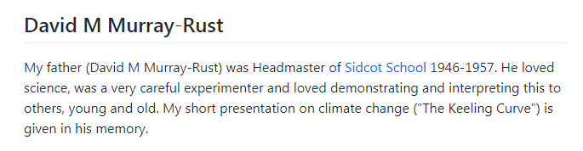
The [Darwen](https://en.wikipedia.org/wiki/John_Davies,_1st_Baron_Darwen) lecture is
held every year at Sidcot School, and in 2019 was given by my brother Hammond Murray-Rust.
"Algae, Sunshine and Snakes; threats to sustainability in Florida" .
I added this short 3 minute presentation on climate change
This material is part of a larger collaborative project to collect published data on climate change.
https://github.com/petermr/climate/
All PMR material licensed CC BY (Attribution 4.0). Wikimedia material CC BY-SA.

Slide 2
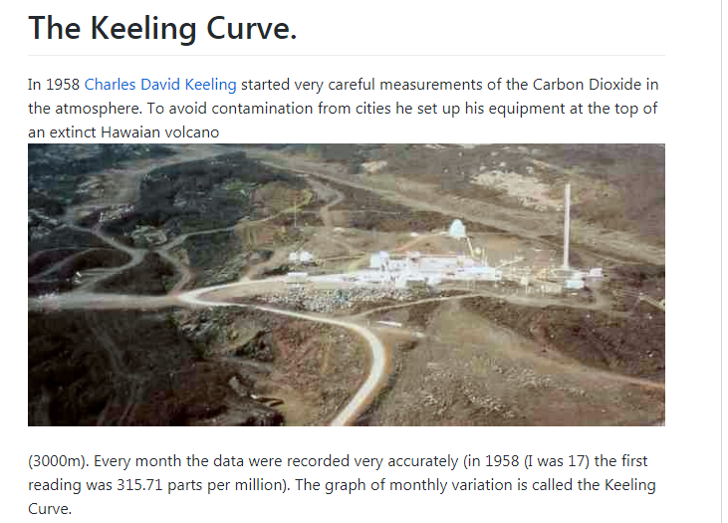
Image Wikimedia https://en.wikipedia.org/wiki/Keeling_Curve

Slide 3
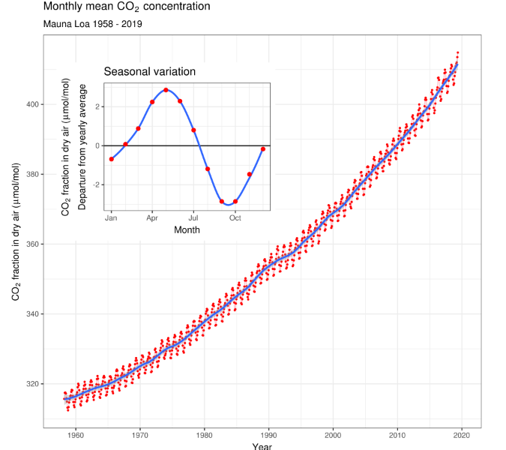
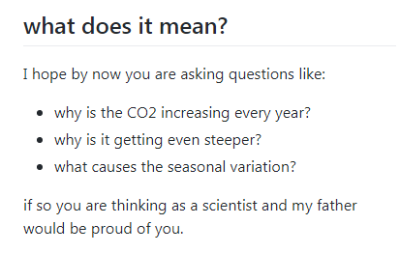
Image Wikimedia https://en.wikipedia.org/wiki/Keeling_Curve

Slide 4
