Slide 1

INCF Software Highlight – HED (Hierarchical Event Descriptors)
Kay Robbins – University of Texas at San Antonio
Member of the HED WORKING GROUP
HED: Moving beyond keywords and trigger numbers to fine-grained, analysis-ready, FAIR annotation of neuroimaging data.
Tools, documentation, and sample datasets available online.
Project home: https://www.hedtags.org
Main resources page: https://www.hed-resources.org HED GitHub Organization Repos: https://github.com/hed-standard
Notes:
Thank you for joining this software highlight on HED (Hierarchical Event Descriptors)
I’m going to talk about what HED is and what it brings to FAIR datasets.
HED is completely open source and everything is available online.

Slide 2
This talk addresses these questions
What is HED and what problem does it solve for FAIR?
How is HED integrated into BIDS (Brain Imaging Data Structure)?
What tools support HED annotation, validation and analysis?
What work is ongoing and planned for the future?
Hierarchical Event Descriptors (HED)
Notes:
My talk is organized into four topics.
1. We’ll introduce HED (Hierarchical Event Descriptors) and describe the problem it solves for FAIR standards.
2. We’ll explain how HED is integrated into BIDS.
3. We’ll discuss the HED tool ecosystem for supporting annotation, validation and analysis.
4. Finally we’ll discuss what’s new and upcoming in HED.

Slide 3

The data-sharing gap
Current data sharing standards require:
High-level / basic annotation data.
Adherence to dataset organizational standards.
Dataset search at the individual publisher level.
Analysis-ready shared neuroimaging timeseries need:
Detailed, unambiguous event descriptions.
Data search based on experiment design, tasks, and cognitive processes.
The context in which each event occurs …
. . . and much more
HED (Hierarchical Event Descriptors) + BIDS =
A practical path to machine-actionable data sharing.
1. What is HED and what problem does it solve for FAIR?
Photo credit: Sammie Chaffin https://unsplash.com/photos/Zdf3zn5XXtU?utm_source=unsplash&utm_medium=referral&utm_content=creditShareLink
Notes:
FAIR requirements generally focus on high-level basic data-sharing standardization.
Standardizing problem-specific metadata is generally an issue for FAIR.
This is especially true for neuroimaging timeseries such as EEG, MEG and non-resting state fMRI as well as behavioral and physiological experiments.
All of which need to
document what happens in the experiment as well as the actual acquired core data.
Hence there is a substantial gap between the information that is shared and what is needed for reproducible analysis-ready data.
Ideally in addition to event descriptions, downstream researchers would like to be able to search for and segregate data based on experimental design, task, and cognitive processes.
Also, in time-series, ongoing event processes provide context for other events.

Slide 4
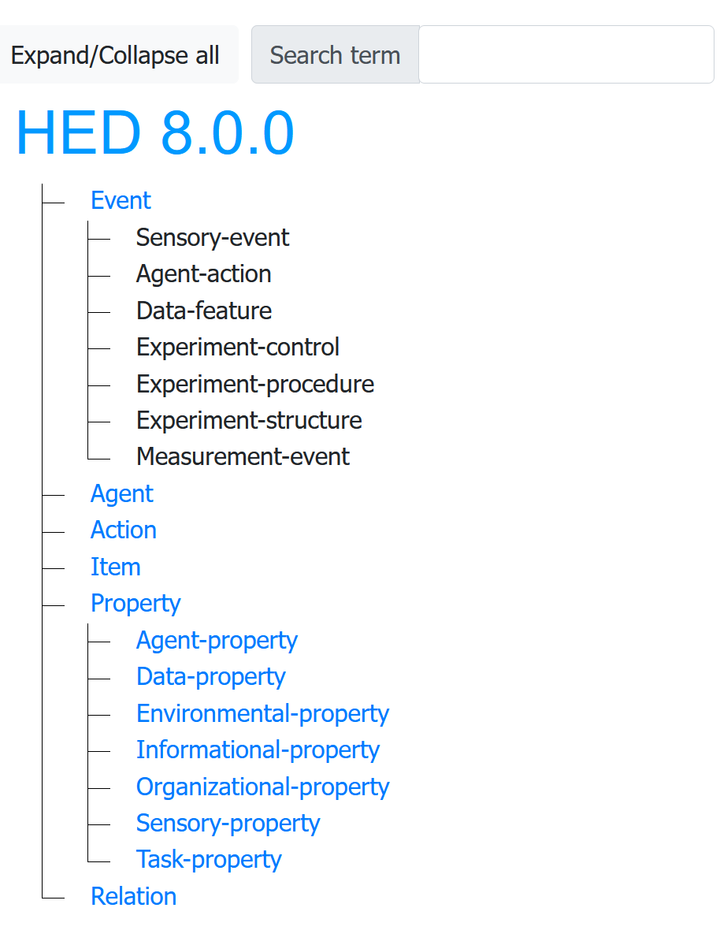
HED basics
Noun-like
HED annotations are comma-separated lists of HED tags:
Sensory-event, Visual-presentation, Cue
HED tags come from specified vocabularies organized in a tree structures called HED schemas.
You can reference a HED tag by its schema path or by individual node name (e.g., the following are the same):
Event/Sensory-event and Sensory-event.
HED is a “sub-tag” system. Each node is a sub-class of its parent so:
Sensory-event “is-a” Event.
Searches for Event can also return Sensory-event.
HED supports advanced annotation features including representation of complex ongoing events, searching, annotation of experimental design.
Verb-like
Descriptive
HED vocabulary viewer available at: https://www.hedtags.org/display_hed.html
Schemas are housed at https://github.com/hed-standard/hed-schemas
1. What is HED and what problem does it solve for FAIR?
Notes:
HED or Hierarchical Event Descriptors is a system for annotating events
HED annotations are comma-separated lists of key-words from a specified vocabulary.
The key-word list is not ordered, but you can use parentheses to convey order and association.
The key-word vocabulary is called a HED schema. (A screenshot of the web-passed schema viewer is shown on the left.)
In addition to the standard schema, HED supports specialized vocabularies called library schemas.
Combinations of standard and library schemas can be used for selecting vocabulary.
HED just released its first official library schema SCORE for annotation of EEG by clinicians
The official HED schemas are housed in a GitHub repository and tools access them during processing.
HED supports searching, annotation of experimental design and representation of complex ongoing events.
Thus, HED extends FAIR to a much finer grain than dataset level annotation.
HED falls into the category of “sub-tag systems.
The vocabulary is organized in 6 independent trees.
Event, Agent, and Item are noun-like
Action is verb like
Property and Relation are descriptive,
But Relation is separated for compatibility with ontologies.
A key aspect is that the terms within a subtree each satisfy the “is-a” relationship with their parent.
Thus, HED supports search generality. Searchers for Event also return Sensory-event or the terms in the Event subtree.

Slide 5
HED integration in BIDS
HED is part of BIDS and is validated as part of BIDS validation.
The HED version is specified in the dataset_description.json file.
There are two use cases and approaches for HED annotation in BIDS:
Use case 1: Annotate each event individually (e.g., for artifact identification).
Use case 2: Annotate the unique “event codes” across the dataset (sidecars).
Combinations of these approaches can be used.
There are tools supporting annotation using either approach.
HED annotated data can directly be used by analysis tools.
2. How is HED integrated into BIDS?
Notes:
Once annotated, analysis tools don’t distinguish because the annotations from all sources for each event are assembled.

Slide 6
BIDS event files with HED
Event file excerpt (Onton and Makeig, 2006)
onset | duration | sample | value | HED
5.716 | 1.257 | 1429 | nonWM | . . .
10.9622 | 0.306 | 2741 | gD | . . .
12.4039 | 0.306 | 3101 | gM | . . .
13.8447 | 0.306 | 3461 | gB | . . .
15.2865 | 0.306 | 3822 | Y | . . .
16.7283 | 0.306 | 4182 | gH | . . .
18.1701 | 0.306 | 4543 | Q | . . .
19.611 | 0.306 | 4903 | C | . . .
21.053 | 0.306 | 5263 | gG | . . .
22.4945 | 0.842 | 5624 | WM | . . .
26.081 | 0.306 | 6520 | rC | . . .
27.439 | 0 | 6860 | 1 | . . .
27.8391 | 0 | 6960 | correct | . . .
30.4181 | 0 | 7605 | 1 | . . .
30.4393 | 1.257 | 7610 | nonWM | . . .
35.6855 | 0.306 | 8921 | J | . . .
Event markers for a data recording are in separate tab-separated value (events.tsv) files.
Each row represents an event marker.
Each column contains a particular type of information about the event.
BIDS requires the onset and duration columns, but you can add other columns as desired.
The optional HED column contains HED annotations for individual event markers.
Use case 1: Directly annotate each event in the events.tsv file.
2. How is HED integrated into BIDS?
Notes:
Event files in BIDS are tab-separated value file with a file name keyed to the corresponding imaging data file.
Each row represents an event-marker, and each column contains information about that event.
The first two columns must be onset and duration, but other columns are allowed.
HED is one of the optional columns explicitly mentioned in the BIDS specification
If you want to annotate each individual event, such as would be the case for clinicians annotating seizures in an EEG recording,
You would want to tag the individual event markers (Use case 1).
However, event files can have thousands of events, so most of the time you want to avoid doing this unless it is necessary.

Slide 7
1. Start with an events.tsv file and create a dictionary of unique column values.
BIDS JSON sidecars with HED
Event file excerpt (Onton and Makeig, 2006)
onset | duration | sample | value
5.716 | 1.257 | 1429 | nonWM
10.9622 | 0.306 | 2741 | gD
12.4039 | 0.306 | 3101 | gM
13.8447 | 0.306 | 3461 | gB
15.2865 | 0.306 | 3822 | Y
16.7283 | 0.306 | 4182 | gH
18.1701 | 0.306 | 4543 | Q
19.611 | 0.306 | 4903 | C
21.053 | 0.306 | 5263 | gG
22.4945 | 0.842 | 5624 | WM
26.081 | 0.306 | 6520 | rC
27.439 | 0 | 6860 | 1
27.8391 | 0 | 6960 | correct
30.4181 | 0 | 7605 | 1
30.4393 | 1.257 | 7610 | nonWM
35.6855 | 0.306 | 8921 | J
value | HED
nonWM | . . .
gD | . . .
gM | . . .
gB | . . .
Y | . . .
gH | . . .
Q | . . .
C | . . .
gG | . . .
WM | . . .
rC | . . .
1 | . . .
correct | . . .
2. Fill in the HED annotations for each dictionary entry.
event | onset | duration | sample | value | HED_assembled
1 | 10.96 | 0.306 | 2741 | gD | . . .
2 | 12.4 | 0.306 | 3101 | gM | . . .
3 | 13.84 | 0.306 | 3461 | gB | . . .
5 | 16.73 | 0.306 | 4182 | gH | . . .
8 | 21.05 | 0.306 | 5263 | gG | . . .
3. At analysis time, do a table look-up to replace the values for each row in the event file with the corresponding HED annotations.
4. Filter based on HED tags and other information to select desired events for analysis or summary.
Use case 2: Annotate the unique lab-specific event codes.
2. How is HED integrated into BIDS?
Notes:
The second way to incorporate HED into BIDS event files is to use sidecars.
Columns in the event file that contain a finite number of values (such as trial_type or event_code) can be annotated by individual unique code rather than annotating each event.
Columns with numerical values can be annotated using a single annotation specifying the kind of value in that column.
I am showing the dictionary as a table. In BIDS it is a JSON file, but there are tools to transform it back and forth.
In typical experiments there might be 20 to 100 unique values or codes – not 20,000 values
Each column can be annotated individually and then the row combined to make an annotation for a single row.

Slide 8
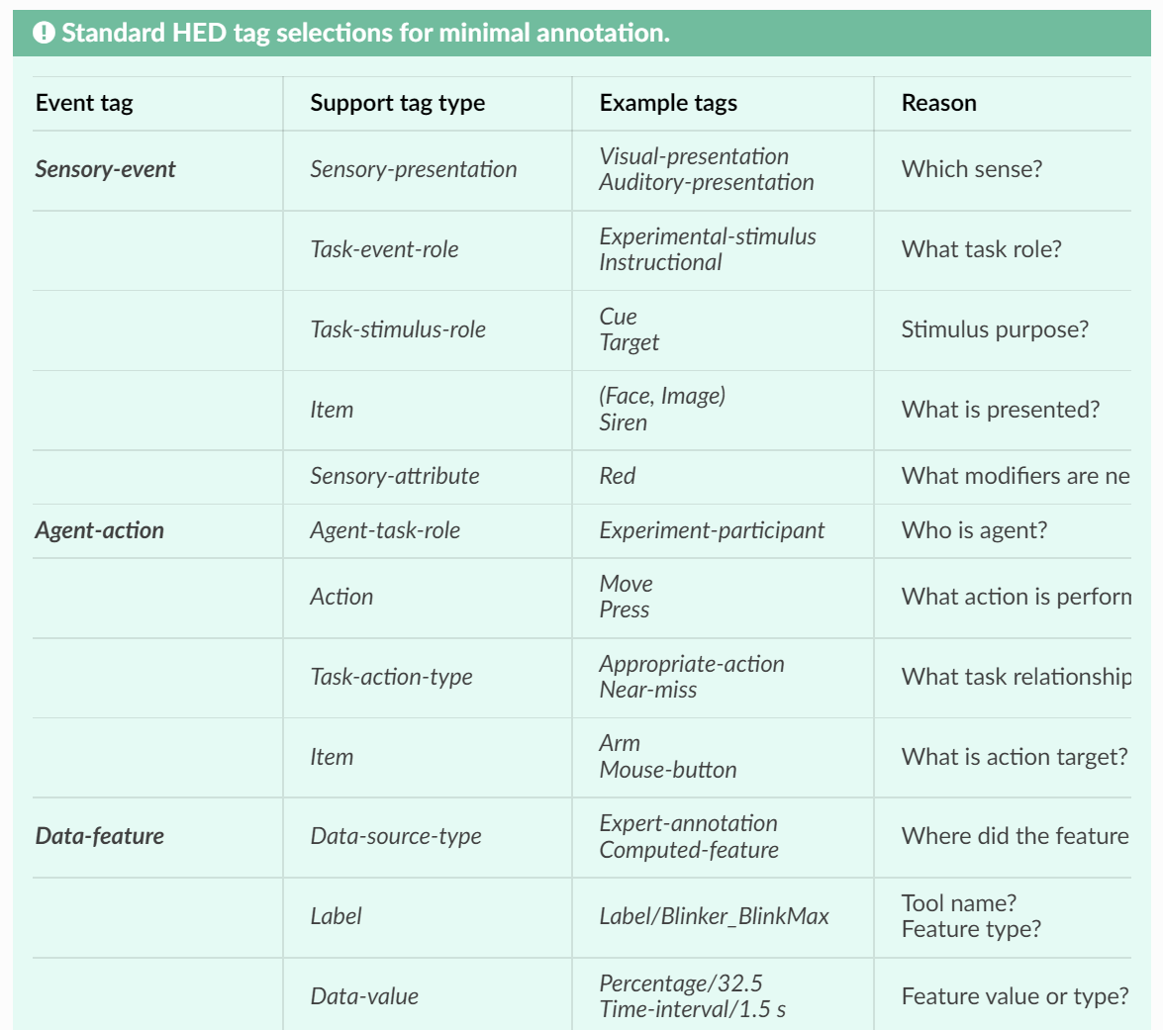
Basic HED annotation (a recipe)
value | HED
nonWM | . . .
gD | . . .
gM | . . .
gB | . . .
Y | . . .
gH | . . .
Q | . . .
C | . . .
gG | . . .
WM | . . .
rC | . . .
1 | . . .
correct | . . .
TASK
Fill in dictionary
(corresponding to JSON sidecar)
Recipe
What type of event?
Add supporting tags.
nonWM → Sensory-event, Visual-presentation, Instructional, Cue, (Dash, Black)
correct → Sensory-event, Auditory-presentation, Feedback, Beep
Basic annotation is straightforward:
Supporting tools are available
https://www.hed-resources.org/en/latest/HedAnnotationQuickstart.html
2. How is HED integrated into BIDS?
Notes:
We’re going to give you a recipe.
The most important thing to annotate is the type of event.
Go over some of the supporting items
Annotation can be incremental, so you can start simple.
With the JSON sidecar approach you only have to change one file to modify the annotation.
Event files are fluid depending on the use.

Slide 9
Tools for HED annotation, validation, and analysis
Python tools (hed-python repo):
Available as hedtools on PyPI.
Main HED code base supporting online tools, remodeling, schema development and analysis.
Online tools (https://hedtools.ucsd.edu/hed hed-web repo):
Available as web menu-based forms and as web-services.
Validation, JSON sidecar generation, schema development.
Interface for remodeling tools applied to individual files.
Deployed in a Docker container (available on GitHub).
CTagger (CTagger repo):
Standalone GUI for annotation and validation.
Also integrated as a plugin for EEGLAB in MATLAB.
JavaScript validator (hed-javascript repo):
Available on npm as hed-validator.
Integrated into the BIDS validator.
MATLAB tools (hed-examples repo, hed-matlab repo):
Integrated into EEGLAB as HEDTools plugin.
MATLAB HED services library calls online tools
HED tools are open source.
3. What tools support HED annotation, validation, and analysis?
Notes:
HED has a growing ecosystem of tools to support users at all phases from experimenters and annotators to analysts.
All of the tools are open-source.
Python: The HED python tools form the core code base.
They are available on PyPI.
Online:
1) Single-file versions access to the most important tools are available both as web menu-based forms or as web-services through the HED online tools.
2) These include validation, sidecar template generation, schema conversion and validation, event assembly as well as an interface for the remodeling tools.
3) Deployed as Docker container – so can be run anywhere.
CTAGGER: Standalone GUID for tagging and validation.
Javascript validator: Called by the BIDS validator to validate the HED portion.

Slide 10
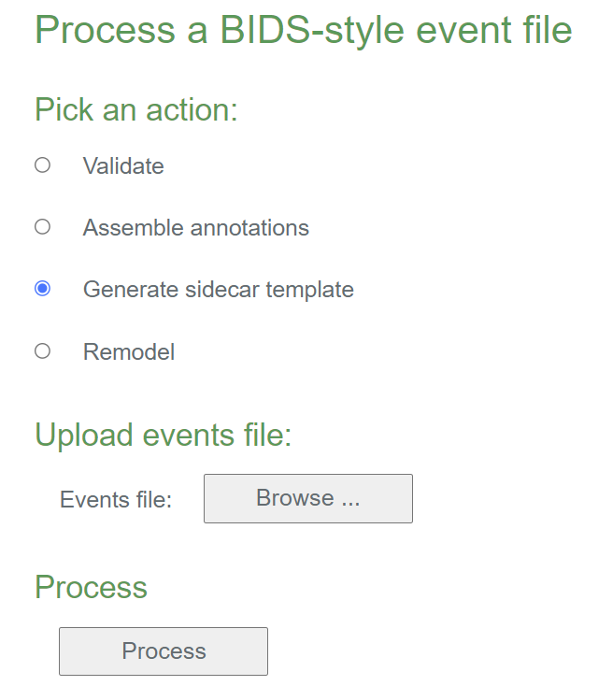
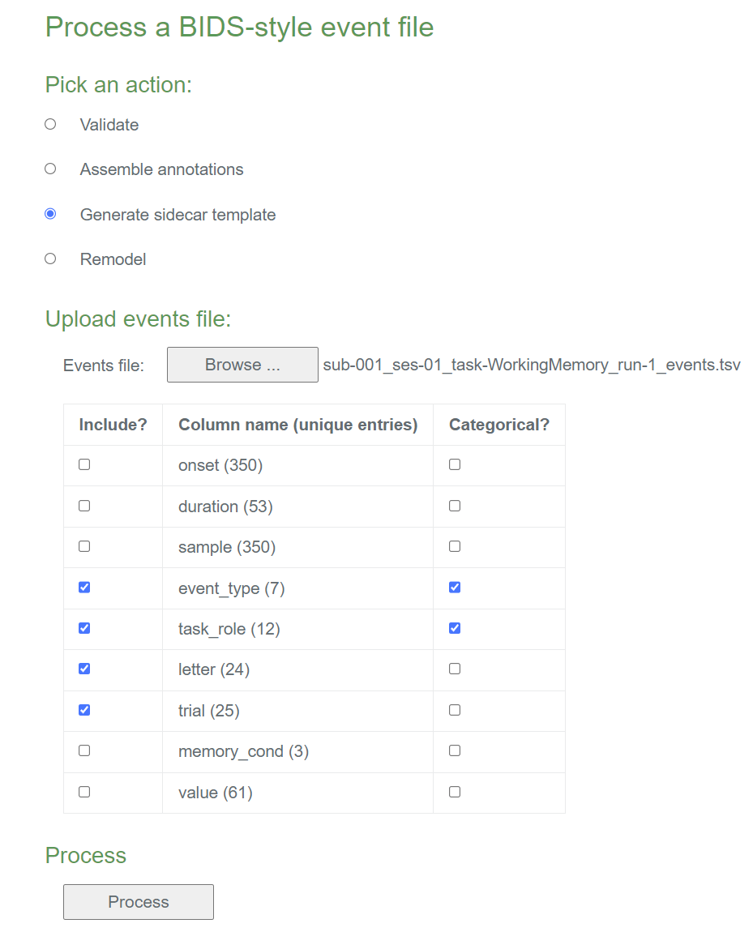
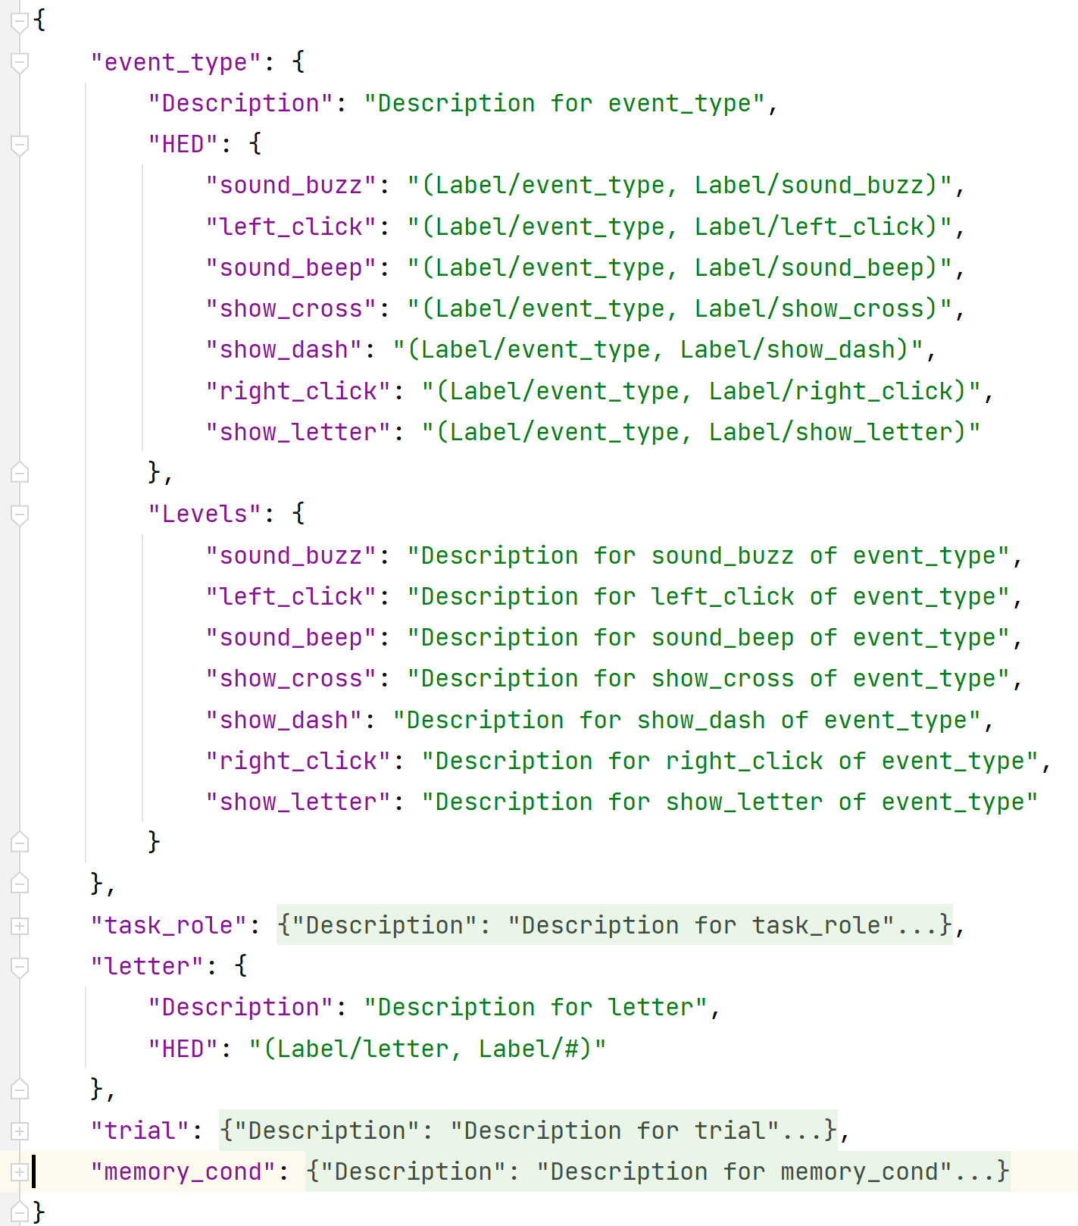
Generate a JSON sidecar template (online)
Online menu:
Sidecar template
Available online at hedtools.ucsd.edu/hed
youTube video demo:
HED Tagging 101
https://www.youtube.com/watch?v=iRAWO-Fn6Bw
3. What tools support HED annotation, validation, and analysis?
https://www.hed-resources.org/en/latest/BidsAnnotationQuickstart.html
Notes:
This example shows the online tools for extracting a JSON sidecar template from an events file.
Starting on the event file menu, select the operation that you want – in this case generating a sidecar template.
Upload the event file you want to use as the source and press Process.
You are then presented with the summary of the columns in the event file.
The left column of checkboxes gives you a list of all the columns and how many unique values are in each column.
As expected onset has a lot of values (one for each event since that is the time of the event).
We pick 5 columns to annotate. Only the event_type and task_role will be categorical so that their individual values are annotated.
Compare the template for event_type (which was selected as a categorical column) and letter (which has one annotation describing the entire column).

Slide 11
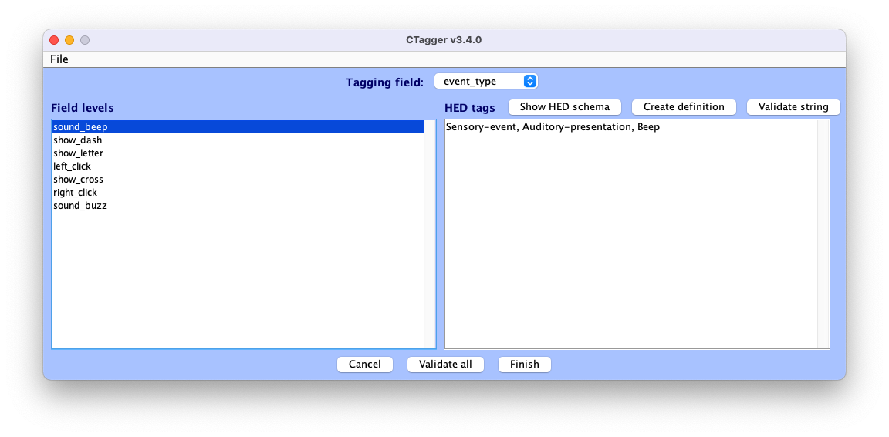
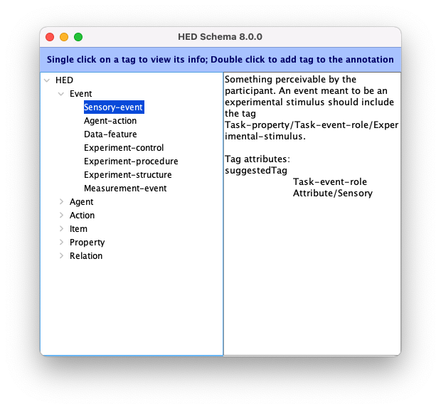
CTagger: Tool for HED annotation
CTagger is available as a standalone tool or as a plugin integrated in MATLAB and EEGLAB
See https://www.hed-resources.org/en/latest/CTaggerGuiTaggingTool.html
3. What tools support HED annotation, validation, and analysis?
Notes:
CTAGGER is GUI-based tool for assisting with tagging.
CTAGGER works with JSON sidecars and with event files to assist with annotation.
For event files, it essentially creates the template based on the unique values in specified event file columns.
CTagger is available both as a standalone tool and as a plugin integrated into MATLAB and EEGLAB
The most important thing to annotate is the type of event.
Go over some of the supporting items
Incremental ---

Slide 12

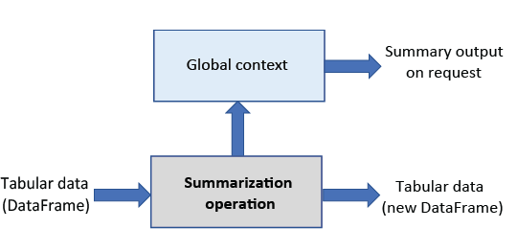
Introducing the HED remodeling tools
Transformations:
Two types of operations:
Transformations
Summaries
Large number of operations.
Specified in a JSON file (no programming needed).
Can string together.
Most HEDtools functionality now available through this interface.
Summaries:
Notes:
HED is very well-integrated into BIDS
Once annotated, analysis tools don’t distinguish because the annotations from all sources for each event are assembled.

Slide 13
Factor events based on HED tag queries
JSON remodel file
(Run using online tools on a single file)
[{
"operation": "factor_hed_tags“,
"description": "Factors based on action correctness.",
"parameters": {
"queries": ["correct-action", "incorrect-action"],
"query-names": ["correct", "incorrect"],
"remove-types": [],
"expand_context": false
}
}]
events.tsv file
onset | duration | trial_type
0.0776 | 0.5083 | go
5.5774 | 0.5083 | unsuccessful_stop
9.5856 | 0.5084 | go
13.594 | 0.5083 | successful_stop
17.102 | 0.5083 | unsuccessful_stop
21.61 | 0.5083 | go
Remodel
JSON sidecar with HED
Provide an event file and a sidecar.
List the queries in the JSON rmdl file.
Remodel (using online tools for single file):
HED annotation for each row assembled.
Factor vectors appended based on query results.
The queries can be VERY complex.
events.tsv file after factors created
onset | duration | trial_type | correct | incorrect
0.0776 | 0.5083 | go | 0 | 0
5.5774 | 0.5083 | unsuccessful_stop | 0 | 1
9.5856 | 0.5084 | go | 0 | 0
13.594 | 0.5083 | successful_stop | 1 | 0
17.102 | 0.5083 | unsuccessful_stop | 0 | 1
21.61 | 0.5083 | go | 0 | 0
3. What tools support HED annotation, validation, and analysis?
Notes:
(run with the online tools).

Slide 14
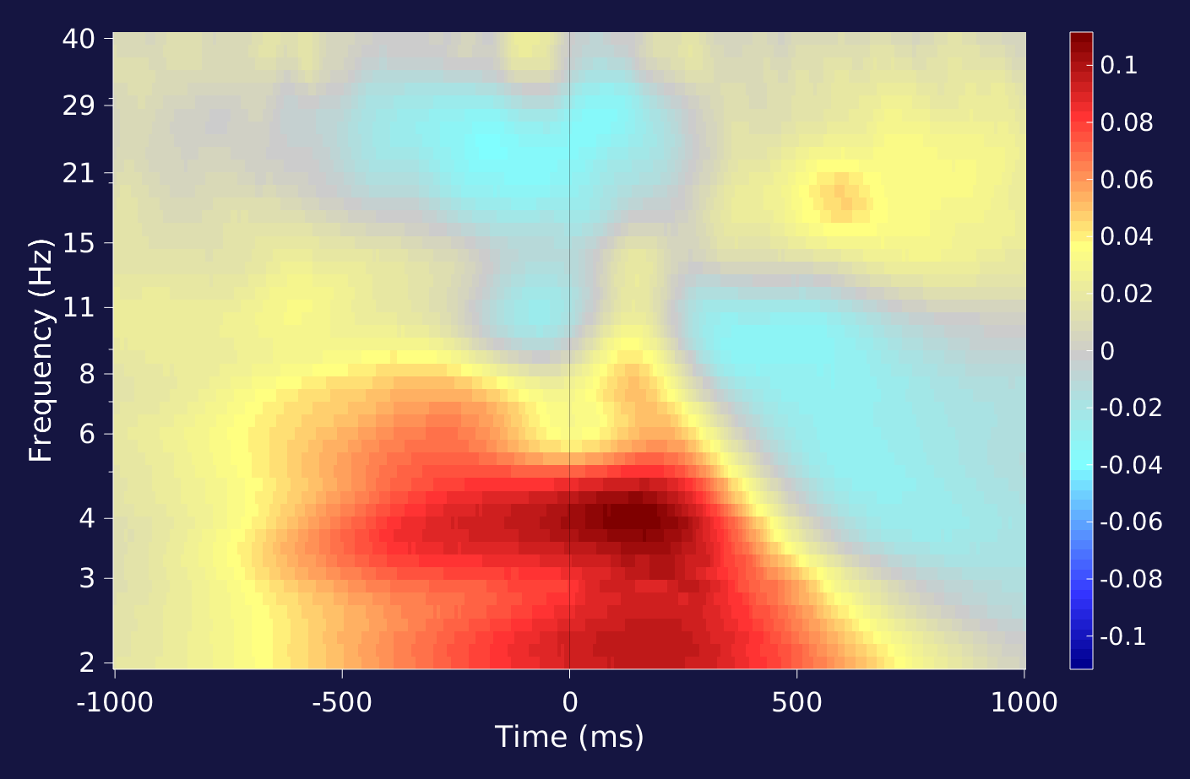
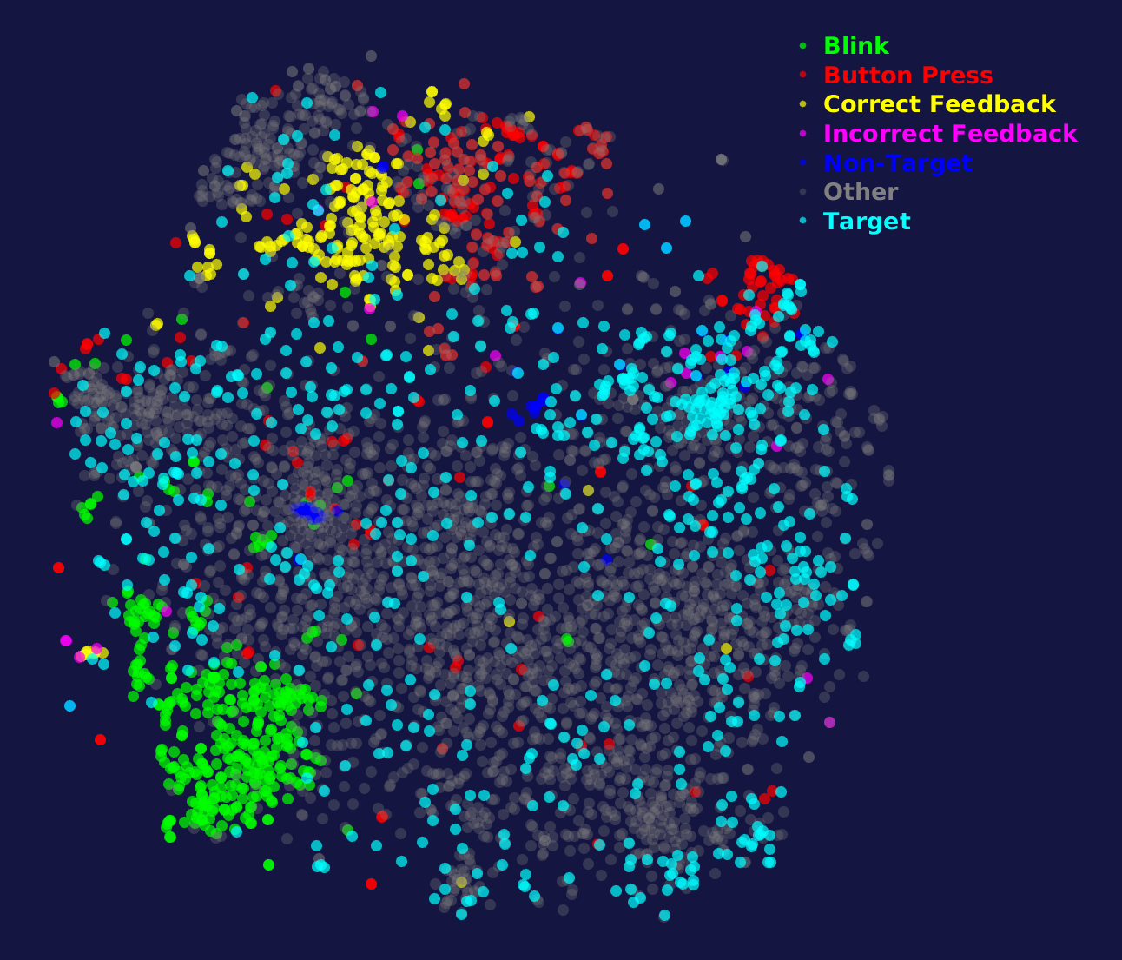
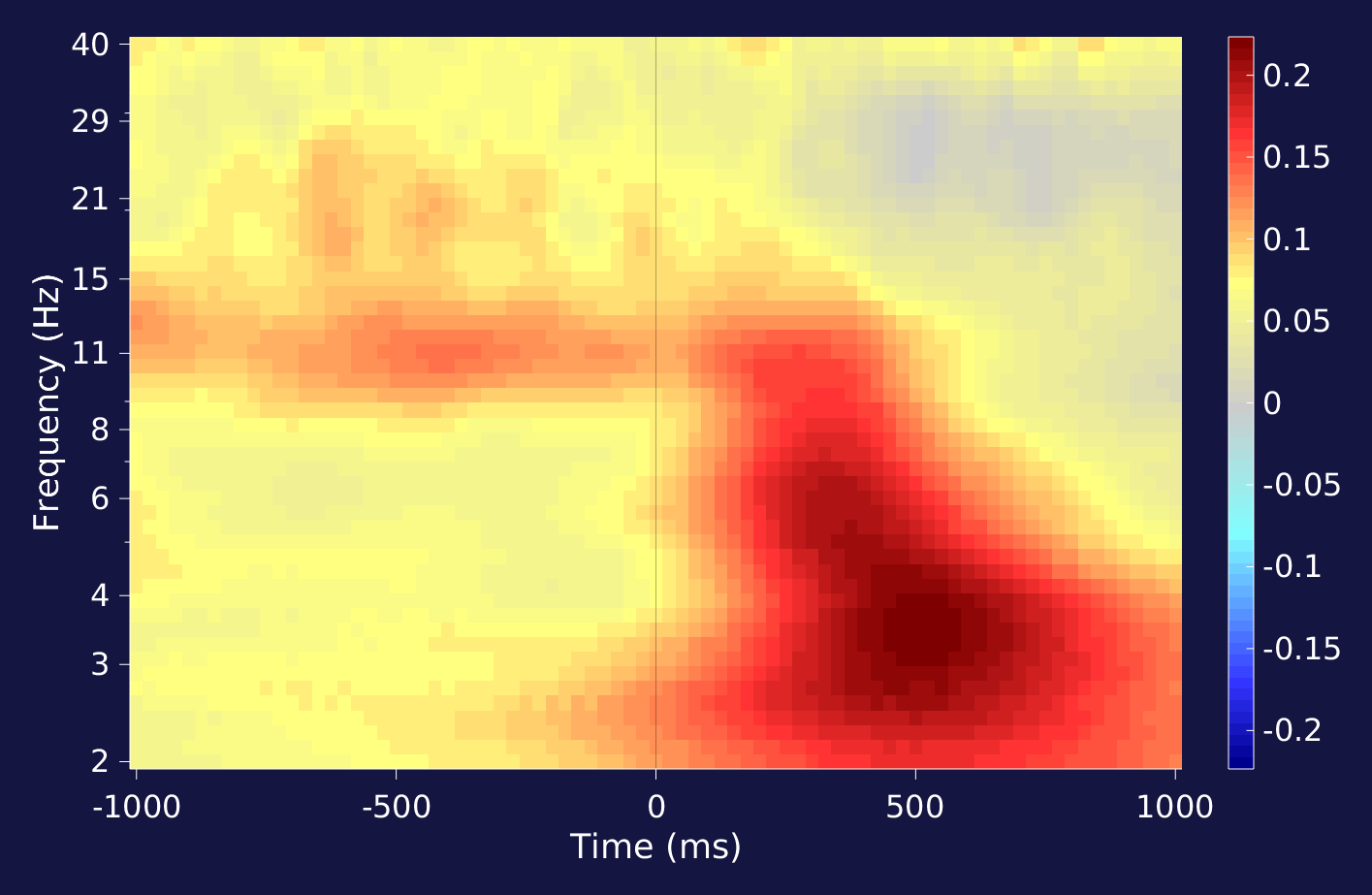
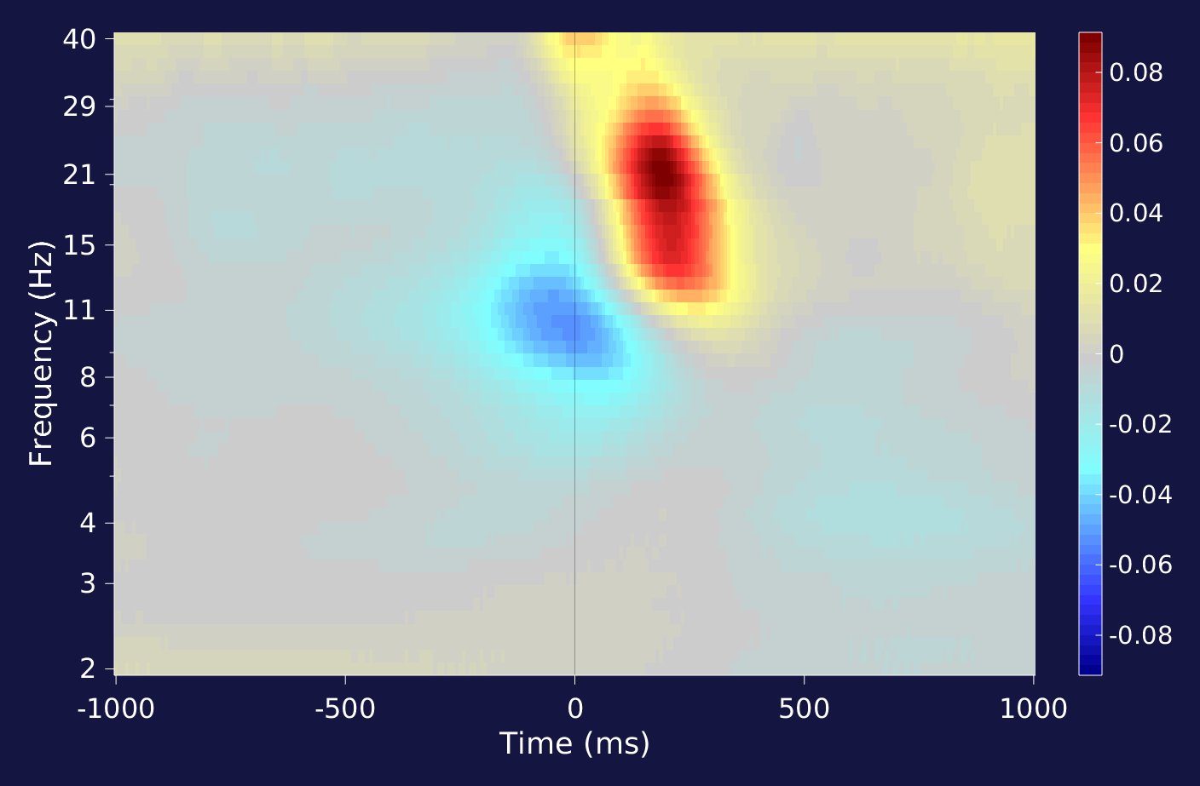
t-SNE clustering of ERSPs across 18 HED-tagged EEG studies
color-coded by primary HED tag
Channel FCz
Channel FCz
Channel FCz
ERSP insets are averages of all individual data recording ERSPs for channel FCz.
3. What tools support HED annotation, validation, and analysis?
Bigdely-shamlo et al. 2020 Neuroimage
Notes:
As an example of using HED tag query factoring for analysis. The following is an example of a meganalysis study that we did using HED tags.
18 HED-tagged studies were processed using the same preprocessing pipeline and ERSPs (Event-related spectral perturbations)
T-SNE t-distributed stochastic neighbor embedding.
ERSPs for individual data recordings were computed using linear regression (not averaging).

Slide 15
Experimental condition summary
JSON remodeling file
[{
"operation": "summarize_hed_type"
"description": "Summarize experimental conditions.",
"parameters": {
"summary_name": "My experimental conditions",
"summary_filename": "condition_variable_sum",
"tag_type": "condition-variable"
} }]
(Run from the command line on entire dataset)
Remodel
Args
context name: My experimental conditions
Context type: hed_type_summary
Context filename: condition_variable_sum
Overall summary:
Dataset: Type=condition-variable Type values=3 Total events=63320 Total files=126
key-assignment: 2 levels in 63320 event(s) out of 63320 total events in 108 file(s)
right-sym-cond [35026 events, 60 files]:
Tags: ['Index-finger', 'Right-side-of', 'Experiment-participant', 'Behavioral-evidence’,
'Symmetrical', 'Index-finger', 'Left-side-of', 'Experiment-participant’,
'Behavioral-evidence', 'Asymmetrical']
Description: Right index finger key press indicates a face with above average symmetry.
. . .
Excerpt from overall summary file.
3. What tools support HED annotation, validation, and analysis?
List the queries in the JSON rmdl file.
Provide an event file and JSON sidecar.
Remodel:
HED annotation for each row assembled.
Factor vectors appended based on query results.
The queries can be VERY complex.
Notes:
Next, I’ll show an example of the HED remodeling summary tools.
We want to run this on the entire dataset rather than a single file.

Slide 16
Example remodeling tools calls
Python
data_root = 'G:/openneuroWH' model_path = 'G:/summarize_conditions_rmdl.json' arg_list = [data_root, model_path, '-b', '-x', 'derivatives', 'beh'] run_remodel.main(arg_list)
Command line
python run_remodel G:/openneuroWH G:/summarize_conditions_rmdl.json -b -x derivatives beh
Argument | Meaning | Format
data_root | Root directory of dataset | Required first argument (string)
model_path | Path of remodeling file | Required second argument (string)
-b | If present, assume BIDS format | Optional boolean
-x | List of directories to exclude | List
3. What tools support HED annotation, validation, and analysis?
3. What tools support HED annotation, validation, and analysis?
Notes:
HED is very well-integrated into BIDS
Once annotated, analysis tools don’t distinguish because the annotations from all sources for each event are assembled.

Slide 17
Example MATLAB calls
From MATLAB:
remodelFile = 'G:\summarize_hed_types_rmdl.json';
dataPath = 'G:\eeg_ds003645s_hed';
remodel_args = {dataPath, remodelFile, '-b', '-x', 'stimuli', 'derivatives'};
runRemodel(remodel_args)
Function:
function runRemodel(remodel_args)
py.importlib.import_module('hed’);
py.hed.tools.remodeling.cli.run_remodel.main(remodel_args);
3. What tools support HED annotation, validation, and analysis?
Notes:
HED is very well-integrated into BIDS
Once annotated, analysis tools don’t distinguish because the annotations from all sources for each event are assembled.

Slide 18

Workflow for event files
Remodel
Generate events
Experiment logs
Usually, multiple iterations are required to turn information for logs into event files.
Remodel
Validate
Often event files need to be restructured to support analysis.
Analyze
Event files require multiple restructurings during their life cycle.
3. What tools support HED annotation, validation, and analysis?
Notes:
Over the years, I’ve really appreciated the researchers who have contributed their tools as open source.
We build tools because we need something, we write the code, and then we think how—can we make this tool more generally useful

Slide 19
HED remodeling with/without backups
With backup
JSON transformation file
Backup events.tsv (done once)
events_orig.tsv
events.tsv
Remodeling
Copy original to events.tsv each time an analysis is done
JSON transformation file
Without backup
events.tsv
Remodeling
HED remodeling backup facility assures a record of the transformations
3. What tools support HED annotation, validation, and analysis?
Notes:
HED is very well-integrated into BIDS
Once annotated, analysis tools don’t distinguish because the annotations from all sources for each event are assembled.

Slide 20

HED past and present
HED-1st generation
versions < 4.0.0
2010 -2012
HED-2nd generation
4.0.0 <=version < 8.0.0
2012 -2019
HED-3rd generation
8.0.0 <=versions
2019 -2020’s
headit.ucsd.edu
12 studies ESS format
NIH R01-MH084819
R01-NS047293
SCCN Swartz Foundation
cancta.net
~30 studies ESS format
ARL W911NF-10-2-0022
openNeuro.org
nemar.org
eegnet.org
Single event hierarchy
CogPO as subset
Nima Bigdely-Shamlo’s
PhD under Scott Makeig
Redesign with orthogonal hierarchies (sub-tag system).
Incorporation into BIDS
Creation of validators and online tools
HED working group formed
Single tag annotation
Library schemas
Events of temporal extent

Slide 21
HED Advanced features
Events of temporal extent (with start, end, and intermediate points):
Example: Annotating a seizure event in EEG with features.
Example: Annotation a reaching movement in motion capture.
Event context (finding events that are ongoing at a given time).
Sophisticated searching.
In development:
Specialized library vocabularies for movies and language.
Encoding of event relationships and tasks.
Integration with experimental control software.
4. What work is ongoing or planned for the future?
Notes:
HED is very well-integrated into BIDS
Once annotated, analysis tools don’t distinguish because the annotations from all sources for each event are assembled.

Slide 22
HED versus ontologies
HED is complementary to formal ontologies.
HED is a front-facing (user-facing) technology – formal ontologies are not.
HED operates at a very fine grain – formal ontologies for e.g., tasks and diseases do not.
HED is primarily concerned with what happens during an experiment – existing formal ontologies are mostly not applicable to description of time evolution.
However, HED can be embedded in an ontology – with the subclass (is-a) relationship giving the graphical structure using HED_xxxx (where xxxx is the HED node) for UUID.
HED-term UUIDs will enable linking HED schema vocabulary to formal ontologies as needed or wished.

Slide 23

HED Working Group (HWG)
Scott Makeig, UCSD
Kay Robbins, UTSA
Arno Delorme, UCSD
Dora Hermes, Mayo
Dung Truong, UCSD
Monique Denissen, Paris Lodren U Salzburg
Tal Pal Attia, Mayo
Deepa Gupta, UCSD
Yahya Shirazi, UCSD
Liana Pakingan, UCSD
Ian Callanan, UTSA
Alexander Jones, UTSA
Project home: https://www.hedtags.org
Main resources page: https://www.hed-resources.org
HED GitHub Organization Repos: https://github.com/hed-standard
HED YouTube Channel: https://youtube.com@hedworkinggroup
R01 MH126700-01A1

