Slide 1
Behavioral Health Information Technologies and Standards (BHITS) II
Omnibus Care Plan
Using SMART-on-FHIR Applications
User Guide
Developed by FEI Systems for SAMHSA BHITS August 2018

Slide 2

Omnibus Care Premise
Patient-centered care revolves around effective and efficient care coordination across care providers, patient engagement, social connectedness, and facilitating the patients’ treatment beyond episodic or chronic treatment.
Today, the healthcare environment is fragmented and ineffectual in providing 360⁰ whole-patient care with the mix of private and public insurers and self-pay with a large number of no-pay patients.
SAMHSA is devoted to the care and treatment of behavioral health patients. New models of paying for care are being developed and initiated with the objective to reduce the cost of healthcare.

Slide 3
About the Omnibus Care Plan
A patient-centric, standards-based, goal-driven treatment plan
Application through which the patient and his or her care team can communicate
Authoritative source for care planning
Synthesize, reconcile, and de-conflict patients’ data
Monitor patients’ data and monitor processes across health care institution boundaries
Real-time integrated view of an individual care plan
Includes structured and narrative information

Slide 4
Omnibus Care Plan Modules
Organization Administration Module–Adding and managing organization details, contact personnel, locations and activity definitions
Practitioners Module–Adding and managing practitioner details, practitioner roles and organization association
Patients Module–Adding and managing patient details, patient’s care teams (which include members across organizations, related persons and other patients) and patient’s insurance/benefits details
OCP Access Module–Register users to OCP and manage user access
Appointments and Scheduling Module–Creating appointments, appointment actions (accept, tentative, decline), calendar view, appointments panel and importing organization Outlook calendar into OCP
Tasks and To-Do Module–Creating, managing and updating patient-related tasks (based on organization defined activity definitions) and patient related To-Dos
Communications Module–Logging patient communications and associate communications with appointments, tasks and To-Dos
Care Planning Module–Creating and managing care plan in Quippe Clinical Lens
Screeners and Assessment Module–Patient screeners and assessments through bhworks CUBS assessment tool
Consent Management Module–Creating and managing patient’s consents through Consent2Share
SMART-on-FHIR Apps Management Module–Consent2Share, Quippe Clinical Lens & Designer, bhworks CUBS Assessment

Slide 5


Omnibus Care Plan Functional Overview
Administrative
Program, Services, Locations
Patient Enrollment
Practitioners, Organizations
Episode of Care
Care Coordination
Caseload Mgmt. Dashboard
Program Mgmt.
Screener/ Assessment
Scored screening and assessments (MA Assessment, PHQ9, PHQ4, etc.)
bhworks Comprehensive Assessment
Care Planning
SOAP/Visit Notes
Outreach/ Activity Management
Smart Notes
Dynamic Care Plan Summary
Scheduling/ Appointment
New Appointments
Encounter Management
Goals and Interventions based on Outcomes/scores
Patient Consent
Computable Scores/sub-scores (LOINC)
Enrollee/ Consumer Dashboard
Standards-based Data Shared Among Applications

Slide 6
Omnibus Care Plan Portal and Users
OCP Administrator
Onboarding of organizations to OCP and adding practitioners to OCP
Managing roles/users in UAA and Helpdesk/Troubleshooting
Organization Administrator
Managing organization locations, healthcare services, activity definitions
Associating practitioners to organization/location and assigning roles
Care Manager
Manage patient information, care teams, and assign care coordinators
Patient consents
Care Coordinator
Tasks, To Do, Appointments, Communication, Assessments
Care Coordination activities and care plan management
Patient
Other Possible Functional Roles
Similar Care coordination activities for Benefits specialist, Front Office, Health Assistant, and so on
Patient information, Care Team
Business Function Role
Capabilities to be Demonstrated
Appointments, Communication, Consents

Slide 7
About the Omnibus Care Plan User Guides
The Omnibus Care Plan User Guides will provide information about how different users navigate the Omnibus Care Plan, and more:
Omnibus Care Plan Administrator User Guide
Organization Administrator User Guide
Care Manager User Guide
Care Coordinator User Guide
SMART-on-FHIR Applications
Note: SMART = Substitutable Medical Appliations, Reusable Technology
Note: FHIR = Fast Healthcare Interoperability Resources

Slide 8

Manage Omnibus Care Plan SMART on FHIR Apps
The Omnibus Care Plan portal is a SMART-on-FHIR (SoF) platform that can launch any application built on SoF standards.
All SoF applications need to be registered in the Omnibus Care Plan platform before they can be used or launched from within the platform.
This enables the use of common FHIR data source.
For example, all SoF applications that are launched will have proper authentication, authorization, and relevant context such as Patient FHIR ID, Organization FHIR ID and so on.
Currently the platform has three native applications registered: Consent2Share, Quippe-Clinical Lens & Designer, and bhworks CUBS Assessment.

Slide 9
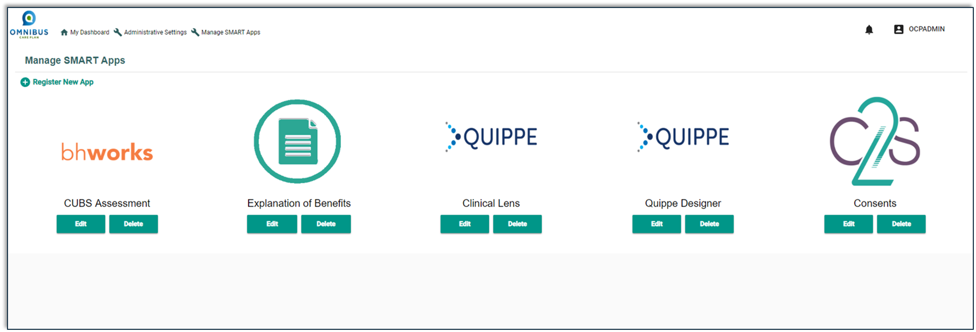
The Goal of this SoF Application User Guide
This guide illustrates how to:
Register a new SMART Application
Manage the bhworks CUBS Assessment Application
Manage the Explanation of Benefits Application
Manage the Consent2Share SMART-on-FHIR Application
Manage the Quippe Clinical Lens & Designer Applications

Slide 10
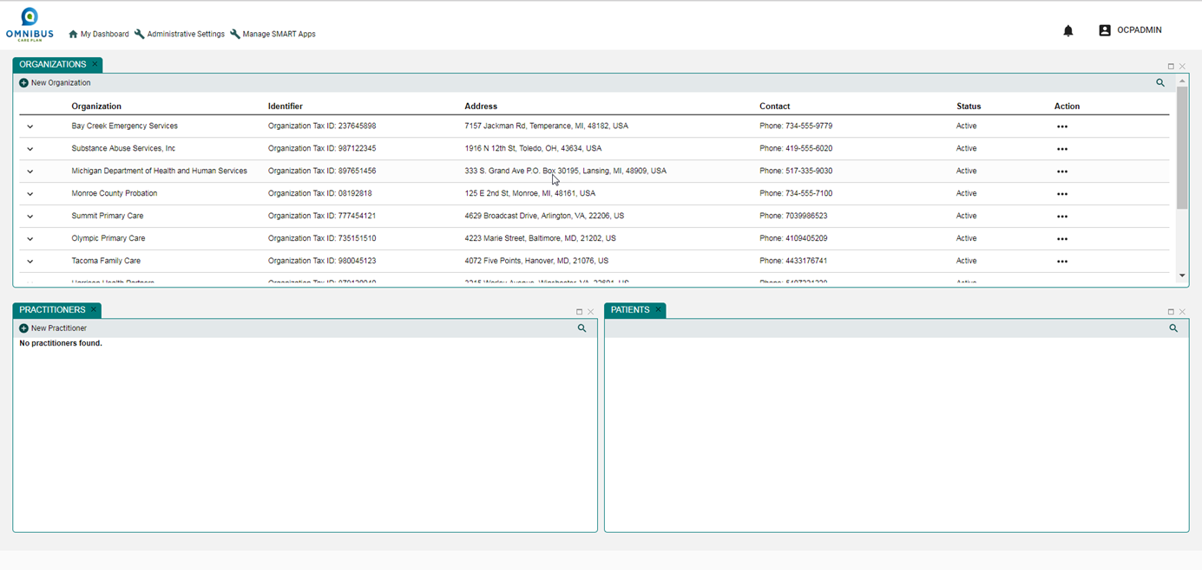
Manage SMART Apps Link

Slide 11
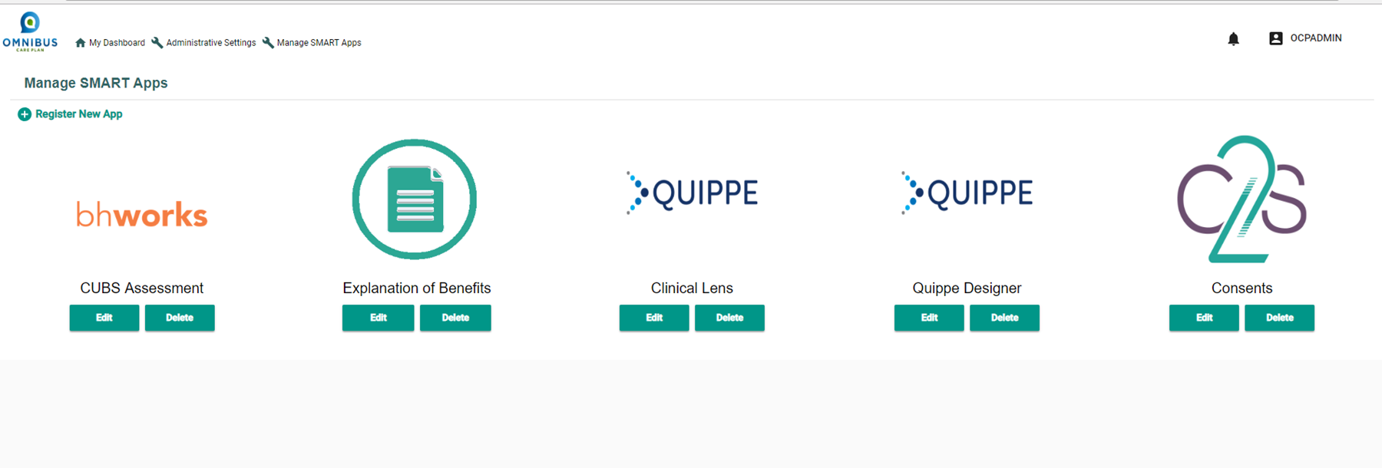
Manage SMART Apps Page

Slide 12
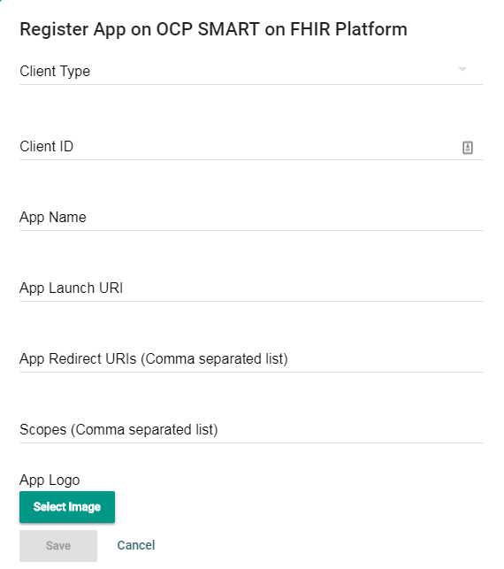
Register New App
Click Register New App icon

Slide 13
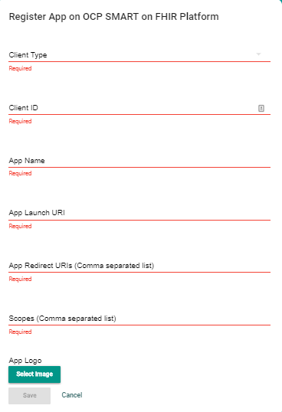
Register New Application: Fields
Enter information in the required fields

Slide 14
Admin User Administrative Settings Page
bhworks: Assessments and screeners application
Explanation of Benefits Application
Quippe Clinical Lens/Quippe Designer Applications
Consent2Share: Patient Consent Management Application

Slide 15
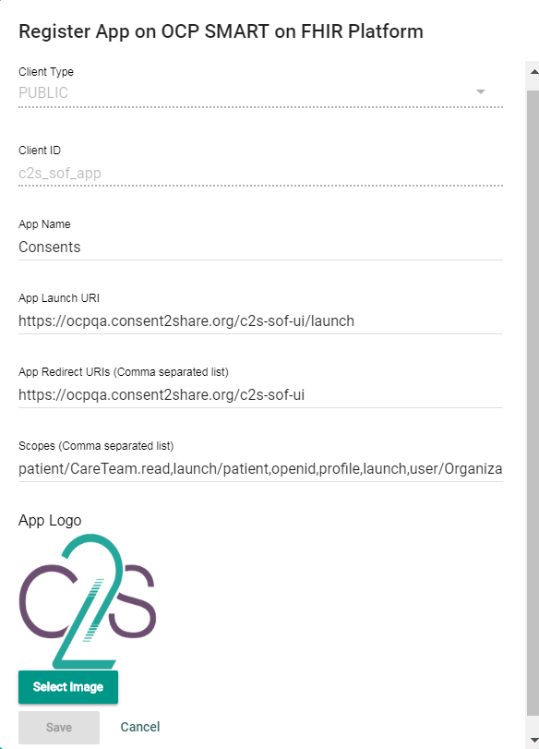
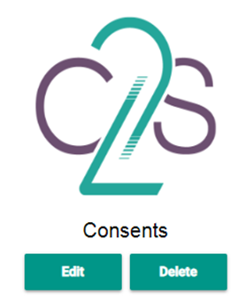
Consent2Share SoF Application

Slide 16
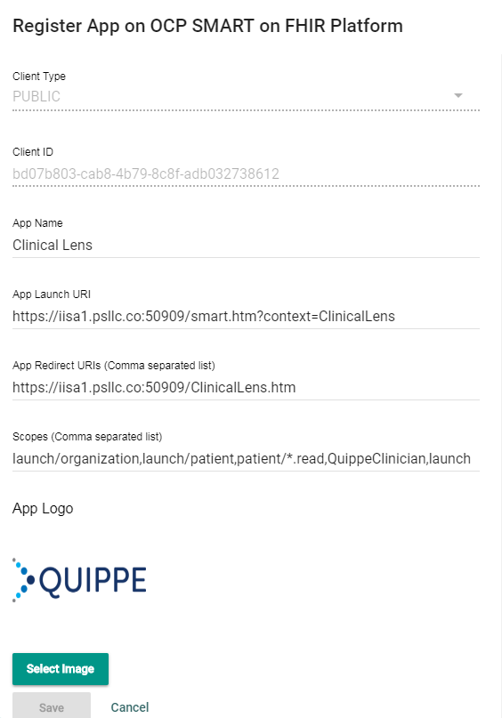

Quippe Clinical Lens SoF App
Notes:
There will be two more slides to this Guide following this slide if Demo Environment is used.

Slide 17
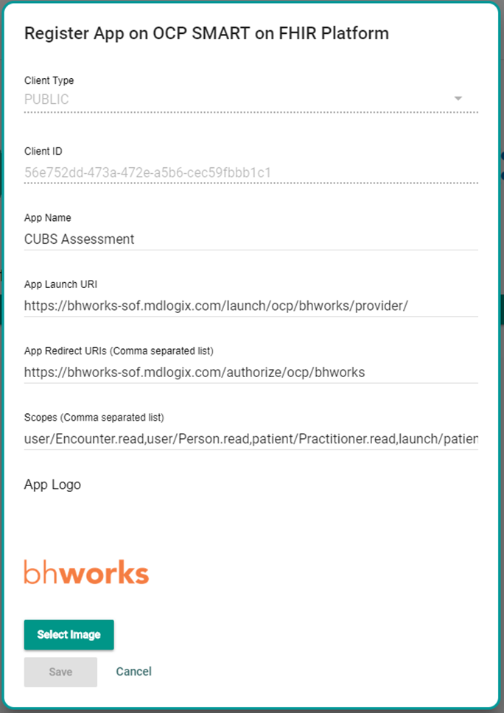
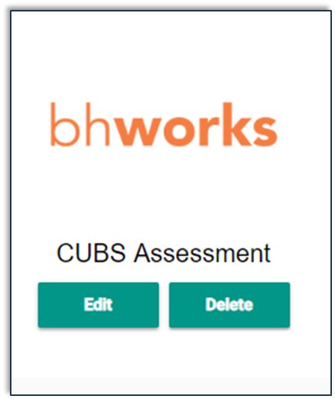
bhworks SoF Application
Notes:
There will be two more slides to this Guide following this slide if Demo Environment is used.

Slide 18
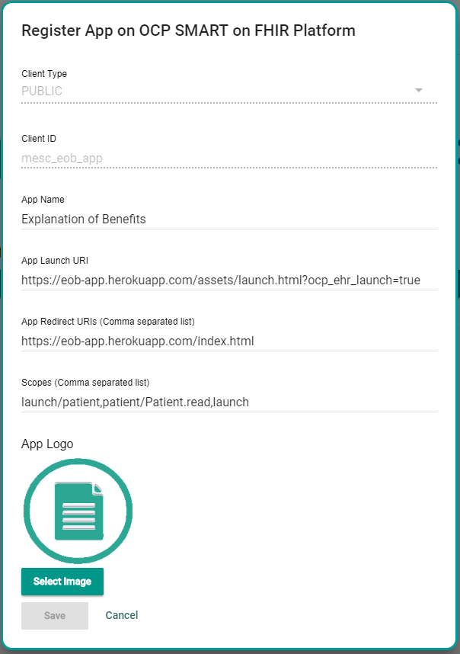
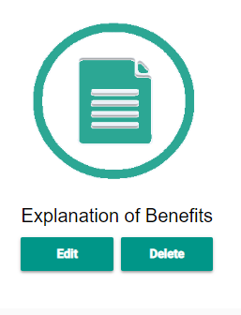
Explanation of Benefits SoF Application

Slide 19

Thanks!

