Slide 1
SCALING Recommendations
NERC OpenShift
Michael Thomas Red Hat Architect

Slide 2
Red hat Openshift
Scalability
Red Hat Openshift can be scaled in various ways. The overall concern on scaling should be driven by the applicable workloads. Group “like” workloads on Specific Openshift Clusters. Scale Clusters by workloads. Advanced Cluster Management can be applied to Clusters of all sizes, whichever size you select.
Small Clusters increase administrative workload
Small Clusters isolate changes to specific workloads
Small Clusters require etcd management with backups
Small Clusters can be more specific in configurations
Small Clusters are timely in recreating (when necessary)
Large Clusters increase the size and complexity of the etcd database and its recurring backups
Large Clusters simplify storage access
Large Clusters increase impact scale
Large Clusters increase upgrade times

Slide 3
Red hat Openshift
Scalability
The previous list should be thoughtfully considered and then used to formulate a valid scale process for the NERC organization. My recommendation is for a hybrid approach. Have a large Openshift cluster when the workloads are similar and requires compute resources heavily. Utilize small Openshift clusters when the workload is specific, requires isolation, and requires separation from other workloads.
Small clusters can be scaled up and large clusters can be scaled down, as necessary. You have some space to experiment with scalability. You can oversize and undersize with the ability to correct the sizing in either direction.
The Keys to a successful hybrid approach are the use of automation to create and manage all size clusters with standardization, having management procedures well documented and enforced, leveraging the management of multiple clusters along with enforcing polices through Advance Cluster Management (ACM), and utilizing limits and quotas to protect Openshift cluster resources.

Slide 4
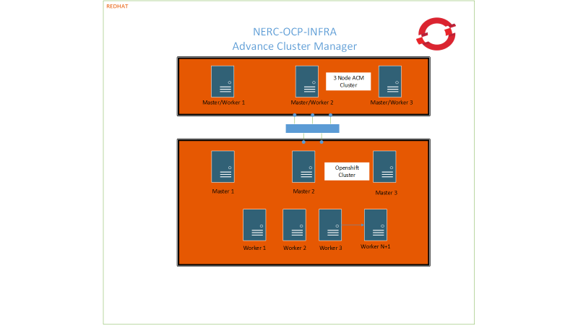
Scaling Recommendation

