Slide 1
Repositories for OCR-D Volker Hartmann volker.hartmann@kit.edu
27.02.2019

Slide 2
Repository
Repository
A central location in which data is stored and managed.
Data Repository
Software Repository
GitHub
GitLab

Slide 3
Glossary OCR-D
Research data repository
The research data repository may contain the results of all steps during document analysis. At least it contains the end results of every processed document and its full provenance. The research data repository does not need to be publicly available.
Ground Truth (GT) data repository
Research data repository that is public available. It contains all the ground truth meta-/data. (Available at: https://ocr-d-repo.scc.kit.edu/api/v1/metastore/bagit)

Slide 4
Technical Data
Supported Format
Containerformat: BagIt Version 0.97+
Profile: https://ocr-d.github.io/bagit-profile.json
Protocol
HTTP (REST)
Link: https://github.com/OCR-D/repository_metastore

Slide 5
Metadata
METS:
Resource Identifier (purl, urn, handle, url)
Header
Ground Truth(GT) Metadata (optional)
(Workflow-)Provenance (optional)
Provenance:
Model: PROV Data Model (PROV-DM / https://www.w3.org/TR/prov-dm/)
Format: PROV-XML (https://www.w3.org/TR/prov-xml/)

Slide 6
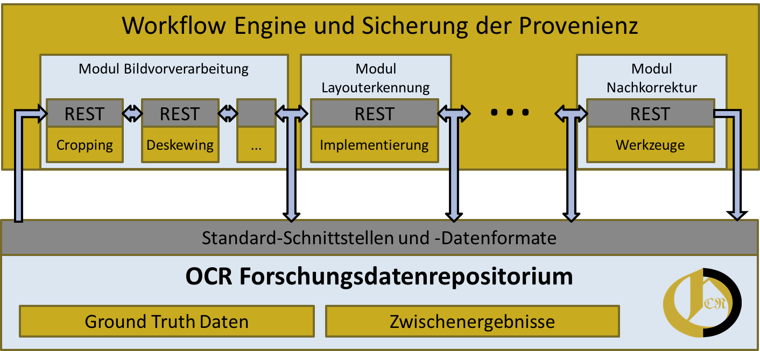
Architecture OCR-D Framework
Meta-/Daten

Slide 7
Ingest into the Research Data Repository
Upload BagIt-Container using REST
curl -u ingest:GENERATED_PASSWORD -v -F "file=@zippedBagItContainer" http://localhost:8080/api/v1/metastore/bagit
Unzip container
Validate container
Extract metadata
METS Header (title, …)
METS file
GT metadata (if available)
PROV XML (if available)
Index metadata (Elasticsearch / Kibana)
Client
Server

Slide 8
Demo OCR-D-GT-Repository
https://hackmd.io/RplyN-srS1mnawLC3ngQMg#

Slide 9
(REST-)Examples for Accessing the Research Data Repository
List URLs of all BagIt-Containers
> curl –X GET https://ocr-d-repo.scc.kit.edu/api/v1/metastore/bagit
[ „https://ocr-d-repo.scc.kit.edu/api/v1/dataresources/9c06dd3b-e921-4264-aef9-ab2e9d276328/data/SBB0000F23300010000.zip“, … ]
List content of all METS files
> curl –X GET https://ocr-d-repo.scc.kit.edu/api/v1/metastore/mets
[{ „id“: „296848“,
„resourceId“ : „ 9c06dd3b-e921-4264-aef9-ab2e9d276328“,
…
„metsContent“ : „<mets:mets xmlns:mets=\“http://www.loc.gov/METS/\“ … </mets:mets>“ },
…
]

Slide 10
(REST-)Examples for Accessing the Research Data Repository
List all resource identifiers for given title ‚Der Herold‘
> curl –X GET „https://ocr-d-repo.scc.kit.edu/api/v1/metastore/mets/title?title=Der%20Herold“
[9c06dd3b-e921-4264-1ef9-ab2e9d276328]
List content of METS files for given resource identifier
> curl –X GET https://ocr-d-repo.scc.kit.edu/api/v1/metastore/mets/9c06dd3b-e921-4264-aef9-ab2e9d276328
{ „id“: „296848“,
„resourceId“ : „ 9c06dd3b-e921-4264-aef9-ab2e9d276328“,
…
„metsContent“ : „<mets:mets xmlns:mets=\“http://www.loc.gov/METS/\“ … </mets:mets>“ }

Slide 11
(REST-)Examples for Accessing the Research Data Repository
Download BagIt-Container from repository
> curl –X GET https://ocr-d-repo.scc.kit.edu/api/v1/dataresources/9c06dd3b-e921-4264-aef9-ab2e9d276328/data/SBB0000F29300010000.zip > SBB0000F29300010000.zip
% Total % Received % Xferd Average Speed Time Time Time Current
Dload Upload Total Spent Left Speed
100 11.7M 100 11.7M 0 0 46.0M 0 --:--:-- --:--:-- --:--:-- 46.1M

Slide 12

Summary
Research Data Repository supporting FAIR principles
Findable
Data described with metadata
Meta-/data are registered or indexed
Accessible
Use open protocol (REST)
Supports AAI if necessary
Retrievable by identifier

Slide 13
Summary
Interoperable
Meta-/data use public formats (BagIt, METS, PAGE XML, TIFF, …)
Re-usable
(GT) Meta-/data are released with a clear and accessible data usage license (CC BY-NC-SA 4.0 International)
Meta-/data are associated with their (workflow-)provenance

Slide 14
Thank you!
Questions?

