Slide 1

Curriculum

Slide 2
Key Points
The OpenChain Curriculum reference slide deck is intended to help companies understand Open Source compliance and to meet the OpenChain Specification requirements.
The reference slide deck is designed to be delivered in a half day training session or through seven individual sessions.
The slides use CC-0 licensing so companies can either use the reference deck directly or “pick and choose” material to expand existing training material.

Slide 3
Release 1
We went live with OpenChain Specification 1.0 on October 4th

Slide 4
75 Slides, 7 Chapters, 1 Purpose
Release 1 of the OpenChain reference slides contained information ranging from the basic concepts of IPR all the way through to what an enterprise compliance process could contain.
It contained material consolidated from ARM, Philips, Qualcomm and Samsung into one beautiful final product.
Think of it as the original iPhone of FOSS compliance training slides.

Slide 5
Release 1 Slide Contents
What is Intellectual Property?
Introduction to FOSS Licenses
Introduction to FOSS Compliance
Key Software Concepts for FOSS Review
Running a FOSS Review
End to End Compliance Management (Example Process)
Avoiding Compliance Pitfalls

Slide 6
Built With The Future In Mind
Each Chapter ended with a “Check Your Understanding” slide that posed some questions.
Example from Chapter 1, ‘What is Intellectual Property?’
What type of material does copyright law protect?
What copyright rights are most important for software?
Can software be subject to a patent?
What rights does a patent give to the patent owner?
If you independently develop your own software, is it possible that you might need a copyright license from a third party for that software? A patent license?

Slide 7
The Slides Captured People’s Attention
The first Korean translation of the OpenChain reference slide deck was released on the 28th of November.
We have a contributor offering to assist with a Japanese translation in the future.
Luis liked the slides too.

Slide 8
Release 2
Making Something Good Even Better

Slide 9
Refining, Polishing and Expanding
There are slide notes for trainers throughout the material to make delivery easier.
There are answers to the “Check Your Understanding” questions at the end of each chapter to assist with the creation of internal exams.
The content of some slides has been adjusted to make things clearer and simpler.

Slide 10
Let’s take a look
Down the rabbit hole we go

Slide 11
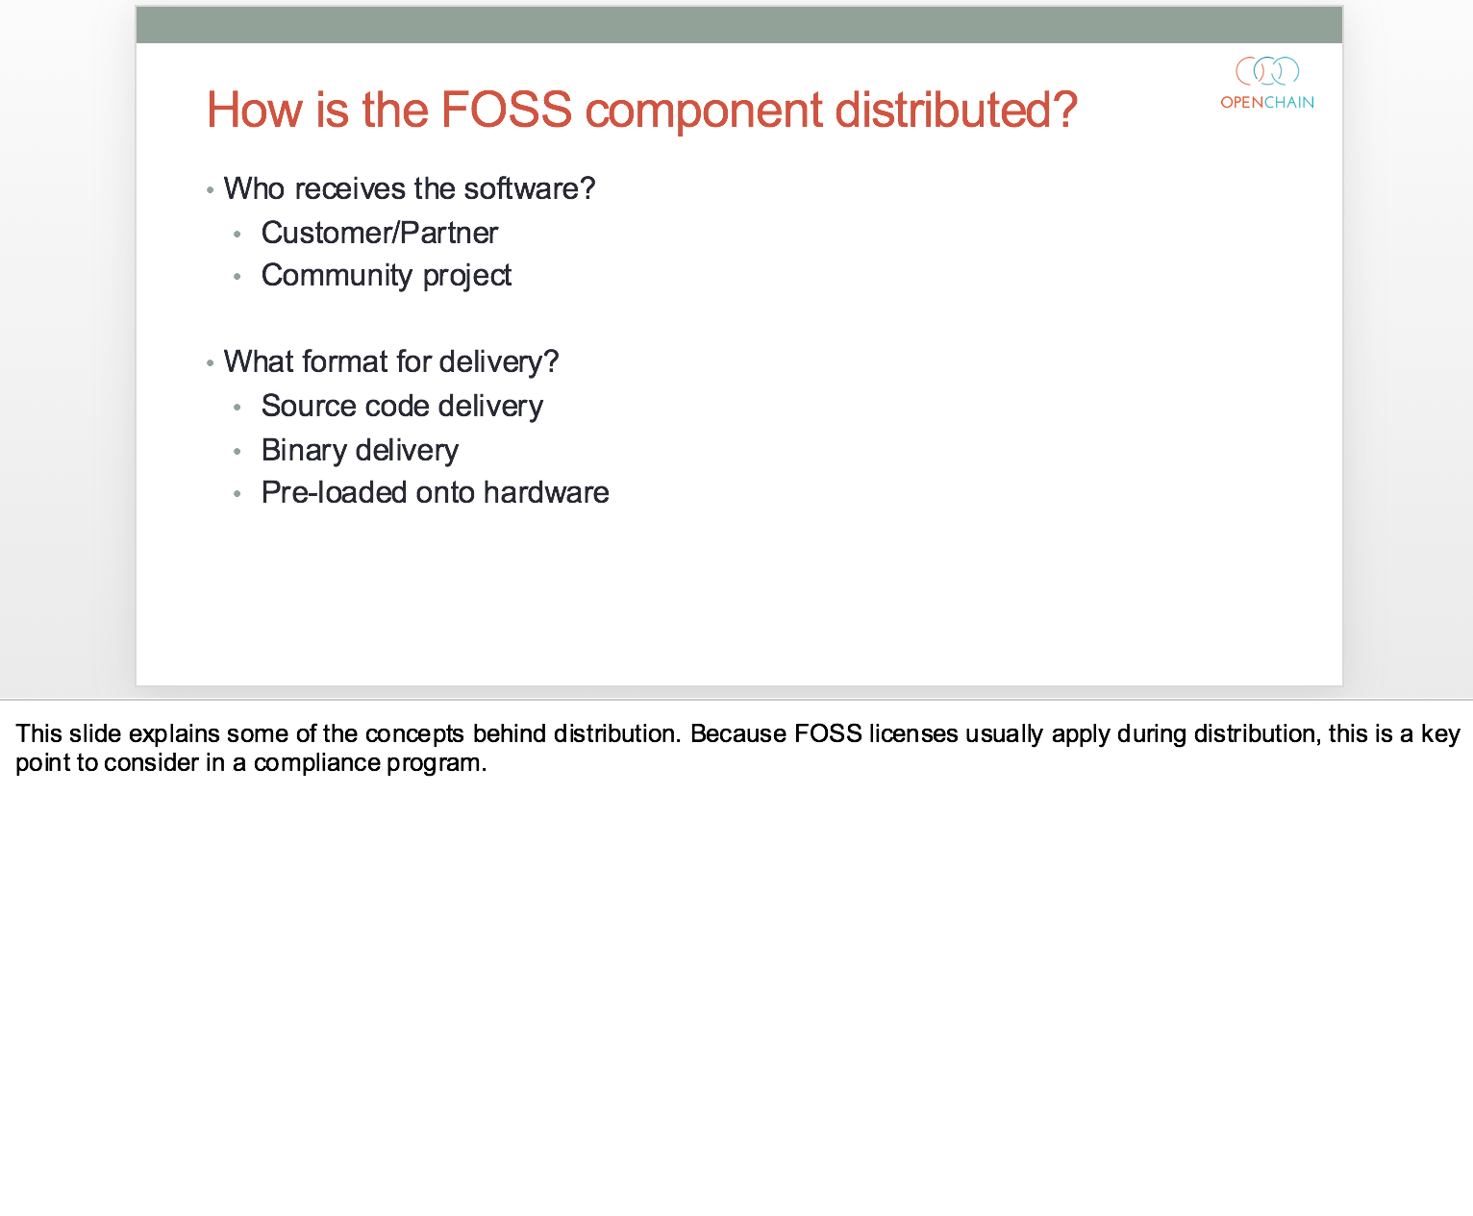

Slide 12
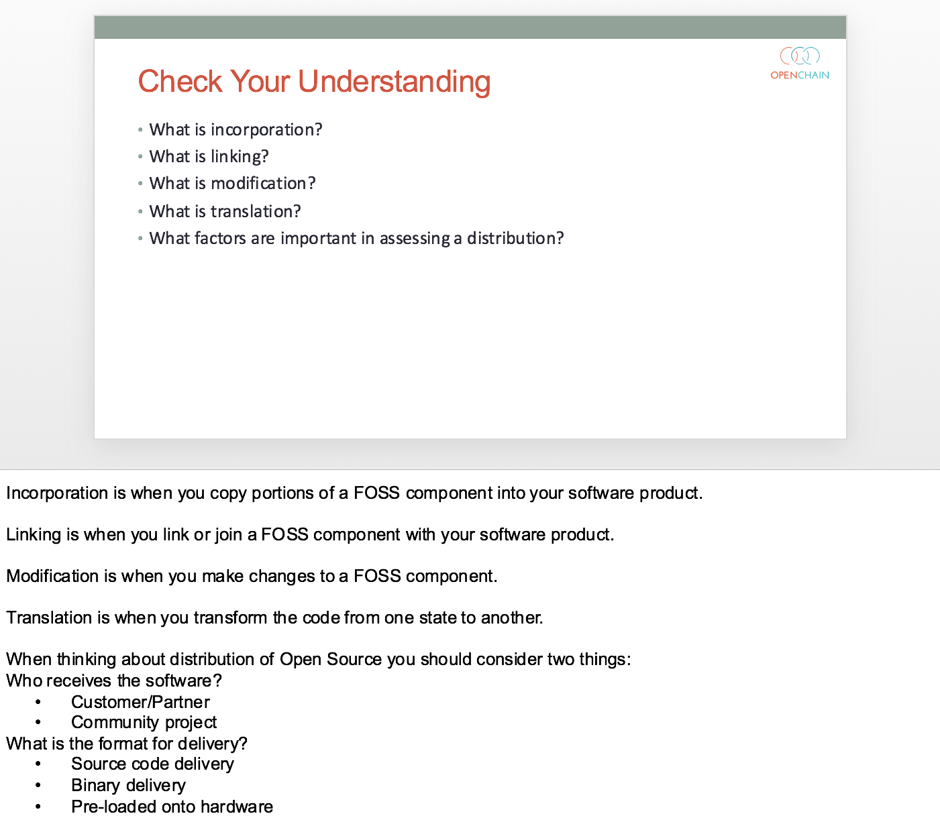

Slide 13
Boring in a good way
The OpenChain Release 2 slides gently improve our material

Slide 14
Key Points
Moving from Release 1 to Release 2 slides will contain no surprises
Translation updates will be straightforward and primarily focus on adding the newly expanded slide notes for trainers
Think of them as the iPhone 3G of FOSS compliance training slides.

Slide 15
Get The Release 2 Slides Now
The OpenChain Release 2 slides are available right now.
You can download them in PowerPoint and PDF format right now at: https://wiki.linuxfoundation.org/openchain/curriculum
They will shortly be featured on the main project page at: https://www.openchainproject.org

Slide 16
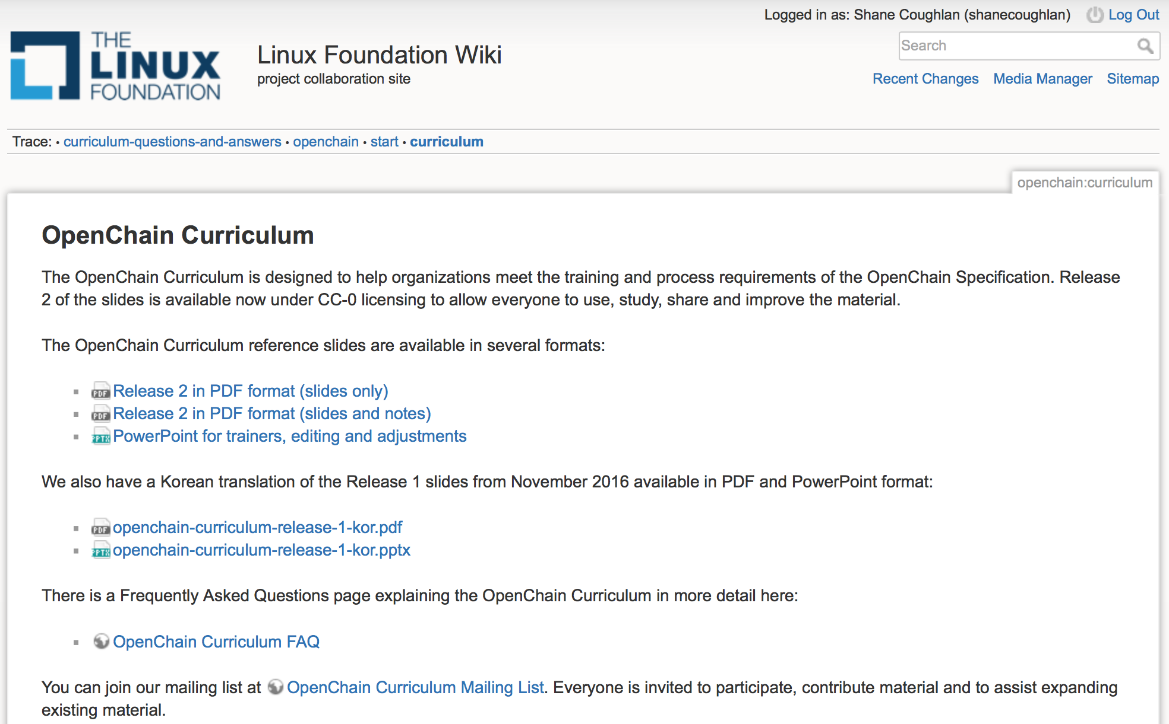

Slide 17
What is coming next?
The OpenChain Release 3 slides will take use further

Slide 18
More Chapters, More Material
In 2017 we will work on adding a new chapter with developer guidelines
We will also rework Chapter 6, ‘End to End Compliance Management’ to contain an SME as well as enterprise compliance process example

Slide 19
Preview of Release 3 Contents
What is Intellectual Property?
Introduction to FOSS Licenses
Introduction to FOSS Compliance
Key Software Concepts for FOSS Review
Running a FOSS Review
End to End Compliance Management (Example Process)
Avoiding Compliance Pitfalls
Developer Guidelines

Slide 20
Be part of This
Main Page: https://wiki.linuxfoundation.org/openchain/curriculum
Mailing List: https://lists.linuxfoundation.org/mailman/listinfo/openchain-curriculum

Slide 21
shane@opendawn.com
Questions, comments and suggestions always welcome

