Slide 1
OpenChain Curriculum
Core Open Source Compliance
Version 1
Preview
This is not legal advice

Slide 2
Disclaimer
Disclaimer
These slides do not provide any legal advice
Please consult with your legal counsel if you need specific legal advice

Slide 3
Contents
What is Intellectual Property?
Definitions and Concepts Deep Dive
Introduction to Open Source Licenses
Introduction to Open Source Compliance
Running an Open Source Review: Summary
Running an Open Source Review: Analysis Steps
End to End Compliance Management
Compliance Failures
GPL Violations 101
Lessons Learned from Disputes
General Guidelines
Summary

Slide 4
Chapter 1
What is Intellectual Property?
Notes:
What is intellectual property?
Umbrella term – 4 categories – Patents, Copyright, Trade marks, Trade Secrets are four
- Lots of confusion over boundaries of each (not helped by there being some overlap)
(patent attorneys may equate “IP” with patents only)
Different theories / justifications for protecting “intellectual property”
*Utilitarian/economic incentive perspective – to promote new and improved works for the common good of society (dominant paradigm)
(for © and patents)
→ NEXT SLIDE

Slide 5


Introduction to Intellectual Property
©
®
Notes:
What is intellectual property?
Umbrella term – 4 categories – Patents, Copyright, Trade marks, Trade Secrets are four
- Lots of confusion over boundaries of each (not helped by there being some overlap)
(patent attorneys may equate “IP” with patents only)
Different theories / justifications for protecting “intellectual property”
*Utilitarian/economic incentive perspective – to promote new and improved works for the common good of society (dominant paradigm)
(for © and patents)
→ NEXT SLIDE

Slide 6
What is “intellectual property”?
Trade secrets: protects confidential and valuable information
Trademarks: protects marks (word, logos, slogans, color, etc.) that identify the source of the product
Consumer and brand protection; avoid consumer confusion and brand dilution
Patents: useful inventions that are novel, useful, non-obvious
Limited monopoly to incentivize innovation
Copyright: protects original works of authorship
Protects expression (not the underlying idea)
Software, books, audiovisual materials, semiconductor masks
Notes:
Quick explanation of each: gloss over trade secrets and trademark law;
Main focus on copyright law, since that is the most relevant when it comes to open source licenses and their interpretation (compliance) and patent law (are there patent grants implicated and to what extent) (Trademark too, but not going to focus on here)

Slide 7

Trademarks
Purpose is to protect consumers, avoid confusion
Similar trademarks can co-exist in different jurisdictions and markets
Trademarks continue in force until abandoned by owner or become un-protectable
Trademark owner must enforce the mark
Can be registered or unregistered
In U.S., rights arise from use in commerce
Notes:
US law
Derives under Commerce Clause (federal law – Lanham Act, also protection under state law)
logos, also, slogans (not copyrightable); color (Tiffany blue; pink insulation), fragrance. Also covers trade dress – e.g. Rolls Royce grill
Also covers service marks
Rationale of consumer protection is key to understand – rely on quality of goods
Protects TM owner from dilution or piggy-backing off quality investment
Use in commerce - (you can’t really be a trademark troll), can also file if you have ‘bona fide intention to use in commerce’
Certification – certify regional or other qualifications
Collective– members of a cooperative
Can be registered ® or unregistered ™
Registered trademarks are more powerful than unregistered
Registrations cover specific goods and services - classified according to an international classification system (NICE)
Can be registered nationally, regionally or internationally
Examination, practice and costs differ in each territory
Trademark registrations can last forever if managed carefully
Generally renewed every 10 years
Continue in force until abandoned by owner or become un-protectable
Trademark owner must enforce the mark
Trademarks generate reputation and goodwill; and protect brands
Valuable IP assets (like patents)

Slide 8
Patents – What do you get?
Inventions are owned by individuals unless and until assigned to a company
Patents have a limited duration
Patents cover limited subject matter
Coverage of software varies by jurisdiction
A patent does not give you any rights:
only the right to stop others
… in return for disclosing the invention to public
U.S. duration is 20 years from filing
Notes:
Novelty – must be new compared to prior art; does not require affirmative action to bring to attention of public – e.g., Conference paper submissions, Covers both written and oral disclosures, where someone could have seen or overheard it – it doesn’t matter if anyone did actually see or hear it. Eg conversation in an empty pub; article hidden in a library book; obscure website.
Non-obviousness – novel, but obvious to a person having ordinary skill in the art
Capable of industrial application – “new and useful” – general, specific, and beneficial utility – type of things fall foul of this are applications for perpetual motion machines
Not excluded subject matter – a bit more on this in the next slide, but various things that are not patentable – the case law on this is constantly evolving and various from country to country
Rights:
A patent is a negative right – it doesn’t give you any rights – only the right to stop others working the invention in return for making the invention available to the public
This monopoly right lasts for 20 years from filing the application
What this means is that other companies who want to use the technology have to come to the patent owner to ask for a license to use the patented idea.

Slide 9
Patents - Excluded Subject Matter
Literary, dramatic, musical, and artistic works (these can be protected by Copyright)
Abstract ideas
Laws of nature
Scheme, rule or method for performing a mental act, playing a game or doing business, or
a program for a computer
As such
Physical phenomena
Inventions which are offensive to public morality
Methods of treatment
or diagnosis
The presentation
of information
Notes:
UK law
Coming back to excluded subject matter, various things around the edge here which are not considered to be patentable.
This is an example from UK/European patent law - The part of the law that’s most relevant here is this centre feature:
Scheme, rule or method for performing a mental act, playing a game or doing business, or a program for a computer As such
These two words “as such” are what keeps patent attorneys busy –evolving case law around what this means, but the general rule of thumb is that if you can demonstrate some appreciable technical effect, then you don’t fall foul of this exception.

Slide 10
Copyright
Protects original works of authorship fixed in a tangible medium
Low threshold of creativity
Protection attaches as soon as work is fixed/created
Covers: Literary, dramatic, choreographic, pictorial/graphic/sculpture, motion picture/audiovisual, sound recordings, architecture
Copyright owner = author
If “work made for hire” = employer is author
Lasts for life of author + 70 years
95 years in case of “entity authors”
Notes:
“original” – pretty low standard, but facts are not copyrightable: Feist (1991) – white pages of phone book are compilation of facts – no protection; although a compilation of facts may be copyrightable if enough originality in how the facts are arranged (case rejected sweat of the brow rationale)
How does this apply to data bases? (EU law recognizes protection in databases...)
“fixation” = Capable of being perceived for more than transitory duration: 1982 video game case – © for audiovisual effects displayed. Ct held images were sufficiently permanent b/c repeat themselves; “fixed” does not mean they have to be identical)
software = literary works
words and short phrases are NOT copyrightable – that gets into trademark
Work for hire – default, can agree otherwise in writing

Slide 11
Copyright – What do you get?
The owner of copyright ... has the exclusive right to do and to authorize any of the following:
To reproduce the copyrighted work...
To prepare derivative works based upon the copyrighted work
To distribute copies ... to the public by sale or other transfer of ownership, or by rental, lease or lending
... To perform the copyrighted work publicly
... To display the copyrighted work publicly
Rights are assignable (transfer ownership/all rights)
Notes:
Bundle of sticks theory/analogy – author has rights, can authorize others to do these things via a license
In other words, no license, no right granted
For infringement, a right of the author or copyright holder must have been violated
- Also critical when determining difference b/w a license and a contract
A "derivative work" is a work based upon one or more preexisting works, such as a translation, musical arrangement, dramatization, fictionalization, motion picture version, sound recording, art reproduction, abridgment, condensation, or any other form in which a work may be recast, transformed, or adapted.
A work consisting of editorial revisions, annotations, elaborations, or other modifications which, as a whole, represent an original work of authorship, is a "derivative work". 17 U.S.C. § 101
Derivative works right is based on economic right and that author should be able to take advantage of any downstream financial benefits
Assuming you have permission, then author of derivative work obtain © ownership in new part, while original work © owner retains ownership in original work
Case-by-case, fact-based analysis...
How “distribution” and “derivative work” is interpreted is critical with open source licenses – will cover this in more detail in later and in part 2

Slide 12
Copyright – What it doesn’t cover
Copyright protects the expression (not the idea)
Merger doctrine = if the idea underlying the work can be expressed only in one way → idea and expression “merge”
Fair Use (fair dealing) = permitted use for limited reasons
E.g., commentary, search engines, criticism, parody, news reporting, research, teaching, library archiving and scholarship
Public Domain = works for which © protection has expired or otherwise not protected
Notes:
Idea-expression dichotomy – copyright law only protects the expression: Baker v. Selden (1879) book describing method of book-keeping; copyright protects the book, not the system the book describes
Recipes and empty forms are generally not copyrightable
“in no case does copyright protection for an original work of authorship extend to any idea, procedure, process, system, method of operation, concept, principle, or discovery regardless of the form ...”
Other elements considered unprotectable (when assessing infringement)
Merger doctrine – cannot have a monopoly on an idea (sweepstakes form case)
De minimus - copying must be “substantial” (usually involves music sampling –Beastie Boys, Pass the Mic – used 3-note sequence: wasn’t the “hook” or heart of the song, sequence only used once in song – very fuzzy...)
Scenes a faire – incidents, characters or setting which are as a practical matter indispensable, or at least standard, in the treatment of a given topic
usually used in literary works (storyline) but also used in computer cases; cited in Oracle v. Google case
– MGM v. Honda case: if you want to make a story about a secret agent, then you have to have certain elements (boss, bad guy, chase, etc.) – not protectable, but it’s in the details
British spy v. “M” “Q” and martinis shaken, not stirred would go too far… characters can be protected by ©
Utilitarian – sculpture that was turned into a bike rack. Copied – no protection b/c cannot separate artistic element from functionality

Slide 13
Licenses
Copyright and patents restrict use by others, unless… a license is granted
Types of use allowed (distribution, derivative works / made, have made, manufacture)
Exclusive or non-exclusive
Geographical scope
Perpetual or time limited
Conditions placed upon exercise of enumerated rights
May also include terms re: warranties, indemnification, support, upgrade, maintenance

Slide 14
Check Your Understanding

Slide 15
Chapter 2
Definitions and Concepts Deep Dive

Slide 16
Proprietary License
A proprietary software license is a license that has rules defined by its creators or owners and includes restrictions that applies on the usage, modification and distribution of the software in question.
Proprietary licenses are unique to each vendor, so there are as many forms as there are vendors and each must be evaluated individually.
FOSS developers often use the term “proprietary license” to describe a commercial non-FOSS license.

Slide 17
Permissive License
A permissive software license is a term used often to describe non-reciprocal free software licenses.
Example: BSD License
The BSD license is an example of a permissive license that allows unlimited redistribution for any purpose as long as its copyright notices and the license's disclaimers of warranty are maintained.
The license contains a clause restricting use of the names of contributors for endorsement of a derived work without specific permission.

Slide 18
Freeware
Freeware is software distributed under a proprietary license at no or very low cost.
The source code may or may not be available, and creation of derivative works is usually restricted.
Freeware software is usually fully functional (no locked features) and available for unlimited use (no locking on days of usage).
Freeware software licenses usually impose restrictions in relation to copying, distributing, and making derivative works of the software, as well as restrictions on the type of usage (personal, commercial, academic, etc.).

Slide 19
Shareware
The term shareware refers to proprietary software provided to users on a trial basis, for a limited time, free of charge and with limited functionalities or features.
The goal of shareware is to give potential buyers the opportunity to use the program and judge its usefulness before purchasing a license for the full version of the software
Most companies are very leery of Shareware, because Shareware vendors often approach companies for large license payments after the software has freely propagated within their organizations.

Slide 20
Public Domain
The term public domain refers to intellectual property not owned or controlled by anyone, and therefore it is considered public property available for anyone to use for any purpose.
An example of public domain source code is the JavaScript implementation of object notation available for download from http://www.json.org/json2.js. The script declares the following:
Public Domain.
NO WARRANTY EXPRESSED OR IMPLIED. USE AT YOUR OWN RISK.

Slide 21
Distribution
Distribution is the provision of a copy of a piece of software in binary or source code form to another entity (an individual or organization outside your company or organization).
The GPL V3 uses the term “conveyance” instead.
The right to distribute verbatim source code and derivative works (i.e. modifications applied to the original source code base) is central to the definition of Open Source.
There are several interpretations of what constitutes a distribution and what triggers license obligations with that respect.
License interpretations are outside the scope of this course. Consult with your Legal counsel on this.

Slide 22
Use and Modification
The rights to use and modify source code are a primary benefit of open source licenses.
Many Open Source Licenses, including the GPL, do not restrict internal use or development within the licensee’s enterprise (unlimited copies, users, etc.).

Slide 23
Derivative Work
The term derivative work refers to a new work based upon an original work to which enough original creative work has been added so that the new work represents an original work of authorship rather than a copy.
The interpretation of what constitutes a derivative work is subject to debate in the FOSS community and within FOSS legal circles.
It is best to assume the broadest interpretation of the license terms and not to rely on any legal ambiguity.

Slide 24
License Reciprocity/Copyleft
License reciprocity, or copyleft, is a term that describes the requirement to license distribution of derivative works under the same terms as the original work.
Example of license reciprocity from the GPL version 2:
“You must cause any work that you distribute or publish, that in whole or in part contains or is derived from the Program or any part thereof, to be licensed...under the terms of this License.”

Slide 25
License Proliferation 1 of 2
License proliferation is a term that refers to the problems created when additional software licenses are written for software packages.
The issue stems from the tendency for organizations to write new licenses in order to address real or perceived needs for their software releases.

Slide 26
License Proliferation 2 of 2
Often when a software developer would like to merge portions of different software programs they are unable to do so because the licenses are incompatible.
When software under two different licenses can be combined into a larger software work, the licenses are said to be compatible.
As the number of licenses increases, the probability that a FOSS developer will want to merge software together that are available under incompatible licenses increases.
There is also a greater cost to companies that wish to evaluate every FOSS license for software packages that they use.

Slide 27
License Compatibility
License compatibility is a term that refers to the problem encountered when combining source code originating from different software components licensed under incompatible licenses making it impossible to combine the source code to create a new software component.
The FSF provides the following example to illustrate the case of license compatibility:
A license p is compatible with a license q (or is q-compatible) if
A work licensed under p can be distributed under the terms of q.
Example:
The X11 license is compatible with the GPL version 2, because works licensed under the X11 license, can be distributed under the terms of the GPL.

Slide 28
GPL Compatibility
GPL compatibility refers to the situation of determining if a certain license has compatible terms with the GPL.
Many of the FOSS licenses, such as the BSD license and the LGPL, are GPL-compatible, meaning that their source code can be combined with a source code that is licensed under the GPL without conflict; the new program resulting from the combination would have to be licensed under the GPL applied.
Other FOSS and proprietary software licenses are not GPL-compatible since they have conflicting terms and conditions.
Reference: http://www.fsf.org/licensing/licenses/

Slide 29
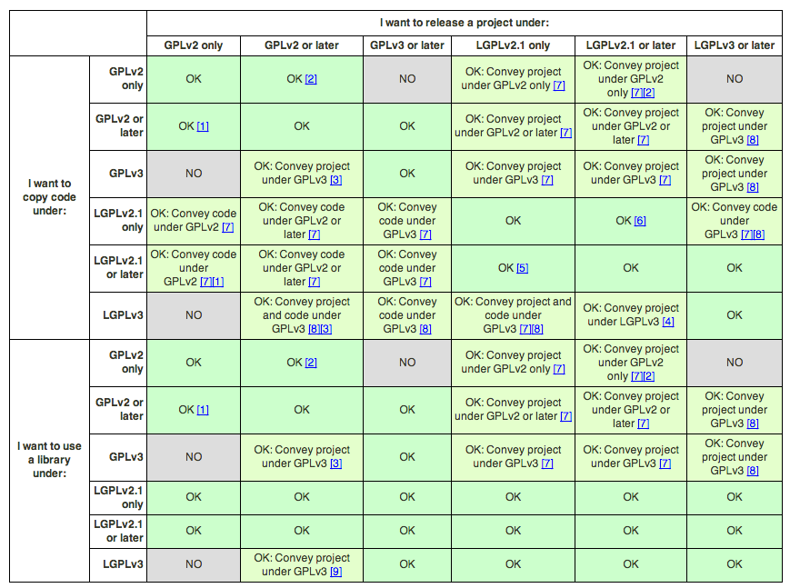
How are the various GNU licenses compatible with each other?

Slide 30
Dual licensing
Dual licensing refers to the practice of distributing software under two different sets of terms and conditions.
When software is dual licensed, recipients can choose which terms they want to use or distribute the software under.
Example: MySQL
MySQL is available under a dual license model: Commercial or GPL.

Slide 31
Notices
Attribution notice - a notice included in the product release that acknowledges the identity of the original authors of the FOSS included in the product.
Copyright notice - an identifier placed on copies of the work to inform the world of copyright ownership. Example: Copyright © Ibrahim Haddad (2011). All Rights Reserved.
License notice - a notice that acknowledges the license terms and conditions of the FOSS included in the product.
Modification notice - a notice of the modifications made to the source code in a change log file, such as those required by the GPL and LGPL. Example of a modification notice at the beginning of the source code file:
/*
* Date Author Comment
* ------ --------- --------------
* 01/05/2010 Ibrahim Haddad Fixed memory leak in FastForward()
*/

Slide 32
Attribution Notice
An attribution notice is a notice included in the product documentation that acknowledges the identity of the original authors of the FOSS included in the product.

Slide 33
Copyright Notice
A copyright notice is an identifier placed on copies of the work to inform the world of copyright ownership.
Example:
Copyright © Ibrahim Haddad (2011). All Rights Reserved.

Slide 34
License Notice
A license notice is a notice that acknowledges the license terms and conditions of the FOSS included in the product.

Slide 35
Modification Notice
A modification notice is a notice of the modifications made to the source code in a change log file, such as those required by the GPL and LGPL.
Example of a modification notice at the beginning of the source code file:
/*
* Date Author Comment
* ------ --------- --------------
* 01/05/2010 Ibrahim Haddad Fixed memory leak in FastForward()
*
*/

Slide 36
Check Your Understanding

Slide 37
Chapter 3
Introduction to Open Source Licenses

Slide 38
Content
Terms and Definitions
License Obligations – GPL example

Slide 39
Open Source Software Licenses
In general, OSS licenses makes the source code available under terms that allow for modification and redistribution without having to pay the original author.
OSS licenses may have restrictions such as requirements related to attributions, copyright statement preservation, providing a written offer to make the source code available, or others.

Slide 40
“Types” of Open Source Licenses
Permissive
License requirements are minimal (retain notice; include copy of license)
Broad grant of rights (with no conditions for particular licensing terms)
Copyleft
Source code must be made available for binary distribution
Original work, any modifications, any derivative work must remain under same license
Entire derivative work or only modified files
Notes:
Also talk about “strong copyleft” versus “weak copyleft”
Viral or contaminating also terms used (perjorative; don’t use these terms) → Virus is something you catch – you should know what software you are using…
Hereditary, self-perpetuating, reciprocal
Copyleft is a concept; the GPL is an implementation
--what is the goal?
If your goal is to encourage wide use of your software (# of users) → permissive license that allows it to combined and used in any way makes sense
If your goal is freedom, in terms of perpetuating the freedom to use, modify, and redistribute the program as you like → then you want something that maintains that freedom going forward

Slide 41
“Types” of Open Source Licenses
Permissive
MIT
BSD
Apache 1.1
Apache 2.0
Copyleft
MPL
CDDL
LGPL
GPL
AGPL
Notes:
(in order of copyleft “strength”)
MPL = Mozilla Public License
CDDL = Common Distribution and Development License
LGPL = Lesser (Library) General Public License
GPL = General Public License
AGPL = Affero General Public License
See spdx.org/licenses
Categories are helpful, but not the end-all-be-all…

Slide 42
Impact of FOSS Licenses
FOSS licenses may impact:
Use of the software
Modification of the software
Maintenance of the software
Distribution of the software and its derivatives
Intellectual property rights (IPR)

Slide 43
Permissions Granted
FOSS licenses may permit:
Modification of the source code
Recompilation of the software
Redistribution of the original source code, modified source code and/or binaries
Integration of the software with proprietary software
Redistribution of the resulting software as part of, or within, proprietary products

Slide 44
Possible Imposed Conditions
FOSS licenses may impose conditions that include one of more of the following:
Notification to the recipient that the software is licensed under the respective FOSS license
Source code distribution to the recipient of the software
Distribution of any integrated proprietary source code
Most FOSS licenses do not include any warranty or indemnity to customers

Slide 45
OSI Approved OSS Licenses
One popular set of open source software licenses are those approved by the Open Source Initiative (OSI) based on their Open Source Definition (OSD)
Complete list of OSI-approved OSS licenses is available at http://www.opensource.org/licenses/
Note:
Many development organization with FOSS policies allow only (a subset) of the OSI Approved licenses without full legal review.
This is because the licenses are well-known.

Slide 46
What is NOT open source software?
Freeware
Free (as in cost)
No access to source code
License usually has various restrictions
License is specific to that program
Shareware
Free (as in cost) for a set period
A.K.A. trialware or demoware
Public Domain
Expired © or not protectable
Some s/w is “released” into the public domain via a “dedication”
Because these are “free” (no cost), sometimes mistaken for
free software or open source software
Notes:
- These are not actually consistently defined terms
Sometimes freeware licenses look like open source (and vice versa)…
Freeware examples: Sun licenses, iTunes, Adobe Reader, DropBox, every mobile app you’ve ever downloaded… etc. *binary only*
Install on one computer; cannot distribute; cannot reverse engineer; might have restrictions on what kind of OS you can use with or otherwise
Shareware – usually the same as Freeware, but only “free” for a period of time or # of uses
Public domain “dedication” (e.g., CC0 – not really a license, but you’ll still hear “public domain license”
- issues with wording (it ends up being a license) – just because it says “public domain” doesn’t mean it is
*public domain could be open source, but open source is not public domain *

Slide 47
Compliance: Typical Conditions & Restrictions
Retain copyright (and other) notices
Provide a copy of the license
Provide notice of modifications
Provide access to source code (whether you modified it or not)
Maintain modified versions (derivative works) under same license
Provide attribution
Do not use the project or copyright holder name or trademark
Do not restrict others of the rights granted
Termination clauses (if you breach, you lose license)
Notes:
Look at permissive v. copyleft in terms of compliance conditions: most of the requirements are pretty easy to fulfill...
- TM/ name restrictions – usually mostly an FYI, basic under TM law... to suggest endorsement or to promote is not allowed
- Patent retaliation clauses (if you file a patent suit)
Other odd ones:
Buy a beer (is this an obligation or suggestion?)
Chicken dance
Buy the author’s book – Jason Hunter license
Good not evil (ridiculous) – sqlite

Slide 48
Open Source License Compliance Analysis
Can you break license requirements into an IF – THEN statement?
IF I am... distributing, modifying… (in binary or source form)...
Trigger or usage model - How am I using the software?
THEN I must... provide a copy of the license, retain notices, provide the source code...
WHAT is the requirement?
HOW does that requirement need to be met?
Devil’s in the details…
Notes:
48
IF = “trigger” or “usage”
If you are NOT distributing the software, you probably don’t have anything to do in terms of compliance (or risk)
We’ll talk more about some of the challenges around this in Part 2, but for now, we’ll finish up with some of the common open source license “triggers”

Slide 49
OSS Compliance Triggers
Distribution
Dissemination of material to a change of hands
May be broader than non-lawyers think
GPLv2: “Activities other than copying, distribution and modification are not covered by this License; they are outside its scope. The act of running the Program is not restricted, . . . “
Is access via a computer network (ever) a “distribution”?
Applications download to the user’s machine (e.g. mobile)
Javascript, web client, or other code that is downloaded to the user’s machine
Some licenses define as such: Affero GPL, Apple Public Source License, RealNetworks, Reciprocal Public License
Notes:
The 1976 House Report: defines “publication” in the negative by saying, “any form of dissemination in which a material object does not change hands – performances or displays on television, for example – is not publication .” Later case law equated distribution with publication.
WHOLLY OWNED SUB – can make argument that unity of ownership = not another person, but if minority-owned sub…
PARTNER/IND. CONTRACTOR – can be considered distribution b/c not an employee; small firms and outsourcing is definitely going to trigger
M&A – definitely distribution; then also have other considerations re: Ks assignable, but IP licenses are not, unless explicitly stated – this can then effect distribution
SAAS/CLOUD – not distribution? But see AGPL
APL: 1.4 "Externally Deploy" means: (a) to sublicense, distribute or otherwise make Covered Code available, directly or indirectly, to anyone other than You; and/or (b) to use Covered Code, alone or as part of a Larger Work, in any way to provide a service, including but not limited to delivery of content, through electronic communication with a client other than You.
RealNetworks: 1.7 "Externally Deploy" means to Deploy the Covered Code in any way that may be accessed or used by anyone other than You, used to provide any services to anyone other than You, or used in any way to deliver any content to anyone other than You, whether the Covered Code is distributed to those parties, made available as an application intended for use over a computer network, or used to provide services or otherwise deliver content to anyone other than You.
Reciprocal: 1.14 "Serve" means to deliver Licensed Software and/or Your Extensions by means of a computer network to one or more computers for purposes of execution of Licensed Software and/or Your Extensions.

Slide 50
OSS Compliance Triggers
Modifications
Changes to the existing program: additions, deletions, etc.
Usually need to provide notice of modification, so important to track this
For internal reasons also?
Modifications may constitute a derivative work
What if you create a new work by combining works? . . . (what is a derivative work?)
Notes:
Why else would you want to track modifications?

Slide 51
How do you know what license applies?
Sometimes it’s in the files, sometimes it’s not...
Code that doesn’t have an obvious license included
Licenses that don’t seem to belong to any particular code
License included is different from the one identified on the project website
Code that has only a © notice and “all rights reserved” with no license text
Comments in code that have additional terms (not in license)
Multiple licenses – conjunctive or disjunctive?
Notes:
ASK: how do you know what license applies?
Examples of when it’s not so clear:
CODE + NO LICENSE – outside research needed (Google code, project site, etc.)
LICENSES + NO CODE - Ex: found a folder called “3rd party licenses” with a bunch of licenses and no associated code in that directory
UNCLEAR LICENSE – many scenarios of this… e.g., “this is licensed under the same license as Ruby”
Scanning is not the end-all, be-all solution either…
From a development perspective – what do you think best practice would look like?

Slide 52
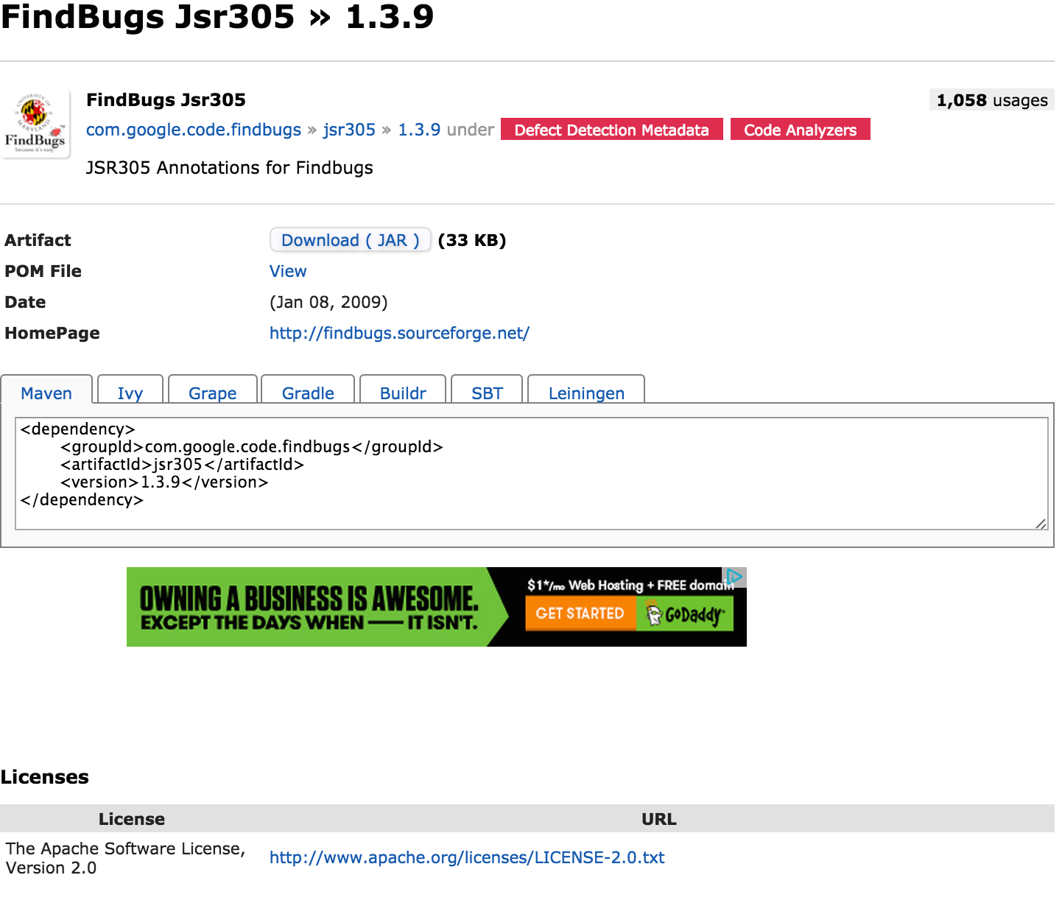
Notes:
Example of where license said one thing in one place (Maven repo), but…

Slide 53
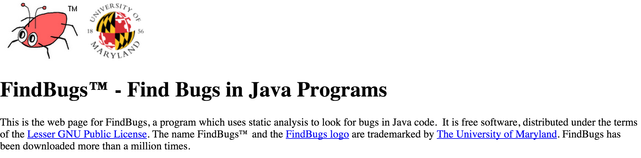
Notes:
Project website said something different – actual license with source code found to be LGPL

Slide 54
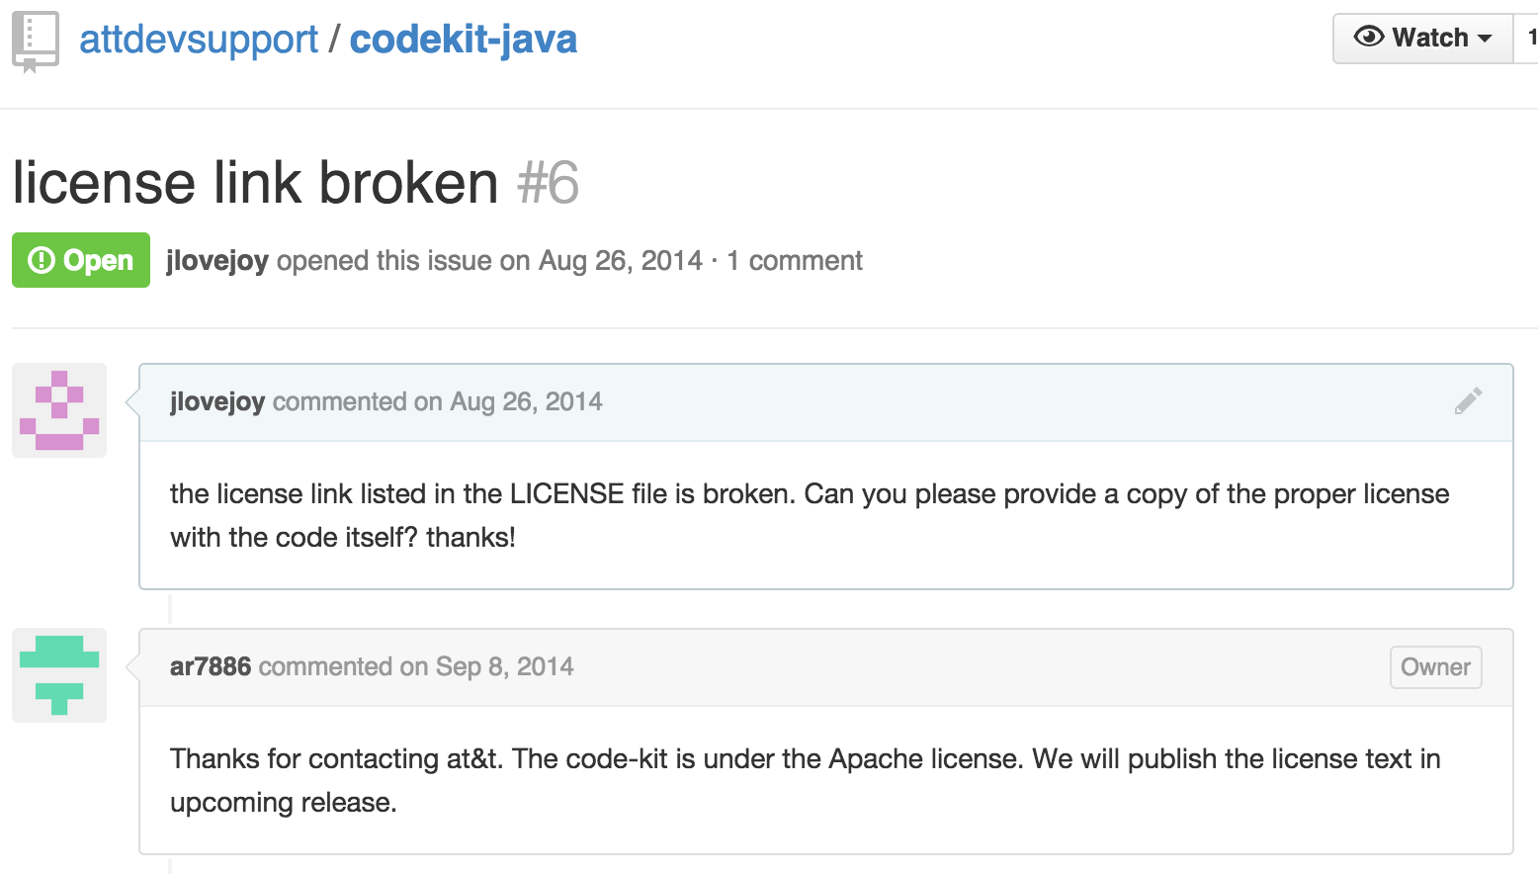
Notes:
When in doubt, ask… usually people are receptive to answering your question or fixing the lack of information

Slide 55
Multiple Licenses
Conjunctive = Multiple licenses apply
GPL-2.0 project also includes code under BSD-3-Clause
→ have to comply with both
Disjunctive = Choice of one open source license or another
Mozilla tri-license
Jetty
Ruby
Dual = Choice of open source license (probably GPL) or commercial license
Notes:
DISJUNTIVE LICENSING = you have a choice of licensing, i.e. GPL and a more permissive license option, you may choose which license you are going to distribute under depending on license compatibility, license requirements.
Sometimes a project has a disjunctive licensing situation, but only one license is included in your code – so perhaps the person you got the code from already made this choice. If they choose the license you weren’t going to use, now you might have to consider if you should figure out who the original © holder is and get the code directly from them
Example:
MPL 1.1/GPL 2.0/LGPL 2.1 - -
“The contents of this file are subject to the Mozilla Public License Version - 1.1 (the "License"); you may not use this file except in compliance with - the License.
. . .
Alternatively, the contents of this file may be used under the terms of - either the GNU General Public License Version 2 or later (the "GPL"), or - the GNU Lesser General Public License Version 2.1 or later (the "LGPL"), - in which case the provisions of the GPL or the LGPL are applicable instead - of those above.
If you wish to allow use of your version of this file only - under the terms of either the GPL or the LGPL, and not to allow others to - use your version of this file under the terms of the MPL, indicate your - decision by deleting the provisions above and replace them with the notice - and other provisions required by the LGPL or the GPL. If you do not delete - the provisions above, a recipient may use your version of this file under - the terms of any one of the MPL, the GPL or the LGPL. “
“dual” = confusing term that may be used for any of these situations, but usually refers to business model of OSS license or commercial license choice
For more on dual-licensing as a business model: http://oss-watch.ac.uk/resources/duallicence2

Slide 56
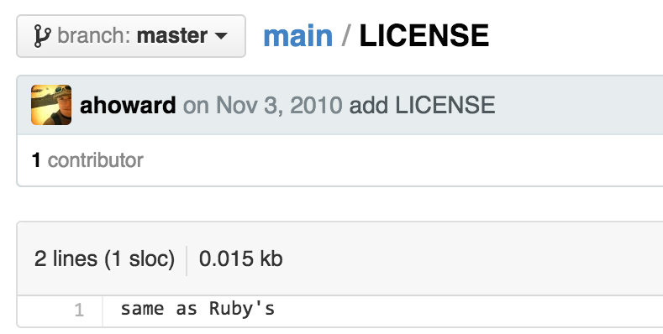
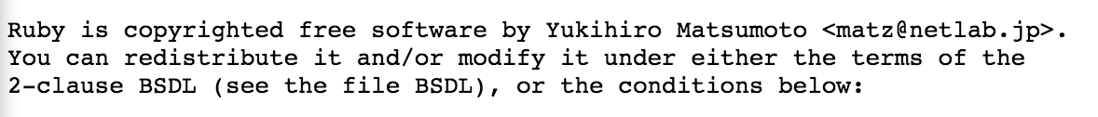
Notes:
Ruby is disjunctively licensed Ruby license or BSD-2-Clause.
For versions prior to 1.9.3, the disjunctive license choice was between the Ruby License or GPL-v2 or later.
Hence “same as Ruby’s” is not really helpful…

Slide 57
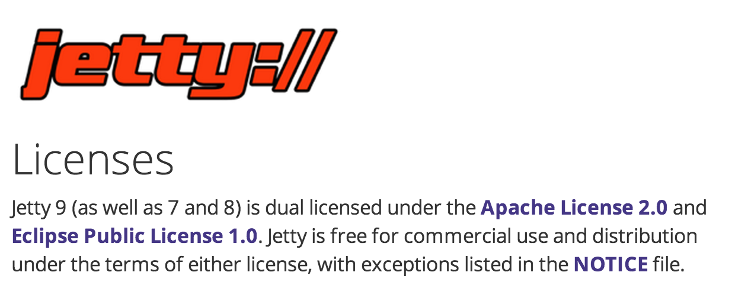
Notes:
Jetty is disjunctively licensed: choice of EPL-1.0 or Apache-2.0 – but use of the word “and” makes this a bit confusing.

Slide 58
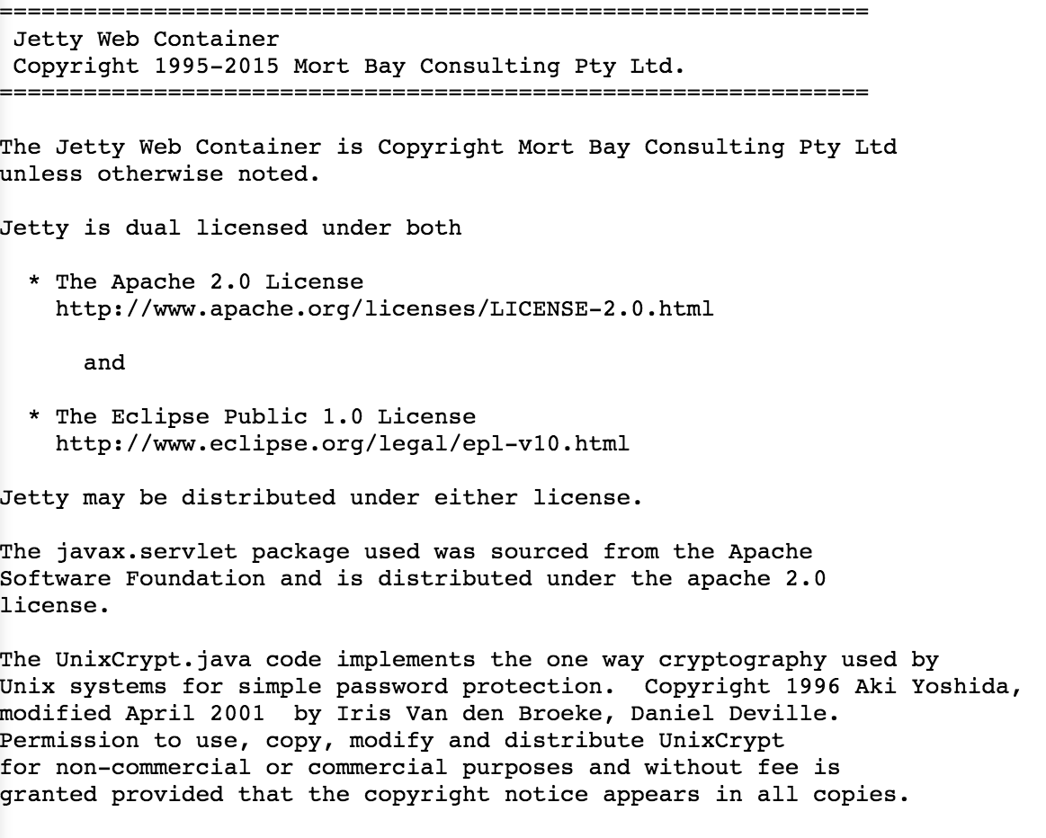
Notes:
This would be better if it said:
“Jetty is disjunctively licensed under… Apache-2.0 or EPL-1.0…”
Instead of using the words “both” and “and”

Slide 59
Multiple Licenses
Conjunctive = AND
Multiple licenses apply
Disjunctive = OR
Choose one
Dual = OR
Choice of open source license or commercial license

Slide 60
Tips for developers/engineers
If you don’t have / can’t find a license, then you don’t have one / can’t use it
Not all “free” licenses are open source
Know what the difference types of licenses mean in terms of process for approval (but you don’t have to be able to identify, Legal can help)
Keep track of what you are using, how you are using, and if modifying it (and how)
Get approval for using the OSS (and license)

Slide 61
Check Your Understanding

Slide 62
Chapter 4
Introduction to Open Source Compliance

Slide 63
Open Source Compliance
Open Source Compliance:
Know your obligations (Detect and track use of FOSS). You should have a process for identifying, tracking and archiving a list of all FOSS components (and their respective identified licenses) from which your software is comprised.
Satisfy all the license obligations for the FOSS that is used. Your program should identify and handle typical FOSS use cases that result from your organization’s business practices.

Slide 64
What Basic Compliance Obligations Must Be Satisfied?
Depending on the license(s) involved, obligations could consist of:
Attribution and Notices. Inclusion of copyright and license in the source code and/or product documentation or user interface, so that downstream users know the origin of the software and their rights under the licenses.
Source code availability. Providing source code for original work, for combined work or modifications, as well as build scripts (scripts that control the build process).
These obligations may trigger upon key events, such as:
External distribution
Whether you have made modifications

Slide 65
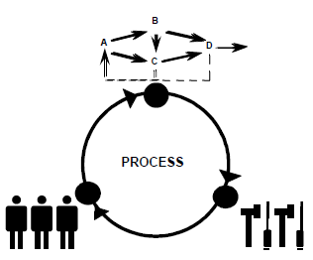
Open Source Compliance Program
Organizations who have been successful at Open Source Compliance have created their own Open Source Compliance Programs (consisting of policies, processes, training and tools) to:
Facilitate effective usage of FOSS in commercial products
Respect FOSS developer rights and comply with license obligations, and ideally to contribute and participate in open communities

Slide 66
Open Source Compliance Program – Business Practices
Prepare business processes and sufficient staff to handle:
Identification of the origin and license of FOSS software
Tracking FOSS software within the development process
Performing FOSS review and identifying license obligations
Fulfillment of license obligations when product ships
Oversight for Open Source Compliance Program, creation of policy, and compliance decisions
Training

Slide 67
Compliance Benefits
Benefits of a robust Open Source Compliance program include:
Increased understanding of the benefits of FOSS and how it impacts your organization
Increased understanding of the costs and risks associated with using FOSS
Better relations with the FOSS community and FOSS organizations
Increased knowledge of available FOSS solutions

Slide 68
Check Your Understanding
What does open source compliance mean?
What are two main goals of an Open Source Compliance Program?
List and describe important business practices of an Open Source Compliance Program.
What are some benefits of an Open Source Compliance Program?

Slide 69
Chapter 5
Running an Open Source Review: Summary

Slide 70
Open Source Review
A key element to an Open Source Compliance Program is the Open Source Review, through which a company can analyze and determine its open source obligations.
The Open Source Review includes the following steps:
Gather relevant information
Analyze and determine license obligations
Provide guidance in light of company policy and business objectives

Slide 71


Initiating an Open Source Review
Initiate an Open Source Review
Program Manager
Product Manager
Engineer
The Open Source Review process should be accessible to Program/Product Managers, Engineers and others who may be working with FOSS.
Note: This process may also start when receiving FOSS-based software from outside vendors.

Slide 72

What information do you need to gather?
When conducting an Open Source Review, collect information about the identity of the FOSS component, its origin, and how the FOSS component will be used. This may include:
Package name
Version
Original download URL
License and License URL
Description
Description of modifications
List of dependencies
Intended use in your product
First product release that will include the package
Availability of source code
Where the source code will be maintained
Whether the package had previously been approved for use in another context
Inclusion of technology subject to export control
If from an external vendor:
Development team's point of contact
Copyright notices, attribution, source code for vendor modifications if needed to satisfy license obligations

Slide 73



Open Source Review Team
Initiate an Open Source Review
Program Manager
Product Manager
Engineer
Legal
Scanning
Specialists
An Open Source Review alerts and engages the various support groups that work together to support, guide, coordinate and review the use of FOSS. This team may include:
Legal team to identify and evaluate license obligations
Scanning and tooling support team to help identify and track FOSS usage
Specialists working with business interests, commercial licensing, export compliance, etc., who may be impacted by FOSS usage

Slide 74
Analyzing Proposed FOSS Usage
Legal
Scanning
Specialists
The Open Source Review team should assess the information it has gathered before providing guidance, including for issues such as:
Completeness, consistency, accuracy
Open source scanning tools may be used to scan for undisclosed open source usage
Does the declared license match what's in the code files?
Does the license truly permit the proposed use of the software?

Slide 75



Working through the Open Source Review
Initiate an Open Source Review
Program Manager
Product Manager
Work
Engineer
Legal
Scanning
Specialists
Guidance
Working through the Open Source review process is interactive. The work crosses disciplines, including engineering, business, and legal, and may result in follow-up discussion so that all parties understand the underlying issues. Ultimately, the process should result in clear guidance on FOSS usage.

Slide 76

Open Source Review Oversight
Initiate an Open Source Review
Program Manager
Product Manager
Work
Engineer
Legal
Scanning
Specialists
Guidance
Executive Review Committee
The Open Source Review process should have sufficient oversight in cases of disagreement between any of the parties involved, or when a decision is particularly important.

Slide 77
Check Your Understanding
What is the purpose of an Open Source Review?
List and describe information may be important in an Open Source Review.
What additional information is important when reviewing a FOSS component from an outside vendor?
What steps can be taken to assess the quality of this information?

Slide 78
Chapter 6
Running an Open Source Review: Analysis Steps

Slide 79
Starting an Open Source Review
Gather the necessary information:
What is the open source component?
How do you want to use it?
How it is distributed or shared?
Notes:
In developing a description for the review you will answer three general questions about the Open Source you want to use.
What is it?
To answer “what is it?”, you will provide documentation.
How do you want to use it?
In addition to providing all of the documentation that describes what it is, you need to explain how you want to use the Open Source material.
Who gets it and how?
Along with providing the documentation and explaining how you want to use the Open Source, you will need to be able to discuss the distribution model. Who gets the deliverable and how will they receive it?

Slide 80
What is the open source component?
How is the software licensed?
License headers
Notice documents
FAQs
Terms of Use
What is the origin of the open source software?
Author
Site where found
When created
Which project
Hosting site, URL
How the files were created
Tools used to create files
Notes:
For all Open Source in your project, you will need to identify and provide a copy of any applicable license.
If you are using multiple Open Source components in your project, make sure that you provide copies of all the licenses.
If there is no license statement or indication of a license, make a note of it. This information will be needed as part of the review.
License and copyright information may be in the code, accompanying files or elsewhere on the site.
You also need to provide a copy of any notice documents or files, such as license.txt, copying, and readme.
In addition, provide a copy of any FAQs or Terms of Use from the site. There may be wording in FAQs and notice documentation that might have important information.
You will also need to record the origin - where the Open Source project materials came from.
Origin information might include the author’s name, the site where you downloaded the Open Source, when it was created, for which open source project it was created, hosting site’s URL, how the files were created, and any tools that were used to create the files. The more information you can provide, the easier it will be to confirm the applicable license.
In the next section we’ll talk about the kinds of tools that need to be reviewed.

Slide 81
How do you know what license applies?
Sometimes it’s in the files, sometimes it’s not...
Code that doesn’t have an obvious license included
Licenses that don’t seem to belong to any particular code
License included is different from the one identified on the project website
Code that has only a © notice and “all rights reserved” with no license text
Comments in code that have additional terms (not in license)
Multiple licenses – conjunctive or disjunctive?
Notes:
ASK: how do you know what license applies?
Examples of when it’s not so clear:
CODE + NO LICENSE – outside research needed (Google code, project site, etc.)
LICENSES + NO CODE - Ex: found a folder called “3rd party licenses” with a bunch of licenses and no associated code in that directory
UNCLEAR LICENSE – many scenarios of this… e.g., “this is licensed under the same license as Ruby”
Scanning is not the end-all, be-all solution either…
From a development perspective – what do you think best practice would look like?

Slide 82
Develop a description
What is it?
How do you want to use it?
Who gets it and how?
Notes:
In developing a description for the review you will answer three general questions about the Open Source you want to use.
What is it?
How do you want to use it?
Who gets it and how?
To answer “what is it?”, you will provide documentation.

Slide 83
Initiate an Open Source Review
Program Manager
Product Manager
Work
Engineer
Legal
Scanning
Specialists
What is it?
Licenses
Notes:
For all Open Source in your project, you will need to identify and provide a copy of any applicable license.
If you are using multiple Open Source components in your project, make sure that you provide copies of all the licenses.
If there is no license statement or indication of a license, make a note of it. This information will be needed as part of the review.

Slide 84
An Example BSD-type License (ref: Opensource.org):
Copyright Statement
Copyright (c) 2012, A. Person All rights reserved.
Redistribution and use in source and binary forms, with or without modification, are permitted provided that the following conditions are met:
Redistributions of source code must retain the above copyright notice, this list of conditions and the following disclaimer.
Redistributions in binary form must reproduce the above copyright notice, this list of conditions and the following disclaimer in the documentation and/or other materials provided with the distribution.
THIS SOFTWARE IS PROVIDED BY THE COPYRIGHT HOLDERS AND CONTRIBUTORS "AS IS" AND ANY EXPRESS OR IMPLIED WARRANTIES, INCLUDING, BUT NOT LIMITED TO, THE IMPLIED WARRANTIES OF MERCHANTABILITY AND FITNESS FOR A PARTICULAR PURPOSE ARE DISCLAIMED. IN NO EVENT SHALL THE COPYRIGHT HOLDER OR CONTRIBUTORS BE LIABLE FOR ANY DIRECT, INDIRECT, INCIDENTAL, SPECIAL, EXEMPLARY, OR CONSEQUENTIAL DAMAGES (INCLUDING, BUT NOT LIMITED TO, PROCUREMENT OF SUBSTITUTE GOODS OR SERVICES; LOSS OF USE, DATA, OR PROFITS; OR BUSINESS INTERRUPTION) HOWEVER CAUSED AND ON ANY THEORY OF LIABILITY, WHETHER IN CONTRACT, STRICT LIABILITY, OR TORT (INCLUDING NEGLIGENCE OR OTHERWISE) ARISING IN ANY WAY OUT OF THE USE OF THIS SOFTWARE, EVEN IF ADVISED OF THE POSSIBILITY OF SUCH DAMAGE.
License
Notes:
This is an example of a BSD-type license. Even if you don’t see a copyright statement, assume that the work is copyrighted.

Slide 85
Notes:
When in doubt, ask… usually people are receptive to answering your question or fixing the lack of information

Slide 86
Notes:
This would be better if it said:
“Jetty is disjunctively licensed under… Apache-2.0 or EPL-1.0…”
Instead of using the words “both” and “and”

Slide 87
Initiate an Open Source Review
Program Manager
Product Manager
Work
Engineer
Legal
Scanning
Specialists
What is it?
Licenses
Notice documents
FAQs
Terms of Use
Notes:
License and copyright information may be in the code, accompanying files or elsewhere on the site.
You also need to provide a copy of any notice documents or files, such as license.txt, copying, and readme.
In addition, provide a copy of any FAQs or Terms of Use from the site. There may be wording in FAQs and notice documentation that might have important information.

Slide 88
Initiate an Open Source Review
Program Manager
Product Manager
Work
Engineer
Legal
Scanning
Specialists
What is it?
Licenses
Notice documents
FAQs
Terms of Use
Origins of project materials
Author
Site where found
When created
Which project
Hosting site, URL
How the files were created
Tools used to create files
Notes:
You will also need to record the origin - where the Open Source project materials came from.
Origin information might include the author’s name, the site where you downloaded the Open Source, when it was created, for which open source project it was created, hosting site’s URL, how the files were created, and any tools that were used to create the files. The more information you can provide, the easier it will be to confirm the applicable license.
In the next section we’ll talk about the kinds of tools that need to be reviewed.

Slide 89
Develop a description
What is it?
How do you want to use it?
Who gets it and how?
Notes:
In addition to providing all of the documentation that describes what it is, you need to explain how you want to use the Open Source material.

Slide 90
How do you want to use it?
Are you creating a derivative work?
Incorporation
Modification
Translation
Linking
Notes:
When discussing how you want to use the Open Source module, an important concept is the idea of derivative works. There are many ways that another work can be used with our work that might create a derivative work.
As a caveat, this idea of derivative works is very complex. Whether a derivative work is created can depend on multiple factors including the applicable law and open source license, in addition to the implementation details. This is an area where Legal and Engineering need to work together closely on a case-by-case basis to arrive at the right conclusion.

Slide 91
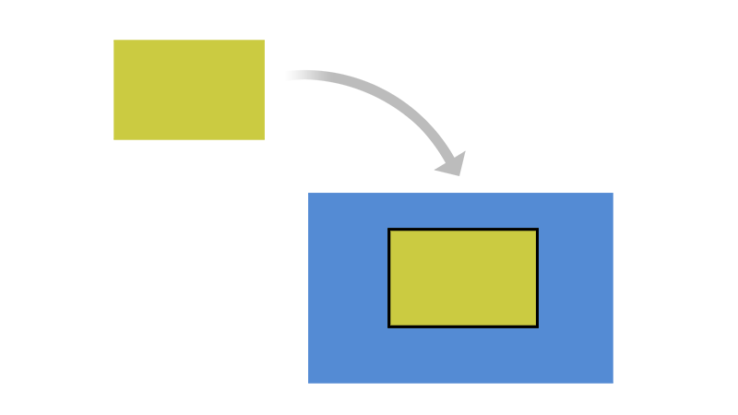
Does your work incorporate all or part of a work?
Examples:
Integrating
Merging
Pasting
Adapting
Inserting
Notes:
Incorporating one work in another may create a derivative work.
Examples of incorporating one work in another include:
Integrating
Merging
Copy-and-Pasting
Adapting
Inserting
Incorporating part of a work in another may create a derivative work.
Examples of incorporating part of a work include:
Snippets
Cells
Circuits
Excerpts from a book or whitepaper
Information from data sheets or technical references

Slide 92
Are you going to create a derivative work?
Another Work
Our Work
Notes:
When discussing how you want to use the Open Source module, an important concept is the idea of derivative works. There are many ways that another work can be used with our work that might create a derivative work.
As a caveat, this idea of derivative works is very complex. Whether a derivative work is created can depend on multiple factors including the applicable law and open source license, in addition to the implementation details. This is an area where Legal and Engineering need to work together closely on a case-by-case basis to arrive at the right conclusion.

Slide 93
Does your work incorporate a work?
Examples:
Integrating
Merging
Pasting
Adapting
Inserting
Notes:
Incorporating one work in another may create a derivative work.
Examples of incorporating one work in another include:
Integrating
Merging
Copy-and-Pasting
Adapting
Inserting

Slide 94
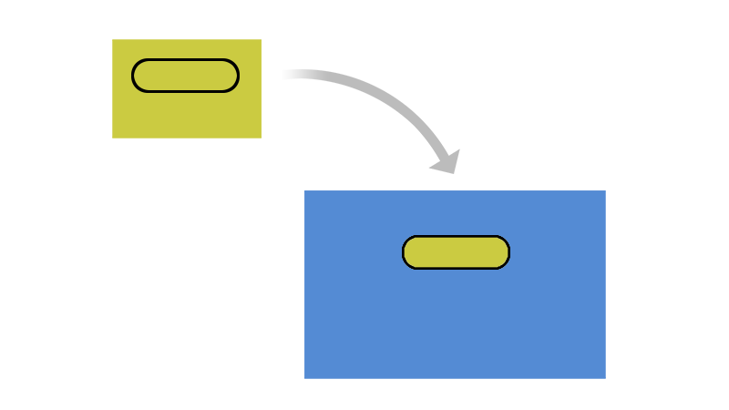
Does your work incorporate part of another work?
Examples:
Snippets
Cells
Circuits
Excerpts
Information
Notes:
Incorporating part of a work in another may create a derivative work.
Examples of incorporating part of a work include:
Snippets
Cells
Circuits
Excerpts from a book or whitepaper
Information from data sheets or technical references

Slide 95

Did you link works together?
Examples:
Static/Dynamic Linking
Pairing
Combining
Wiring together
Utilizing
Packaging
Creating interdependency
Notes:
Joining works together may create a derivative work.
Examples of joining works together include:
Pairing
Combining
Wiring together
Linking
Utilizing
Packaging
Creating interdependency

Slide 96
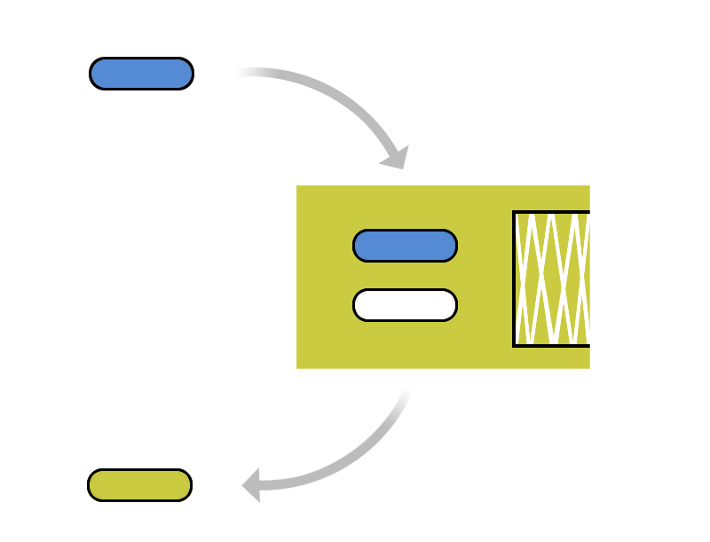
Did you modify a work?
Adding
Injecting
Fixing
Optimizing
Changing
Deleting
Notes:
Modifying a work can create a derivative work.
Examples of modifying a work include:
Adding
Injecting
Fixing
Optimizing
Changing
Deleting

Slide 97

Did you translate a work?
Examples :
Translating Chinese to English
Converting C++ to Java
Compiling VHDL in a mask or net list
Compiling into binary
Compiling into binary does not remove the license obligations
Notes:
Translating material can create a derivative work.
Examples of translating a work include:
Translating Chinese to English
Converting C++ to Java
Compiling VHDL into a mask or net list
Compiling into binary
It’s important to note that compiling source code into binary does not remove the license obligations simply because you can’t read the header text any more.

Slide 98
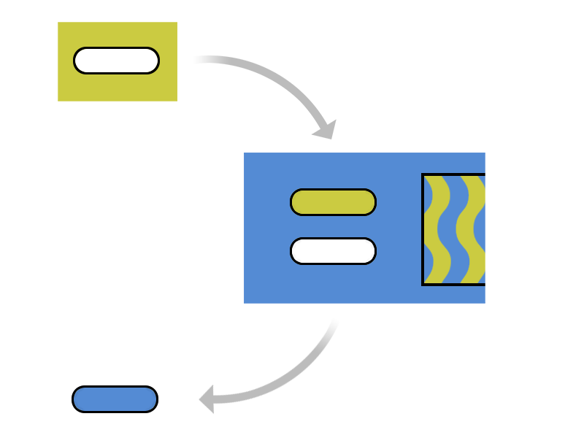
Tools may create a derivative work.
Inject material
Translate the material
Modify the material
Notes:
Development tools also require attention because their use may create a derivative work without your realizing it. Tools may inject material, translate the material, or modify the material. If you want to use a tool or distribute its output, make sure to include this as part of the Open Source review.
Some examples of these could include compilers, the Bison XML Parser Generator, or Microsoft Visual Basic.

Slide 99
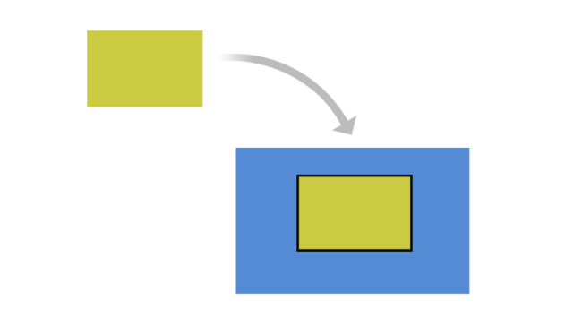
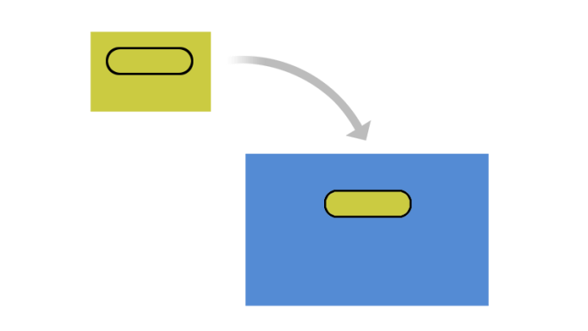

Licenses tell what you can do.
Notes:
As a reminder, Open Source license obligations may include requirements that you must do or restrictions on what you can do.
Since the act of creating derivative works is a Copyright right, Open Source licenses might attempt to put requirements or restrictions on what you do with the derivative works you create.

Slide 100
Open Source licenses and Derivative Works
Potential requirements
Distribute full source along with the binary you compiled (which created a derivative work by compilation)
Distribute your derivative work under the same Open Source license as the original work
Include a statement in advertising materials that your product is based on a particular Open Source project
Potential restrictions
May not charge money for the derivative work
May not create a competing project
Notes:
As a reminder, Open Source license obligations may include requirements that you must do or restrictions on what you can do.
Since the act of creating derivative works is a Copyright right, Open Source licenses might attempt to put requirements or restrictions on what you do with the derivative works you create.
Some open source licenses will state requirements that you must do if you create a derivative work. Some requirements you might see include:
You might be required to distribute source along with anything you release as binary
You might be required to distribute your derivative work under the same open source license
You might be required to include a statement in your advertising that it is based on a particular open source project.
Also, some open source licenses may have restrictions on what you can do with the derivative work you have created. Some restrictions you might see include:
You might be prohibited from charging money for the derivative work you created
You might be prohibited from creating a derivative work that directly competes with the open source project

Slide 101
How is it distributed or shared?
Who gets it?
Customer
Partner
Community project
How do they get it?
Demo
Sample
Prototype
Commercial product
Open source release
What format?
Source code delivery
Binary delivery
Pre-loaded onto hardware
Code retrieval script
Notes:
Who will get your planned distribution? Will you be giving it to a current or prospective customer? Are you working with a partner doing co-development? Are you planning on contributing your changes and additions back to the original community project?
How will you be giving it to them? Are you going to do a demo in a trade show? Are you going to be giving out samples or prototypes for some period of time? Are you selling a commercial product?
What is the format of your delivery? Are you planning on distributing source code, or only binary? Will you have software pre-loaded on to hardware, or are you only distributing software directly? Are you distributing software at all, or only giving customers a PERL script to retrieve code themselves?

Slide 102
Develop a description
What is it?
How do you want to use it?
Who gets it and how?
Notes:
Along with providing the documentation and explaining how you want to use the Open Source, you will need to be able to discuss the distribution model. Who gets the deliverable and how will they receive it?

Slide 103
Initiate an Open Source Review
Work
Who gets it?
Customer
Partner
Community project
How do they get it?
Demo
Sample
Prototype
Commercial product
What format?
Source code delivery
Binary delivery
Pre-loaded onto hardware
Code retrieval script
Notes:
Who will get your planned distribution? Will you be giving it to a current or prospective customer? Are you working with a partner doing co-development? Are you planning on contributing your changes and additions back to the original community project?
How will you be giving it to them? Are you going to do a demo in a trade show? Are you going to be giving out samples or prototypes for some period of time? Are you selling a commercial product?
What is the format of your delivery? Are you planning on distributing source code, or only binary? Will you have software pre-loaded on to hardware, or are you only distributing software directly? Are you distributing software at all, or only giving customers a PERL script to retrieve code themselves?

Slide 104
Initiate an Open Source Review
Program Manager
Product Manager
Work
Engineer
Legal
Analyzes and interprets application of licenses
Notes:
The legal team will analyze and interpret the application of the Open Source licenses that you provided in the description, in order to identify any obligations or any other legal concerns.

Slide 105
Initiate an Open Source Review
Program Manager
Product Manager
Work
Engineer
Scanning
Notes:
The Scanning teams will contact you if they need more information. These teams have specialized knowledge and tools to help you scan your code to identify open source materials and the associated licensing. They will not give legal advice, but they will help you gather the information you need for the discussion with the legal group.

Slide 106
Initiate an Open Source Review
Program Manager
Product Manager
Work
Engineer
Legal
Scanning
Specialists
Knowledge of your project
Knowledge of how to work with Open Source
Notes:
Working on an Open Source review is an interactive and collaborative dialogue.
You bring your knowledge of your project and all of these support groups bring their knowledge of how to work with Open Source.

Slide 107
Initiate an Open Source Review
Program Manager
Product Manager
Work
Engineer
Engineer
Legal
Scanning
Specialists
Guidance
Notes:
At the closing of the Open Source review you will receive guidance.
Guidance for the review may include changes to usage, code architecture, or distribution model in order to satisfy licenses.

Slide 108
Initiate an Open Source Review
Program Manager
Product Manager
Work
Engineer
Legal
Scanning
Specialists
Guidance
Executive Review Committee
Notes:
An Open Source review may require an Executive Committee review to provide more complex, higher-level evaluation of the legal obligations and business or engineering needs.

Slide 109
Check Your Understanding

Slide 110
Chapter 7
End to End Compliance Management

Slide 111
Introduction
Compliance management consists of a set of actions that controls the intake and distribution of FOSS used in products.
The result of compliance due diligence is an identification of all FOSS used in the product and confirmation that all FOSS license obligations have been or will be met.
Notes:
Changed "commercial products" to "distributed products" in bullet 1. Reason - even if the company contributes to open source products, they need to comply with the obligations if that contribution includes other open source packages (upstream)
Changed bullet 2 from “and a plan to meet the FOSS license obligatios” to “confirmation that all FOSS license obligation are or will be met”
There seems to be a lot of overlap in the steps associated with due diligence and compliance management. We could reduce the number of slides if we simplify this down to one.

Slide 112
Compliance End-to-End Process
Compliance management activities provide a record of diligence with regard to the usage of FOSS and provide appropriate compliance records demonstrating the diligence process and allowing you to build a product map identifying all the software components of the product and their origin from an authorship and license perspective.
Compliance
Due Diligence
Applicable FOSS + modifications + compliance artifacts
made available
Incoming
FOSS
Notes:
Should the "all software components" be changed to "all software components which use FOSS"?
Not sure what Applicable FOSS is - is this FOSS requiring source being made available? If so, we could be more specific "FOSS requiring redistribution including any modifications"

Slide 113
Review and approve
compliance record of FOSS software components
Compile notices
for publication
Post publication
verifications
Incoming Software
Outgoing Software
Identification
Audit
Resolve Issues
Reviews
Approvals
Registration
Notices
Verifications
Distribution
Verifications
Notices & Attributions
Proprietary Software
Written Offer
3rd Party Software
FOSS
Identify source
code changes in the
build environment
(new, modified and
retired components)
Scan source code
and identify possible
code matches
– and –
Confirm origin and
license of source
code
Resolve any
issues (code
matched)
– and –
Ensure linkages
are in line with
company policies
Record approved
software/version
in inventory per
product and per
release
Verify source code packages for distribution
– and –
Verify appropriate notices are provided
Publish source code,
notices and provide written offer
Compliance Management End-to-End
Notes:
Review and approve every single (top of slide) - this does not allow for the concept of "white listed" licenses. Also, should only apply to FOSS.
Add box at end to include source redistribution.
Consider adding a process audit for the FOSS process in general - an annual event where the process itself is audited

Slide 114
Compliance End-to-End Process
Compliance due diligence involves the following:
FOSS used in the product has been identified, reviewed and approved
The product implementation includes only the approved FOSS
FOSS used in the product have been registered in the FOSS inventory system
All obligations related to the use of licensed material have been identified
Appropriate notices have been provided in the product documentation: these include a written offer to provide source code, attributions and copyright notices
Source code including modifications and associated build tools (when applicable) have been prepared and ready to be made available once the product ships
Verifications of all the steps in the process
Notes:
Added "and associated build tools" to bullet 6

Slide 115
Elements of Compliance Management
Identification of FOSS
Auditing source code
Resolving any issues uncovered by the audit
Completing reviews
Receiving approval to use FOSS
Updating software inventory
Updating end user documentation
Performing verification of all previous steps prior to distribution
Distributing FOSS including associated build tools and modifications (if any) when applicable
Performing final verifications in relation to distribution
Notes:
Note: in the presentation, we use the terms BoM and software inventory - I believe these are the same. There was also another term relating to software components. We may want to go through and make this consistent.
Added "and associated build tools" to bullet 9

Slide 116
Identification of FOSS
Identification
Incoming:
FOSS
Audit
Resolve Issues
Reviews
Approvals
Registration
Notices
Verifications
Distribution
Verifications
Outgoing:
FOSS + Mods
Goal: Identify and begin tracking FOSS from all sources
Pre-requisites:
One of the following conditions is met:
The development team requests the review of a FOSS component
A discovery of a FOSS being used (without proper authorization)
A discovery of a FOSS being used as part of third party software
Steps:
Incoming requests are recorded
Scans of entire platform may be performed
Due diligence on any 3rd party provided software
Recognize and review any FOSS components added to a repository without an incoming request
Outcome:
A compliance record is created (or updated) for the FOSS
An audit is requested to scan the source code
Notes:
Platform scan hasn't been mentioned yet - it seems it should be part of this process (last bullet under pre-requisites).I'm just going to remove it from the slide (bullet 3 under pre-requistes) -
Changed "An incoming OSRB form requesting using a specific FOSS" to "The development team requests the review of a FOSS component" to make it it be more generic for those organizations that notify requests in ways other than "OSRB forms"

Slide 117
Auditing Source Code
Audit
Incoming:
FOSS
identification
Resolve Issues
Reviews
Approvals
Registration
Notices
Verifications
Distribution
Verifications
Outgoing:
FOSS + Mods
Goal: Confirm the identification of the software components, origin, and licenses
Pre-requisites:
A proper compliance record is created capturing all necessary information about the usage of that specific FOSS and providing the location of the source code within the internal build system.
In some cases, specifically when a full platform scan is done, a FOSS component may be scanned before having a proper compliance report. In this case, a record is created when the FOSS component is discovered.
Steps:
Source code for the scan is identified
Source is scanned by a software tool
“Hits” from the scan are reviewed and verified as to the proper origin of the code
Scans are performed iteratively based on the software development and release lifecycles
Outcome:
An audit report identifying the origins and licenses of the source code

Slide 118
Resolving Issues
Resolving Issues
Incoming:
FOSS
identification
Audit
Reviews
Approvals
Registration
Notices
Verifications
Distribution
Verifications
Outgoing:
FOSS + Mods
Goal: Resolve all identified issues
Pre-requisites:
A source code scan has been completed
An audit report is generated identifying the origins and licenses of the source code and flagging source code files that were not identified and that need further investigation
Steps:
OSRB Chair will assign working tickets to the appropriate engineers to rework the code and report on completion.
Once the engineers have resolved the identified issues, the OSRB Chair will issue a new audit to get a confirmation that the resolved issues do not exist anymore.
Outcome:
A resolution for each of the flagged files in the report and a resolution for any flagged license conflict
Notes:
Could move all of these to a single slide each (rather than 2 to 3 slides each) by adding a column "Goals", trimming down the content

Slide 119
Reviews
Reviews
Incoming:
FOSS
identification
Audit
Resolve Issues
Approvals
Registration
Notices
Verifications
Distribution
Verifications
Outgoing:
FOSS + Mods
Goal: ensure that all involved parties have reviewed the audit report, agree on the how the discovered issues have been resolved.
Pre-requisites:
Source code has been audited
All identified issues have been resolved
Steps:
Reviewer include Internal package owner, OSRB chair (Compliance Officer), Auditing personnel, Legal counsel, OSRB engineering representative, OSRB (Open Source Review Board), OSEC (Open Source Executive Committee)
Architecture and linkage reviews for any copyleft of partial copyleft components would confirm no proprietary source would require redistribution
Outcome:
OSRB members perform an architecture review and a linkage analysis for the specific component and mark it as ready for the next step (i.e. Approval) if no issues were uncovered

Slide 120
Architecture Review – Example
Legend
Proprietary
3rd Party Commercial
GPL
[Insert Components]
User Space
LGPL
[Insert interaction method]
FOSS Permissive
[Insert Components]
Kernel Space
[Insert interaction method]
(fc)
Function call
(si)
Socket interface
(sc)
System call
[Insert Components]
Hardware
(sh)
Shared headers

Slide 121
Linkage Analysis Review
The goal with linkage analysis is to find potentially problematic code combinations at the static and dynamic link level, such as linking a GPL library to proprietary source code component.
If a linkage conflict is identified, it is reported to Engineering to resolve it by reworking the source code.
Notes:
Removed bullet 2 stating that this is done by an automated tool
Last bullet, removed OSRB Chair

Slide 122
Approvals
In this step, the software component is either approved for usage in the product or not.
The approval comes from the OSRB.
Approvals
Incoming:
FOSS
identification
Audit
Resolve Issues
Reviews
Registration
Notices
Verifications
Distribution
Verifications
Outgoing:
FOSS + Mods

Slide 123
Registration
Once is software component has been approved for usage in a product, its compliance ticket will be update to reflect the approval and it will be added to the software inventory that tracks FOSS that used in products.
Registration
Incoming:
FOSS
identification
Audit
Resolve Issues
Reviews
Approvals
Notices
Verifications
Distribution
Verifications
Outgoing:
FOSS + Mods
A software component is approved based on a specific version and usage model in a specific product version.
If a new version of this software component is available, engineering teams need to go through the process again to get approval for using the new version.
If engineering teams want to use the same software component in a different product, they need to issue a new request.
Approvals are dependent on usage models and for instance, a GPL software component that is approved for inclusion in Product A will not be approved for inclusion in Product B based on a different usage model.

Slide 124
Notices
In this step of the compliance due diligence, the OSRB Chair prepares the notices and passes it to the appropriate departments for fulfillment
Notices
Incoming:
FOSS
identification
Audit
Resolve Issues
Reviews
Approvals
Registration
Verifications
Distribution
Verifications
Outgoing:
FOSS + Mods
Companies using FOSS in a commercial product must:
Acknowledge the use of FOSS by providing full copyright and attribution notices
Inform the end user of their product on how to obtain a copy of the FOSS source code (when applicable, for example in the case of GPL and LGPL)
Reproduce the entire text of the license agreements for the FOSS code included in the product.
Notes:
A bit detailed - but "must" depends on the OSS license. However, it is a good practice and easier to implement a process where you document the notices consistently for all FOSS rather than making them license specific.

Slide 125
Pre-Distribution Verifications
Verifications
Incoming:
FOSS
identification
Audit
Resolve Issues
Reviews
Approvals
Registration
Notices
Distribution
Verifications
Outgoing:
FOSS + Mods
Goal: ensure that all steps required for meeting the obligations are planned to be met
Pre-requisites:
Component has been approved for usage
Component it has been registered in the software inventory
All notices have been captured and sent for fulfillment
Steps:
Verify FOSS packages destined for distribution have been identified and approved
Verify the source code packages (including modifications) have been match the binary equivalents shipping in the product
Verify All appropriate notices have been included to inform end-users of their right to request source code for identified FOSS
Outcome:
The method and mode of distribution has been determined
Ensure that all the pre-distribution verifications have been successfully completed

Slide 126
Distribution
Distribution
Incoming:
FOSS
identification
Audit
Resolve Issues
Reviews
Approvals
Registration
Notices
Verifications
Verifications
Outgoing:
FOSS + Mods
Goal: make the FOSS requiring redistribution available
Pre-requisites:
All pre-distribution verification have been checked and no issue is discovered
Steps:
Files including any associated build tools and documentation is made available (e.g. by uploading to a distribution website).
FOSS id identified with labels as to which product and version it corresponds to.
Outcome:
The source code of the component in question is made available for distribution
Notes:
Changed the above bullet to make it a bit more generic on how the FOSS packages can be distrubted

Slide 127
Final Verifications
Verifications
Incoming:
FOSS
identification
Audit
Resolve Issues
Reviews
Approvals
Registration
Notices
Verifications
Distribution
Outgoing:
FOSS + Mods
Goal: validation that all steps to meet license obligations have been performed without error
Pre-requisites:
The source code for FOSS requiring redistribution has been made available
Notices have been made available
Steps:
Verify all code requiring redistribution has been uploaded correctly
Verify uploaded code corresponds to the same version that was approved
Verify code is accessible
Verify notices have been properly published and made available
Outcome:
Verified distribution of code and verified availability of notices
Notes:
Added "and built" to the bullet

Slide 128
Check your Understanding
What do compliance management activities provide?
What is involved in compliance due diligence (name 4 of the 7 items mentioned)?
What is the first step in compliance management?
What types of issues may need to be resolved as part of compliance management?
Who should be involved in reviewing audit results?
What does an architecture review look for?
What should be included in the OSS Notices?
What needs to be distributed for code under a Copy-Left license (e.g. GPL)?
What is the last step in compliance management?

Slide 129
Chapter 8
Compliance Failures

Slide 130
Chapter 8
Compliance Failures

Slide 131
Type of Compliance Failures
Intellectual Property (IP) failures
License Compliance failures
Compliance Process failures

Slide 132
Intellectual Property Failures
How might an IP failure materialize?
When the proprietary, third party, or FOSS code is contaminated by the source code, which has incompatible licenses.
What is at least ONE significant consequence of an IP failure?*
Companies may lose their product differentiation through the release of the source code to the FOSS community.
What is an example of an IP failure?
Failure Type & Description​ | Discovery​ | Avoidance​
Inclusion of proprietary code into FOSS through source code modifications | This type of failure can be discovered using the bill of materials difference tool to identify and analyze the source code you introduced to the FOSS. | This type of failures can be avoided by: Offering training to engineering staff Conducting regular code inspections
Notes:
Additional Consequences of IP Failures
An injunction preventing a company from shipping a product
A requirement to publish a company’s proprietary source code under an open source license
Significant re-engineering to eliminate incompatible licenses (especially between 3rd party proprietary licenses and FOSS licensed code)
Embarrassment or worse with customers, distributors, 3rd party proprietary software suppliers and FOSS suppliers

Slide 133
License Compliance Failures
How might a License Compliance failure materialize?
Answer TBD.
What is at least ONE significant consequence of a License Compliance failure?*
An injunction may prevent a company from shipping a product until the source code is published.
What is an example of a License Compliance failure?
Failure Type & Description | Avoidance
Source Code Versioning Failure | This type of failure can be avoided by adding a verification step into the compliance process to ensure that the exact version of source code that corresponds to the distributed binary version is being published.
Notes:
Additional Consequences of License Compliance Failures
Support or Customer Service headaches as a result of version mis-matches
Embarrassment and/or bad publicity with customers and FOSS suppliers

Slide 134
Compliance Process Failures
How might a Compliance Process failure materialize?
Answer TBD.
Note: when the compliance process fails to function correctly, other IP failures or license compliance failures might also occur.
What is at least ONE significant consequence of a Compliance Process failure?*
The failure may negatively impact product development and release schedules.
What is an example of a Compliance Process failure?
Description | Avoidance | Prevention
Failure to resolve the audit findings (analyzing the “hits” reported by the tool) | This type of failure can be avoided by not allowing a compliance ticket to be resolved (i.e. closed) if the audit report is not finalized. A compliance ticket is closed only if there are no open sub-tasks attached to it and no open issues) | This type of failure can be prevented by implementing a policy in the compliance management system that does not allow it to close a compliance ticket if it has open sub-tasks or open issues
Notes:
Additional Consequence(s) of Compliance Process Failures
Introduce bugs due to undocumented component version skew

Slide 135
Check Your Understanding
✓ Source code should be carefully vetted and approved before use. ​
✓ The meaning of license terms and limitations should be specified and clear.​
✓ Each step of the compliance process should always be performed thoroughly.​
✓ Seemingly small compliance failures have the ability to create massive problems.​

Slide 136
Chapter 9
GPL Violations 101

Slide 137
Introduction
GPL enforcement started soon after the GPL was published in 1989, but was usually pursued in a private process
Beginning in the early 2000’s, GPL enforcement and related legal action was pursued in a more formal way
Several organizations are involved in enforcing compliance on behalf and with the help of FOSS developers and enthusiasts who monitor product announcements and license compliance activities.
The most notable enforcers are:
Free Software Foundation (FSF)
Software Freedom Law Center (SFLC)
Software Freedom Conservancy (SFC)
gpl-violations.org
Notes:
History and Context: GPL enforcement started soon after the publication of GPL but was mostly a private process: Copyright holders were encouraged to settle amicably with their violators (see GPL Compliance Lab)
In the beginning of the 2000’s legal actions were pursued in a more formal way and several court decisions in US and European jurisdictions dealt with GPL enforcement questions
Question: Mention Patrick MacHardy as an example of copyright trolling and consequences?
FSF, FSFE (see Freedom Task Force). SFLC, SFC, GPL-violations.org are the most prominent stewards and enforcers – and provide more details and information on actual case law

Slide 138
Legal Consequences
Preliminary injunction
Withdrawal of products
Right to information
Damages and compensation
Reimbursement of costs
Source code release
Notes:
Legal consequences can include

Slide 139











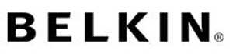









Partial List of Companies Targeted with Non-Compliance
And many more …

Slide 140










Example: The Trail of the CISCO Compliance Problem
used GPL code to customize Broadcom’s standard Linux distribution
embedded the code in one of its chipsets
adopted this technology into its WRT54G wireless broadband router
bought for $500M in 2003
FSF accused Cisco of a license violation
After much bad press, source code was made available by
How did this story end?
Major loss of Cisco’s Intellectual Property rights and competitive advantage. Loss of revenue est. $50M

Slide 141
GPL Enforcement in Europe
Welte vs. Sitecom Deutschland GmbH
District Court of Munich granted Harald Welte, the author of code that appeared in Sitecom’s products a preliminary injunction against Sitecom Deutschland GmbH, prohibiting Sitecom from distributing its products unless it complied with terms of the GPL.
On appeal Sitecom lost and posted GPL terms on FAQ page for its products.
Hellwig vs. VMware
The Hamburg District Court dismissed Christoph Hellwig’s case against VMware based on German evidentiary arguments related to the documentation of Hellwig’s contributions that appear in VMware products.
Hellwig announced that he will appeal the ruling…..
Notes:
Enforcement not only taking place in US but also in Europe, especially Germany.
Examples include Welte vs. Sitecom, Welte vs. Skype, or Hellwig vs. VMware
Question: Do we need more examples? Details?

Slide 142
Chapter 10
Lessons Learned from Disputes

Slide 143
Lessons Learned from Compliance Disputes
In none of the publicly known compliance disputes, the defendants chose to challenge the allegations
All cases that reached a verdict confirmed the lack of compliance status
Open Source compliance disputes move rapidly to lawsuits, especially when there was a lack of responsiveness or cooperation
Open Source compliance disputes originally addressed fully incompliant distributions, but increasingly address distributions that are not fully compliant

Slide 144
Lessons Learned from Compliance Disputes
Our number one goal in any GPL violation case is to get proper and full compliance with the license; everything else is secondary.
– David Turner, GPL Compliance Engineer, Free Software Foundation, 29 September 2003
In fact, in nearly every GPL enforcement cases that I've worked on in my career, the fact that infringement had occurred was never in dispute. The typical GPL violator started with a work under GPL, made some modifications to a small portion of the codebase, and then distributed the whole work in binary form only. It is virtually impossible to act in that way and still not infringe the original copyright.
– Bradley M. Kuhn, Policy Analyst and IT Director, Software Freedom Law Center, 8 May 2007

Slide 145
Lessons Learned from Compliance Disputes
All of the publicly known disputes reached a settlement agreement which included one or more of the below mentioned terms:
Company to appoint a compliance officer to monitor and ensure GPL complianceCompany to take necessary action to become compliant
Company to notify previous recipients of the product that the product contains GPL code and inform them of their rights to receive a copy of the source code
Company to publish licensing notice on their website, add notices in product publications
Company to cease binary distribution of the FOSS in question until it has published complete corresponding source code on its website
Company to pay an undisclosed amount of financial consideration to the plaintiffs
Company to make available the complete and corresponding source code used in their product, sometimes including releasing code that contains their product differentiation as open source under the GPL.

Slide 146
Lessons Learned from Compliance Disputes
Company incurred costs associated with non-compliance. The costs included:
Discovery and diligence in response to the compliance inquiry where company teams spent time to investigate and perform diligence in relation with the inquiry
Settlement costs
Outside and/or in-house legal costs
Costs related to enforcement
Effort to regain compliance status
In almost all cases, the failure to comply with the FOSS license obligations has also resulted in:
Public embarrassment
Negative press
Damaged relationships with some of their customers, suppliers and most notably the FOSS community

Slide 147
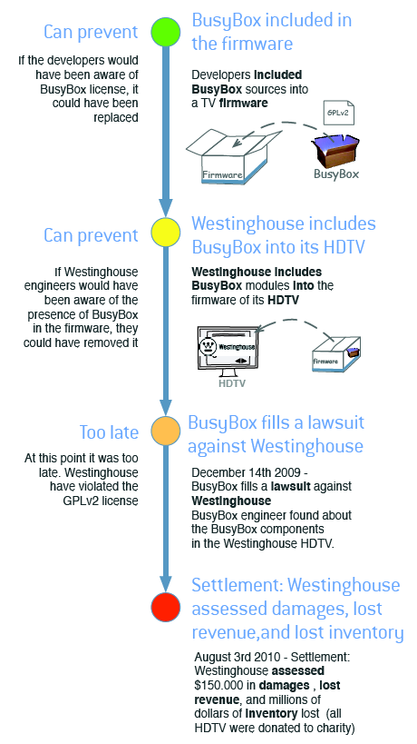

Settlement with WestingHouse
Case was settled early August 2010 and included:
~ 150,000 USD in damages, lost revenue and lawyer fees
Millions $ in inventory lost (HDTV using busy box were donated to charity)

Slide 148
Avoid Disputes: Ensure Compliance Prior to Product Shipment
To avoid being successfully challenged with regard to FOSS compliance, companies must make compliance a priority before any product (in whatever form) ships.
Companies must establish and maintain consistent review and compliance policies and procedures and ensure that FOSS licenses, proprietary and 3rd party licenses co-exist well before shipment.

Slide 149
Ensure Compliance Prior to Product Shipment
To that effect, companies need to implement an end-to-end FOSS management infrastructure that will allow it to:
Identify all FOSS being used in its products
Collect the applicable FOSS licenses for review by the legal department
Develop FOSS use and distribution policies, also for source code
Institutionalize FOSS and compliance training to ensure that all employees potentially handling or responsible for decisions relating to FOSS are aware of the implications and legal risks involved when using FOSS and that all employees are aware of company policies
Ensure that your software vendors, suppliers and subcontractors are adhering to (your) FOSS license requirements
Furthermore, companies need to know not only which FOSS they are using, but also how they are using them.

Slide 150




Value of community relationship
As a company that uses FOSS in commercial product, it is best to create and maintain a good relationship with the FOSS community, in particular, the specific communities related to the FOSS projects you use and deploy in your commercial product.
In addition, good relationships with open source organizations can be very helpful in advising on best way to be compliant and also help out if you experience a compliance issue.
Good relationships with the software communities may also be helpful for two-way communication: upstreaming improvements and getting support from the software developers.

Slide 151
Check Your Understanding

Slide 152
Chapter 11
General Guidelines

Slide 153
General Guidelines
Request formal approval for each open source software you are using in product or in SDK (refer to your company’s Usage Policy)
Request formal approval for your contribution to open source software (refer to your company’s Contribution Policy)
Save the web site from which you downloaded the open source package and save a mint copy of the package you downloaded
Consult with your manager when you upgrade your open source software version. License changes can occur between versions.
Don’t change or eliminate existing comments in headers
Do not check un-approved code into any source tree without authorization

Slide 154
General Guidelines
Do not re-name open source modules
Do not send modifications to any public source tree without getting approval. Making even small contributions without your company’s permission can compromise your company’s IP (due to implicit or explicit patent licenses)
Do not discuss coding or compliance practices with persons outside the company
Good programming practices are also legal best practices
Clean integration
Modularity
Minimization of data sharing
Transparent APIs

Slide 155
General Guidelines
Clean Bill of Material
Ensure that any in-bound software does not include FOSS.
If it does, you need a complete listing for all FOSS, versions, licenses.
Always audit source code you received from your software providers or alternatively make it a company policy that software providers must deliver you a source code audit report for any source code you receive.
Approval Form for Each FOSS
Request approval for every FOSS you are using in product.
Understand the Risks
Understand the FOSS implications of any software of an entity to be acquired as part of the due diligence performed prior to approval the corporate transaction.

Slide 156
General Guidelines
Upgrading to Newer Versions of FOSS
Ensure that each new version of the same FOSS component is reviewed and approved. When you upgrade the version of a FOSS package, make sure that the license of the new version is the same as the license of the older used version. License changes can occur between version upgrades. If the license changed, contact the OSRB to ensure that compliance records are updated and that the new license does not create a conflict.
Compliance Verification Golden Rule
Compliance is verified on a product-by-product basis: Just because a FOSS package is approved for use in one product does not necessarily mean it will be approved for use in a second product.

Slide 157
General Guidelines
Copy/Paste
Do not copy/paste FOSS code into proprietary or third party source code or vice versa without OSRB approval.
Approvals are given on a case-by-case basis.
Mixing Source Code with Different Licenses
Mixing of different FOSS licenses in a derivative work must be avoided.
Many FOSS licenses are incompatible with each other, especially when mixing licenses with the GPL.
When in doubt, always refer to the FSF resource page on license compatibility available at http://www.fsf.org/licensing/licenses/index_html.
The open source review board in your company must review all cases where more than one type of FOSS license is used and provide approval on a case-by-case basis.

Slide 158
General Guidelines
Source Code Comments
Do not leave any inappropriate comments in the source code that includes private comments, product code names, mention of competitors, etc.
Existing Licensing Information
Do not remove or in any way disturb existing FOSS licensing copyrights or other licensing information from any FOSS components that you use. All copyright and licensing information is to remain intact in all FOSS components.

Slide 159
Check Your Understanding

Slide 160
Chapter 12
Summary

Slide 161
Licenses
Copyright and patents restrict use by others, unless… a license is granted
Types of use allowed (distribution, derivative works / made, have made, manufacture)
Exclusive or non-exclusive
Geographical scope
Perpetual or time limited
Conditions placed upon exercise of enumerated rights
May also include terms re: warranties, indemnification, support, upgrade, maintenance

Slide 162
Open Source Software Licenses
In general, OSS licenses makes the source code available under terms that allow for modification and redistribution without having to pay the original author.
OSS licenses may have restrictions such as requirements related to attributions, copyright statement preservation, providing a written offer to make the source code available, or others.

Slide 163
License Compatibility
License compatibility is a term that refers to the problem encountered when combining source code originating from different software components licensed under incompatible licenses making it impossible to combine the source code to create a new software component.
The FSF provides the following example to illustrate the case of license compatibility:
A license p is compatible with a license q (or is q-compatible) if
A work licensed under p can be distributed under the terms of q.
Example:
The X11 license is compatible with the GPL version 2, because works licensed under the X11 license, can be distributed under the terms of the GPL.

Slide 164
GPL Compatibility
GPL compatibility refers to the situation of determining if a certain license has compatible terms with the GPL.
Many of the FOSS licenses, such as the BSD license and the LGPL, are GPL-compatible, meaning that their source code can be combined with a source code that is licensed under the GPL without conflict; the new program resulting from the combination would have to be licensed under the GPL applied.
Other FOSS and proprietary software licenses are not GPL-compatible since they have conflicting terms and conditions.
Reference: http://www.fsf.org/licensing/licenses/

Slide 165
How are the various GNU licenses compatible with each other?

Slide 166
Open Source Compliance
Open Source Compliance:
Know your obligations (Detect and track use of FOSS). You should have a process for identifying, tracking and archiving a list of all FOSS components (and their respective identified licenses) from which your software is comprised.
Satisfy all the license obligations for the FOSS that is used. Your program should identify and handle typical FOSS use cases that result from your organization’s business practices.

Slide 167
Open Source Review
A key element to an Open Source Compliance Program is the Open Source Review, through which a company can analyze and determine its open source obligations.
The Open Source Review includes the following steps:
Gather relevant information
Analyze and determine license obligations
Provide guidance in light of company policy and business objectives

Slide 168
Initiate an Open Source Review
Program Manager
Product Manager
Work
Engineer
Legal
Scanning
Specialists
Guidance
Executive Review Committee
Notes:
An Open Source review may require an Executive Committee review to provide more complex, higher-level evaluation of the legal obligations and business or engineering needs.

Slide 169
Review and approve
compliance record of every single software component
Compile notices
for publication
Post publication
verifications
Incoming Software
Outgoing Software
Identification
Audit
Resolve Issues
Reviews
Approvals
Registration
Notices
Verifications
Distribution
Verifications
Open Source BoM:
Notices & Attributions
Proprietary Software
Written Offer
3rd Party Software
FOSS
Identify source
code changes in the
build environment
(new, modified and
retired components)
Scan source code
and identify possible
code matches
– and –
Confirm origin and
license of source
code
Resolve any
issues (code
matched)
– and –
Ensure linkages
are in line with
company policies
Record approved
software/version
in inventory per
product and per
release
Verify source code packages for distribution
– and –
Verify appropriate notices are provided
Publish source code,
notices and provide written offer
Compliance Management End-to-End
Notes:
Review and approve every single (top of slide) - this does not allow for the concept of "white listed" licenses. Also, should only apply to FOSS.
Add box at end to include source redistribution.
Consider adding a process audit for the FOSS process in general - an annual event where the process itself is audited

Slide 170
Type of Compliance Failures
Intellectual property (IP) failures
License failures
Compliance process failures

Slide 171
Example of Intellectual Property Failures
Failure Type & Description | Discovery | Avoidance
Inclusion of FOSS into proprietary or 3rd party code: This type of failure occurs during the development process when engineers add FOSS code into proprietary or 3rd party source code in the form of copy and paste into proprietary or 3rd party software. | This type of failure can be discovered by scanning the source code for possible matches with: FOSS source code Copyright notices Automated source code scanning tools are used for this purpose | This type of failure can be avoided by: Offering training to engineering staff to bring awareness to compliance issues and to the different types and categories of FOSS licenses and the implications of including FOSS source code in proprietary source code Conducting regular source code scanning for all the source code in the build environment (proprietary, 3rd party and FOSS) which will flag

Slide 172
Example of Intellectual Property Failures
Failure Type & Description | Discovery | Avoidance
Linking of FOSS into proprietary source code (or vice versa): This type of failure occurs as a result of linking software (FOSS, proprietary, 3rd party) that have conflicting and Incompatible licenses, or if the FOSS has a license with a “viral effect”. | This type of failure can be discovered using the dependency tracking tool that allows you to discover linkages between different software components. | This type of failure can be avoided by: Offering training to engineering staff to avoid linking software components with conflicting licenses Continuously running the dependency tracking tool over your build environment
Inclusion of proprietary code into FOSS through source code modifications | This type of failure can be discovered using the bill of materials difference tool to identify and analyze the source code you introduced to the FOSS. | This type of failures can be avoided by: Offering training to engineering staff Conducting regular code inspections

Slide 173
License Compliance Failures
Failure Type & Description | Avoidance
Source Code Publishing Failure | This type of failure can be avoided by making source code publishing a checklist item in the product release cycle before the product becomes available in the market place.
Source Code Versioning Failure | This type of failure can be avoided by adding a verification step into the compliance process to ensure that the exact version of source code that corresponds to the distributed binary version is being published.
Failure to Publish Source Code Modifications | This type of failure can be avoided by: Re-introducing the revised software component in the compliance process Adding the “compute diffs” of any modified FOSS to the checklist item before releasing FOSS used in the product

Slide 174
License Compliance Failures
Failure Type & Description | Avoidance
Failure to mark FOSS Source Code Modifications: Failure to mark FOSS source code that has been changed or failure to include a description of the changes. | This type of failure can be avoided by: Adding source code marking as a checklist item before releasing the source code to ensure you flag all the source code you introduced to the original copy you downloaded Conducting source code inspections before releasing the source code Adding a milestone in the compliance process to verify that changed source code has been marked as such Offering training to engineering staff to ensure they modify the change log of all FOSS or proprietary software that is going to be released to the public

Slide 175
Compliance Process Failures
Description | Avoidance | Prevention
Failure to submit an OSRB request to use FOSS | This type of failure can be avoided by offering training to Engineering staff on the company’s OSS policies and processes. If a FOSS component was found In the build system and does not have a corresponding compliance ticket, then a new ticket (usage request form) is then re-generated | This type of failure can be prevented by: Conducting periodic full scan for the software platform to detect any “undeclared” Offering training to engineering staff on the company’s OSS policies and processes Including compliance in the employees performance review
Failure to take the FOSS training | This type of failure can be avoided by ensuring that the completion of the FOSS training is part of the employee’s professional development plan and it is monitored for completion as part of the performance review | This type of failure can be prevented by mandating engineering staff to take the OSS training by a specific date

Slide 176
Compliance Process Failures
Description | Avoidance | Prevention
Failure to audit the source code | This type of failure can be avoided by: Conducting periodic source code scans/audits Ensuring that auditing is a milestone in the iterative development process | This type of failure can be prevented by: Providing proper staffing as to not fall behind in schedule Enforcing periodic audits
Failure to resolve the audit findings (analyzing the “hits” reported by the tool) | This type of failure can be avoided by not allowing a compliance ticket to be resolved (i.e. closed) if the audit report Is not finalized. A compliance ticket is closed only if there are no open sub-tasks attached to it and no open issues) | This type of failure can be prevented by implementing a policy in the compliance management system that does not allow it to close a compliance ticket if it has open sub-tasks or open issues
Failure to submit OSRB form in time | This type of failure can be avoided by filing OSRB requests early even if engineering did not yet decide on the adoption of the FOSS source code | This type of failure can be prevented through education

Slide 177
Lessons Learned from Compliance Disputes
In none of the publicly known compliance disputes, the defendants chose to challenge the allegations
All cases that reached a verdict confirmed the lack of compliance status
Open Source compliance disputes move rapidly to lawsuits, especially when there was a lack of responsiveness or cooperation
Open Source compliance disputes originally addressed fully incompliant distributions, but increasingly address distributions that are not fully compliant

Slide 178
General Guidelines
Request formal approval for each open source software you are using in product or in SDK (refer to your company’s Usage Policy)
Request formal approval for your contribution to open source software (refer to your company’s Contribution Policy)
Save the web site from which you downloaded the open source package and save a mint copy of the package you downloaded
Consult with your manager when you upgrade your open source software version. License changes can occur between versions.
Don’t change or eliminate existing comments in headers
Do not check un-approved code into any source tree without authorization

Slide 179
General Guidelines
Do not re-name open source modules
Do not send modifications to any public source tree without getting approval. Making even small contributions without your company’s permission can compromise your company’s IP (due to implicit or explicit patent licenses)
Do not discuss coding or compliance practices with persons outside the company
Good programming practices are also legal best practices
Clean integration
Modularity
Minimization of data sharing
Transparent APIs

Slide 180
Check Your Understanding
What is Open Source?
What is the first action you should take if you want to use Open Source materials?
What kinds of information might you collect for an Open Source review?
Why is it important to know if you are creating a derivative work when you use Open Source?
What should you do if you have a question about using Open Source?

