Slide 1
Chapter 3: Inter Process Communication (IPC)

Slide 2
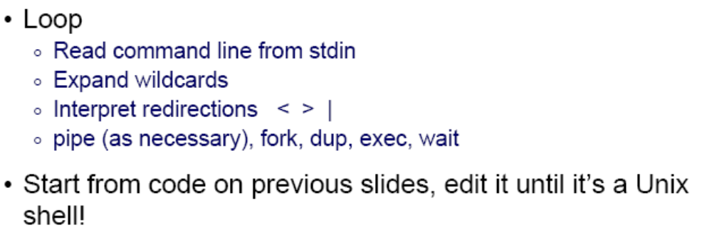
A Unix Shell!

Slide 3
Create Your Own Unix Shell
Command is entered and if length is non-null, keep it in history.
Parsing : Parsing is the breaking up of commands into individual words and strings
Checking for special characters like pipes, etc is done
Checking if built-in commands are asked for.
If pipes are present, handling pipes.
Executing system commands and libraries by forking a child and calling execvp.
Printing current directory name and asking for next input.

Slide 4
Question 6 in Project 1
Main component:
  A loop
  Parsing the user input
  fork(), execvp()
Code structure (pseudocode):
  while (command != “exit”) {
    cout<<“MiniShell>”;
    cin>>command;
    Parsing command;
    pid = fork();
    if (pid < 0) erro;
    else if (pid == 0) execvp();
    else wait();
  }

Slide 5
Tips for Question 6 of Project 1
You need a loop to make a shell always waiting to user input:
while(strcmp(command,"exit")!=0){
cout<<“MiniShell>";
cin.getline(command,50);
}
A typical bug:
  Sometimes, if the results do not pop up immediately, but do show up when user enter the next command, then you can try to use fflush(stdout)

Slide 6
Test “fflush”
#include <stdlib.h>
#include <stdio.h>
#include <fcntl.h>
int main(int argc, char **argv)
{
int pid, status;
int newfd; /* new file descriptor */
if (argc != 2) {
fprintf(stderr, "usage: %s output_file\n", argv[0]);
exit(1);
}
if ((newfd = open(argv[1], O_CREAT|O_TRUNC|O_WRONLY, 0644)) < 0) {
perror(argv[1]); /* open failed */
exit(1);
}
printf("This goes to the standard output.\n");
printf("Now the standard output will go to \"%s\".\n", argv[1]);
fflush(stdout);
dup2(newfd, 1);
printf("This goes to the standard output too.\n");
exit(0);
}

Slide 7
Tips for Question 6 of Project 1
How to use execvp:
Syntax:
  int execvp (const char *file, char *const argv[]);
  file: points to the file name associated with the file being executed.
  argv: is a null terminated array of character pointers.
Example
  char *cmd = "ls";
  char *argv[3];
  argv[0] = "ls";
  argv[1] = "-la";
  argv[2] = NULL;
  execvp(cmd, argv);
  //This will run "ls -la" as if it were a command

Slide 8
Tips for Question 7&8 of Project 1
Parsing command:
p=strtok(command, " ");
while(p&&strcmp(p,"|")!=0){
command_arrayA[countA]=p;
countA++;
p=strtok(NULL," ");
}

Slide 9
Question 8 in Project 1
How does “ls | wc” work?
Two steps involved:
  “ls” is executed, and some intermediate results will be obtained
  The above intermediate results will be passed by a pipe “|” to become the new input to be processed by “wc”
How to implement “|” in your own shell?
  dup2(fd1, fd2) function is needed

Slide 10
Redirecting Standard I/O
A process that communicates solely with another process doesn’t use its standard I/O.
If process communicates with another process only via pipes, redirect standard I/O to the pipe ends
Functions: dup2
How to use?
#include <unistd.h>
int dup2(int FD1,int FD2);

Slide 11
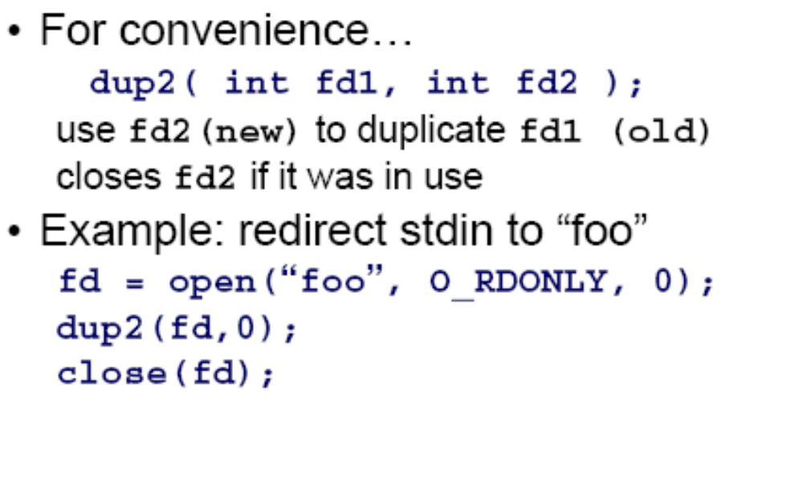
Dup2

Slide 12
Dup2 Redirect STDOUT to a File
#include <stdio.h>
#include <unistd.h>
#include <fcntl.h>
int main() {
int file = open("myfile.txt", O_WRONLY | O_CREAT | O_TRUNC, 0644);
if (file < 0) {
perror("open");
return 1;
}
// redirecting standard output to the file
if (dup2(file, STDOUT_FILENO) < 0) {
perror("dup2");
close(file);
return 1;
}
// will be redirected to the file
printf("This will print in myfile.txt\n");
close(file);
return 0;
}

Slide 13
Redirect STDOUT to File by Executing Command
#include <stdio.h>
#include <stdlib.h>
#include <unistd.h>
#include <fcntl.h>
int main(int argc, char **argv)
{
int pid, status;
int newfd; /* new file descriptor */
char *cmd[] = { "/bin/ls", "-al", "/", 0 };
if (argc != 2) {
fprintf(stderr, "usage: %s output_file\n", argv[0]);
exit(1);
}
if ((newfd = open(argv[1], O_CREAT|O_TRUNC|O_WRONLY, 0644)) < 0) {
perror(argv[1]); /* open failed */
exit(1);
}
printf("writing output of the command %s to \"%s\"\n", cmd[0], argv[1]);
dup2(newfd, 1);
/* now we run the command. It runs in this process and will have */
/* this process' standard input, output, and error */
execvp(cmd[0], cmd);
perror(cmd[0]); /* execvp failed */
exit(1);
}
Try it to understand how dup2() redirect standard output to a file

Slide 14
An Example of “ls | less”
#include <stdio.h>
#include <stdlib.h>
#include <fcntl.h>
#include <unistd.h>
int main(int agrc, char* agrv[])
{
int pipefds[2];
pid_t pid;
if(pipe(pipefds) == -1){
perror("pipe");
exit(EXIT_FAILURE);
}
pid = fork();
if(pid == -1){
perror("fork");
exit(EXIT_FAILURE);
}
if(pid == 0){
//replace stdout with the write end of the pipe
dup2(pipefds[1],STDOUT_FILENO);
//close read to pipe, in child
close(pipefds[0]);
execlp("ls","ls",NULL);
exit(EXIT_SUCCESS);
}else{
//Replace stdin with the read end of the pipe
dup2(pipefds[0],STDIN_FILENO);
//close write to pipe, in parent
close(pipefds[1]);
execlp("less","less",NULL);
exit(EXIT_SUCCESS);
}
}

Slide 15
Tips for Question 8 of Project 1
How to digest “|” in your shell:
fork A
if(pid A<0)
{...}
else if(pid A==0)
{ 1. Redirect STDOUT to the write end of the pipe
2. Execute command before “|” }
else
{ fork B
if (pid B<0)
{...}
else if (pid B==0)
{1. Redirect the read end of the pipe to STDIN
2. Execute the arg after “|” }
else
{...}
}

