Slide 1
Chapter 11: File-System

Slide 2
Objectives
To explain the function of file systems
To describe the interfaces to file systems
To discuss file-system design

Slide 3
File System
File system is the most visible aspect of an operating system. It provides the mechanism for on-line storage of and access to programs and data. It provides the persistent storage capability to a system.
File systems consists of a collection of files, a directory structure, access methods, secondary storage management and partitions (which separate logical and physical collection of directories.)

Slide 4

File Types – Name, Extension

Slide 5
File Attributes
Name – only information kept in human-readable form
Identifier – unique tag (number) identifies file within file system
Type – needed for systems that support different types
Location – pointer to file location on device
Size – current file size
Protection – controls who can do reading, writing, executing
Time, date, and user identification – data for protection, security, and usage monitoring
Information about files are kept in the directory structure, which is maintained on the disk
Many variations, including extended file attributes such as file checksum
Information kept in the directory structure

Slide 6
File Operations
File is an abstract data type
Create
Write – at write pointer location
Read – at read pointer location
Reposition within file - seek
Delete
Truncate
Open(F_{i}) – search the directory structure on disk for entry F_{i}, and move the content of entry to memory
Close (F_{i}) – move the content of entry F_{i} in memory to directory structure on disk

Slide 7
File Management
Users and application programs interact with file system by means of commands for performing operations on files.
These commands are translated into specific file manipulation commands, after ensuring that the kind of access requested is allowed.
User view may be that of records or few bytes, but the actual IO is done in blocks. Data conversion to block “packing” is done. Optimized where applicable.
Now IO subsystems takes over by translating the file sub commands into IO subsystem (disk IO) commands.
User &
Prgm
Commands
Dir
Mgt.
File
Structure
File
API
Blocks
File management
Disk
OS Disk
Scheduling etc.

Slide 8

Implementing Files (1)
(a) Contiguous allocation of disk space for 7 files
(b) State of the disk after files D and E have been removed

Slide 9

Implementing Files (2)
Storing a file as a linked list of disk blocks

Slide 10
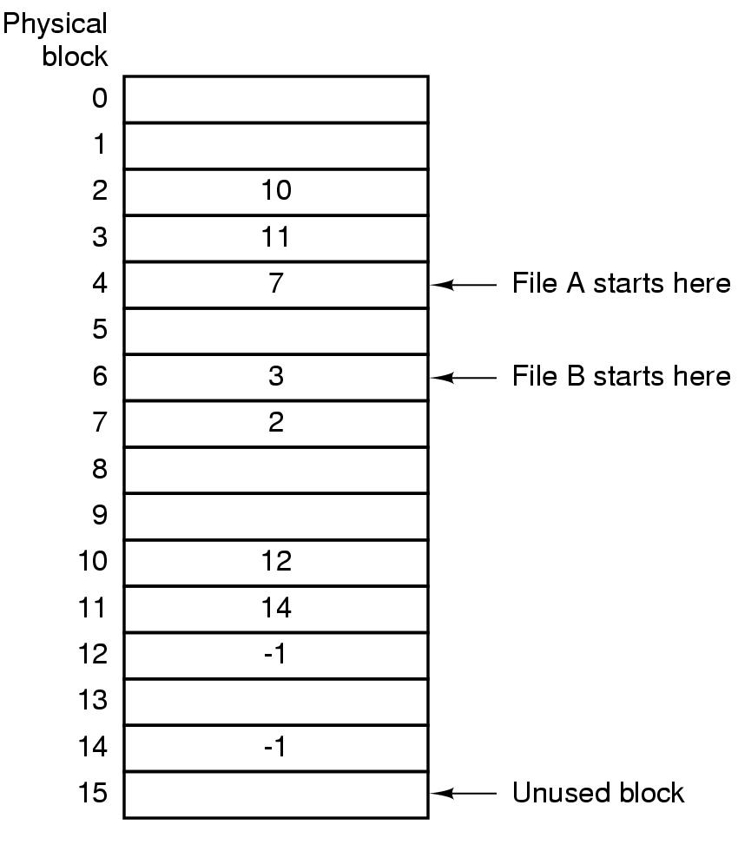
Implementing Files (3)
Linked list allocation using a
file allocation table in RAM

Slide 11
Directory Structure
A collection of nodes containing information about files
Directory
Files
F 1
F 2
F 3
F 4
F n
Both the directory structure and the files reside on disk

Slide 12
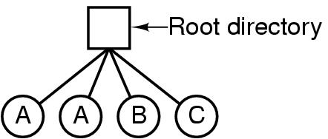
Single-Level Directory Systems
A single level directory system
  contains 4 files
  owned by 3 different people, A, B, and C

Slide 13
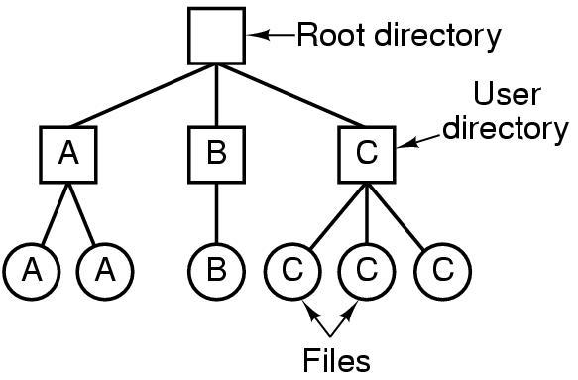
Two-level Directory Systems
Letters indicate owners of the directories and files

Slide 14
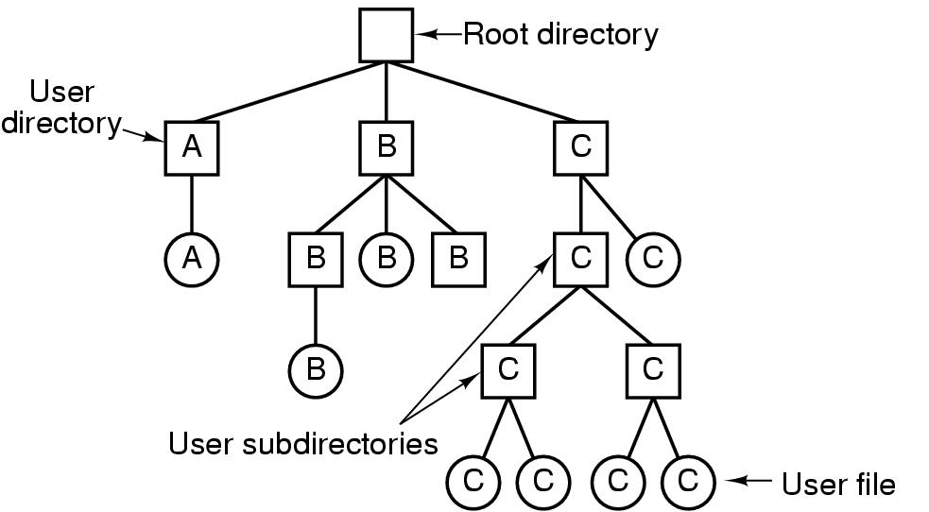
Hierarchical Directory Systems
A hierarchical directory system

Slide 15
Directory Operations
Create
Delete
Opendir
Closedir
Readdir
Rename
Link
Unlink

Slide 16
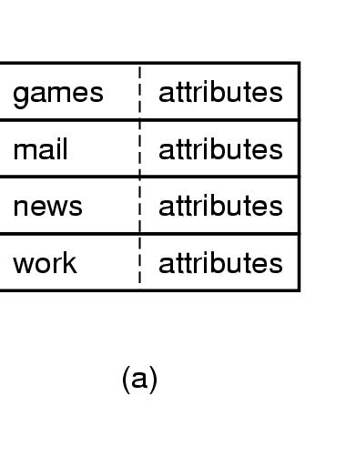
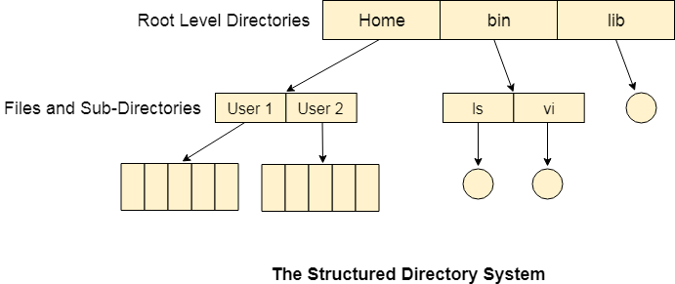
Implementing Directories
(b)
(a) A simple directory
  fixed size entries
  disk addresses and attributes in directory entry
(b) Tree structure

Slide 17
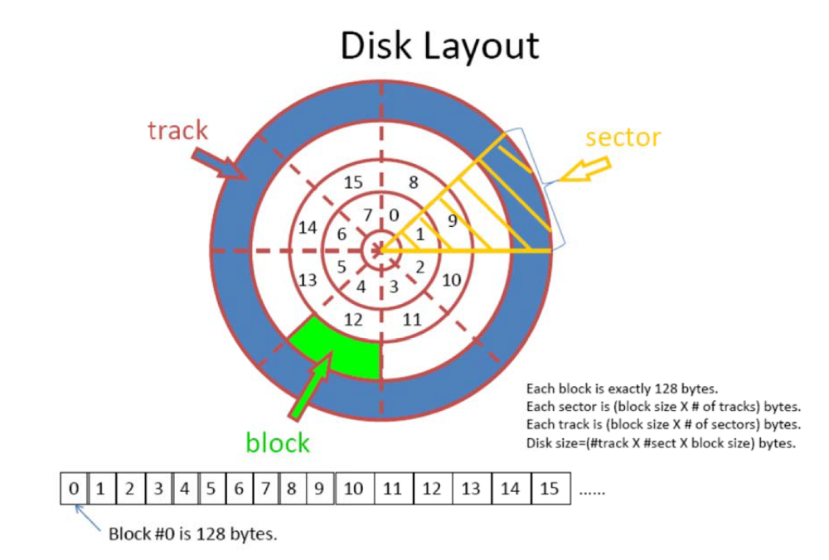
Project 3 Disk Layout
Chop the file into multiple blocks, and give each block an index (0, 1, …., n)
Based on the cylinder ‘c’ and sector ‘s’, to calculate the block index is : block index = （c-1） * (# of sectors on the disk) + s
For example, R 10 6. If you set the # of sectors on the disk to be 8 as shown in the figure on the left, then the block you are going to read is 10 * 8 + 6 = 86, which is #86 block

Slide 18
Project 3 Disk Protocol
The server must understand the following commands, and give the following responses:
• I: information request. The disk returns two integers representing the disk geometry: the number of cylinders, and the number of sectors per cylinder.
• R c s: read request for the contents of cylinder c sector s. The disk returns ’1’ followed by those 128 bytes of information, or ’0’ if no such block exists. (This will return whatever data happens to be on the disk in a given sector, even if nothing has ever been explicitly written there before.)
• W c s l data: write request for cylinder c sector s. l is the number of bytes being provided, with a maximum of 128. The data is those l bytes of data. The disk returns ’1’ to the client if it is a valid write request (legal values of c, s and l), or returns a ’0’ otherwise. At what point in time this return code is sent, depends on the setting of the S synchronization mode. In cases where l < 128, the contents of those bytes of the sector between byte l and byte 128 is undefined—you may implement it any way that you want (for example: old data; zero-fill; etc.).

Slide 19
Project 3 Disk Protocol (cont)
The data format that you must use for c s and l above is a regular ASCII string, followed by a white-space (space, tab or newline) character. So, for example, a read request for the contents of sector 17 of cylinder 130 would look like: R 130 17 . And then 129 bytes of data would be returned: the character 1, followed immediately by the 128 bytes read from that sector.

Slide 20
Project 3 Disk Client
The clients that you need to write here are mostly for testing purposes. The real use of this “disk” will be the filesystem implemented in the later parts of this project. So, for testing/demonstration purposes, you need to implement two clients:
Command-line driven client: This client should work in a loop, having the user type commands in the format of the above protocol, send the commands to the disk server, and display the results to the user. (It would be difficult to debug your disk server without such a debugging tool anyway.)
Random data client: This client should query the disk for its size (using the I command), and then generate a series of N random requests to the disk. Each request should randomly be W or R, and the cylinder number and sector number should be randomly chosen from the valid range for that disk. Write requests should all write 128 bytes of data. The value of N, and the seed for the random number generator, should be specified on the command line. This client must not print out the data that is read/written - simply printing a single character representing each request (to show progress) is sufficient.

Slide 21
Project 3 File Operations
The server must understand the following commands, and give the following responses. (See the Appendix for some suggested, but not required, algorithms to implement some of these operations.)
C f: create file.
D f: delete file.
L b: directory listing.
R f: read file.
W f l data: write file.

Slide 22
Project 3 Directory Operations
mkdir dirname : create a directory of name dirname.
cd dirname : change current working directory to dirname
pwd : print the working directory name.
rmdir dirname: remove the directory given. Throw an error if it is not present.

Slide 23
End of Chapter 11

