Slide 1
Chapter 12: Cache

Slide 2
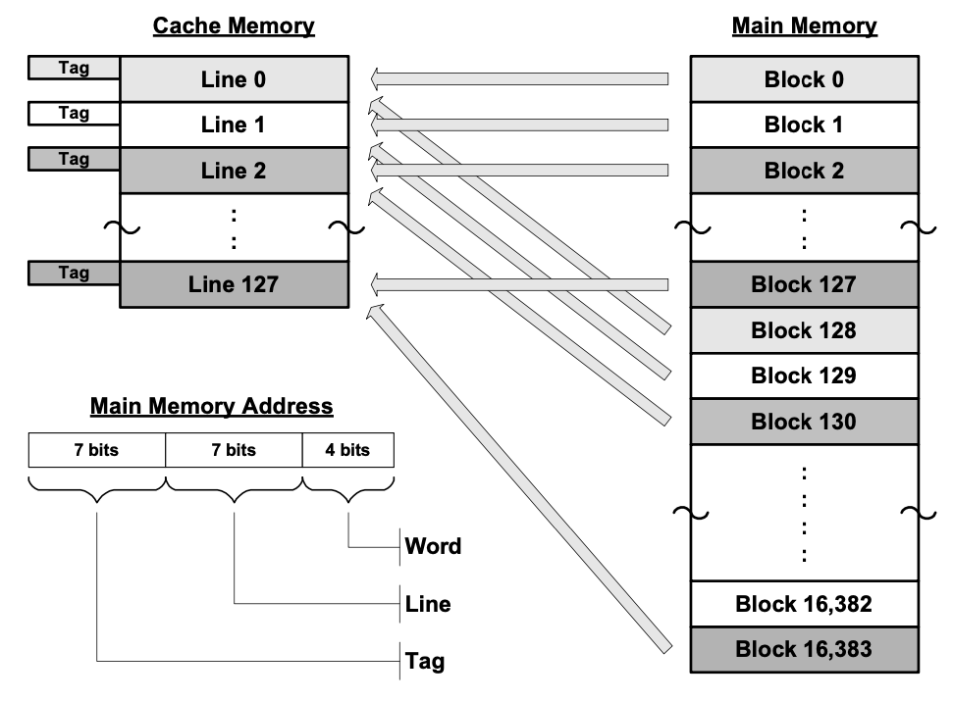
Direct Mapping
Which line to store the information?
  Line ID = Block ID mod number of lines
How many lines are there in a cache?
  number of lines = cache size / words per line
  E.g., cache size 2048 words, 16 words per line, there are 128 lines
  Line bits = log2(number of lines)
  Cache size: 2^(line bits + word bits)
How many tags are there?
  number of tags = number of blocks / number of lines (or memory size / cache size)
  Tag bits = log2(number of tags)
  Memory size: 2^(tag bits + line bits + word bits)

Slide 3
Direct Mapping cont.
To search for a word in the cache,
  Determine what line to look in – easy; just index into the cache using the line bits of the address.
  Compare the tag bits (leading seven bits) of the address with the tag of the line. If it matches, the block is in the cache.
  Select the desired word from the line using the word bits.
Advantages:
  Fast lookup (only one comparison needed).
  Cheap hardware (no associative comparison).
  Easy to decide where it is or where to place it.

Slide 4
Accessing Direct-Mapped Caches
Set selection
  Use the set index bits to determine the set of interest.
set 0:
valid
tag
cache block
selected set
set 1:
valid
tag
cache block
• • •
set S-1:
valid
tag
cache block
t bits
s bits
b bits
0 0 0 0 1
m-1
tag
set index
block offset
0

Slide 5
Accessing Direct-Mapped Caches
Line matching and word selection
  Line matching: Find a valid line in the selected set with a matching tag
  Word selection: Then extract the word
=1?
(1) The valid bit must be set
0
1
2
3
4
5
6
7
selected set (i):
1
0110
b₀
b₁
b₂
b₃
(2) The tag bits in the cache line must match the tag bits in the address
= ?
If (1) and (2), then cache hit
t bits
s bits
b bits
0110
i
100
m-1
tag
set index
block offset
0

Slide 6
Accessing Direct-Mapped Caches
Line matching and word selection
  Line matching: Find a valid line in the selected set with a matching tag
  Word selection: Then extract the word
0
1
2
3
4
5
6
7
selected set (i):
1
0110
b₀
b₁
b₂
b₃
(3) If cache hit,
block offset selects starting byte.
t bits
s bits
b bits
0110
i
100
m-1
tag
set index
block offset
0

Slide 7
Direct-Mapped Cache Simulation
M=16 byte addresses, B=2 bytes/block,
S=4 sets, E=1 entry/set
Address trace (reads):
0 [0000₂],
1 [0001₂],
7 [0111₂],
8 [1000₂],
0 [0000₂]
t=1
s=2
b=1
x
xx
x
miss
hit
miss
miss
miss
set
v
tag
data
00
0
?
?
1
1
1
0
1
0
M[0-1]
M[8-9]
M[0-1]
01
10
11
1
0
M[6-7]

Slide 8
Example: Set Associative Cache
Characterized by more than one line per set
set 0:
valid
tag
cache block
E=2
lines per set
valid
tag
cache block
set 1:
valid
tag
cache block
valid
tag
cache block
• • •
valid
tag
cache block
set S-1:
valid
tag
cache block
E-way associative cache

Slide 9
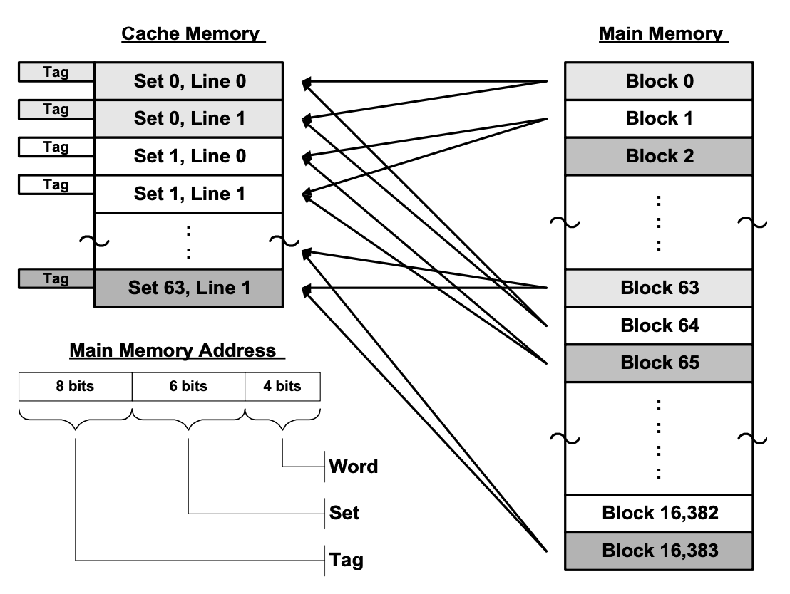
Set-associative Cache
Give away line/set bits to tag bits
  2-way set associative cache gives away 1 line/set bit to tag bit
Which set to store the information?
  Set ID = Block ID mod number of sets
How many sets are there in a cache?
  number of sets = (cache size / words per line) / lines per set
  E.g., cache size 2048 words, 16 words per line, 2-way associative cache has 64 sets
  Set bits = log2(number of sets)
  Cache size: 2^(set bits + word bits) * lines per set
How many tags are there?
  number of tags = number of blocks / number of sets
  Tag bits = log2(number of tags)
  Memory size: 2^(tag bits + set bits + word bits)

Slide 10
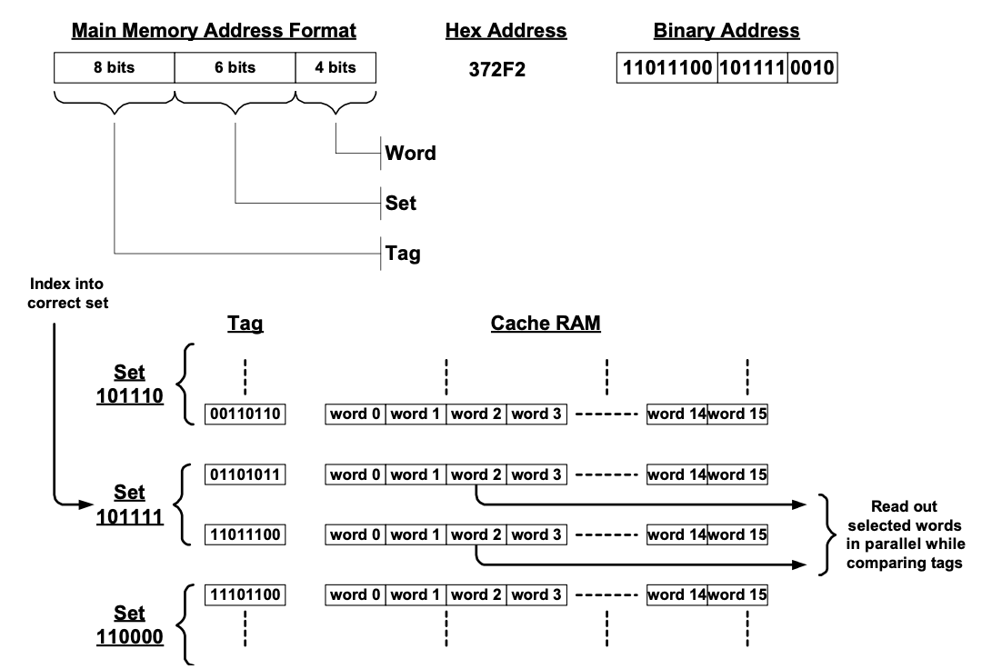
Accessing in Set-associative Cache
Index into the set using the set bits of the address (i mod s).
Simultaneously compare the tag bits (leading 8 bits) of the address with the tag of all lines in the set. If it matches any one, the desired block is in the cache.
Concurrent with comparing the tag bits, begin reading out the selected data words of all lines in the set (using the word bits) so the data words will be available at the end of the compare cycle.
If a tag match is found, get the data word from the selected line to the cache-output buffer and on to the processor. Discard the other words.

Slide 11
2-Way Associative Cache Simulation
M=16 byte addresses, B=2 bytes/block,
S=2 sets, E=2 entry/set
Address trace (reads):
0 [0000₂],
1 [0001₂],
7 [0111₂],
8 [1000₂],
0 [0000₂]
t=2
s=1
b=1
xx
x
x
miss
hit
miss
miss
hit
set
v
tag
data
0
?
?
0
1
00
M[0-1]
1
10
M[8-9]
0
1
01
M[6-7]
1
0
0

Slide 12
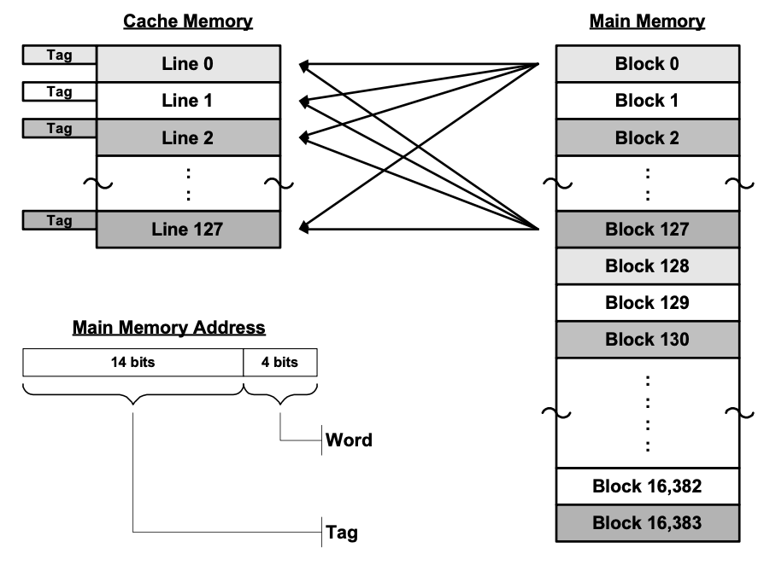
Fully-associative Cache
Give away all set bits to tag bits
Less collision, but slow look up

Slide 13
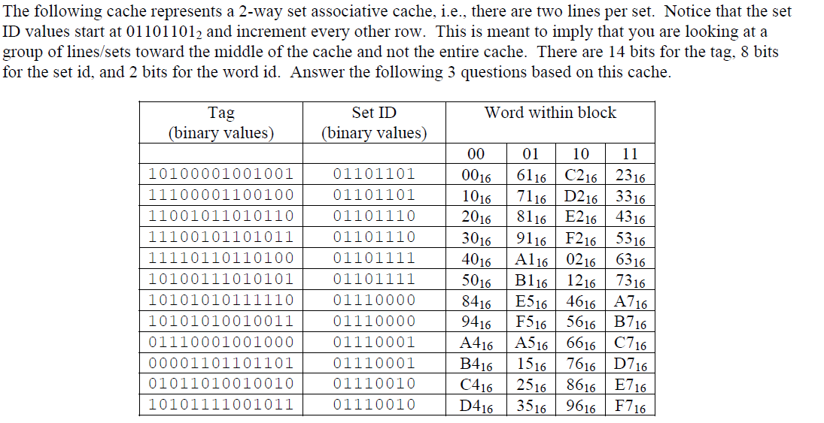
In Class Practice
What is the data for the address of 7121C5 (hex)?
What is the total memory size?
What is the total cache size?
A5
16MB
2KB

Slide 14
End of Chapter 12

