Slide 1
Chapter 6: Deadlocks

Slide 2
Chapter 6: Deadlocks
System Model
Deadlock Characterization
Methods for Handling Deadlocks
Deadlock Prevention
Deadlock Avoidance
Deadlock Detection
Recovery from Deadlock

Slide 3

Dining-Philosophers Problem
Philosophers spend their lives alternating thinking and eating
Don’t interact with their neighbors, occasionally try to pick up 2 chopsticks (one at a time) to eat from bowl
  Need both to eat, then release both when done
In the case of 5 philosophers
  Shared data
    Bowl of rice (data set)
    Semaphore chopstick [5] initialized to 1

Slide 4
Dining-Philosophers Problem Algorithm
The structure of Philosopher i:
    do {
    wait (chopstick[i] );
    wait (chopStick[ (i + 1) % 5] );
    // eat
    signal (chopstick[i] );
    signal (chopstick[ (i + 1) % 5] );
    // think
    } while (TRUE);
What is the problem with this algorithm?

Slide 5
Problems with Semaphores
Incorrect use of semaphore operations:
  signal (mutex) …. wait (mutex)
  wait (mutex) … wait (mutex)
  Omitting of wait (mutex) or signal (mutex) (or both)
Deadlock and starvation are possible.

Slide 6
Starvation
Semaphores do not wake blocked processes in any specific order
  In other words, it does not use a FIFO queue
  This means, starvation of a process can occur
When starvation occurs, it means a process doesn’t get the chance to run

Slide 7
Visualize Starvation
Semaphore
Blocked
Thread 1
Wait
Some shared resource or variable
Thread 2
Thread modifies the resource or variable
Wait
Signal
…..
Blocked
Thread N
Wait

Slide 8

Starvation Example
Have 4 semaphores: DigHole = 0, Curley2go = 0, Moe2go = 0, and Shovel = 1.
Larry (digger)
Curley (planter)
Moe (filler)
wait(DigHole)
wait(Curley2go)
wait(Moe2go)
wait(Shovel)
Starvation
wait(Shovel)
Larry digs hole
Curley plants hole
Moe fills hole
signal(Shovel)
signal(Shovel)
signal(Curley2go)
signal(Moe2go)
signal(DigHole)

Slide 9
Deadlocks
Semaphores do not prevent deadlock
  They can prevent deadlock, if used cleverly (this will be discussed more in Lecture – “Dining Philosophers”)
When deadlocks occur, it means multiple processes are executing forever.

Slide 10

Visualize a Deadlock
Some shared resource or variable
“A”
Modify/Assigned
Deadlock!
Wait/Request
Blocked
Wait/Request
Blocked
Process 1
Process 2
Wait/Request
Modify/Assigned
Wait/Request
Some shared resource or variable
“B”

Slide 11
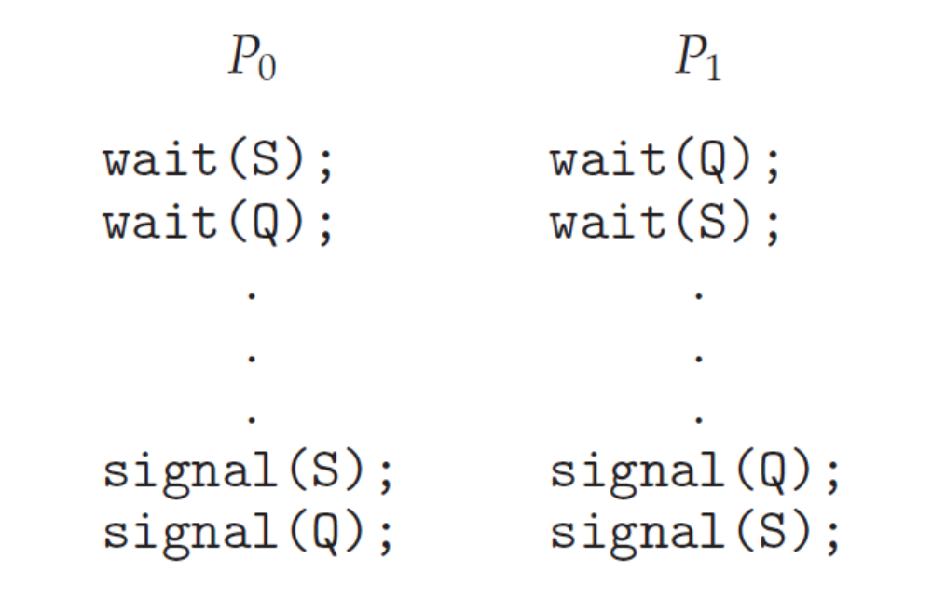
Deadlock Example

Slide 12
Deadlock in Dinning-Philosopher
Deadlock:
  Suppose that all five philosophers become hungry at the same time and each grabs her left chopstick. All the elements of chopstick will now be equal to 0. When each philosopher tries to grab her right chopstick, she will be delayed forever.
Deadlock handling solutions:
  Allow at most 4 philosophers to be sitting simultaneously at the table.
  Allow a philosopher to pick up the forks only if both are available (picking must be done in a critical section.
  Use an asymmetric solution -- an odd-numbered philosopher picks up first the left chopstick and then the right chopstick. Even-numbered philosopher picks up first the right chopstick and then the left chopstick.

Slide 13
Deadlock Characterization
Deadlock can arise if four conditions hold simultaneously.
Mutual exclusion: only one process at a time can use a resource
Hold and wait: a process holding at least one resource is waiting to acquire additional resources held by other processes
No preemption: a resource can be released only voluntarily by the process holding it, after that process has completed its task
Circular wait: there exists a set {P₀, P₁, …, P_{n}} of waiting processes such that P₀ is waiting for a resource that is held by P₁, P₁ is waiting for a resource that is held by P₂, …, P_{n–1} is waiting for a resource that is held by P_{n}, and P_{n} is waiting for a resource that is held by P₀.

Slide 14
System Model
System consists of resources
Resource types R₁, R₂, . . ., R_{m}
    CPU cycles, memory space, I/O devices
Each resource type R_{i} has W_{i} instances.
Each process utilizes a resource as follows:
  request
  use
  release

Slide 15
Resource-Allocation Graph
A set of vertices V and a set of edges E.
V is partitioned into two types:
  P = {P₁, P₂, …, P_{n}}, the set consisting of all the processes in the system
    Represented as circle
  R = {R₁, R₂, …, R_{m}}, the set consisting of all resource types in the system
    Represented as rectangle and dots (instances)
request edge – directed edge P_{i} → R_{j}
  It signifies that process Pi has requested an instance of resource type Rj and is currently waiting for that resource.
assignment edge – directed edge R_{j} → P_{i}
  it signifies that an instance of resource type Rj has been allocated to process Pi .

Slide 16



Resource-Allocation Graph (Cont.)
Process
Resource Type with 4 instances
P_{i} requests instance of R_{j}
P_{i} is holding an instance of R_{j}
P_{i}
R_{j}
P_{i}
R_{j}

Slide 17
Resource-Allocation Graph (cont)
When process Pi requests an instance of resource type Rj , a request edge is inserted in the resource-allocation graph.
When this request can be fulfilled, the request edge is instantaneously transformed to an assignment edge.
When the process no longer needs access to the resource, it releases the resource. As a result, the assignment edge is deleted.

Slide 18

Example of a Resource Allocation Graph

Slide 19
Deadlocks
In the resource-allocation graph:
  If the graph contains no cycles, then no process in the system is deadlocked.
  If the graph does contain a cycle, then a deadlock may exist.
    If each resource type has exactly one instance, then a cycle implies that a deadlock has occurred. Each process involved in the cycle is deadlocked
    If each resource type has several instances, then a cycle does not necessarily imply that a deadlock has occurred

Slide 20


Deadlocks Examples
Graph With A Cycle That is A Deadlock
Graph With A Cycle But No Deadlock

Slide 21
Basic Facts
If graph contains no cycles ⇒ no deadlock
If graph contains a cycle ⇒
  if only one instance per resource type, then deadlock
  if several instances per resource type, possibility of deadlock

Slide 22
Methods for Handling Deadlocks
Ensure that the system will never enter a deadlock state:
  Deadlock prevention (user/process responsibility, limit requests, may have side effect)
  Deadlock avoidence
Allow the system to enter a deadlock state and then recover
Ignore the problem and pretend that deadlocks never occur in the system; used by most operating systems, including UNIX

Slide 23
Deadlock Avoidance Algorithms
Single instance of a resource type
  Use a resource-allocation graph
Multiple instances of a resource type
  Use the banker’s algorithm

Slide 24
Resource-Allocation Graph Scheme
Claim edge P_{i} → R_{j} indicated that process P_{j} may request resource R_{j}; represented by a dashed line
Claim edge converts to request edge when a process requests a resource
Request edge converted to an assignment edge when the resource is allocated to the process
When a resource is released by a process, assignment edge reconverts to a claim edge
Resources must be claimed a priori in the system

Slide 25

Resource-Allocation Graph

Slide 26
Resource-Allocation Graph Algorithm
Suppose that process P_{i} requests a resource R_{j}
The request can be granted only if converting the request edge to an assignment edge does not result in the formation of a cycle in the resource allocation graph
We check for safety by using a cycle-detection algorithm. An algorithm for detecting a cycle in this graph requires an order of n2 operations, where n is the number of processes in the system.
  If no cycle exists, then the allocation of the resource will leave the system in a safe state.
  If a cycle is found, then the allocation will put the system in an unsafe state. In that case, process Pi will have to wait for its requests to be satisfied.

Slide 27

Unsafe State In Resource-Allocation Graph

