Slide 1
Chapter 8: Memory Management

Slide 2

Virtual Memory That is Larger Than Physical Memory

Slide 3

Demand Paging
Could bring entire process into memory at load time
Or bring a page into memory only when it is needed – Demand Paging
  Less I/O needed, no unnecessary I/O
  Less memory needed
  Faster response
  More users
Similar to paging system with swapping (diagram on right)
Page is needed ⇒ reference to it
  invalid reference ⇒ abort
  not-in-memory ⇒ bring to memory
Lazy swapper – never swaps a page into memory unless page will be needed
  Swapper that deals with pages is a pager

Slide 4
Basic Concepts
Instead, pager brings in only those pages that are currently demanded into memory
If pages needed are already memory resident (Valid)
  No difference from non demand-paging
If page needed and not memory resident (Invalid)
  Need to detect and load the page into memory from storage
    Without changing program behavior
    Without programmer needing to change code

Slide 5

Valid-Invalid Bit
A new MMU functionality with valid-invalid bit.
With each page table entry a valid–invalid bit is associated
(v ⇒ in-memory – memory resident, i ⇒ not-in-memory)
Initially valid–invalid bit is set to i on all entries
Example of a page table snapshot:
During MMU address translation, if valid–invalid bit in page table entry is i ⇒ page fault

Slide 6

Page Table When Some Pages Are Not in Main Memory

Slide 7
Page Fault
If there is a reference to a page, first reference to that page will trap to operating system:
page fault
Operating system looks at another table to decide:
  Invalid reference ⇒ abort
  Just not in memory
Find free frame
Swap page into frame via scheduled disk operation
Reset tables to indicate page now in memory
Set validation bit = v
Restart the instruction that caused the page fault

Slide 8

Steps in Handling a Page Fault

Slide 9
What Happens if There is no Free Frame?
Used up by process pages
Also in demand from the kernel, I/O buffers, etc
How much to allocate to each?
Page replacement – find some page in memory, but not really in use, page it out
  Algorithm – terminate? swap out? replace the page?
  Performance – want an algorithm which will result in minimum number of page faults
Same page may be brought into memory several times

Slide 10
Page Replacement
Prevent over-allocation of memory by modifying page-fault service routine to include page replacement
Use modify (dirty) bit to reduce overhead of page transfers – only modified pages are written to disk
Page replacement completes separation between logical memory and physical memory – large virtual memory can be provided on a smaller physical memory
Find a victim frame to replace.

Slide 11
Basic Page Replacement
Find the location of the desired page on disk
Find a free frame:
- If there is a free frame, use it
- If there is no free frame, use a page replacement algorithm to select a victim frame
- Write victim frame to disk if dirty
Bring the desired page into the (newly) free frame; update the page and frame tables
Continue the process by restarting the instruction that caused the trap

Slide 12

Page Replacement

Slide 13
Page and Frame Replacement Algorithms
Frame-allocation algorithm determines
  How many frames to give each process
  Which frames to replace
Page-replacement algorithm
  Want lowest page-fault rate on both first access and re-access
Evaluate algorithm by running it on a particular string of memory references (reference string) and computing the number of page faults on that string
  String is just page numbers, not full addresses
  Repeated access to the same page does not cause a page fault
  Results depend on number of frames available
In all our examples, the reference string of referenced page numbers is
7,0,1,2,0,3,0,4,2,3,0,3,0,3,2,1,2,0,1,7,0,1

Slide 14

First-In-First-Out (FIFO) Algorithm
Reference string: 7,0,1,2,0,3,0,4,2,3,0,3,0,3,2,1,2,0,1,7,0,1
3 frames (3 pages can be in memory at a time per process)
How to track ages of pages?
  Just use a FIFO queue
15 page faults

Slide 15

Optimal Algorithm
Replace page that will not be used for longest period of time
  9 is optimal for the example (OPT)
How do you know this?
  Can’t read the future
Used for measuring how well your algorithm performs

Slide 16

Least Recently Used (LRU) Algorithm
Use past knowledge rather than future
Replace page that has not been used in the most amount of time
Associate time of last use with each page
12 faults – better than FIFO but worse than OPT
Generally good algorithm and frequently used
But how to implement?

Slide 17

Use Of A Stack to Record Most Recent Page References

Slide 18
In Class Practice
Consider a paged virtual memory system, in which a process is allocated with a 3 frames window. Assume the memory reference string is 1, 2, 3, 4, 1, 2, 5, 1, 2, 3, 4, 5.
Using LRU page-replacement algorithm, how many page faults in total?
10

Slide 19
Structure of the Page Table
Memory structures for paging can get huge using straight-forward methods
  Consider a 32-bit logical address space as on modern computers
  Page size of 4 KB (2¹²)
  Page table would have 1 million entries (2³² / 2¹²)
  If each entry is 4 bytes -> 4 MB of physical address space / memory for page table alone
    That amount of memory used to cost a lot
    Don’t want to allocate that contiguously in main memory
Hierarchical Paging

Slide 20
Hierarchical Page Tables
Break up the logical address space into multiple page tables
A simple technique is a two-level page table
We then page the page table

Slide 21
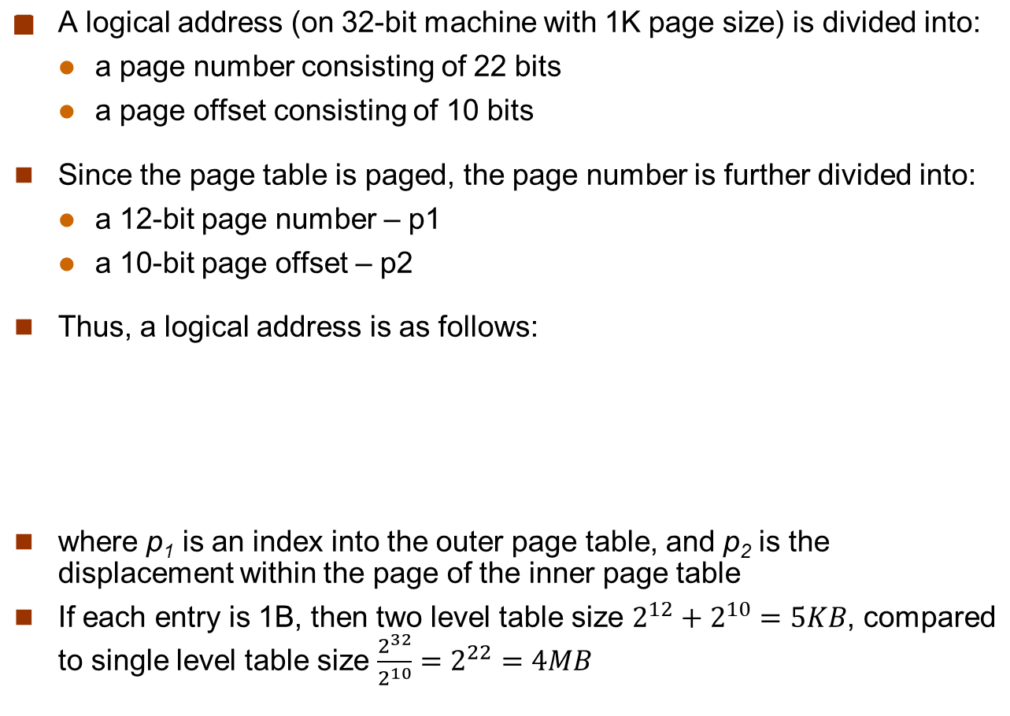
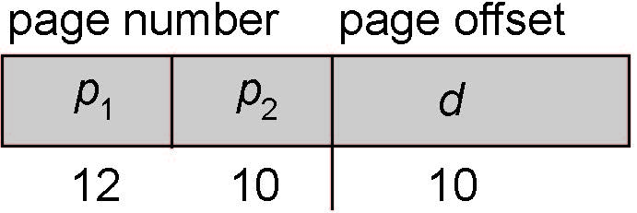
Two-Level Paging Example

Slide 22

Two-Level Page-Table Scheme

Slide 23

Address-Translation Scheme

Slide 24
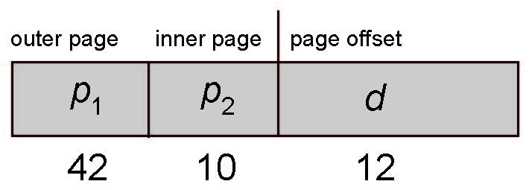
64-bit Logical Address Space
Even two-level paging scheme not sufficient
If page size is 4 KB (2¹²)
  Then page table has 2⁵² entries
  If two level scheme, inner page tables could be 2¹⁰ 4-byte entries
  Address would look like
  Outer page table has 2⁴² entries or 2⁴⁴ bytes
  One solution is to add a 2nd outer page table
  But in the following example the 2nd outer page table is still 2³⁴ bytes in size
    And possibly 4 memory access to get to one physical memory location

Slide 25


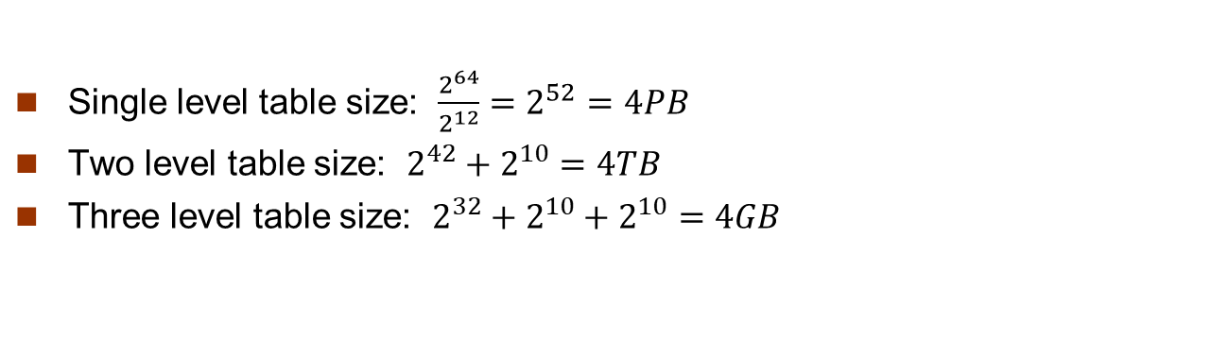
Three-level Paging Scheme

Slide 26
Review of Memory Management
How to defragmentation?
  Segmentation
    Split the request into smaller modules – segmentation, so that they are flexible to use the fragmented memory
  Paging
    CPU see a set of continuous logical address
    The physical address in the memory can be discontinuous
    Page table maps logical address to physical address
      Hierarchical page table addresses the scalability issue
  Swap and backing store
    Increase the size of usable physical memory
    Page fault
    Page replacement

