Slide 1
Chapter 12: Cache

Slide 2
Storage Hierarchy and Locality
Capacity +
Speed -
Disk
SRAM Cache
Main Memory
Row buffer
L3 Cache
L2 Cache
ITLB
Instruction Cache
Data Cache
DTLB
Register File
Speed +
Capacity -

Slide 3
Memory Latency is Long
60-100ns not totally uncommon
Quick back-of-the-envelope calculation:
  2GHz CPU
  → 0.5ns / cycle
  100ns memory → 200 cycle memory latency!
Solution: Caches

Slide 4
Hardware cache memories
Cache memories are small, fast SRAM-based memories managed automatically in hardware
  Hold frequently accessed blocks of main memory
CPU looks first for data in L1, then in main memory
Typical system structure:
CPU chip
register file
L1
cache
ALU
bus
main
memory
bus interface

Slide 5
Cache Basics
Fast (but small) memory close to processor
When data referenced
  If in cache, use cache instead of memory
  If not in cache, bring into cache
  (actually, bring entire block of data, too)
  Maybe have to kick something else out to do it!
Key: Optimize the
average memory
access latency

Slide 6
General cache mechanics
Smaller, faster, more expensive
memory caches a subset of
the blocks
8
Cache:
4
9
14
3
10
Data is copied between
levels in block-sized transfer units
10
4
0
1
2
3
4
Memory:
4
5
6
7
Larger, slower, cheaper memory
is partitioned into “blocks”
8
9
10
10
11
12
13
14
15
From lecture-9.ppt

Slide 7
Cache Performance Metrics
Miss Rate
  Fraction of memory references not found in cache (misses / accesses)
    1 – hit rate ☺
  Typical numbers (in percentages):
    3-10% for L1
    can be quite small (e.g., < 1%) for L2, depending on size, etc.
Hit Time
  Time to deliver a line in the cache to the processor
    includes time to determine whether the line is in the cache
  Typical numbers:
    1-2 clock cycle for L1
    5-20 clock cycles for L2
Miss Penalty
  Additional time required because of a miss
    typically 50-200 cycles for main memory (Trend: increasing!)

Slide 8
Lets think about those numbers
Huge difference between a hit and a miss
  100X, if just L1 and main memory
Would you believe 99% hits is twice as good as 97%?
  Consider these numbers:
  cache hit time of 1 cycle
  miss penalty of 100 cycles
  So, average access time is:
  97% hits: 0.97 * 1 cycle + 0.03 * 100 cycles = 4 cycles
  99% hits: 0.99 * 1 cycle + 0.01 * 100 cycles = 2 cycles
Average/effective access time =
hit_rate*cache_latency + (1-hit_rate)*memory_latency

Slide 9
In Class Practice
A CPU is equipped with a cache; Accessing a word takes 20 clock cycles if the data is in not in the cache and 5 clock cycles if the data is in the cache.
(1) What is the effective memory access time in clock cycles if the hit ratio is 90%.
(2) What should be the hit ratio if the effective memory access time is 8 clock cycles.
(1) 6.5
(2) 80%

Slide 10
Key Issues Related To Cache
Important decisions
  Structure: what is the general organization of cache?
  Identification: how do we find a block in cache?
  Placement: where in the cache can a block go?
  Replacement: what to kick out to make room in cache?
    LRU can also be applied here

Slide 11
General Organization of a Cache
Cache is an array
of sets
Each set contains
one or more lines
Each line holds a
block of data
1 valid bit per line
t tag bits
per line
B = 2^{b} bytes
per cache block
valid
tag
0
1
• • •
B–1
E lines
per set
set 0:
• • •
valid
tag
0
1
• • •
B–1
valid
tag
0
1
• • •
B–1
S sets
set 1:
• • •
valid
tag
0
1
• • •
B–1
• • •
valid
tag
0
1
• • •
B–1
set S-1:
• • •
valid
tag
0
1
• • •
B–1
Cache size: C = B x E x S data bytes

Slide 12
Addressing Caches
Address A:
t bits
s bits
b bits
m-1
0
v
tag
0
1
• • •
B–1
set 0:
• • •
v
tag
0
1
• • •
B–1
<tag>
<set index>
<block offset>
v
tag
0
1
• • •
B–1
set 1:
• • •
v
tag
0
1
• • •
B–1
• • •
The word at address A is in the cache if
the tag bits in one of the <valid> lines in
set <set index> match <tag>
The word contents begin at offset
<block offset> bytes from the beginning
of the block
v
tag
0
1
• • •
B–1
set S-1:
• • •
v
tag
0
1
• • •
B–1

Slide 13
Addressing Caches
Address A:
t bits
s bits
b bits
m-1
0
v
tag
0
1
• • •
B–1
set 0:
• • •
v
tag
0
1
• • •
B–1
<tag>
<set index>
<block offset>
v
tag
0
1
• • •
B–1
set 1:
• • •
v
tag
0
1
• • •
B–1
• • •
Locate the set based on
<set index>
Locate the line in the set based on
<tag>
Check that the line is valid
Locate the data in the line based on
<block offset>
v
tag
0
1
• • •
B–1
set S-1:
• • •
v
tag
0
1
• • •
B–1

Slide 14
Figuring out what’s in the cache
Set Index in the middle.
Now we can tell exactly which addresses of main memory are stored in the cache, by concatenating the cache block tags with the block indices.
Main memory address in cache block
00 + 00 = 0000
11 + 01 = 1101
01 + 10 = 0110
01 + 11 = 0111
Tag
Index 00
01
10
11
Data
00
11
01
01
10

Slide 15
Set associative caches are a general idea
By now you may have noticed the 1-way set associative cache is the same as a direct-mapped cache.
Similarly, if a cache has 2^{k} blocks, a 2^{k}-way set associative cache would be the same as a fully-associative cache.
1-way
8 sets,
1 block each
2-way
4 sets,
2 blocks each
4-way
2 sets,
4 blocks each
8-way
1 set,
8 blocks
Set
Set
Set
Set
0
1
2
3
4
5
6
7
0
1
2
3
0
1
0
direct mapped
fully associative

Slide 16
Example: Direct-Mapped Cache
Simplest kind of cache, easy to build, and fastest mapping
(only 1 tag compare required per access)
Characterized by exactly one line per set.
set 0:
valid
tag
cache block
E=1 lines per set
set 1:
valid
tag
cache block
• • •
set S-1:
valid
tag
cache block

Slide 17
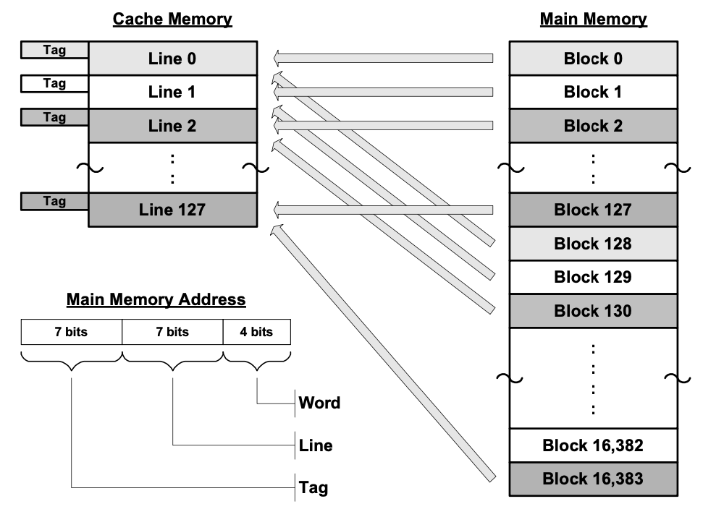
Direct Mapping
Which line to store the information?
  Line ID = Block ID mod number of lines
How many lines are there in a cache?
  number of lines = cache size / words per line
  E.g., cache size 2048 words, 16 words per line, there are 128 lines
  Line bits = log2(number of lines)
  Cache size: 2^(line bits + word bits)
How many tags are there?
  number of tags = number of blocks / number of lines (or memory size / cache size)
  Tag bits = log2(number of tags)
  Memory size: 2^(tag bits + line bits + word bits)

