Slide 1
Chapter 16: Distributed System and Cloud Computing

Slide 2
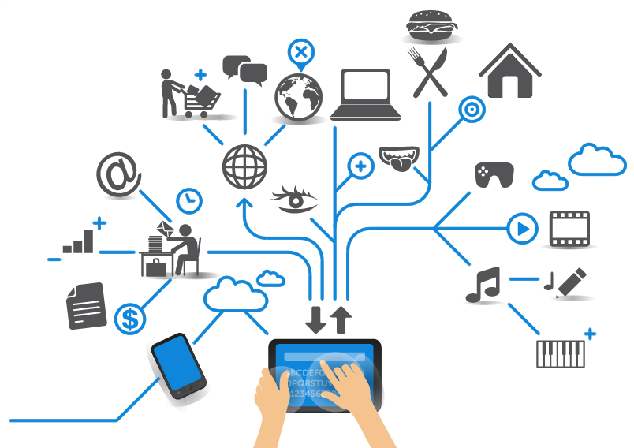
Distributed System
A number of networked computers communicate and coordinate actions only by passing massages
Computing
Networking
Storage
More power to execute jobs that cannot be done in a single machine, achieving pervasive computing

Slide 3
Selected applications on distributed systems
Finance and commerce | eCommerce e.g. Amazon and eBay, PayPal, online banking and trading
The information society | Web information and search engines, ebooks, Wikipedia; social networking: Facebook and MySpace.
Creative industries and entertainment | online gaming, music and film in the home, user-generated content, e.g. YouTube, Flickr
Healthcare | health informatics, on online patient records, monitoring patients
Education | e-learning, virtual learning environments; distance learning
Transport and logistics | GPS in route finding systems, map services: Google Maps, Google Earth
Science | The Grid as an enabling technology for collaboration between scientists
Environmental management | sensor technology to monitor earthquakes, floods or tsunamis

Slide 4
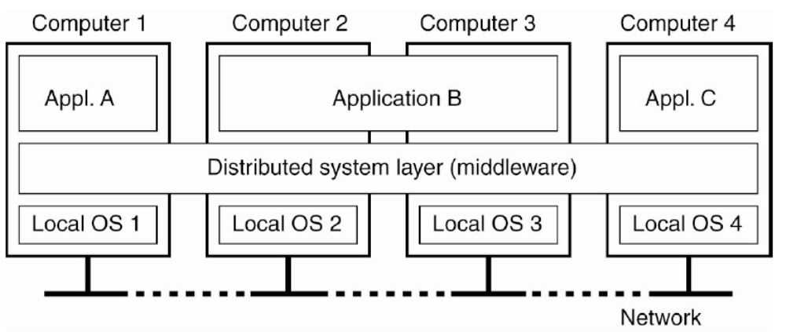
Distributed System (cont.)
Distributed system is an operating system that manages multiple computer through networks.
It serves as a middleware that provides interface for multiple applications across multiple machines

Slide 5
Resource sharing
Resource allocation in a physical infrastructure
Computing, networking and storage resources
Efficiency, scalability and reliability/availability
Distributed system’s perspective
Sharing a service, e.g., web search engine
Read, write and delete operations on files
An interface that provides and manages these
operations
Remote invocation through communication

Slide 6
Challenges in Distributed System
Concurrency
  Concurrent execution of jobs
  Coordinate actions
No global clock
  Synchronization
Independent failure
  Hardware/software failure
  Protection, recovery and availability

Slide 7
What is Cloud Computing?
Cloud Computing is a general term used to describe a new class of network based computing that takes place over the Internet,
  basically a step on from Grid Computing
  a collection/group of integrated and networked hardware, software and Internet infrastructure (called a platform).
  Using the Internet for communication and transport provides hardware, software and networking services to clients
These platforms hide the complexity and details of the underlying infrastructure from users and applications by providing very simple graphical interface or API (Applications Programming Interface).

Slide 8
What is Cloud Computing? (cont.)
In addition, the platform provides on demand services, that are always on, anywhere, anytime and any place.
Pay for use and as needed, elastic
  scale up and down in capacity and functionalities
The hardware and software services are available to
  general public, enterprises, corporations and businesses markets

Slide 9
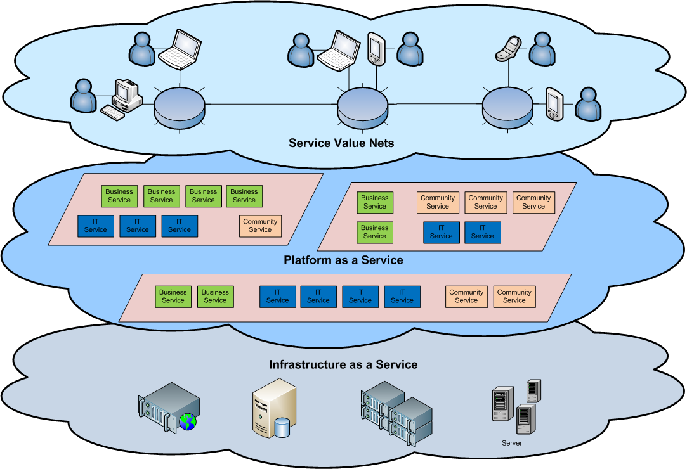
Cloud Architecture

Slide 10
Virtualization
Virtual workspaces:
  An abstraction of an execution environment that can be made dynamically available to authorized clients by using well-defined protocols,
  Resource sharing (e.g. CPU, memory share),
  Software configuration (e.g. O/S, provided services).
Implement on Virtual Machines (VMs):
  Abstraction of a physical host machine,
  Hypervisor intercepts and emulates instructions from VMs, and allows management of VMs,
  VMWare, Xen, etc.
Provide infrastructure API:
  Plug-ins to hardware/support structures
App
App
App
OS
OS
OS
Hypervisor
Hardware
Virtualized Stack

Slide 11
Virtual Machines
App
App
App
App
App
Xen
Guest OS
(Linux)
Guest OS
(NetBSD)
Guest OS
(Windows)
VMWare
VM
VM
VM
Virtual Machine Monitor (VMM) / Hypervisor
UML
Denali
Hardware
etc.

Slide 12
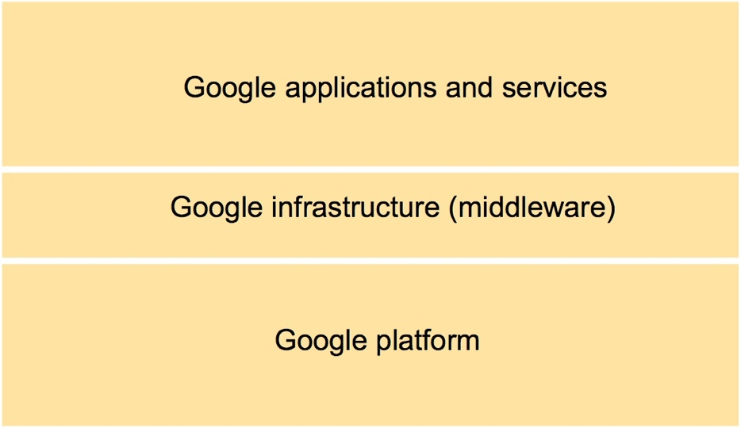
Overall Google Systems Architecture

Slide 13
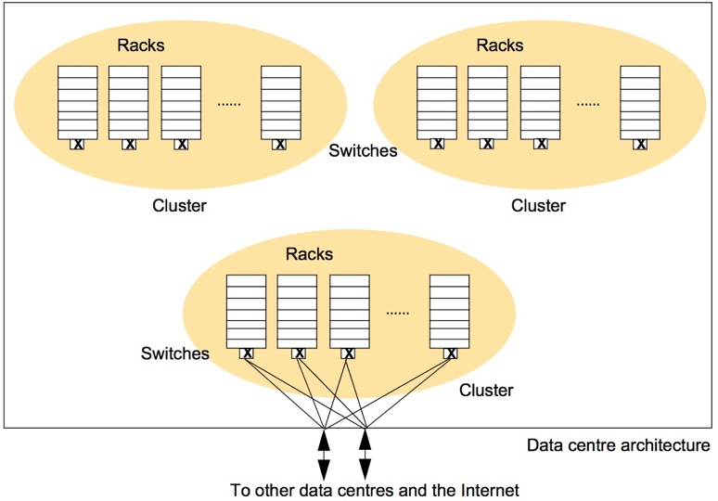
Physical Model of the Google Infrastructure

Slide 14
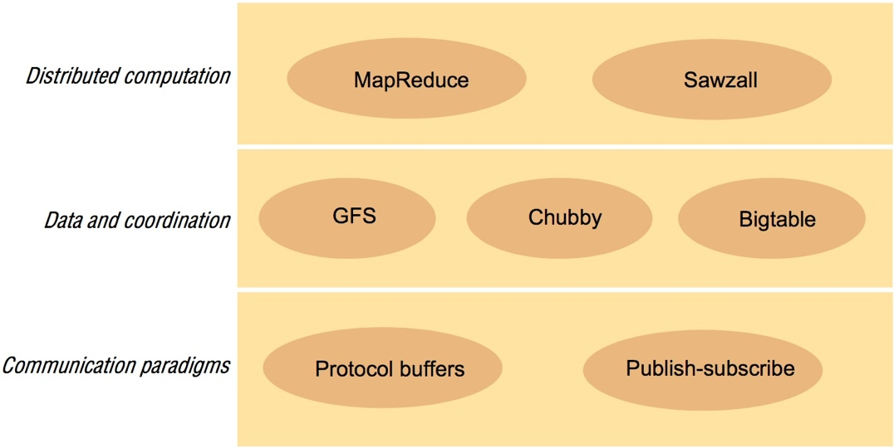
Architecture of Google Infrastructure

Slide 15
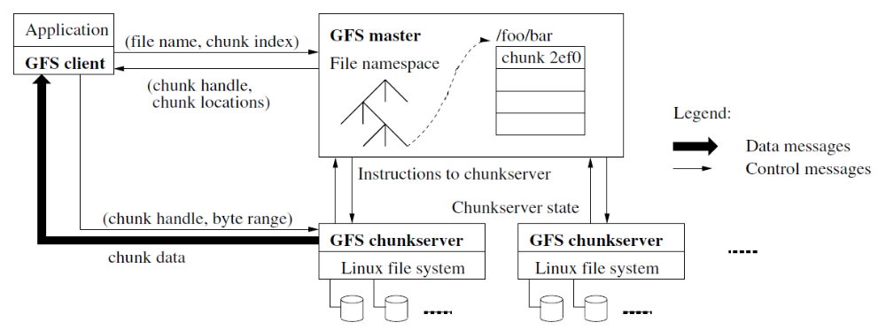
Google File System (GFS)
Chunk
  64MB fixed size
  Chunk handle (64 bit unique identification)
  Default three replicas
Single master
  File and chunk
  Mapping from file to chunks
  Chunk location
Chunk location
  Masters polls chunkserver for location information
  Clients contact master for location information and
  cache it for a while
  Clients contact chunkserver directly for download

Slide 16
GFS Master
Metadata
  File and chunk
  Mapping from file to chunk
  Location of each chunk
Problems
  Single point of failure, scalability bottleneck
Solution
  Shadow master, minimize master involvement
Operational log
  Keeps track of activities, providing a logical time line
  Replicated in multiple sites for reliability

Slide 17
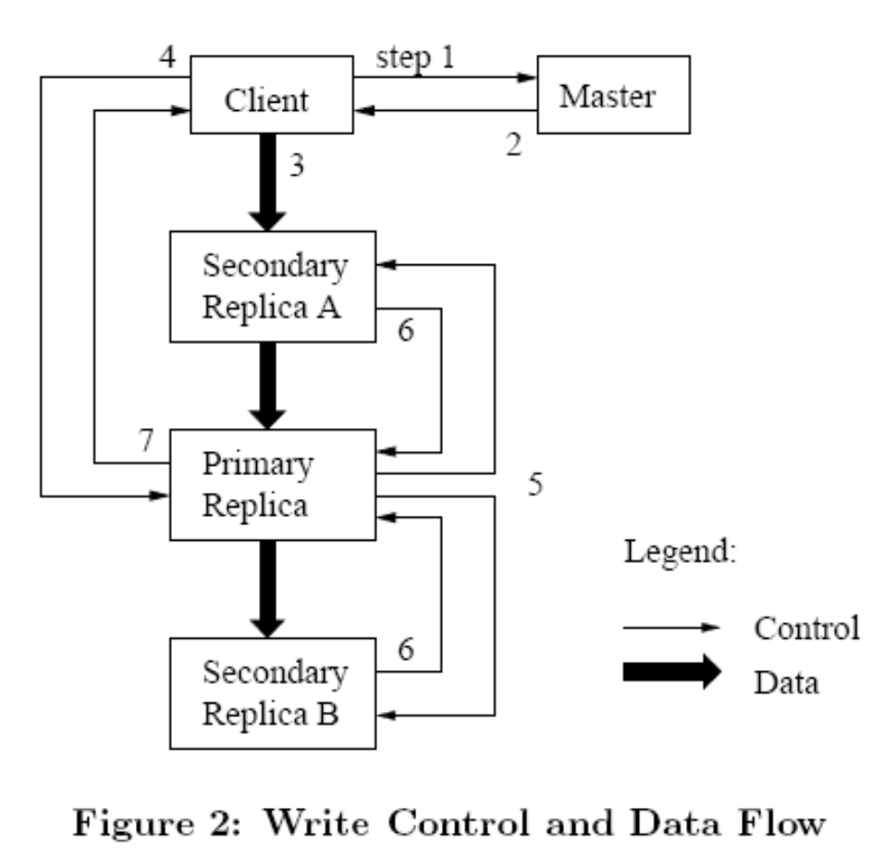
Read and Write in GFS
Read operation:
  Simply read from the primary chunkserver
Write operation:
  Master picks one replica as primary;
  Primary defines the mutation order;
  The other replicas follow the same order;
  Minimize overhead at the master;
  Data flow is in a carefully defined linear chain;

Slide 18
End of Chapter 16

