Slide 1
Chapter 2: Processes

Slide 2
Objectives
To introduce the notion of a process -- a program in execution, which forms the basis of all computation
To describe the various features of processes, including scheduling, creation and termination, and communication
To explore interprocess communication using shared memory and message passing
To describe communication in client-server systems

Slide 3
Process Concept
An operating system executes a variety of programs:
  Batch system – jobs
  Time-shared systems – user programs or tasks
Textbook uses the terms job and process almost interchangeably
Process – a program in execution; process execution must progress in sequential fashion
Multiple parts
  The program code, also called text section
  Current activity including program counter, processor registers
  Stack containing temporary data
    Function parameters, return addresses, local variables
  Data section containing global variables
  Heap containing memory dynamically allocated during run time

Slide 4
Process Concept (Cont.)
Program is passive entity stored on disk (executable file), process is active
  Program becomes process when executable file loaded into memory
Execution of program started via GUI mouse clicks, command line entry of its name, etc
One program can be several processes
  Consider multiple users executing the same program

Slide 5
Process State
As a process executes, it changes state
  new: The process is being created
  running: Instructions are being executed
  waiting: The process is waiting for some event to occur
  ready: The process is waiting to be assigned to a processor
  terminated: The process has finished execution

Slide 6

Diagram of Process State

Slide 7

Process Control Block (PCB)
Information associated with each process
(also called task control block)
Process state – running, waiting, etc
Program counter – location of instruction to next execute
CPU registers – contents of all process-centric registers
CPU scheduling information- priorities, scheduling queue pointers
Memory-management information – memory allocated to the process
Accounting information – CPU used, clock time elapsed since start, time limits
I/O status information – I/O devices allocated to process, list of open files

Slide 8

CPU Switch From Process to Process

Slide 9
Operations on Processes
System must provide mechanisms for:
  process creation,
  process termination,
  and so on as detailed next

Slide 10

Process Creation
Parent process create children processes, which, in turn create other processes, forming a tree of processes
Generally, process identified and managed via a process identifier (pid)

Slide 11

Process Creation (Cont.)
Address space
  Child duplicate of parent
  Child has a program loaded into it
UNIX examples
  fork() system call creates new process
  exec() system call used after a fork() to replace the process’ memory space with a new program
Execution options
  Parent and children execute concurrently
  Parent waits until children terminate

Slide 12

C Program Forking Separate Process

Slide 13
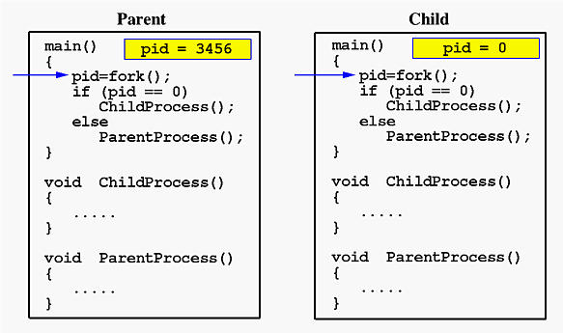
Fork I

Slide 14
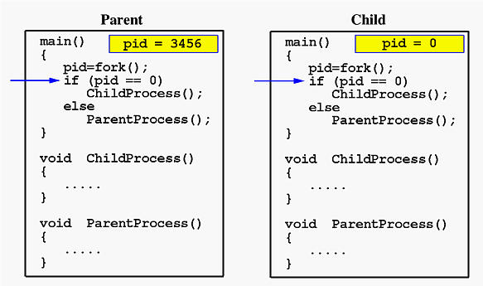
Fork II

Slide 15
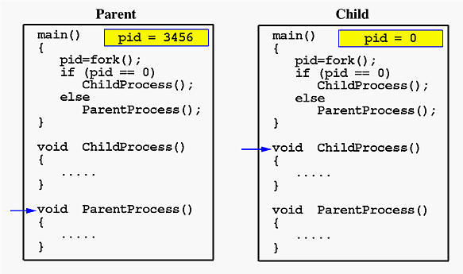
Fork III

Slide 16
Process Termination
Process executes last statement and then asks the operating system to delete it using the exit() system call.
  Returns status data from child to parent (via wait())
  Process’ resources are deallocated by operating system
Parent may terminate the execution of children processes using the abort() system call. Some reasons for doing so:
  Child has exceeded allocated resources
  Task assigned to child is no longer required
  The parent is exiting and the operating systems does not allow a child to continue if its parent terminates

Slide 17
Process Termination
Some operating systems do not allow child to exists if its parent has terminated. If a process terminates, then all its children must also be terminated.
  cascading termination. All children, grandchildren, etc. are terminated.
  The termination is initiated by the operating system.
The parent process may wait for termination of a child process by using the wait()system call. The call returns status information and the pid of the terminated process
pid = wait(&status);
If no parent waiting (did not invoke wait()) process is a zombie
If parent terminated without invoking wait , process is an orphan

Slide 18
In Class Practice
Use fork() to create a new child process.
In the appropriate places, insert print() to print a sentence in parent process, e.g., “This is parent process.”, and print a sentence in child process saying “This is child process”. You can also print out the pid#.
In the child process, use exec() system call to execute “ls” command
Question 3 of Project 1
Question 6 and 7 Project 1

