Slide 1
SLIDE 1 — TEAM
William Chen
Founder & CEO, Touchdown Labs — vendor-neutral inference-optimization research
Relevant experience
• Built Edge AI and on-device / local AI before — shipping models that run close to the user.
• Touchdown Labs: research + tooling for cutting AI inference cost without losing quality.
Team ⟷ problem fit
Local & on-device AI is exactly my lane. This product makes local agents reuse structured context instead of re-paying the cloud to rediscover it — the on-device inference problem I already work on.
Context Autopilot · Touchdown Labs · Built on EverMind + Butterbase (LIVE) · github.com/OCWC22/context-autopilot

Slide 2
SLIDE 2 — PRODUCT
Context Autopilot
One line: a $0 local engine that indexes ANY folder (code, docs, notes, projects) into reusable structured context — so Hermes, OpenClaw, or any local agent loads it instead of rediscovering everything.
Problem
Local agents (Hermes, OpenClaw, Claude Code) rediscover your project every task — code, docs, notes — burning tokens reloading what they already saw (~90K to reload a 359 KB project).
Solution
Index once into a reusable SKILL.md + DAG map; agents reuse it across tasks, frontier only for the hard step. EverMind = memory, Butterbase = state.
Proof: same task 11,947 → 299 tokens (−98.7%, tests pass). Real repo psf/requests: 147,794 → ~1,025 tokens (57×, −99.3%).
Context Autopilot · Touchdown Labs · Built on EverMind + Butterbase (LIVE) · github.com/OCWC22/context-autopilot

Slide 3
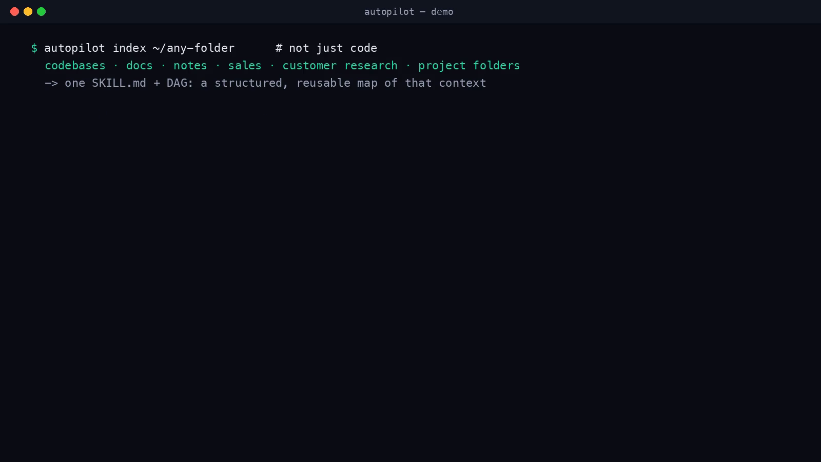
SLIDE 3 — DEMO
Working product — watch the token meter drop (≤2 min)
Context Autopilot · Touchdown Labs · Built on EverMind + Butterbase (LIVE) · github.com/OCWC22/context-autopilot

