Slide 1
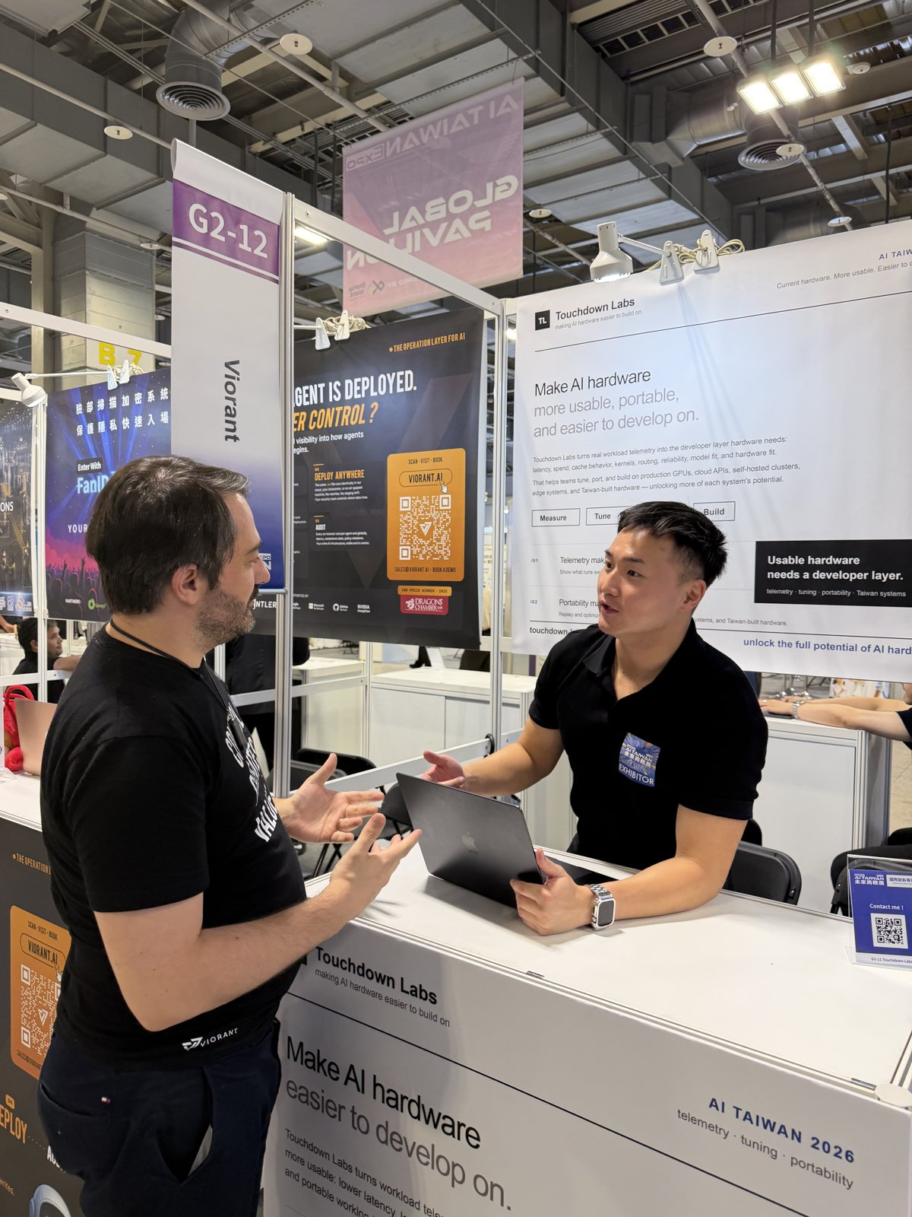
TL
Touchdown Labs
SLIDE 01 / TEAM INTRODUCTION
Touchdown Labs. Twenty months at the kernel layer.
William Chen — Founder & CEO, Touchdown Labs. Twenty months studying CUDA kernel generation and AMD GPU kernels — through chip-design study, AMD developer hackathons, and joint IC-design research with Taiwan's NYCU — building the inference-optimization company that measures cost per successful AI task from the kernel up to the token bill.
Team-to-problem alignment: our day job runs from CUDA kernels to token bills. This lab teaches students the same discipline — on the coding agent they already use — with the same evidence standard we hold our own kernel work to.
AI EXPO Taiwan 2026 · Global Pavilion booth · exhibitor
PROOF OF WORK · WON THE TRACK
Won Mercor's OpenEnv Hackathon track (San Francisco, March 2026) with an RL environment for automated CUDA kernel generation — the first public event built around RL environments and post-training. Writeup: Automated CUDA Is Almost Here.
HARDWARE FIELD WORK
Exhibited at AI EXPO Taiwan (Global Pavilion booth, Taipei, June 2026) and flew to Computex 2026 — writeup: Seeing the Physical Layer of the AI Factory — attended GTC 2026. Joint IC-design research with NYCU and a growing research-partner network, plus MI355X kernel experiments and AMD developer hackathons.
THIS BUILD, ALREADY VERIFIED
10 / 10 local tests passing, frozen acceptance contract, and a live Butterbase data write (receipt row e5ff8fc6…9454). Fixture and live states are always labeled.
Touchdown Labs · AI for Education Hackathon · Stanford · July 2026
01 / 03

Slide 2
TL
Touchdown Labs
SLIDE 02 / PRODUCT OVERVIEW
Run one coding task. See every token the agent remembered, recomputed, and wasted — then fix it.
THE PAIN
Coding agents hide the bill inside the loop. One small retry-bug fix loaded 40,176 characters of harness context — 17,420 of them repeated (43%) across 14 tool calls. Students see a patch; nobody teaches them what the system paid, or how to make it cheaper without breaking the tests.
THE BUILT SOLUTION
A browser lab on a frozen, reproducible coding task. A three-minute, nine-stage lesson: classify context lifetime, apply one optimization policy at a time, watch the engine decision flip from local MLX-LM to vLLM on Nebius at 100 users, follow text → tokens → prefill → KV cache → HBM, and export a signed optimization receipt. EverOS memory makes the next lesson adapt; Butterbase persists the evidence.
CONTEXT AFTER ONE POLICY
−42%
40,176 → 23,210 characters on the same task, same acceptance test still passing.
DETERMINISTIC FIXTURE · LABELED
REPEATED CONTEXT
−70%
17,420 → 5,180 repeated characters once stable prefix + tool-output projection are applied.
DETERMINISTIC FIXTURE · LABELED
MEMORY VS FULL REPLAY
−92%
~4,210 → ~323 estimated tokens by retrieving an EverOS Case instead of replaying the full trajectory.
LOCAL ESTIMATE · NOT A PROVIDER MEASUREMENT
LEARN HOW TO DO THIS — THE LAB SHIPS ITS OWN CURRICULUM
• Accounting first: total input = input_tokens + cache_creation_input_tokens + cache_read_input_tokens (Claude Code) — the agent-optimizer skill makes every claim a before/after receipt.
• Take it home: run the same KV-cache loop on your own laptop — Set Up a Local OpenClaw or Hermes KV-Cache Learning Loop with Mac MLX (mirrored in this repo).
• Go deeper: KV Cache Is Becoming the Memory Hierarchy of Inference — why the same waste shows up at GB200 scale.
Touchdown Labs · AI for Education Hackathon · Stanford · July 2026
02 / 03

Slide 3
TL
Touchdown Labs
SLIDE 03 / VIDEO DEMO · WORKING OPERATIONAL BUILD
1:48. The complete lifecycle, end to end.
Shown in order: the principle and the loop bar, all nine live lesson stages with every interaction exercised — context-lifetime controls toggled, the engine decision flipped to one hundred users, all three sponsor operations run, recalled memory applied, the result verified, the receipt persisted — then the challenge ladder, the résumé-vs-receipt comparison, the incentive-alignment thesis, the thirteen-phase continuous lab down to the GPU/HBM package and facility lanes, and the learner-to-contributor journey closing on the portfolio receipt.
Evidence boundary: the walkthrough uses the demo's explicitly labeled deterministic fixture states. It does not present fixture data as a live production run.
▶
Open the 1:48 lifecycle demo
demo-video/touchdown-inference-lab-lifecycle-demo.mp4
1:48 RUNTIME · UNDER THE 2:00 CAP 1280 × 720 · H.264 · 30 FPS BROWSER-ONLY WALKTHROUGH OF THE LIVE LOCAL BUILD
npm test · 10/10
npm run verify · pass
Butterbase live write
Receipt schema + secret scan
Touchdown Labs · AI for Education Hackathon · Stanford · July 2026
03 / 03

