Slide 1
Writing PowerShell Modules
Tips, Tools, and Best Practices

Slide 2
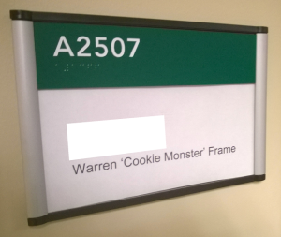


Who is this guy
Warren Frame
Perpetual student
Occasionally use and write about PowerShell
Hit me up!
twitter.com/pscookiemonster
ramblingcookiemonster.github.io
github.com/ramblingcookiemonster

Slide 3
Logistics
All materials will be available at bit.ly/psmodules
Including list of references
Updates based on feedback
Questions / discussion
Yes!
Find me afterwards (here, Slack, twitter, etc.) if we table anything

Slide 4
Why Bother With Modules?
Code organization
Group related functions and tools together
Share state between functions, not with the user
Re-use helper functions that shouldn’t be exposed to the user
Improve discoverability:
PowerShellGallery.com
Find-Module Abc
Get-Command -Module Abc
Simplify distribution:
Install-Module Abc
Versioning

Slide 5
Best Practices
Best practices are bad
It depends
What if you find something else more helpful and widely applicable?
Generally Helpful Practices, from Warren’s perspective
Not endorsed by Microsoft
Not endorsed by the community
Ask questions, try different things, see what works

Slide 6
Who should we think about?
Users
PowerShell community?
Coworkers?
You
Contributors
You
Coworkers?
PowerShell community?
Not just code. Bug reports, suggestions, etc.

Slide 7
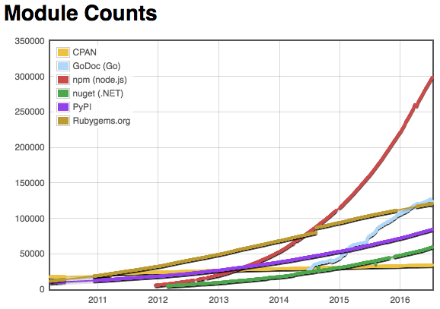


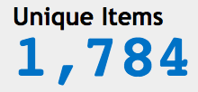
It should be available on the PowerShell Gallery
Discoverability
Distribution
Versioning
Tools:
PowerShellGallery.com
PowerShellGet, PackageManagement
Nuget.exe
PSPrivateGallery, ProGet, Artifactory, etc.
PSDepend
Source:.modulecounts.com
July 2016
April 2017

Slide 8
It should have a README.md and about_ModuleName help topic
Readme: Quickstart
About_ModuleName: More detail
Tools:
PlatyPS
Plaster

Slide 9
It should feel PowerShell-y
Essentially, functions should follow good practices
Tools:
Nope nope nope
Monad Manifesto
References on good practices for functions
Experience

Slide 10
It shouldn’t collide with the user’s environment
Global variables
ScriptsToProcess
Get-VM…
Tools
Common sense

Slide 11

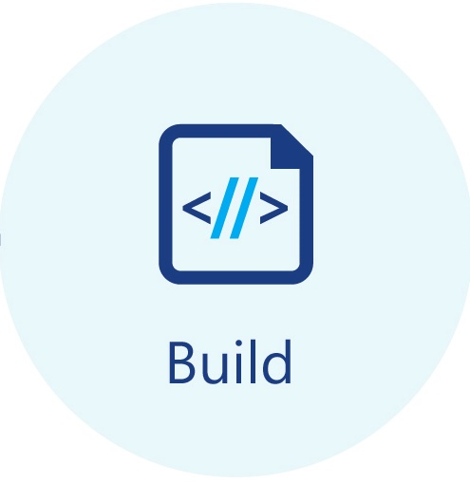

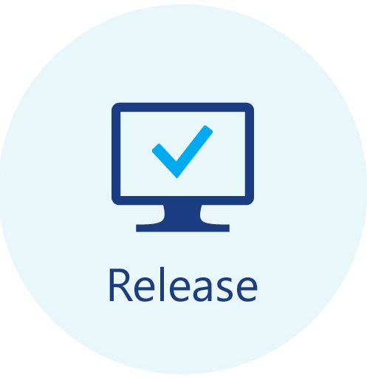










It should use a collaboration and source control platform like GitHub
Git-based, if you like a trove of tools and references
Issues
Browse code
CI/CD
Fork and pull request workflow
Tools
GitHub, GitLab, VSTS, BitBucket, etc.
GitHub ecosystem
Waffle.io, Gitter, etc.
Octotree

Slide 12
It should be organized in a reasonable way
Readme, build-as-code, gitignore, license, etc. in root
Module in subfolder - src, ModuleName, up to you!
One function per ps1, usually Function-Name.ps1
Authoring: Always
Publishing: Scenario specific. Consider debug implications of dumping to psm1
Tools:
Plaster!
Interesting community modules

Slide 13
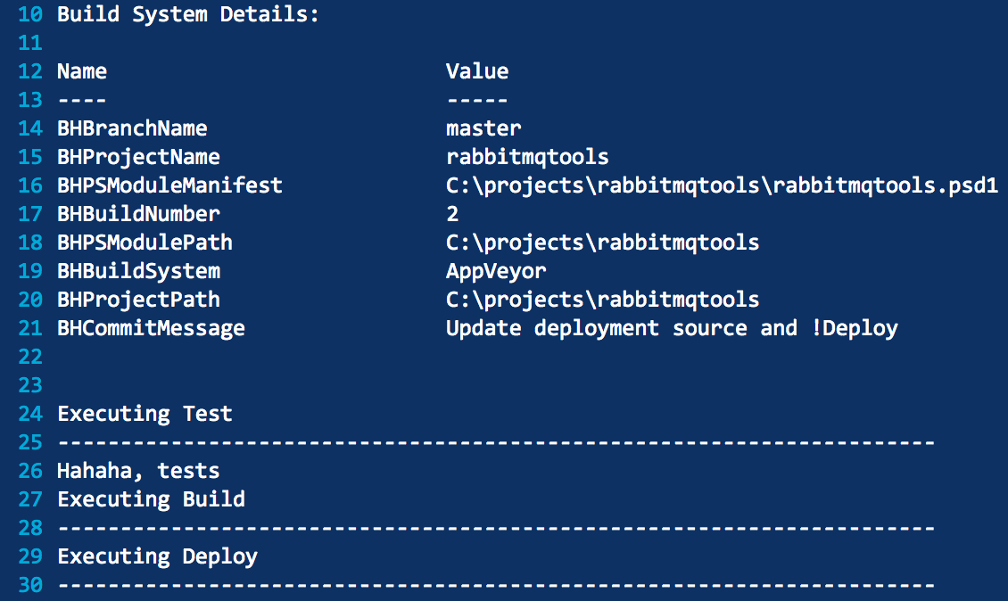
It ”should have tests” {
Scaffolding
Extent of tests up to you
You should actually use what you write
Tools:
PSScriptAnalyzer
Pester
PoshSpec
AppVeyor, GitLab CI, Jenkins, VSTS, etc.

Slide 14
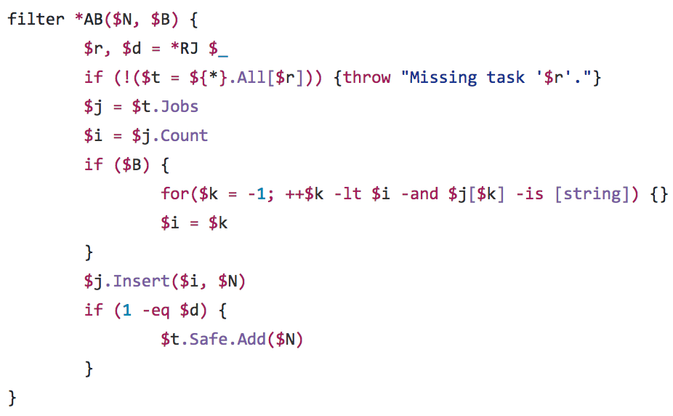
It should be PowerShell-y
Maintainability is important
Lower the barrier to contribution
“I know it when I see it”
Tools
Nope nope nope

Slide 15
Recap: Users
It should be available on the PowerShell Gallery
It should have a README.md and about_ModuleName help topic
It should feel PowerShell-y
It shouldn’t collide with the user’s environment
You should actually use it

Slide 16
Recap: Contributors
It should use a collaboration and source control platform like GitHub
It should be organized in a reasonable way
It should have tests
It should be PowerShell-y
Functions should follow good practices

Slide 17
fin
Materials, references, and updates at bit.ly/psmodules soon
Questions?

