Slide 1
Last Note
Compositing
Optical compositing and mattes
The alpha channel
Compositing operators
Premultiplied alpha
Project 1

Slide 2
This Note
Graphics Toolkit
Coordinate system
2D Transformation
Composing transformations
Homogeneous coordinates
3D Transformations
Directions
Rotation
Details of Transformation is in Prof. Yao’s Fundamental of CG
Project 1 Due & Demo

Slide 3
Graphics Toolkits
Graphics toolkits typically take care of the details of producing images from geometry
Input (via API functions):
Where the objects are located and what they look like
Where the camera is and how it behaves
Parameters for controlling the rendering
Functions (via API):
Perform well defined operations based on the input environment
Output: Pixel data in a framebuffer – an image in a special part of memory
Data can be put on the screen
Data can be read back for processing (part of toolkit)

Slide 4
OpenGL
OpenGL is an open standard graphics toolkit
Derived from SGI’s GL toolkit
Provides a range of functions for modeling, rendering and manipulating the framebuffer
What makes a good toolkit?
Alternatives: Direct3D, Java3D - more complex and less well supported

Slide 5
A Good Toolkit…
Everything is a trade-off
Functionality
Compact: a minimalist set of commands
Orthogonal: commands do different things and can be combined in a consistent way
Speed
Ease-of-Use and Documentation
Portability
Extensibility
Standards and ownership
Not an exhaustive list …

Slide 6
Coordinate Systems
The use of coordinate systems is fundamental to computer graphics
Coordinate systems are used to describe the locations of points in space, and directions in space
Multiple coordinate systems make graphics algorithms easier to understand and implement

Slide 7
Coordinate Systems (2)
Different coordinate systems represent the same point in different ways
Some operations are easier in one coordinate system than in another
For instance, it’s easier to determine what you can see if one axis of your coordinate system points away from you
v
(2,3)
v
(1,2)
y
y
u
u
x
x

Slide 8
Transformation Details
© NTUST CSIE 2011
What’s transformation
Purpose of transformations
Types of transformations: rotations, translates, …
Composing multiple transformations
Representing transformations as matrices
Hierarchical transformations

Slide 9
Transformations (I)
Transformations convert points between coordinate systems
v
(2,3)
u=x-1
v=y-1
v
(1,2)
y
y
u
x=u+1
y=v+1
u
x
x

Slide 10
Transformations (Alternate Interpretation)
Transformations modify an object’s shape and location in one coordinate system
The previous interpretation is better for some problems, this one is better for others
(2,3)
x’=x-1
y’=y-1
y
y
(1,2)
x=x’+1
y=y’+1
x
x

Slide 11
Transformations
What? Functions acting on points
Why?
Viewing
Window coordinates to framebuffer coordinates
Virtual camera: parallel/perspective projections
Modeling
Create objects in convenient coordinates
Multiple instances of a prototype shape
Kinematics of linkages/skeletons - robots

Slide 12
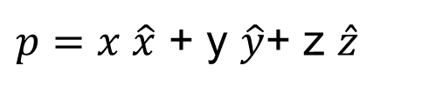
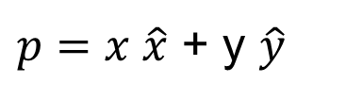
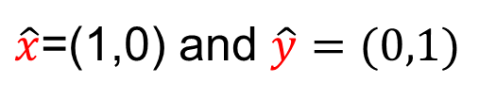
Coordinate Systems (Basis, Linear)
$p=x \hat{x}$ + y $\hat{y}$
2D: where
3D: where
Transform 2D: (Linear transformation)
Transform 3D: (Linear transformation)
$\hat{x}$=(1,0) and $\hat{y}=(0,1)$
$p=x \hat{x}$ + y $\hat{y}\text{+ }\text{z} \hat{z}$
$\hat{x}=\left(1,0,0\right)and$ $\hat{y}=\left(0,1,0\right) \hat{z}=(0,0,1)$
$T(p)=T(x \hat{x}$ + y $\hat{y}$)=$xT(\hat{x})$ + yT( $\hat{y}$)
$T(p)=T(x \hat{x}$ + y $\hat{y}$+ z $\hat{z}$)=$xT(\hat{x})$ + yT( $\hat{y}$) + zT( $\hat{z}$)

Slide 13
General Transformations
A transformation maps points to other points and/or vectors to other vectors

Slide 14
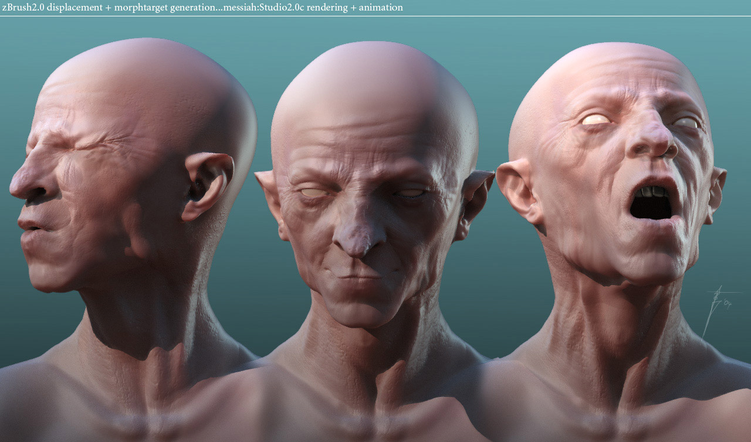
Non-Linear Transforms!!

Slide 15
Pipeline Implementation
(from application program)
frame
buffer
transformation
rasterizer
vertices
vertices
pixels

Slide 16
Representation
We can represent a 2D point, in the plane
as a column vector
as a row vector

Slide 17
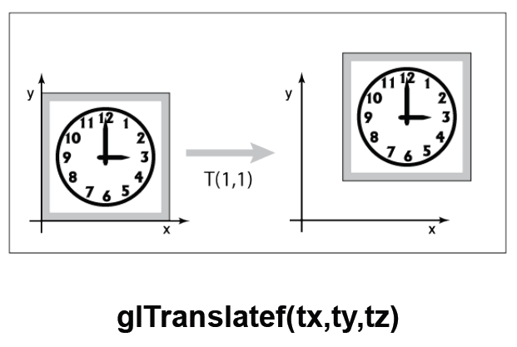
2D Translation
Moves an object
y
y
b_{y}
x
b_{x}
x

Slide 18
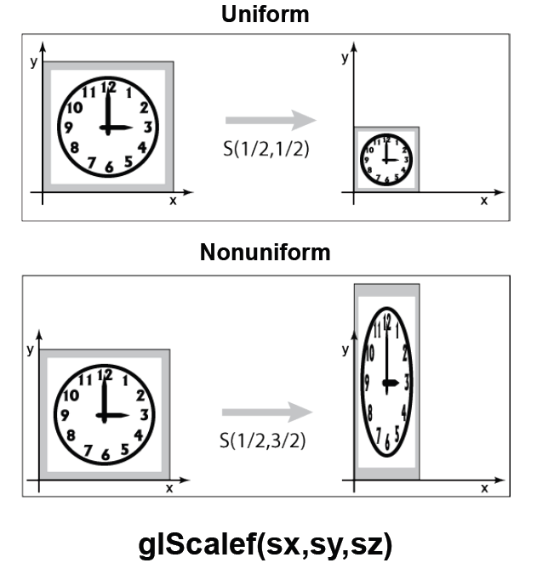
2D Scaling
Resizes an object in each dimension
y
y
s_{y}y
y
x
x
s_{x}x
x

Slide 19
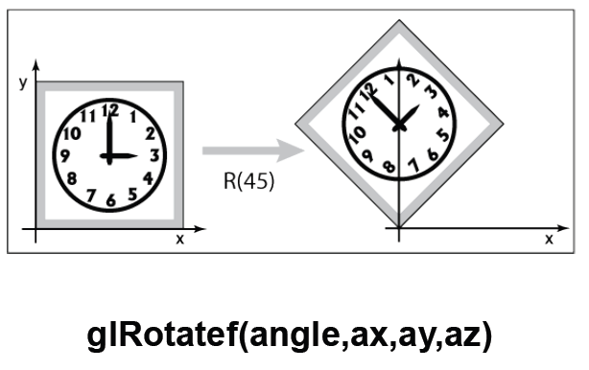
2D Rotation
Rotate counter-clockwise about the origin by an angle θ
y
y
θ
x
x

Slide 20
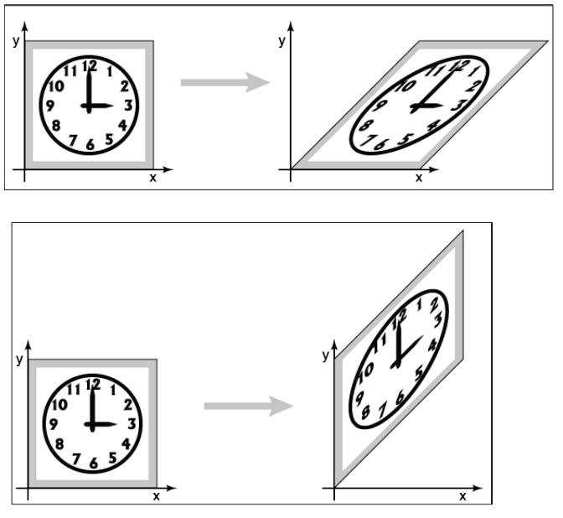
X-Axis Shear
Shear along x axis (What is the matrix for y axis shear?)
y
y
x
x

Slide 21
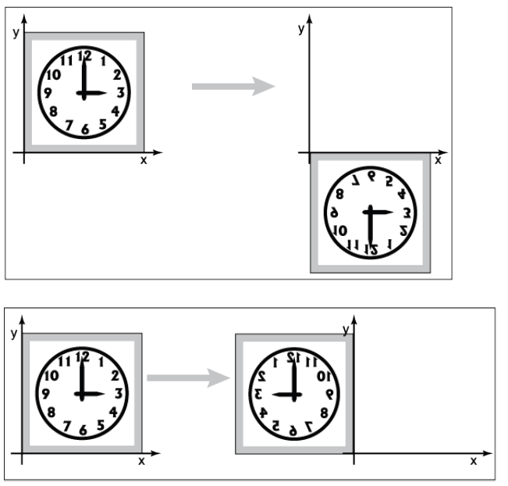
Reflect About X Axis
What is the matrix for reflect about Y axis?
x
x

Slide 22
2D Affine Transformations
An affine transformation is one that can be written in the form:

Slide 23
Why Affine Transformations?
Affine transformations are linear
Transforming all the individual points on a line gives the same set of points as transforming the endpoints and joining them
Interpolation is the same in either space: Find the halfway point in one space, and transform it. Will get the same result if the endpoints are transformed and then find the halfway point

Slide 24
Composition of Affine Transforms
Any affine transformation can be composed as a sequence of simple transformations:
Translation
Scaling (possibly with negative values)
Rotation
See Shirley 1.3.6

Slide 25
OpenGL Order of Transformations
Math
P’ = (R(45) (T(1, 1)(P)))
OpenGL (last one specified is the first one applied)
glRotatef(45.0, 0., 0., 1.);
glTranslatef(1.0, 1.0, 0.0);
That is, the translate is applied before the rotate

Slide 26
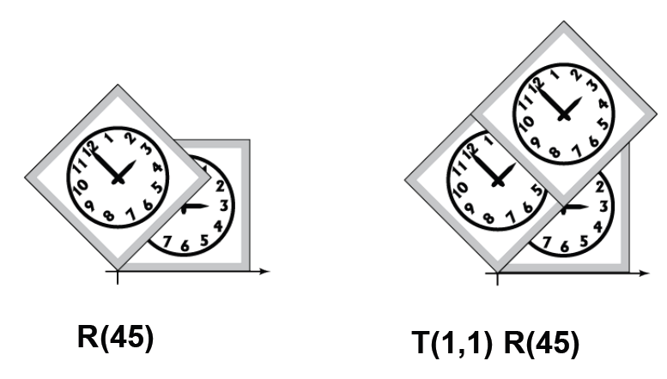
Rotate, Then Translate

Slide 27
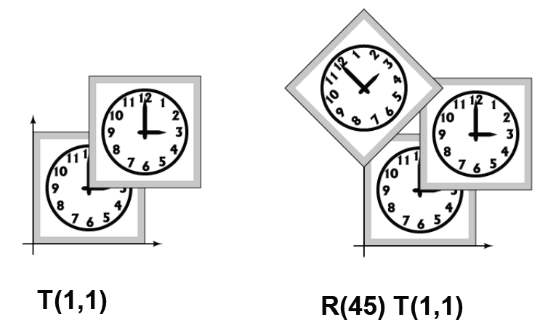
Translate, Then Rotate

Slide 28
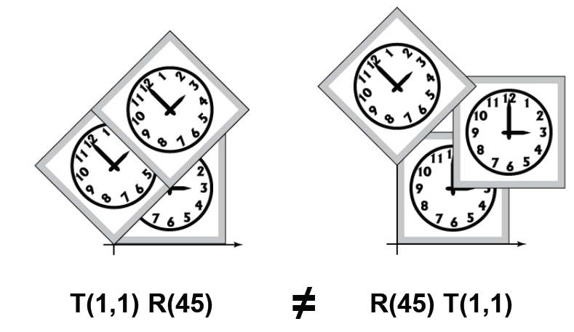
Order Matters

Slide 29
Back to Rotation About a Pt
Say R is the rotation matrix to apply, and p is the point about which to rotate
Translation to Origin:
Rotation:
Translate back:
The translation component of the composite transformation involves the rotation matrix. What a mess!

Slide 30
Homogeneous Coordinates
Why & What is homogeneous coordinates?
If points are expressed in homogeneous coordinates, all three transformations can be treated as multiplications.
usually 1
can not be 0

Slide 31
Homogeneous Coordinates
W
P
X
W=1 plane
Y

Slide 32
Homogeneous Coordinates
Use three numbers to represent a point
(x,y)=(wx,wy,w) for any constant w≠0
Typically, (x,y) becomes (x,y,1)
To go backwards, divide by w
Translation can now be done with matrix multiplication!

Slide 33
Homogeneous 2D OperationTranslation

Slide 34
Properties of Transformations
Rigid-body transformations
rotation & translation
preserving angles and lengths
Affine transformations
rotation & translation & scaling
preserving parallelism of lines

Slide 35
Composition of 2D Transformations
y
y
y
y
P₁
P₁
x
x
x
x
Original
After translation of P₁ to origin
After rotation
After translation to original P₁

Slide 36
Advantages of the Matrix Formulation
Combine a sequence of transforms into a single transform
p’ = A ( B ( C ( D ( p ) ) ) )
= ( A B C D ) P
= M P
Compute the matrix M once; apply to many points. Very inefficient to keep recomputing the matrices

Slide 37
Homogeneous Transform Advantages
Unified view of transformation as matrix multiplication
Easier in hardware and software
To compose transformations, simply multiply matrices
Order matters: AB is generally not the same as BA
Allows for non-affine transformations:
Perspective projections!
Bends, tapers, many others

Slide 38
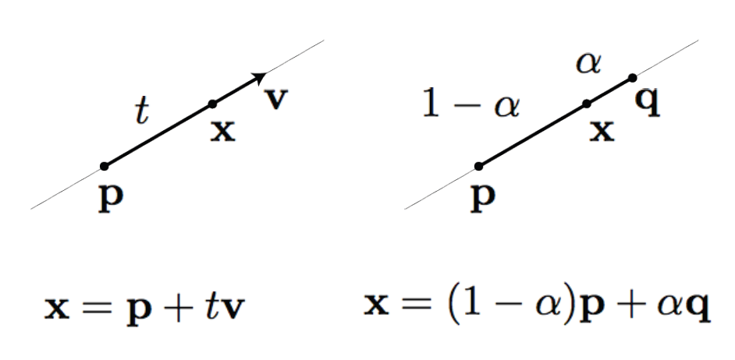
Parametric Forms of a Line

Slide 39

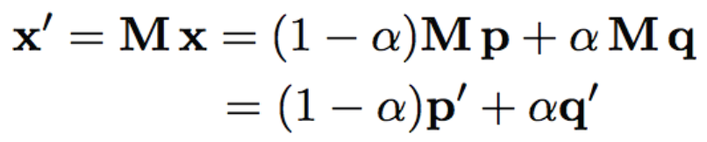
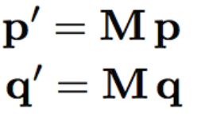
Why Called Linear Transformations?
Because lines are transformed into lines. Start with a line
Transform it
Thus, a line transforms into a linear combination of transformed points, which is a line

Slide 40
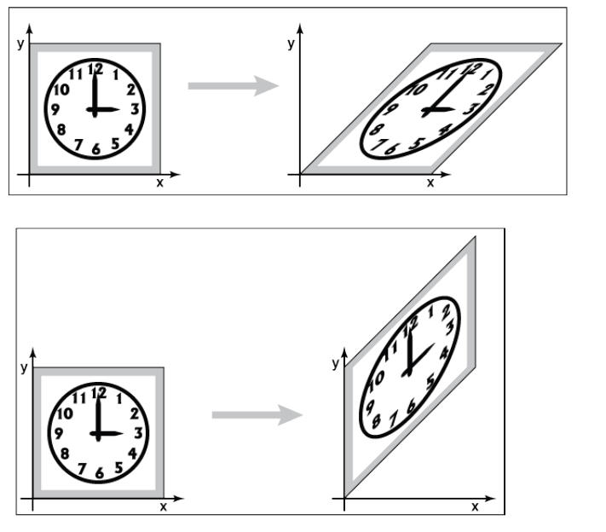
Lines go to Lines → Linear Transform

Slide 41
Directions vs. Points
We have been talking about transforming points
Directions are also important in graphics
Viewing directions
Normal vectors
Ray directions
Directions are represented by vectors, like points, and can be transformed, but not like points
(1,1)
(-2,-1)

Slide 42
Transforming Directions
Say I define a direction as the difference of two points: d=a–b
This represents the direction of the line between two points
Now I translate the points by the same amount: a’=a+t, b’=b+t
How should I transform d?

Slide 43
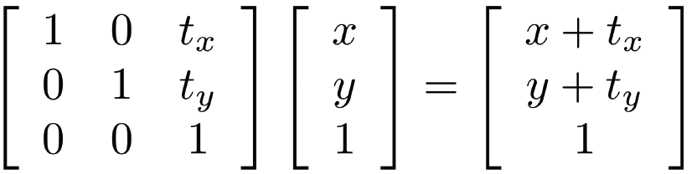
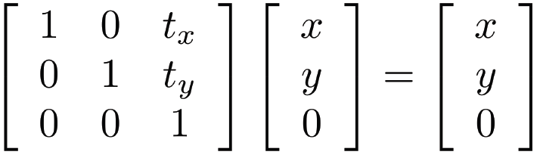
Points and Vectors Translate Differently
Points (x,y,1) are shifted by translates
Vectors (x,y,0) are NOT shifted by translates
adf
This is the homogenous coordinate representation p/v

Slide 44
Homogeneous Directions
Translation does not affect directions!
Homogeneous coordinates give us a very clean way of handling this
The direction (x,y) becomes the homogeneous direction (x,y,0)
The correct thing happens for rotation and scaling also
Scaling changes the length of the vector, but not the direction
Normal vectors are slightly different – we’ll see more later

Slide 45
The Window-to-Viewport Transformation
Maximum range of screen coordinates
Viewport 2
Window
Viewport 1
World coordinates
Screen coordinates

Slide 46
The Window-to-Viewport Transformation
Maximum range of screen coordinates
y
y
v
v
(x_{max},y_{max})
(u_{max},v_{max})
(x_{min},y_{min})
(u_{min},v_{min})
x
x
u
u
Window in world coordinates
Translated to origin
Scaled to size of viewport
Translated to final position

Slide 47
3D Transformations
Homogeneous coordinates: (x,y,z)=(wx,wy,wz,w)
Transformations are now represented as 4x4 matrices
Typical graphics packages allow for specification of translation, rotation, scaling and arbitrary matrices
OpenGL: glTranslate[fd], glRotate[fd], glScale[fd], glMultMatrix[fd]

Slide 48
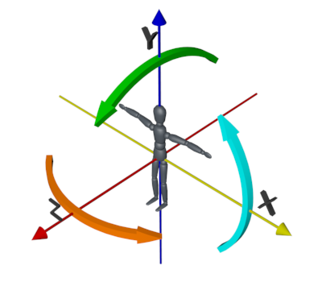
Right-handed Coordinate System

Slide 49
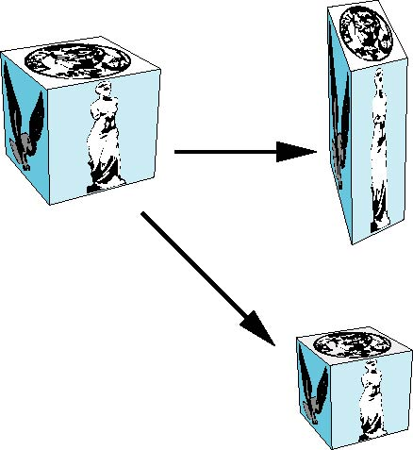
3D Translation & 3D Scaling

Slide 50
3D Reflection & 3D Shearing

Slide 51
3D Rotations

Slide 52
General Rotation About the Origin
A rotation by about an arbitrary axis can be decomposed into the concatenation of rotations about the , , and axes
, , are called the Euler angles
Note that rotations do not commute
We can use rotations in another order but with different angles.

Slide 53
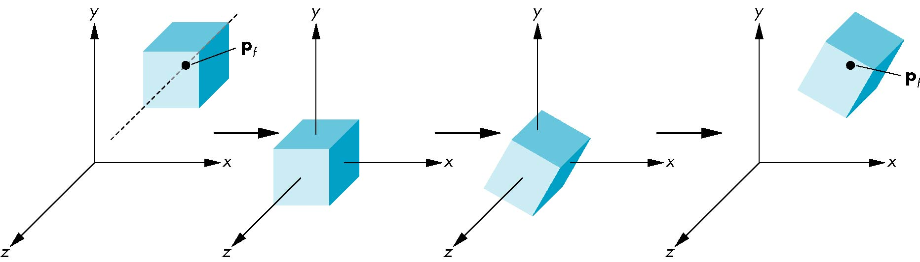
Rotation About a Fixed Point Other than the Origin
Move fixed point to origin
Rotate
Move fixed point back

Slide 54
Smooth Rotation
From a practical standpoint, we are often want to use transformations to move and reorient an object smoothly
Problem: find a sequence of model-view matrices , ,…, so that when they are applied successively to one or more objects we see a smooth transition
For orientating an object, we can use the fact that every rotation corresponds to part of a great circle on a sphere
Find the axis of rotation and angle
Virtual trackball

Slide 55
Incremental Rotation
Consider the two approaches
For a sequence of rotation matrices , ,…, , find the Euler angles for each and use
Not very efficient
Use the final positions to determine the axis and angle of rotation, then increment only the angle
Quaternions can be more efficient than either

Slide 56
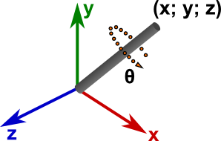
3D Rotation
Rotation in 3D is about an axis in 3D space passing through the origin
Using a matrix representation, any matrix with an orthonormal top-left 3x3 sub-matrix is a rotation
Rows are mutually orthogonal (0 dot product)
Determinant is 1
Implies columns are also orthogonal, and that the transpose is equal to the inverse

Slide 57
3D Rotation

Slide 58
Problems with Rotation Matrices
Specifying a rotation really only requires 3 numbers
Axis is a unit vector, so requires 2 numbers
Angle to rotate is third number
Rotation matrix has a large amount of redundancy
Orthonormal constraints reduce degrees of freedom back down to 3
Keeping a matrix orthonormal is difficult when transformations are combined
Rotations are a very complex subject, and a detailed discussion is way beyond the scope of this course

Slide 59
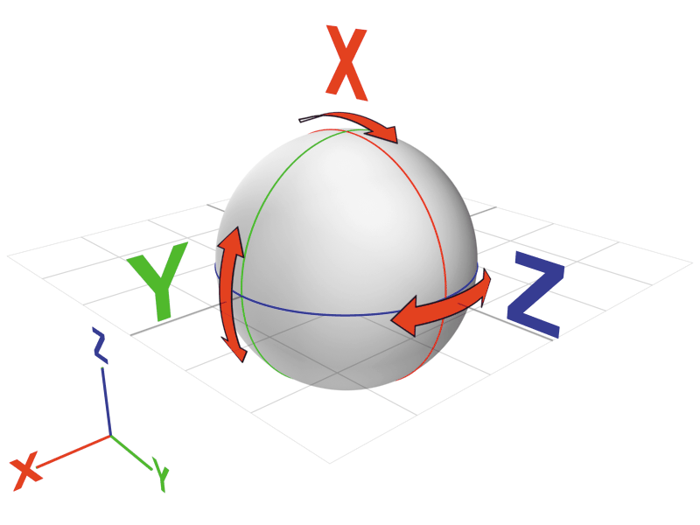
Quaternions
4-vector related to axis and angle, unit magnitude
Rotation about axis (n_{x},n_{y},n_{z}) by angle θ:
Reasonably easy to compose
Reasonably easy to go to/from rotation matrix
Only normalized quaternions represent rotations, but you can normalize them just like vectors, so it isn’t a problem
Easy to perform spherical interpolation

Slide 60
Quaternions
Extension of imaginary numbers from 2 to 3 dimensions
Requires one real and three imaginary components , ,
where
is called scalar and is called vector
Quaternions can express rotations on sphere smoothly and efficiently. Process:
Model-view matrix → Quaternion
Carry out operations with Quaternions
Quaternion → Model-view matrix

Slide 61
Basic Operations Using Quaternions I
Addition
Multiplication
Conjugate
Length
Norm

Slide 62
Basic Operations Using Quaternions II
Inverse
Unit Quaternion
is a unit quaternion if and then
Identity
[1, (0, 0, 0)] (when involving multiplication)
[0, (0, 0, 0)] (when involving addition)

Slide 63
Angle and Axis & Eular Angles
Angle and Axis
Eular Angles

Slide 64
Matrix-to-Quaternion Conversion
MatToQuat (float m[4][4], QUAT * quat) {
float tr, s, q[4];
int i, j, k;
int nxt[3] = {1, 2, 0};
tr = m[0][0] + m[1][1] + m[2][2];
if (tr > 0.0) {
s = sqrt (tr + 1.0);
quat->w = s / 2.0;
s = 0.5 / s;
quat->x = (m[1][2] - m[2][1]) * s;
quat->y = (m[2][0] - m[0][2]) * s;
quat->z = (m[0][1] - m[1][0]) * s;
}
else {
i = 0;
if (m[1][1] > m[0][0]) i = 1;
if (m[2][2] > m[i][i]) i = 2;
j = nxt[i];
k = nxt[j];
s = sqrt ((m[i][i] - (m[j][j] + m[k][k])) + 1.0);
q[i] = s * 0.5;
if (s != 0.0) s = 0.5 / s;
q[3] = (m[j][k] - m[k][j]) * s;
q[j] = (m[i][j] + m[j][i]) * s;
q[k] = (m[i][k] + m[k][i]) * s;
quat->x = q[0];
quat->y = q[1];
quat->z = q[2];
quat->w = q[3];
}
}

Slide 65
Quaternion-to-Matrix Conversion
QuatToMatrix (QUAT * quat, float m[4][4]) {
float wx, wy, wz, xx, yy, yz, xy, xz, zz, x2, y2, z2;
x2 = quat->x + quat->x; y2 = quat->y + quat->y;
z2 = quat->z + quat->z;
xx = quat->x * x2; xy = quat->x * y2; xz = quat->x * z2;
yy = quat->y * y2; yz = quat->y * z2; zz = quat->z * z2;
wx = quat->w * x2; wy = quat->w * y2; wz = quat->w * z2;
m[0][0] = 1.0 - (yy + zz); m[1][0] = xy - wz;
m[2][0] = xz + wy; m[3][0] = 0.0;
m[0][1] = xy + wz; m[1][1] = 1.0 - (xx + zz);
m[2][1] = yz - wx; m[3][1] = 0.0;
m[0][2] = xz - wy; m[1][2] = yz + wx;
m[2][2] = 1.0 - (xx + yy); m[3][2] = 0.0;
m[0][3] = 0; m[1][3] = 0;
m[2][3] = 0; m[3][3] = 1;
}

Slide 66
SLERP-Spherical Linear intERPolation
Interpolate between two quaternion rotations along the shortest arc.
where
If two orientations are too close, use linear interpolation to avoid any divisions by zero.

Slide 67
Alternative Representations
Specify the axis and the angle (OpenGL method)
Hard to compose multiple rotations
Euler angles: Specify how much to rotate about X, then how much about Y, then how much about Z
Hard to think about, and hard to compose
Any three axes will do e.g. X,Y,X
Specify the axis, scaled by the angle
Only 3 numbers, called the exponential map
Quaternions

Slide 68
Other Rotation Issues
Rotation is about an axis at the origin
For rotation about an arbitrary axis, use the same trick as in 2D: Translate the axis to the origin, rotate, and translate back again
Rotation is not commutative
Rotation order matters
Experiment to convince yourself of this

Slide 69
Transformation Leftovers
Scale, shear etc extend naturally from 2D to 3D
Rotation and Translation are the rigid-body transformations:
Do not change lengths or angles, so a body does not deform when transformed

Slide 70
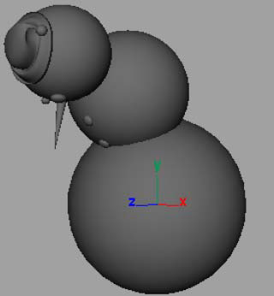
Example: Modeling
Modeling with primitive shapes

Slide 71
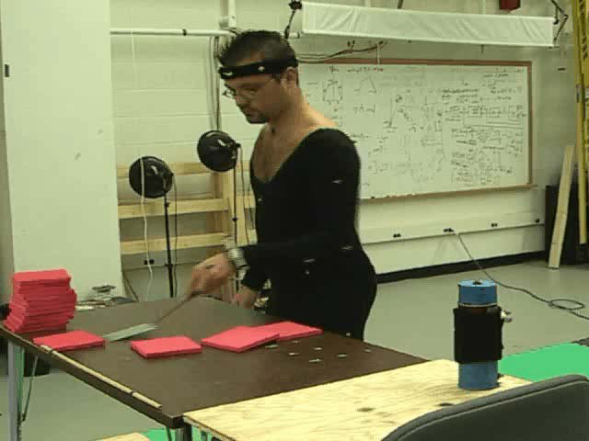

Example: Animation
Setting up a scene and animating

Slide 72
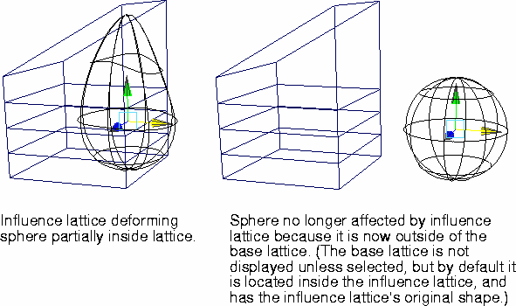
Example: Modeling Deformations
Incorporating deformations into a modeling system

Slide 73
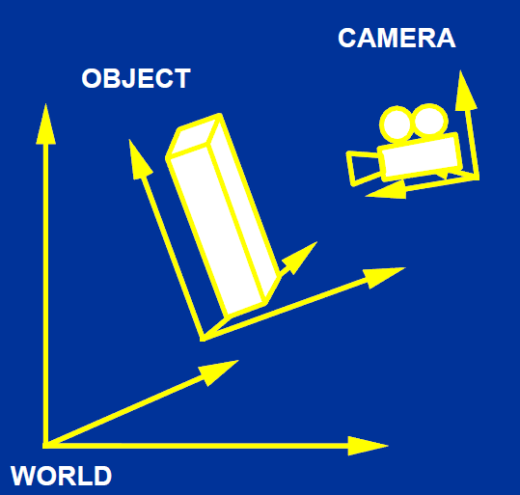
Example: Viewing Transformation

Slide 74
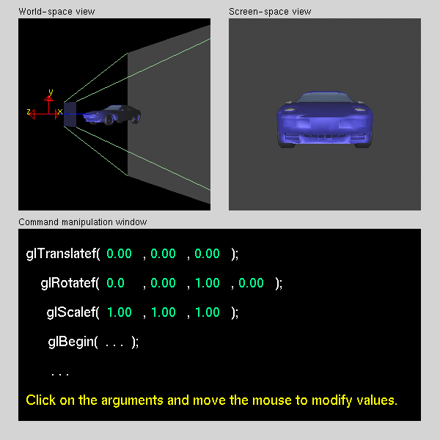
Example

Slide 75
Implementing Transformation Sequences
Calculate the matrices and cumulatively multiply them into a global Current Transformation Matrix
Postmultiplication is more convenient in hierarchies – multiplication is computed in the opposite order of function application
The calculation of the transformation matrix, M,
initialize M to the identity
in reverse order compute a basic transformation matrix, T
post-multiply T into the global matrix M, M ← MT
Example - to rotate by θ around [x,y]:
glLoadIdentity() /* initialize M to identity mat.*/
glTranslatef(x, y, 0) /* LAST: undo translation */
glRotatef(theta,0,0,1) /* rotate about z axis */
glTranslatef(-x, -y, 0) /* FIRST: move [x,y] to origin. */
Remember the last T calculated is the first applied to the points
calculate the matrices in reverse order

Slide 76
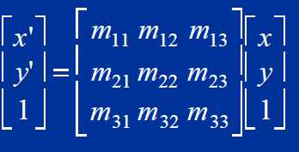
Column Vector Convention
The convention in the slides
Transformation is by matrix times vector, Mv
textbook uses this convention, 90% of the world too
The composite function A(B(C(D(x)))) is the matrixvector product ABCDx

Slide 77
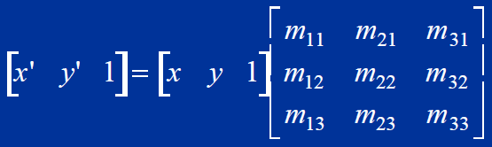
Beware: Row Vector Convention
The transpose is also possible
How does this change things?
All transformation matrices must be transposed
ABCDx transposed is x^{T}D^{T}C^{T}B^{T}A^{T}
pre- and post-multiply are reversed
OpenGL uses transposed matrices!
You’ll only notice this if you DIRECTLY pass matrices as arguments to OpenGL subroutines, e.g. glLoadMatrix.
Most routines take only scalars or vectors as arguments

