Slide 1
Last Note
2D Transformation
Translation
Scaling
Rotation
…
2D Homogeneous Operation
3D Transformation
3D Homogeneous Operation

Slide 2
This Note
Graphics transform pipeline
Intro. to viewing
Viewing transformations
Describing cameras and views
Orthogonal
Perspective
More details are discussed in Prof. Yao’s Fundamental of CG
Project 2. is announced and is due Oct. 29

Slide 3
Rendering
Generate an image showing the contents of some region of space
The region is called the view volume, and it is defined by the user
Determine where each object should go in the image
Viewing, Projection
Determine which pixels should be filled
Rasterization
Determine which object is in front at each pixel
Hidden surface elimination, Hidden surface removal, Visibility
Determine what color it is
Lighting, Shading

Slide 4
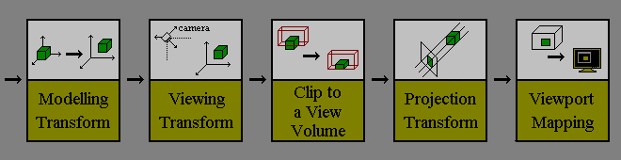
Getting Geometry on the Screen
Given geometry positioned in the world coordinate system, how do we get it onto the display?
Model the object in its local coordinate.
Place it in the world coordinate and look with the camera coordinate.
Transform (warp) into canonical view volume and clip
Project to display coordinates and rasterize

Slide 5
Graphics Transform Pipeline
Graphics hardware employs a sequence of coordinate systems
The location of the geometry is expressed in each coordinate system in turn, and modified along the way
The movement of geometry through these spaces is considered a pipeline
Local Coordinate Space
World Coordinate Space
View Space
Canonical View Volume
Display Space

Slide 6
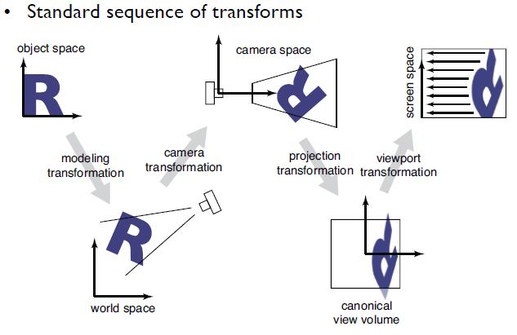
Pipeline of Transformations
Local Coordinate Space
World Coordinate Space
View Space
Canonical View Volume
Display Space

Slide 7
View Volumes
Only stuff inside the Canonical View Volume gets drawn
The window is of finite size, and we can only store a finite number of pixels
We can only store a discrete, finite range of depths
Like color, only have a fixed number of bits at each pixel
Points too close or too far away will not be drawn
But, it is inconvenient to model the world as a unit box
A view volume is the region of space we wish to transform into the Canonical View Volume for drawing
Only stuff inside the view volume gets drawn
Describing the view volume is a major part of defining the view

Slide 8
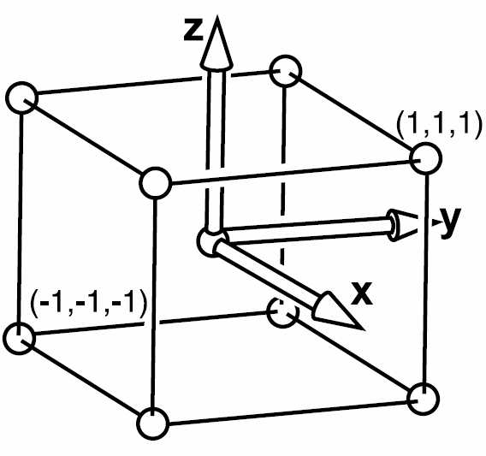
Canonical View Volume
Why this shape?
Easy to clip to
Trivial to project from 3D to 2D image plane

Slide 9
Viewing in 3D
3D Viewing Process
Classical Viewing and Projections
3D Synthetic Camera Model
Specification of an Arbitrary 3D View
Parallel Projection
Perspective Projection
3D Clipping for Canonical View Volume

Slide 10
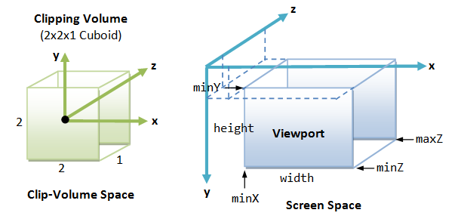
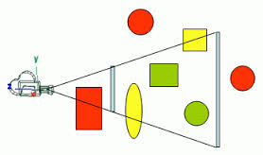
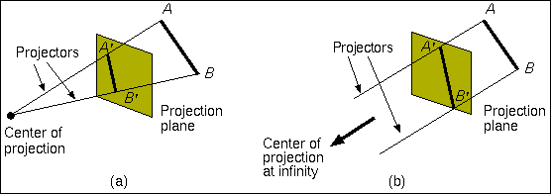
3D Viewing Process
Transform into viewport in 2D device coordinates for display
Clip against view volume
Clipped world coordinates
3D world-coordinate output primitives
2D device coordinates
Project onto projection plane

Slide 11
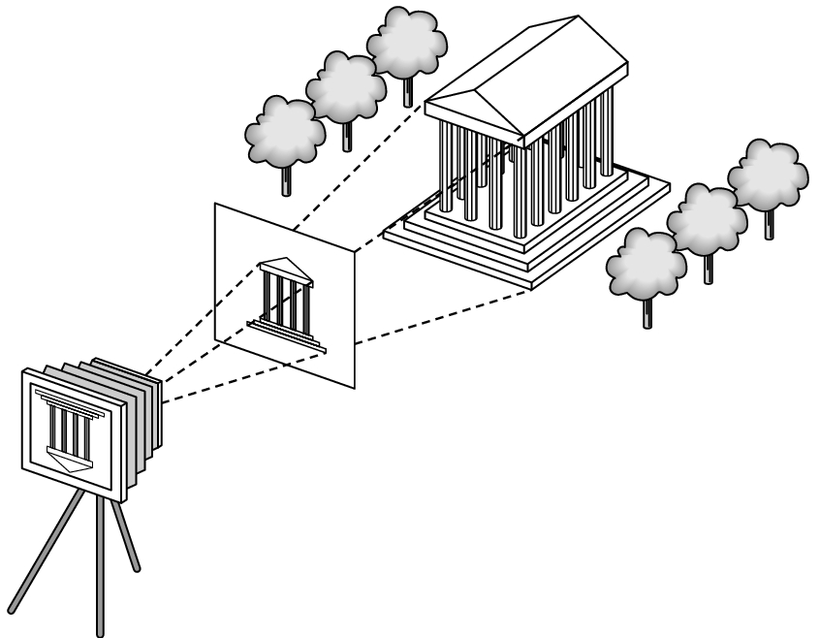
3D Synthetic Camera Model
The synthetic camera model involves two components, specified independently:
One or more objects (a.k.a geometry)
A viewer with a projection surface (a.k.a camera)
Projectors that go from the object(s) to the projection surface

Slide 12
3D Synthetic Camera Model
The viewer picks up the object and orients it how she would like to see it
The image is rendered onto an image plane or project plane (usually in front of the camera).
Projectors emanate from the center of projection (COP) at the center of the lens (or pinhole).
projector
P
image plane
projection of P
center of projection
The image of an object point P is at the intersection of the projector through P and the image plane.
Each object is assumed to be constructed from flat principal faces
Buildings, polyhedra, manufactured objects

Slide 13
Viewing and Projection
Our eyes collapse 3-D world to 2-D retinal image (brain then has to reconstruct 3D)
In CG, this process occurs by projection.
Projection has two parts:
Viewing transformations: camera position and direction
Perspective/orthographic transformation: reduces 3-D to 2-D
Use homogeneous transformations (of course…)
Build this up in stages
Canonical view volume to screen
Orthographic projection to canonical view volume
Perspective projection to orthographic space

Slide 14
Projections
Projections transform points in n-space to m-space, where m < n.
In 3D, we map points from 3D-space to the projection plane (PP) along projectors emanating from the center of projection (COP).
There are two basic type of projections:
Perspective – distance from COP to PP finite
Parallel (orthogonal)– distance from COP to PP infinite
PP
COP

Slide 15
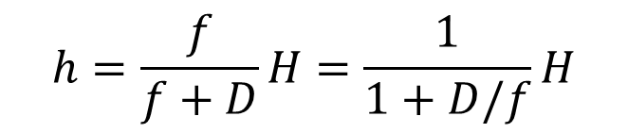


Projections
Projection:
Perspective – h is related to the focus length and the distance
Parallel (orthogonal) – h approaches H when f go to infinity
$$h=\frac{f}{f+D}H=\frac{1}{1+D/f}H$$
$$f→∞$$
$$h=H$$
H
h
f
D

Slide 16
Planar Geometric Projections
Standard projections project onto a plane
Projectors are lines that either
Converge at a center of projection (perspective)
Are parallel to each other (orthogonal)
Such projections preserve lines
but not necessarily angles
Non-planar projections are needed for applications such as map construction

Slide 17
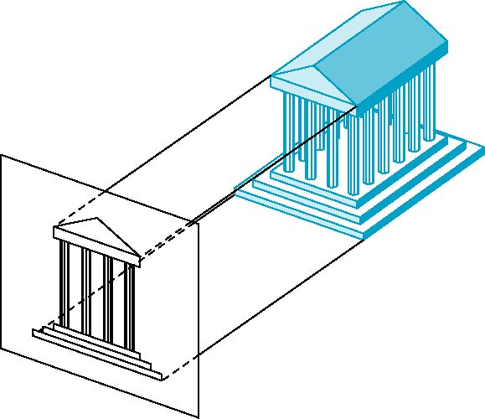
Orthographic Projection
Projectors are orthogonal to projection surface
Notes:
17

Slide 18
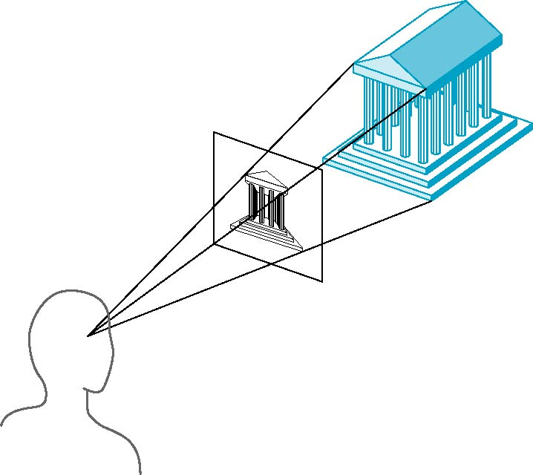
Perspective Projection
Projectors converge at center of projection
Notes:
18

Slide 19
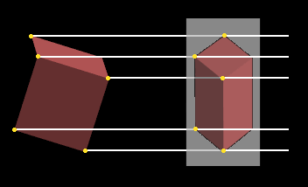
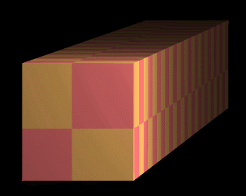
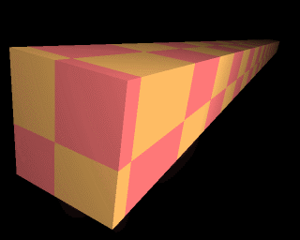
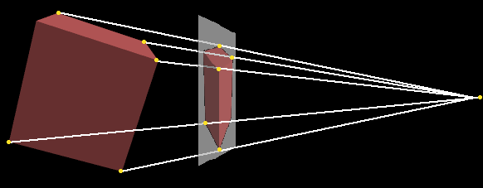
Comparison
Parallel--Orthogonal
Perspective

Slide 20
Taxonomy of Planar Geometric Projections
planar geometric projections
parallel
perspective
1 point
2 point
3 point
multiview
orthographic
axonometric
oblique
isometric
dimetric
trimetric

Slide 21
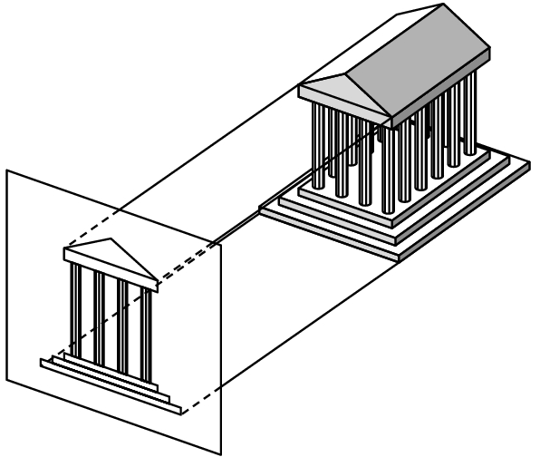
Orthographic Projection
The focal point is at infinity, the rays are parallel, and orthogonal to the image plane.
Good model for telephoto lens. No perspective effects.
When xy-plane is the image plane (x, y, z) → (x, y, 0) front orthographic view

Slide 22
Orthographic Projection
Orthographic projection projects all the points in the world along parallel lines onto the image plane
Projection lines are perpendicular to the image plane
Like a camera with infinite focal length
The result is that parallel lines in the world project to parallel lines in the image, and ratios of lengths are preserved
This is important in some applications, like medical imaging and some computer aided design tasks

Slide 23
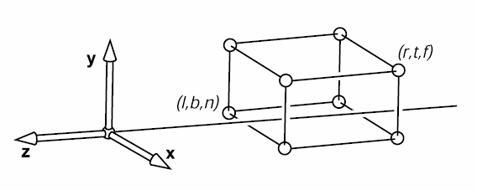
Orthographic Projection
X=l left plane
X=r right plane
Y=b bottom plane
Y=t top plane
Z=n near plane
Z=f far plane
Why near plane? Prevent points behind the camera being seen
Why far plane? Allows z to be scaled to a limited fixed-point value (z-buffering)

Slide 24
General Orthographic
Subtle point: it doesn’t precisely matter where we put the image plane.
e
image plane
g
t,n
y
t,f
b,n
(0,0)
x
b,f

Slide 25
The Mathematics of Orthographic Parallel Projection
Projection
plane
x
x_{p}
P(x, y, z)
z
View along y axis
View along x axis
z
y_{p}
P(x, y, z)
Projection
plane
y

Slide 26
Advantages (1/2)
Preserves both distances and angles if faces parallel to projection plane
Shapes preserved
Can be used for measurements
Building plans
Manuals
Can pick the angles to emphasize a particular face
Architecture: plan oblique, elevation oblique
Some optical illusions possible
Parallel lines appear to diverge
Used in CAD applications
Notes:
26

Slide 27
Advantages (2/2)
From other directions
Lines are scaled (foreshortened) but can find scaling factors
Lines preserved but angles are not
Projection of a circle in a plane not parallel to the projection plane is an ellipse
Can see three principal faces of a box-like object
Notes:
27

Slide 28
Disadvantages
Cannot see what object really looks like real
Surfaces hidden from view
Often we add the isometric
In physical world, cannot create with simple camera; possible with bellows camera or special lens (architectural)
Far objects are scaled the same as near objects
Notes:
28

Slide 29
Defining Cameras
View Space is the camera’s local coordinates
The camera is in some location
The camera is looking in some direction
It is tilted in some orientation
It is inconvenient to describe everything in terms of View Space
Biggest problem is that the camera might be moving – we don’t want to have to explicitly move every object too
We specify the camera, and hence View Space, with respect to World Space
How can we specify the camera?

Slide 30
Specifying a View
The location of View Space with respect to World Space
A point in World Space for the origin of View Space, (e_{x},e_{y},e_{z})
The direction in which we are looking: gaze direction
Specified as a vector: (g_{x},g_{y},g_{z})
This vector will be normal to the image plane
A direction that we want to appear up in the image
(up_{x},up_{y},up_{z}), this vector does not have to be perpendicular to g
We also need the size of the view volume – l,r,t,b,n,f
Specified with respect to the eye and image plane, not the world

Slide 31
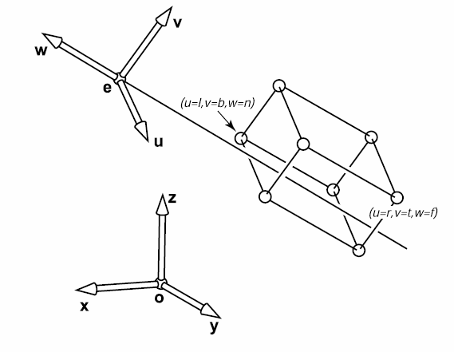
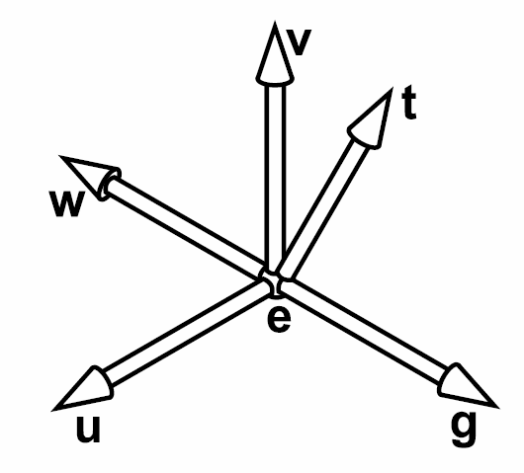
Arbitrary View Positions
Eye position: e
Gaze direction: g
view-up vector: t

Slide 32
Specification of an Arbitrary 3D View
v
View plane
VUP
VRP
VPN
u
n
VRP: view reference point
VPN: view-plane normal
VUP: view-up vector

Slide 33
VRC: The Viewing-Reference Coordinate System
v
(u_{max},v_{max})
View plane
(u_{min},v_{min})
CW
VRP
VPN
u
n
CW: center of the window

Slide 34
Infinite Parallelepiped View Volume
DOP
View plane
CW
PRP
VRP
VPN
n
DOP: direction of projection
PRP: projection reference point

Slide 35
Truncated View Volume for an Orthographic Parallel Projection
Back
Clipping
plane
View
plane
Front
Clipping
plane
VRP
VPN
DOP
B
F

Slide 36
Orthographic View Space
View Space: a coordinate system with the viewer looking in the –z direction, with x horizontal to the right and y up
A right-handed coordinate system! All ours will be
The view volume is a rectilinear box for orthographic projection
The view volume has:
a near plane at z=n
a far plane at z=f , (f < n)
a left plane at x=l
a right plane at x=r, (r>l)
a top plane at y=t
and a bottom plane at y=b, (b<t)
y
(l,t,f)
z
x
(r,b,n)

Slide 37
Rendering the Volume
To find out where points end up on the screen, we must transform View Space into Canonical View Space
We know how to draw Canonical View Space on the screen
This transformation is “projection”
The mapping looks similar to the one for Canonical to Window …

Slide 38
The Steps of Implementation of Orthographic Parallel Projection
Translate the VRP to the origin
Rotate VRC such that the VPN becomes the z axis
Shear such that the DOP becomes parallel to the z axis
Translate and scale into the parallel-projection canonical view volume

Slide 39
Getting there…
We wish to end up in View Space, so we need a coordinate system with:
A vector toward the viewer, View Space z
A vector pointing right in the image plane, View Space x
A vector pointing up in the image plane, View Space y
The origin at the eye, View Space (0,0,0)
We must:
Say what each of these vectors are in World Space
Transform points from the World Space into View Space
We can then apply the orthographic projection to get to Canonical View Space, and so on

Slide 40
View Space in World Space
Given our camera definition, in World Space:
Where is the origin of view space? It will transform into (0,0,0)_{view}
What is the normal to the view plane, w? It will become z_{view}
How do we find the right vector, u? It will become x_{view}
How do we find the up vector, v? It will become y_{view}
Given these points, how do we do the transformation?

Slide 41
View Space
The origin is at the eye: (e_{x},e_{y},e_{z})
The normal vector is the normalized viewing direction:
We know which way up should be, and we know we have a right handed system, so u=up×w, normalized:
We have two vectors in a right handed system, so to get the third: v=w×u

Slide 42
World to View
We must translate so the origin is at (e_{x},e_{y},e_{z})
To complete the transformation we need to do a rotation
After this rotation:
The direction u in world space should be the direction (1,0,0) in view space
The vector v should be (0,1,0)
The vector w should be (0,0,1)
The matrix that does the rotation is:
It’s a “change of basis” matrix

Slide 43
Simplified to Discuss in 2D (1/3)
Point in view coordinate can be expressed as
When transform from world to view is equivalent to
We can think about the transform unit in ( axis direction in world coordinate) and unit in ( axis direction in world coordinate)

Slide 44
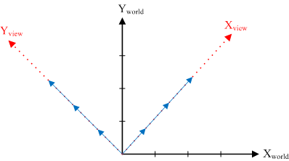
Simplified to Discuss in 2D (2/3)
Let’s see transform
Thus we can get
Similarly to , we can get

Slide 45
Simplified to Discuss in 2D (2/2)
Let’s see transform
Thus we can get
Similarly to , we can get
From world to view can be

Slide 46
All Together
We apply a translation and then a rotation, so the result is:
And to go all the way from world to screen:

Slide 47
Orthographic Projection Matrix (Orthographic View to Canonical Matrix)

Slide 48
OpenGL and Transformations
OpenGL internally stores two matrices that control viewing of the scene
The GL_MODELVIEW matrix is intended to capture all the transformations up to view space
The GL_PROJECTION matrix captures the view to canonical conversion
You also specify the mapping from the canonical view volume into window space
Directly through a glViewport function call
Matrix calls, such as glRotate, multiply some matrix M onto the current matrix C, resulting in CM
Set view transformation first, then set transformations from local to world space – last one set is first one applied
This is the convenient way for modeling, as we will see

Slide 49
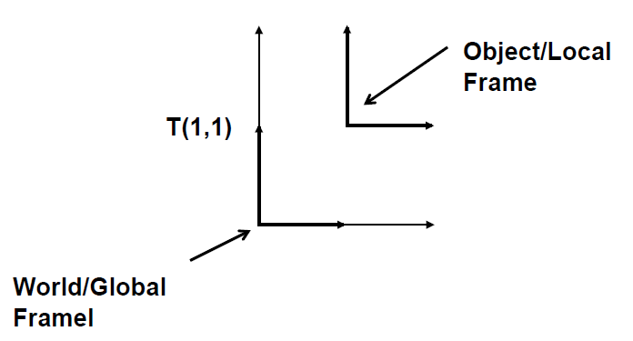
OpenGL: Global vs. Object Frames / Coordinates
Transforms create new frames of reference. These “frames” define “coordinate systems”

Slide 50
OpenGL Camera
The default OpenGL image plane has u aligned with the x axis, v aligned with y, and n aligned with z
Means the default camera looks along the negative z axis
Makes it easy to do 2D drawing (no need for any view transformation)
glOrtho(…) sets the view->canonical matrix
Modifies the GL_PROJECTION matrix
gluLookAt(…) sets the world->view matrix
Takes an image center point, a point along the viewing direction and an up vector
Multiplies a world->view matrix onto the current GL_MODELVIEW matrix
You could do this yourself, using glMultMatrix(…) with the matrix from the previous slides

Slide 51
OpenGL: Graphics Coordinate Frames
Object
Raw values as provided by glVertex (ex. Teacup centered at origin)
World
Object at final location in environment (ex. teacup recendered to be on top of a table)
Screen
Object at final screen position

Slide 52
Current Transformation Matrix
OpenGL maintains a current transformation matrix (CTM). All geometry is transformed by the CTM.
The CTM defines the current or object or local coordinate system. All geometry is defined in the current coordinate system.
Transformation commands are concatenated onto the CTM. Note: The last transformation specified is the first to be performed.
CTM’ = CTM * T
The CTM may be pushed and popped from a stack, onto a transformation stack.

Slide 53
OpenGL Matrix Functions (1/2)
glMatrixMode( mode )
Sets which transformation matrix to modify
GL_MODELVIEW: object to world transform
GL_PROJECTION: world to screen transform
CTM = GL_PROJECTION * GL_MODELVIEW
glLoadIdentity( )
Reset the selected transform matrix to the identity matrix
glLoadMatrix( matrix M )
Replace the selected transform matrix with M
glMultMatrix( matrix M )
Multiplies selected transform matrix by M
glRotate, glTranslate, glScale etc. are just wrappers for glMultMatrix

Slide 54
OpenGL Matrix Functions (1/2)
There is a matrix stack for each matrix mode
The stack makes it possible to save/restore the matrix
glPushMatrix ( )
Adds the current matrix to the top of the matrix stack
glPopMatrix ( )
Pops the matrix off the top of the matrix stack and loads it as the current matrix
This makes it possible to model complex hierarchical assemblies of parts (robots, avatars, etc.)

Slide 55
Typical Usage
glMatrixMode(GL_PROJECTION);
glLoadIdentity();
glOrtho(l, r, b, t, n, f);
glMatrixMode(GL_MODELVIEW);
glLoadIdentity();
gluLookAt(ex,ey,ez,cx,cy,cz,ux,uy,uz);
GLU functions, such as gluLookAt(…), are not part of the core OpenGL library
They can be implemented with other core OpenGL commands
For example, gluLookAt(…) uses glMultMatrix(…) with the matrix from the previous slides
They are not dependent on a particular graphics card

Slide 56
Left v.s. Right Handed View Space
You can define u as right, v as up, and n as toward the viewer: a right handed system u×v=w
Advantage: Standard mathematical way of doing things
You can also define u as right, v as up and n as into the scene: a left handed system v×u=w
Advantage: Bigger n values mean points are further away
OpenGL is right handed
Many older systems, notably the Renderman standard developed by Pixar, are left handed

Slide 57
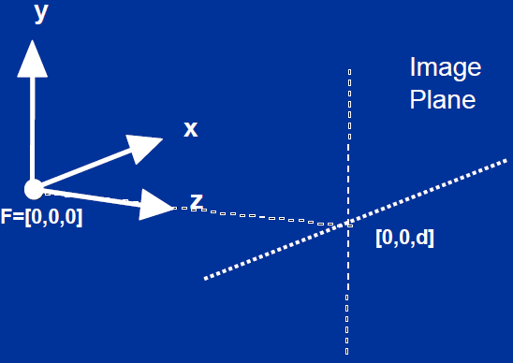
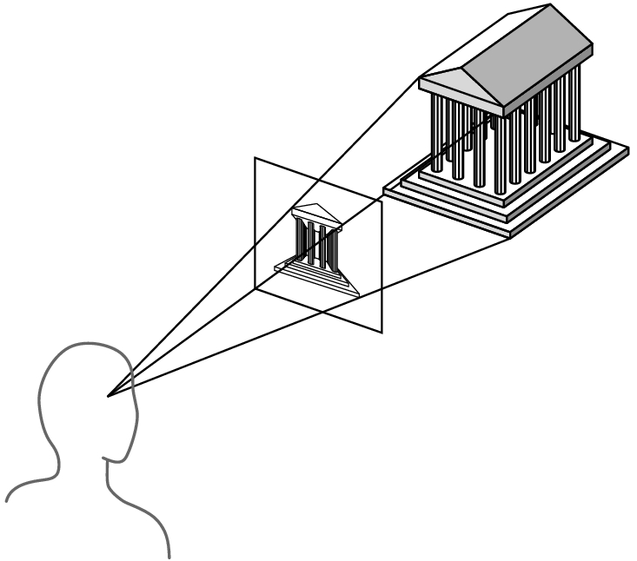
Simple Perspective Camera
Canonical case:
Camera looks along the z-axis
Focal point is the origin
Image plane is parallel to the xy-plane at distance d
(We call d the focal length, mainly for historical reasons)

Slide 58
Advantages and Disadvantages
Objects further from viewer are projected smaller than the same sized objects closer to the viewer (diminuition)
Looks realistic
Equal distances along a line are not projected into equal distances (nonuniform foreshortening)
Angles preserved only in planes parallel to the projection plane
More difficult to construct by hand than parallel projections (but not more difficult by computer)

Slide 59
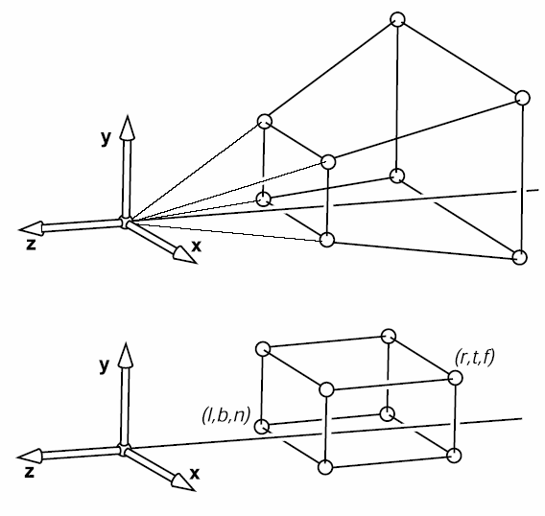
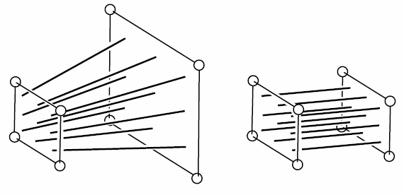
Perspective Projection

Slide 60
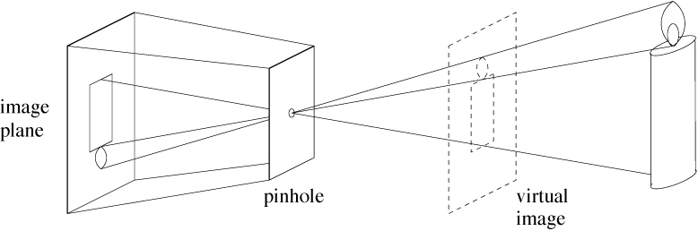
Perspective Projection
Abstract camera model - box with a small hole in it
Pinhole cameras work in practice

Slide 61
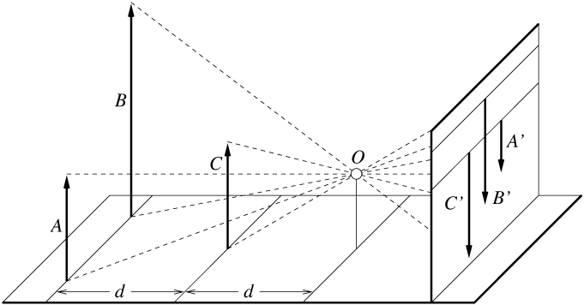
Distant Objects Are Smaller

Slide 62
Basic Perspective Projection
We are going to temporarily ignore canonical view space, and go straight from view to window
Easier to understand and use for Project 2
Assume you have transformed to view space, with x to the right, y up, and z back toward the viewer
Assume the origin of view space is at the center of projection (the eye)
Define a focal distance, d, and put the image plane there (note d is negative)
You can define d to control the size of the image

Slide 63
Basic Perspective Projection
If you know P(x_{v},y_{v},z_{v}) and d, what is P(x_{s},y_{s})?
Where does a point in view space end up on the screen?
P(x_{v},y_{v},z_{v})
y_{v}
P(x_{s},y_{s})
d
-z_{v}
x_{v}

Slide 64
Perspective Projection (Pinhole Camera)
Projection
plane
x
P(x, y, z)
x_{p}
z
d
View along y axis
View along x axis
d
z
y_{p}
Projection
plane
P(x, y, z)
y

Slide 65
Perspective Division
However W ≠ 1, so we must divide by W to return from homogeneous coordinates

Slide 66
Simple Perspective Transformation
Using homogeneous coordinates we can write:
Our next big advantage to homogeneous coordinates

Slide 67
General Perspective
The basic equations we have seen give a flavor of what happens, but they are insufficient for all applications
They do not get us to a Canonical View Volume
They make assumptions about the viewing conditions
To get to a Canonical Volume, we need a Perspective Volume …

Slide 68
Truncated View Volume for an Perspective Projection
Back
Clipping
plane
View
plane
Front
Clipping
plane
VRP
VPN
F
B

Slide 69
General Perspective
This matrix leaves points with z=n unchanged
It is just like the simple projection matrix, but it does some extra things to z to map the depth properly
We can multiply a homogenous matrix by any number without changing the final point, so the two matrices above have the same effect

Slide 70
The Steps of Implementation of Perspective Projection
Translate the VRP to the origin
Rotate VRC such that the VPN becomes the z axis
Translate such that the PRP is at the origin
Shear such that the DOP becomes parallel to the z axis
Scale such that the view volume becomes the canonical perspective view volume

Slide 71
Complete Perspective Projection
After applying the perspective matrix, we map the orthographic view volume to the canonical view volume:

Slide 72
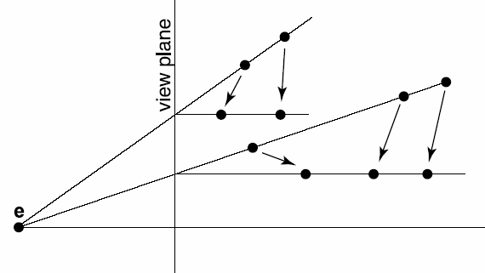
Perspective Projection
Warping a perspective projection into and orthographic one
Lines for the two projections intersect at the view plane
How can we put this in matrix form?
Need to divide by z—haven’t seen a divide in our matrices so far…
Requires our w from last time (or h in the book)

Slide 73
Mapping Lines
We want to map all the lines through the center of projection to parallel lines
This converts the perspective case to the orthographic case, we can use all our existing methods
The relative intersection points of lines with the near clip plane should not change
The matrix that does this looks like the matrix for our simple perspective case

Slide 74
Perspective View Volume
Recall the orthographic view volume, defined by a near, far, left, right, top and bottom plane
The perspective view volume is also defined by near, far, left, right, top and bottom planes – the clip planes
Near and far planes are parallel to the image plane: z_{v}=n, z_{v}=f
Other planes all pass through the center of projection (the origin of view space)
The left and right planes intersect the image plane in vertical lines
The top and bottom planes intersect in horizontal lines

Slide 75
Parallel Lines Meet?
Parallel lines are of the form:
Parametric form: x₀ is a point on the line, t is a scalar (distance along the line from x₀) and d is the direction of the line (unit vector)
Different x₀ give different parallel lines
Transform and go from homogeneous to regular:
Limit as t→∞ is

Slide 76
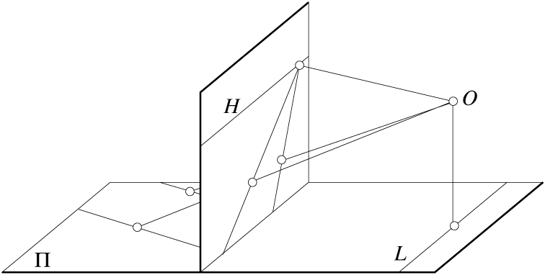
Parallel lines meet
Common to draw film plane
in front of the focal point

Slide 77
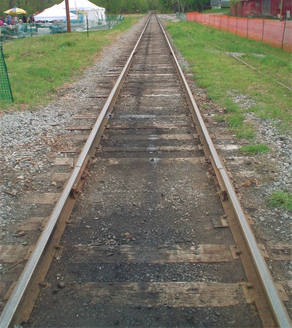
Perspective Projections
Used for:
fine art
Human visual system…
Pros:
gives a realistic view and feeling for 3D form of object
Cons:
does not preserve shape of object or scale (except where object intersects projection plane)
If we were viewing this scene using parallel project, the tracks would not converge

Slide 78
Perspective Projections
Different from a parallel projection because
parallel lines not parallel to the projection plane converge
size of object is diminished with distance
foreshortening is not uniform
Two understandings: Vanishing Point and View Point
There are also oblique perspective projections (same idea as parallel oblique), we’ll see an example next lecture
If we were viewing this scene using parallel project, the tracks would not converge

Slide 79
Vanishing points
Each set of parallel lines (=direction, not parallel to the projection plan) meets at a different point: The vanishing point for this direction
Classic artistic perspective is 3-point perspective
Sets of parallel lines on the same plane lead to collinear vanishing points: the horizon for that plane
Good way to spot faked images
Drawing simple perspectives by hand uses these vanishing point(s)
vanishing point

Slide 80
Stereo Viewing
The aim is to show each eye what it would see if the virtual scene was physically located in the real world
“Fish tank” Virtual Reality
Left eye
Virtual Scene (fixed)
Head moves
Right eye
Screen (fixed)

Slide 81
Stereo Frustum
“Gaze” vector (image plane normal) is not the direction the viewer is looking – it is perpendicular to the screen
View volume is not symmetric
Left eye
g
l
n
r
Screen (fixed)

Slide 82
Perspective Projection Matrices
We want a matrix that will take points in our perspective view volume and transform them into the orthographic view volume
This matrix will go in our pipeline before an orthographic projection matrix
(r,t,f)
(r,t,n)
(r,t,f)
(r,t,n)
(l,b,n)
(l,b,n)

Slide 83
OpenGL Perspective Projection
For OpenGL you give the distance to the near and far clipping planes
The total perspective projection matrix resulting from a glFrustum call is:

Slide 84
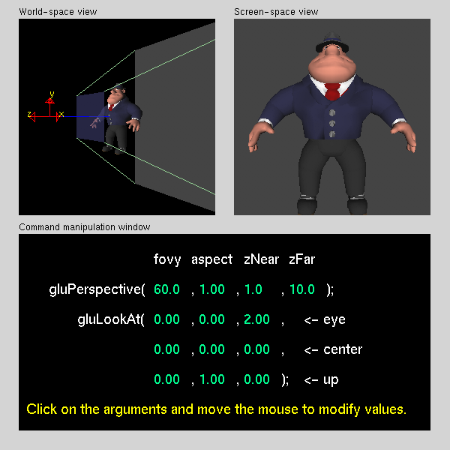
Viewing and Projection

Slide 85
Canonical → Window Transform
Problem: Transform the Canonical View Volume into Window Space (real screen coordinates)
Drop the depth coordinate and translate
The graphics hardware and windowing system typically take care of this – but we’ll do the math to get you warmed up
The windowing system adds one final transformation to get your window on the screen in the right place

Slide 86
Canonical → Window Transform
Typically, windows are specified by a corner, width and height
Corner expressed in terms of screen location
This representation can be converted to (x_{min},y_{min}) and (x_{max},y_{max})
We want to map points in Canonical View Space into the window
Canonical View Space goes from (-1,-1,-1) to (1,1,1)
Lets say we want to leave z unchanged
What basic transformations will be involved in the total transformation from 3D screen to window coordinates?

Slide 87
Canonical → Window Transform
(1,1)
(x_{max},y_{max})
(x_{min},y_{min})
(-1,-1)

Slide 88
Canonical → Window Transform
(1,1)
(x_{max},y_{max})
(x_{min},y_{min})
(-1,-1)

Slide 89
Canonical → Window Transform ( OpenGL)
You almost never have to worry about the canonical to window transform
In OpenGL, you tell it which part of your window to draw in – relative to the window’s coordinates
That is, you tell it where to put the canonical view volume
You must do this whenever the window changes size
Window (not the screen) has origin at bottom left
glViewport(minx, miny, maxx, maxy)
Typically: glViewport(0, 0, width, height)fills the entire window with the image
Why might you not fill the entire window?
The textbook derives a different transform, but the same idea

Slide 90
Camera Control Values
All we need is a single translation and angle-axis rotation (orientation), but...
Good animation requires good camera control--we need better control knobs
Translation knob - move to the look from point Orientation can be specified in several ways:
Specify camera rotations
Specify a lookat point (solve for camera rotations)

Slide 91
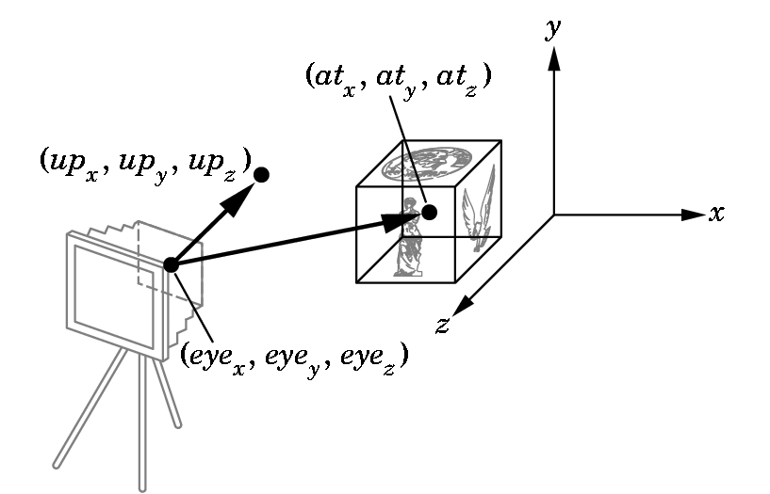
A Popular View Specification Approach
Focal length, image size/shape and clipping planes are in the perspective transformation
In addition:
lookfrom: where the focal point (camera) is
lookat: the world point to be centered in the image
Also specify camera orientation about the lookat-lookfrom axis

Slide 92
Implementation
Implementing the lookat/lookfrom/vup viewing scheme
Translate by -lookfrom, bring focal point to origin
Rotate lookat-lookfrom to the z-axis with matrix R:
v = (lookat-lookfrom) (normalized) and z = [0,0,1]
rotation axis: a = (vxz)/|vxz|
rotation angle: cosθ = v•z and sinθ = |vxz|
glRotate(θ, ax, ay, az)
Rotate about z-axis to get vup parallel to the y-axis

Slide 93
The Whole Picture
LOOKFROM: Where the camera is
LOOKAT: A point that should be centered in the image
VUP: A vector that will be pointing straight up in the image
FOV: Field-of-view angle.
d: focal length
WORLD COORDINATES

Slide 94
Project 2 Intro
You are given the following:
Rooms, defined in 2D by the edges that surround the room
The height of the ceiling
Each edge is marked opaque or clear
For each clear edge, there is a pointer to the thing on the other side
You know where the viewer is and what the field of view is
The viewer is given as (c_{x},c_{y},c_{z}) position
The view frustum is given as a viewing angle and an angle for the field of view
(c_{x},c_{y},c_{z})
X

Slide 95
Project 2 (2)
Represent the frustum as a left and right clipping line
You don’t have to worry about the top and bottom
Each clip line starts at the viewer’s position and goes to infinity in the viewing direction
Write a procedure that clips an edge to the view frustum
This takes a frustum and returns the endpoints of the clipped edge, or a flag to indicate that the edge is not visible

Slide 96
Project 2 (3)
Write a procedure that takes a room and a frustum, and draws the room
Clip each edge to the frustum
If the edge is visible, draw the wall that the edge represents
Create the 3D wall from the 2d piece of edge
Project the vertices
Draw the polygon in 2D
If the edge is clear, recurse into neighboring polygon
Draw the floor and ceiling first, because they will be behind everything

