Slide 1
Last Note
Graphics transform pipeline
Intro. to viewing
Viewing transformations
Describing cameras and views
Orthogonal
Perspective
More details are discussed in Prof. Yao’s Fundamental of CG
Project 2. is announced and is due Apr. 10

Slide 2
This Note
Clipping
Liang-Barsky Details
Weiler-Atherton clipping algorithm
Drawing points and lines
Project 2 is due Oct. 31

Slide 3
Review
View Space is a coordinate system with the viewer looking down the –z axis, with x to the right and y up
The World→View transformation takes points in world space and converts them into points in view space
The Projection matrix, or View → Canonical matrix, takes points in view space and converts them into points in Canonical View Space
Canonical View Space is a coordinate system with the viewer looking along –z, x to the right, y up, and everything to be drawn inside the cube [-1,1]x[-1,1]x[-1,1] using parallel projection
GL camera: GL_MODELVIEW, GL_PROJECTION, glortho…, gluLookAt, …

Slide 4
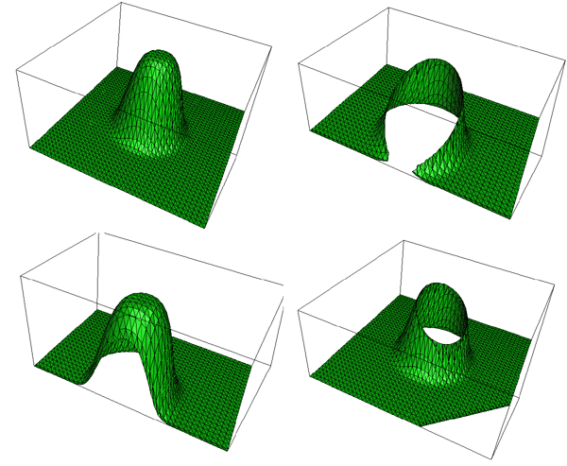
Clipping
Viewports and Algorithms

Slide 5
Perspective Projection Problem
Top View
Image
a
b
a
b
eye

Slide 6
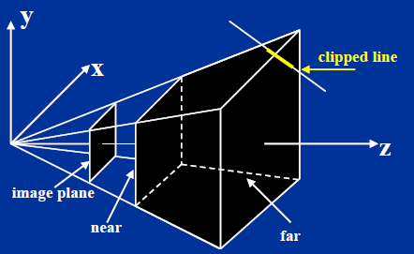
Clipping
Something is missing between projection and viewing...
Before projecting, we need to eliminate the portion of scene that is outside the viewing frustum
Need to clip objects to the frustum (truncated pyramid)
Now in a canonical position but it still seems kind of tricky...

Slide 7
Clipping
Parts of the geometry to be rendered may lie outside the view volume
View volume maps to memory addresses
Out-of-view geometry generates invalid addresses
Geometry outside the view volume also behaves very strangely under perspective projection
Triangles can be split into two pieces, for instance
Clipping removes parts of the geometry that are outside the view
Best done in canonical space before perspective divide
Before dividing out the homogeneous coordinate

Slide 8
Clipping
In hardware, clipping is done in canonical space before perspective divide
Before dividing out the homogeneous coordinate
Clipping is useful in many other applications
Building BSP trees for visibility and spatial data structures
Hidden surface removal algorithms
Removing hidden lines in line drawings
Finding intersection/union/difference of polygonal regions
2D drawing programs: cropping, arbitrary clipping
We will make explicit assumptions about the geometry and the clip region
Assumption depend on the algorithm

Slide 9
Clipping Terminology
Clip region: the region we wish to restrict the output to
Geometry: the thing we are clipping
Only those parts of the geometry that lie inside the clip region will be output
Clipping edge/plane: an infinite line or plane and we want to output only the geometry on one side of it
Frequently, one edge or face of the clip region
Geometry
Clip region
Output

Slide 10
Types of Geometry
Points are clipped via inside/outside tests
Many algorithms for this task, depending on the clip region
Many algorithms for clipping lines exist
You need one for the 2nd project
Two main algorithms for clipping polygons exist
Sutherland-Hodgman
Weiler

Slide 11
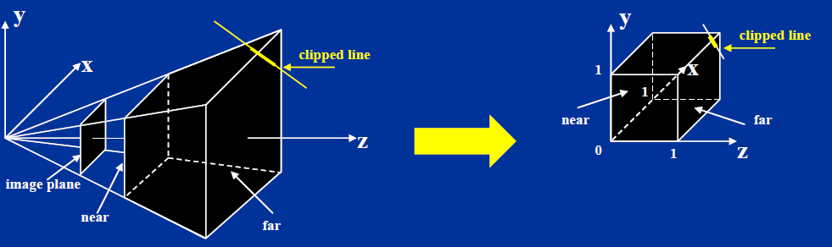
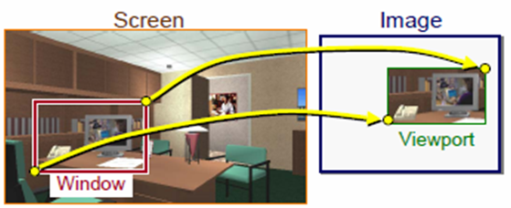
Normalizing the Viewing Frustum
Solution: transform frustum to a cube before clipping
Converts perspective frustum to orthographic frustum. Yet another homogeneous transform!

Slide 12
Clipping Planes
Left Clip
Plane
Near Clip Plane
x_{v}
Far Clip Plane
View Volume
l
n
f
-z_{v}
r
Right Clip
Plane

Slide 13
Where is the Image Plane?
Notice that it doesn’t really matter where the image plane is located, once you define the view volume
You can move it forward and backward along the z axis and still get the same image, only scaled
The left/right/top/bottom planes are defined according to where they cut the near clip plane
Or, define the left/right and top/bottom clip planes by the field of view

Slide 14
Field of View
Assumes a symmetric view volume
Left Clip
Plane
Near Clip Plane
x_{v}
Far Clip Plane
View Volume
FOV
f
-z_{v}
Right Clip
Plane

Slide 15
Perspective Parameters
We have seen several different ways to describe a perspective camera
Focal distance, Field of View, Clipping planes
The most general is clipping planes – they directly describe the region of space you are viewing
For most graphics applications, field of view is the most convenient
It is image size invariant – having specified the field of view, what you see does not depend on the image size
But, not sufficient for stereo viewing (more later)
You can convert one thing to another

Slide 16
Focal Distance to FOV
You must have the image size to do this conversion
Why? Same d, different image size, different FOV
Project 2 does the inverse conversion to find the focal length
height/2
d
FOV/2
d

Slide 17
OpenGL
gluPerspective(…)
Field of view in the y direction, FOV, (vertical field-of-view)
Aspect ratio, a, should match window aspect ratio
Near and far clipping planes, n and f
Defines a symmetric view volume
glFrustum(…)
Give the near and far clip plane, and places where the other clip planes cross the near plane
Defines the general case
Used for stereo viewing, mostly

Slide 18
gluPerspective to glFrustum
As noted previously, glu functions don’t add basic functionality, they are just more convenient
So how does gluPerspective convert to glFrustum?
Symmetric, so only need t and l
y
?
t
FOV / 2
n
z

Slide 19
Near/Far and Depth Resolution
It may seem sensible to specify a very near clipping plane and a very far clipping plane
Sure to contain entire scene
But, a bad idea:
OpenGL only has a finite number of bits to store screen depth
Too large a range reduces resolution in depth - wrong thing may be considered “in front”
See Shirley for a more complete explanation
Always place the near plane as far from the viewer as possible, and the far plane as close as possible

Slide 20
Clipping Points to View Volume
A point is inside the view volume if it is on the “inside” of all the clipping planes
The normals to the clip planes are considered to point inward, toward the visible region
Now we see why clipping is done in canonical view space
For instance, to check against the left plane:
X coordinate in 3D must be > -1
In homogeneous screen space, same as: x_{screen} > -w_{screen}
In general, a point, p, is “inside” a plane if:
You represent the plane as n_{x}x+n_{y}y+n_{z}z+d=0, with (n_{x},n_{y},n_{z}) pointing inward
And n_{x}p_{x}+n_{y}p_{y}+n_{z}p_{z}+d > 0

Slide 21
Sutherland-Hodgman (1/4)
Clip polygons to convex clip regions
Clip the polygon against each edge of the clip region in turn
Clip polygon each time to line containing edge
Only works for convex clip regions (Why? Example that breaks?)

Slide 22
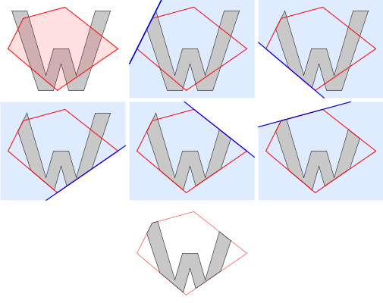

Sutherland-Hodgman (1/4)

Slide 23
Sutherland-Hodgman (2/4)
To clip a polygon to a line/plane:
Consider the polygon as a list of vertices
One side of the line/plane is considered inside the clip region, the other side is outside
We are going to rewrite the polygon one vertex at a time – the rewritten polygon will be the polygon clipped to the line/plane
Check start vertex: if “inside”, emit it, otherwise ignore it
Continue processing vertices as follows…
p₂
p₃
p₁
p₄
p₀
p₀
p₁
p₂
p₃
p₄
points in
Clipper
points out

Slide 24
Sutherland-Hodgman (3/4)
Inside
Outside
Inside
Outside
Inside
Outside
Inside
Outside
s
p
i
s
p
p
s
i
p
s
Output p
Output i
No output
Output i and p

Slide 25
Sutherland-Hodgman (4/4)
Look at the next vertex in the list, p, and the edge from the last vertex, s, to p. If the…
polygon edge crosses the clip line/plane going from out to in: emit crossing point, i, next vertex, p
polygon edge crosses clip line/plane going from in to out: emit crossing, i
polygon edge goes from out to out: emit nothing
polygon edge goes from in to in: emit next vertex, p

Slide 26
Inside-Outside Testing
Lines/planes store a vector pointing toward the inside of the clip region – the outward pointing normal
Could re-define for inward pointing
Dot products give inside/outside information
Note that x (a vector) is any point on the clip line/plane
Inside
Outside
x
n
f
i
s

Slide 27
Finding Intersection Pts
Use the parametric form for the edge between two points, x₁ and x₂:
For planes of the form x=a:
Similar forms for y=a, z=a
Solution for general plane can also be found

Slide 28
Inside/Outside in Screen Space
In canonical screen space, clip planes are x_{s}=±1, y_{s}=±1, z_{s}=±1
Inside/Outside reduces to comparisons before perspective divide

Slide 29
Hardware Sutherland-Hodgman
Suitable for hardware implementation
Only need the clip edge, the endpoints of the current edge, and the last output point
Polygon edges are output as they are found, and passed right on to the next clip region edge
Algorithm also works for clipping lines and points
Clip Top
Clip Right
Clip Bottom
Vertices in
Clip Far
Clip Near
Clip Left
Clipped vertices out

Slide 30
Sutherland-Hodgman Pseudo Code
List outputList = subjectPolygon;
for (Edge clipEdge in clipPolygon) do
List inputList = outputList;
outputList.clear();
Point S = inputList.last;
for (Point E in inputList) do
if (E inside clipEdge) then
if (S not inside clipEdge) then
outputList.add(ComputeIntersection(S,E,clipEdge));
end if
outputList.add(E);
else if (S inside clipEdge) then
outputList.add(ComputeIntersection(S,E,clipEdge));
end if
S = E;
done
done

Slide 31
Another Way to Clip: Early Rejection
If a polygonal object is closed, then no back-facing face is visible
Front-facing faces must occlude all back-facing ones
Reject back-facing polygons in view space
Transform face normal and check
OpenGL supports optional back-face culling (and front-face culling too)
Bounding volumes enclosing many polygons can be checked against the view volume
Done in software in world or view space
Visibility can reject whole chunks of geometry without even looking at them

Slide 32
Clipping In General
Apart from clipping to the view volume, clipping is a basic operation in many other algorithms
Special purpose rendering might use different clipping (Project 2)
Breaking space up into chunks
2D drawing and windowing
Modeling
May require more complex geometry than rectangular boxes

Slide 33
Additional Clipping Planes
Useful for doing things like cut-away views
Use a clip plane to cut off part of the object
Only works if piece to be left behind is convex
OpenGL allows you to do it
Also one way to query OpenGL for all objects in a region of space (uses the selection mechanism)

Slide 34
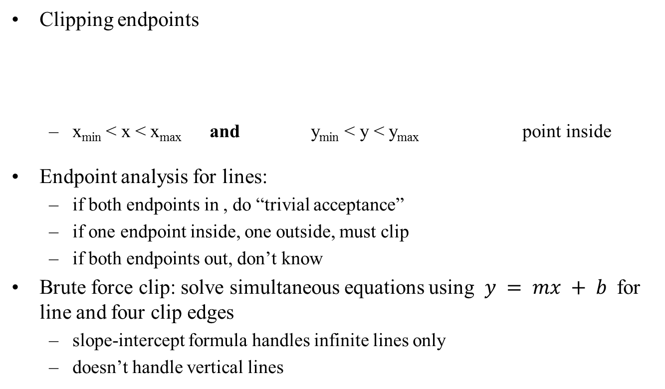
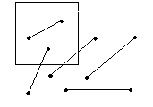
Line Clipping
(x_{max} , y_{max})
(x, y)
(x_{min} , y_{min})

Slide 35
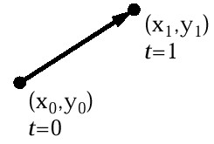
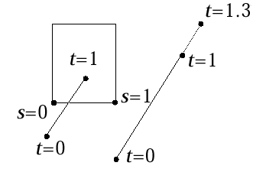
Parametric Line Formulation For Clipping
Parametric form for line segment
X = x₀ + t(x₁ – x₀) 0 < t < 1
Y = y₀ + t(y₁ – y₀)
P(t) = P₀ + t(P₁ – P₀)
“true,” i.e., interior intersection, if s_{edge} and t_{line} in [0,1]
(hard to compute)

Slide 36
Clipping Lines
Lines can also be clipped by Sutherland-Hodgman
Slower than necessary, unless you already have hardware
Better algorithms exist
Cohen-Sutherland
Liang-Barsky
Nicholl-Lee-Nicholl (we won’t cover this one – only good for 2D)

Slide 37
Cohen-Sutherland (1)
Works basically the same as Sutherland-Hodgman
Was developed earlier
Clip line against each edge of clip region in turn
If both endpoints outside, discard line and stop
If both endpoints in, continue to next edge (or finish)
If one in, one out, chop line at crossing pt and continue
Works in both 2D and 3D for convex clipping regions

Slide 38
Cohen-Sutherland (2)
1
2
1
2
3
3
4
4
3
3
4
4
1
2
1
2

Slide 39
Cohen-Sutherland (3)
Some cases lead to premature acceptance or rejection
If both endpoints are inside all edges
If both endpoints are outside one edge
General rule of clipping – if a fast test can cover many cases, do it first

Slide 40
Cohen-Sutherland - Details
Only need to clip line against edges where one endpoint is out
Use outcode to record endpoint in/out wrt each edge. One bit per edge, 1 if out, 0 if in.
Trivial reject:
outcode(x1) & outcode(x2)!=0
Trivial accept:
outcode(x1) | outcode(x2)==0
Which edges to clip against?
outcode(x1) ^ outcode(x2)
1
2
0010
3
4
0101

Slide 41
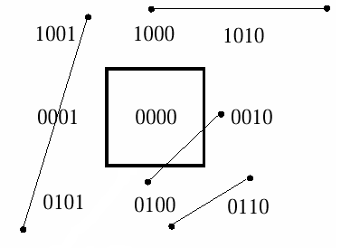
Outcodes for Cohen-Sutherland Line Clipping in 2D
Divide plane into 9 regions
Compute the sign bit of 4 comparisons between a vertex and an edge
ymax – y; y – ymin; xmax – x; x - xmin
point lies inside only if all four sign bits are 0, otherwise exceeds edge
4 bit outcode records results of four bounds tests:
First bit: outside halfplane of top edge, above top edge
Second bit: outside halfplane of bottom bottom edge
Third bit: outside halfplane of right edge, to edge, below right of right edge
Fourth bit: outside halfplane of left edge, to left of left edge
Compute outcodes for both vertices of each edge (denoted OC₀ and OC₁)
Lines with OC₀ = 0 and OC₁ = 0 can be trivially accepted (i.e., outcode 0000)
Lines lying entirely in a half plane outside an edge can be trivially rejected: OC0 AND OC1 ≠ 0 (i.e., they share an “outside” bit)
Clip Rectangle

Slide 42
Outcodes for Cohen-Sutherland Line Clipping in 3D
Very similar to 2D
Divide volume into 27 regions (Picture a Rubik’s cube)
6-bit outcode records results of 6 bounds tests
First bit: outside back plane, behind back plane
Second bit: outside front plane, in front of front plane
Third bit: outside top plane, above top plane
Fourth bit: outside bottom plane, below bottom plane
Fifth bit: outside right plane, to right of right plane
Sixth bit: outside left plane, to left of left plane
Again, Lines with OC₀ = 0 and OC₁ = 0 can be trivially accepted
Lines lying entirely in a volume on outside of a plane can be trivially rejected: OC₀ AND OC₁ ≠ 0 (i.e., they share an “outside” bit)
Back plane
000000 (in front)
100000 (behind)
Front plane
010000 (in front)
000000 (behind)
Top plane
001000 (above)
000000 (below)
Bottom plane
000000 (above)
000100 (below)
Right plane
000000 (to left of)
000010 (to right of)
Left plane
000001 (to left of)
000000 (to right of)

Slide 43
Cohen-Sutherland Algorithm (1/2)
If we can neither trivially accept/reject (T/A, T/R), divide and conquer
Subdivide line into two segments; then T/A or T/R one or both segments:
use a clip edge to cut line
use outcodes to choose edge that is crossed
edges where the two outcodes differ at that particular bit are crossed
pick an order for checking edges: top – bottom – right – left
compute the intersection point
the clip edge fixes either x or y
can substitute into the line equation
iterate for the newly shortened line, “extra” clips may happen (e.g., E-I at H)
D
C
I
B
A
H
Clip rectangle
G
F
E

Slide 44
Cohen- Sutherland Algorithm (2/2)
y = y0 + slope*(x - x0) and x = x0 + (1/slope)*(y - y0)
Algorithm:
ComputeOutCode(x0, y0, outcode0);
ComputeOutCode(x1, y1, outcode1);
repeat
check for trivial reject or trivial accept
pick the point that is outside the clip rectangle
if TOP then
x = x0 + (x1 – x0) * (ymax – y0)/(y1 – y0); y = ymax;
else if BOTTOM then
x = x0 + (x1 – x0) * (ymin – y0)/(y1 – y0); y = ymin;
else if RIGHT then
y = y0 + (y1 – y0) * (xmax – x0)/(x1 – x0); x = xmax;
else if LEFT then
y = y0 + (y1 – y0) * (xmin – x0)/(x1 – x0); x = xmin;
if (x0, y0 is the outer point) then
x0 = x; y0 = y; ComputeOutCode(x0, y0, outcode0)
else
x1 = x; y1 = y; ComputeOutCode(x1, y1, outcode1)
until done

Slide 45
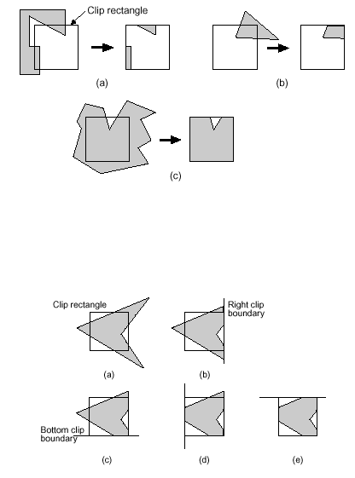
Sutherland-Hodgman Polygon Clipping

Slide 46
Parametric Line Clipping for Upright Clip Rectangle (1/2)
D = P₁ – P₀ = (x₁ – x₀, y₁ – y₀)
Leave P_{Ei} as an arbitrary point on clip edge; it’s a free variable and drops out
Calculations for Parametric Line Clipping Algorithm
Clip Edge_{i}
Normal N_{i}
P_{Ei}
P₀-P_{Ei}
left: x = x_{min}
(-1,0)
(x_{min}, y)
(x₀- x_{min},y₀-y)
right: x = x_{max}
(1,0)
(x_{max},y)
(x₀- x_{max},y₀-y)
bottom: y = y_{min}
(0,-1)
(x, y_{min})
(x₀-x,y₀- y_{min})
top: y = y_{max}
(0,1)
(x, y_{max})
(x₀-x,y₀- y_{max})

Slide 47
Canonical View Volume for Orthographic Parallel Projection
x or y
Back
plane
1
Front
plane
-z
-1
-1
x = -1, y = -1, z = 0
x = 1, y = 1, z = -1

Slide 48
The Extension of the Cohen-Sutherland Algorithm
bit 1 – point is above view volume y > 1
bit 2 – point is below view volume y < -1
bit 3 – point is right of view volume x > 1
bit 4 – point is left of view volume x < -1
bit 5 – point is behind view volume z < -1
bit 6 – point is in front of view volume z > 0

Slide 49
Intersection of a 3D Line
a line from to can be represented as
so when y = 1

Slide 50
Canonical View Volume for Perspective Projection
x or y
Back
plane
1
Front
plane
-z
-1
-1
x = z, y = z, z = -z_{min}
x = -z, y = -z, z = -1

Slide 51
The Extension of the Cohen-Sutherland Algorithm
bit 1 – point is above view volume y > -z
bit 2 – point is below view volume y < z
bit 3 – point is right of view volume x > -z
bit 4 – point is left of view volume x < z
bit 5 – point is behind view volume z < -1
bit 6 – point is in front of view volume z > z_{min}

Slide 52
Intersection of a 3D Line
so when y = z

Slide 53
Clipping in Homogeneous Coordinates
Why clip in homogeneous coordinates ?
it is possible to transform the perspective-projection canonical view volume into the parallel-projection canonical view volume

Slide 54
Clipping in Homogeneous Coordinates
The corresponding plane equations are
X = -W
X = W
Y = -W
Y = W
Z = -W
Z = 0

Slide 55
Parametric Line Clipping for Upright Clip Rectangle (2/2)
Examine t:
numerator is just the directed distance to an edge; sign corresponds to OC
denominator is just the horizontal or vertical projection of the line, dx or dy; sign determines PE or PL for a given edge
ratio is constant of proportionality: “how far over” from P₀ to P₁ intersection is relative to dx or dy

Slide 56
Liang-Barsky Clipping
Parametric clipping - view line in parametric form and reason about the parameter values
Parametric form: x = x₁+(x₂-x₁)t
t∈[0,1] are points between x₁ and x₂
Liang-Barsky is more efficient than Cohen-Sutherland
Computing intersection vertices is most expensive part of clipping
Cohen-Sutherland may compute intersection vertices that are later clipped off, and hence don’t contribute to the final answer
Works for convex clip regions in 2D or 3D

Slide 57
Parametric Clipping
Recall, points inside a convex region are inside all clip planes
Parametric clipping finds the values of t, the parameter, that correspond to points inside the clip region
Consider a rectangular clip region
Top, y =y_{max}
Left, x=x_{min}
Right, x=x_{max}
Bottom, y=y_{min}

Slide 58
Parametric Intersection
Consider line to be infinite
Find parametric intersections
t_{right}
t_{top}
t_{left}
t_{bottom}

Slide 59
Entering and Leaving
Recall, a point is inside a view volume if it is on the inside of every clip edge/plane
Consider the left clip edge and the infinite line. Two cases:
t<t_{left} is inside, t>t_{left} is outside → leaving
t<t_{left} is outside, t>t_{left} is inside → entering
To be inside a clip plane we either:
Started inside, and have not left yet
Started outside, and have entered
entering
inside
leaving
Clip edge

Slide 60
Liang-Barsky Intuition
To be inside the clip region, you must have entered every clip edge before you have left any clip edge
Leave
Enter
Leave
Leave
Leave
Enter
Enter
Enter

Slide 61
When are we Inside?
We want parameter values that are inside all the clip planes
Last parameter value to enter is the start of the visible segment
First parameter value to leave is the end of the visible segment
If we leave some clip plane before we enter another, we cannot see any part of the line
First to leave will be before last to enter
All this leads to an algorithm – Liang-Barsky

Slide 62
When are we Inside?
We want parameter values that are inside all the clip planes
Any clip plane that we started inside we must not have left yet
First parameter value to leave is the end of the visible segment
Any clip plane that we started outside we must have already entered
Last parameter value to enter is the start of the visible segment
If we leave some clip plane before we enter another, we cannot see any part of the line
All this leads to an algorithm – Liang-Barsky

Slide 63
Liang-Barsky Sub-Tasks
Find parametric intersection points
Parameter values where line crosses each clip edge/plane
Find entering/leaving flags
For every clip edge/plane, are either entering or leaving
Find last parameter to enter, and first one to leave
Check that enter before leave
Convert these into endpoints of clipped segment

Slide 64
Parametric Intersection
Segment goes from (x₁,y₁) to (x₂,y₂):
Rectangular clip region with x_{min}, x_{max}, y_{min}, y_{max}
Infinite line intersects rectangular clip region edges when:
where

Slide 65
Entering or Leaving?
When p_{k}<0, as t increases line goes from outside to inside – entering
When p_{k}>0, line goes from inside to outside – leaving
When p_{k}=0, line is parallel to an edge
Special case: one endpoint outside, no part of segment visible, otherwise, ignore this clip edge and continue

Slide 66
Find Visible Segment ts
Last parameter is enter is t_{small}=max(0, entering t’s)
First parameter is leave is t_{large}=min(1, leaving t’s)
If t_{small}>t_{large}, there is no visible segment
If t_{small}<t_{large}, there is a line segment
Compute endpoints by substituting t values into parametric equation for the line segment
Improvement (and actual Liang-Barsky):
compute t’s for each edge in turn (some rejects occur earlier like this)

Slide 67
General Liang-Barsky
Liang-Barsky works for any convex clip region
E.g. Perspective view volume in world or view coordinates
Require a way to perform steps 1 and 2
Compute intersection t for all clip lines/planes
Label them as entering or exiting
Far
Near
Left
Right

Slide 68
In View Space
For Project 2, you need to clip edges to a view frustum in world space
Situation is:
x_{left}
x_{right}
frustum
x₁
x₂
eye, e

Slide 69
First Step
Compute inside/outside for endpoints of the line segment
Determine which side of each clip plane the segment endpoints lie
Use the cross product
What do we know if (x₁ - e) × (x_{left} - e) > 0 ?
Other cross products give other information
What can we say if both segment endpoints are outside one clip plane?
Stop here if we can, otherwise…

Slide 70
Finding Parametric Intersection
Left clip edge: x = e + (x_{left} - e) t
Line: x = x₁ + (x₂ - x₁) s
Solve simultaneous equations in t and s:
Use endpoint inside/outside information to label as entering or leaving
Now we have general Liang-Barsky case

Slide 71
General Clipping
Liang-Barsky can be generalized to clip line segments to arbitrary polygonal clip regions
Consider clip edges as non-infinite segments
Look at all intersecting ts between 0 and 1
Clipping general polygons against general clip regions is quite hard: Weiler-Atherton algorithm
Start with polygons as lists of vertices
Replace crossing points with vertices
Double all edges and form linked lists of edges
Adjust links at crossing vertices
Enumerate polygon patches

Slide 72
Weiler-Atherton – Form Lists
Original Polygons
Double Linked Lists -
outside and inside lists

Slide 73
Weiler-Atherton – Find Crossings
Crossing vertices added –
links re-written

Slide 74
Weiler-Atherton – Enumerate
“Clip and Poly”
“Poly not Clip”
“Not clip not poly”
“Clip not Poly”
Every link used once

Slide 75
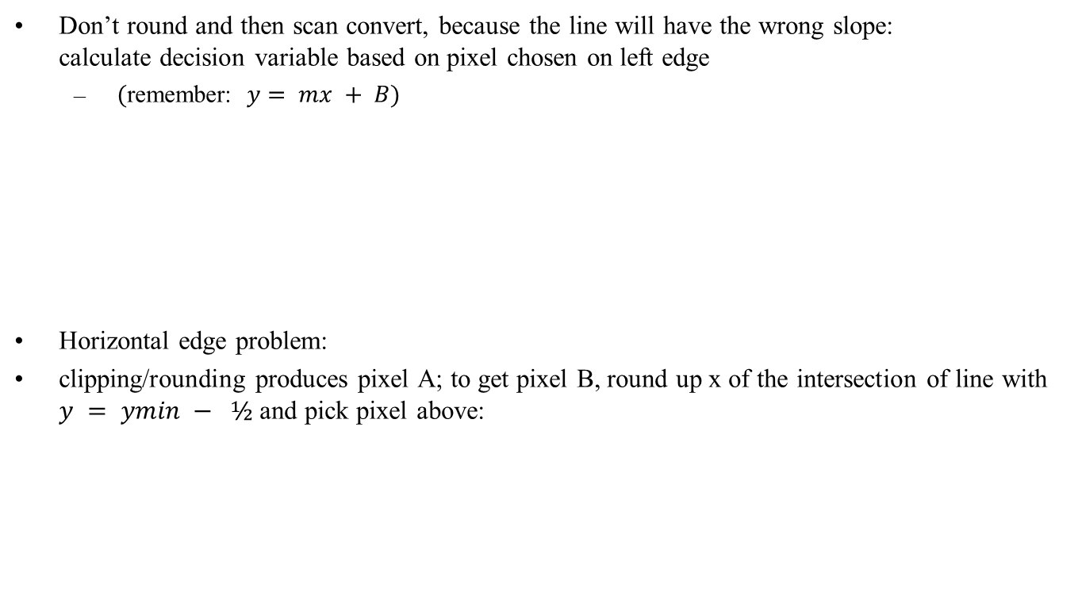





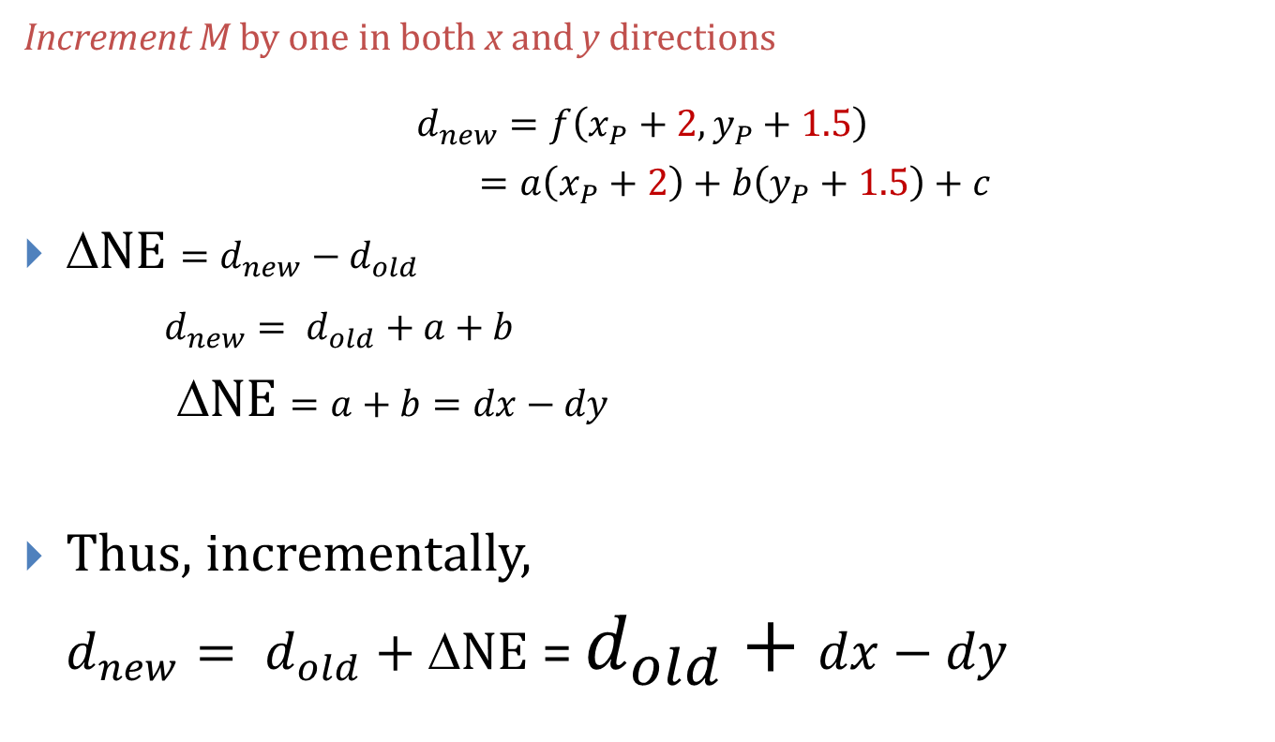
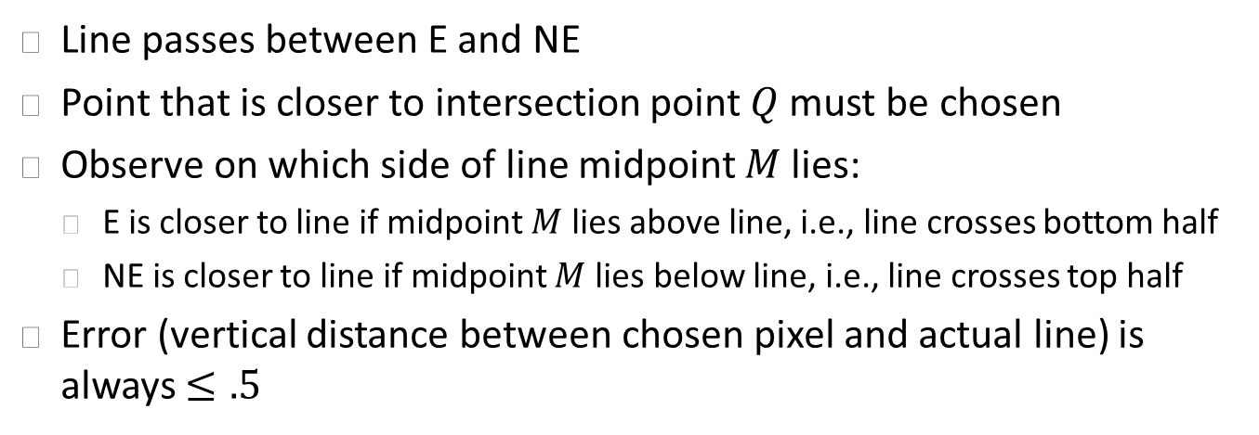
Scan Conversion after Clipping
Clip rectangle
x = x_{min}
y = y_{min}
B
A
y = y_{min} – 1/2
y = y_{min} – 1

