Slide 1
Benton County COVID 19 Modeling
Peter Banwarth
Public Health Data Scientist

Slide 2
Comparison of the 4/28 model with the 4/7 model
4/7 model
4/28 model
Adding students
Ability to control physical distancing policies
Externally introduced infections
Multiple trials for confidence intervals
One fully mixed population
Many partially mixed populations
Fixed parameters with external changes in R0
Variable parameters with internally dynamic R0
SEIR-M
SEIR-S/Im/M
Susceptible, Exposed, Infected, Recovered, (re)Susceptible, Immune, Mortality

Slide 3
R package: SimInf
A flexible and efficient framework for data-driven stochastic disease spread simulations.
Developed by Widgren, Bauer, Eriksson, and Engblom
Widgren S, Bauer P, Eriksson R, Engblom S (2019). “SimInf: An R Package for Data-Driven
Stochastic Disease Spread Simulations.” Journal of Statistical Software, 91(12), 1–42. doi:
10.18637/jss.v091.i12.
https://cran.r-project.org/web/packages/SimInf/vignettes/SimInf.pdf
https://cran.r-project.org/web/packages/SimInf/SimInf.pdf
https://github.com/stewid/SimInf

Slide 4
Components of SimInf
Nodes – self-contained sub-populations within which the disease can spread.
Compartments – the various disease compartments (e.g. SIR)
Transitions – the disease dynamics model
gdata = global parameters common to all nodes and trials
ldata = local parameters that can vary by node/trial
u0 = the initial state for the different compartments
v0 = the initial state for continuous variables used in the transitions
Events = a set of timed events for moving individuals into, out of, and between different nodes and compartments.
pts_function = Post-time-step function. A function written in C that can alter any of the continuous variables, which in turn can alter the disease dynamics.

Slide 5
SimInf conceptual flow
Build model
Run model
Result
Specify model
Parameters
Compartments
Transitions
Set initial states
Compartments: u0
Continuous variables: v0
Write post-time-step function
Will change continuous variables which will affect disease dynamics
Generate events
Enter nodes
Exit nodes
Transfer between nodes
Transfer between compartments
Advance individuals through compartments using Transitions
Move individuals in/out/between nodes using Events
Advance time step
Change continuous variables using pts_function
Trajectories of compartments
Evolution of continuous variables

Slide 6
Benton County COVID-19 model characteristics
Susceptible/Exposed/Infected/Recovered with imperfect post-infection immunity and mortality: SEIR-S/Im/M. These are called the “compartments”.
Most recovered become immune, some return to susceptible after a period of time.
Homogeneous, closed population.
Multiple partitions (“nodes”) of the population, with occasional transfers between nodes to represent partial mixing within population.
Transfers can be between any compartments (SEIRIm) except M.
Multiple transfers can occur from a node or to a node in any time step.
Occasional “parachuting” of infected individuals to represent introduction of disease from outside closed population.
Multiple simulation trials run simultaneously to provide a confidence interval.

Slide 7
COVID-19 model visual at a random time step
Node 2
pop2
External pool of infected individuals
Node 1 detail:
External infected
Node 1
pop1
E
I
Node 3
pop3
S
M
Node 4 pop4
R
Im
Node 5
pop5
Node 6 pop6
Transfers between nodes (all compartments are eligible)
Transfer(s) from Node 2
Total population:
Sum(pop_i)
Transfers to Node 2 and Node 4

Slide 8
Events specific to Oregon and Benton County
Current high level of physical distancing in place. Physical distancing will be lifted in three phases.
Physical distancing will be re-instituted if COVID-19 prevalence crosses a certain threshold.
Two levels of increased physical distancing available (minor and major).
Population of Benton County will increase sharply when OSU students return in late September.
Assumes that most students will be susceptible, but that some will be exposed, infected, recovered, or immune.
Students are randomly distributed across a subset of the existing nodes.

Slide 9
Additional model options
Seasonality of the effective reproduction number (i.e. probability of transmission is increased in winter and decreased in summer).
Ability to “turn off” physical distancing policies at a certain point.
Mostly used for counterfactual examination of what would happen if we did not respond when prevalence starts increasing again.

Slide 10
Model specification
All of the following parameter categories can be changed to simulate different scenarios.
Simulation parameters
Population parameters
Disease dynamic parameters
Physical distancing parameters
Event parameters
Plotting parameters

Slide 11
Simulation parameters
numTrials = Number of trials. Used to produce confidence intervals. Minimum number of trials = 1, maximum allowed = 100
tSpan = Time span. How long the simulation lasts in days. No minimum or maximum.
startofSimDay = Day that the simulation starts.

Slide 12
Population parameters
N = Number of nodes – used to partition the population into different segments to represent partial mixing.
trialPop = Total population of the trial.
Population per node is approximately (trialPop/N) with some randomization
I0Pop = Initial number of infected individuals.
maxINodeProp = Proportion of nodes with one or more infected individuals – models the fact that disease distribution is not uniform across nodes.

Slide 13
Disease dynamics parameters
Beta = transmissibility of COVID-19. Beta = R0*gamma. Used to transition S to E
Sigma = reciprocal of exposed period (how long after infection before individual becomes contagious)
Gamma = reciprocal of infectious period (aka recovery rate)
Eta = case fatality rate
Delta = proportion of recovered who lose immunity and become susceptible again
Kappa = reciprocal of recovered period; how long an individual has temporary immunity before either becoming permanently immune or susceptible again.
Phi = Proportionate reduction in Beta due to physical distancing. Beta is multiplied by 1/phi. Phi is changed in the post-time-step function
Season = factor that represents seasonality of effective reproduction number. Calculated using cosine function with peak in February and trough in August. Beta is multiplied by Season.
cosAmp = Amplitude of season factor. Large cosAmp = more seasonal variation.
BetaFactor = randomizer to create more variation in beta between different trials.

Slide 14
Physical distancing parameters
maxPrev1 = first prevalence threshold for instituting minor physical distancing. When prevalence > maxPrev, phi starts to increase.
maxPrev1 can be a number (e.g. 40 infected individuals) or a proportion (e.g. 1% of the population)
maxPrev2 = second prevalence threshold for instituting major physical distancing. When prevalence > maxPrev1, phi starts to increase even more. maxPrev2 can also be a number or a proportion.
phiFactor1 = Target for increased phi under minor physical distancing.
phiFactor2 = Target for increased phi under major physical distancing.
upDelay = how many days after maxPrev1 (maxPrev2) is exceeded before phi begins to change toward phiFactor1 (phiFactor2). Represents how long COVID-19 prevalence increases before we notice.
downDelay = how many days after prevalence drops below maxPrev2 (maxPrev1) before phi begins to change toward phiFactor1 (toward baseline = 1). Represents how long we wait before relaxing physical distancing.
phiMovement = how quickly phi converges on phiFactor1, phiFactor2, or baseline = 1. Larger phiMovement means phi converges more quickly. Represents how quickly people respond to changes in physical distancing policies.
kbSwitch = Indicator if current major physical distancing is still in place. kbSwitch = 0 means current (March 23rd) physical distancing requirements are in effect. kbSwitch = 1 through 3 represents the three phases of lifting the physical distancing policies.
switchOffPolices = Indicator if physical distancing policies will no longer be used after a certain day. switchOffPolicies = 0 means that phi will change according to the prevalence of COVID-19, representing physical distancing. switchOffPolicies = 1 means that phi will always equal 1, representing no more physical distancing policies. Used mostly to explore counterfactuals “what if we stopped responding to COVID-19 with physical distancing?”

Slide 15
Event parameters - Event types
There are five event types in the simulation:
Parachuting events – one infected individual enters a random node in the otherwise closed population at random times.
Transfer events – a random number of individuals from all compartments (except M) transfer from a random subset of nodes to another random subset at a random time.
Student event – OSU students return in September
Three events representing the phased lifting of current physical distancing policies
A “switch off policies event”, used for counterfactuals

Slide 16
Event parameters – Parachuting events
parachuteRate = the reciprocal of the expected number of days between a parachute event. E.g. if parachuteRate = 1/30, then every month or so a parachute events occurs.
parachuteNum = the number of infected individuals in each parachute event.
parachuteDist = the distribution of parachute events. Allows the simulation to have more parachute events at certain times than others.
paraChi_df = parameter to shape the distribution of parachute events. Default is to assume events start low due to travel restrictions, increase once restrictions ease, then decrease once global prevalence decreases.

Slide 17
Event parameters – transfer events
transferRate = expected number of days between transfer events. E.g. if transferRate = 1/7, then people move between nodes approximately every week.
transferMinProp = minimum proportion of node population that can transfer.
transferMaxProp = maximum proportion of node population that can transfer.
Transfers are constrained to nodes within the same trial. Transfers can happen at any point during the simulation.

Slide 18
Event parameters – student event
StudentReturnDate = expected date students return to Benton County. Model allows for some spreading out of student return.
StudentPop = Number of students. How many students return to Benton County for Fall Term.
maxStudentNodes = number of nodes into which students are added. Models the fact that students don’t distribute uniformly across the whole county when they arrive.
sSProp through sMProp: Student proportions of SEIRIm – used to specify the mix of students when they are added. Must sum to 1; sMProp = 0.

Slide 19
Event parameters – Lift physical distancing and switch off policies events
These events are controlled within pts_function.
kbDay1 through kbDay3 = dates that all current (i.e. March 23rd) physical distancing policies are phased out.
switchOffPolicies = Indicator if physical distancing policies will no longer be used after a certain day. switchOffPolicies = 0 means that phi will change according to the prevalence of COVID-19, representing physical distancing. switchOffPolicies = 1 means that phi will always equal 1, representing no more physical distancing policies. Used mostly to explore counterfactuals “what if we stopped responding to COVID-19 with physical distancing?”
switchOffDay = date that physical distancing policies will no longer be used.

Slide 20
Plotting parameters
Each trial produces its own trajectory for the compartments, as well as for prevalence and some other continuous parameters. The plotting function plots the distribution of a trajectory of selected compartment(s) by plotting the median, 95th percentile, and 5th percentile for each compartment.
plotCompList = the set of compartments to plot.
rollM = the number of days to average if a rolling average is used to smooth the projections.
dateBreaks = how to show dates on the x-axis: month, week, day, etc.
titleString, xString, yString, lString = Names of the title, x-axis, y-axis, and legend, respectively.

Slide 21
Three example scenarios
Baseline Scenario
No seasonality of Beta
No student return in September 2020
Physical distancing will be re-imposed in response to increased COVID-19 prevalence
Best guess scenario
Seasonality of Beta
Students return in September 2020
Physical distancing will be re-imposed in response to increased COVID-19 prevalence
Counterfactual scenario
Seasonality of Beta
Students return in September 2020
No more physical distancing whatsoever after July 2020

Slide 22
Baseline Scenario parameters (1)
Simulation |  | Population |  | Disease Dynamics
numTrials = 50 | 50 simulations | N = 500 | 500 distinct nodes | Beta = .1875 | Transmissibility
tSpan = 365 | One year trajectory | trialPop = 65,000 | Total population | Sigma = 1/4 | 1/(exposed period)
startOfSimDay = 04/01/2020 | Simulation starts on April 1st, 2020 | I0Pop = 40 | Initial number of infected | Gamma = 1/12 | 1/(infectious period)
 |  | maxINodeProp = 0.1 | Up to 50 nodes with an initial infected | Eta = .024 | Case fatality rate
 |  | trialPop/N = 130 | Approximately 130 individuals per node | Delta = 1/10 | Proportion of recovered who lose immunity
 |  |  |  | Kappa = 1/100 | Reciprocal of temporary immunity period
 |  |  |  | Initial phi = 3 | Beta reduction factor (effective R0 = R0/3)
 |  |  |  | Season/cosAmp = 0 | No seasonal variation
 |  |  |  | BetaFactor in [.9,1.1] | Beta randomized between trials

Slide 23
Baseline Scenario parameters (2)
Physical distancing |  | Parachuting events
maxPrev1 = 15 | If 15 or more people have an active infection, institute minor physical distancing | parachuteRate = 1/30 | 1 parachute event approximately every 30 days
maxPrev2 = 30 | If 30 or more people have an active infection, institute major physical distancing | parachuteNum = 1 | 1 infected individual in each parachute event
phiFactor1 --> R0 = 1.15 | Minor physical distancing reduces R0 to 1.15 | paraChi_df = 4 | More parachute events in months 2 through 7 then in other months
phiFactor2 --> R0 = .75 | Major physical distancing reduces R0 to .75 | Transfer events
upDelay = 7 | Takes 7 days to identify uptick in prevalence | transferRate = 1/7 | One transfer event approximately every 7 days
downDelay = 28 | Wait 28 days after prevalence drops before lifting a physical distancing policy | transferMinProp = .01 | At least 1% of population of node transfers every event
phiMovement = .25 | Moderate response to changes in physical distancing policies | transferMaxProp = .1 | At most 10% of population of node transfers every event
kbSwitch = 0 | Current (March 23rd) physical distancing in place at beginning of simulation | Phasing out current physical distancing
 |  | kbDay1, kbDay2, kbDay3 | 5/25/2020, 6/14/2020, 7/1/2020

Slide 24
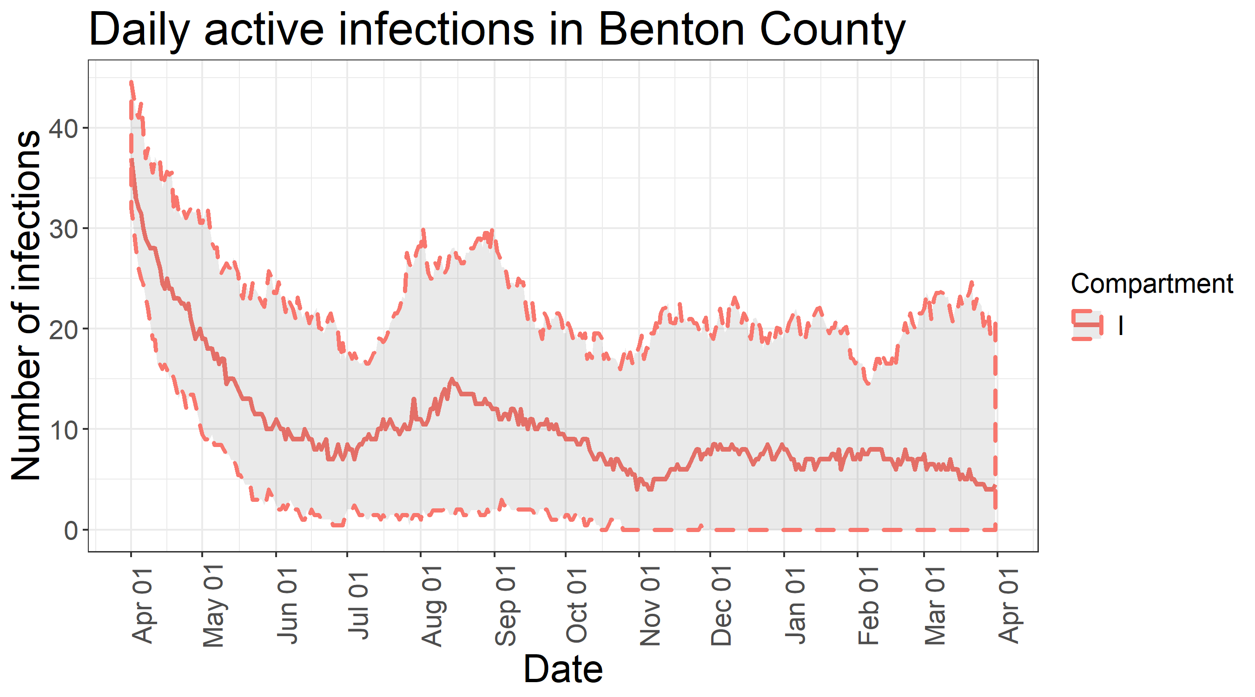
Projections of active COVID-19 infections under the baseline scenario

Slide 25
Baseline scenario - interpretations
The baseline scenario predicts a resurgence of COVID-19 cases that starts basically immediately after the current physical distancing policies are fully lifted.
Basically, the relaxation of physical distancing will allow COVID-19 to persist in the community and/or support new infections as they parachute in. The prevalence will begin to rise relatively quickly after the current physical distancing policies are completely lifted in July.
Under the assumption that physical distancing will be reimposed if more than 15 active cases exist, the epidemic growth will quickly be controlled once it recurs in July and August.
Under this scenario, this up-and-down wave will likely recur occasionally until global prevalence drops far enough to make parachuting extremely unlikely, or a vaccine is developed to reduce the number of susceptible below the threshold necessary to sustain a local epidemic.
Note: In this scenario, the waves are not dependent on returning students: the baseline scenario specifically excludes the return of students.

Slide 26
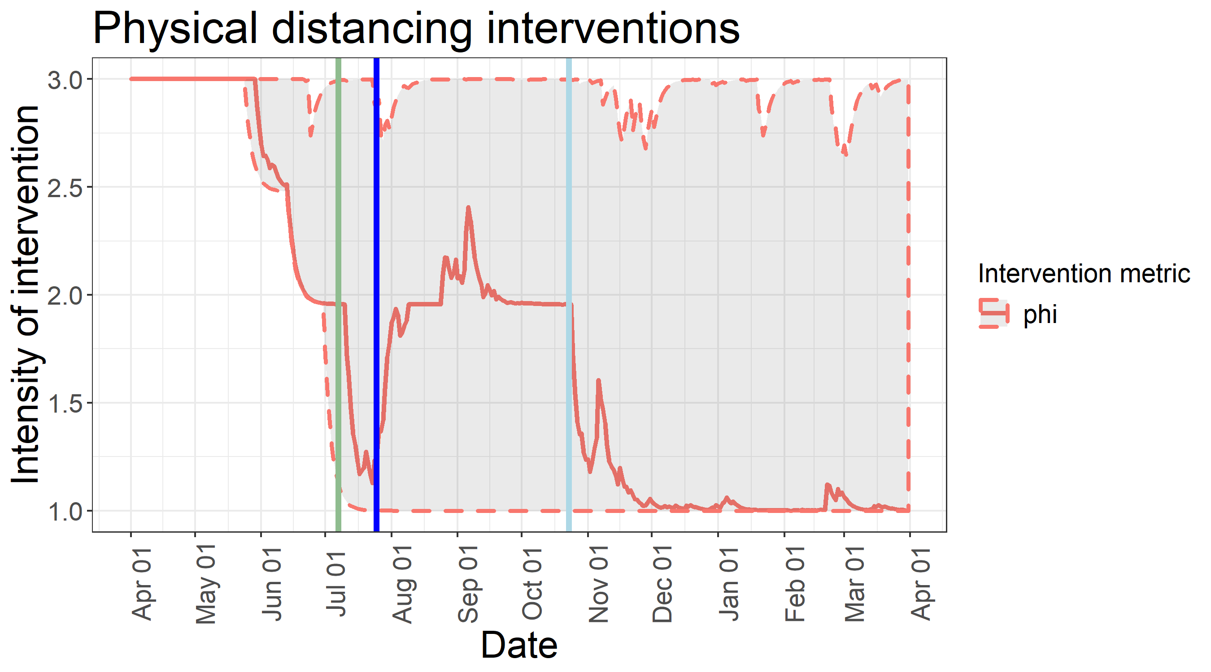
Baseline scenario – physical distancing policies
This graph visualizes physical distancing policies. At the beginning of the simulation, the current major physical distancing policies are in effect. They are fully removed on July 7th, (green line). In response to a growing number of cases, minor physical distancing is re-imposed on September 28th (blue line), then relaxed on October 23nd (light blue line). The jagged spikes are an artifact of the confidence intervals and can be ignored without losing the overall evolution of physical distancing.

Slide 27
Best Guess Scenario parameters (1). Changes from baseline are in Orange
Simulation |  | Population |  | Disease Dynamics
numTrials = 50 | 50 simulations | N = 500 | 500 distinct nodes | Beta = .1875 | Transmissibility
tSpan = 365 | One year trajectory | trialPop = 65,000 | Total population | Sigma = 1/4 | 1/(exposed period)
startOfSimDay = 04/01/2020 | Simulation starts on April 1st, 2020 | I0Pop = 40 | Initial number of infected | Gamma = 1/12 | 1/(infectious period)
 |  | maxINodeProp = 0.1 | Up to 50 nodes with an initial infected | Eta = .024 | Case fatality rate
Student arrival |  | trialPop/N = 130 | Approximately 130 individuals per node | Delta = 1/10 | Proportion of recovered who lose immunity
studentPop = 25,000 | Student population is 25,000 |  |  | Kappa = 1/100 | Reciprocal of temporary immunity period
studentReturnDate = 09/21/2020 | Students return around 9/21/2020 |  |  | Initial phi = 3 | Beta reduction factor (effective R0 = R0/3)
maxStudentNodes = 100 | Students distribute across 100 nodes |  |  | Season/cosAmp = .25 | Beta peaks 25% above average in February, dips 25% below in August.
sSProp = .9; sEProp = .0001; sIProp = .001; sRProp = .9*remaining; sImProp = .1*remaining |  | Most students are susceptible, with a few exposed, infected, and recovered/immune |  | BetaFactor in [.9,1.1] | Beta randomized between trials

Slide 28
Best Guess Scenario parameters (2). Same as baseline parameters (2)
Physical distancing |  | Parachuting events
maxPrev1 = 15 | If 15 or more people have an active infection, institute minor physical distancing | parachuteRate = 1/30 | 1 parachute event approximately every 30 days
maxPrev2 = 30 | If 30 or more people have an active infection, institute major physical distancing | parachuteNum = 1 | 1 infected individual in each parachute event
phiFactor1 --> R0 = 1.15 | Minor physical distancing reduces R0 to 1.15 | paraChi_df = 4 | More parachute events in months 2 through 7 then in other months
phiFactor2 --> R0 = .75 | Major physical distancing reduces R0 to .75 | Transfer events
upDelay = 7 | Takes 7 days to identify uptick in prevalence | transferRate = 1/7 | One transfer event approximately every 7 days
downDelay = 28 | Wait 28 days after prevalence drops before lifting a physical distancing policy | transferMinProp = .01 | At least 1% of population of node transfers every event
phiMovement = .25 | Moderate response to changes in physical distancing policies | transferMaxProp = .1 | At most 10% of population of node transfers every event
kbSwitch = 0 | Current (March 23rd) physical distancing in place at beginning of simulation | Phasing out current physical distancing
 |  | kbDay1, kbDay2, kbDay3 | 5/25/2020, 6/14/2020, 7/1/2020

Slide 29
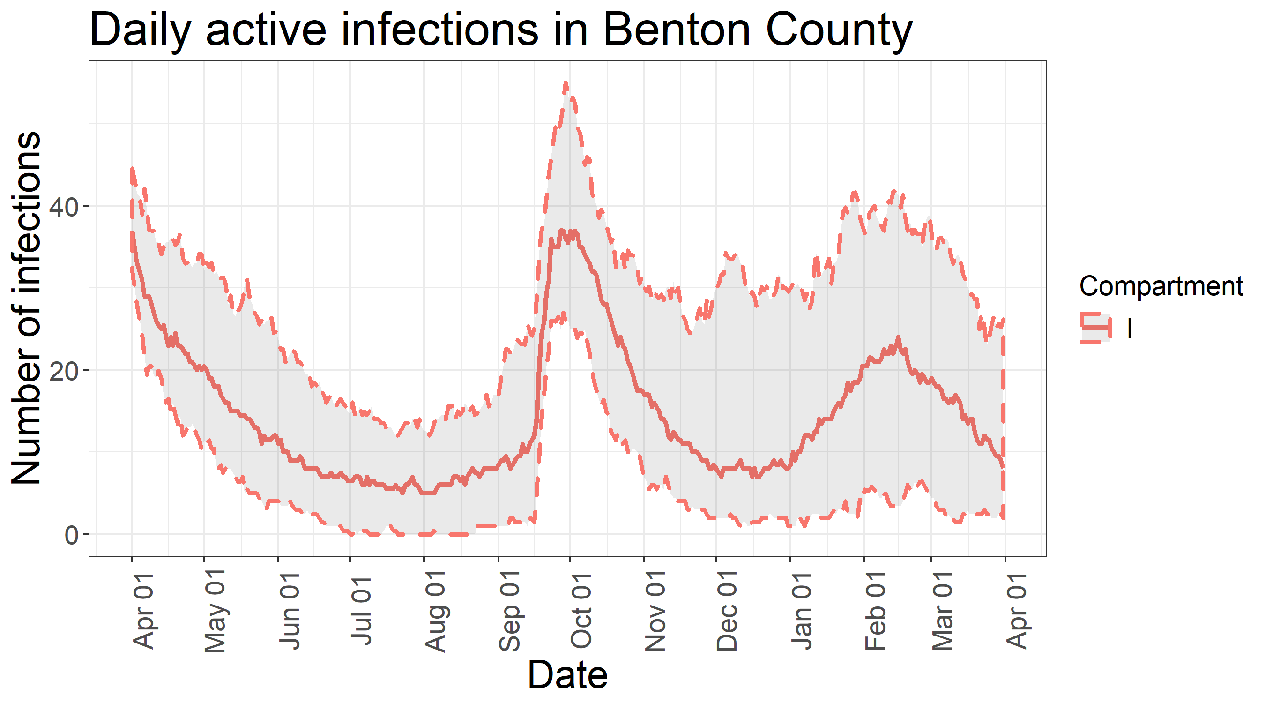
Projections of active COVID-19 infections under the best-guess scenario

Slide 30
Baseline scenario - interpretations
The best-guess scenario also predicts a resurgence of COVID-19 cases that starts basically immediately after the current physical distancing policies are fully lifted. However, this resurgence is hard to distinguish once the students return, bringing with them about 25 new cases of coronavirus.
The import of infected students immediately starts a strong physical distancing response, which is why there is a sharp peak followed by a drop-off from late September through December.
Physical distancing in this scenario would be lifted toward the end of November, leading to another increase in cases in January and February, followed again by more physical distancing.
Under this scenario, this up-and-down wave will likely recur occasionally until global prevalence drops far enough to make parachuting extremely unlikely, or a vaccine is developed to reduce the number of susceptible below the threshold necessary to sustain a local epidemic.

Slide 31
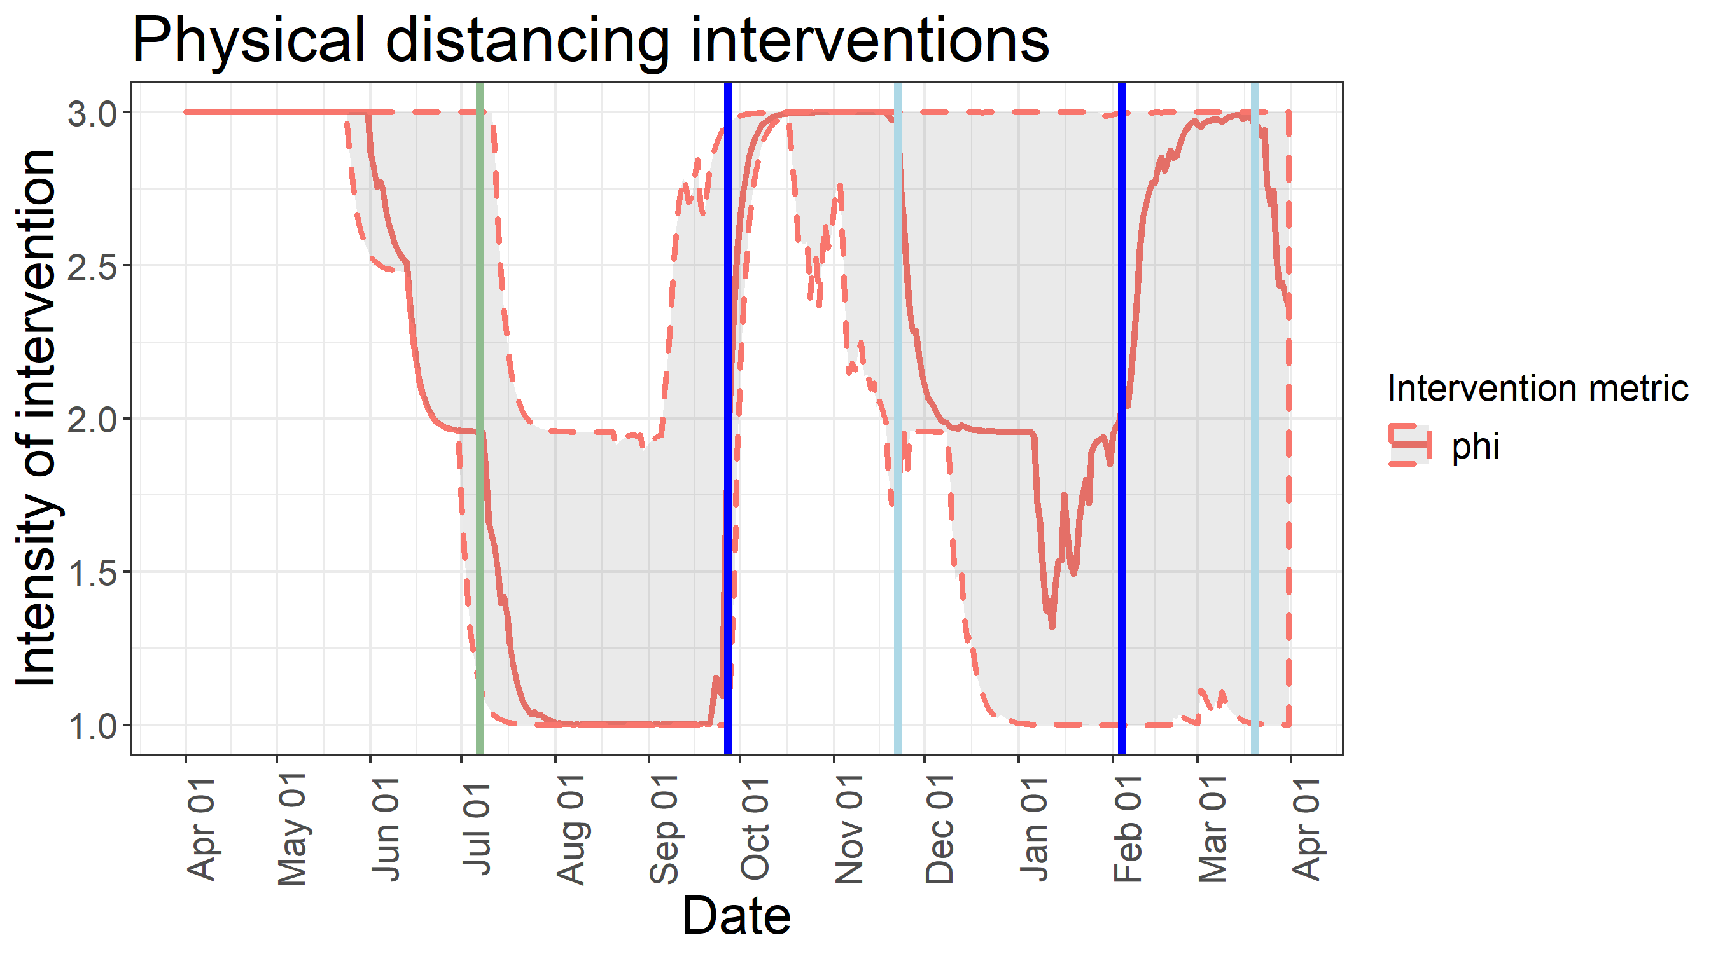
Best-guess scenario – physical distancing policies
This graph visualizes physical distancing policies. At the beginning of the simulation, the current major physical distancing policies are in effect. They are fully removed on July 7th, (green line). In response to the import of infected students in September, major physical distancing is re-imposed on September 28th (blue line), then moderately relaxed on November 22nd (light blue line). Epidemic growth causes the resumption of major physical distancing from February 2021 through April 2021.

Slide 32
Counterfactual Scenario parameters (1). Changes from baseline are in Orange
Simulation |  | Population |  | Disease Dynamics
numTrials = 50 | 50 simulations | N = 500 | 500 distinct nodes | Beta = .1875 | Transmissibility
tSpan = 365 | One year trajectory | trialPop = 65,000 | Total population | Sigma = 1/4 | 1/(exposed period)
startOfSimDay = 04/01/2020 | Simulation starts on April 1st, 2020 | I0Pop = 40 | Initial number of infected | Gamma = 1/12 | 1/(infectious period)
 |  | maxINodeProp = 0.1 | Up to 50 nodes with an initial infected | Eta = .024 | Case fatality rate
Student arrival |  | trialPop/N = 130 | Approximately 130 individuals per node | Delta = 1/10 | Proportion of recovered who lose immunity
studentPop = 25,000 | Student population is 25,000 |  |  | Kappa = 1/100 | Reciprocal of temporary immunity period
studentReturnDate = 09/21/2020 | Students return around 9/21/2020 |  |  | Initial phi = 3 | Beta reduction factor (effective R0 = R0/3)
maxStudentNodes = 100 | Students distribute across 100 nodes |  |  | Season/cosAmp = .25 | Beta peaks 25% above average in February, dips 25% below in August.
sSProp = .9; sEProp = .0001; sIProp = .001; sRProp = .9*remaining; sImProp = .1*remaining |  | Most students are susceptible, with a few exposed, infected, and recovered/immune |  | BetaFactor in [.9,1.1] | Beta randomized between trials

Slide 33
Counterfactual Scenario parameters (2). Changes from baseline are in Orange
Physical distancing |  | Parachuting events
maxPrev1 = 15 | If 15 or more people have an active infection, institute minor physical distancing | parachuteRate = 1/30 | 1 parachute event approximately every 30 days
maxPrev2 = 30 | If 30 or more people have an active infection, institute major physical distancing | parachuteNum = 1 | 1 infected individual in each parachute event
phiFactor1 --> R0 = 1.15 | Minor physical distancing reduces R0 to 1.15 | paraChi_df = 4 | More parachute events in months 2 through 7 then in other months
phiFactor2 --> R0 = .75 | Major physical distancing reduces R0 to .75 | Transfer events
upDelay = 7 | It takes 7 days to identify an uptick in prevalence | transferRate = 1/7 | One transfer event approximately every 7 days
downDelay = 28 | Wait 28 days after prevalence drops before lifting a physical distancing policy | transferMinProp = .01 | At least 1% of population of node transfers every event
phiMovement = .25 | Moderate response to changes in physical distancing policies | transferMaxProp = .1 | At most 10% of population of node transfers every event
kbSwitch = 0 | Current (March 23rd) physical distancing in place at beginning of simulation | Phasing out current physical distancing
 |  | kbDay1, kbDay2, kbDay3 | 5/25/2020, 6/14/2020, 7/1/2020
 |  | Beginning on July 1st, 2020, there will no longer be any physical distancing measures imposed whatsoever.

Slide 34
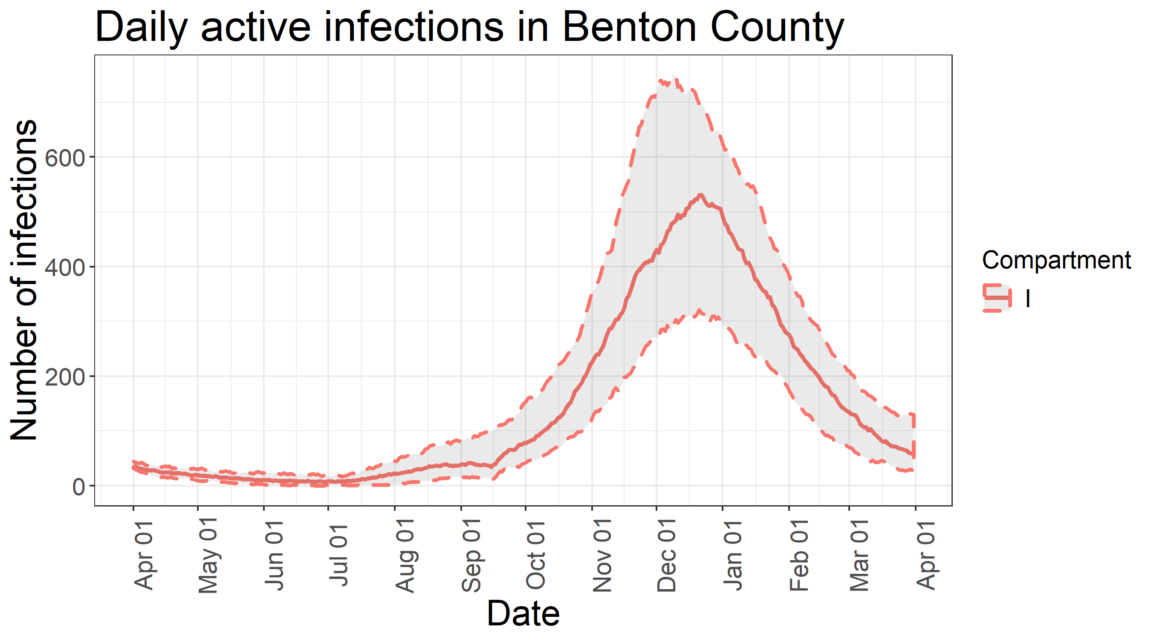
Projections of active COVID-19 infections under the best-guess scenario

Slide 35
Counterfactual scenario - interpretations
The counterfactual scenario predicts a resurgence of COVID-19 cases that starts basically immediately after the current physical distancing policies are fully lifted. Without physical distancing policies, the return of students would be a drop in the bucket as far as additional infections are concerned. The students would increase the susceptible population by about 22,000, but that doesn’t materially change the shape of the curve.
This model predicts that the epidemic would peak December 2020 – January 2021.
Under this counterfactual scenario, the epidemic would burn through Benton County in one wave, after which enough of the population would have been infected that the epidemic would die out.
Note:
Given the successful control of COVID-19 through physical distancing, enough susceptible people will remain in Benton County that this scenario is likely to play out if we ever stop using physical distancing to control the epidemic before the development and widespread use of an effective vaccine.

Slide 36
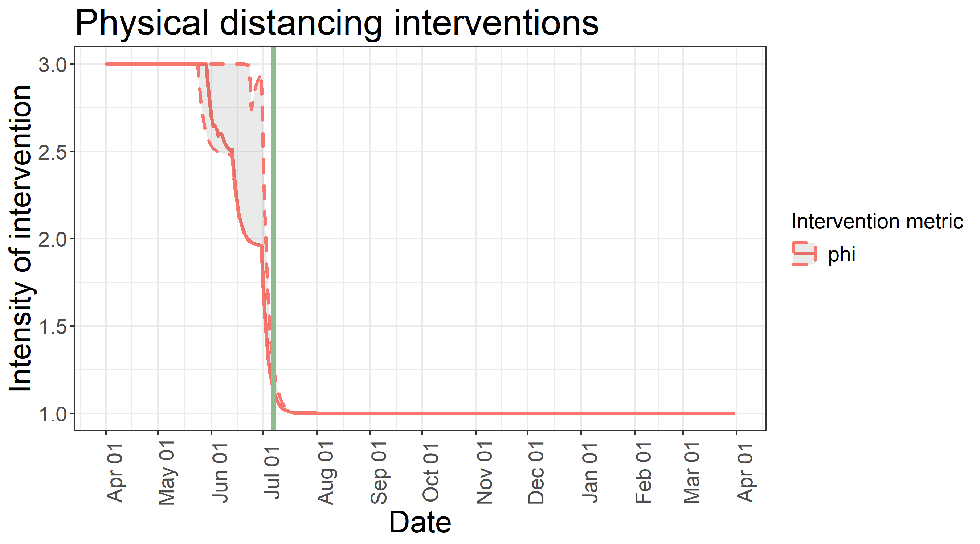
Counterfactual scenario – physical distancing policies
This graph visualizes physical distancing policies. At the beginning of the simulation, the current major physical distancing policies are in effect. They are fully removed on July 7th, (green line). Under this counterfactual scenario, no more physical distancing policies are used.

