Slide 1
COVID-19 modeling for Elementary Schools
Peter Banwarth
Public Health Data Scientist
Benton County Health Department

Slide 2
Background
As K-12 school districts prepare to resume operations in the fall, it is important to understand how COVID-19 may spread within school settings. These slides consider two dimensions of COVID-19 spread and possible resulting disease dynamics:
Classroom-to-Classroom Mixing and Interpersonal Interactions.
These models represent an archetypical elementary school. The scenarios do not show data from any actual school or district.

Slide 3
Basic parameters
School population: 450 students
Number of grades: 6 (K-5)
Students per classroom: 25
Length of simulation: September 1st 2020 through December 10th, 2020
The model runs 500 scenarios to generate a spread of possible disease trajectories.

Slide 4
Assumptions about disease spread and symptom monitoring
Assume that 1 to 4 infections are introduced at random points during Fall Term.
Assume that 50% of cases are symptomatic and that all of those cases are identified and isolated approximately 4 days after the case become infectious.
Assume that contact tracing identifies and isolates 50% of contacts of each case, so that any of these contacts who later become infectious are isolated before they become infectious. Think of this as daily temperature monitoring of all staff and students.

Slide 5
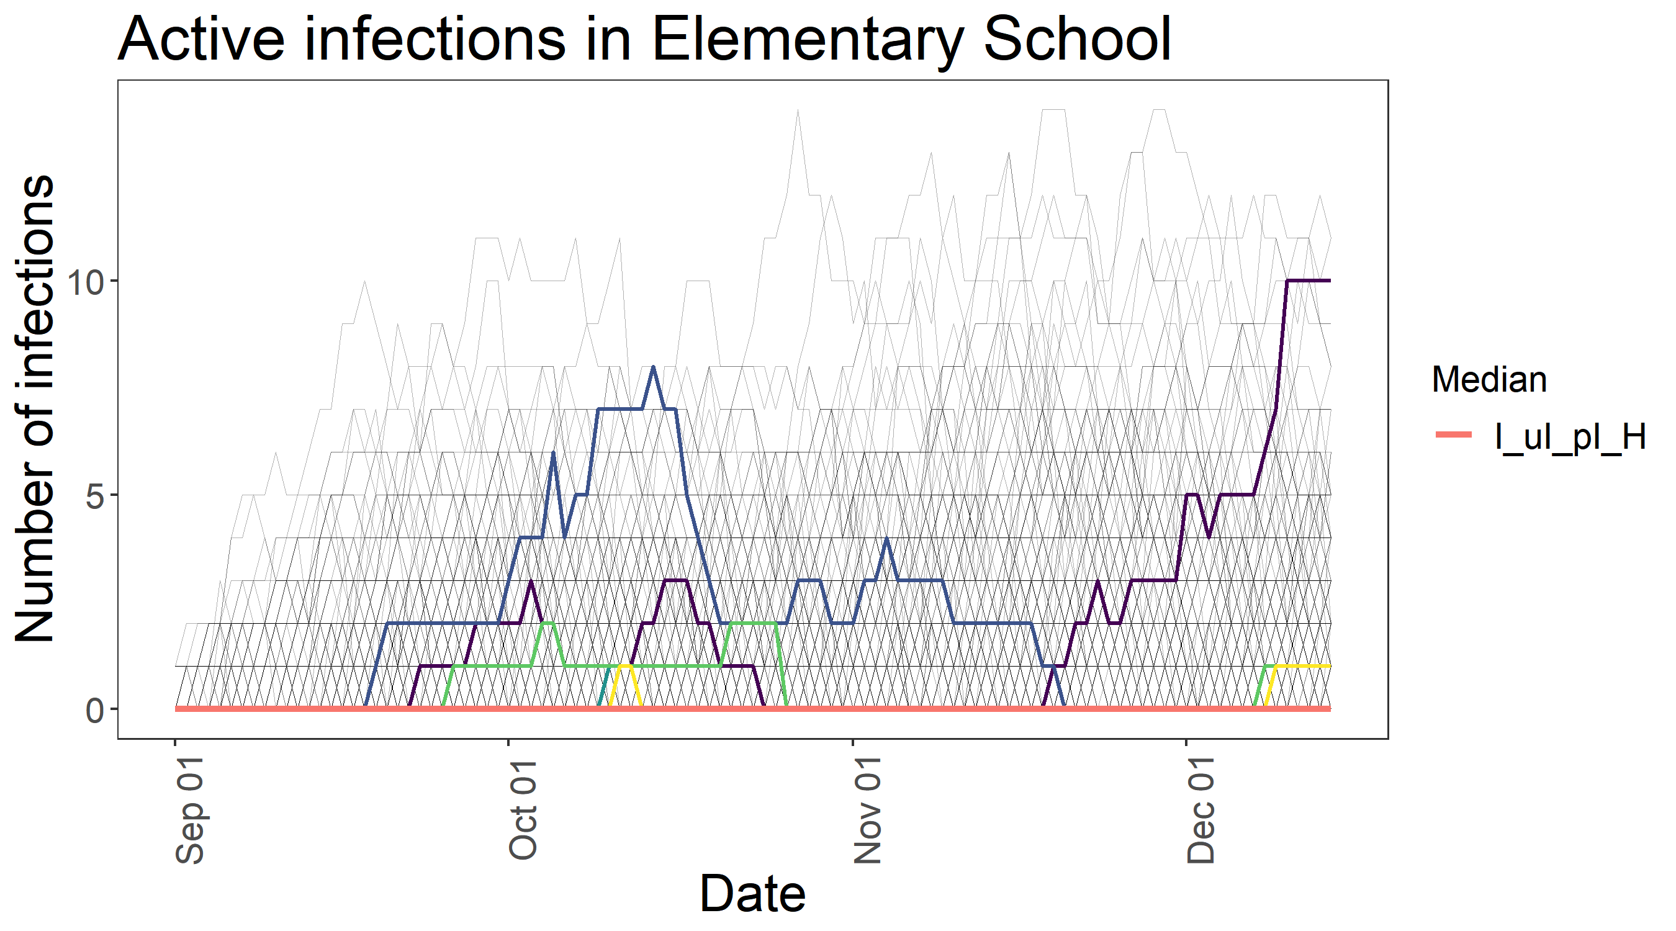
An example graph
The vertical axis of this graph shows daily total infections. It represents everyone among the 450 people who is currently infected with COVID-19. Not all of these people will be symptomatic. Included in this tally are people who are isolated and are not at risk of infecting others, as well as people who may be asymptomatic and are spreading the coronavirus without being aware of it.
The horizontal axis is the date. The time period for this simulation covers September 1st, 2020 through December 10th, 2020.
In order to demonstrate the great variability in possible trajectories, the graph shows all 500 simulations with light black lines. By looking at the overall picture, you see more than 5 active cases at a time is pretty rare.
In order to demonstrate some possible trajectories, 5 trajectories are chosen at random and are superimposed on the graph. You can see that some trajectories stay close to zero the entire time, while others experience 1 or more peaks as infections are (re)introduced.
The red line shows the median (average) of each simulation at each time point. In this scenario, more than half of all the simulations show 0 infections at any given time. However, this does not mean that more than half of the simulations are always zero.
Note: The vertical axis on the graph changes depending on the range of data. Do not directly compare the height of trajectories from one graph to another.
Low Mixing and Low Interactions; 450 people in the school, no initial infections, between 1 and 4 infections introduced at random times between 9/1/2020 and 12/10/2020. Low Mixing means all classrooms are isolated from each other and students do not mix between classrooms. Low Interactions can be interpreted as using face coverings, physical distancing, and many other infection prevention measures.

Slide 6
Dimensions of COVID-19 spread scenarios
These scenarios consider two dimensions of COVID-19 spread – how close interpersonal interactions are, and how much the classrooms mix with each other. |  | Mixing within school populations
 |  | Low mixing: All classrooms completely isolated from each other | Moderate mixing: All grades separated from each other; classrooms in the same grades mix, some mixing between grades | High mixing: K-2 and 3-5 mix evenly; some mixing between young and old.
Interpersonal interactions | Low interpersonal contact, e.g. face coverings at all times, six foot spacing at all times. | Low Mixing; Low Interactions | Moderate Mixing; Low Interactions | High Mixing; Low Interactions
 | Moderate interpersonal contact, e.g. six foot spacing, handwashing, no face coverings. | Moderate Mixing; Low Interactions | Moderate Mixing; Moderate Interactions | High Mixing; High Interactions
 | High interpersonal contact, e.g. no restrictions | Low Mixing; High Interactions | Moderate Mixing; High Interactions | High Mixing; High Interactions

Slide 7
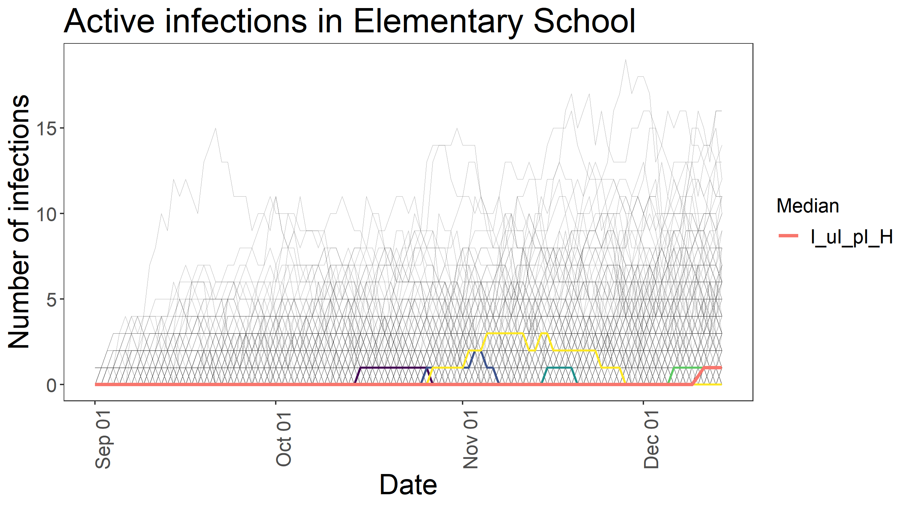
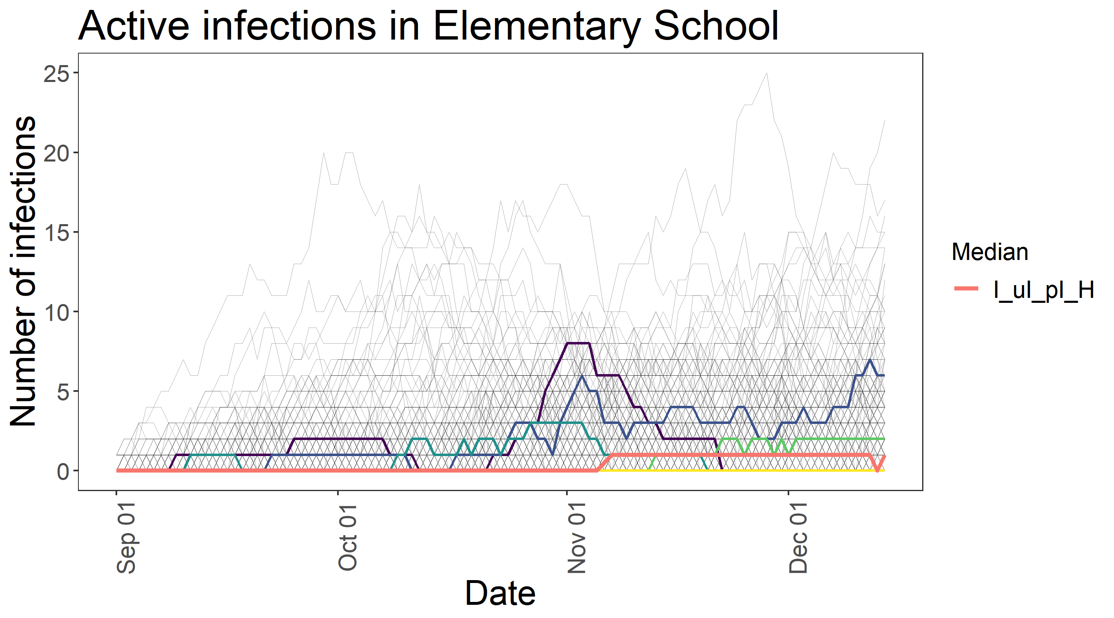
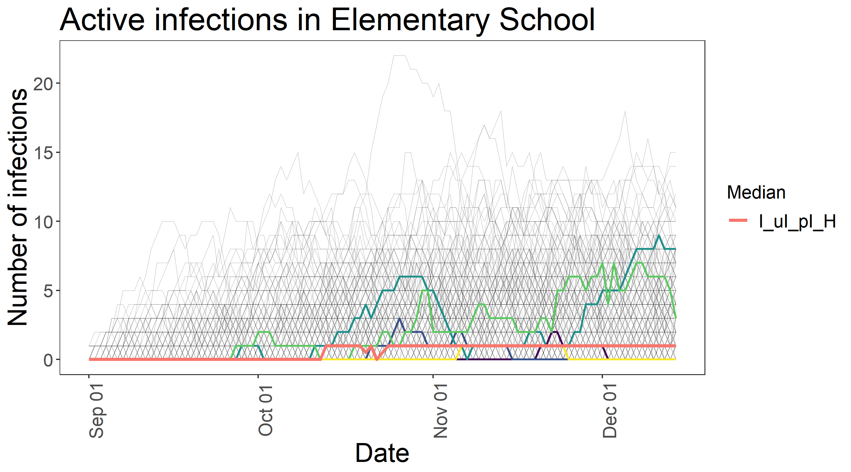
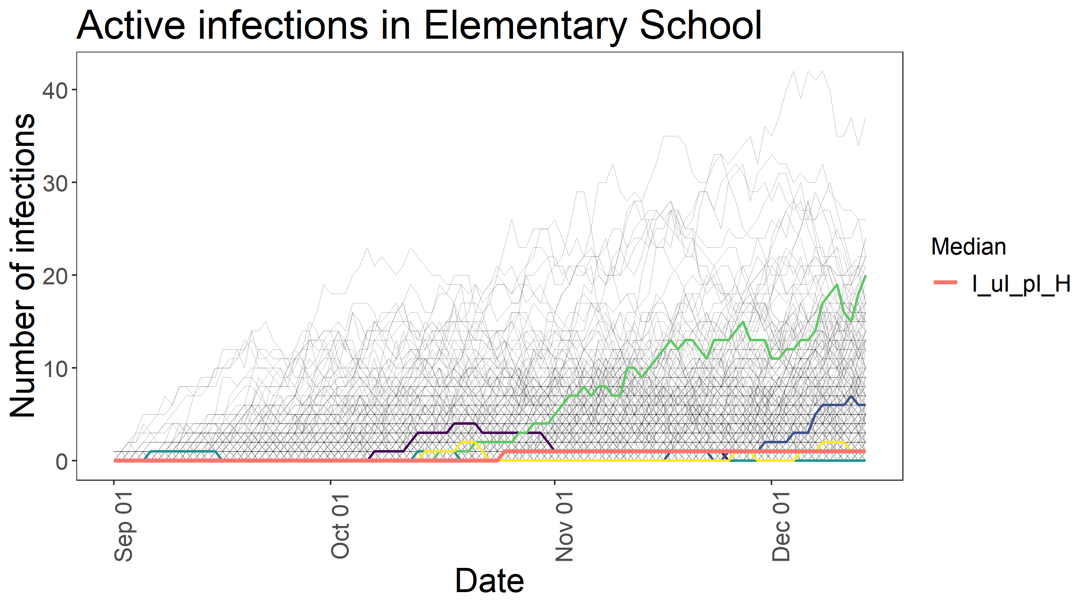
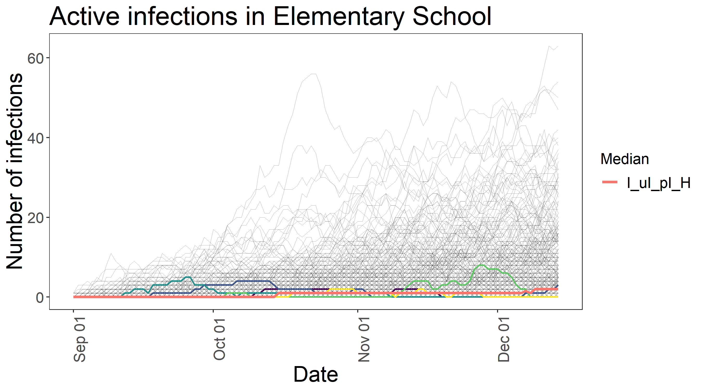
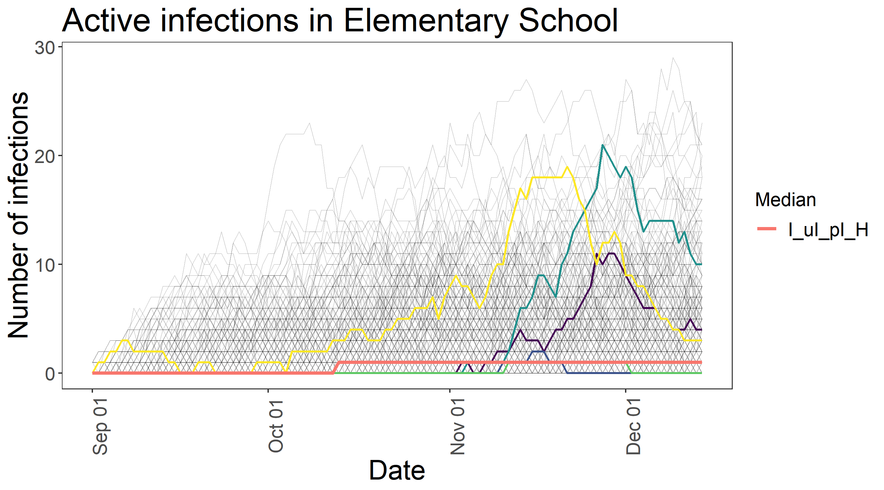
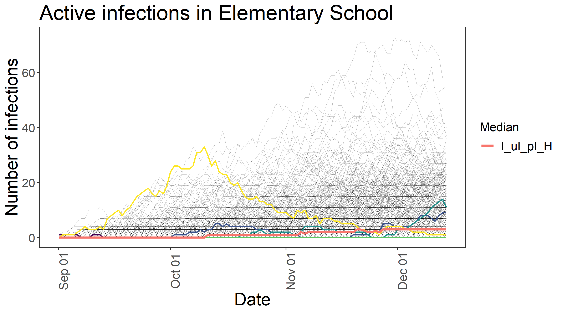
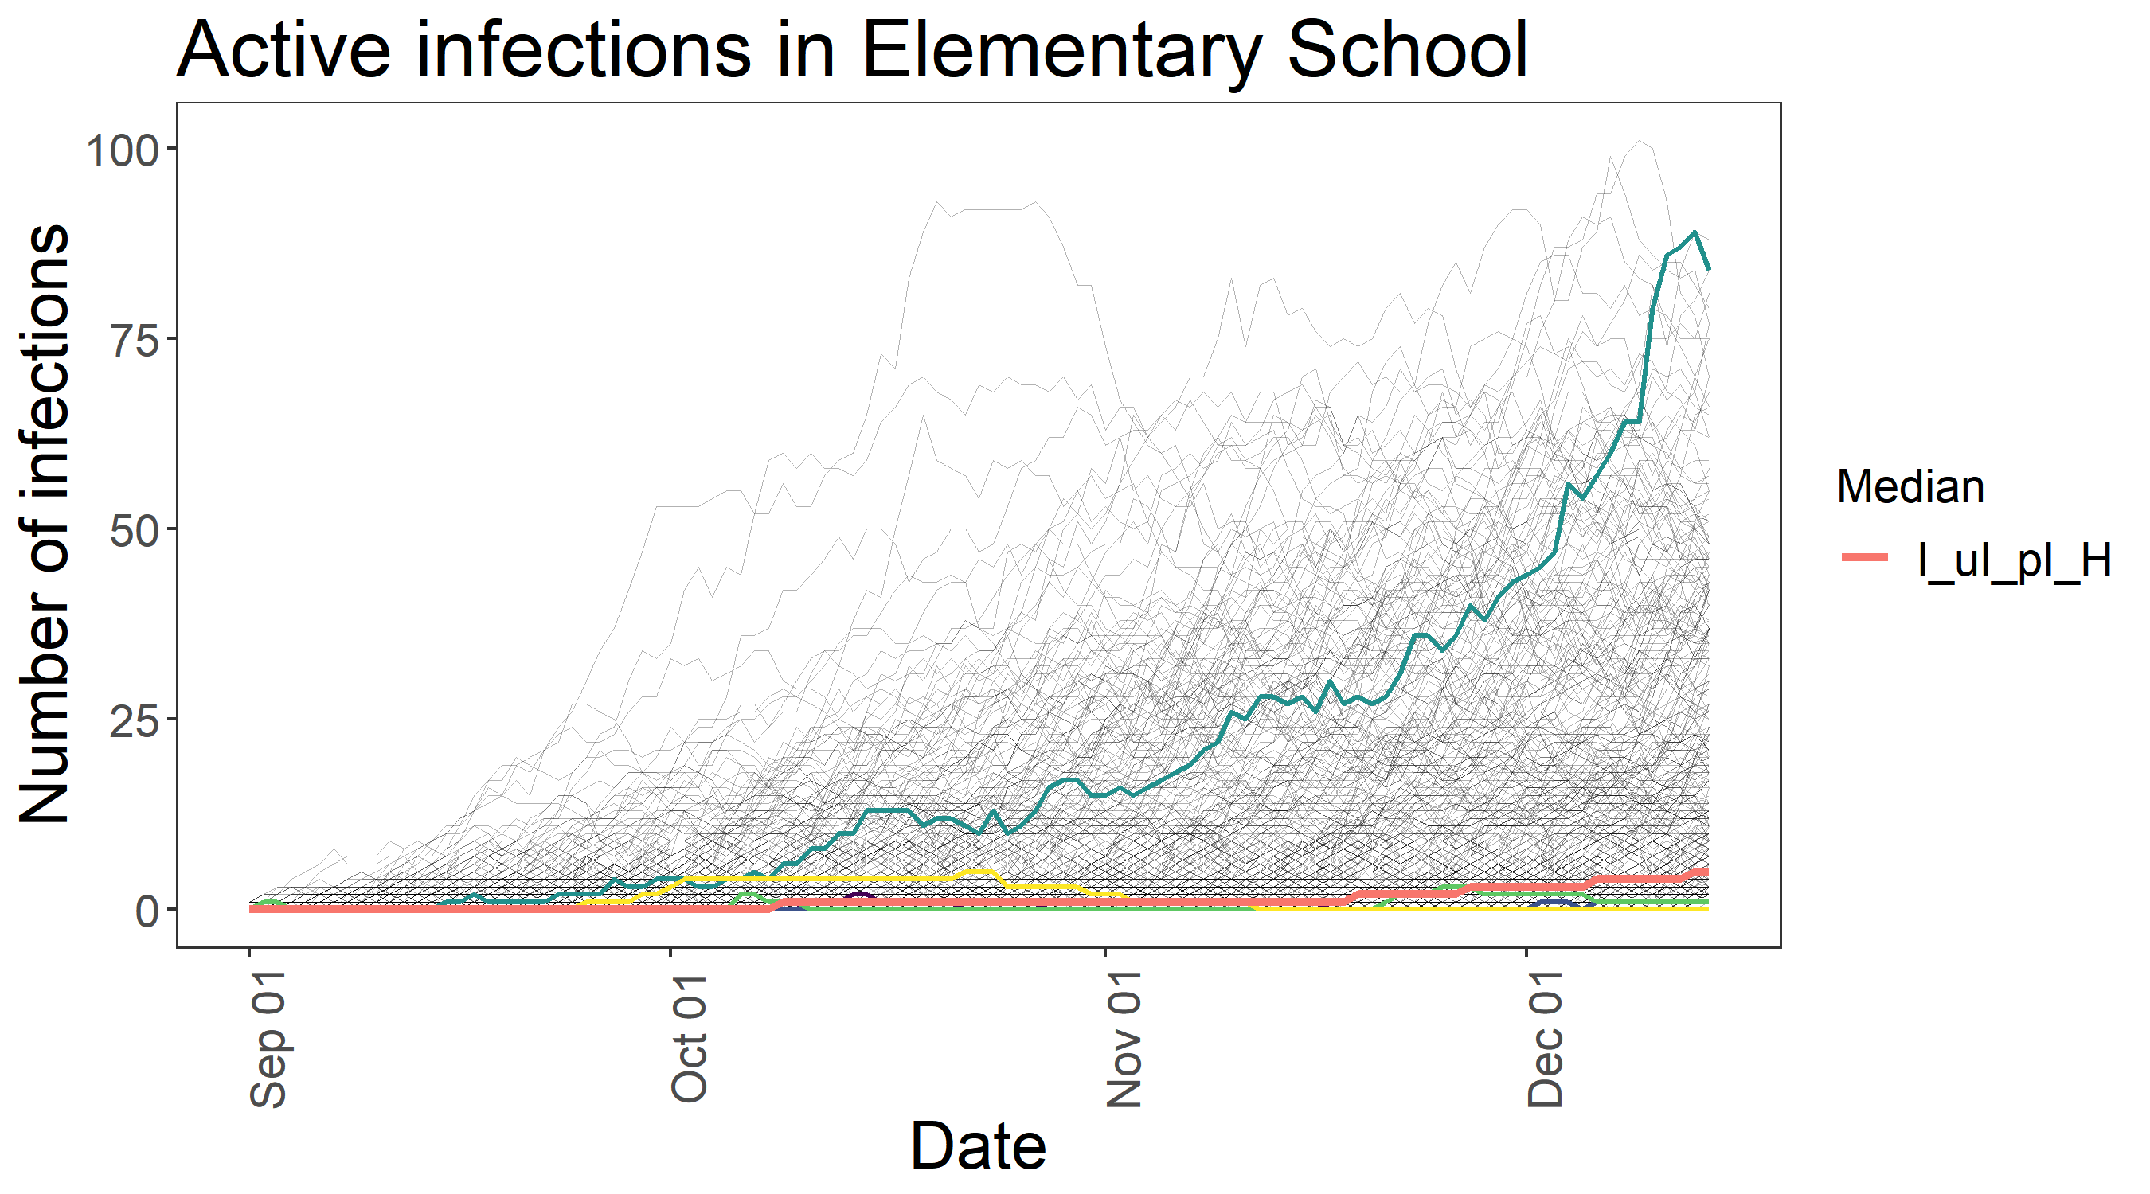

Slide 8
Summary
Reducing mixing and reducing interpersonal interactions are two ways to reduce the likelihood of COVID-19 spread in an elementary school. On the other hand, increased mixing leads to more sustained mini-outbreaks. Increased interpersonal interactions lead to stronger infection growth (higher peaks).
On average, introduced infections are quickly controlled; no simulation produced more than about 12 infections at one time. | More sustained mini-outbreaks. | High mixing led to sustained mini-outbreaks, and somewhat higher case numbers. Some scenarios peaked at around 20 infections, other scenarios showed positive infection totals for more than two months.
Stronger growth in infections. | Some scenarios show strong, sustained growth of outbreaks, others dwindle quickly. In general, infection rates grow as fall term progresses, with many scenarios ranging between 10 and 20 infections. | Sustained mini-outbreaks, stronger growth in infections.
Increased interpersonal interactions led to strong growth when an infection was introduced, with some scenarios indicating whole classrooms could be at risk. | Strong growth in infections, more sustained mini-outbreaks.
Many simulations show the school experiencing between 30 and 100 cases at a time. By the end of the fall term, more than half of the
simulations have an ongoing outbreak
of six infections or more.

Slide 9
Contact for more information
Peter Banwarth
Benton County Public Health
peter.banwarth@co.Benton.or.us
https://github.com/banwarp/benton_epi/tree/master/covid19

Slide 10
All nine graphs: Low Mixing, Low Interactions

Slide 11
All nine graphs: Low Mixing, Moderate Interactions

Slide 12
All nine graphs: Low Mixing, High Interactions

Slide 13
All nine graphs: Moderate Mixing, Low Interactions

Slide 14
All nine graphs: Moderate Mixing, Moderate Interactions

Slide 15
All nine graphs: Moderate Mixing, High Interactions

Slide 16
All nine graphs: High Mixing, Low Interactions

Slide 17
All nine graphs: High Mixing, Moderate Interactions

Slide 18
All nine graphs: High Mixing, High Interactions

