Slide 1
Lessons from GTFS
How do we make a de facto standard?

Slide 2
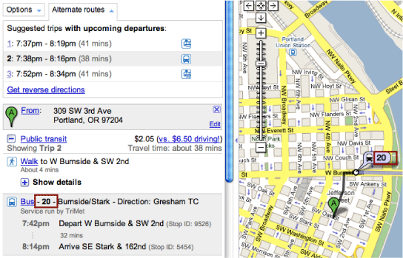
Pre-specification - clear use cases
Originally, GTFS = Google Transit

Slide 3
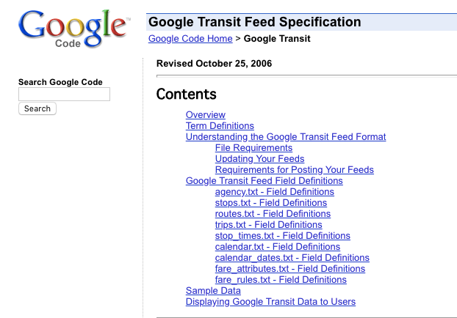
2. Development of the specification
Originally, GTFS = Google Transit

Slide 4
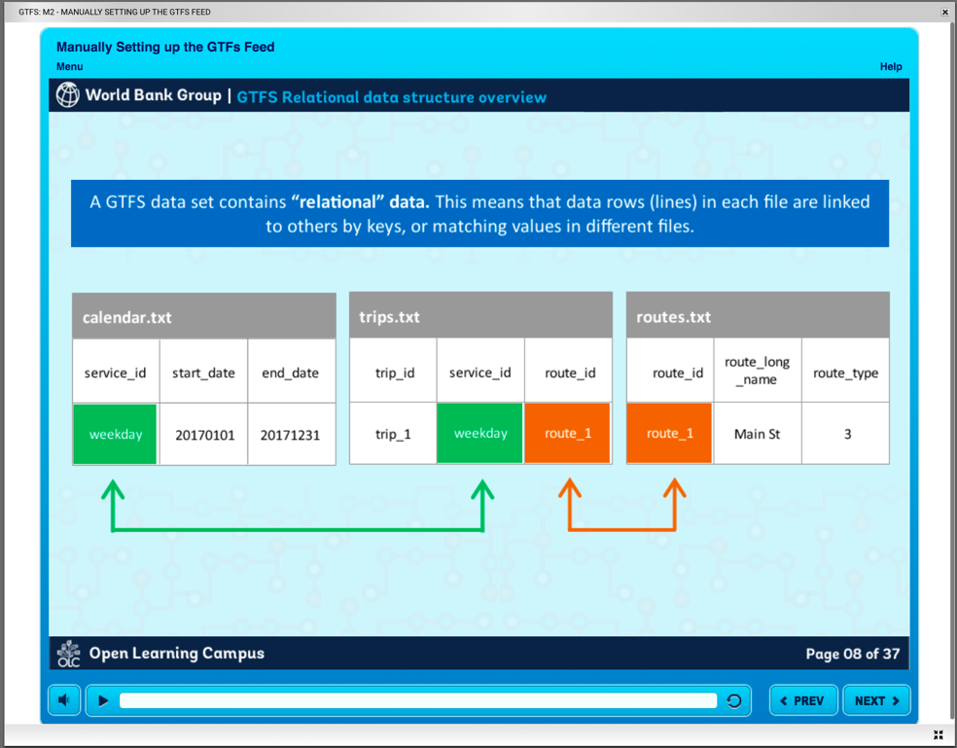
3. Provide training resources - see bit.ly/gtfs-examples

Slide 5
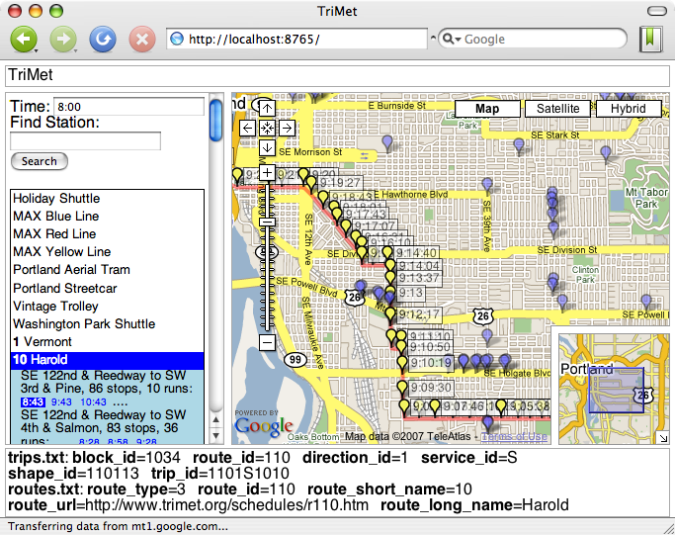
4. Validation tools (e.g. FeedValidator and schedule_viewer)

Slide 6
4. Validation tools (e.g. FeedValidator and schedule_viewer)

Slide 7
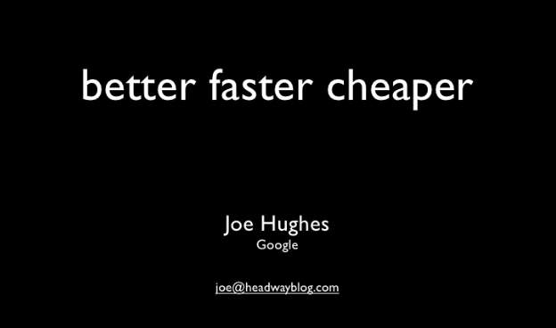
5. Encouraging adoption

Slide 8
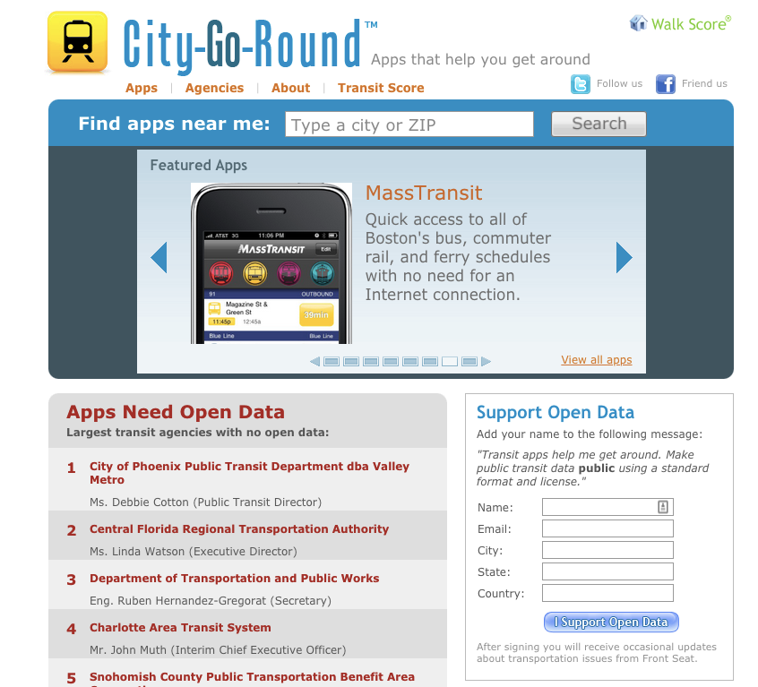

Slide 9
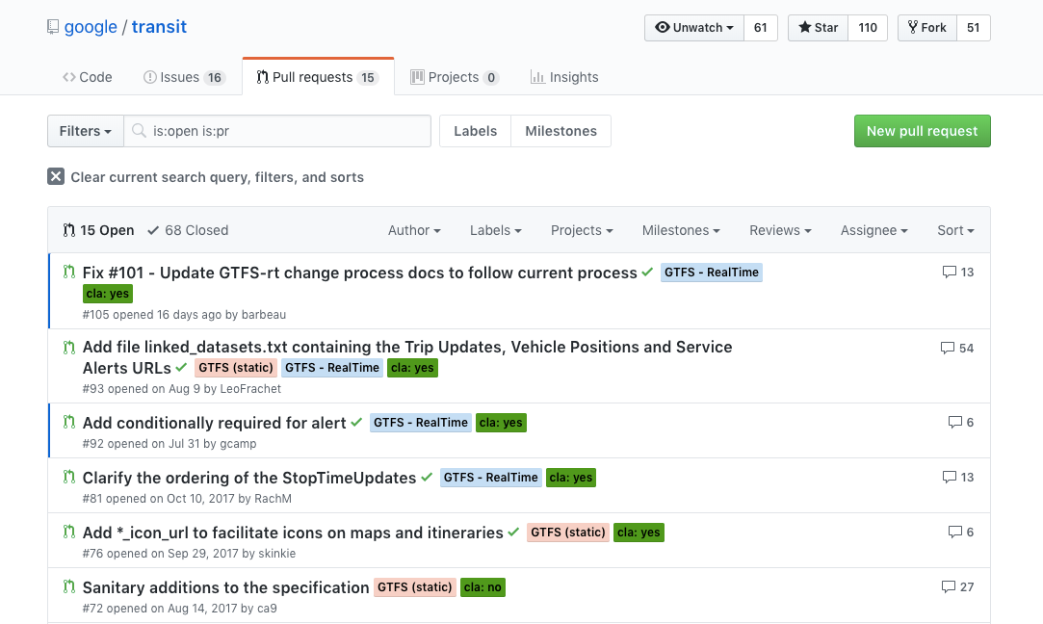
6. Experimentation, practice observation
7. Ongoing development

Slide 10
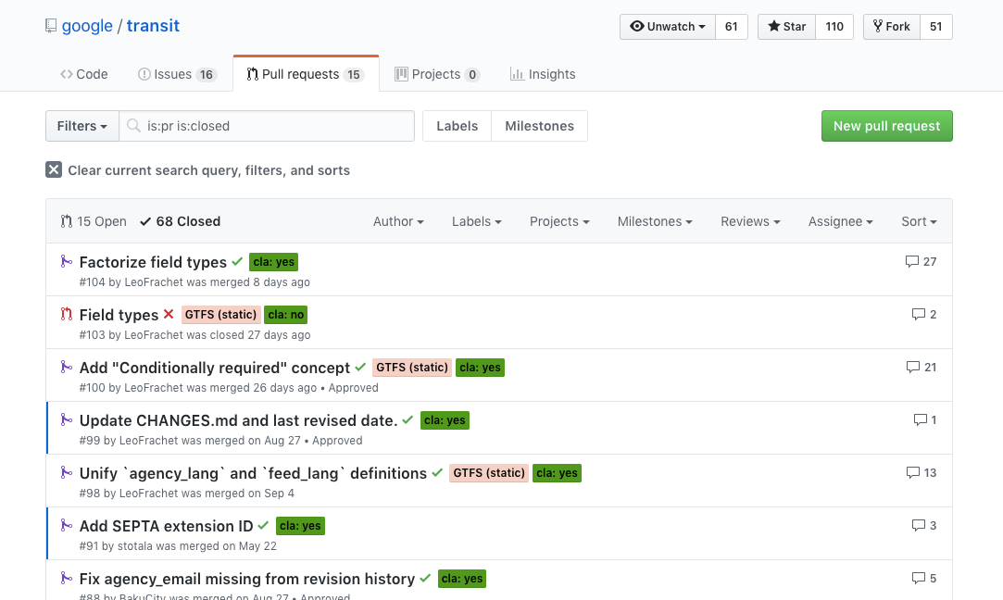
6. Experimentation, practice observation
7. Ongoing development

