Slide 1
GTFS-ride: The First Standard for Transit Ridership Data
Oregon Department of Transportation¹, Oregon State University², COGITO Partners³
Matthew Barnes¹, Josh Roll¹
Dr. J. David Porter², Phillip Carleton², Chris Watchie³

Slide 2
Meeting Outline
Meeting 3 Protocol
Project and Attendee Introductions
Project Updates and Discussion
Zephyr Foundation Presentation
Plans for Future of GTFS-ride
Group Interaction, Feedback, and Insights

Slide 3
Interactive Meeting Protocols
2/1/2019

Slide 4
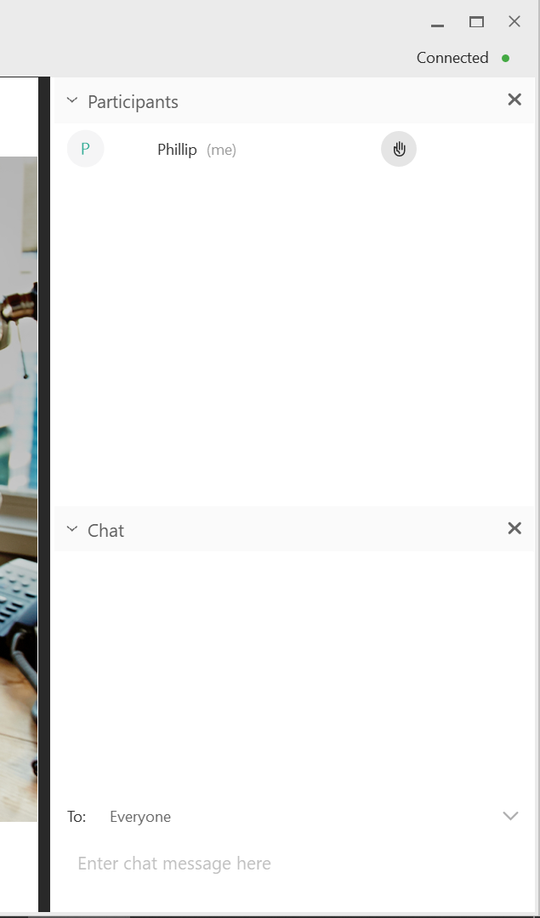
Suggestions for Interaction
A combined Q & A will take place at the end of all presentations
You may submit questions and comments in writing in the chat dialogue box (with option to be seen by “everyone”) during the presentation
Questions and comments will be addressed at the end of the presentation to allow time for all presenters
Notes:
Content from CW version of this slide:
“This will be confirmed during our dry run of presentation.
To make a comment or question,
please use the X function.
All questions and comments will be
addressed during the meeting or in
the summary report.
“
This needs to be updated once we do the dry run - CW

Slide 5
Project and Consortium Group Members
2/1/2019

Slide 6
Introductions
Oregon Department of Transportation (ODOT)
Matthew Barnes, Transit Network Coordinator
Josh Roll, Research Coordinator
Oregon State University (OSU)
Dr. J. David Porter, Professor
Phillip Carleton, Graduate Student
COGITO Partners
Chris Watchie, Principal (Meeting Facilitator)
Zephyr Foundation
Clint Daniels (RSG), Board Representative
Notes:
“aaron@trilliumtransit.com'" <aaron@trilliumtransit.com>, "'Andrew.Martin@ltd.org'" <Andrew.Martin@ltd.org>, BARNES Matthew M <Matthew.M.BARNES@odot.state.or.us>, "'carletop@oregonstate.edu'" <carletop@oregonstate.edu>, "'charlie@remix.com'" <charlie@remix.com>, "'chris@cogitopartners.com'" <chris@cogitopartners.com>, "'cpangilinan@transitcenter.org'" <cpangilinan@transitcenter.org>, "'David.Porter@oregonstate.edu'" <David.Porter@oregonstate.edu>, "'DBarker@mbta.com'" <DBarker@mbta.com>, "'DPilant@tillamookbus.com'" <DPilant@tillamookbus.com>, "'easall@gmail.com'" <easall@gmail.com>, "'fieldsbe@oregonstate.edu'" <fieldsbe@oregonstate.edu>, "'gabriel@korbato.com'" <gabriel@korbato.com>, "'GilligaM@trimet.org'" <GilligaM@trimet.org>, "'hooversy@oregonstate.edu'" <hooversy@oregonstate.edu>, "'jay@korbato.com'" <jay@korbato.com>, "'john.levin@metrotransit.org'" <john.levin@metrotransit.org>, "'jonny@goswift.ly'" <jonny@goswift.ly>, "'jsullivan@rvtd.org'" <jsullivan@rvtd.org>, "'lreed@conveyal.com'" <lreed@conveyal.com>, "'maddie@goswift.ly'" <maddie@goswift.ly>, "'mike.kowalski@fuse.net'" <mike.kowalski@fuse.net>, "'mike@goswift.ly'" <mike@goswift.ly>, "'mindy.montgomery@moovel.com'" <mindy.montgomery@moovel.com>, "'nick.fischer@utatransit.net'" <nick.fischer@utatransit.net>, "'ritesh.warade@ibigroup.com'" <ritesh.warade@ibigroup.com>, "'satinder.bhalla@transsight.com'" <satinder.bhalla@transsight.com>, "'schancey@co.josephine.or.us'" <schancey@co.josephine.or.us>, "'tkowalski@fuse.net'" <tkowalski@fuse.net>, "'tyler.gislason@tripspark.com'" <tyler.gislason@tripspark.com> “ -CW

Slide 7
Introductions
Please introduce yourself in the chat box!
Name, Title, Organization, Email Address

Slide 8
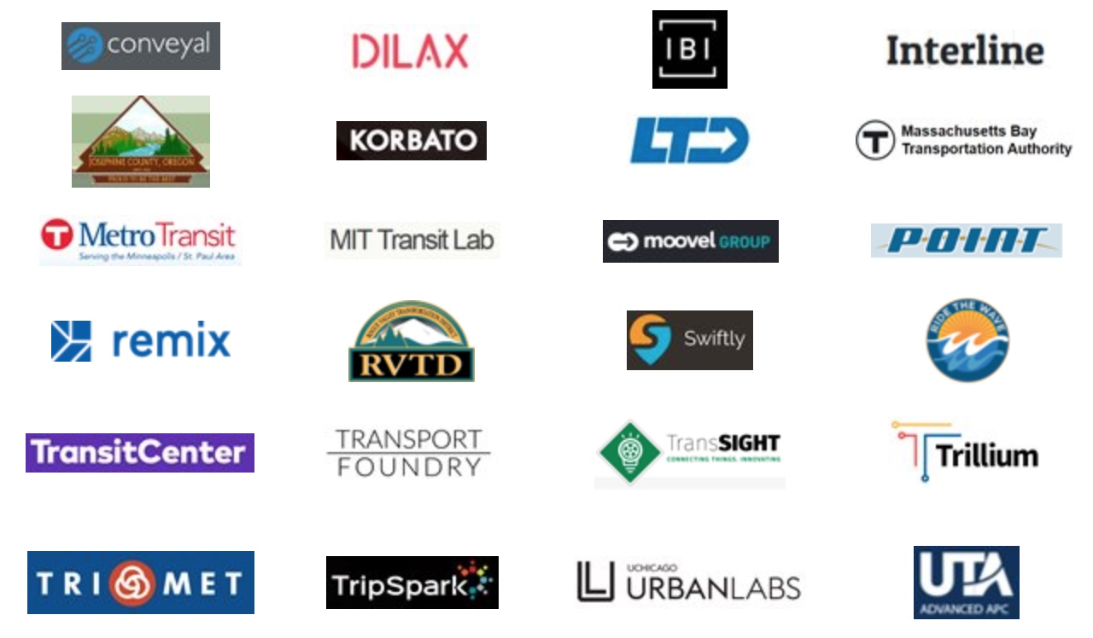
Consortium Group Members

Slide 9
Consortium Group – Roles Recap
Provide your time and commitment for three meetings to
Suggest adjustments and actions
Steer the development
Review of transit agencies input
Come well prepared to all meetings
Notes:
“From the intro email:
Look at the GTFS-ride data standard and suggest adjustments that will both meet your possible future needs and provide value to other GTFS-ride users.
Suggest actions that will help us move GTFS-ride from a data format to a data standard.
Help steer the development of a simple suite of open source software tools to support use of the data standard.
Review of transit agencies input on pilot use of GTFS-ride and suggested changes to data standard.
Note to group: how much time 10-15 hrs. total? “ - CW

Slide 10
Project Updates and Discussion
2/1/2019

Slide 11
GTFS-ride Project Recap
Project impetus and goals
Research methodology
GTFS-ride initial release and iterative feedback
Software tool development, redesign, and enhancement
Dataset conversion piloting
Dissemination and promotion efforts

Slide 12
GTFS-ride Promotion Activities
Conference Presentations
Past
Oregon Public Transportation Conference
Bend, OR – October
CALACT Technology & Shared Mobility Conference
Napa, CA – November
Transportation Research Board Annual Meeting
Washington, D.C. – January
- Zephyr Foundation Reception
- TIDES Project Meeting
Upcoming
Institute of Industrial and Systems Engineers Annual Conference
Orlando, FL – May (https://www.iise.org/Annual/)

Slide 13
GTFS-ride Promotion Activities
TRR publication
Manuscript about the development of GTFS-ride and case studies was accepted for publication on 1/31/2019
Possible membership on TIDES TCPR panel
Project G-18: Improving Access and Management of Transit ITS Data
Presentations/Discussions with DOTs
Google group/GitHub discussions
Draft final project report submitted to ODOT

Slide 14
Future Funding Opportunities
ODOT STIF grant
https://www.oregon.gov/odot/rptd/pages/stif.aspx
PacTrans Tech Transfer Funds
http://depts.washington.edu/pactrans/partnerships/technology-transfer/
TRB’s Transit IDEA program
http://www.trb.org/IDEAProgram/IDEATransit.aspx

Slide 15
Zephyr Foundation Presentation

Slide 16
Open Discussion and Q & A
2/1/2019

Slide 17
Technical Discussion Topics 1
Potential to fully implement GTFS-ride at early adopter agency and vendor pair
Potential for GTFS-ride in creating better transit demand models and near-term prediction of loads
Potential for GTFS-ride to simplify reporting to NTD
Potential integration and synergies with other standards (e.g., GTFS-Realtime, -Flex, -Retro, -Plus, -Vehicles, MDS, GBFS, etc.)

Slide 18
Technical Discussion Topics 2
Need to define the versioning and publishing frequency of GTFS for purposes of linking historical ridership in GTFS-ride
The need or desire for GTFS-ride to be able to represent summary data and statistics in addition to collected counts
UK’s decision to move away from GTFS (http://netex-cen.eu/)

Slide 19
Project Future Topics
Need to define tasks and scope at Zephyr for 2019 to ensure active project progression
Opportunities for pooled funds for strategic partnerships and to mitigate risks
Opportunities to work with MPOs, DOTs, and federal agencies (FTA, NTD, etc.) to promote the use of GTFS-ride (e.g., OMX format and MDS at LADOT) more strongly
Need to keep stakeholders and interested groups and individuals informed
Interest from consortium members to join Zephyr working group and take active role in the future of GTFS-ride

Slide 20

Thank You!
Additional questions or comments can be directed to:
Dr. J. David Porter
David.Porter@oregonstate.edu
For more information please visit www.gtfs-ride.org

