Slide 1
GTFS-ride: The First Standard for Transit Ridership Data
Oregon Department of Transportation¹, Oregon State University², COGITO Partners³
Matthew Barnes¹, Josh Roll¹
Dr. J. David Porter², Phillip Carleton², Sylvan Hoover², Ben Fields²
Chris Watchie³

Slide 2
Meeting Outline
Interactive Meeting Protocol
Project and Consortium Group Members
Project Members’ Roles and Responsibilities
Project Background
Live Software Demo
Plans for Progress and Future Meetings
Group Interaction, Feedback, and Insights

Slide 3
Interactive Meeting Protocols
6/27/2018

Slide 4
Suggestions for Interaction
Submit questions and comments in writing in the chat dialogue box (with option to be seen by “everyone”) during the presentation
Questions and comments will be addressed
Please wait for your name to be called upon to interact
Notes:
Content from CW version of this slide:
“This will be confirmed during our dry run of presentation.
To make a comment or question,
please use the X function.
All questions and comments will be
addressed during the meeting or in
the summary report.
“
This needs to be updated once we do the dry run - CW

Slide 5
Consortium Group – Roles & Responsibilities
Provide your time and commitment for three meetings to
Suggest adjustments and actions
Steer the development
Review of transit agencies input
Come well prepared to all meetings
Notes:
“From the intro email:
Look at the GTFS-ride data standard and suggest adjustments that will both meet your possible future needs and provide value to other GTFS-ride users.
Suggest actions that will help us move GTFS-ride from a data format to a data standard.
Help steer the development of a simple suite of open source software tools to support use of the data standard.
Review of transit agencies input on pilot use of GTFS-ride and suggested changes to data standard.
Note to group: how much time 10-15 hrs total? “ - CW

Slide 6
Project and Consortium Group Members
6/27/2018

Slide 7
Project Team Members
Oregon Department of Transportation (ODOT)
Matthew Barnes, Transit Network Coordinator
Josh Roll, Research Coordinator
Oregon State University (OSU)
Dr. J. David Porter, Professor
Phillip Carleton, Graduate Student
Sylvan Hoover, Graduate Student
Ben Fields, Graduate Student
COGITO Partners
Chris Watchie, Principal (Meeting Facilitator)
Notes:
“aaron@trilliumtransit.com'" <aaron@trilliumtransit.com>, "'Andrew.Martin@ltd.org'" <Andrew.Martin@ltd.org>, BARNES Matthew M <Matthew.M.BARNES@odot.state.or.us>, "'carletop@oregonstate.edu'" <carletop@oregonstate.edu>, "'charlie@remix.com'" <charlie@remix.com>, "'chris@cogitopartners.com'" <chris@cogitopartners.com>, "'cpangilinan@transitcenter.org'" <cpangilinan@transitcenter.org>, "'David.Porter@oregonstate.edu'" <David.Porter@oregonstate.edu>, "'DBarker@mbta.com'" <DBarker@mbta.com>, "'DPilant@tillamookbus.com'" <DPilant@tillamookbus.com>, "'easall@gmail.com'" <easall@gmail.com>, "'fieldsbe@oregonstate.edu'" <fieldsbe@oregonstate.edu>, "'gabriel@korbato.com'" <gabriel@korbato.com>, "'GilligaM@trimet.org'" <GilligaM@trimet.org>, "'hooversy@oregonstate.edu'" <hooversy@oregonstate.edu>, "'jay@korbato.com'" <jay@korbato.com>, "'john.levin@metrotransit.org'" <john.levin@metrotransit.org>, "'jonny@goswift.ly'" <jonny@goswift.ly>, "'jsullivan@rvtd.org'" <jsullivan@rvtd.org>, "'lreed@conveyal.com'" <lreed@conveyal.com>, "'maddie@goswift.ly'" <maddie@goswift.ly>, "'mike.kowalski@fuse.net'" <mike.kowalski@fuse.net>, "'mike@goswift.ly'" <mike@goswift.ly>, "'mindy.montgomery@moovel.com'" <mindy.montgomery@moovel.com>, "'nick.fischer@utatransit.net'" <nick.fischer@utatransit.net>, "'ritesh.warade@ibigroup.com'" <ritesh.warade@ibigroup.com>, "'satinder.bhalla@transsight.com'" <satinder.bhalla@transsight.com>, "'schancey@co.josephine.or.us'" <schancey@co.josephine.or.us>, "'tkowalski@fuse.net'" <tkowalski@fuse.net>, "'tyler.gislason@tripspark.com'" <tyler.gislason@tripspark.com> “ -CW

Slide 8
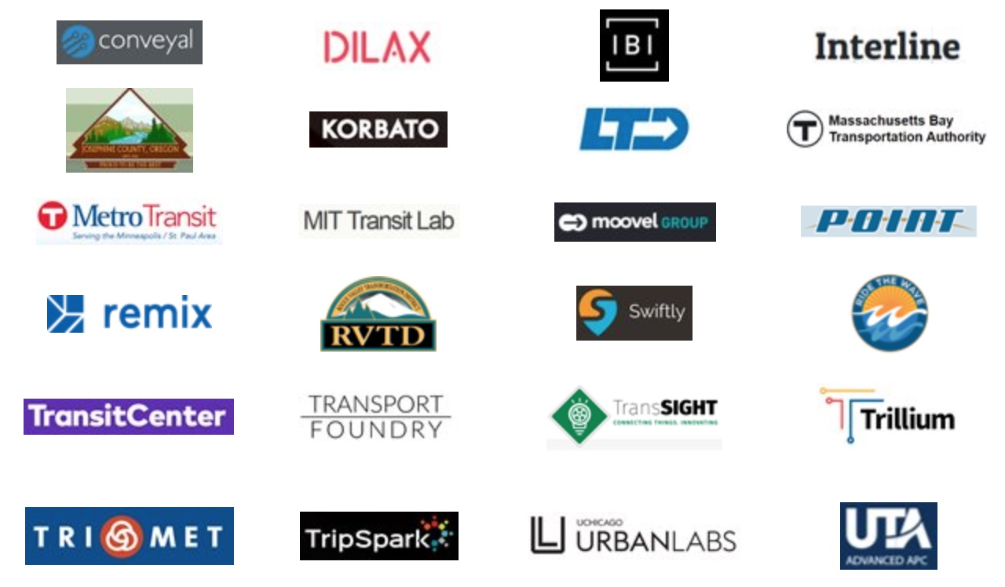
Consortium Group Members

Slide 9
Roles and Responsibilities of Project Members
6/27/2018

Slide 10
ODOT / OSU – Roles & Responsibilities
ODOT
Strategic vision
Project management
Funded first phase of project
Federal Highway Administration
Funding current project phase via a State Transportation Innovation Councils (STIC) grant
OSU
Conduct project work tasks
Maintain open dialogue with consortium group
Implement agreed-upon consortium group recommendations
Communicate project progress and challenges
Notes:
Please add to this. - CW
I’ve added the items under OSU – PC

Slide 11
Project Background
6/27/2018

Slide 12
Motivation and Goals
Need
The Oregon Department of Transportation (ODOT) desires consistent, high-quality statewide ridership data to:
Better inform analyses and funding decisions
Avoid inefficiency in each agency creating own systems
Reduce friction from lack of standardization
Challenge
Many problems with available ridership data across the state
Goals
Create a public transit ridership data standard
GTFS-ride
Develop software tools to support the new standard
Promote the adoption and use of the standard
Notes:
“Slide(s) could be revised to reflect:
History bullet points
Purpose/Motivation
Key Players
Overall Project Goals” - CW

Slide 13
Methodology
State-of-Art Review
State-of-Practice Review
Development of GTFS-ride
Functional Requirements
Draft Design
Iterative Stakeholder Review and Update
Stakeholder-Based Evolution
Software Support Tool Development
GTFS-ride Initial Release
Partner Agencies to Pilot Adoption

Slide 14
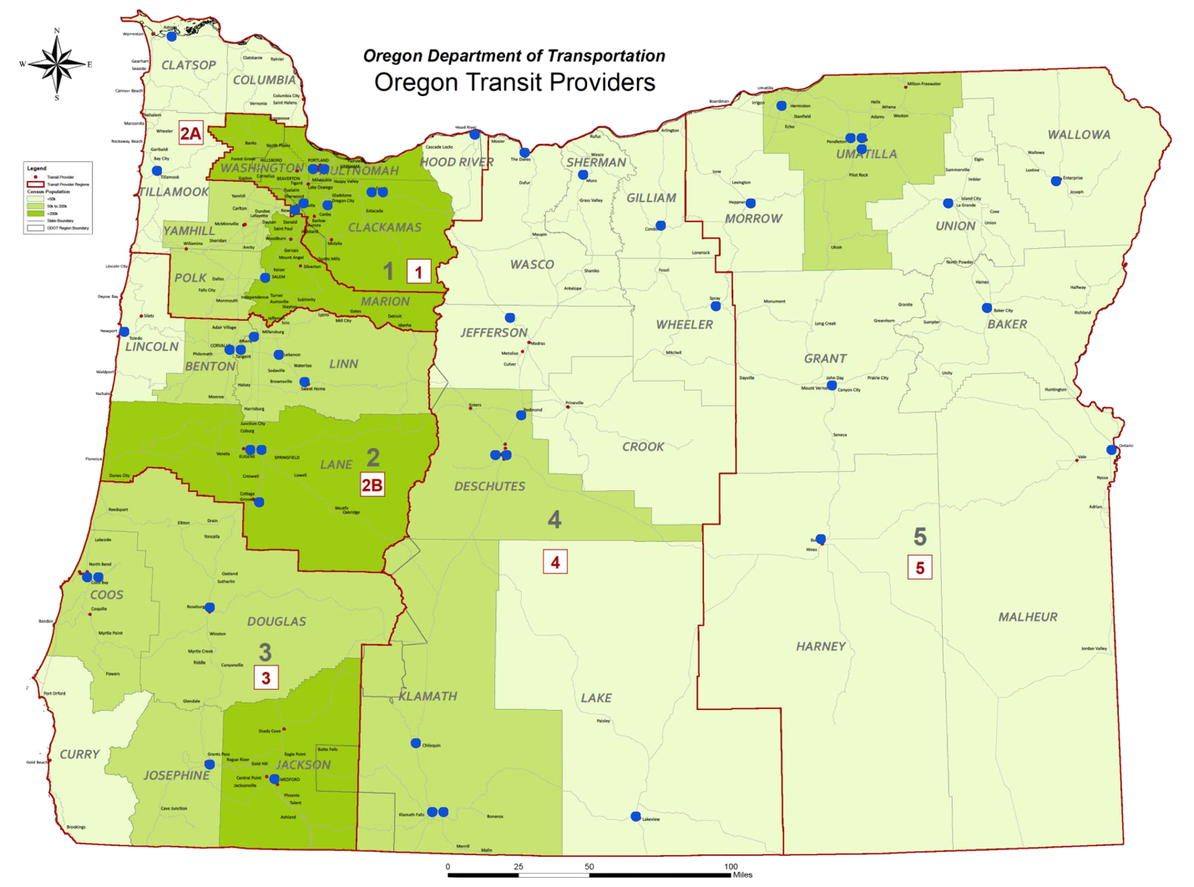
Questionnaire Participants
Out-of-State Respondents
Blacksburg Transit (VA)
RTC of Southern Nevada
San Diego Metropolitan Transit System
King County Metro (Seattle, WA)
Community Transit (Snohomish County, WA)
Transport for London

Slide 15
State-of-Practice Summary
Limited adoption of automated collection
Cost is main barrier to automation adoption
Also, limited analysis of ridership at smaller agencies
Automation increases resolution of data
Most agencies consider unaggregated/ processed data unacceptable for distribution
Methods of Data Collection – Transit Agencies/Services in Oregon

Slide 16
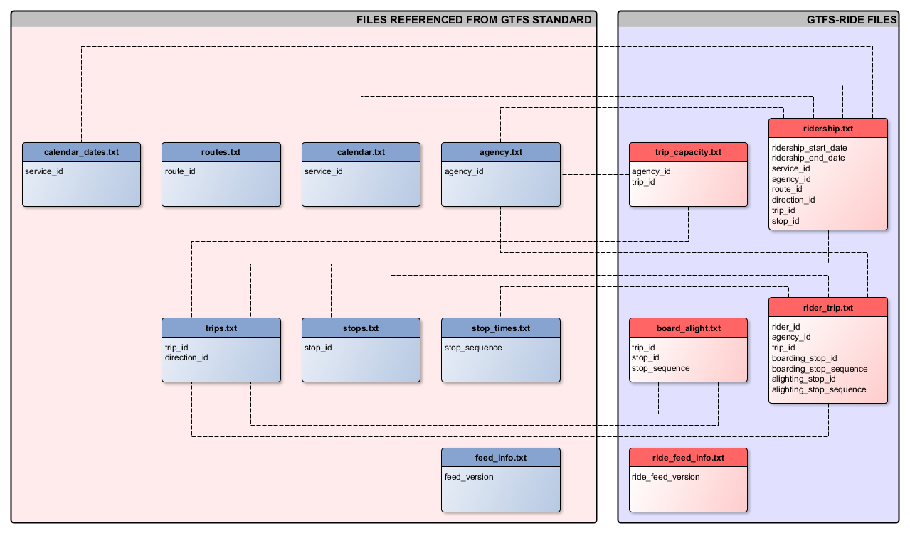
GTFS-ride Initial Release

Slide 17
GTFS-ride Files and Functions
board_alight.txt
Two uses: (1) record individual stop visit data, (2) record augmentations to GTFS service
Used by larger and/or technologically capable agencies
Will facilitate detailed analysis
rider_trip.txt
Contains data for a specific rider and trip instance
Used by agencies with automated fare collection
Can be used to link origin/destination pairs
Can allow demographic and fare analyses
ride_feed_info.txt
Corollary to GTFS file feed_info.txt
For versioning and setting active date ranges
Only explicitly required file
Field to indicate files containing ridership
ridership.txt
Predominate file for ridership data
Can accommodate many aggregation levels and temporal ranges
Can be used by agencies of all sizes and capabilities
trip_capacity.txt
Location to store information on vehicle capacities
Will allow for utilization analyses when paired with ridership data

Slide 18
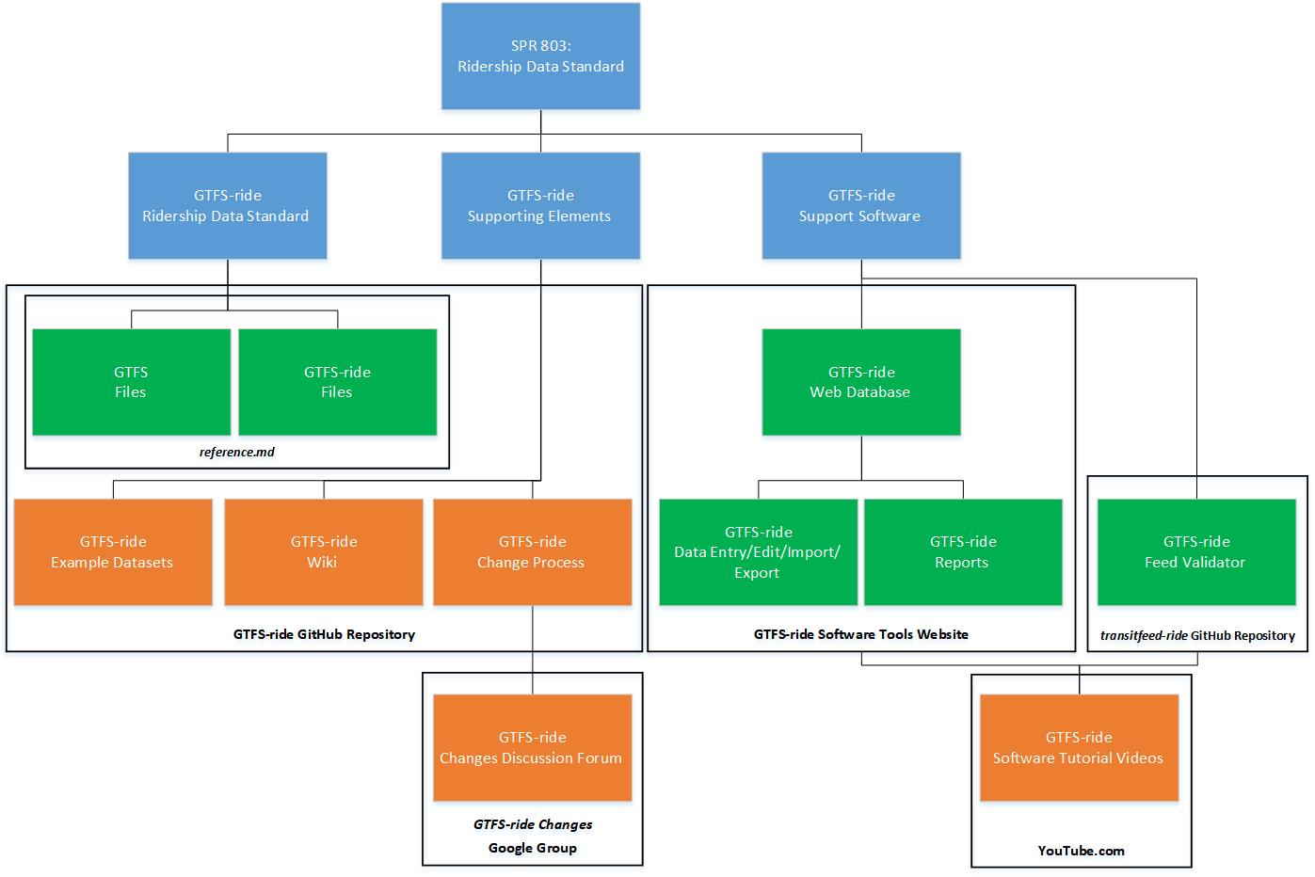
GTFS-ride Project Elements
GTFS-ride.org

Slide 19
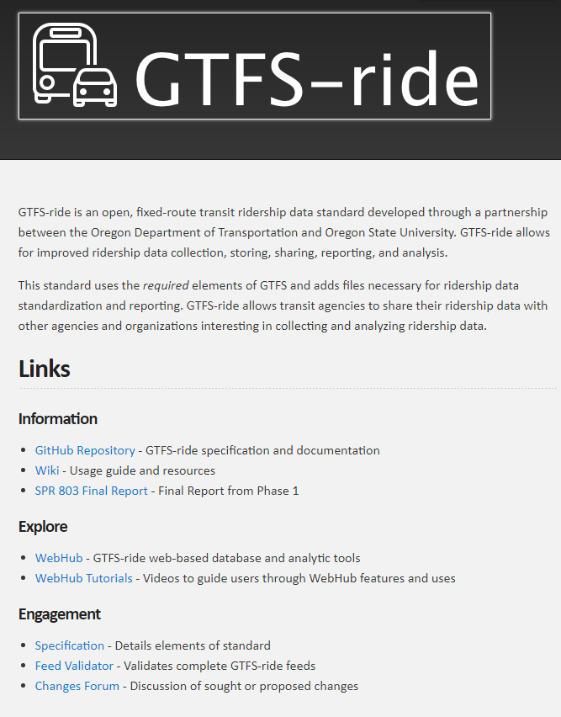
GTFS-ride.org

Slide 20
Current Activities
Closer agency engagement to better understand GTFS-ride implementation process and challenges
Raw data regularly requires inferences and tailored processing to reach compliance
Raw data often not reliable
Most currently do some ridership analysis, but would like to do more
Strong agency desire for value proposition before full adoption
Need any new processes to not add significant additional burdens on resources

Slide 21
Current Activities (cont.)
Software vendor engagement to facilitate integration and use of standard
Varying levels of readiness and interest for implementation in existing products
Increasing availability of ridership data from non-traditional collection methods (e.g., location and time data from app usage on mobile devices)
Also need clear understanding of value proposition and evidences of desire for GTFS-ride support from their customers

Slide 22
Data Issues
Availability
Variable in resolution levels and collection frequencies
Quality
May have errors or suspect entries
Consistency
May have temporal gaps, e.g., breakdowns, non-routine collection
Disconnect with GTFS elements
May not be able to associate ridership
Completeness
Problems with availability, quality, consistency, and associativity all contribute to incomplete datasets
Standardization
Every scenario is unique
Can preclude generalized solutions procedures
Notes:
Consistency e.g., - Some have counts of 0 for boardings and/or alightings for certain entries and not value for other entries. -PC

Slide 23
Consortium Group Input
Why are you interested in ridership data standards and GTFS-ride?
Notes:
Prompt for adoption incentives - CW

Slide 24
Consortium Group Input
If you have reviewed the GTFS-ride data format, do you see any fundamental problems with its approach?
Notes:
Prompt for adoption incentives - CW

Slide 25
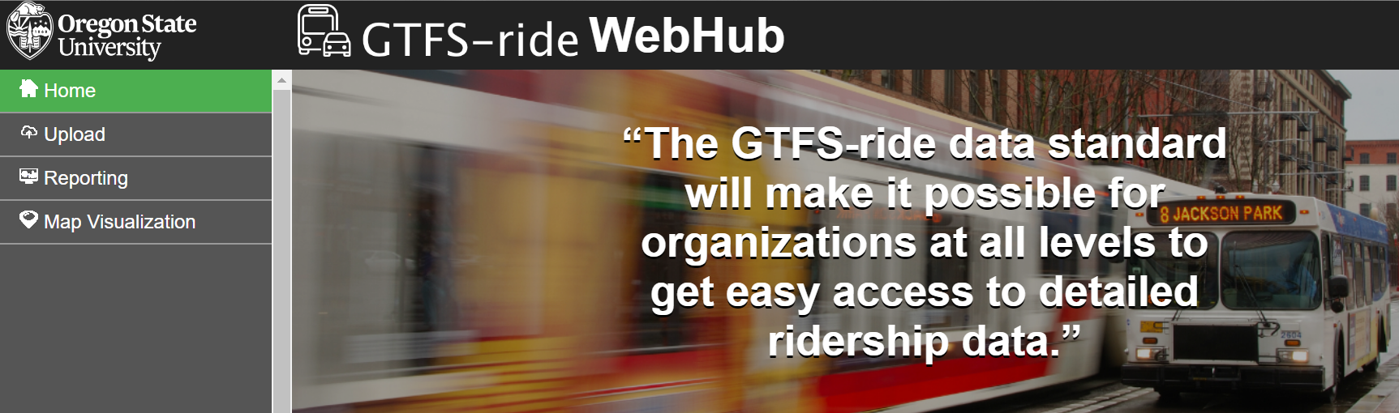
GTFS-ride WebHub
GTFS-ride WebHub is the collection of open source, web-based software tools designed to support the creation and use of GTFS-ride datasets
Validate
Create
Edit
Import/Export
Visualize
Analyze
Report
Share

Slide 26
Live Software Demo
6/27/2018

Slide 27
Consortium Group Input
To avoid an endless conversation where software vendors say, "if a significant portion of our customers and prospective customers have GTFS-ride data we are willing to support the standard", and transit agencies say "if creating GTFS-ride data will give us access to new/better functionality we will create GTFS-ride data”.
How do we move from a data format to a data standard?

Slide 28
Plans for Progress and Future Meetings
6/27/2018

Slide 29
Upcoming Tasks
Continuing promotion of GTFS-ride
Facilitating interactions between research team, transit agencies, and software vendors
Continue facilitating data standard and software development
Demonstration of web-based tools showing value of data standardization
National Transit Database (NTD) metric reporting
On map ridership visualization and area selection for graphical and tabular reports

Slide 30
Future Opportunities and Challenges
Improve data resolution and consistency through automated ridership data collection
Cost is primary challenge
Enriching transit analysis through increase use of integrative ridership analysis tools
Tools need to be easy to use and able to be integrated within existing systems
Increase public perception of and confidence in transit agencies
Open and transparent data will require diligence in safeguarding privacy and security
More can be done to continually update the utility of the standard and support tools, administer and support the initial adoption of GTFS-ride, and promote its benefits
Research funding for this project ends in December 2018

Slide 31
Anticipated Future Meetings
October Meeting
Adjustments to standard (as needed)
Updates on software tool development (i.e., WebHub)
Continuing conversation on how to promote use of GTFS-ride
January Meeting
Updates and next steps
Notes:
Could we do a simple timeline here? - CW

Slide 32
Group Interaction and Feedback
6/27/2018

Slide 33

Thank You!
Additional questions or comments can be directed to:
Dr. J. David Porter
David.Porter@oregonstate.edu
For more information please visit www.gtfs-ride.org

